Slide 1
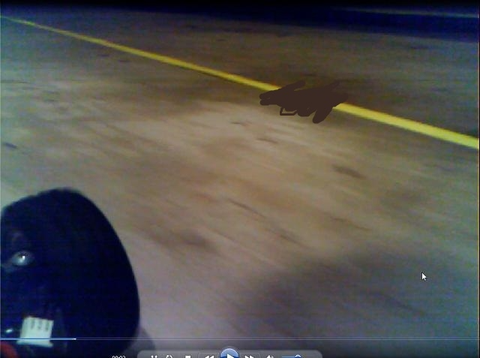
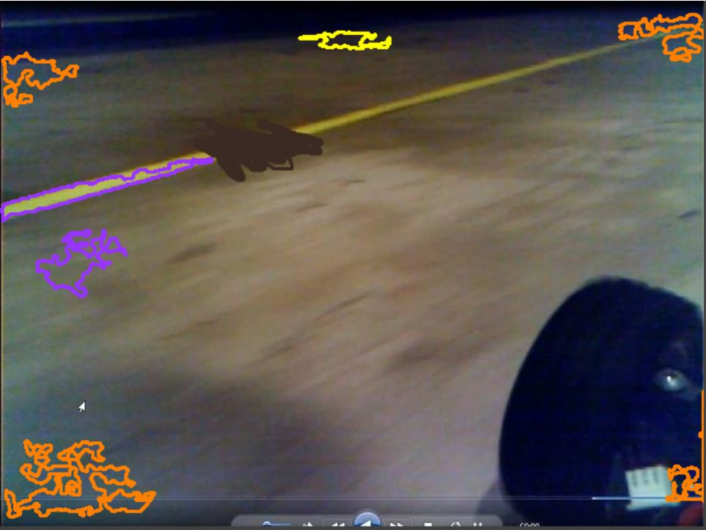
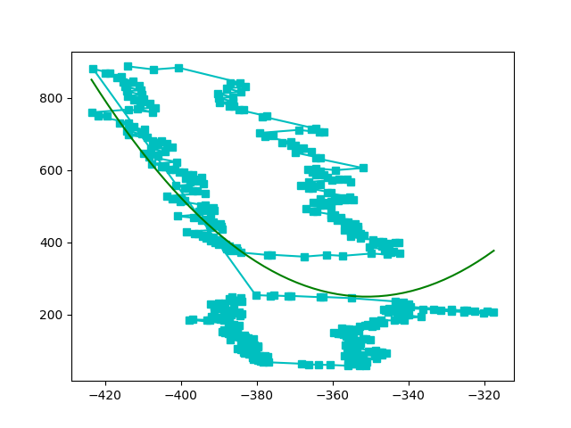
Raw Video Feed (from Ib)
Outlines from colour masking (from Jack L)
The /example_code colour masking is bad, so this is the only correct outline marking the yellow line. LOL.
After perspective transform (from Bryce)
Empty space, just in case we need to add something else
The gap is the black scribble from the video to simulate imperfect camera capture of the yellow line.
Ignore the green line
The arrow indicate the direction the path planner tells the car to drive in. Its length represents the speed. Car is at the base of the arrow. Needs text annotation showing direction and speed in PWM. Negative degree is turn right, and positive degree is turn left.
-30 deg
PWM: 200

