Slide 1

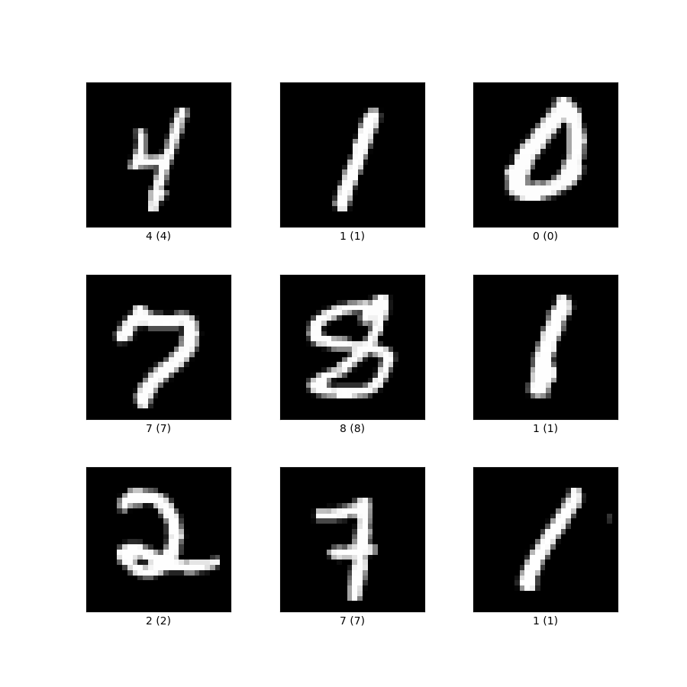

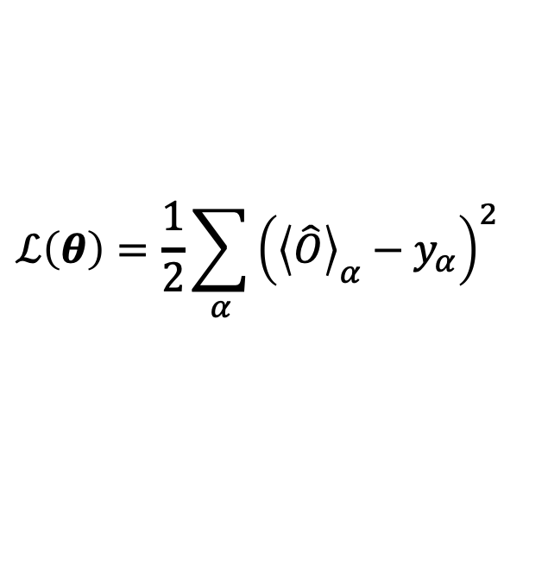




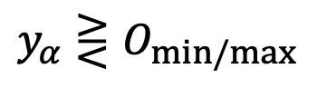


Quantum data
Quantum neural network
Quantum physical systems
0 or 1
$${\left\langle \hat{O}\right\rangle }_{α}=\left\langle ψ_{α}\left|U^{†}\hat{O}U\right|ψ_{α}\right\rangle$$
Quantum sensor networks
0 or 1
$$ℒ\left(θ\right)=\frac{1}{2}\sum_{α}{{\left({\left\langle \hat{O}\right\rangle }_{α}−y_{α}\right)}^{2}}$$
$$y_{α}⋛O_{min/max}$$
Classical data encoding
Convergence dynamics diagram
Ensemble theory interpretation
$$y_{2}$$
frozen-error
mixed-frozen
frozen-error
critical-frozen-kernel
Frame potential
Restricted Haar ensemble
$$O_{max}$$
mixed-frozen
frozen-kernel
mixed-frozen
critical-frozen-error
Haar ensemble
$$O_{min}$$
frozen-error
mixed-frozen
frozen-error
critical point
₀
_{Dim-1}
Number of data
$$O_{min}$$
$$O_{max}$$
$$y_{1}$$

