Slide 1
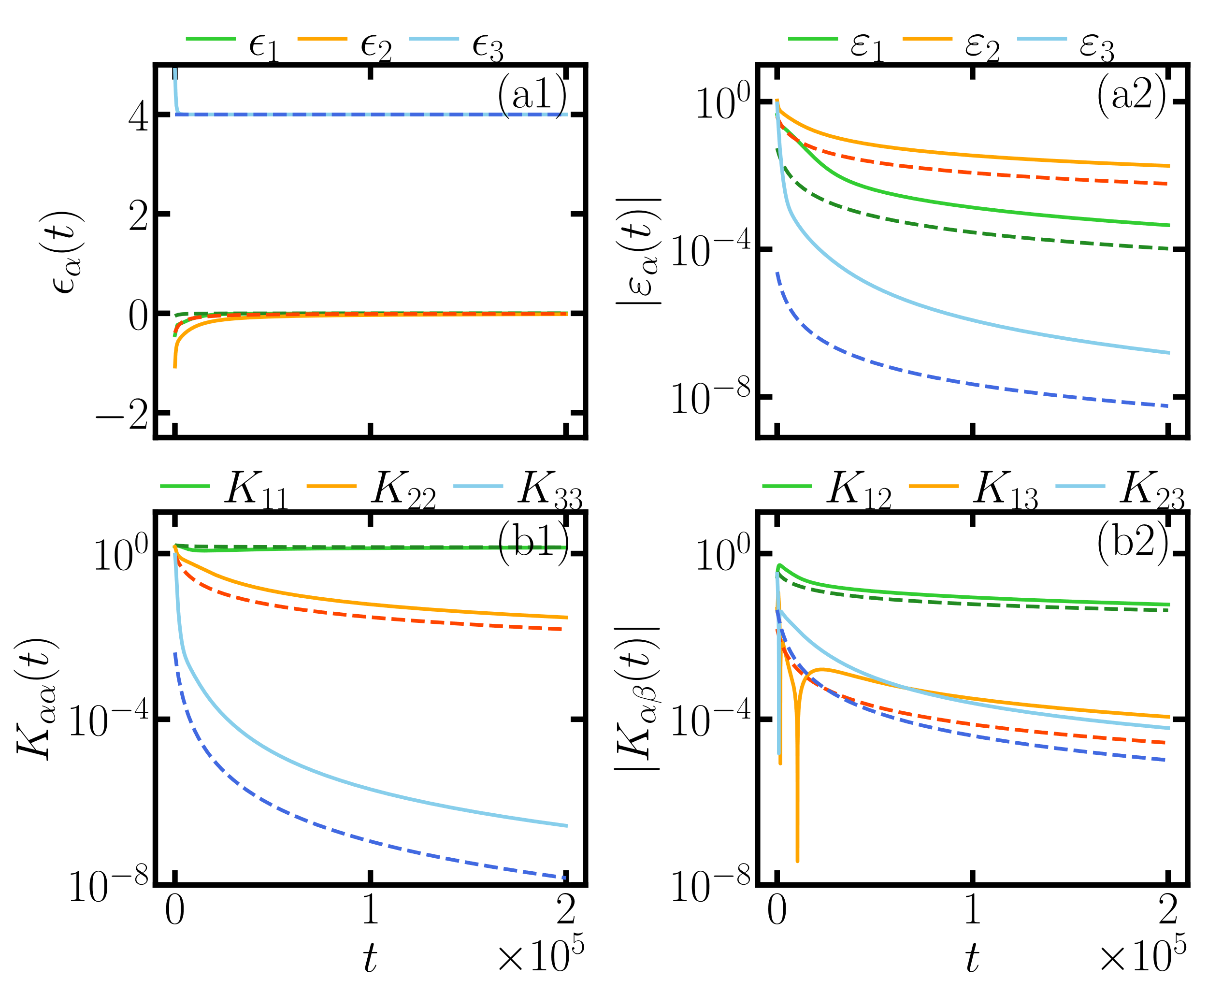







$$1/t$$
$$1/t^{3/2}$$
$$1/t^{2}$$
const
$$1/\sqrt{t}$$
$$1/t$$
$$1/t^{3/2}$$
$$1/t^{2}$$
$$1/t^{3}$$

