Slide 1
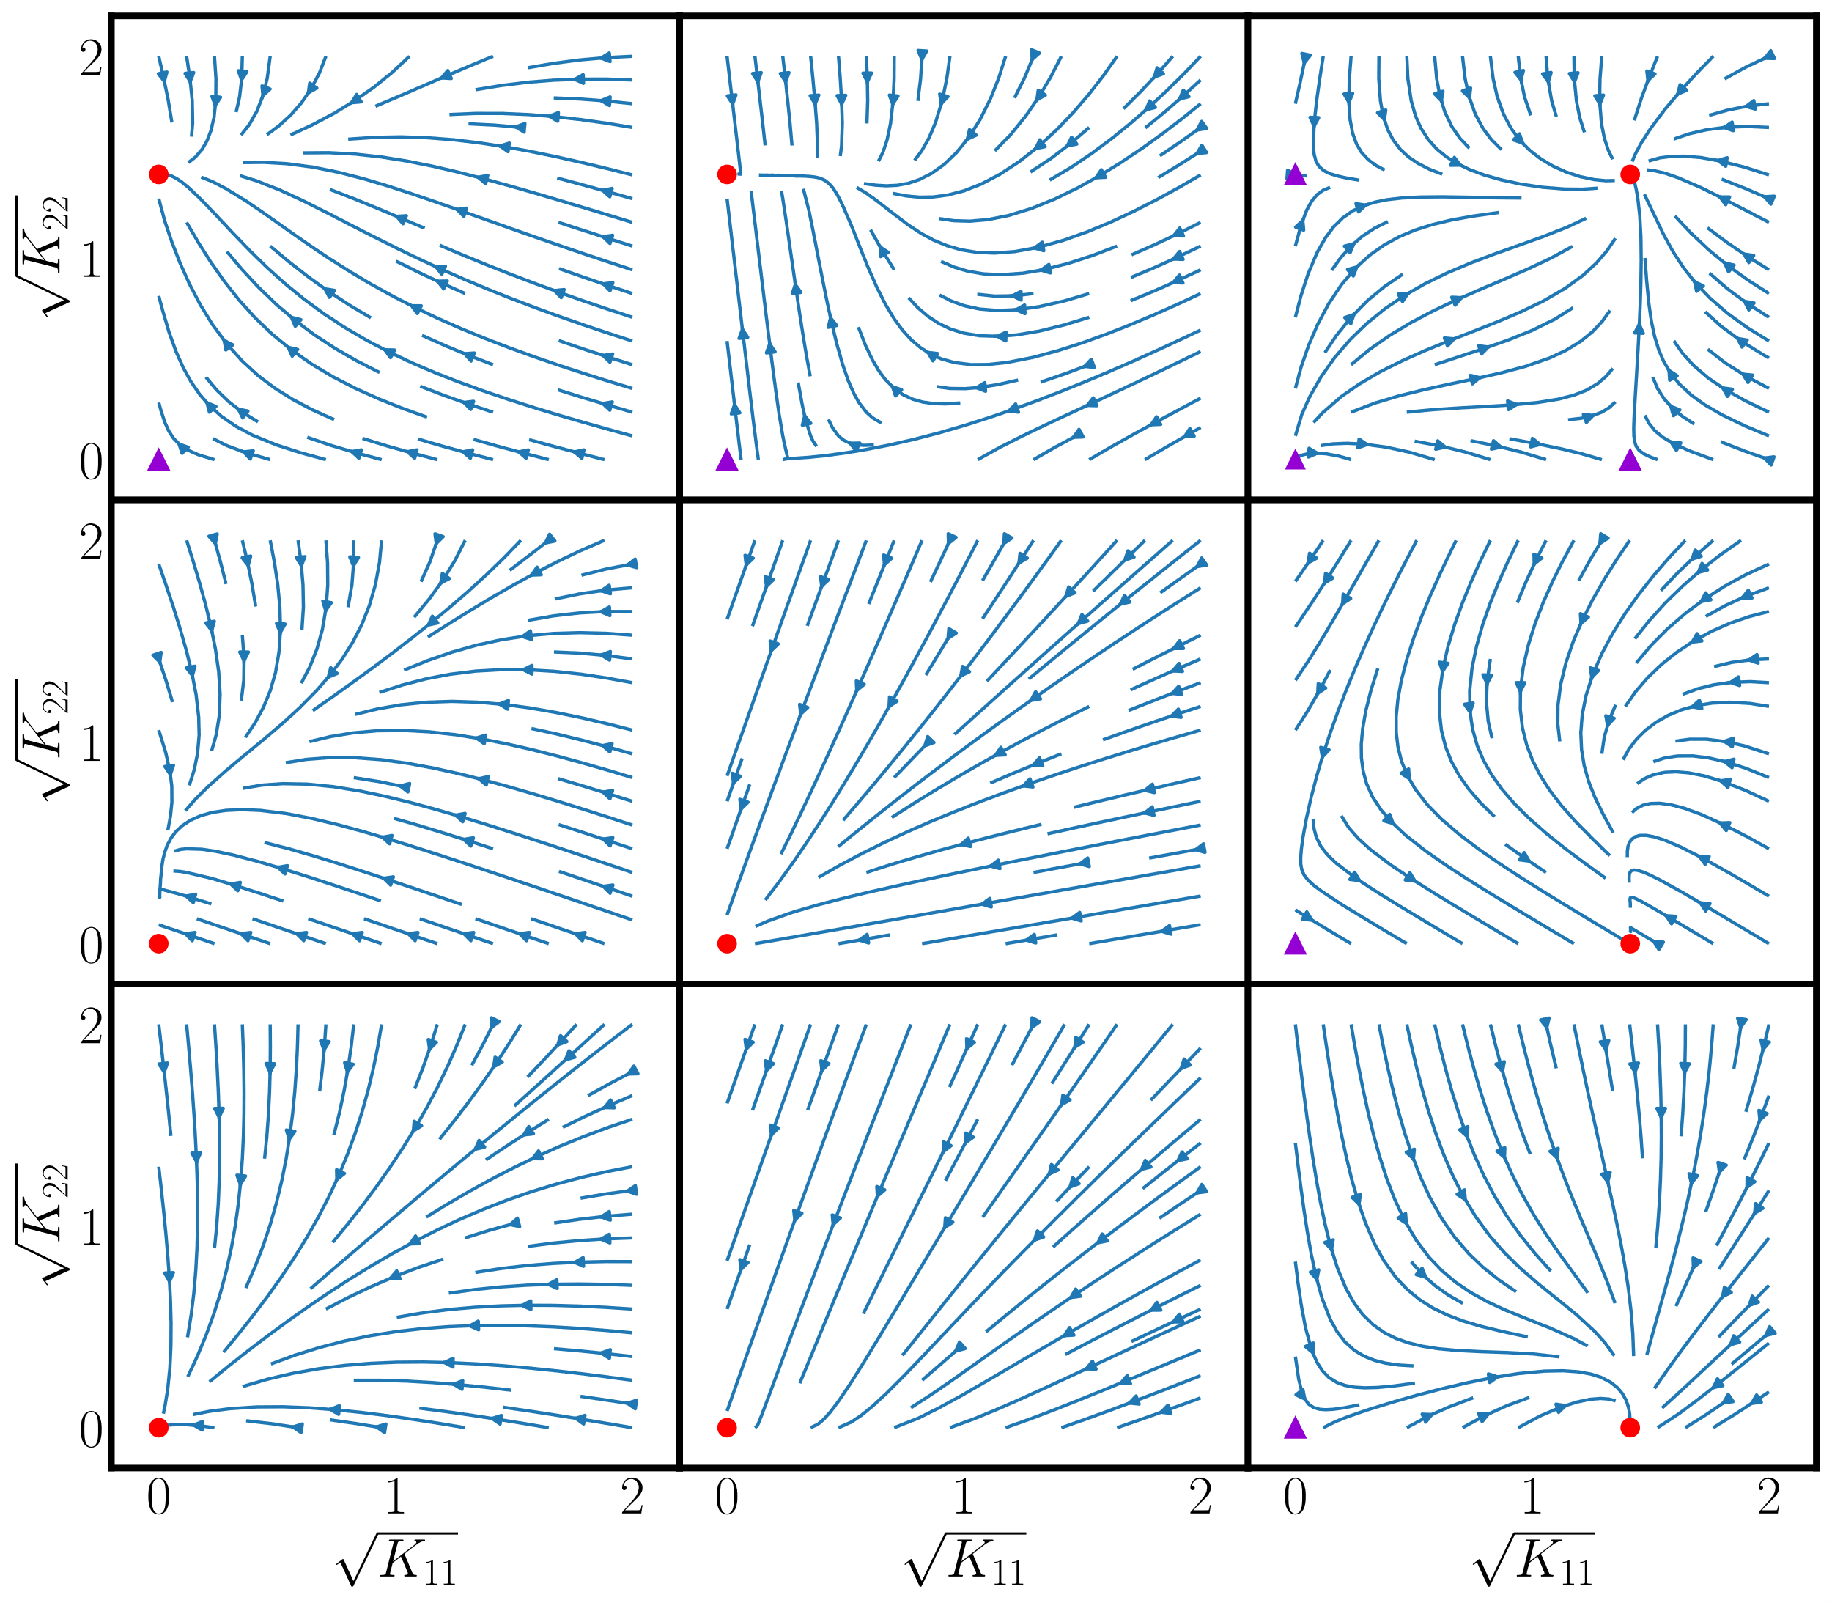






$$C_{1}<0$$
$$C_{1}=0$$
$$C_{1}>0$$
(a) mixed-frozen
(b) critical-frozen-kernel
(c) frozen-kernel
$$C_{2}>0$$
(d) critical-frozen-error
(e) critical point
(f) critical-frozen- kernel
$$C_{2}=0$$
(g) frozen- error
(h) critical-frozen- error
(i) mixed-frozen
$$C_{2}<0$$

