Slide 1
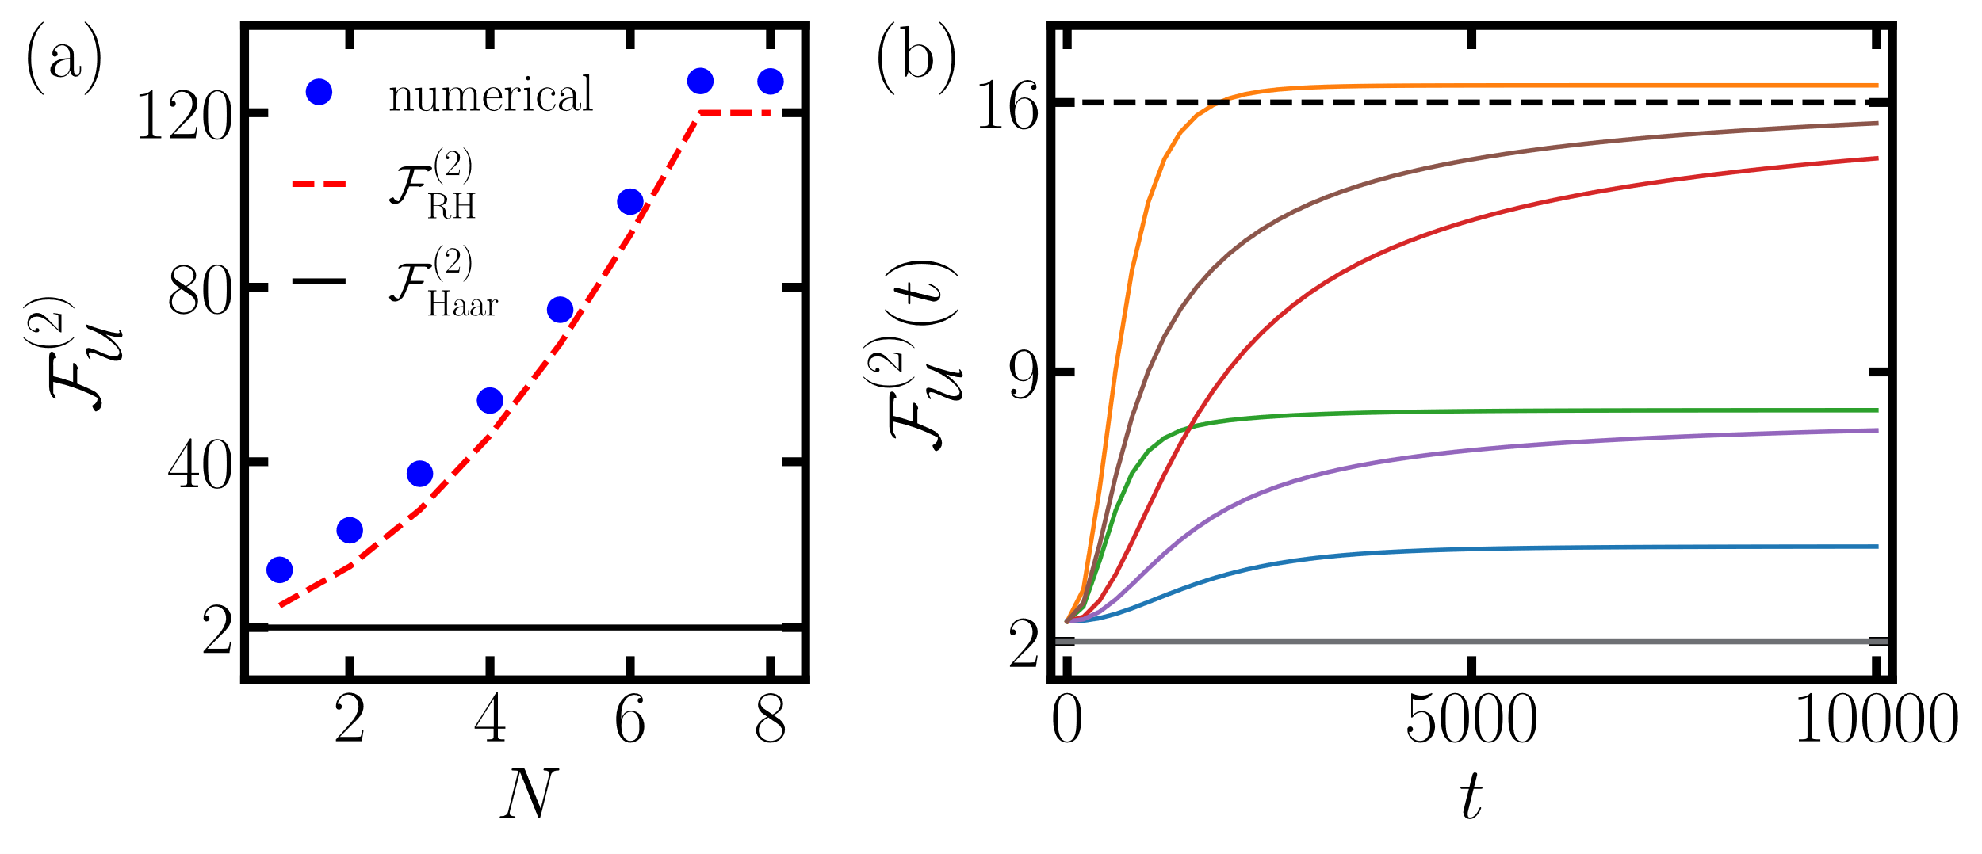






$frozen$-$error$
$critical$-$frozen$-$error$
$critical$ $point$
$mixed$-$frozen$
$critical$-$frozen$-$kernel$
$frozen$-$kernel$

