Slide 1
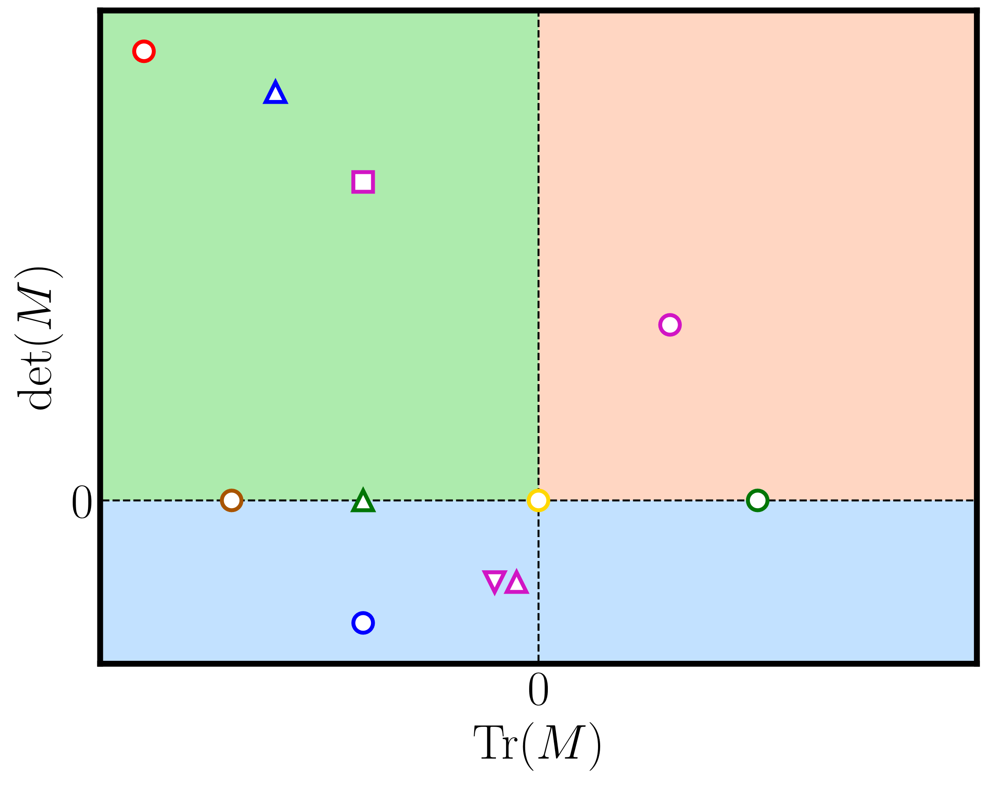
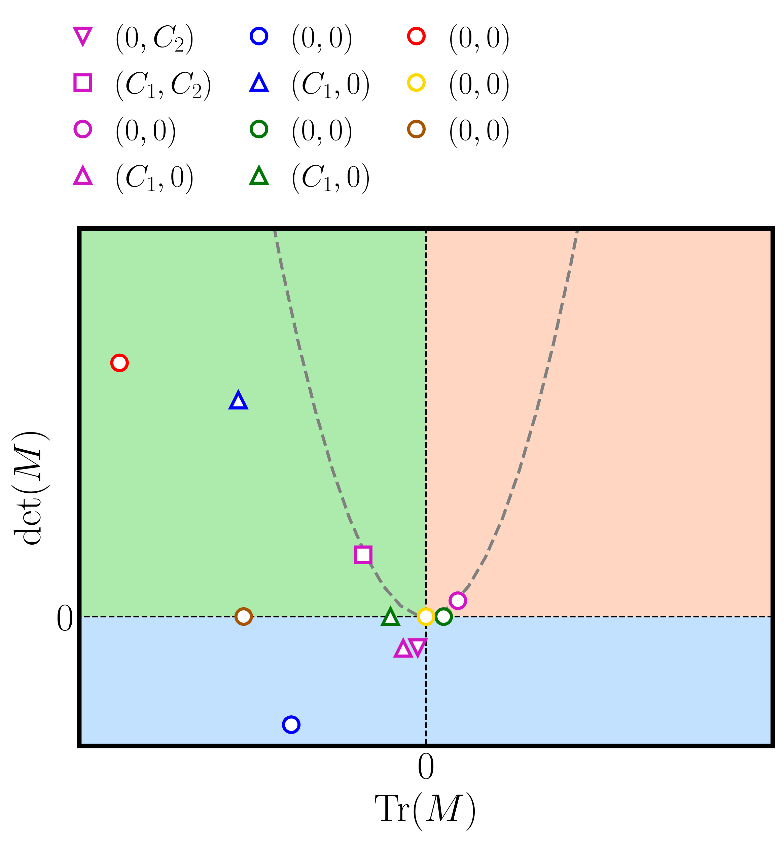
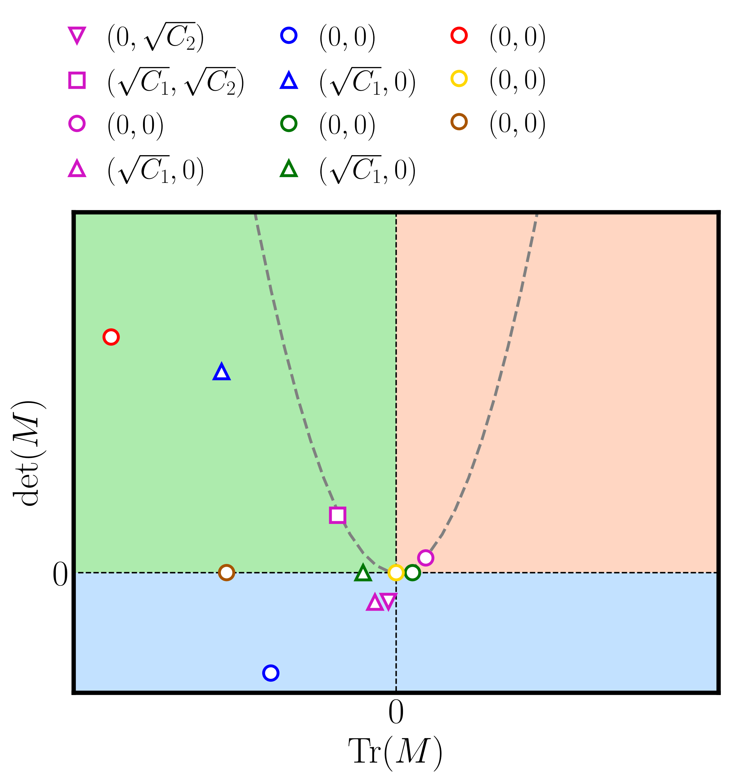
frozen-kernel dynamics
mixed-frozen dynamics
critical-frozen-kernel dynamics
Sink
Source
frozen-error dynamics
critical-frozen-error dynamics
critical point
Saddle point

