Slide 1
Stacks

Slide 2
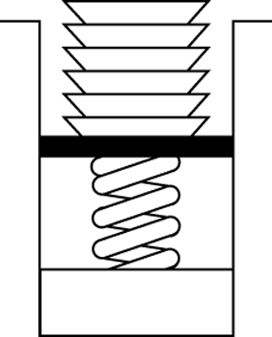
Developing an ADT During the Design of a Solution
A stack
Last-in, first-out (LIFO) property
The last item placed on the stack will be the first item removed
Analogy
A stack of dishes in a cafeteria

Slide 3
Stack
ADT stack operations
Create an empty stack
Determine whether a stack is empty
Add a new item to the stack
Remove from the stack the item that was added most recently
Remove all the items from the stack
Retrieve from the stack the item that was added most recently

Slide 4
The Abstract Data Type: Developing an ADT During the Design of a Solution
Specifications of an abstract data type for a particular problem
Can emerge during the design of the problem’s solution
Examples
SolveMaze algorithm
displayBackward algorithm

Slide 5
Simple Applications of the ADT Stack: Checking for Balanced Braces
A stack can be used to verify whether a program contains balanced braces
An example of balanced braces
abc{defg{ijk}{l{mn}}op}qr
An example of unbalanced braces
abc{def}}{ghij{kl}m
Notes:
Requirements for balanced braces
Each time you encounter a “}”, it matches an already encountered “{”
When you reach the end of the string, you have matched each “{”

Slide 6
Implementations of the ADT Stack
The ADT stack can be implemented using
An array
A linked list

Slide 7
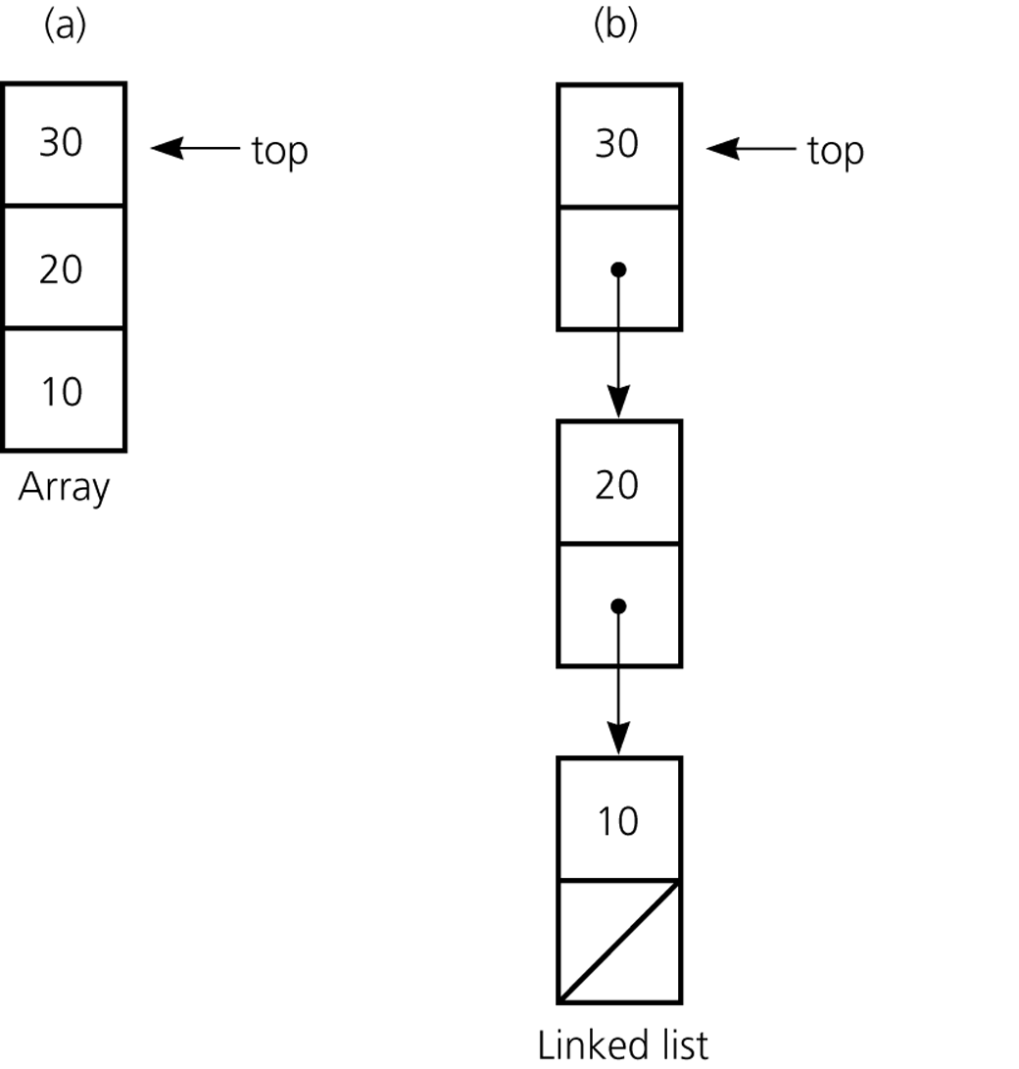
Implementations of the ADT Stack
The ADT stack can be implemented using
a) An array
b) A linked list

Slide 8
Implementing Stacks (ArrayList or LinkedList
Using an array list to implement Stack
Since the insertion and deletion operations on a stack are made only at the end of the stack, using an array list to implement a stack is more efficient than a linked list.

Slide 9

Design of the Stack
There are two ways to design the Stack class
Using inheritance: You can define the stack class by extending the array list class, or the stack class by extending the linked list class.
(a) Using inheritance
Using composition: You can define an array list as a data field in the stack class, and a linked list as a data field in the queue class.
(b) Using composition
Notes:
Both designs are fine, but using composition is better because it enables you to define a complete new stack class and queue class without inheriting the unnecessary and inappropriate methods from the array list and linked list.

Slide 10
MyStack and MyQueue

Slide 11
The Java Collections Framework Class Stack
JCF contains an implementation of a stack class called Stack (generic)
Derived from Vector
Includes methods: peek, pop, push, and search
search returns the 1-based position of an object on the stack

Slide 12
Application: Algebraic Expressions
When the ADT stack is used to solve a problem, the use of the ADT’s operations should not depend on its implementation
Convert the infix expression to postfix form
Evaluate the postfix expression

Slide 13
Converting Infix Expressions to Equivalent Postfix Expressions
An infix expression can be evaluated by first being converted into an equivalent postfix expression
Facts about converting from infix to postfix
Operands always stay in the same order with respect to one another
An operator will move only “to the right” with respect to the operands
All parentheses are removed

Slide 14
Evaluating Postfix Expressions
A postfix calculator
Requires you to enter postfix expressions
Example: 2, 3, 4, +, *
When an operand is entered, the calculator
Pushes it onto a stack
When an operator is entered, the calculator
Applies it to the top two operands of the stack
Pops the operands from the stack
Pushes the result of the operation on the stack

Slide 15
Application: A Search Problem
High Planes Airline Company (HPAir)
Problem
For each customer request, indicate whether a sequence of HPAir flights exists from the origin city to the destination city

Slide 16
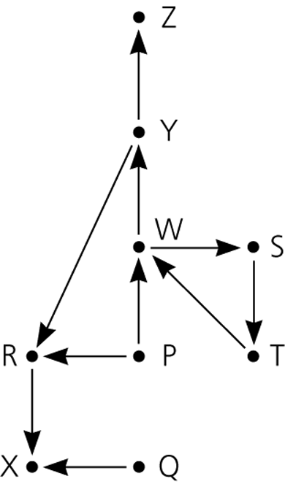
Representing the Flight Data
The flight map for HPAir is a graph
Adjacent vertices
Two vertices that are joined by an edge
Directed path
A sequence of directed edges
Flight map for HPAir

Slide 17
A Nonrecursive Solution that Uses a Stack
The solution performs an exhaustive search
Beginning at the origin city, the solution will try every possible sequence of flights until either
It finds a sequence that gets to the destination city
It determines that no such sequence exists
The ADT stack is useful in organizing an exhaustive search
Backtracking can be used to recover from a wrong choice of a city

Slide 18
Representing the Flight Data
P
R
W
Q
X
R
X
S
T
T
W
W
S
Y
X
Y
R
Z
Z

Slide 19
A Non-Recursive Solution
Create a stack (aStack)
Create a visited list (LinkedList)
aStack.push(originalCity)
add the originalCity to visited
While ( !aStack.isEmpty()) {
if top of aStack is endcity, then
print the content of aStack in reverse order
Else {
if ( no flight exist from city on top of stack to unvisited cities)
temp = aStack.pop()
else {
select an unvisited dest. city c for a flight from the city on the top of the stack
aStack.push(c)
mark c as visited
}
}
}

Slide 20
A Recursive Solution
Possible outcomes of the recursive search strategy
You eventually reach the destination city and can conclude that it is possible to fly from the origin to the destination
You reach a city C from which there are no departing flights
You go around in circles

Slide 21
A Recursive Solution
A refined recursive search strategy
searchR(originCity, destinationCity)
Mark originCity as visited
if (originCity is destinationCity) {
Terminate -- the destination is reached
}
else {
for (each unvisited city C adjacent to originCity) {
searchR(C, destinationCity)
}
}

Slide 22
The Relationship Between Stacks and Recursion
The ADT stack has a hidden presence in the concept of recursion
Typically, stacks are used by compilers to implement recursive methods
During execution, each recursive call generates an activation record that is pushed onto a stack
Stacks can be used to implement a nonrecursive version of a recursive algorithm

