Slide 1
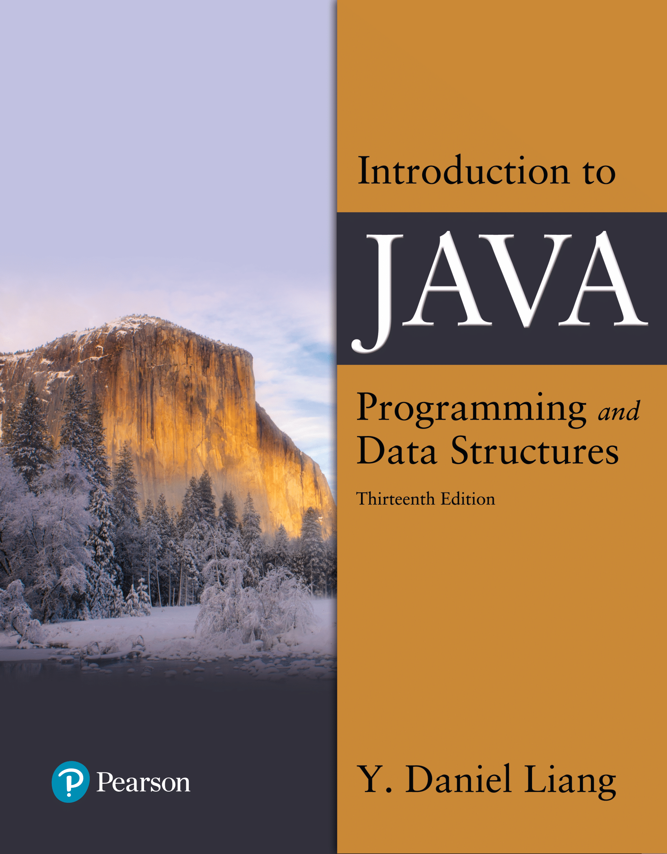

Introduction to Java Programming and Data Structures
Thirteenth Edition
Chapter 9
Objects and Classes
Copyright © 2024 Pearson Education, Inc. All Rights Reserved
Notes:
If this PowerPoint presentation contains mathematical equations, you may need to check that your computer has the following installed:
1) MathType Plugin
2) Math Player (free versions available)
3) NVDA Reader (free versions available)
Slides in this presentation contain hyperlinks. JAWS users should be able to get a list of links by using INSERT+F7

Slide 2
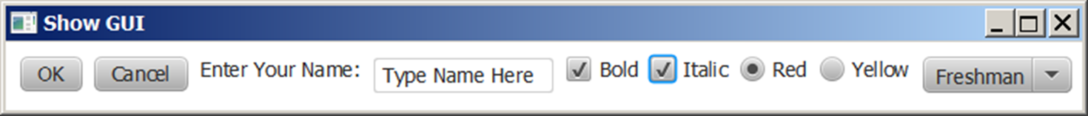
Motivations
After learning the preceding chapters, you are capable of solving many programming problems using selections, loops, methods, and arrays. However, these Java features are not sufficient for developing graphical user interfaces and large scale software systems. Suppose you want to develop a graphical user interface as shown below. How do you program it?

Slide 3
Objectives (1 of 2)
9.1 To describe objects and classes, and use classes to model objects (§9.2).
9.2 To use U M L graphical notation to describe classes and objects (§9.2).
9.3 To demonstrate how to define classes and create objects (§9.3).
9.4 To create objects using constructors (§9.4).
9.5 To define a reference variable using a reference type and access objects via object reference variables (§9.5).
9.6 To access an object’s data and methods using the object member access operator (.) (§9.5.1).
9.7 To define data fields of reference types and assign default values for an object’s data fields (§9.5.2).
9.8 To distinguish between object reference variables and primitive data type variables (§9.5.3).

Slide 4
Objectives (2 of 2)
9.9 To use the Java library classes Date, Random, and Point2D (§9.6).
9.10 To distinguish between instance and static variables and methods (§9.7).
9.11 To define private data fields with appropriate get and set methods (§9.8).
9.12 To encapsulate data fields to make classes easy to maintain (§9.9).
9.13 To develop methods with object arguments and differentiate between primitive-type arguments and object-type arguments (§9.10).
9.14 To store and process objects in arrays (§9.11).
9.15 To create immutable objects from immutable classes to protect the contents of objects (§9.12).
9.16 To determine the scope of variables in the context of a class (§9.13).
9.17 To use the keyword this to refer to the calling object itself (§9.14).

Slide 5
Classes
In an object-oriented programming language, like Java, you create programs that are made of objects.
In software, an object has two capabilities:
An object can store data.
An object can perform operations.
The data stored in an object are commonly called attributes or fields.
The operations that an object can perform are called methods.

Slide 6
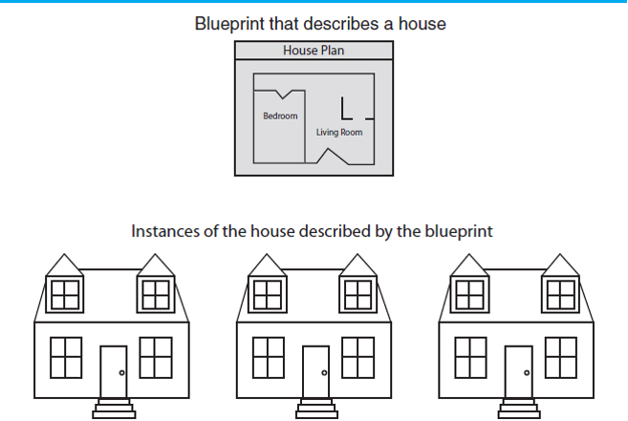
Classes and Instances
Many objects can be created from a class.
Each object is independent of the others.

Slide 7
Objects and Programs
For example, the String class provides methods:
Examples: length() and charAt() methods
String greeting = new String(“Hello World”);
int len = greeting.length();
char c1 = greeting.charAt(0);
A String object
The greeting variable
Holds the address of a String object.
address
“Hello World”

Slide 8
Objects
An object has both a state and behavior. The state defines the object, and the behavior defines what the object does.
Notes:
Class name, Circle.
Data fields. Radius is, blank space. Methods, getArea.
Three objects of the Circle class are as follows.
Circle object 1. Data fields, radius is 10.
Circle object 2. Data fields, radius is 25.
Circle object 3. Data fields, radius is 125.

Slide 9
Classes (2 of 2)
Notes:
Line 1, indicates class Circle open braces. Line 2, slash forward address address The radius of this circle address slash forward. Line 3, double radius equal to 1.0 semicolon. The line 3 is Data field. Line 4, Blank. Line 5, slash forward address address Construct a circle object address slash forward. Line 6, Circle open parenthesis close parenthesis open braces. Line 7, close braces. Line 8, Blank. Line 9, slash forward address address Construct a circle object address slash forward. Line 10, Circle open parenthesis double new Radius close parenthesis open braces. Line 11, radius equal to new Radius semicolon. Line 12, close braces. The lines 5, 6, 7, 8, 9, 10, 11 and 12 are Constructors. Line 13, Blank. Line 14, slash forward address address Return the area of this circle address slash forward. Line 15, double get Area open parenthesis close parenthesis open braces. The line 15 is Method. Line 16, return radius address radius address 3 period 14159 semicolon. Line 17, close braces. Line 18, close braces.

Slide 10
Diagram of a Class
Private Data
Each object has its own private data that other objects cannot directly access
Methods of the public interface provide access to private data, while hiding implementation details:
This is called Encapsulation
Public Interface
Each object has a set of methods available for other objects to use
Class
Private Data
(Variables)
Public Interface
(Methods)
Notes:
Classes should be as limited in scope as needed to accomplish the goal.
Each class should contain all that is needed for it to operate.
Enclosing the proper attributes and methods inside a single class is called encapsulation.
Encapsulation ensures that the class is self-contained.

Slide 11
An access modifier is a Java key word that indicates how a field or method can be accessed.

Slide 12
U M L Class Diagram
Circle
-radius : double
+Circle() +Circle(newRadius: double) +getRadius(): double +setRadius(newRadius): void +getArea(): double +getPerimeter(): double
Notes:
. Constructors are a special kind of methods that are invoked to construct objects.
A constructor with no parameters is referred to as a no-arg constructor.
Constructors must have the same name as the class itself.
Constructors do not have a return type—not even void.
Constructors are invoked using the new operator when an object is created. Constructors play the role of initializing objects.
Example: new ClassName();
A class may be defined without constructors. In this case, a no-arg constructor with an empty body is implicitly defined in the class. This constructor, called a default constructor, is provided automatically only if no constructors are explicitly defined in the class.
To reference an object, assign the object to a reference variable.
To declare a reference variable, use the syntax:
ClassName objectRefVar;
Example:
Circle myCircle;

Slide 13

Designing a Class
When designing a class, decisions about the following must be made.
what data must be accounted for
what actions need to be performed
what data can be modified
what data needs to be accessible
any rules as to how data should be modified
Class design typically is done with the aid of a Unified Modeling Language (UML) diagram.

Slide 14
UML Class Diagram
A UML class diagram is a graphical tool that can aid in the design of a class.
The diagram has three main sections.
Class Name
UML diagrams are easily converted
to Java class files. There will be more
about UML diagrams a little later.
Attributes
Methods
The class name should concisely reflect what the class represents.

Slide 15
Attributes
The data elements of a class define the object to be instantiated from the class.
The attributes must be specific to the class and define it completely.
Example: A rectangle is defined by
length
width
The attributes are then accessed by methods within the class.
Notes:
Another aspect of encapsulation is the concept of data hiding.
Classes should not only be self-contained but they should be self-governing as well.
Classes use the private access modifier on fields to hide them from other classes.
Classes need methods to allow access and modification of the class’ data.

Slide 16
Methods
The class’ methods define the actions that an instance of the class can perform
Methods headers have a format:
AccessModifier ReturnType MethodName(Parameters)
{
// Method body.
}
Methods that need to be used by other classes should be made public.

Slide 17
Methods
The attributes of a class might need to be:
changed
accessed
calculated
The methods that change and access attributes are called accessors and mutators.
Notes:
Because of the concept of data hiding, fields in a class are private.
The methods that retrieve the data of fields are called accessors.
The methods that modify the data of fields are called mutators.
Each field that the programmer wishes to be viewed by other classes needs an accessor.
Each field that the programmer wishes to be modified by other classes needs a mutator.

Slide 18
Stale Data
Rather than use an area variable in a rectangle class:
public double getArea()
{
return length * width;
}
This dynamically calculates the value of the rectangle’s area when the method is called.
Now, any change to the length or width variables will not leave the area of the rectangle stale.
Notes:
Some data is the result of a calculation.
Consider the area of a rectangle.
length times width
It would be impractical to use an area variable here.
Data that requires the calculation of various factors has the potential to become stale.
To avoid stale data, it is best to calculate the value of that data within a method rather than store it in a variable.

Slide 19
UML Data Type and Parameter Notation
UML diagrams are language independent.
UML diagrams use an independent notation to show return types, access modifiers, etc.
Rectangle
- width : double
+ setWidth(w : double) : void

Slide 20
The UML Diagram for Rectangle class
Rectangle
width : double
length : double
+ setWidth(w : double) : void
+ setLength(len : double): void
+ getWidth() : double
+ getLength() : double
+ getArea() : double
+ getPerimeter() : double
Notes:
Implement the class
The layout of a source code file can vary by individual programmers.
Generally the layout is:
Attributes are typically listed first
Methods are typically listed second
The main method is sometimes first, sometimes last.
Accessors and mutators are typically grouped.

Slide 21
A Driver Program
An application in Java is a collection of classes that interact.
The class that starts the application must have a main method.
This class can be used as a driver to test the capabilities of other classes.
In the Rectangle class example, notice that there was no main method.

Slide 22
Constructors
Classes can have special methods called constructors.
Constructors are used to perform operations at the time an object is created.
Constructors typically initialize instance fields and perform other object initialization tasks.

Slide 23
Constructors in UML
Rectangle
width : double
length : double
+Rectangle(len:double, w:double)
+ setWidth(w : double) : void
+ setLength(len : double): void
+ getWidth() : double
+ getLength() : double
+ getArea() : double
In UML, the most common way constructors are defined is:

Slide 24
The Random Class
You have used Math.random() to obtain a random double value between 0.0 and 1.0 (excluding 1.0). A more useful random number generator is provided in the java.util.Random class.

Slide 25
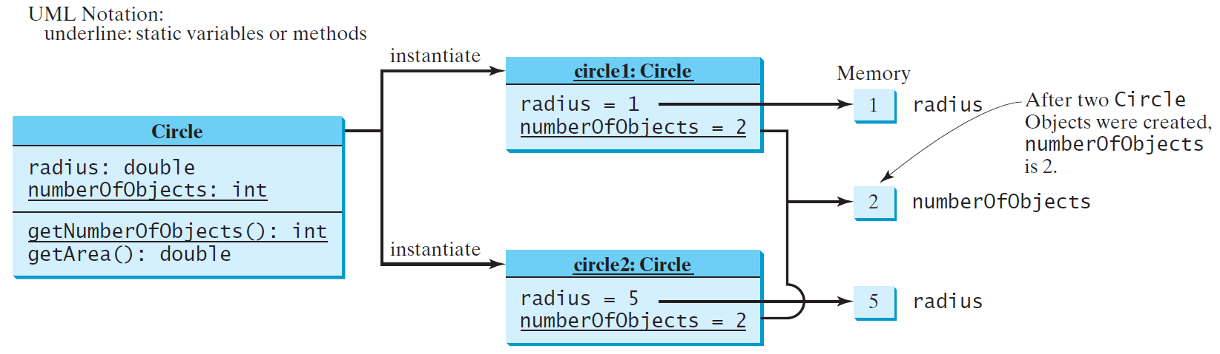
Static Variables, Constants, and Methods

Slide 26
Example of Data Field Encapsulation

Slide 27
Example of Data Field Encapsulation
CircleWithStaticDataFields
TestCircleWithStaticDataFields

Slide 28
The this Keyword
The this keyword is the name of a reference that refers to an object itself. One common use of the this keyword is reference a class’s hidden data fields.
Another common use of the this keyword to enable a constructor to invoke another constructor of the same class.

Slide 29
Reference the Hidden Data Fields

Slide 30
Scope of Variables
The scope of instance and static variables is the entire class. They can be declared anywhere inside a class.
The scope of a local variable starts from its declaration and continues to the end of the block that contains the variable. A local variable must be initialized explicitly before it can be used.

Slide 31
Calling Overloaded Constructor

Slide 32
Passing Objects to Methods
Passing by value for primitive type value (the value is passed to the parameter)
Passing by value for reference type value (the value is the reference to the object)
TestPassObject

Slide 33
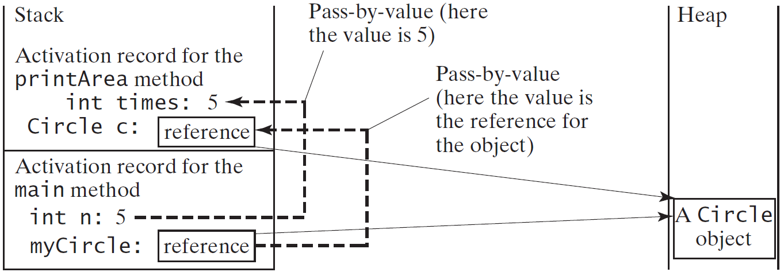
Passing Objects to Methods, cont.

Slide 34
Array of Objects
Circle[] circleArray = new Circle[10];
An array of objects is actually an array of reference variables. So invoking circleArray[1].getArea() involves two levels of referencing as shown in the next figure. circleArray references to the entire array. circleArray[1] references to a Circle object.

Slide 35
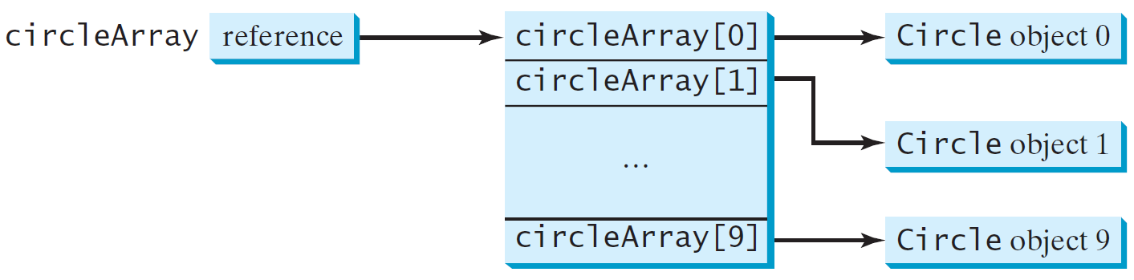
Array of Objects, cont.
Circle[] circleArray = new Circle[10];

Slide 36
Array of Objects, cont.
Summarizing the areas of the circles
create an array of five random circles.
Print the circles and their area.
Print their total area.
TotalArea

Slide 37

Objects & Classes
Rational Class

Slide 38
Rational Numbers UML
Rational
- numerator : int - denominator : int
+ Rational() + Rational(n : int, d : int) + getNumerator() : int + setNumerator(n : int) + getDenominator() : int + setDenominator(d : int) + add(r : Rational) : Rational + subtract(r : Rational) : Rational + divide(r : Rational) : Rational + multiply(r : Rational) : Rational + equals(r : Rational) : Boolean + compareTo(r : Rational) : int + toString() : String - gcd(n : int , d : int) : int
default value for a Rational object is 0/1 Rational objects must be in reduced form Rational objects should not be modified by any of the methods toString() format is “numerator/denominator”

Slide 39
Given n, write a program that will compute the following summation series using the Rational class. output should be as follows:
$\frac{1}{1}+\frac{1}{2}+\frac{1}{3}+…$ + $\frac{1}{n}$ = result

Slide 40
Given n Rational numbers, find the maximum

