Slide 1
Sorting

Slide 2
Sorting
We seek algorithms to arrange items, ai such that:
entry 1 ≤ entry 2 ≤ . . . ≤ entry n
Sorting an array is usually easier than sorting other data structures.
Efficiency of a sorting algorithm is significant
The data to be sorted might be integers, doubles, characters, or objects.

Slide 3
Bubble Sort
Bubble sort
  Strategy
    Compare adjacent elements and exchange them if they are out of order
      Comparing the first two elements, the second and third elements, and so on, will move the largest (or smallest) elements to the end of the array
      Repeating this process will eventually sort the array into ascending (or descending) order
© 2011 Pearson Addison-Wesley. All rights reserved
10 B-<number>

Slide 4
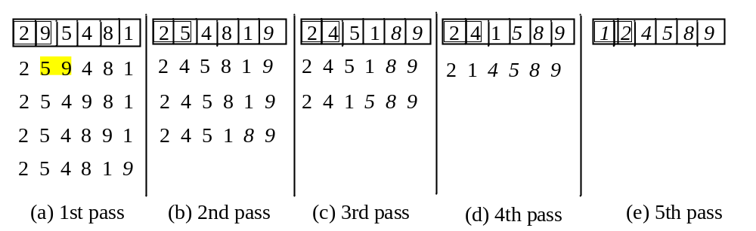
Bubble Sort
BubbleSort

Slide 5
Selection Sort
Steps for selection sort.
Scan the array and find the minimum item.
Swap the item with the first location.
Now the first location number is in it’s correct position.
Scan the rest of the array and repeat steps one and two.
Repeat the steps above to get a fully sorted array.

Slide 6
Insertion Sort
Insertion sort is relatively faster than bubble sort and selection sort. Here are the steps.
Have a sorted and unsorted region in your list.
Initially the sorted region will contain the first item and the unsorted region will contain the rest of the array.
Compare the first in the unsorted region with the item in the sorted region. Place in correct location.
Increase the sorted region by one.
Repeat the above process for rest of the items in the unsorted region.

Slide 7
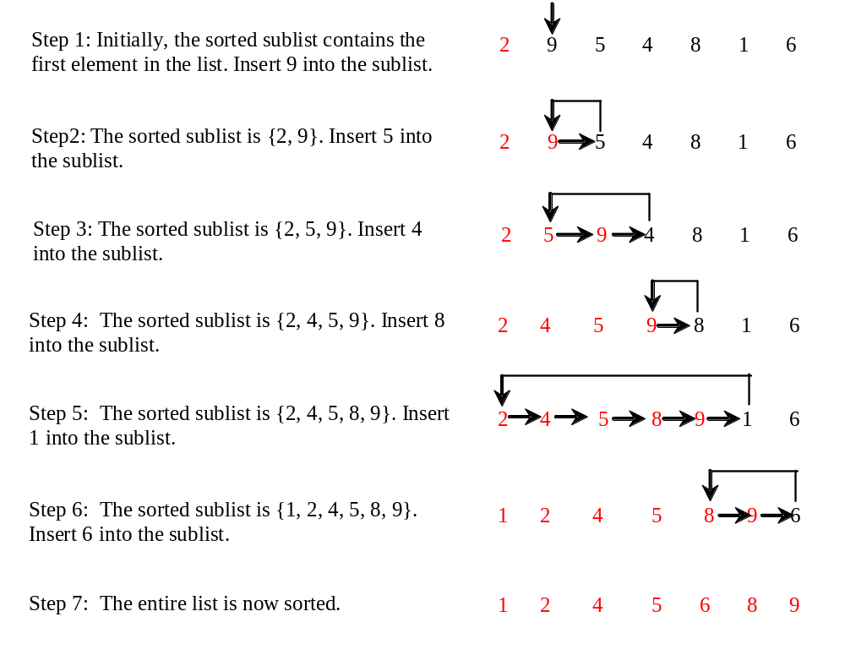
Insertion Sort
int[] myList = {2, 9, 5, 4, 8, 1, 6}; // Unsorted
The insertion sort algorithm sorts a list of values by repeatedly inserting an unsorted element into a sorted sublist until the whole list is sorted.
Notes:
Analysis
Worst case: O(n²)
For small arrays
Insertion sort is appropriate due to its simplicity
For large arrays
Insertion sort is prohibitively inefficient

Slide 8
Mergesort
Important divide-and-conquer sorting algorithms
  Mergesort
  Quicksort
Mergesort
  A recursive sorting algorithm
  Gives the same performance, regardless of the initial order of the array items
  Strategy
    Divide an array into halves
    Sort each half
    Merge the sorted halves into one sorted array

Slide 9
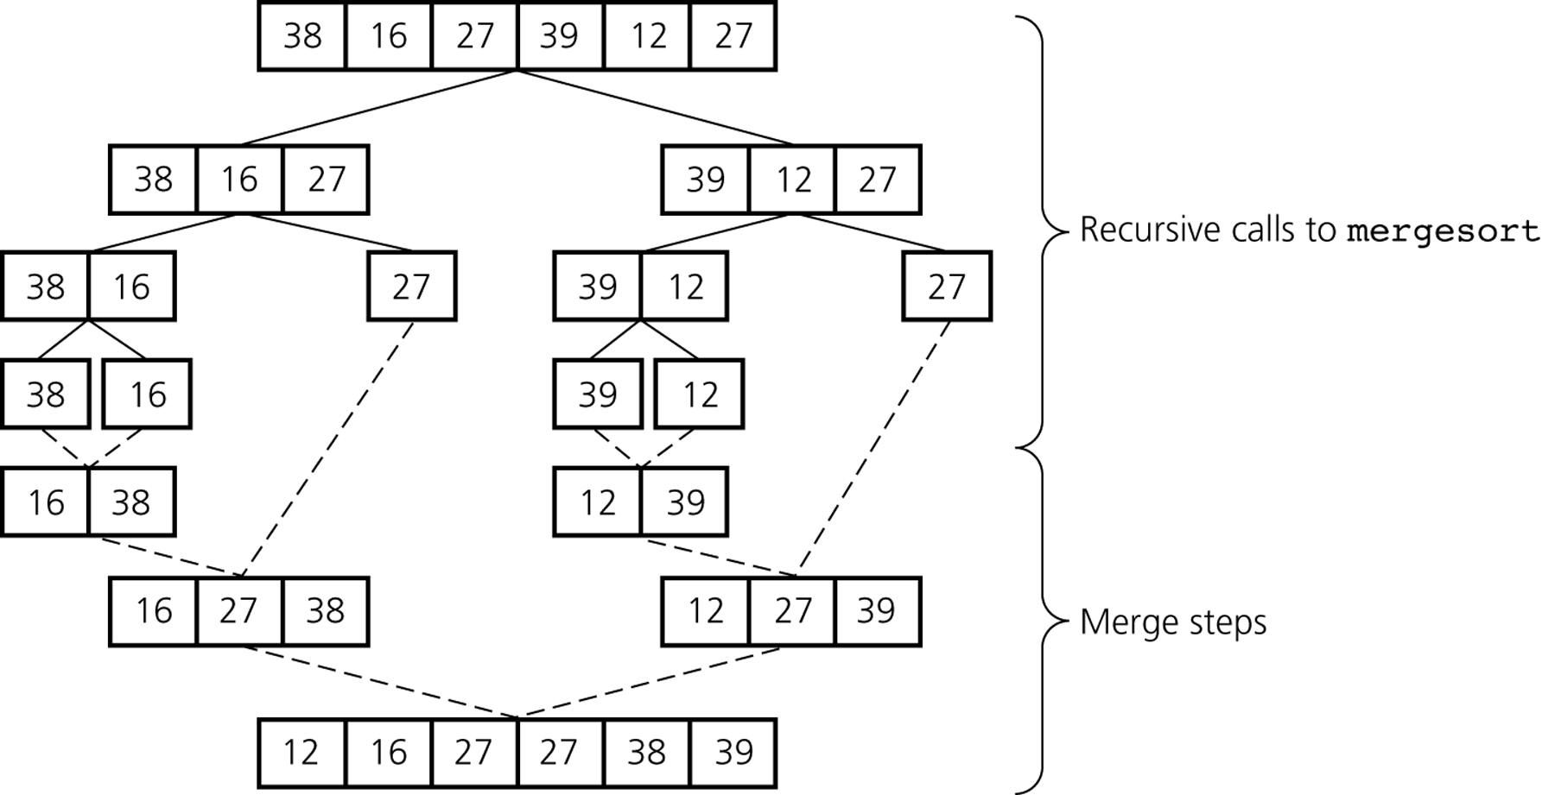
Mergesort
A mergesort of an array of six integers
© 2011 Pearson Addison-Wesley. All rights reserved
10 B-<number>

Slide 10
Recursive Merge Sort
Recursive algorithm for merge sort.
Algorithm mergeSort(list) {
if (list.length > 1)
{
// mergeSort the first half
// mergeSort the second half
merge(firstHalf,secondHalf,list)
}
}

Slide 11
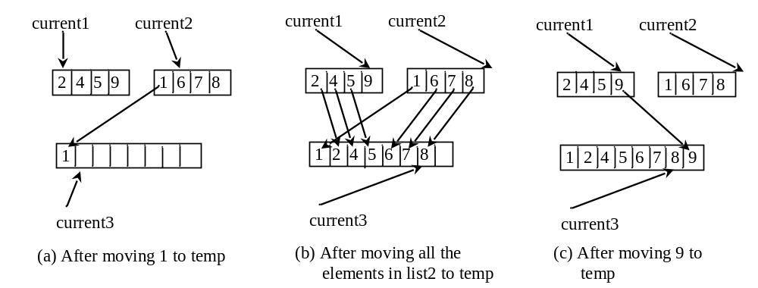
Merge Two Sorted Lists
Animation for Merging Two Sorted Lists

Slide 12
Analysis
Dividing an array in half requires logN time.
Merging requires N comparisons
Efficiency of mergesort is O(N* logN)

Slide 13
Mergesort
Analysis
  Worst case: O(n * log₂n)
  Average case: O(n * log₂n)
  Advantage
    It is an extremely efficient algorithm with respect to time
  Drawback
    It requires a second array as large as the original array
© 2011 Pearson Addison-Wesley. All rights reserved
10 B-<number>

Slide 14
Quick Sort
Divides an array into two pieces
  Pieces are not necessarily halves of the array
  Chooses one entry in the array—called the pivot
    Pivot is in position that it will occupy in final sorted array
    Entries in positions before pivot are less than or equal to pivot
    Entries in positions after pivot are greater than or equal to pivot
  Recursively apply the quick sort algorithm to the first part and then the second part.

Slide 15
Algorithm quickSort(list, first, last)
// Sorts the array entries list[first..last] recursively.
if (last > first)
{
    Choose a pivot
    Partition the array about the pivot
    pivotIndex = index of pivot
    quickSort(list, first, pivotIndex − 1) // Sort Smaller
    quickSort(list, pivotIndex + 1, last) // Sort Larger
}

Slide 16
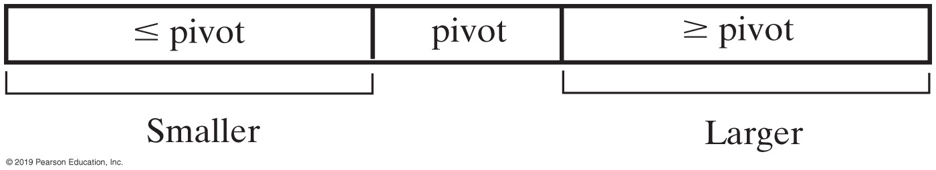
Quick Sort

Slide 17
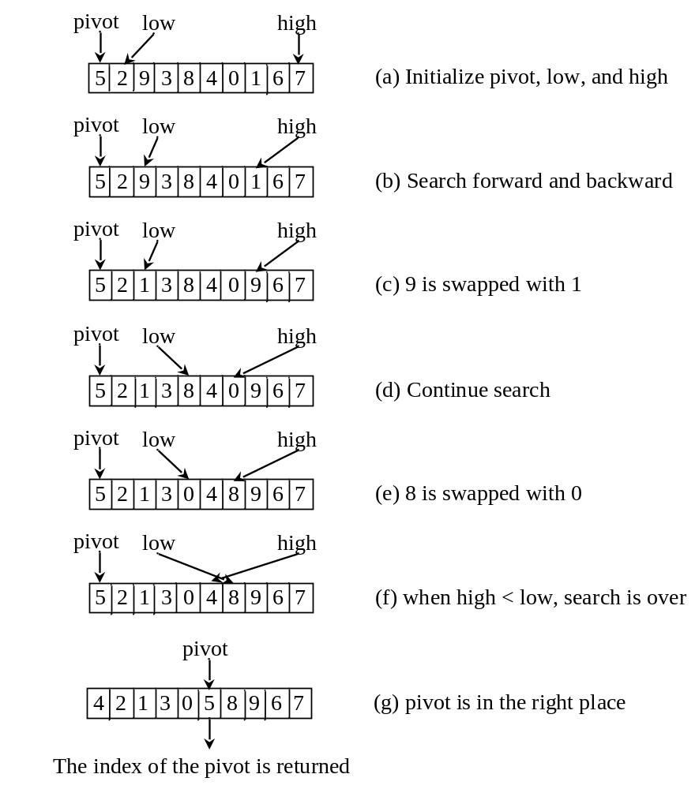
Partition
Animation for partition
Quick Sort

Slide 18
Analysis
A single partition runs in O(N) time.
Dividing an array in half requires logN time.
Efficiency of quicksort is O(N* logN)

Slide 19
Bucket Sort and Radix Sort
All sort algorithms discussed so far are general sorting algorithms that work for any types of keys (e.g., integers, strings, and any comparable objects). These algorithms sort the elements by comparing their keys. The lower bound for general sorting algorithms is O(nlogn). So, no sorting algorithms based on comparisons can perform better than O(nlogn). However, if the keys are small integers, you can use bucket sort without having to compare the keys.

Slide 20
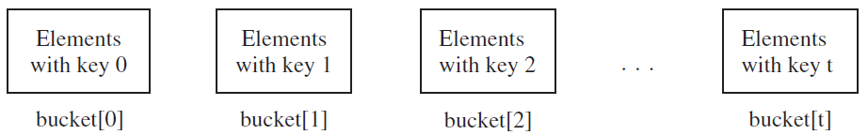
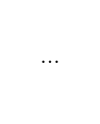
Bucket Sort
The bucket sort algorithm works as follows. Assume the keys are in the range from 0 to N-1. We need N buckets labeled 0, 1, ..., and N-1. If an element’s key is i, the element is put into the bucket i. Each bucket holds the elements with the same key value. You can use an ArrayList to implement a bucket.

Slide 21
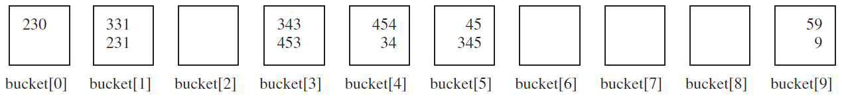
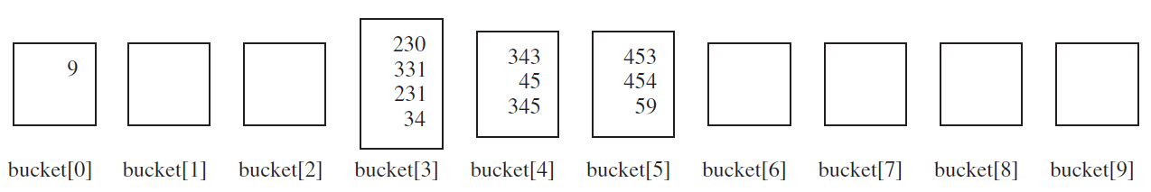
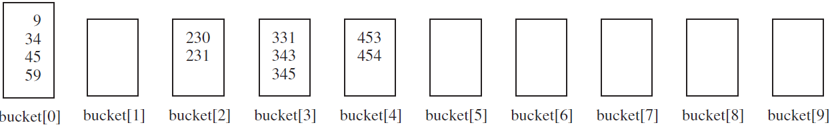
Radix Sort
Sort 331, 454, 230, 34, 343, 45, 59, 453, 345, 231, 9
230, 331, 231, 343, 453, 454, 34, 45, 345, 59, 9
9, 230, 331, 231, 34, 343, 45, 345, 453, 454, 59
9, 34, 45, 59, 230, 231, 331, 343, 345, 453, 454

Slide 22
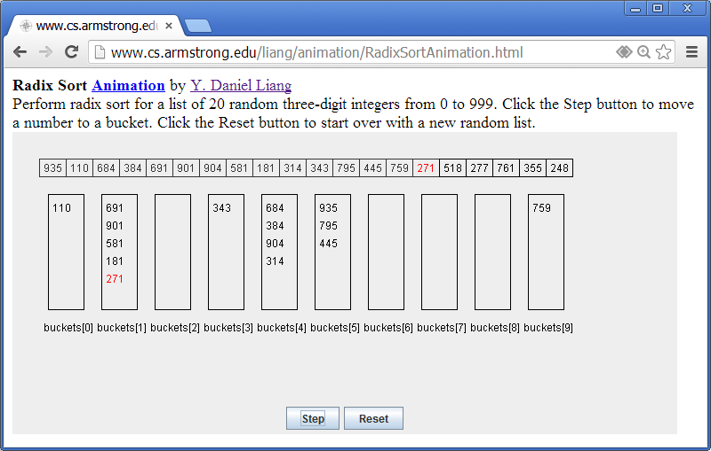
Radix Sort Animation
https://liveexample.pearsoncmg.com/dsanimation/RadixSorteBook.html

Slide 23
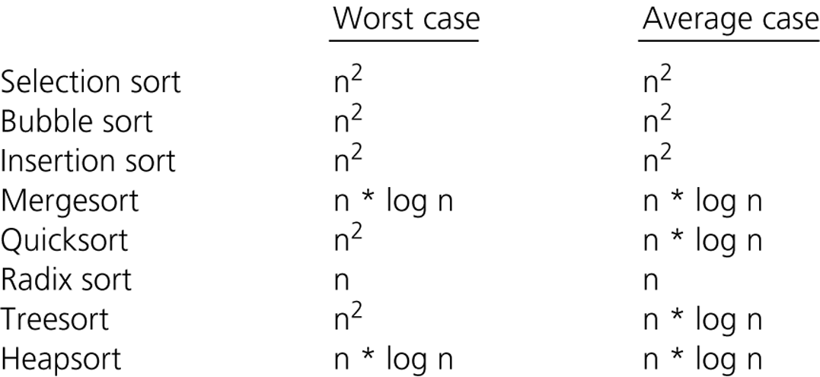
A Comparison of Sorting Algorithms
Approximate growth rates of time required for eight sorting algorithms
© 2011 Pearson Addison-Wesley. All rights reserved
10 B-<number>
Notes:
Selection sort, bubble sort, and insertion sort are all O(n²) algorithms
Quicksort and mergesort are two very efficient sorting algorithms

