Slide 1
Program Structure
Typical Java program consists of
User written classes
Java Application Programming Interface (API) classes
Java application
Has one class with a main method
Java program basic elements:
Packages
Classes
Data fields
Methods

Slide 2
Diagram of a Class
Private Data
Each object has its own private data that other objects cannot directly access
Methods of the public interface provide access to private data, while hiding implementation details:
This is called Encapsulation
Public Interface
Each object has a set of methods available for other objects to use
Class
Private Data
(Variables)
Public Interface
(Methods)

Slide 3

Designing a Class
When designing a class, decisions about the following must be made.
what data must be accounted for
what actions need to be performed
what data can be modified
what data needs to be accessible
any rules as to how data should be modified
Class design typically is done with the aid of a Unified Modeling Language (UML) diagram.

Slide 4
UML Class Diagram
A UML class diagram is a graphical tool that can aid in the design of a class.
The diagram has three main sections.
Class Name
UML diagrams are easily converted
to Java class files. There will be more
about UML diagrams a little later.
Attributes
Methods
The class name should concisely reflect what the class represents.

Slide 5
Rational Numbers UML
Rational
- numerator : int - denominator : int
+ Rational() + Rational(n : int, d : int) + getNumerator() : int + setNumerator(n : int) + getDenominator() : int + setDenominator(d : int) + add(r : Rational) : Rational + subtract(r : Rational) : Rational + divide(r : Rational) : Rational + multiply(r : Rational) : Rational + equals(r : Rational) : Boolean + compareTo(r : Rational) : int + toString() : String - gcd(n : int , d : int) : int
default value for a Rational object is 0/1 Rational objects must be in reduced form Rational objects should not be modified by any of the methods toString() format is “numerator/denominator”

Slide 6
Inheritance
Technique for creating a new class that is based on one that already exists.
Desire to add new features
Desire to define a more specific data type
We don’t want to change the original class
Example: GeometricObject and circle, Rectangle
We already have the GeometricObject class
Circle and Rectangle will be everything a GeometricObject is, but more.

Slide 7
Inheritance
GeometricObject
Contains those attributes and methods that are shared by all Geometric Objects.
Circle
Rectangle
Contains those attributes and methods that are specific to a Rectangle.
Contains those attributes and methods that specific to a Circle.
Notes:
We can extend the capabilities of a class.
Inheritance involves a superclass and a subclass.
The superclass is the general class and
the subclass is the specialized class.
The subclass is based on, or extended from, the superclass.
Superclasses are also called base classes, and
subclasses are also called derived classes.
The relationship of classes can be thought of as parent classes and child classes.

Slide 8
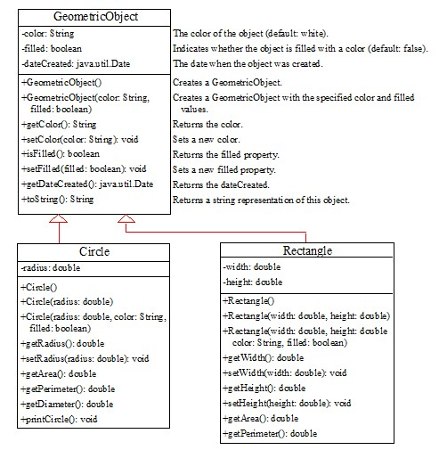
Superclasses and Subclasses
GeometricObject
Circle
Rectangle
TestCircleRectangle
Notes:
It has 3 rows. Row 1, shows the Geometric Object. Row 2, shows the coding and it has 3 lines. Line 1, minus color colon String. Line 2, minus filled colon Boolean. Line 3, minus data C related colon java period util period Date. Row 3, shows the coding and it has 9 lines. Line 1, plus Geometric Object open parenthesis close parenthesis. Line 2, plus Geometric Object open parenthesis color colon String comma. Line 3, filled colon Boolean close parenthesis. Line 4, plus get Color open parenthesis close parenthesis colon String. Line 5, plus set Color open parenthesis color colon String close parenthesis colon void. Line 6, plus is Filled open parenthesis close parenthesis colon Boolean. Line 7, plus set Filled open parenthesis filled colon Boolean close parenthesis colon void. Line 8, plus get Date C related open parenthesis close parenthesis colon java period util period Date. Line 9, plus to String open parenthesis close parenthesis colon String. A left downward side computer code shows the coding and it is divided in 3 rows. Row 1, shows the Circle. Row 2, shows the minus radius colon double. Row 3, has 10 lines. Line 1, plus Circle open parenthesis close parenthesis. Line 2, plus Circle open parenthesis radius colon double close parenthesis. Line 3, plus Circle open parenthesis radius colon double comma color colon String comma. Line 4, filled colon Boolean close parenthesis. Line 5, plus get Radius open parenthesis close parenthesis colon double. Line 6, plus set Radius open parenthesis radius colon double close parenthesis colon void. Line 7, get Area open parenthesis close parenthesis colon double. Line 8, plus get Perimeter open parenthesis close parenthesis colon double. Line 9, plus get Diameter open parenthesis close parenthesis colon double. Line 10, plus print Circle open parenthesis close parenthesis colon void. A right downward side computer code shows the coding and it has 3 rows. Row 1, shows the Rectangle. Row 2, shows the coding for 2 lines. Line 1, minus width colon double. Line 2, minus height colon double. Row 3, also shows the coding for 10 lines. Line 1, plus Rectangle open parenthesis close parenthesis. Line 2, plus Rectangle open parenthesis width colon double comma height colon double close parenthesis. Line 4, color colon String comma filled colon Boolean close parenthesis. Line 5, plus get Width open parenthesis close parenthesis colon double. Line 6, plus set Width open parenthesis width colon double close parenthesis colon void. Line 7, get Height open parenthesis close parenthesis colon double. Line 8, plus set Height open parenthesis height colon double close parenthesis colon void. Line 9, plus get Area open parenthesis close parenthesis colon double. Line 10, plus get Perimeter open parenthesis close parenthesis colon double.
GeometricObject: https://liveexample.pearsoncmg.com/html/SimpleGeometricObject.html
Circle: https://liveexample.pearsoncmg.com/html/CircleFromSimpleGeometricObject.html
Rectangle: https://liveexample.pearsoncmg.com/html/RectangleFromSimpleGeometricObject.html
TestCircleRectangle: https://liveexample.pearsoncmg.com/html/TestCircleRectangle.html

Slide 9
Inheritance
Terminology
Base class (or superclass): the original class from which we create the new one
Derived class (or subclass): the new class we create
We say that the subclass inherits data members and operations of its superclass.
Accessibility
Subclass has access to attributes of its superclass, but the superclass cannot access attributes of its subclass(s)

Slide 10
Useful Java Classes
The Object class
Java supports a single class inheritance hierarchy
With class Object as the root
More useful methods
public boolean equals(Object obj)
protected void finalize()
public int hashCode()
public String toString()

Slide 11
Useful Java Classes
The Arrays class
import java.util.Arrays;
Contains static methods for manipulating arrays
Commonly used examples
Sort (does it in ascending order)
Binary search (quickly finds a value in the array)
toString
Example: Let’s say a is an array of 1000 ints
Arrays.sort(a);

Slide 12
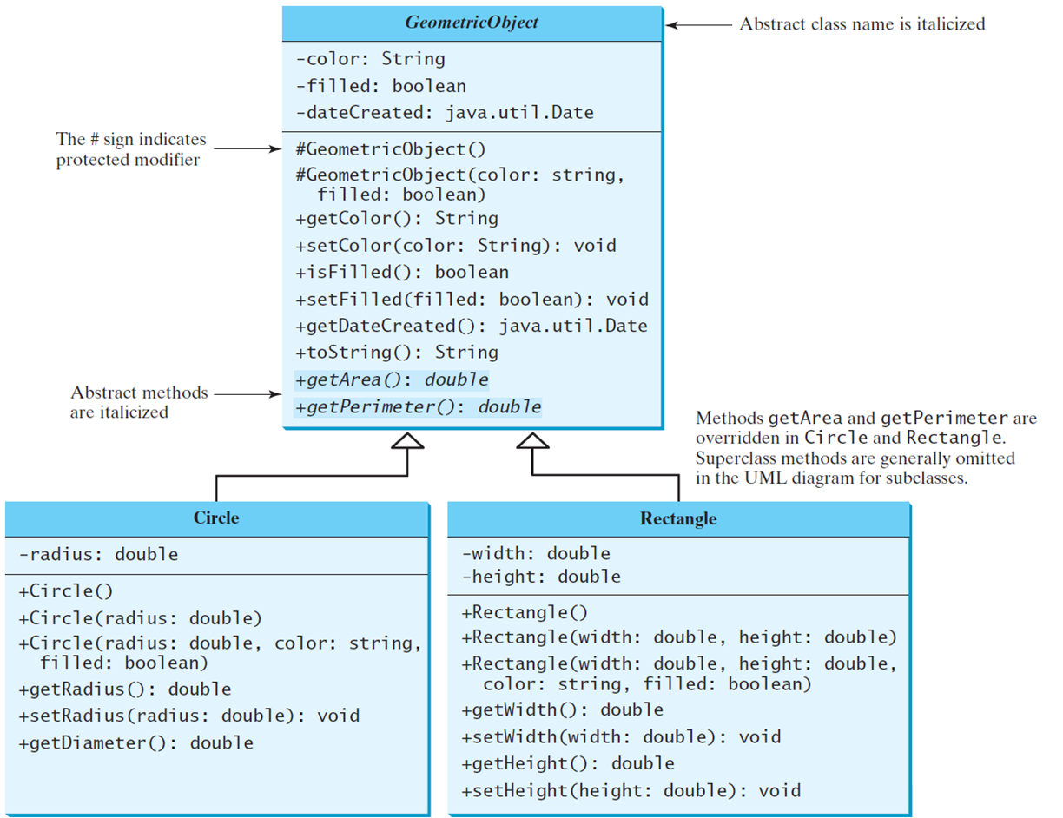
Abstract Classes and Abstract Methods
GeometricObject
Circle
Rectangle
TestGeometricObject
Notes:
The code is divided into 3 boxes that are for Geometric Object, Circle, and Rectangle. A Geometric Object box shows the coding, and it's divided into 2 rows. Row 1 shows the coding for 3 lines. Line 1, minus color colon String. Line 2, minus filled colon boolean. Line 3, minus Date Create colon java period util period Date. Row 2 also shows the coding but for 11 lines. Line 1, protected modifier Geometric Object open parenthesis close parenthesis. Line 2, protected modifier Geometric Object open parenthesis color colon String comma. Line 3, filled colon boolean close parenthesis. Line 4, plus get Color open parenthesis close parenthesis colon String. Line 5, plus set Color open parenthesis color colon String close parenthesis colon void. Line 6, plus is Filled open parenthesis close parenthesis colon boolean. Line 7, plus set Filled open parenthesis filled colon boolean close parenthesis colon void. Line 8, plus get Date Created open parenthesis close parenthesis colon java period util period Date. Line 9, plus to String open parenthesis close parenthesis colon String. Line 10, plus get Area open parenthesis close parenthesis colon double. Line 11, plus get Perimeter open parenthesis close parenthesis colon double. A Circle box shows the coding, but it's divided into two rows. Row 1, shows the coding for 1 line. Line 1, minus radius colon double. Row 2, also shows the coding but for 7 lines. Line 1, plus Circle open parenthesis close parenthesis. Line 2, plus Circle open parenthesis radius colon double close parenthesis. Line 3, plus Circle open parenthesis radius colon double comma color colon string comma. Line 4, filled colon boolean close parenthesis. Line 5, plus get Radius open parenthesis close parenthesis colon double. Line 6, plus set Radius open parenthesis radius colon double close parenthesis colon void. Line 7, plus get Diameter open parenthesis close parenthesis colon double and this box makes an arrow to represent the Geometric Object box. A Rectangle box also shows the coding and divided into 2 rows. Row 1, shows the coding for 2 lines. Line 1, minus width colon double. Line 2, minus height colon double. Row 2, also shows coding but for 8 lines. Line 1, plus Rectangle open parenthesis close parenthesis. Line 2, plus Rectangle open parenthesis width colon double comma height colon double close parenthesis. Line 3, plus Rectangle open parenthesis width colon double comma height colon double comma. Line 4, color colon string comma filled colon boolean close parenthesis. Line 5, plus get Width open parenthesis close parenthesis colon double. Line 6, plus set Width open parenthesis width colon double close parenthesis colon void. Line 7, plus get Height open parenthesis close parenthesis colon double. Line 8, plus set Height open parenthesis height colon double close parenthesis colon void.
GeometricObject: https://liveexample.pearsoncmg.com/html/GeometricObject.html
Circle: https://liveexample.pearsoncmg.com/html/Circle.html
Rectangle: https://liveexample.pearsoncmg.com/html/Rectangle.html
TestGeometricObject: https://liveexample.pearsoncmg.com/html/TestGeometricObject.html

Slide 13
Abstract Method in Abstract Class
An abstract method cannot be contained in a nonabstract class. If a subclass of an abstract superclass does not implement all the abstract methods, the subclass must be defined abstract. In other words, in a nonabstract subclass extended from an abstract class, all the abstract methods must be implemented, even if they are not used in the subclass.
Notes:
An abstract class cannot be instantiated using the new operator, but you can still define its constructors, which are invoked in the constructors of its subclasses. For instance, the constructors of GeometricObject are invoked in the Circle class and the Rectangle class.
A class that contains abstract methods must be abstract. However, it is possible to define an abstract class that contains no abstract methods. In this case, you cannot create instances of the class using the new operator. This class is used as a base class for defining a new subclass.
A subclass can be abstract even if its superclass is concrete. For example, the Object class is concrete, but its subclasses, such as GeometricObject, may be abstract.

Slide 14
Abstract Class as Type
You cannot create an instance from an abstract class using the new operator, but an abstract class can be used as a data type. Therefore, the following statement, which creates an array whose elements are of GeometricObject type, is correct.
GeometricObject[] geo = new GeometricObject[10];

Slide 15
Interfaces
What is an interface?
Why is an interface useful?
How do you define an interface?
How do you use an interface?

Slide 16
What Is an Interface? Why Is an Interface Useful?
An interface is a class like construct that contains only constants and abstract methods. In many ways, an interface is similar to an abstract class, but the intent of an interface is to specify common behavior for objects. For example, you can specify that the objects are comparable, edible, cloneable using appropriate interfaces.

Slide 17
Define an Interface
To distinguish an interface from a class, Java uses the following syntax to define an interface:
public interface InterfaceName {
constant declarations;
abstract method signatures;
}
Notes:
An interface is treated like a special class in Java. Each interface is compiled into a separate bytecode file, just like a regular class. Like an abstract class, you cannot create an instance from an interface using the new operator, but in most cases you can use an interface more or less the same way you use an abstract class. For example, you can use an interface as a data type for a variable, as the result of casting, and so on.

Slide 18
Example
public interface MyList<E> { /** Remove the element at the specified position in this list * Shift any subsequent elements to the left. * Return the element that was removed from the list. */ public E remove(int index); /** Remove the element at the beginning of this this list * Return the element that was removed */ public E removeFirst(); /** Remove the element at the end of this this list * Return the element that was removed */ public E removeLast(); /** Add a new element at the specified position*/ public void add(int index, E e); /** Add a new element at the end of this list */ public void addLast(E e); /** Add a new element at the beginning of this list */ public void addFirst(E e); /** Return true if this list contains no elements */ public boolean isEmpty(); /** Return size of this list */ public int size(); }

Slide 19
Example: The Comparable Interface
// This interface is defined in
// java.lang package
package java.lang;
public interface Comparable<E> {
public int compareTo(E o);
}

Slide 20
The toString, equals, and hashCode Methods
Each wrapper class overrides the toString, equals, and hashCode methods defined in the Object class. Since all the numeric wrapper classes and the Character class implement the Comparable interface, the compareTo method is implemented in these classes.

Slide 21
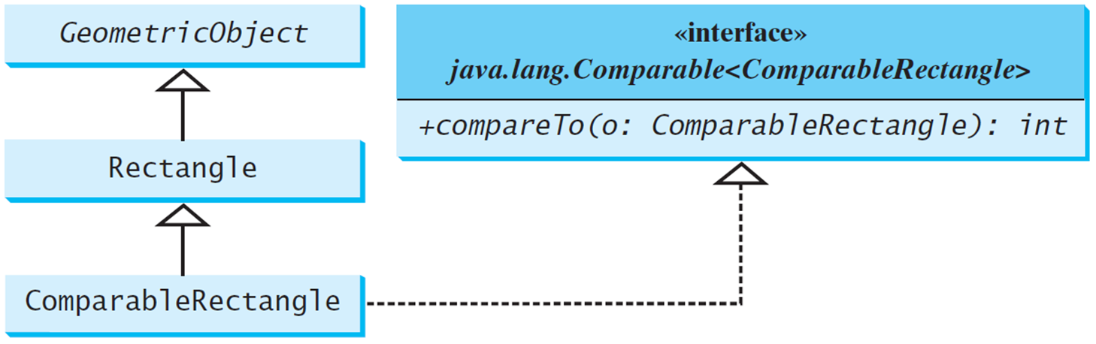
Defining Classes to Implement Comparable
ComparableRectangle
SortRectangles
Notes:
It has 4 boxes. Box 1 shows the Geometric Object. Box 2 shows the Rectangle, and it makes an arrow upward to show box 1. Box 3 shows the Comparable Rectangle, and it makes 2 arrows, one for upward to show box 2 and another for the right hand side to show box 4. Box 4, has 2 rows. Row 1, has 2 lines. Line 1, open braces open braces interface close braces close braces. Line 2, java period lang period Comparable less than Comparable Rectangle greater than. Row 2, plus compare To open parenthesis o colon Comparable Rectangle close parenthesis colon int.
ComparableRectangle: https://liveexample.pearsoncmg.com/html/ComparableRectangle.html
SortRectangles: https://liveexample.pearsoncmg.com/html/SortRectangles.html

Slide 22
Interfaces versus Abstract Classes (1 of 2)
In an interface, the data must be constants; an abstract class can have all types of data.
Each method in an interface has only a signature without implementation; an abstract class can have concrete methods.
Blank | Variables | Constructors | Methods
Abstract class | No restrictions. | Constructors are invoked by subclasses through constructor chaining. An abstract class cannot be instantiated using the new operator. | No restrictions.
Interface | All variables must be public static final | No constructors. An interface cannot be instantiated using the new operator. | All methods must be public abstract instance methods

