Slide 1
Data Structures & Algorithms
Lecture 04

Slide 2
What is Data Structure?
A data structure is a collection of data organized in some fashion. The structure not only stores data, but also supports operations for accessing and manipulating the data.
Basic data structures
Record
Array
Linked List
Binary Tree
Hash Table
Heap
Graph

Slide 3
Java Collection Framework hierarchy
A collection is a container object that holds a group of objects, often referred to as elements. The Java Collections Framework supports two types of collections:
One, for storing a collection , is simply called collection.
The other, for storing key/value pairs, is called a map.

Slide 4
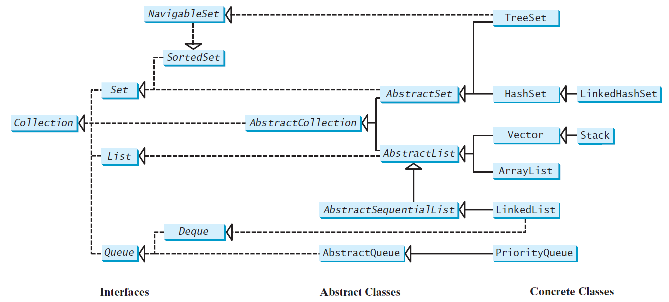
Java Collection Framework hierarchy, cont.
Set and List are subinterfaces of Collection.

Slide 5
The Collection Interface
The Collection interface is for manipulating a collection of objects.
UML Diagram
TestCollection

Slide 6
Iterators
Iterator is a classic design pattern for walking through a data structure without having to expose the details of how data is stored in the data structure.
TestIterator

Slide 7
Using the forEach Method
Java 8 added a new forEach method in the Iterable interface. It functions like a foreach loop.
TestForEach

Slide 8
Abstract Data Types
Procedural abstraction
Separates the purpose and use of a module from its implementation
A module’s specifications should
Detail how the module behaves
Identify details that can be hidden within the module
Information hiding
Hides certain implementation details within a module
Makes these details inaccessible from outside the module

Slide 9
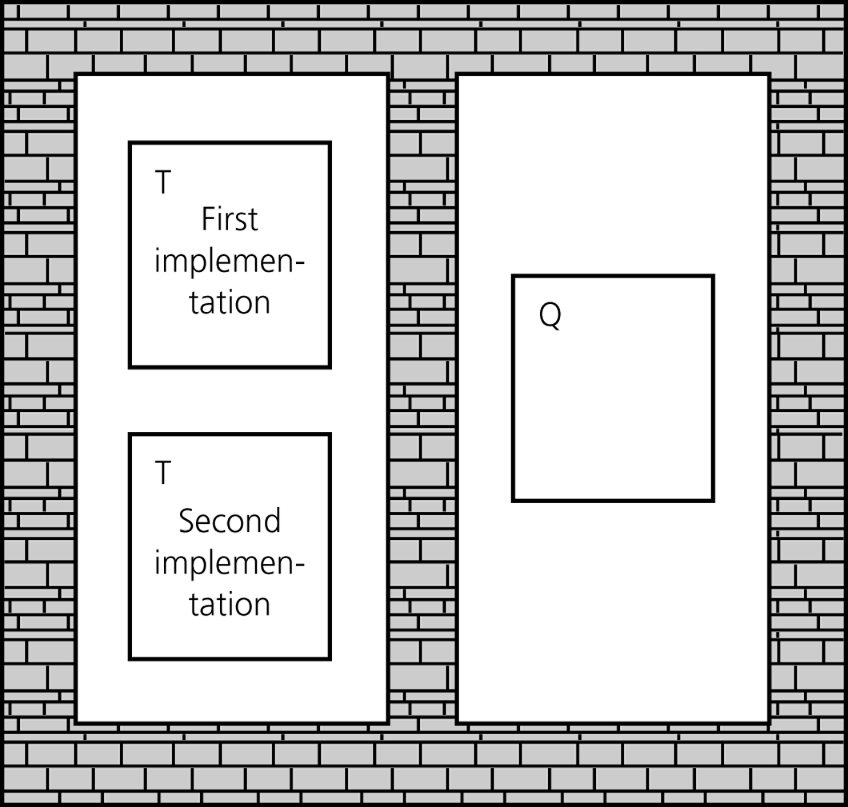
Abstract Data Types
Isolated tasks: the implementation of task T does not affect task Q
Notes:
The wall (information hiding) around each task T prevents the other task (Q) from seeing “How” T is performed.
Changing implementation of method in T, does not effect Q

Slide 10
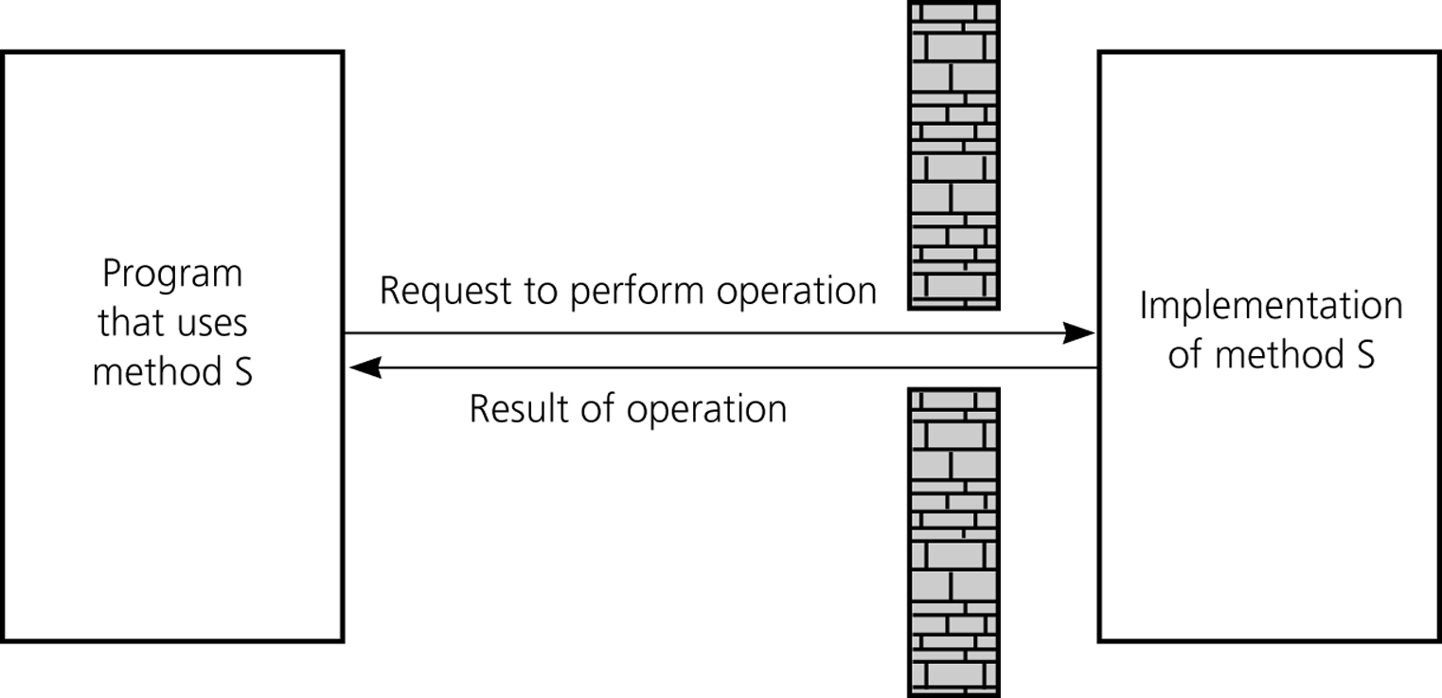
Abstract Data Types
The isolation of modules is not total
Methods’ specifications, or contracts, govern how they interact with each other
A slit in the wall
Notes:
Task Q does not know how task T is performed
It must know what task T is and hot to initiate it.
For example:
We know That a module has a method “S” to sort an array of names.
Program that uses Method S doesn’t need to know how the sorting is done.
It only needs to know what the signature of the method is (return-type method-name parameter-list)

Slide 11
Abstract Data Types
Typical operations on data
Add data to a data collection
Remove data from a data collection
Ask questions about the data in a data collection
Data abstraction
Asks you to think what you can do to a collection of data independently of how you do it
Allows you to develop each data structure in relative isolation from the rest of the solution
A natural extension of procedural abstraction
Notes:
Often the solution to a problem requires operations on data.
The details of operation vary from application to application
The other modules of the solution will “KNOW” what operations they can perform on the data, but they should not depend on how the data is stored or how the operations are performed

Slide 12
Abstract Data Types
Abstract data type (ADT)
An ADT is composed of
A collection of data
A set of operations on that data
Specifications of an ADT indicate
What the ADT operations do, not how to implement them
Implementation of an ADT
Includes choosing a particular data structure

Slide 13
Abstract Data Types
Data structure
A construct that is defined within a programming language to store a collection of data
Example: arrays
ADTs and data structures are not the same
Data abstraction
Results in a wall of ADT operations between data structures and the program that accesses the data within these data structures
Notes:
An abstract data type is a collection of data and set of operations on that data
A data structure is a construct within a programming language that stores a collection of data
Circle[] circles = new Circle[10];
Array circles is a data structure (an array)
Circle is ADT that represents a circle with its given methods

Slide 14
ADT (Refrigerator ice dispenser)
Out-of-ice indicator
Chilled
water
Crushed
ice
Ice
cude
Operations
output
Data
Water
Break in the wall (input)
Wall
Notes:
As a user you know how it works.
Manufacturer needs to built the dispenser and they have to worry about the inner working of each component
For example: how is the iced crushed (using a hammer or blades)
Manufacturer must build the unit most efficient (cost & maintenance)

Slide 15
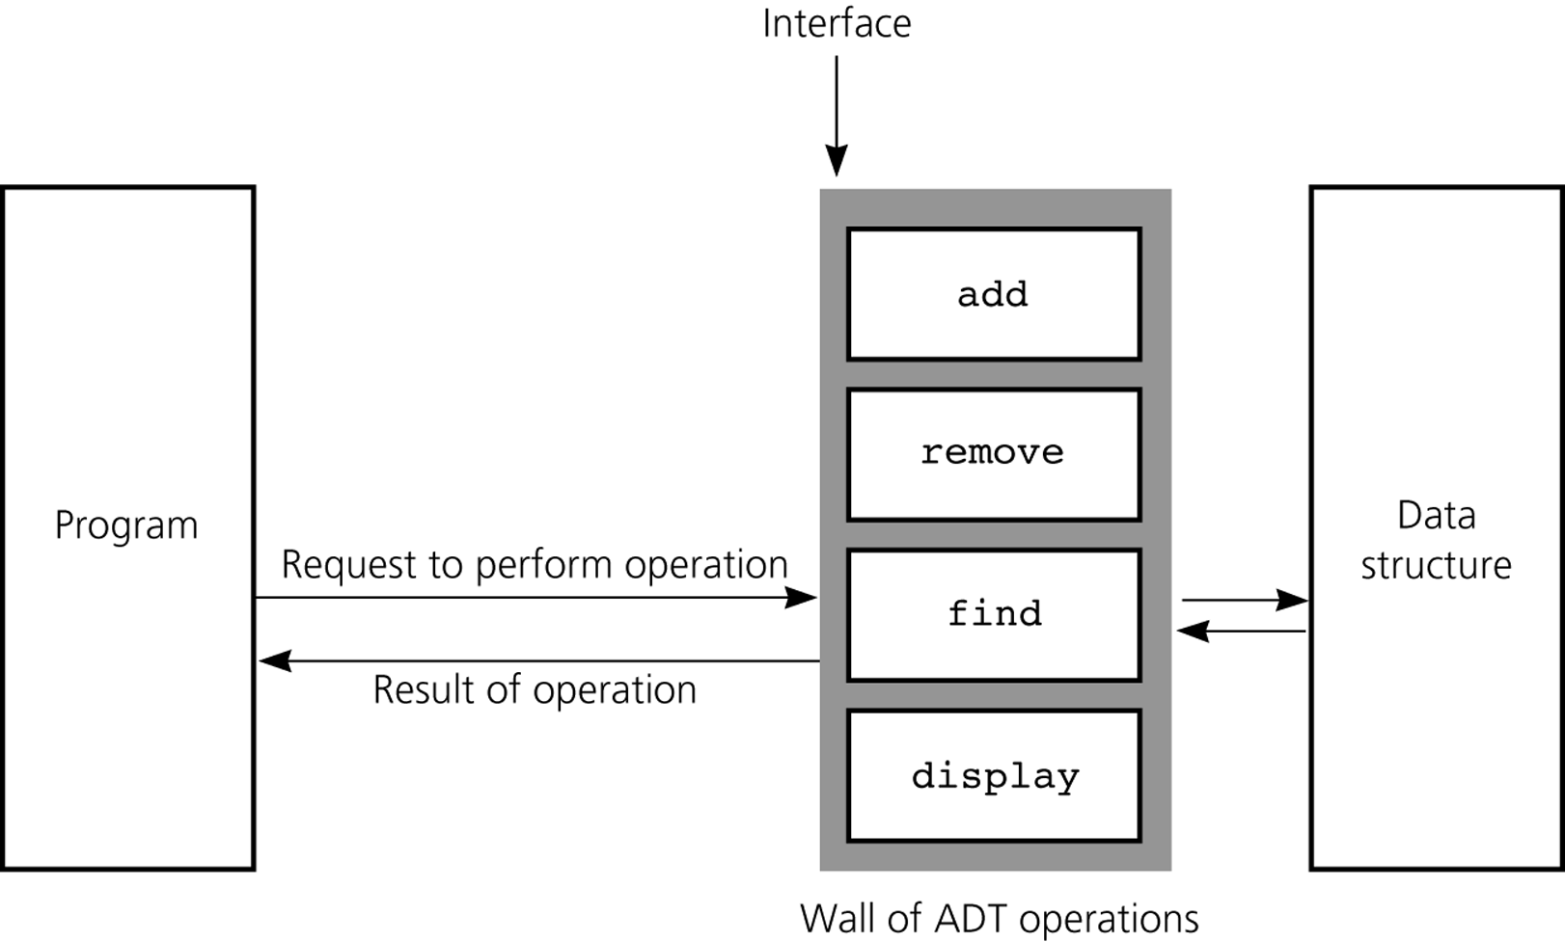
Abstract Data Types
A wall of ADT operations isolates a data structure from the program that uses it
Notes:
To summarize
Program Side: only sees an interface that enables you to communicate with the data structure

Slide 16
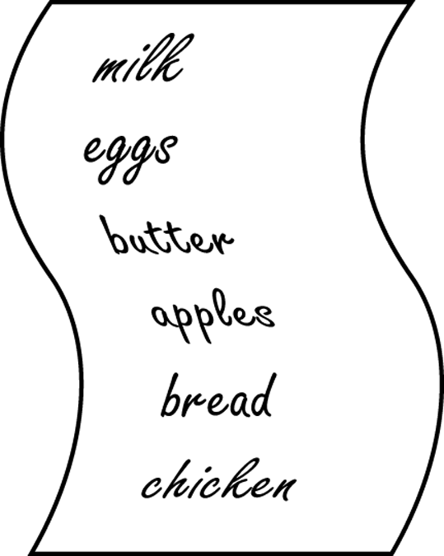
Specifying ADTs
In a list
Except for the first and last items, each item has
A unique predecessor
A unique successor
Head or front
Does not have a predecessor
Tail or end
Does not have a successor
Notes:
List contains items of the same type
You probably add items to the end of the list or you insert so that list is sorted
Items appear in sequence
Operations
Add items
Remove items
Look up item
Length of the list
The items on the list and opertions that you perform on the items, form an ADT

Slide 17
The List Interface
A list stores elements in a sequential order, and allows the user to specify where the element is stored. The user can access the elements by index.

Slide 18
Lists
A list is a popular data structure to store data in sequential order. For example, a list of students, a list of available rooms, a list of cities, and a list of books, etc. can be stored using lists. The common operations on a list are usually the following:
· Retrieve an element from this list.
· Insert a new element to this list.
· Delete an element from this list.
· Find how many elements are in this list.
· Find if an element is in this list.
· Find if this list is empty.

Slide 19
Two Ways to Implement Lists
There are two ways to implement a list.
Using arrays. One is to use an array to store the elements. The array is dynamically created. If the capacity of the array is exceeded, create a new larger array and copy all the elements from the current array to the new array.
Using linked list. The other approach is to use a linked structure. A linked structure consists of nodes. Each node is dynamically created to hold an element. All the nodes are linked together to form a list.

Slide 20
Design of ArrayList and LinkedList
For convenience, let’s name these two classes: MyArrayList and MyLinkedList. These two classes have common operations, but different data fields. The common operations can be generalized in an interface or an abstract class. Prior to Java 8, a popular design strategy is to define common operations in an interface and provide an abstract class for partially implementing the interface. So, the concrete class can simply extend the abstract class without implementing the full interface. Java 8 enables you to define default methods. You can provide default implementation for some of the methods in the interface rather than in an abstract class.

Slide 21
MyList Interface
MyList.java

Slide 22
Array Lists
Array is a fixed-size data structure. Once an array is created, its size cannot be changed. Nevertheless, you can still use array to implement dynamic data structures. The trick is to create a new larger array to replace the current array if the current array cannot hold new elements in the list.
Initially, an array, say data of Object[] type, is created with a default size. When inserting a new element into the array, first ensure there is enough room in the array. If not, create a new array with the size as twice as the current one. Copy the elements from the current array to the new array. The new array now becomes the current array.

Slide 23
Insertion
Before inserting a new element at a specified index, shift all the elements after the index to the right and increase the list size by 1.

Slide 24
Deletion
To remove an element at a specified index, shift all the elements after the index to the left by one position and decrease the list size by 1.

Slide 25
Implementing MyArrayList
MyArrayList.java

