Slide 1
Motivations
Data stored in a text file is represented in human-readable form. Data stored in a binary file is represented in binary form. You cannot read binary files. They are designed to be read by programs. For example, Java source programs are stored in text files and can be read by a text editor, but Java classes are stored in binary files and are read by the J V M. The advantage of binary files is that they are more efficient to process than text files.

Slide 2
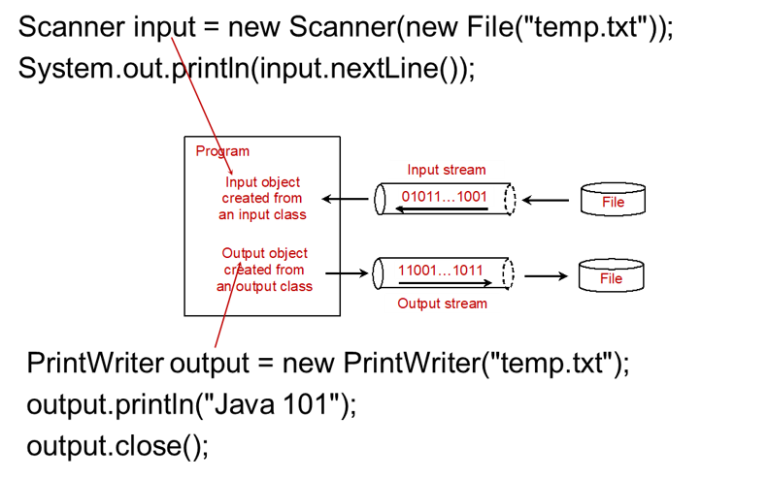
How Is I/O Handled in Java?
A File object encapsulates the properties of a file or a path, but does not contain the methods for reading/writing data from/to a file. In order to perform I/O, you need to create objects using appropriate Java I/O classes.

Slide 3
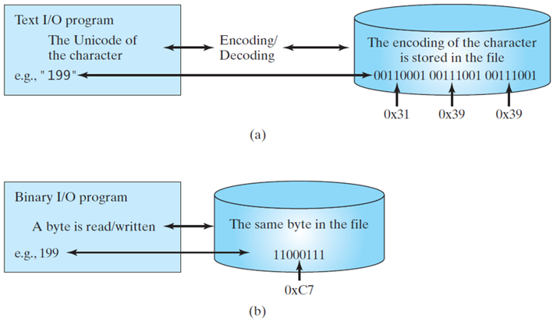
Binary I/O
Text I/O requires encoding and decoding. The J V M converts a Unicode to a file specific encoding when writing a character and coverts a file specific encoding to a Unicode when reading a character. Binary I/O does not require conversions. When you write a byte to a file, the original byte is copied into the file. When you read a byte from a file, the exact byte in the file is returned.
Notes:
Data stored in a text file are represented in human-readable form. Data stored in a binary file are represented in binary form. You cannot read binary files. Binary files are designed to be read by programs. For example, the Java source programs are stored in text files and can be read by a text editor, but the Java classes are stored in binary files and are read by the J V M. The advantage of binary files is that they are more efficient to process than text files.
Although it is not technically precise and correct, you can imagine that a text file consists of a sequence of characters and a binary file consists of a sequence of bits. For example, the decimal integer 199 is stored as the sequence of three characters: '1', '9', '9' in a text file and the same integer is stored as a byte-type value C7 in a binary file, because decimal 199 equals to hex C7.

Slide 4
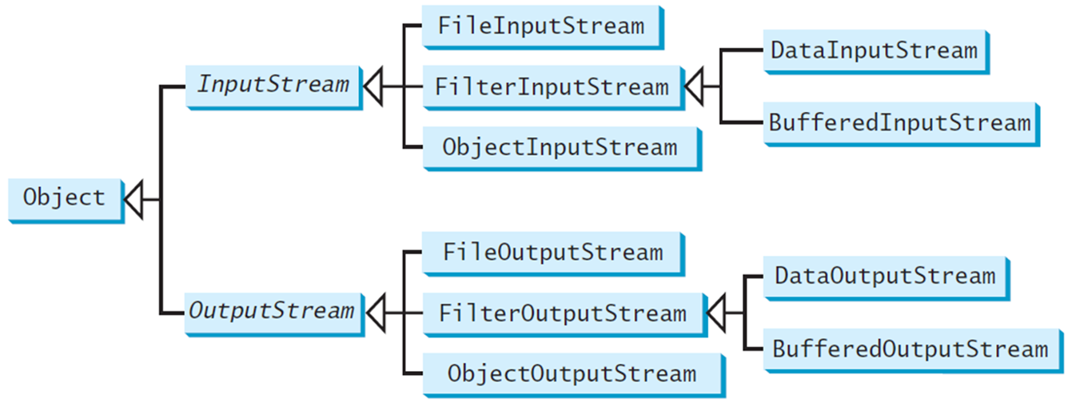
Binary I/O Classes

Slide 5
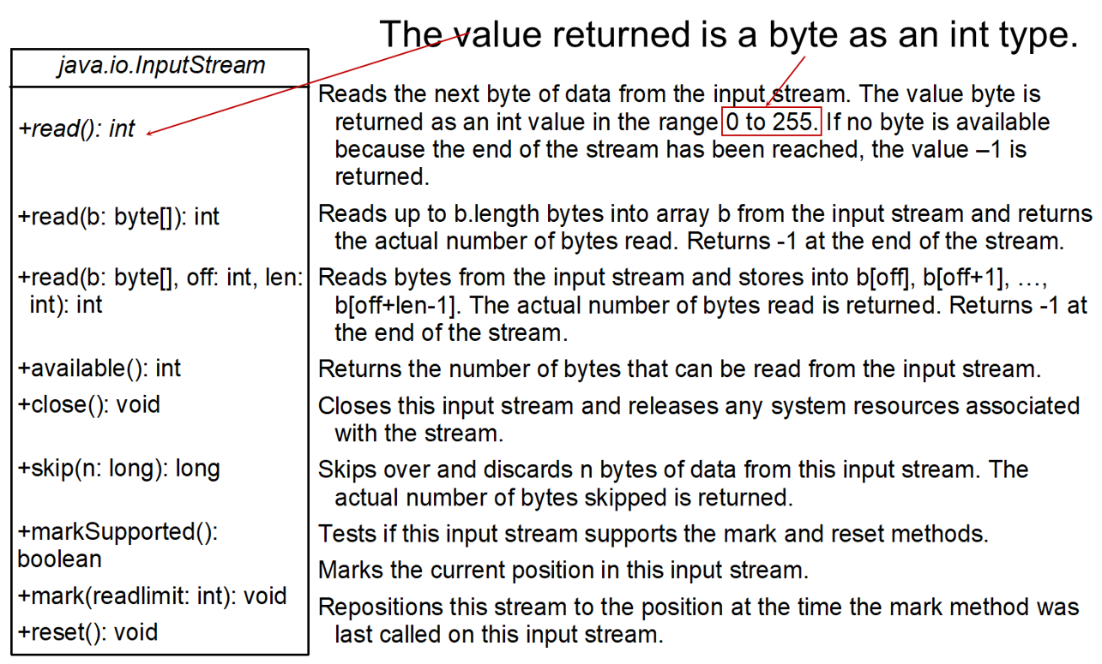
InputStream

Slide 6
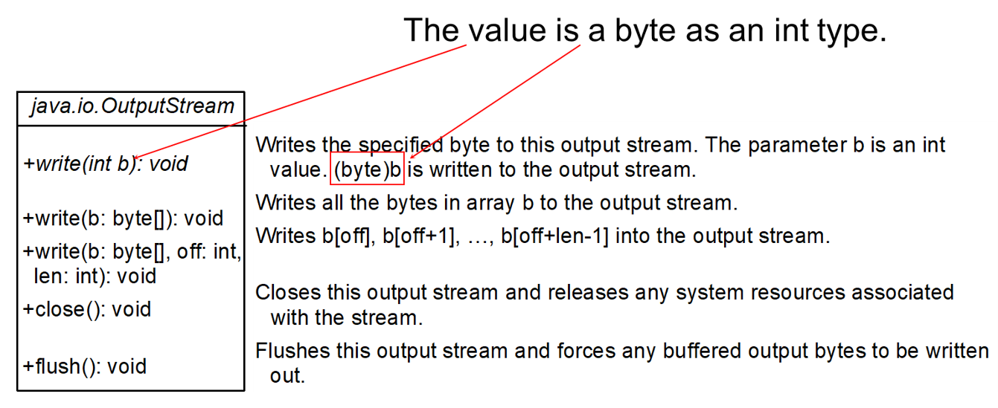
OutputStream

Slide 7
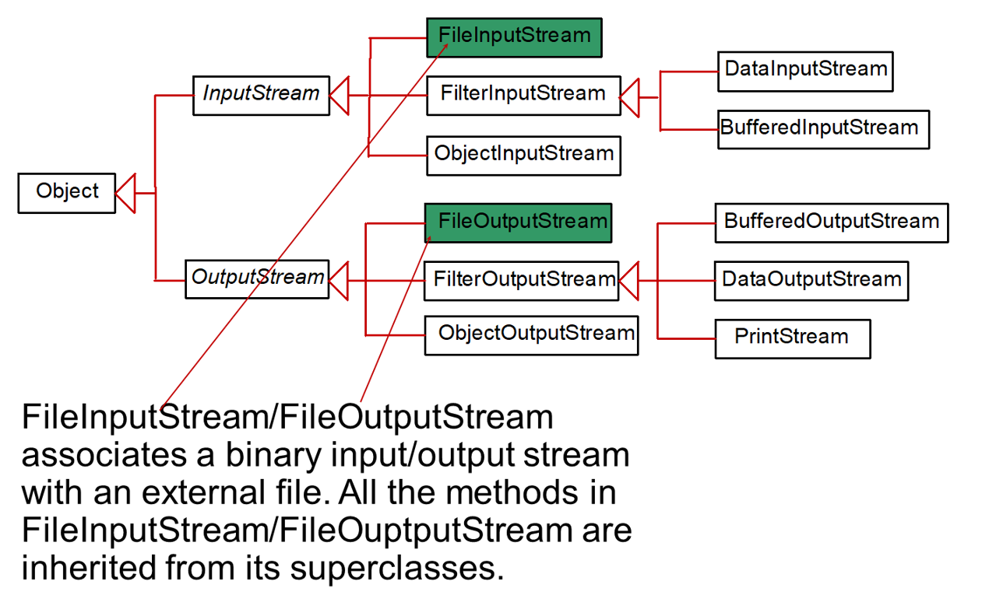
FileInputStream/FileOutputStream

Slide 8
FileInputStream
To construct a FileInputStream, use the following constructors:
public FileInputStream(String filename)
public FileInputStream(File file)
A java.io.FileNotFoundException would occur if you attempt to create a FileInputStream with a nonexistent file.

Slide 9
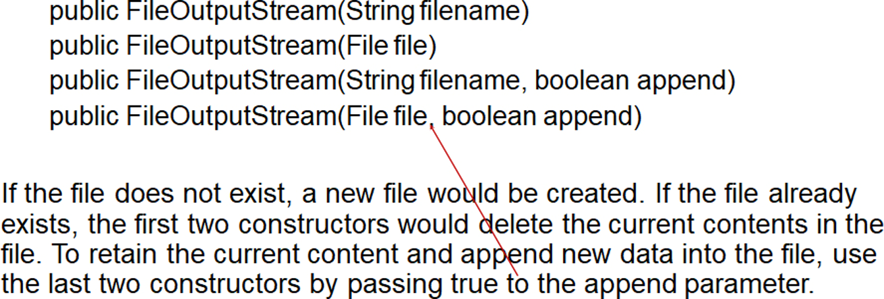
FileOutputStream
To construct a FileOutputStream, use the following constructors:
TestFileStream
Notes:
TestFileStream: https://liveexample.pearsoncmg.com/html/TestFileStream.html

Slide 10
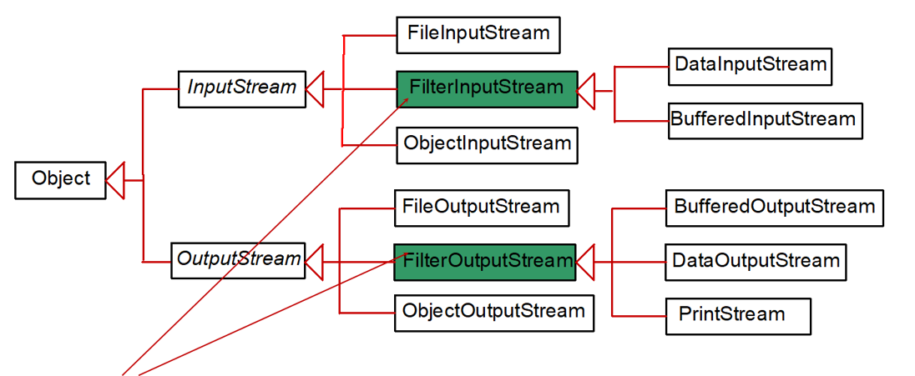
FilterInputStream/FilterOutputStream
Filter streams are streams that filter bytes for some purpose. The basic byte input stream provides a read method that can only be used for reading bytes. If you want to read integers, doubles, or strings, you need a filter class to wrap the byte input stream. Using a filter class enables you to read integers, doubles, and strings instead of bytes and characters. FilterInputStream and FilterOutputStream are the base classes for filtering data. When you need to process primitive numeric types, use DatInputStream and DataOutputStream to filter bytes.

Slide 11
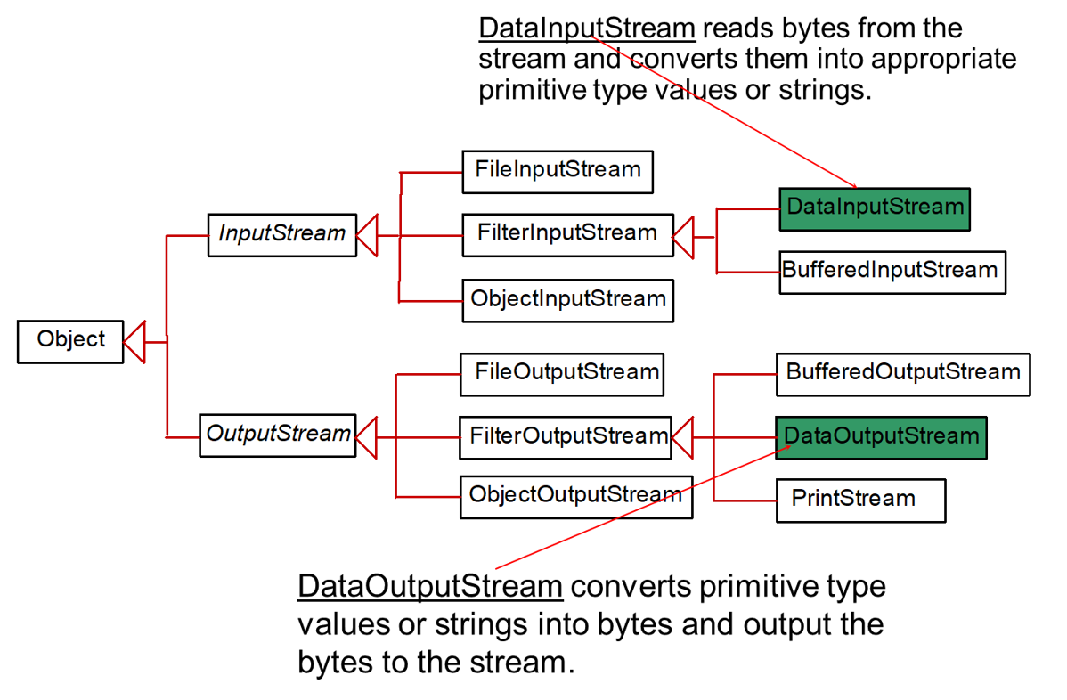
DataInputStream/DataOutputStream

Slide 12
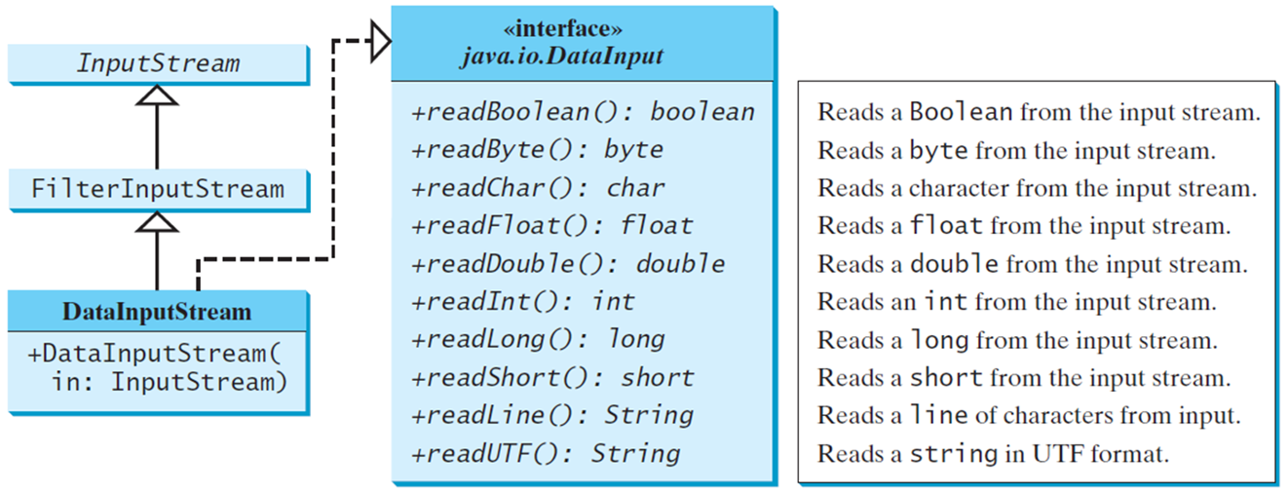
DataInputStream
DataInputStream extends FilterInputStream and implements the DataInput interface.

Slide 13
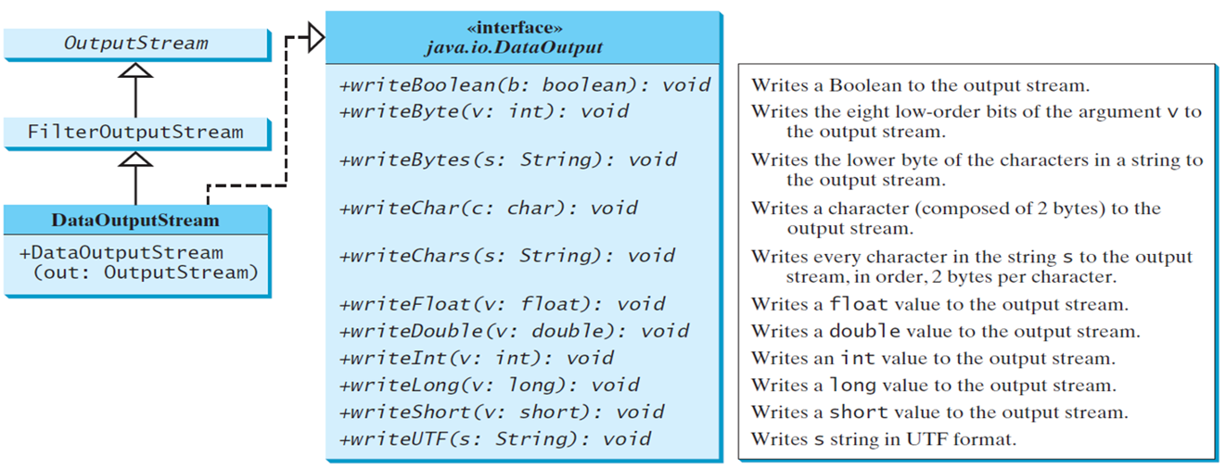
DataOutputStream
DataOutputStream extends FilterOutputStream and implements the DataOutput interface.

Slide 14
Characters and Strings in Binary I/O
A Unicode consists of two bytes. The writeChar(char c) method writes the Unicode of character c to the output. The writeChars(String s) method writes the Unicode for each character in the string s to the output.
Why U T F-8? What is U T F-8?
U T F-8 is a coding scheme that allows systems to operate with both A S C I I and Unicode efficiently. Most operating systems use A S C I I. Java uses Unicode. The A S C I I character set is a subset of the Unicode character set. Since most applications need only the A S C I I character set, it is a waste to represent an 8-bit A S C I I character as a 16-bit Unicode character. The U T F-8 is an alternative scheme that stores a character using 1, 2, or 3 bytes. A S C I I values (less than 0x7F) are coded in one byte. Unicode values less than 0x7F F are coded in two bytes. Other Unicode values are coded in three bytes.

Slide 15
Using DataInputStream/DataOutputStream
Data streams are used as wrappers on existing input and output streams to filter data in the original stream. They are created using the following constructors:
public DataInputStream(InputStream instream)
public DataOutputStream(OutputStream outstream)
The statements given below create data streams. The first statement creates an input stream for file in.dat; the second statement creates an output stream for file out.dat.
DataInputStream infile =
new DataInputStream(new FileInputStream("in.dat"));
DataOutputStream outfile =
new DataOutputStream(new FileOutputStream("out.dat"));
Notes:
TestDataStream: https://liveexample.pearsoncmg.com/html/TestFileStream.html

Slide 16
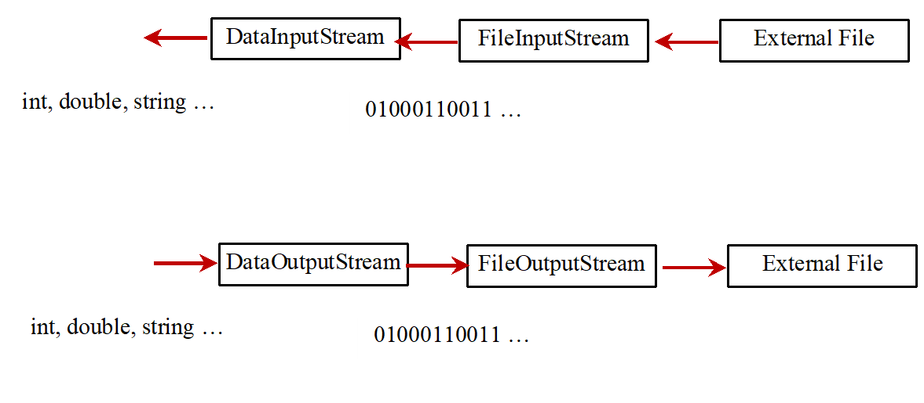
Concept of Pipe Line

Slide 17
Order and Format
Caution: You have to read the data in the same order and same format in which they are stored. For example, since names are written in U T F-8 using writeUTF, you must read names using readUTF.
Checking End of File
Tip: If you keep reading data at the end of a stream, an EOFException would occur. So how do you check the end of a file? You can use input.available() to check it. input.available() == 0 indicates that it is the end of a file.
TestDataStream

Slide 18
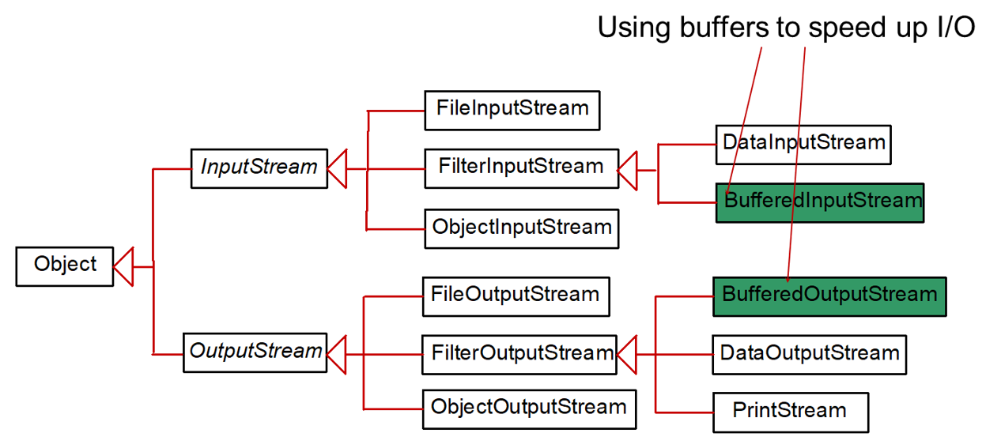
BufferedInputStream/BufferedOutputStream
BufferedInputStream/BufferedOutputStream does not contain new methods. All the methods BufferedInputStream/BufferedOutputStream are inherited from the InputStream/OutputStream classes.

Slide 19
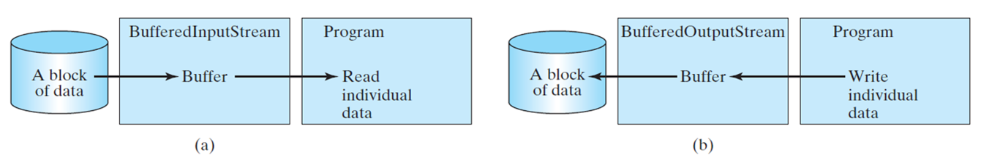
Constructing BufferedInputStream/BufferedOutputStream
// Create a BufferedInputStream
public BufferedInputStream(InputStream in)
public BufferedInputStream(InputStream in, int bufferSize)
// Create a BufferedOutputStream
public BufferedOutputStream(OutputStream out)
public BufferedOutputStream(OutputStreamr out, int bufferSize)

Slide 20
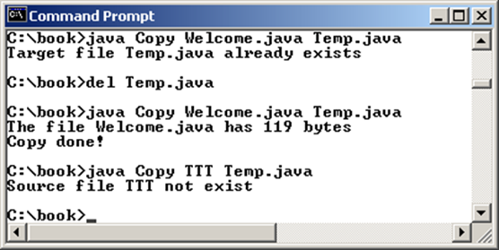
Case Studies: Copy File
This case study develops a program that copies files. The user needs to provide a source file and a target file as command-line arguments using the following command:
java Copy source target
The program copies a source file to a target file and displays the number of bytes in the file. If the source does not exist, tell the user the file is not found. If the target file already exists, tell the user the file already exists.
Copy
Notes:
Copy: https://liveexample.pearsoncmg.com/html/Copy.html

Slide 21
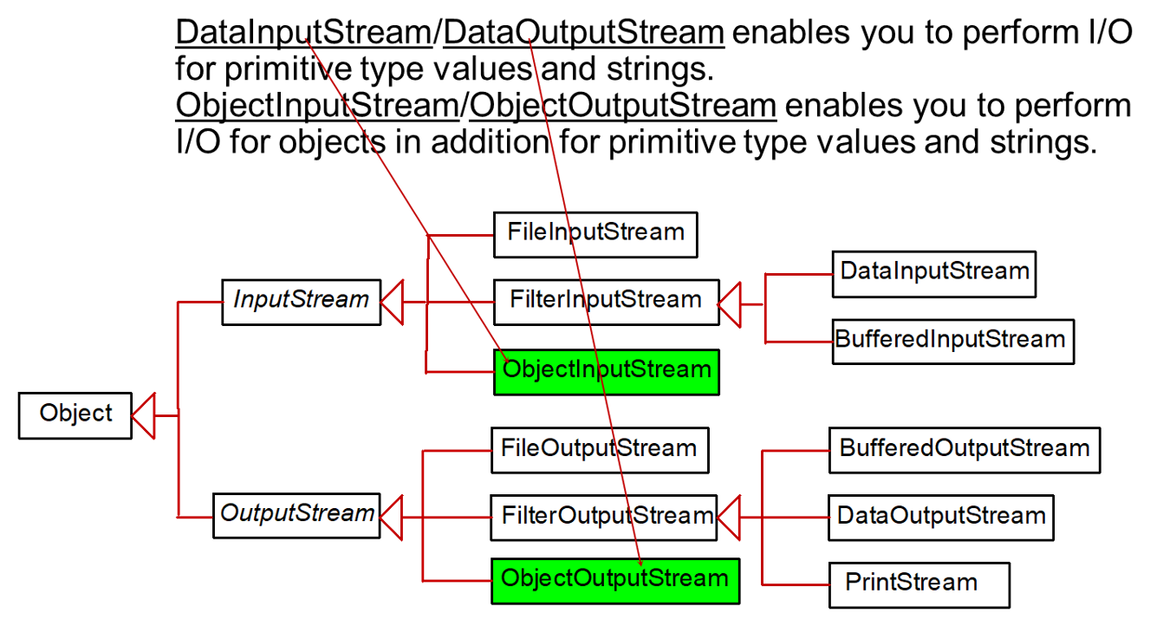
Object I/O

Slide 22
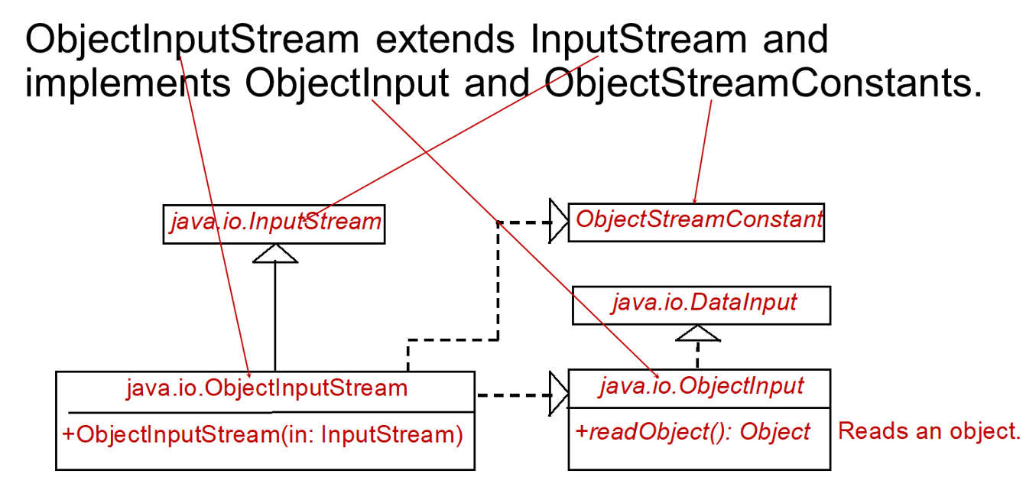
ObjectInputStream

Slide 23
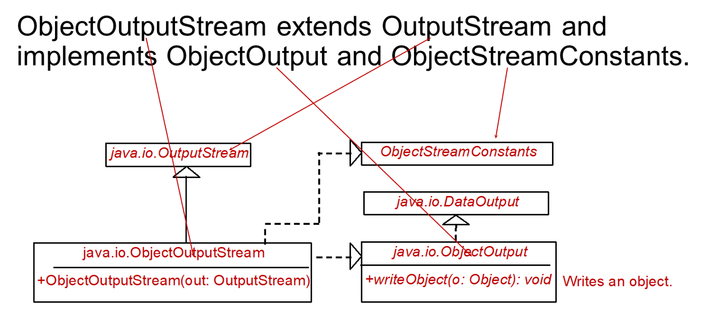
ObjectOutputStream

Slide 24
Using Object Streams
You may wrap an ObjectInputStream/ObjectOutputStream on any InputStream/OutputStream using the following constructors:
// Create an ObjectInputStream
public ObjectInputStream(InputStream in)
// Create an ObjectOutputStream
public ObjectOutputStream(OutputStream out)
TestObjectOutputStream
TestObjectInputStream
Notes:
TestObjectOutputStream: https://liveexample.pearsoncmg.com/html/TestObjectOutputStream.html
TestObjectInputStream: http://www.cs.armstrong.edu/liang/intro11e/html/TestObjectInputStream.html

