Slide 1
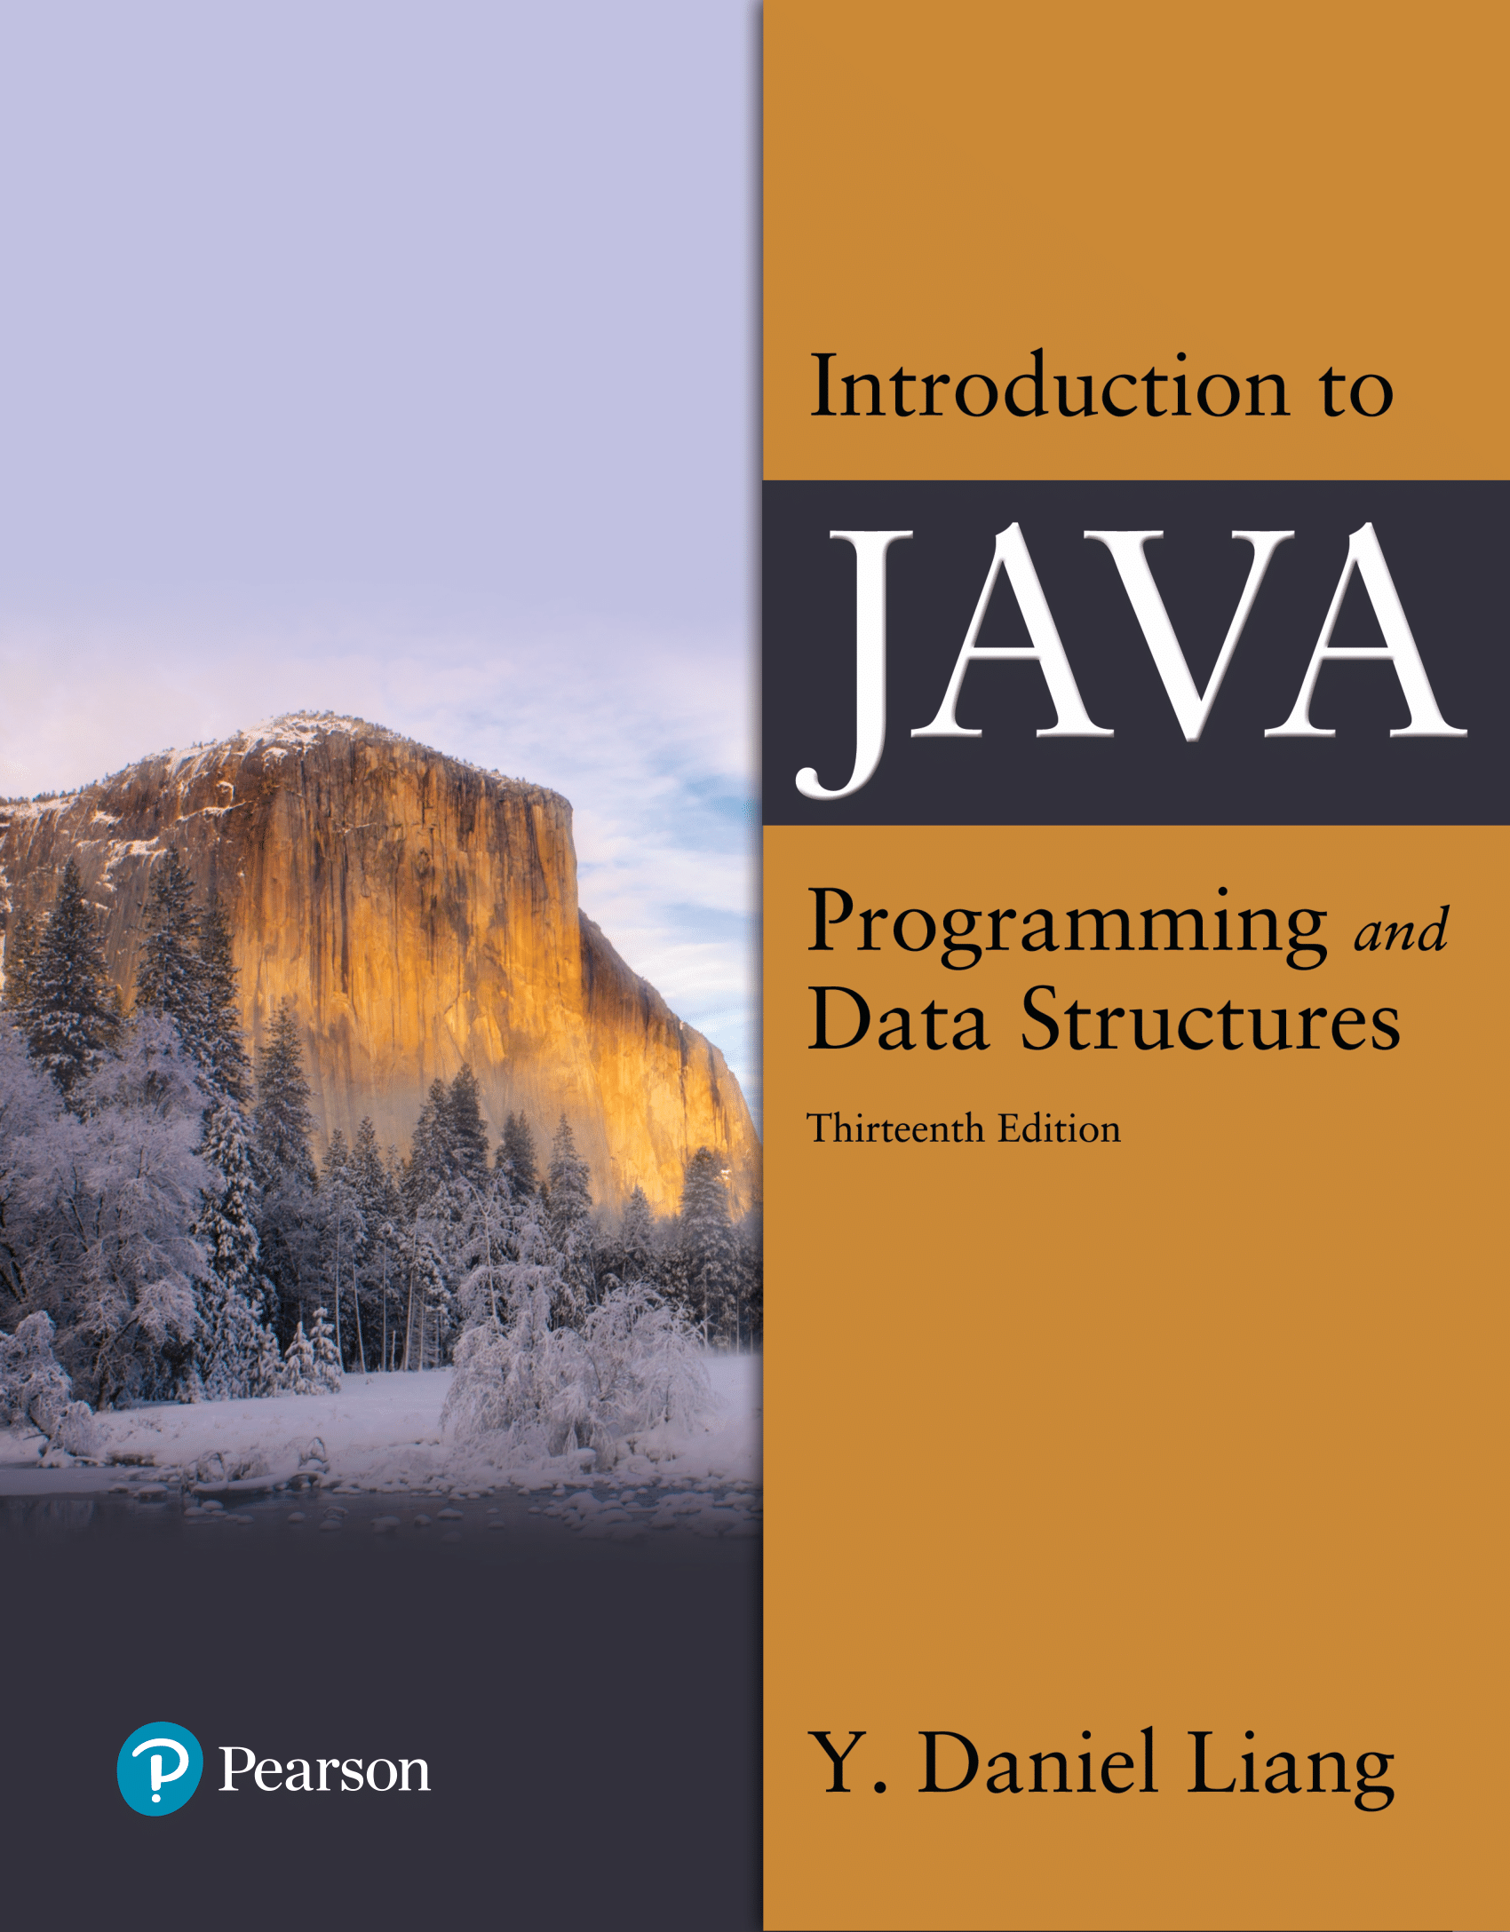

Introduction to Java Programming and Data Structures
Thirteenth Edition
Chapter 4
Mathematical Functions, Characters, and Strings
Copyright © 2024 Pearson Education, Inc. All Rights Reserved
Notes:
If this PowerPoint presentation contains mathematical equations, you may need to check that your computer has the following installed:
1) MathType Plugin
2) Math Player (free versions available)
3) NVDA Reader (free versions available)
Slides in this presentation contain hyperlinks. JAWS users should be able to get a list of links by using INSERT+F7

Slide 2
Mathematical Functions
Java provides many useful methods in the Math class for performing common mathematical functions.

Slide 3
The Math Class
Class constants:
PI
E
Class methods:
Trigonometric Methods
Exponent Methods
Rounding Methods
min, max, abs, and random Methods

Slide 4
Exponent Methods
pow(double a, double b)
Returns a raised to the power of b.
sqrt(double a)
Returns the square root of a.
Examples:
Math.pow(2, 3) returns 8.0
Math.pow(3, 2) returns 9.0
Math.pow(3.5, 2.5) returns 22.91765
Math.sqrt(4) returns 2.0
Math.sqrt(10.5) returns 3.24

Slide 5
Rounding Methods
double ceil(double x)
x rounded up to its nearest integer. This integer is returned as a double value.
double floor(double x)
x is rounded down to its nearest integer. This integer is returned as a double value.
double rint(double x)
x is rounded to its nearest integer. If x is equally close to two integers, the even one is returned as a double.
int round(float x)
Return (int)Math.floor(x+0.5).
long round(double x)
Return (long)Math.floor(x+0.5).

Slide 6
Rounding Methods Examples (1 of 2)
Math.ceil(2.1) returns 3.0
Math.ceil(2.0) returns 2.0
Math.ceil(-2.0) returns –2.0
Math.ceil(-2.1) returns -2.0
Math.floor(2.1) returns 2.0
Math.floor(2.0) returns 2.0
Math.floor(-2.0) returns –2.0
Math.floor(-2.1) returns -3.0
Math.rint(2.1) returns 2.0
Math.rint(2.0) returns 2.0
Math.rint(-2.0) returns –2.0
Math.rint(-2.1) returns -2.0
Math.rint(2.5) returns 2.0

Slide 7
Rounding Methods Examples (2 of 2)
Math.rint(-2.5) returns -2.0
Math.round(2.6f) returns 3
Math.round(2.0) returns 2
Math.round(-2.0f) returns -2
Math.round(-2.6) returns -3

Slide 8
min, max, and abs
max(a, b) and min(a, b)
Returns the maximum or minimum of two parameters.
abs(a)
Returns the absolute value of the parameter.
random()
Returns a random double value in the range [0.0, 1.0).
Examples:
Math.max(2, 3) returns 3
Math.max(2.5, 3) returns 3.0
Math.min(2.5, 3.6) returns 2.5
Math.abs(-2) returns 2
Math.abs(-2.1) returns 2.1

Slide 9
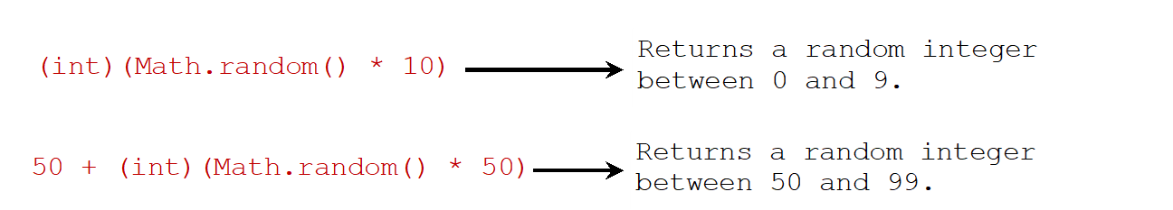
The random Method
Generates a random double value greater than or equal to 0.0 and less than 1.0 (0 <= Math.random() < 1.0).
Examples:
In general,
Notes:
Math.random left parenthesis right parenthesis times 10 right parenthesis. From this equation, an arrow points to Returns a random integer between 0 and 9.
50 + left parenthesis int right parenthesis left parenthesis Math.random left parenthesis right parenthesis times 50 right parenthesis. From this equation, an arrow points to Returns a random integer between 50 and 99.

Slide 10
Introduction to Java Programming and Data Structures
Thirteenth Edition
Appendix F
Number Systems
Copyright © 2024 Pearson Education, Inc. All Rights Reserved
Notes:
If this PowerPoint presentation contains mathematical equations, you may need to check that your computer has the following installed:
1) MathType Plugin
2) Math Player (free versions available)
3) NVDA Reader (free versions available)

Slide 11
Number Systems (1 of 4)
binary
0, 1
octal
0, 1, 2, 3, 4, 5, 6, 7
decimal
0, 1, 2, 3, 4, 5, 6, 7, 8, 9
hexdecimal
0, 1, 2, 3, 4, 5, 6, 7, 8, 9, A, B, C, D, E, F

Slide 12
Number Systems (2 of 4)
Computers use binary numbers internally because storage devices like memory and disk are made to store 0s and 1s. A number or a text inside a computer is stored as a sequence of 0s and 1s. Each 0 and 1 is called a bit, short for binary digit. The binary number system has two digits, 0 and 1.
Binary numbers are not intuitive, since we use decimal numbers in our daily life. When you write a number like 20 in a program, it is assumed to be a decimal number. Internally, computer software is used to convert decimal numbers into binary numbers, and vice versa.

Slide 13
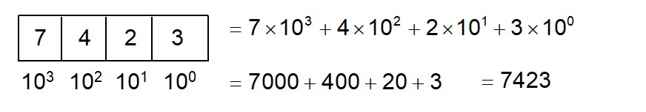
Number Systems (3 of 4)
The digits in the decimal number system are 0, 1, 2, 3, 4, 5, 6, 7, 8, and 9. A decimal number is represented using a sequence of one or more of these digits. The value that each digit in the sequence represents depends on its position. A position in a sequence has a value that is an integral power of 10. For example, the digits 7, 4, 2, and 3 in decimal number 7423 represent 7000, 400, 20, and 3, respectively, as shown below:
The decimal number system has ten digits and the position values are integral powers of 10. We say that 10 is the base or radix of the decimal number system. Similarly, the base of the binary number system is 2 since the binary number system has two digits and the base of the hex number system is 16 since the hex number system has sixteen digits.
Notes:
The number 10 to third power is below the first box, 10 to second power is below the second box, 10 to first power is below the third box, and 10 to 0 power is below the fourth box.
= 7 times 10 to third power + 4 times 10 to second power + 2 times 10 to first power + 3 times 10 to 0 power = 7000 + 400 + 20 + 3 = 7423.

Slide 14
Number Systems (4 of 4)
Binary numbers tend to be very long and cumbersome. Hexadecimal numbers are often used to abbreviate binary numbers.
The octal number system has 8 digits: 0, 1, 2, 3, 4, 5, 6, 7
The hexadecimal number system has 16 digits: 0, 1, 2, 3, 4, 5, 6, 7, 8, 9, A, B, C, D, E, and F. The letters A, B, C, D, E, and F correspond to the decimal numbers 10, 11, 12, 13, 14, and 15.

Slide 15
Binary Numbers => Decimals
Given a binary number
the equivalent
decimal value is
10 in binary
= 2 in decimal
1000 in binary
= 8 in decimal
10101011 in binary
= 171 in decimal

Slide 16
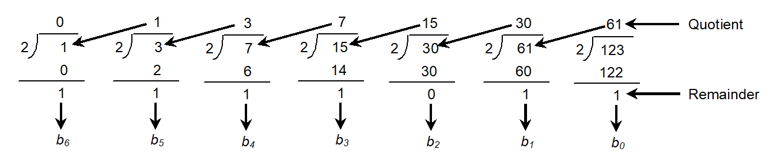
Decimals => Binary
To convert a decimal number d to a binary number is to find the binary
digits..
such that
These numbers can be found by successively dividing d by 2 until the
quotient is 0. The remainders are
For example, the decimal number 123 is 1111011 in binary. The conversion is conducted as follows:
Notes:
3 divide by 2 gives 1 as quotient and 1 as remainder, labeled, b5.
7 divide by 2 gives 3 as quotient and 1 as remainder, labeled, b4.
15 divide by 2 gives 7 as quotient and 1 as remainder, labeled, b3.
30 divide by 2 gives 15 as quotient and 0 as remainder, labeled, b2.
61 divide by 2 gives 30 as quotient and 1 as remainder, labeled, b1.
123 divide by 2 gives 61 as quotient and 1 as remainder, labeled, b0.

Slide 17



Octal Numbers => Decimals
Given a binary number
O$nOn−1On−2…O2O1O0$
the equivalent
decimal value is
O$n×8^{n}+On−1×8^{n−1}+On−2×8^{n−2}+...+O2×8+O1×8+O0×8^{0}$
10 in Octal
$1×8^{1}+0$ x 8⁰
= 8 in decimal
2070 in binary
$2×8^{3}+0×8^{2}+7×81+0$ x 8⁰
= 1080 in decimal

Slide 18


Decimals => Octal
To convert a decimal number d to a binary number is to find the binary
digits..
O$n,On−1,On−2,...,O2,O1,O0$
such that
$$d=On×8^{n}+On−1×8^{n−1}+On−2×8^{n−2}+...+O2×8^{2}+O1×8^{1}+O0×8^{0}$$
These numbers can be found by successively dividing d by 2 until the
quotient is 0. The remainders are
$$O0,O1,O2,...,On−2,On−1,On$$
For example, the decimal number 123 is 173 in octal. The conversion is conducted as follows:
0
1
Quotient
15
8
1
8
15
8
123
0
8
120
1
7
3
Remainder
O2
O1
O0
Notes:
3 divide by 2 gives 1 as quotient and 1 as remainder, labeled, b5.
7 divide by 2 gives 3 as quotient and 1 as remainder, labeled, b4.
15 divide by 2 gives 7 as quotient and 1 as remainder, labeled, b3.
30 divide by 2 gives 15 as quotient and 0 as remainder, labeled, b2.
61 divide by 2 gives 30 as quotient and 1 as remainder, labeled, b1.
123 divide by 2 gives 61 as quotient and 1 as remainder, labeled, b0.

Slide 19
Hexadecimals to Decimals
The hexadecimal number system has sixteen digits: 0, 1, 2, 3, 4, 5, 6, 7, 8, 9, A, B, C, D, E, and F. The letters A, B, C, D, E, and F correspond to the decimal numbers 10, 11, 12, 13, 14, and 15. Given a hexadecimal number
The equivalent decimal value is
7F in hex
= 127 in decimal
FFFF in hex
= 65535 in decimal

Slide 20
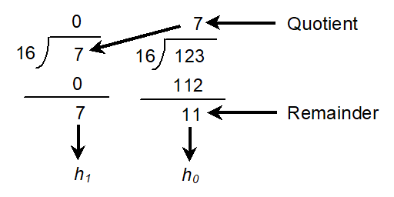
Decimals => Hexadecimal
To convert a decimal number d to a hexadecimal number is to find the
hexadecimal digits …
such that
These numbers can be found by successively dividing d by 16 until
the quotient is 0. The remainders are
For example, the decimal number 123 is 7B in hexadecimal. The conversion is conducted as follows:

Slide 21
Hexadecimal A Two Way Arrow Binary
Decimal | Binay | Octal | Headecimal
0 | 0000 | 0 | 0
1 | 0001 | 1 | 1
2 | 0010 | 2 | 2
3 | 0011 | 3 | 3
4 | 0100 | 4 | 4
5 | 0101 | 5 | 5
6 | 0110 | 6 | 6
7 | 0111 | 7 | 7
8 | 1000 | 8 | 10
9 | 1001 | 9 | 11
10 | 1010 | A | 12
11 | 1011 | B | 13
12 | 1100 | C | 14
13 | 1101 | D | 15
14 | 1110 | E | 16
15 | 1111 | F | 17
To convert a hexadecimal number to a binary number, simply convert each digit in the hexadecimal number into a four-digit binary number.
To convert a binary number to a hexadecimal, convert every four binary digits from right to left in the binary number into a hexadecimal number. For example,

Slide 22
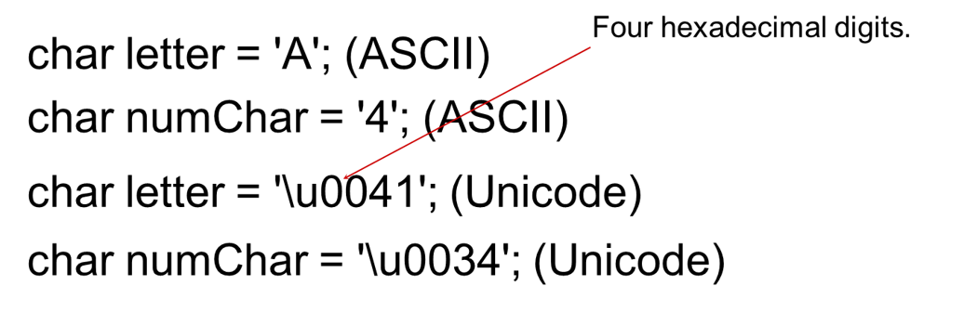
Character Data Type
Note: The increment and decrement operators can also be used on char variables to get the next or preceding Unicode character. For example, the following statements display character b.
char ch = 'a';
System.out.println(++ch);

Slide 23
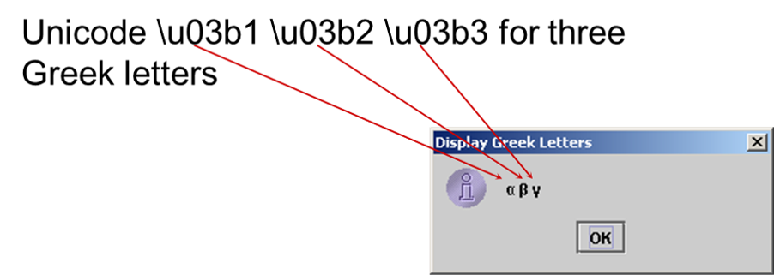
Unicode Format
Java characters use Unicode, a 16-bit encoding scheme established by the Unicode Consortium to support the interchange, processing, and display of written texts in the world’s diverse languages. Unicode takes two bytes, preceded by \u, expressed in four hexadecimal numbers that run from '\u0000' to '\uFFFF'. So, Unicode can represent 65535 + 1 characters.

Slide 24
A S C I I Code for Commonly Used Characters
Characters | Code Value in Decimal | Unicode Value
'0' to '9' | 48 to 57 | \u0030 to \u0039
'A' to 'Z' | 65 to 90 | \u0041 to \u005A
'a' to 'z' | 97 to 122 | \u0061 to \u007A

Slide 25
Escape Sequences for Special Characters
Escape Sequence | Name | Unicode Code | Decimal Value
\b | Backspace | \u0008 | 8
\t | Tab | \u0009 | 9
\n | Linefeed | \u000A | 10
\f | Formfeed | \u000C | 12
\r | Carriage Return | \u000D | 13
\\ | Backslash | \u005C | 92
\” | Double Quote | \u0022 | 34

Slide 26
Appendix B: A S C I I Character Set (1 of 2)
A S C I I Character Set is a subset of the Unicode from \u0000 to \u007f
Table B.1 A S C I I Character Set in the Decimal Index
blank | 0 | 1 | 2 | 3 | 4 | 5 | 6 | 7 | 8 | 9
0 | nul | soh | stx | etx | eot | enq | ack | bel | bs | ht
1 | nl | vt | ff | cr | so | si | dle | dcl | dc2 | dc3
2 | dc4 | nak | syn | etb | can | em | sub | esc | fs | gs
3 | rs | us | sp | ! | “ | # | $ | % | & | ‘
4 | ( | ) | * | + | , | - | . | / | 0 | 1
5 | 2 | 3 | 4 | 5 | 6 | 7 | 8 | 9 | : | ;
6 | < | = | > | ? | @ | A | B | C | D | E
7 | F | G | H | I | J | K | L | M | N | O
8 | P | Q | R | S | T | U | V | W | X | Y
9 | Z | [ | \ | ] | ^ | _ | ` | a | b | c
10 | d | e | f | g | h | i | j | k | l | m
11 | n | o | p | q | r | s | t | u | v | w
12 | x | y | z | { | | | } | ~ | del | Blank | Blank

Slide 27
Casting Between char and Numeric Types
int i = 'a'; // Same as int i = (int)'a';
char c = 97; // Same as char c = (char)97;

Slide 28
Comparing and Testing Characters
if (ch >= 'A' && ch <= 'Z')
System.out.println(ch + " is an uppercase letter");
else if (ch >= 'a' && ch <= 'z')
System.out.println(ch + " is a lowercase letter");
else if (ch >= '0' && ch <= '9')
System.out.println(ch + " is a numeric character");

Slide 29
Methods in the Character Class
Method | Description
isDigit(ch) | Returns true if the specified character is a digit.
isLetter(ch) | Returns true if the specified character is a letter.
isLetterOfDigit(ch) | Returns true if the specified character is a letter or digit.
isLowerCase(ch) | Returns true if the specified character is a lowercase letter.
isUpperCase(ch) | Returns true if the specified character is an uppercase letter.
toLowerCase(ch) | Returns the lowercase of the specified character.
toUpperCase(ch) | Returns the uppercase of the specified character.

Slide 30
Formatting Output
Use the printf statement.
System.out.printf(format, items);
Where format is a string that may consist of substrings and format specifiers. A format specifier specifies how an item should be displayed. An item may be a numeric value, character, boolean value, or a string. Each specifier begins with a percent sign.

Slide 31
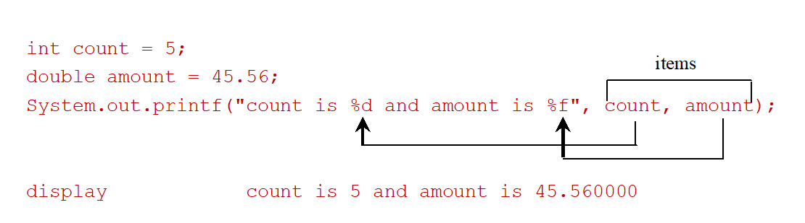
Frequently-Used Specifiers
Specifier | Output | Example
%b | a boolean value | true or false
%c | a character | 'a'
%d | a decimal integer | 200
%f | a floating-point number | 45.460000
%e | a number in standard scientific notation | 4.556000e+01
%s | a string | "Java is cool"
Notes:
double amount = 45.56;
System.out.print left parenthesis double quotes count is percent symbol d and amount is percent symbol f double quotes, count, amount right parenthesis;
Count and amount are labeled as items. The text from percent symbol d to count is labeled as display. The text from percent symbol f to amount is labeled as count is 5 and amount is 45.560000.

Slide 32
FormatDemo
The example gives a program that uses printf to display a table.
FormatDemo
Notes:
FormatDemo: https://liveexample.pearsoncmg.com/html/FormatDemo.html

Slide 33
The String Type
The char type only represents one character. To represent a string of characters, use the data type called String. For example,
String message = "Welcome to Java";
String is actually a predefined class in the Java library just like the System class and Scanner class. The String type is not a primitive type. It is known as a reference type. Any Java class can be used as a reference type for a variable. Reference data types will be thoroughly discussed in Chapter 9, “Objects and Classes.” For the time being, you just need to know how to declare a String variable, how to assign a string to the variable, how to concatenate strings, and to perform simple operations for strings.

Slide 34
Simple Methods for String Objects (1 of 2)
Method | Description
length() | Returns the number of characters in this string.
charAt(index) | Returns the character at the specified index from this string.
concat(s1) | Returns a new string that concatenates this string with string s1.
toUpperCase() | Returns a new string with all letters in uppercase.
toLowerCase() | Returns a new string with all letters in lowercase.
trim() | Returns a new string with whitespace characters trimmed on both sides.

Slide 35
Simple Methods for String Objects (2 of 2)
Strings are objects in Java. The methods in the preceding table can only be invoked from a specific string instance. For this reason, these methods are called instance methods. A non-instance method is called a static method. A static method can be invoked without using an object. All the methods defined in the Math class are static methods. They are not tied to a specific object instance. The syntax to invoke an instance method is
referenceVariable.methodName(arguments).

Slide 36
Getting String Length
String message = "Welcome to Java";
System.out.println("The length of " + message + " is "
+ message.length());

Slide 37
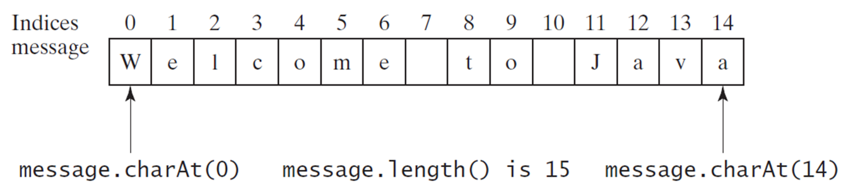
Getting Characters From a String
String message = "Welcome to Java";
System.out.println("The first character in message is "
+ message.charAt(0));
Notes:
A row of numbers are placed above a table with single row and 15 columns. The numbers are labeled as Indices, and the row shows the message. The numbers and their respective text in the row are,
0, W in upper case
1, e in lower case
2, l in lower case
3, c in lower case
4, o in lower case
5, m in lower case
6, e in lower case
7, blank
8, t in lower case
9, o in lower case
10, blank
11, J in upper case
12, a in lower case
13, v in lower case
14, a in lower case
W is labeled as message.charAt left parenthesis 0 right parenthesis
message. length left parenthesis right parenthesis is 15.
The last a of Java is labeled message.charAt left parenthesis 14 right parenthesis.

Slide 38
Converting Strings
"Welcome".toLowerCase() returns a new string, welcome.
"Welcome".toUpperCase() returns a new string, WELCOME.
" Welcome to java ".trim() returns a new string, Welcome to java.

Slide 39
String Concatenation
String s3 = s1.concat(s2); or String s3 = s1 + s2;
// Three strings are concatenated
String message = "Welcome " + "to " + "Java";
// String Chapter is concatenated with number 2
String s = "Chapter" + 2; // s becomes Chapter2
// String Supplement is concatenated with character B
String s1 = "Supplement" + 'B'; // s1 becomes SupplementB

Slide 40
Reading a String From the Console
Scanner input = new Scanner(System.in);
System.out.print("Enter three words separated by spaces: ");
String s1 = input.next();
String s2 = input.next();
String s3 = input.next();
System.out.println("s1 is " + s1);
System.out.println("s2 is " + s2);
System.out.println("s3 is " + s3);

Slide 41
Reading a Character From the Console
Scanner input = new Scanner(System.in);
System.out.print("Enter a character: ");
String s = input.nextLine();
char ch = s.charAt(0);
System.out.println("The character entered is " + ch);

Slide 42
Comparing Strings
Method | Description
equals(s1) | Returns true if this string is equal to string s1.
equalsIgnoreCase(s1) | Returns true if this string is equal to string s1; it is case insensitive.
compareTo(s1) | Returns an integer greater than 0, equal to 0, or less than 0 to indicate whether this string is greater than, equal to, or less than s1.
compareToIgnoreCase(s1) | Same as compareTo except that the comparison is case insensitive.
startsWith(prefix) | Returns true if this string starts with the specified prefix.
endsWith(suffix) | Returns true if this string ends with the specified suffix.
OrderTwoCities
Notes:
OrderTwoCities: https://liveexample.pearsoncmg.com/html/OrderTwoCities.html

Slide 43
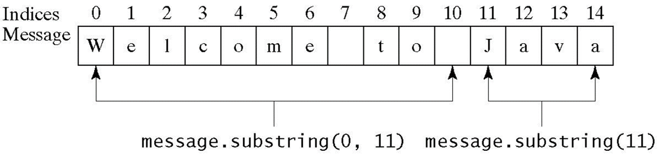
Obtaining Substrings
Method | Description
substring(beginIndex) | Returns this string’s substring that begins with the character at the specified beginIndex and extends to the end of the string, as shown in Figure 4.2.
substring(beginIndex, endIndex) | Returns this string’s substring that begins at the specified beginIndex and extends to the character at index endIndex – 1, as shown in Figure 9.6. Note that the character at endIndex is not part of the substring.
Notes:
The numbers are labeled as Indices, and the row shows the message. The numbers and their respective text in the row are,
0, W in upper case
1, e in lower case
2, l in lower case
3, c in lower case
4, o in lower case
5, m in lower case
6, e in lower case
7, blank
8, t in lower case
9, o in lower case
10, blank
11, J in upper case
12, a in lower case
13, v in lower case
14, a in lower case
The area from W of Welcome up to the blank box before Java is labeled as message. substring left parenthesis 0, 11 right parenthesis.
The area from J of Java to the last a of Java is labeled message.substring left parenthesis 11 right parenthesis.

Slide 44
Finding a Character or a Substring in a String (1 of 2)
Method | Description
indexOf(ch) | Returns the index of the first occurrence of ch in the string. Returns -1 if not matched.
indexOf(ch, fromIndex) | Returns the index of the first occurrence of ch after fromIndex in the string. Returns -1 if not matched.
indexOf(s) | Returns the index of the first occurrence of string s in this string. Returns -1 if not matched.
indexOf(s, fromIndex) | Returns the index of the first occurrence of string s in this string after fromIndex. Returns -1 if not matched.
lastIndexOf(ch) | Returns the index of the last occurrence of ch in the string. Returns -1 if not matched.
lastIndexOf(ch, fromIndex) | Returns the index of the last occurrence of ch before fromIndex in this string. Returns -1 if not matched.
lastIndexOf(s) | Returns the index of the last occurrence of string s. Returns -1 if not matched.
lastIndexOf(s, fromIndex) | Returns the index of the last occurrence of string s before fromIndex. Returns -1 if not matched.

Slide 45
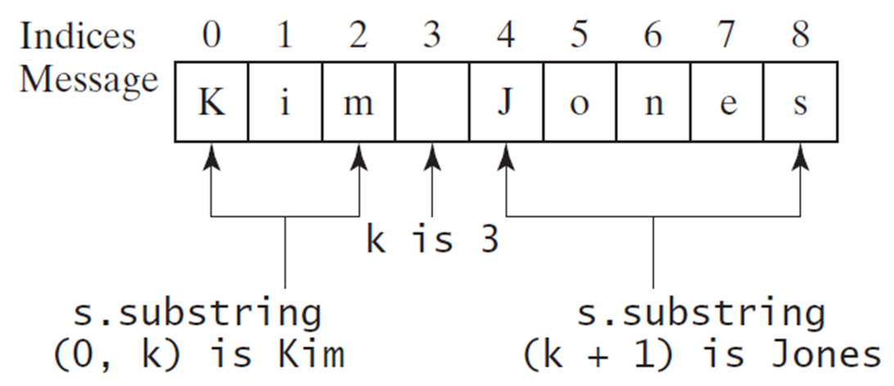
Finding a Character or a Substring in a String (2 of 2)
int k = s.indexOf(' ');
String firstName = s.substring(0, k);
String lastName = s.substring(k + 1);
Notes:
It shows a series of numbers from 0 to 8, labeled Indices. These numbers are above a row of letters with multiple columns. This row is labeled Message.
0, K in upper case
1, I in lower case
2, m in lower case
3, blank
4, J in upper case
5, o in lower case
6, n in lower case
7, e in lower case
8, s in lower case
Kim is labeled as s.substring left parenthesis 0, k right parenthesis is Kim. The blank box between Kim and Jones is labeled as k is 3. Jones is labeled as s.substring left parenthesis 0, k + 1 right parenthesis is Jones.

Slide 46
Conversion Between Strings and Numbers
int intValue = Integer.parseInt(intString);
double doubleValue = Double.parseDouble(doubleString);
String s = number + "";

Slide 47
Case Study: Converting a Hexadecimal Digit to a Decimal Value
Write a program that converts a hexadecimal digit into a decimal value.
HexDigit2Dec
Notes:
HexDigit2Dec: https://liveexample.pearsoncmg.com/html/HexDigit2Dec.html

