Slide 1
Weighted Graphs and Applications

Slide 2
Lecture Outline
Review DFS, BFS, Unweighted Shortest Paths
Weighted Graphs
Minimum Spanning Tree (MST)
Prim’s Algorithm
Kruskal’s Algorithm
Weighted Shortest Path Problem
Dijkstra’s Algorithm
Definition & Examples
Implementing Dijkstra’s

Slide 3
DFS
Follow a “choice” all the way to the end, then come back to revisit other choices
BFS
Explore layer-by-layer: examine every node at a certain distance from start, then examine nodes that are one level farther
dfs(Graph graph, Vertex start) {
Stack<Vertex> perimeter = new Stack<>();
Set<Vertex> visited = new Set<>();
...
bfs(Graph graph, Vertex start) {
Queue<Vertex> perimeter = new Queue<>();
Set<Vertex> visited = new Set<>();
perimeter.add(start);
visited.add(start);
while (!perimeter.isEmpty()) {
Vertex from = perimeter.remove();
for (Edge edge : graph.edgesFrom(from)) {
Vertex to = edge.to();
if (!visited.contains(to)) {
perimeter.add(to);
visited.add(to);
}
}
}
}
* Can also be implemented recursively; though be careful of stack overflow!
BFS and DFS are just techniques for iterating! (think: for loop over an array)
Need to add code that actually processes something to solve a problem
A lot of interview problems on graphs can be solved with modifications on top of BFS or DFS! Very worth being comfortable with the pseudocode ☺

Slide 4
Review Using BFS for the Shortest Path Problem
...
Map<Vertex, Edge> edgeTo = ...
Map<Vertex, Double> distTo = ...
edgeTo.put(start, null);
distTo.put(start, 0.0);
while (!perimeter.isEmpty()) {
Vertex from = perimeter.remove();
for (Edge edge : graph.edgesFrom(from)) {
Vertex to = edge.to();
if (!visited.contains(to)) {
edgeTo.put(to, edge);
distTo.put(to, distTo.get(from) + 1);
perimeter.add(to);
visited.add(to);
}
}
}
return edgeTo;
}
(Unweighted) Shortest Path Problem
The start required no edge to arrive at, and is on level 0
Given source vertex s and a target vertex t, how long is the shortest path from s to t? What edges make up that path?
This is a little harder, but still totally doable! We just need a way to keep track of how far each node is from the start.
Sounds like a job for?
BFS!
Remember how we got to this point, and what layer this vertex is part of

Slide 5
Review BFS for Shortest Paths: Example
...
Map<Vertex, Edge> edgeTo = ...
Map<Vertex, Double> distTo = ...
edgeTo.put(start, null);
distTo.put(start, 0.0);
while (!perimeter.isEmpty()) {
Vertex from = perimeter.remove();
for (Edge edge : graph.edgesFrom(from)) {
Vertex to = edge.to();
if (!visited.contains(to)) {
edgeTo.put(to, edge);
distTo.put(to, distTo.get(from) + 1);
perimeter.add(to);
visited.add(to);
}
}
}
return edgeTo;
}
PERIMETER
A
B
C
D
E
DISTTO
2
E
VISITED
0
start
A
1
C
EDGETO
1
B
2
D
The edgeTo map stores backpointers: each vertex remembers what vertex was used to arrive at it!
Note: this code stores visited, edgeTo, and distTo as external maps (only drawn on graph for convenience). Another implementation option: store them as fields of the nodes themselves

Slide 6
Review What about the Target Vertex?
This modification on BFS didn’t mention the target vertex at all!
Instead, it calculated the shortest path and distance from start to every other vertex
This is called the shortest path tree
A general concept: in this implementation, made up of distances and backpointers
Shortest path tree has all the answers!
Length of shortest path from A to D?
Lookup in distTo map: 2
What’s the shortest path from A to D?
Build up backwards from edgeTo map: start at D, follow backpointer to B, follow backpointer to A – our shortest path is A → B → D
All our shortest path algorithms will have this property
If you only care about t, you can sometimes stop early!
Shortest Path Tree:
DISTTO
2
E
0
start
A
1
C
EDGETO
1
B
2
D

Slide 7
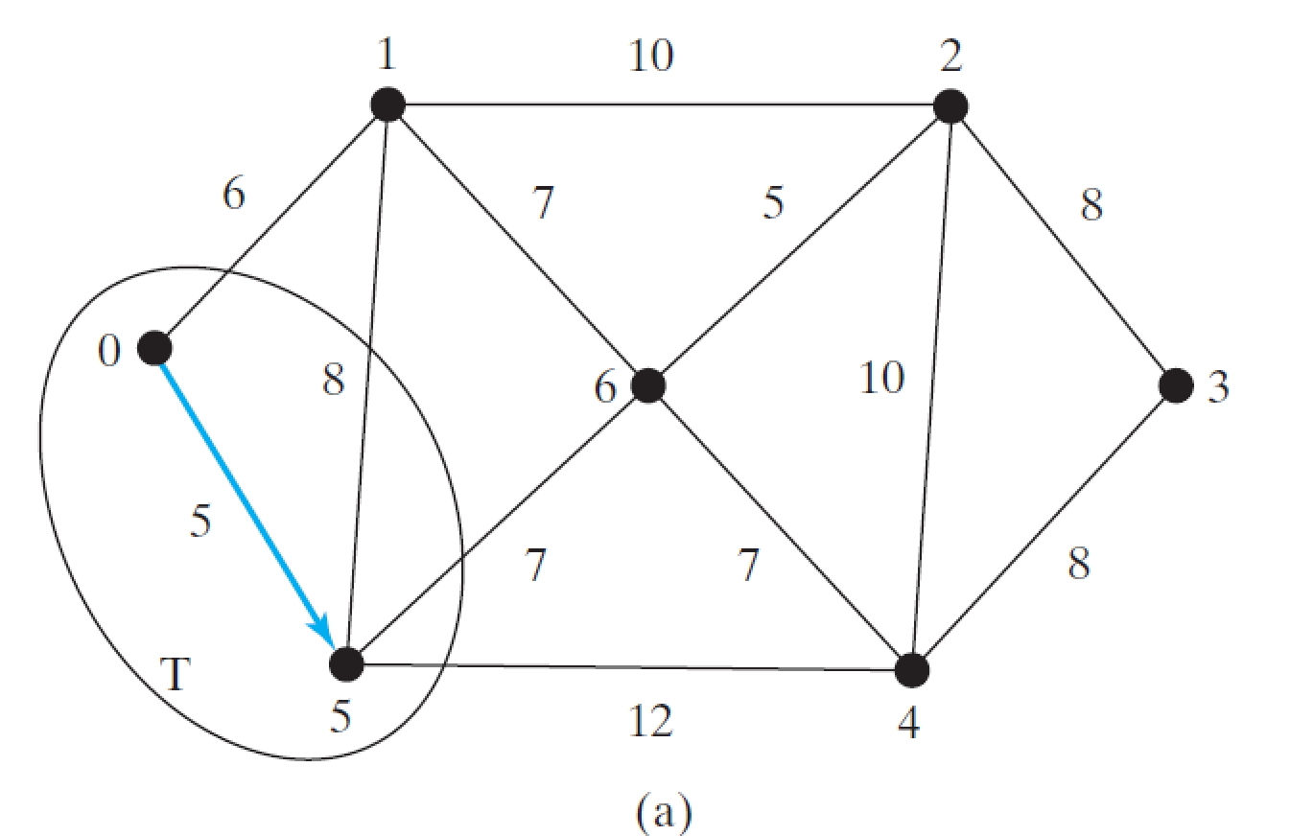
0 | (0,1) (0,5)
1 | (1,0) (1,2) (1,5) (1,6)
2 | (2,1) (2,3) (2,4) (2,6)
3 | (3,2) (3,4)
4 | (4,2) (4,3) (4,5) (4,6)
5 | (5,0) (5,1) (5,4) (5,6)
6 | (6,1) (6,2) (6,4) (6,5)

Slide 8
Lecture Outline
Review DFS, BFS, Unweighted Shortest Paths
Weighted Graphs
Minimum Spanning Tree (MST)
Prim’s Algorithm
Kruskal’s Algorithm
Weighted Shortest Path Problem
Dijkstra’s Algorithm
Definition & Examples
Implementing Dijkstra’s

Slide 9
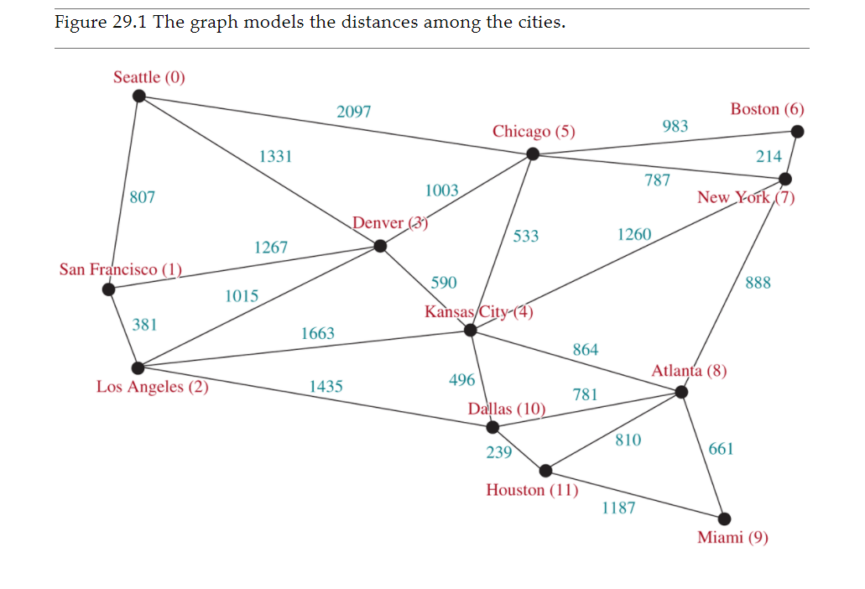
Weighted Graph

Slide 10
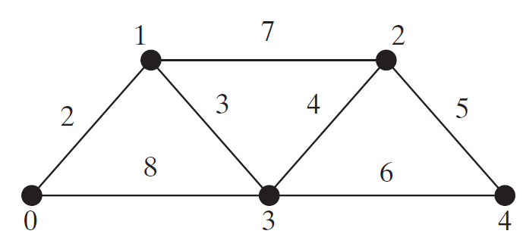
Representing Weighted Graphs
Representing Weighted Edges: Edge Array
Weighted Adjacency Matrices
Adjacency Lists

Slide 11
Representing Weighted Edges: Edge Array
int[][] edges = {{0, 1, 2}, {0, 3, 8},
{1, 0, 2}, {1, 2, 7}, {1, 3, 3},
{2, 1, 7}, {2, 3, 4}, {2, 4, 5},
{3, 0, 8}, {3, 1, 3}, {3, 2, 4}, {3, 4, 6},
{4, 2, 5}, {4, 3, 6}
};

Slide 12
Representing Weighted Edges: Edge Array

Slide 13
Edge Adjacency Lists
java.util.List<WeightedEdge>[] neighbors = new java.util.List[5];

Slide 14
What is the output of the following code?
List<WeightedEdge> list = new ArrayList<>();
list.add(new WeightedEdge(1, 2, 3.5));
list.add(new WeightedEdge(2, 3, 4.5));
WeightedEdge e = java.util.Collections.max(list);
System.out.println(e.u);
System.out.println(e.v);
System.out.println(e.weight);

Slide 15
If a priority queue is used to store weighted edges, what is the output of the following code?
PriorityQueue<WeightedEdge> q = new PriorityQueue<>();
q.offer(new WeightedEdge(1, 2, 3.5));
q.offer(new WeightedEdge(1, 6, 6.5));
q.offer(new WeightedEdge(1, 7, 1.5));
System.out.println(q.poll().weight);
System.out.println(q.poll().weight);
System.out.println(q.poll().weight);

Slide 16
If a priority queue is used to store weighted edges, what is wrong in the following code? Fix it and show the output.
List<PriorityQueue<WeightedEdge>> queues = new ArrayList<>();
queues.get(0).offer(new WeightedEdge(0, 2, 3.5));
queues.get(0).offer(new WeightedEdge(0, 6, 6.5));
queues.get(0).offer(new WeightedEdge(0, 7, 1.5));
queues.get(1).offer(new WeightedEdge(1, 0, 3.5));
queues.get(1).offer(new WeightedEdge(1, 5, 8.5));
queues.get(1).offer(new WeightedEdge(1, 8, 19.5));
System.out.println(queues.get(0).peek().compareTo(queues.get(1).peek()));
Notes:
import java.util.*;
public class GraphExamples {
public static void main(String[] args) {
// TODO Auto-generated method stub
List<PriorityQueue<WeightedEdge>> q = new ArrayList<>();
q.add(new PriorityQueue<WeightedEdge>());
q.get(0).offer(new WeightedEdge(0,2,3.5));
q.get(0).offer(new WeightedEdge(0,6,6.5));
q.get(0).offer(new WeightedEdge(0,7,1.5));
q.add(new PriorityQueue<WeightedEdge>());
q.get(1).offer(new WeightedEdge(1,0,3.5));
q.get(1).offer(new WeightedEdge(1,5,8.5));
q.get(1).offer(new WeightedEdge(1,8,19.5));
System.out.println(q.get(0).peek().compareTo(q.get(1).peek()));
}
}

Slide 17
Lecture Outline
Review DFS, BFS, Unweighted Shortest Paths
Weighted Graphs
Minimum Spanning Tree (MST)
Prim’s Algorithm
Kruskal’s Algorithm
Weighted Shortest Path Problem
Dijkstra’s Algorithm
Definition & Examples
Implementing Dijkstra’s

Slide 18
Spanning Trees
A Spanning tree of a connected undirected graph G is a subgraph of G that contains all of G’s vertices and enough of its edges to form a tree.
A spanning tree is subgraph of G that is connected with no cycles
A graph may have many spanning trees.
A
A
5
7
5
7
(b)
10
C
C
A
B
B
5
7
8
6
D
8
D
B
C
(a)
6
A
D
(d)
5
7
(c)
10
C
B
D

Slide 19
Minimum Spanning Trees
A graph may have many spanning trees. Suppose that the edges are weighted. A minimum spanning tree is a spanning tree with the minimum total weights. For example, the trees in Figures (b), (c), (d) are spanning trees for the graph in Figure (a). The trees in Figures (c) and (d) are minimum spanning trees.
Total w: 42
(b)
Total w: 38
(a)
Total w: 38
(d)
(c)

Slide 20
MST
Given a connected and undirected graph, a spanning tree of that graph is a subgraph that is a tree and connects all the vertices together.
A MST has (V-1) edges where V is the number of vertices in the given graph.

Slide 21
Lecture Outline
Review DFS, BFS, Unweighted Shortest Paths
Weighted Graphs
Minimum Spanning Tree (MST)
Prim’s Algorithm
Kruskal’s Algorithm
Weighted Shortest Path Problem
Dijkstra’s Algorithm
Definition & Examples
Implementing Dijkstra’s

Slide 22
Prim’s Minimum Spanning Tree Algorithm
Input: G = (V, E) with non-negative weights.
Output: a MST
MST minimumSpanningTree(sv) { // sv ← startVertex
Let V denote the set of vertices in the graph;
Let T be a set for the vertices in the spanning tree;
Let MST be a set for the edges in the spanning tree;
Initially, add the sv to T;
Add edgeList of sv to a collection (What kind? Later)
while (size of T < n) {
find v in T and u in V – T with the smallest weight
on the edge (u, v), as shown in the figure;
add u to T; add edge to MST
add edgeList of u to collection
}
}
Find a vertex in V-T that has the smallest weighted edge connecting to a vertex in T.
V-T
0
5
MST
5

Slide 23
MST Example
V
0
1
2
3
4
5
6
{0,1,6} {0,5,5}
{1,0,6} {1,2,10}{1,5,8} {1,6,7}
{2,1,10} {2,3,8} {2,4,10} {2,6,5}
{3,2,8} {3,4,8}
{$,2,10} {4,3,8} {4,5,12} {4,6,7}
{5,0,5} {5,1,8} {5,4,12} {5,6,7}
{6,1,7} {6,2,5} {6,4,7} {6,5,7}

Slide 24
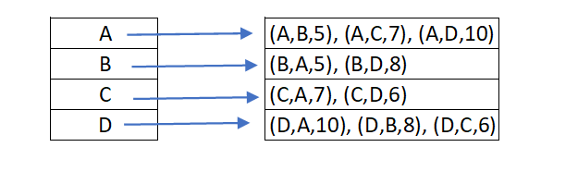
MST Example
A
T PQ
B <B,A,5>
<B,D,8>
A <A,C,7>
<B,D,8>
<A,D,10>
C <C,D,6>
<B,D,8>
<A,D,10>
D <B,D,8>
<A,D,10>
5
7
10
C
B
8
6
D
Suppose we start with B
MST {}
MST { <B,A,5> }
MST { <B,A,5>, <A,C,7> }
MST { <B,A,5>, <A,C,7>, <C,D,6>}

Slide 25
Lecture Outline
Review DFS, BFS, Unweighted Shortest Paths
Weighted Graphs
Minimum Spanning Tree (MST)
Prim’s Algorithm
Kruskal’s Algorithm
Weighted Shortest Path Problem
Dijkstra’s Algorithm
Definition & Examples
Implementing Dijkstra’s

Slide 26
Kruskal’s MST
Sort all the edges in non-decreasing order of their weight.
Pick the smallest edge. Check if it forms a cycle with the spanning tree formed so far.
If (cycle is not formed)
include this edge in MST
else
discard it.
Repeat step # 2 until there are (V-1) edges in the spanning tree.

Slide 27
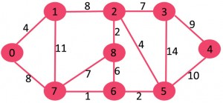
Kruskal’s MST
After sorting
Weight src dest
1 7 6
2 8 2
2 6 5
4 0 1
4 2 5
6 8 6
7 2 3
7 7 8
8 0 7
8 1 2
9 3 4
10 5 4
11 1 7
14 3 5

Slide 28
Step # 2 (Cycle Detection) Union-Find algorithm
A disjoint-set data structure is a data structure that keeps track of a set of elements partitioned into a number of disjoint (non-overlapping) subsets.
A union-find algorithm is an algorithm that performs two useful operations on such a data structure:
Find: Determine which subset a particular element is in. This can be used for determining if two elements are in the same subset.
Union: Join two subsets into a single subset.

Slide 29
Lecture Outline
Review DFS, BFS, Unweighted Shortest Paths
Weighted Graphs
Minimum Spanning Tree (MST)
Prim’s Algorithm
Kruskal’s Algorithm
Weighted Shortest Path Problem
Dijkstra’s Algorithm
Definition & Examples
Implementing Dijkstra’s

Slide 30
Our Graph Problem Collection
NEW
Unweighted Shortest Path Problem
Weighted Shortest Path Problem
s-t Connectivity Problem
Given source vertex s and target vertex t, what path from s to t minimizes the number of edges? How long is that path, and what edges make it up?
Given source vertex s and target vertex t, what path from s to t minimizes the total weight of its edges? How long is that path, and what edges make it up?
Given source vertex s and a target vertex t, does there exist a path from s to t?
SOLUTION
Base Traversal: BFS or DFS
Modification: Check if each vertex == t
SOLUTION
Base Traversal: BFS
Modification: Generate shortest path tree as we go
???

Slide 31
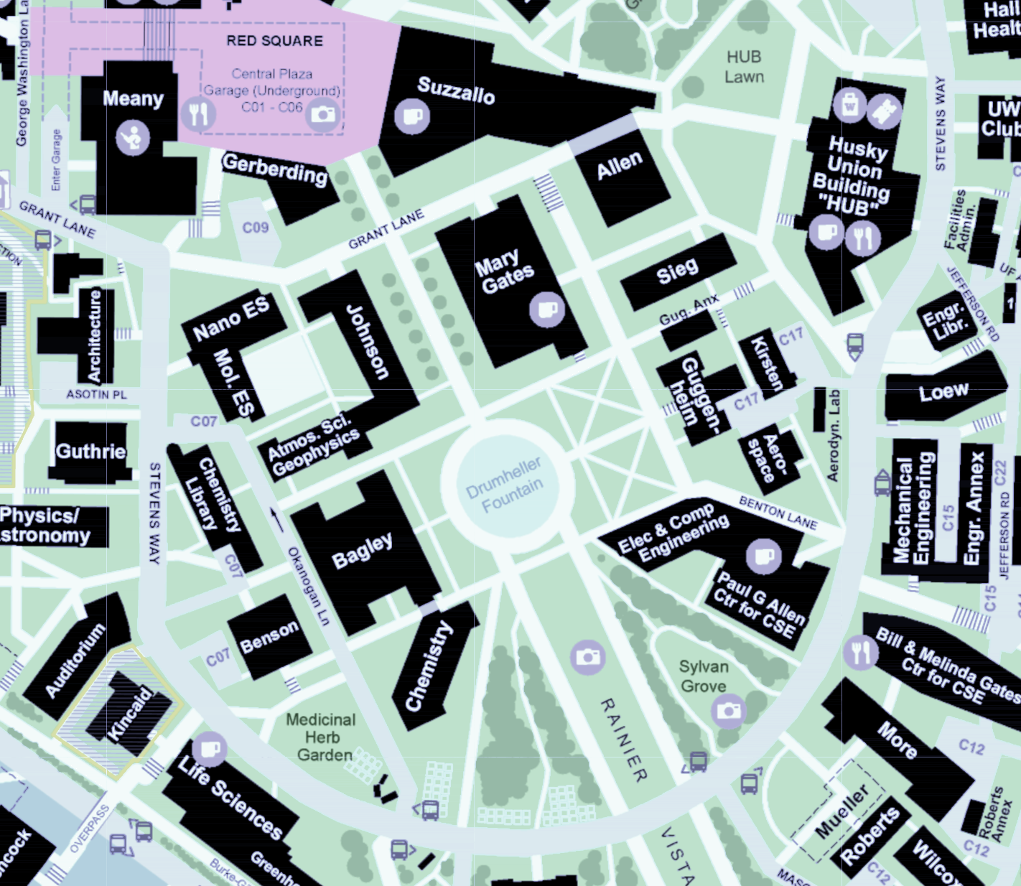
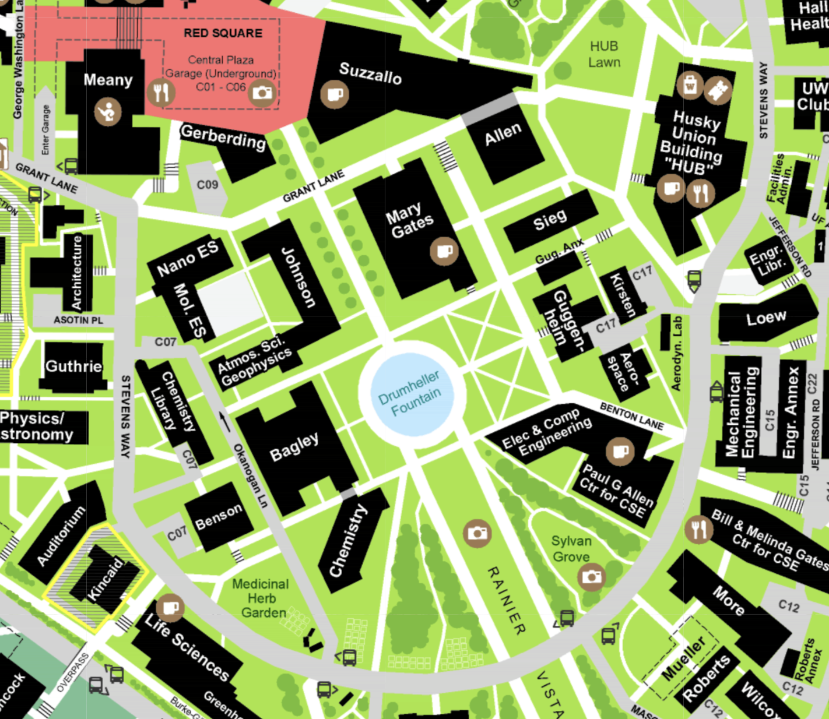
The Weighted Shortest Path Problem
King Lane
0.05 Miles
It’s lunchtime, and that Pagliacci slice isn’t going to eat itself – Suppose we want to find the fastest path from Meany Hall to the HUB
Model as a graph: buildings & road meeting points are vertices, roads are edges
Of course, want to take Asotin – Grant – King, not Stevens Way!
Use edge weights to model distance, since not all edges have the same cost
Would BFS give us the right answer here?
Asotin Place
0.05 Miles
NE Grant Lane
0.2 Miles
HUB
Meany Hall
Stevens Way
0.7 Miles
0.05
0.2
Meany Hall
0.7
0.05
HUB

Slide 32
Why does BFS work for unweighted graphs?
Observation: The “First Try Phenomenon”
BFS only enqueues each vertex once (makes it efficient)
As soon as BFS enqueues a vertex, the final path to that vertex has been chosen! Never re-evaluate its path.
1
0
D
start
A
E
1
Key Intuition: BFS works because:
IF we always process the closest vertices first,
THEN the first path we discover to a new vertex will always be the shortest!
B
2
F
C
target
BFS Tracking:
Example: For shortest path to C, why do we choose edge (B,C) and not (F,C)?
Exactly because we visit B before F!
1
DISTTO
Z
VISITED
EDGETO

Slide 33
Why doesn’t BFS work for weighted graphs?
We want the path that minimizes the sum of edge weights
A-D-E-F-C: total distance 4
A-B-C: total distance 300.
Do the edge weights affect how BFS runs?
Nope! Exactly the same path chosen
1
0
1.0
D
1.0
start
A
E
100.0
1.0
1
Observation: still have “First Try Phenomenon”
Key Intuition: yet BFS breaks because we no longer process the closest vertices first (that is, not closest according to the edge weights!)
So we can’t rely on first path found being best anymore ☹
B
2
F
200.0
C
1.0
target
BFS Tracking:
1
DISTTO
Z
VISITED
EDGETO

Slide 34
Lecture Outline
Review DFS, BFS, Unweighted Shortest Paths
Weighted Graphs
Minimum Spanning Tree (MST)
Prim’s Algorithm
Kruskal’s Algorithm
Weighted Shortest Path Problem
Dijkstra’s Algorithm
Definition & Examples
Implementing Dijkstra’s

Slide 35
Lecture Outline
Review DFS, BFS, Unweighted Shortest Paths
Weighted Shortest Path Problem
Reductions: Weighted → Unweighted
Dijkstra’s Algorithm
Definition & Examples
Implementing Dijkstra’s

Slide 36
Dijkstra’s Algorithm
Named after its inventor, Edsger Dijkstra (1930-2002)
Truly one of the “founders” of computer science
1972 Turing Award
This algorithm is just one of his many contributions!
Example quote: “Computer science is no more about computers than astronomy is about telescopes”
The idea: reminiscent of BFS, but adapted to handle weights
Grow the set of nodes whose shortest distance has been computed
Nodes not in the set will have a “best distance so far”

Slide 37
Dijkstra’s Algorithm: Idea
PERIMETER
2
4??
UNKNOWN
0
2
2
3
∞
start
A
B
F
H
1
4
5
10
2
∞
1
9
1
3
G
4
2
C
KNOWN
D
11
1
E
7
12??
Initialization:
Start vertex has distance 0; all other vertices have distance ∞
At each step:
Pick closest unknown vertex v
Add it to the “cloud” of known vertices
Update “best-so-far” distances for vertices with edges from v

Slide 38
Dijkstra’s Pseudocode (High-Level)
0
KNOWN
start
A
2
2
PERIMETER
B
5
3
Suppose we already visited B, distTo[D] = 7
Now considering edge (C, D):
oldDist = 7
newDist = 3 + 1
That’s better! Update distTo[D], edgeTo[D]
3
7??
Similar to “visited” in BFS, “known” is nodes that are finalized (we know their path)
C
u
1
v
D
dijkstraShortestPath(G graph, V start)
Set known; Map edgeTo, distTo;
initialize distTo with all nodes mapped to ∞, except start to 0
while (there are unknown vertices):
let u be the closest unknown vertex
known.add(u);
for each edge (u,v) from u with weight w:
oldDist = distTo.get(v) // previous best path to v
newDist = distTo.get(u) + w // what if we went through u?
if (newDist < oldDist):
distTo.put(v, newDist)
edgeTo.put(v, u)
Dijkstra’s algorithm is all about updating “best-so-far” in distTo if we find shorter path! Init all paths to infinite.
Order matters: always visit closest first!
Consider all vertices reachable from me: would getting there through me be a shorter path than they currently know about?

Slide 39
Dijkstra’s Algorithm: Key Properties
Once a vertex is marked known, its shortest path is known
Can reconstruct path by following back-pointers (in edgeTo map)
While a vertex is not known, another shorter path might be found
We call this update relaxing the distance because it only ever shortens the current best path
Going through closest vertices first lets us confidently say no shorter path will be found once known
Because not possible to find a shorter path that uses a farther vertex we’ll consider later
dijkstraShortestPath(G graph, V start)
Set known; Map edgeTo, distTo;
initialize distTo with all nodes mapped to ∞, except start to 0
while (there are unknown vertices):
let u be the closest unknown vertex
known.add(u)
for each edge (u,v) to unknown v with weight w:
oldDist = distTo.get(v) // previous best path to v
newDist = distTo.get(u) + w // what if we went through u?
if (newDist < oldDist):
distTo.put(v, newDist)
edgeTo.put(v, u)

Slide 40
Dijkstra’s Algorithm: Example #1
0
2
∞
∞
∞
start
B
2
3
A
F
H
1
4
5
10
2
∞
1
9
∞
3
G
∞
2
C
11
∞
D
1
E
Vertex | Known? | distTo | edgeTo
A
B
C
D
E
F
G
H
7
Order Added to Known Set:

Slide 41
Dijkstra’s Algorithm: Example #1
0
2
2??
∞
∞
start
B
2
3
A
F
H
1
4
5
10
2
∞
1
9
1??
3
G
4??
2
C
11
∞
D
1
E
Vertex | Known? | distTo | edgeTo
A | Y | 0 | /
B |  | ≤ 2 | A
C |  | ≤ 1 | A
D |  | ≤ 4 | A
E |  | ∞
F |  | ∞
G |  | ∞
H |  | ∞
7
Order Added to Known Set:
A

Slide 42
Dijkstra’s Algorithm: Example #1
0
2
2??
∞
∞
start
B
2
3
A
F
H
1
4
5
10
2
∞
1
9
1
3
G
4??
2
C
11
12??
D
1
E
Vertex | Known? | distTo | edgeTo
A | Y | 0 | /
B |  | ≤ 2 | A
C | Y | 1 | A
D |  | ≤ 4 | A
E |  | ≤ 12 | C
F |  | ∞
G |  | ∞
H |  | ∞
7
Order Added to Known Set:
A, C
Notes:
Note how E’s distance is 12 (path length) instead of 11 (edge weight)

Slide 43
Dijkstra’s Algorithm: Example #1
0
2
2
4??
∞
start
B
2
3
A
F
H
1
4
5
10
2
∞
1
9
1
3
G
4??
2
C
11
12??
D
1
E
Vertex | Known? | distTo | edgeTo
A | Y | 0 | /
B | Y | 2 | A
C | Y | 1 | A
D |  | ≤ 4 | A
E |  | ≤ 12 | C
F |  | ≤ 4 | B
G |  | ∞
H |  | ∞
7
Order Added to Known Set:
A, C, B
Notes:
Note how
Again, we don’t set F’s pathlen to 2 (the edge weight); we set it to 4 (length of A->B->F)
We don’t update C with distance 7 (A->B->C); its optimal path is already known
We don’t update E with distance 12 (A->B->E); the path length is the same

Slide 44
Dijkstra’s Algorithm: Example #1
0
2
2
4??
∞
start
B
2
3
A
F
H
1
4
5
10
2
∞
1
9
1
3
G
4
2
C
11
12??
D
1
E
Vertex | Known? | distTo | edgeTo
A | Y | 0 | /
B | Y | 2 | A
C | Y | 1 | A
D | Y | 4 | A
E |  | ≤ 12 | C
F |  | ≤ 4 | B
G |  | ∞
H |  | ∞
7
Order Added to Known Set:
A, C, B, D
Notes:
Nothing was updated; we already had an optimal path to C

Slide 45
Dijkstra’s Algorithm: Example #1
0
2
2
4
7??
start
B
2
3
A
F
H
1
4
5
10
2
∞
1
9
1
3
G
4
2
C
11
12??
D
1
E
Vertex | Known? | distTo | edgeTo
A | Y | 0 | /
B | Y | 2 | A
C | Y | 1 | A
D | Y | 4 | A
E |  | ≤ 12 | C
F | Y | 4 | B
G |  | ∞
H |  | ≤ 7 | F
7
Order Added to Known Set:
A, C, B, D, F

Slide 46
Dijkstra’s Algorithm: Example #1
0
2
2
4
7
start
B
2
3
A
F
H
1
4
5
10
2
8??
1
9
1
3
G
4
2
C
11
12??
D
1
E
Vertex | Known? | distTo | edgeTo
A | Y | 0 | /
B | Y | 2 | A
C | Y | 1 | A
D | Y | 4 | A
E |  | ≤ 12 | C
F | Y | 4 | B
G |  | ≤ 8 | H
H | Y | 7 | F
7
Order Added to Known Set:
A, C, B, D, F, H

Slide 47
Dijkstra’s Algorithm: Example #1
0
2
2
4
7
start
B
2
3
A
F
H
1
4
5
10
2
8
1
9
1
3
G
4
2
C
11
11??
D
1
E
Vertex | Known? | distTo | edgeTo
A | Y | 0 | /
B | Y | 2 | A
C | Y | 1 | A
D | Y | 4 | A
E |  | ≤ 11 | G
F | Y | 4 | B
G | Y | 8 | H
H | Y | 7 | F
7
Order Added to Known Set:
A, C, B, D, F, H, G
Notes:
Note how we found a better path to E at last (A->B->F->H->G->E), with cost 11; formerly path A->C->E had cost 12

Slide 48
Dijkstra’s Algorithm: Example #1
0
2
2
4
7
start
B
2
3
A
F
H
1
4
5
10
2
8
1
9
1
3
G
4
2
C
11
11
D
1
E
Vertex | Known? | distTo | edgeTo
A | Y | 0 | /
B | Y | 2 | A
C | Y | 1 | A
D | Y | 4 | A
E | Y | 11 | G
F | Y | 4 | B
G | Y | 8 | H
H | Y | 7 | F
7
Order Added to Known Set:
A, C, B, D, F, H, G, E
Notes:
Done!

Slide 49
Dijkstra’s Algorithm: Interpreting the Results
0
2
2
4
7
Now that we’re done, how do we get the path from A to E?
Follow edgeTo backpointers!
distTo and edgeTo make up the shortest path tree
start
B
2
3
A
F
H
1
4
5
10
2
8
1
9
1
3
G
4
2
C
11
11
D
1
E
Vertex | Known? | distTo | edgeTo
A | Y | 0 | /
B | Y | 2 | A
C | Y | 1 | A
D | Y | 4 | A
E | Y | 11 | G
F | Y | 4 | B
G | Y | 8 | H
H | Y | 7 | F
7
Order Added to Known Set:
A, C, B, D, F, H, G, E
Notes:
Walk through the chain of “previous” (E->G->H->F->B->A)

Slide 50
Review: Key Features
Once a vertex is marked known, its shortest path is known
Can reconstruct path by following backpointers
While a vertex is not known, another shorter path might be found!
The “Order Added to Known Set” is unimportant
A detail about how the algorithm works (client doesn’t care)
Not used by the algorithm (implementation doesn’t care)
It is sorted by path-distance; ties are resolved “somehow”
If we only need path to a specific vertex, can stop early once that vertex is known
Because its shortest path cannot change!
Return a partial shortest path tree

Slide 51
Dijkstra’s Algorithm: Example #2
0
∞
start
2
B
A
1
1
∞
2
5
E
∞
1
∞
1
D
C
5
3
∞
2
6
G
Vertex | Known? | distTo | edgeTo
A |  | ∞
B |  | ∞
C |  | ∞
D |  | ∞
E |  | ∞
F |  | ∞
G |  | ∞
∞
10
F
Order Added to Known Set:
Notes:
Can print this on the worksheet

Slide 52
Dijkstra’s Algorithm: Example #2
0
∞
start
2
B
A
1
1
∞
2
5
E
1??
1
2??
1
D
C
5
3
∞
2
6
G
Vertex | Known? | distTo | edgeTo
A | Y | 0 | /
B |  | ∞
C |  | ≤ 2 | A
D |  | ≤ 1 | A
E |  | ∞
F |  | ∞
G |  | ∞
∞
10
F
Order Added to Known Set:
A

Slide 53
Dijkstra’s Algorithm: Example #2
0
6??
start
2
B
A
1
1
2??
2
5
E
1
1
2??
1
D
C
5
3
6??
2
6
G
Vertex | Known? | distTo | edgeTo
A | Y | 0 | /
B |  | ≤ 6 | D
C |  | ≤ 2 | A
D | Y | 1 | A
E |  | ≤ 2 | D
F |  | ≤ 7 | D
G |  | ≤ 6 | D
7??
10
F
Order Added to Known Set:
A, D

Slide 54
Dijkstra’s Algorithm: Example #2
0
6??
start
2
B
A
1
1
2??
2
5
E
1
1
2
1
D
C
5
3
6??
2
6
G
Vertex | Known? | distTo | edgeTo
A | Y | 0 | /
B |  | ≤ 6 | D
C | Y | 2 | A
D | Y | 1 | A
E |  | ≤ 2 | D
F |  | ≤ 4 | C
G |  | ≤ 6 | D
4??
10
F
Order Added to Known Set:
A, D, C

Slide 55
Dijkstra’s Algorithm: Example #2
0
3??
start
2
B
A
1
1
2
2
5
E
1
1
2
1
D
C
5
3
6??
2
6
G
Vertex | Known? | distTo | edgeTo
A | Y | 0 | /
B |  | ≤ 3 | E
C | Y | 2 | A
D | Y | 1 | A
E | Y | 2 | D
F |  | ≤ 4 | C
G |  | ≤ 6 | D
4??
10
F
Order Added to Known Set:
A, D, C, E

Slide 56
Dijkstra’s Algorithm: Example #2
0
3
start
2
B
A
1
1
2
2
5
E
1
1
2
1
D
C
5
3
6??
2
6
G
Vertex | Known? | distTo | edgeTo
A | Y | 0 | /
B | Y | 3 | E
C | Y | 2 | A
D | Y | 1 | A
E | Y | 2 | D
F |  | ≤ 4 | C
G |  | ≤ 6 | D
4??
10
F
Order Added to Known Set:
A, D, C, E, B

Slide 57
Dijkstra’s Algorithm: Example #2
0
3
start
2
B
A
1
1
2
2
5
E
1
1
2
1
D
C
5
3
6??
2
6
G
Vertex | Known? | distTo | edgeTo
A | Y | 0 | /
B | Y | 3 | E
C | Y | 2 | A
D | Y | 1 | A
E | Y | 2 | D
F | Y | 4 | C
G |  | ≤ 6 | D
4
10
F
Order Added to Known Set:
A, D, C, E, B, F

Slide 58
Dijkstra’s Algorithm: Example #2
0
3
start
2
B
A
1
1
2
2
5
E
1
1
2
1
D
C
5
3
6
2
6
G
Vertex | Known? | distTo | edgeTo
A | Y | 0 | /
B | Y | 3 | E
C | Y | 2 | A
D | Y | 1 | A
E | Y | 2 | D
F | Y | 4 | C
G | Y | 6 | D
4
10
F
Order Added to Known Set:
A, D, C, E, B, F, G

Slide 59
Dijkstra’s Algorithm: Example #3 (undirected)
0
∞
start
2
B
A
1
1
∞
2
5
E
∞
1
∞
1
D
C
5
2
∞
12
6
G
Vertex | Known? | distTo | edgeTo
A |  | ∞
B |  | ∞
C |  | ∞
D |  | ∞
E |  | ∞
F |  | ∞
G |  | ∞
∞
1
F
Order Added to Known Set:
Notes:
Can print this on the worksheet

Slide 60
Dijkstra’s Algorithm: Example #3 (undirected)
0
2
start
2
B
A
1
1
∞
2
5
E
1
1
2
1
D
C
5
2
∞
12
6
G
Vertex | Known? | distTo | edgeTo
A | Y | 0 | /
B |  | ≤ 2 | A
C |  | ≤ 2 | A
D |  | ≤ 1 | A
E |  | ∞
F |  | ∞
G |  | ∞
∞
1
F
Order Added to Known Set:
A,
Notes:
Can print this on the worksheet

Slide 61
Dijkstra’s Algorithm: Example #3 (undirected)
0
2
start
2
B
A
1
1
2
2
5
E
1
1
2
1
D
C
5
2
6
12
6
G
Vertex | Known? | distTo | edgeTo
A | Y | 0 | /
B |  | ≤ 2 | A
C |  | ≤ 2 | A
D | Y | ≤ 1 | A
E |  | ≤ 2 | D
F |  | ≤ 7 | D
G |  | ≤ 6 | D
7
1
F
Order Added to Known Set:
A, D,
Notes:
Can print this on the worksheet

Slide 62
Dijkstra’s Algorithm: Example #3 (undirected)
0
2
start
2
B
A
1
1
2
2
5
E
1
1
2
1
D
C
5
2
6
12
6
G
Vertex | Known? | distTo | edgeTo
A | Y | 0 | /
B | Y | ≤ 2 | A
C |  | ≤ 2 | A
D | Y | ≤ 1 | A
E |  | ≤ 2 | D
F |  | ≤ 7 | D
G |  | ≤ 6 | D
7
1
F
Order Added to Known Set:
A, D, B,
Notes:
Can print this on the worksheet

Slide 63
Dijkstra’s Algorithm: Example #3 (undirected)
0
2
start
2
B
A
1
1
2
2
5
E
1
1
2
1
D
C
5
2
6
12
6
G
Vertex | Known? | distTo | edgeTo
A | Y | 0 | /
B | Y | ≤ 2 | A
C | Y | ≤ 2 | A
D | Y | ≤ 1 | A
E |  | ≤ 2 | D
F |  | ≤ 7 | C
G |  | ≤ 6 | D
7
1
F
Order Added to Known Set:
A, D, B, C,
Notes:
Can print this on the worksheet

Slide 64
Dijkstra’s Algorithm: Example #3 (undirected)
0
2
start
2
B
A
1
1
2
2
5
E
1
1
2
1
D
C
5
2
4
12
6
G
Vertex | Known? | distTo | edgeTo
A | Y | 0 | /
B | Y | ≤ 2 | A
C | Y | ≤ 2 | A
D | Y | ≤ 1 | A
E | Y | ≤ 2 | D
F |  | ≤ 7 | C
G |  | ≤ 4 | E
7
1
F
Order Added to Known Set:
A, D, B, C, E
Notes:
Can print this on the worksheet

Slide 65
Dijkstra’s Algorithm: Example #3 (undirected)
0
2
start
2
B
A
1
1
2
2
5
E
1
1
2
1
D
C
5
2
4
2
6
G
Vertex | Known? | distTo | edgeTo
A | Y | 0 | /
B | Y | ≤ 2 | A
C | Y | ≤ 2 | A
D | Y | ≤ 1 | A
E | Y | ≤ 2 | D
F |  | ≤ 6 | G
G | Y | ≤ 4 | E
6
1
F
Order Added to Known Set:
A, D, B, C, E, G
Notes:
Can print this on the worksheet

Slide 66
Dijkstra’s Algorithm: Example #3 (undirected)
0
2
start
2
B
A
1
1
2
2
5
E
1
1
2
1
D
C
5
2
4
2
6
G
Vertex | Known? | distTo | edgeTo
A | Y | 0 | /
B | Y | ≤ 2 | A
C | Y | ≤ 2 | A
D | Y | ≤ 1 | A
E | Y | ≤ 2 | D
F | Y | ≤ 5 | G
G | Y | ≤ 4 | E
5
1
F
Order Added to Known Set:
A, D, B, C, E, G,F
Path → A, D, E,G, F
Notes:
Can print this on the worksheet

Slide 67
Why Does Dijkstra’s Work?
Dijkstra’s Algorithm Invariant
All vertices in the “known” set have the correct shortest path
INVARIANT
KNOWN
5
1
6??
Similar “First Try Phenomenon” to BFS
How can we be sure we won’t find a shorter path to X later?
Key Intuition: Dijkstra’s works because:
IF we always add the closest vertices to “known” first,
THEN by the time a vertex is added, any possible relaxing has happened and the path we know is always the shortest!
3
A
8??
1
X
Example:
We’re about to add X to the known set
But how can we be sure we won’t later find a path through some node A that is shorter to X?
Because if we could, Dijkstra’s would explore A first

Slide 68
Why Does Dijkstra’s Work?
Dijkstra’s Algorithm Invariant
All vertices in the “known” set have the correct shortest path
INVARIANT
KNOWN
5
1
6
Similar “First Try Phenomenon” to BFS
How can we be sure we won’t find a shorter path to X later?
Key Intuition: Dijkstra’s works because:
IF we always add the closest vertices to “known” first,
THEN by the time a vertex is added, any possible relaxing has happened and the path we know is always the shortest!
3
A
7??
1
X
Example:
We’re about to add X to the known set
But how can we be sure we won’t later find a path through some node A that is shorter to X?
Because if we could, Dijkstra’s would explore A first

Slide 69
When Doesn’t Dijkstra’s Work?
KNOWN
5
6
11??
3
A
8??
-5
X
Example:
Which vertex do we add first?
X, using edge 3, because 8 < 11

Slide 70
When Doesn’t Dijkstra’s Work?
😵
Dijkstra’s Algorithm Invariant
All vertices in the “known” set have the correct shortest path
INVARIANT
KNOWN
5
6
11??
Dijkstra’s Algorithm is not guaranteed to work on graphs with negative edge weights
It can work, but is fooled when a negative edge “hides” behind a large edge weight
Will still run, but give wrong answer
3
A
8
-5
X
Example:
Which vertex do we add first?
X, using edge 3, because 8 < 11
Is 8 the correct shortest path length to X?
No! Going through A, we could have gotten a path of length 6

Slide 71
Lecture Outline
Review DFS, BFS, Unweighted Shortest Paths
Weighted Graphs
Minimum Spanning Tree (MST)
Prim’s Algorithm
Kruskal’s Algorithm
Weighted Shortest Path Problem
Dijkstra’s Algorithm
Definition & Examples
Implementing Dijkstra’s
Topological Sorting

Slide 72
Topological Sort

Slide 73
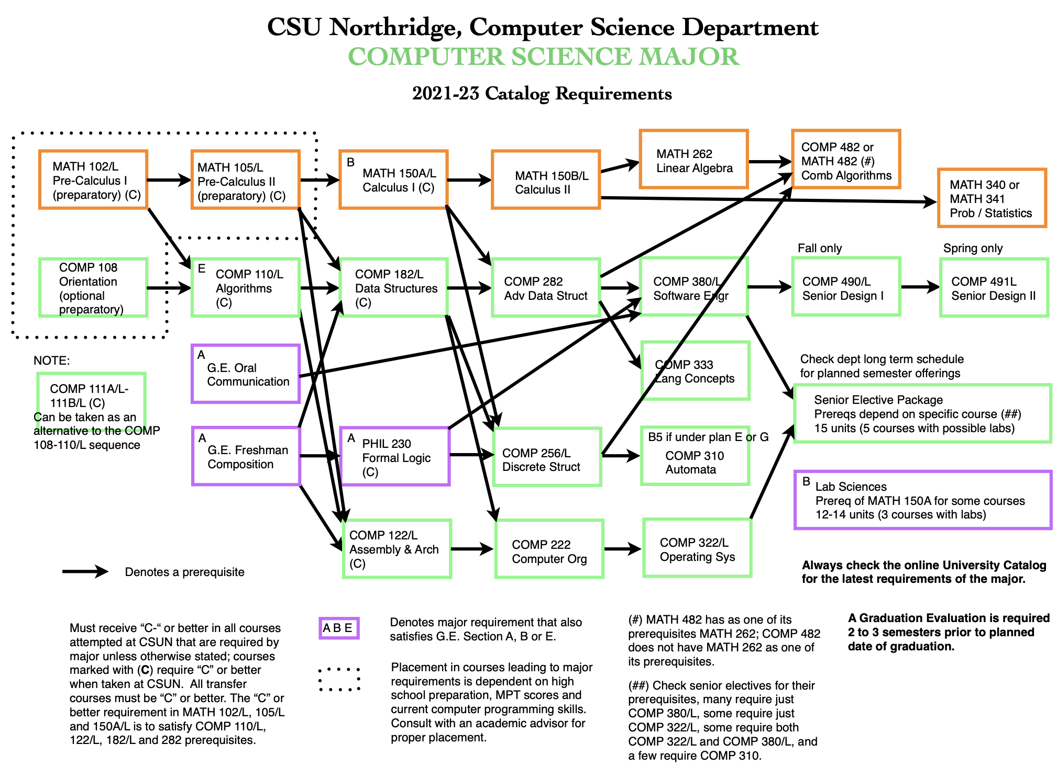

Slide 74
Sorting Dependencies
Given a set of courses and their prerequisites, find an order to take the courses in (assuming you can only take one course per quarter)
Possible ordering:
A
B
C
E
F
G
D
A
G
D
B
E
C
F
A
B
G
D
E
F
C

Slide 75
Topological Sort
Input:
A topological sort of a directed graph G without cycles is an ordering of the nodes, where for every edge in the graph, the origin appears before the destination in the ordering
Intuition: a “dependency graph”
An edge (u, v) means u must happen before v
A topological sort of a dependency graph gives an ordering that respects dependencies
Applications:
Graduating
Compiling multiple Java files
Multi-job Workflows
A before C
A
A before B
C
B
B before C
Topological Sort:
A
B
C
With original edges for reference:
A
B
C

Slide 76
Can We Always Topo Sort a Graph?
Can you topologically sort this graph?
What’s the difference between this graph and our first graph?
A graph has a topological ordering iff it is a DAG
But a DAG can have multiple orderings
A
🤔 Where do I start?
Where do I end? 🤔
No 😭
B
C
A directed graph without any cycles
Edges may or may not be weighted
DIRECTED ACYCLIC GRAPH
A
C
E
F
G
D
Notes:
3:00

Slide 77
How To Perform Topo Sort?
Input:
Topo sort is an ordering problem. Could we use… BFS?
2
0
3
5
IDEA 1
1
4
6
Performing Topo Sort
7
Use BFS, starting from a vertex with no incoming edges
BFS starting at 0:
0
1
3
4
7
Doesn’t reach all vertices ☹

Slide 78
How To Perform Topo Sort?
Input:
Okay, there may be multiple “roots”. What if we use BFS multiple times?
2
0
3
5
IDEA 2
1
4
6
Performing Topo Sort
7
Use BFS, starting from ALL vertices with no incoming edges
BFS starting at 0:
+ BFS starting at 2:
0
1
3
4
7
2
5
6

Slide 79
How To Perform Topo Sort?
Input:
Okay, there may be multiple “roots”. What if we use BFS multiple times?
2
0
3
5
IDEA 2
1
4
6
Performing Topo Sort
7
Use BFS, starting from ALL vertices with no incoming edges
BFS starting at 0:
+ BFS starting at 2:
Doesn’t respect all edges ☹
0
1
3
4
7
2
5
6

Slide 80
Idea: DFS:
In DFS, we print a vertex and then recursively call DFS for its adjacent vertices. In topological sorting, we need to print a vertex before its adjacent vertices.
We can modify DFS to find the Topological Sorting of a graph. In DFS,
We start from a vertex, we first print it, and then
Recursively call DFS for its adjacent vertices.
In topological sorting,
We use a temporary stack.
We don’t print the vertex immediately,
We first recursively call topological sorting for all its adjacent vertices, then push it to a stack.
Finally, print the contents of the stack.
Demo for topSort
Notes:
https://www.geeksforgeeks.org/topological-sorting/

Slide 81
2
2
2
2
*
0
3
5
0
3
5
0
3
5
0
3
5
*
*
1
4
6
1
4
6
1
4
6
1
4
6
*
7
7
7
7
Postorder: []
Postorder: []
Postorder: []
Postorder: [7]
2
2
2
2
*
*
0
3
5
0
3
5
0
3
5
0
3
5
*
*
1
4
6
4
6
4
6
1
4
6
1
1
7
7
7
7
Postorder: [7, 4]
Postorder: [7, 4, 1]
Postorder: [7, 4, 1]
Postorder: [7, 4, 1, 3]

Slide 82
Topological Sort (Demo 2/2)
2
2
*
2
2
*
*
*
0
3
5
0
3
5
0
3
5
0
3
5
4
6
4
6
4
6
1
4
6
1
1
1
7
7
7
7
Postorder: [7, 4, 1, 3]
Postorder: [7, 4, 1, 3, 0]
Postorder: [7, 4, 1, 3, 0]
Postorder: [7, 4, 1, 3, 0]
2
2
2
*
0
3
5
0
3
5
*
0
3
5
4
6
*
1
4
6
4
6
1
1
7
7
7
Postorder: [7, 4, 1, 3, 0, 6]
Postorder: [7, 4, 1, 3, 0, 6, 5]
Postorder: [7, 4, 1, 3, 0, 6, 5, 2]

Slide 83
Topological Sort
2
0
3
5
2
5
6
0
3
1
4
7
1
4
6
7
The reason it’s called topological sort: Can think of this process as sorting our nodes so they appear in an order consistent with edges, e.g. [2, 5, 6, 0, 3, 1, 4, 7]
When nodes are sorted in diagram, arrows all point rightwards.

Slide 84
None Recursive Algorithm
Created visited list
While the visited list does not contain all the vertices
Find a vertex that has no successor
Remove all the edges that lead to it from edgeList
Add it to the visited list
Add it to the topological list

Slide 85
B
C
A
D
E
F
G

Slide 86
B
C
A
A
B
C
D
E
F
G
B
D
C
E
E
C
F
D
E
F
G
D

Slide 87
Loop 1: Vertex C is selected
A
B
C
D
E
F
G
visitedList {C}
List {C}
B
D
C
E
A
B
C
D
E
F
G
B
D
E
E
C
F
E
D
F
D

Slide 88
Loop 2: Vertex F is selected
visitedList {C,F}
List {F,C}
A
B
C
D
E
F
G
B
D
E
A
B
C
D
E
F
G
B
D
E
E
F
E
D
D

Slide 89
Loop 3: Vertex E is selected
visitedList {C,F,E}
List {E,F,C}
A
B
C
D
E
F
G
B
D
E
A
B
C
D
E
F
G
D
B
E
D
D

Slide 90
Loop 4: Vertex B is selected
visitedList {C,F,E,B}
List {B,E,F,C}
A
B
C
D
E
F
G
B
D
A
B
C
D
E
F
G
D
D
D

Slide 91
Loop 5: Vertex D is selected
visitedList {C,F,E,B,D}
List {D,B,E,F,C}
A
B
C
D
E
F
G
D
A
B
C
D
E
F
G
D

Slide 92
Loop 6: Vertex A is selected
visitedList {C,F,E,B,D,A}
List {A,D,B,E,F,C}
A
B
C
D
E
F
G
A
B
C
D
E
F
G

Slide 93
Loop 7: Vertex G is selected
visitedList {C,F,E,B,D,A,G}
List {G,A,D,B,E,F,C}
A
B
C
D
E
F
G
A
B
C
D
E
F
G
C
B
A
D
E
F
G
Topological Sorting: G → A → D → B → E → F → C

Slide 94
Opening Problem
The Seven Bridges of Königsberg problem.
The Seven Bridges of Königsberg is a famous mathematical problem that involves finding a route across each of seven bridges in the city of Königsberg (now Kaliningrad) exactly once.
Leonhard Euler proved that such a route was impossible, laying the foundation for graph theory.
Eulerian Walk

