Slide 1
Priority queues and binary heaps
COMP 182 Lecture 11
Operations, implementation choices, and time complexity
n = number of stored items
Bounds assume constant-time comparisons
01
Notes:
Adapted from the supplied Lecture11-PQ.pptx. Original Pearson material: © 2011 Pearson Addison-Wesley. All rights reserved.
Analysis assumes n stored items, O(1) comparisons, and O(1) array access. Worst-case bounds unless labeled otherwise.
The companion folder contains complete Java 17 sources for the displayed code and its supporting heap, priority queue, and heapsort classes. Keep that folder beside the PowerPoint for local links. Print Notes Pages for slide thumbnails and teaching notes; the separate PDF contains slides only.

Slide 2
The priority queue ADT
Each removal returns an item with the highest priority under the chosen ordering.
Example: an emergency department treats more urgent cases first.
A max priority queue returns the greatest key.
A min priority queue returns the smallest key.
Equal-priority items need an explicit rule if FIFO order matters.
The ADT defines behavior. The implementation determines cost.
Java: StablePriorityQueueDemo.java
02
Notes:
Adapted from the supplied Lecture11-PQ.pptx. Original Pearson material: © 2011 Pearson Addison-Wesley. All rights reserved.
Analysis assumes n stored items, O(1) comparisons, and O(1) array access. Worst-case bounds unless labeled otherwise.
The stable example adds a monotonically increasing sequence number as a secondary comparison key. Smaller numeric priority is more urgent in that example; this is a stated policy rather than a universal convention. Equal priorities alone do not guarantee FIFO behavior.
Local Java: StablePriorityQueueDemo.java.

Slide 3
A consistent Java interface
This course interface returns null when peek() or remove() finds an empty queue.
public interface PriorityQueueInterface<T
extends Comparable<? super T>> {
boolean add(T newEntry);
T remove();
T peek();
boolean isEmpty();
int size();
void clear();
}
Use T consistently in both the type parameter and method signatures.
Java: PriorityQueueInterface.java
Java: TestPQ.java
03
Notes:
Adapted from the supplied Lecture11-PQ.pptx. Original Pearson material: © 2011 Pearson Addison-Wesley. All rights reserved.
Analysis assumes n stored items, O(1) comparisons, and O(1) array access. Worst-case bounds unless labeled otherwise.
The custom course API rejects null items and returns null for an empty peek or remove. The heap add method returns void; the MaxPriorityQueue and MinPriorityQueue adapters implement the interface boolean add by returning true after a successful insertion. Do not confuse this empty-remove behavior with the JDK API.
Local Java: PriorityQueueInterface.java, TestPQ.java.

Slide 4
Priority queue implementations
Worst-case time for n items. The next slides explain each representation.
Representation | Insert | Peek / remove extreme
Unsorted array | O(1) amortized | O(n) / O(n)
Sorted array | O(n) | O(1) / O(1)
Sorted linked list | O(n) | O(1) / O(1)
Balanced BST | O(log n) | O(log n) / O(log n)
Binary heap | O(log n)* | O(1) / O(log n)
*Heap repair is O(log n). A resizing insertion can take O(n).
Arrays remove at the end. Lists remove at the head. BST has no cached extreme.
04
Notes:
Adapted from the supplied Lecture11-PQ.pptx. Original Pearson material: © 2011 Pearson Addison-Wesley. All rights reserved.
Analysis assumes n stored items, O(1) comparisons, and O(1) array access. Worst-case bounds unless labeled otherwise.
Ask students to connect the displayed representation or trace with the heap invariant and the operation cost. Use HeapDemo to compare the illustrated sequence with level-order array values.

Slide 5
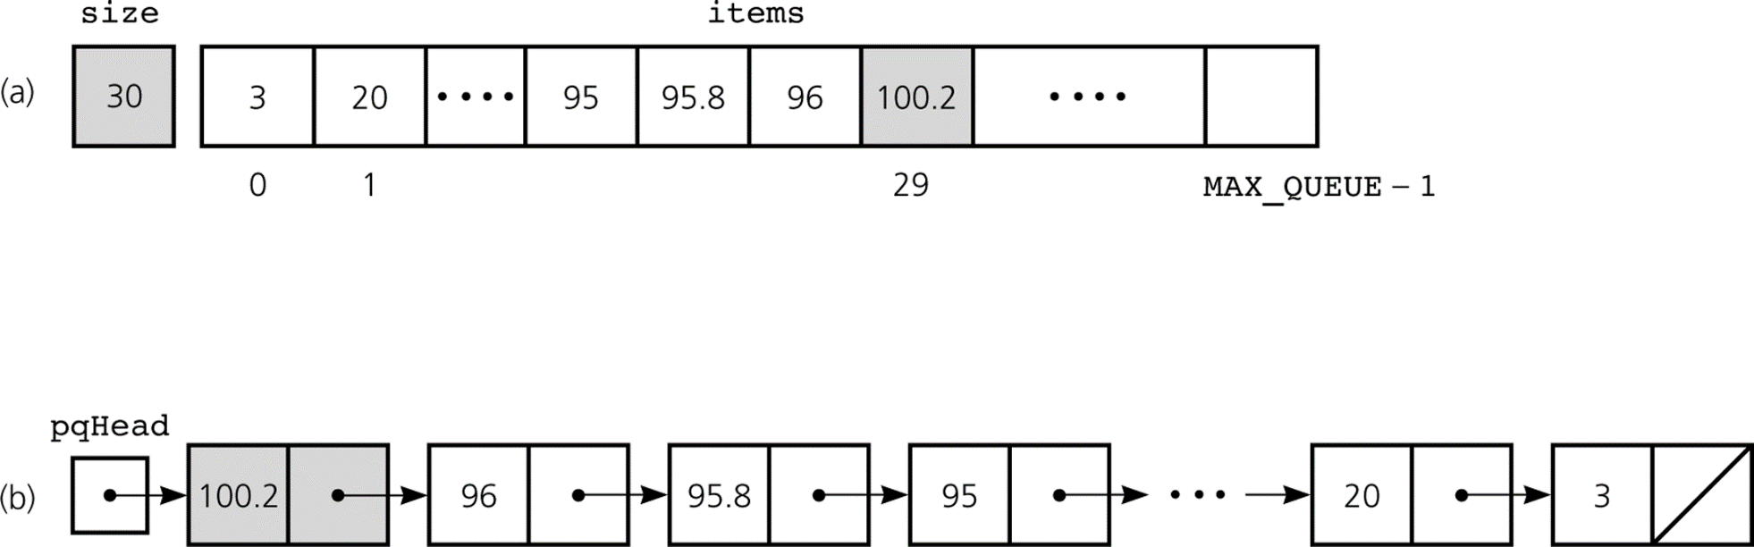
Max priority queues with sorted storage
Both representations place the maximum where removal needs no search.
Sorted array: binary search O(log n), then shifting O(n).
Sorted linked list: search O(n), then relink O(1).
Insert O(n) Peek O(1) Remove maximum O(1)
Original diagram: © 2011 Pearson Addison-Wesley
05
Notes:
Adapted from the supplied Lecture11-PQ.pptx. Original Pearson material: © 2011 Pearson Addison-Wesley. All rights reserved.
Analysis assumes n stored items, O(1) comparisons, and O(1) array access. Worst-case bounds unless labeled otherwise.
Ask students to connect the displayed representation or trace with the heap invariant and the operation cost. Use HeapDemo to compare the illustrated sequence with level-order array values.

Slide 6
Min priority queues with sorted storage
Reverse the ordering so the minimum occupies the removal position.
Representation | Ordering | Minimum location
Sorted array | Descending | Last occupied index
Sorted linked list | Ascending | Head
An array sorted in ascending order needs O(n) shifting to remove index 0.
With the ordering above: insert O(n), peek O(1), remove minimum O(1)
06
Notes:
Adapted from the supplied Lecture11-PQ.pptx. Original Pearson material: © 2011 Pearson Addison-Wesley. All rights reserved.
Analysis assumes n stored items, O(1) comparisons, and O(1) array access. Worst-case bounds unless labeled otherwise.
Ask students to connect the displayed representation or trace with the heap invariant and the operation cost. Use HeapDemo to compare the illustrated sequence with level-order array values.

Slide 7
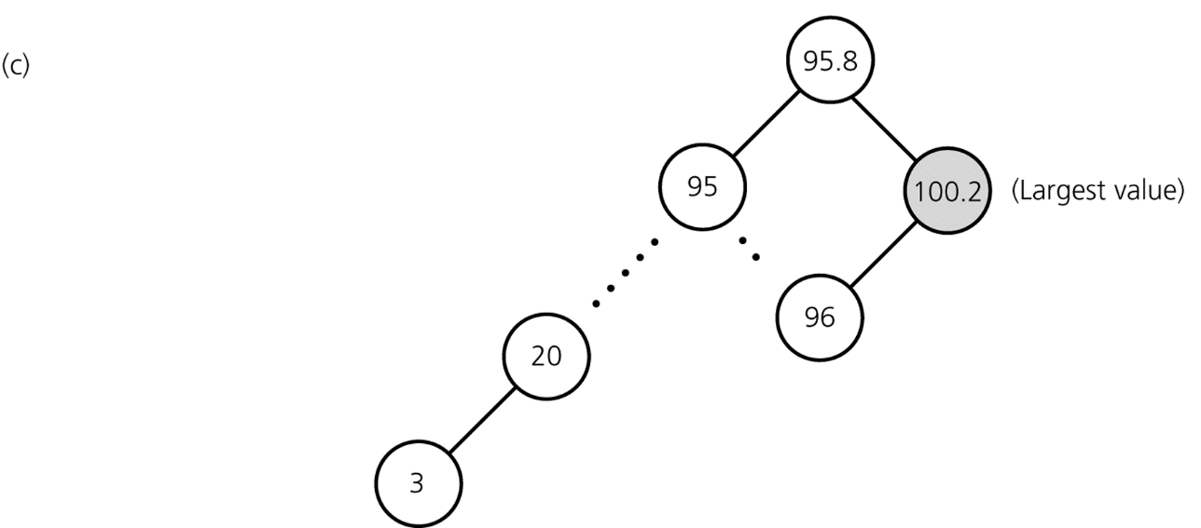
A binary search tree implementation
The maximum is the rightmost node. Its location depends on tree height h.
Insert: O(h)
Find and remove maximum: O(h)
Balanced BST: h = O(log n)
Unbalanced BST: h can be n − 1
A plain BST can degrade to O(n) per operation.
Original diagram: © 2011 Pearson Addison-Wesley
07
Notes:
Adapted from the supplied Lecture11-PQ.pptx. Original Pearson material: © 2011 Pearson Addison-Wesley. All rights reserved.
Analysis assumes n stored items, O(1) comparisons, and O(1) array access. Worst-case bounds unless labeled otherwise.
Ask students to connect the displayed representation or trace with the heap invariant and the operation cost. Use HeapDemo to compare the illustrated sequence with level-order array values.

Slide 8
The two heap properties
A binary heap combines a complete tree shape with a local ordering rule.
Shape: every level is full except possibly the last.
The last level fills from left to right.
Max-heap order: each parent key is at least each child key.
Every subtree satisfies the same ordering rule.
A heap supports fast access to one extreme. Arbitrary search is O(n).
Java: MaxHeap.java
08
Notes:
Adapted from the supplied Lecture11-PQ.pptx. Original Pearson material: © 2011 Pearson Addison-Wesley. All rights reserved.
Analysis assumes n stored items, O(1) comparisons, and O(1) array access. Worst-case bounds unless labeled otherwise.
A heap is not a binary search tree and its array is not globally sorted. Checking a parent against its children is enough to establish the local invariant; complete shape gives logarithmic height.
Local Java: MaxHeap.java.

Slide 9
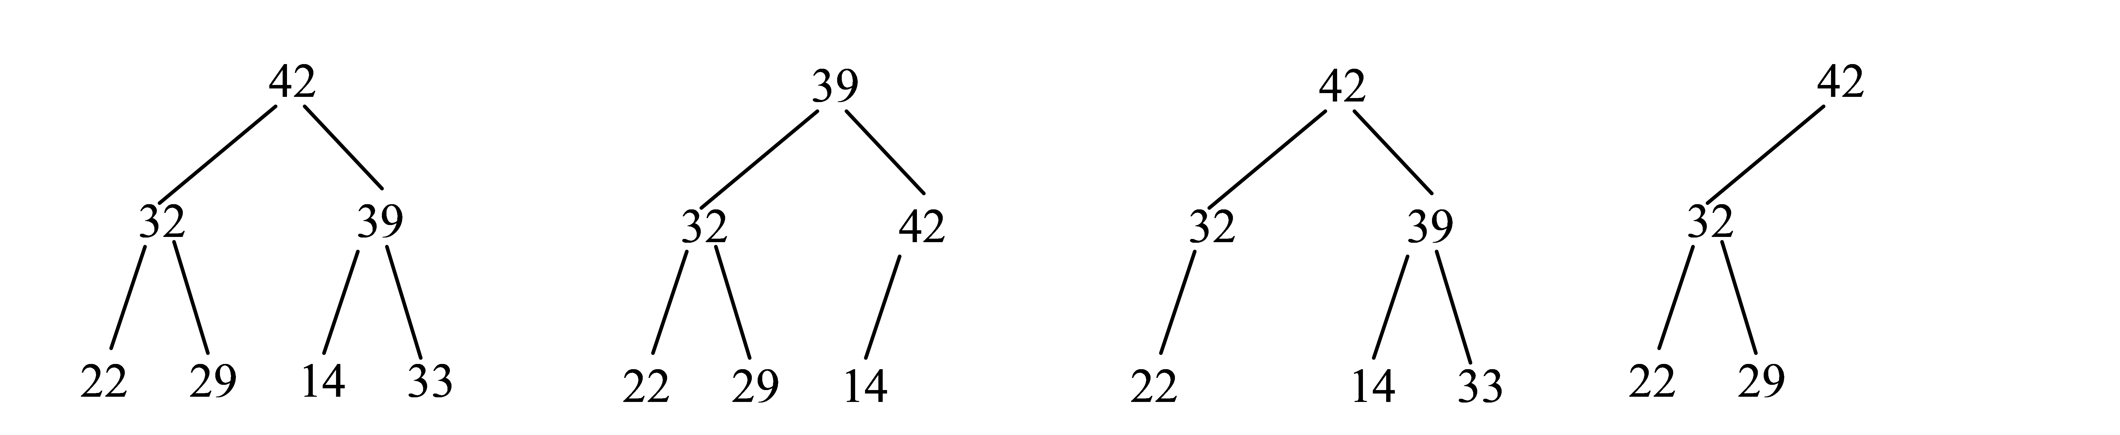
Complete trees and heap order
Completeness constrains the shape. Heap order constrains the keys.
(a) Complete and a max-heap. (b) Complete, but 39 < 42 violates heap order.
(c) and (d) are incomplete because the final level has gaps.
For n ≥ 1, a complete binary tree has height floor(log2(n)).
Original diagram: © 2011 Pearson Addison-Wesley
09
Notes:
Adapted from the supplied Lecture11-PQ.pptx. Original Pearson material: © 2011 Pearson Addison-Wesley. All rights reserved.
Analysis assumes n stored items, O(1) comparisons, and O(1) array access. Worst-case bounds unless labeled otherwise.
Ask students to connect the displayed representation or trace with the heap invariant and the operation cost. Use HeapDemo to compare the illustrated sequence with level-order array values.

Slide 10
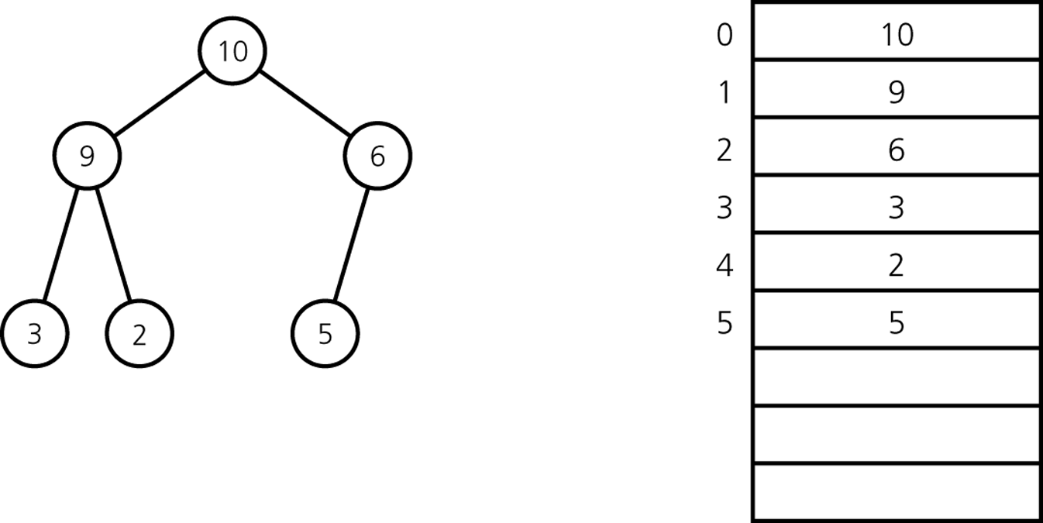
Max-heaps and min-heaps
Max-heap: parent ≥ children.
The root contains a maximum.
Min-heap: parent ≤ children.
The root contains a minimum.
Peek at the root: O(1) in either heap.
Java: MaxHeap.java
Java: MinHeap.java
Original diagram: © 2011 Pearson Addison-Wesley
10
Notes:
Adapted from the supplied Lecture11-PQ.pptx. Original Pearson material: © 2011 Pearson Addison-Wesley. All rights reserved.
Analysis assumes n stored items, O(1) comparisons, and O(1) array access. Worst-case bounds unless labeled otherwise.
MaxHeap and MinHeap are separate implementations with opposite comparisons. Their snapshot methods return an independent unmodifiable level-order list, not a sorted sequence. Mutable element references are shared; do not change comparison keys while an element is queued.
Local Java: MaxHeap.java, MinHeap.java.

Slide 11
Heap operation costs
Array-backed binary heap with no shrinking during removal.
Operation | Time | Reason
Empty constructor | O(1) | No items to process
peek / size / isEmpty | O(1) | Read root or count
Insert | O(log n)* | Sift up one path
Remove root | O(log n) | Sift down one path
clear | O(n) | Null occupied references
*Repair bound. Dynamic array growth can make one insertion O(n).
With geometric growth, insertion is O(log n) amortized.
Java: MaxHeap.java
11
Notes:
Adapted from the supplied Lecture11-PQ.pptx. Original Pearson material: © 2011 Pearson Addison-Wesley. All rights reserved.
Analysis assumes n stored items, O(1) comparisons, and O(1) array access. Worst-case bounds unless labeled otherwise.
Ask students to connect the displayed representation or trace with the heap invariant and the operation cost. Use HeapDemo to compare the illustrated sequence with level-order array values.
Local Java: MaxHeap.java.

Slide 12
An array representation
Level-order storage keeps the complete tree compact. Indices start at 0.
Root: index 0
Left child of i: 2i + 1
Right child of i: 2i + 2
Parent of i > 0: floor((i - 1) / 2)
Index calculations and random access take O(1). Storage is O(n).
Java: HeapDemo.java
Original diagram: © 2011 Pearson Addison-Wesley
12
Notes:
Adapted from the supplied Lecture11-PQ.pptx. Original Pearson material: © 2011 Pearson Addison-Wesley. All rights reserved.
Analysis assumes n stored items, O(1) comparisons, and O(1) array access. Worst-case bounds unless labeled otherwise.
HeapDemo prints level-order arrays. For zero-based indexing, only compute the parent when i is positive. The root has no parent. A child index is used only while it lies within logical size.
Local Java: HeapDemo.java.

Slide 13
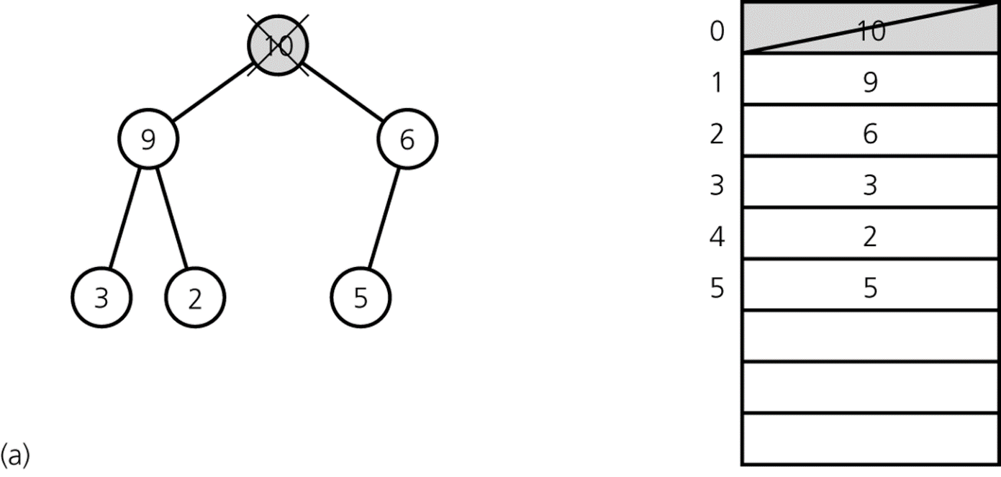
Remove the root: save the result
Save the maximum before changing the heap.
Saving the root takes O(1). Repair comes after replacing it.
Java: HeapDemo.java
Original diagram: © 2011 Pearson Addison-Wesley
13
Notes:
Adapted from the supplied Lecture11-PQ.pptx. Original Pearson material: © 2011 Pearson Addison-Wesley. All rights reserved.
Analysis assumes n stored items, O(1) comparisons, and O(1) array access. Worst-case bounds unless labeled otherwise.
Ask students to connect the displayed representation or trace with the heap invariant and the operation cost. Use HeapDemo to compare the illustrated sequence with level-order array values.
Local Java: HeapDemo.java.

Slide 14
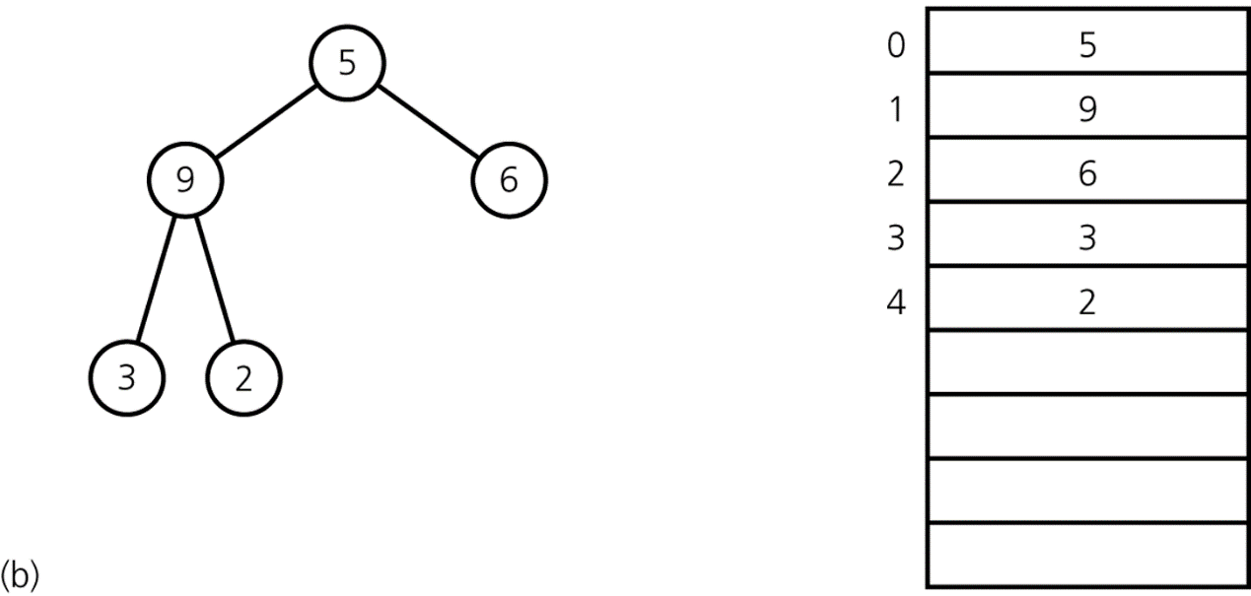
Remove the root: replace it with the last item
Move the final array entry to index 0, then remove the final entry.
Replacement and removal at the array end take O(1).
Java: HeapDemo.java
Original diagram: © 2011 Pearson Addison-Wesley
14
Notes:
Adapted from the supplied Lecture11-PQ.pptx. Original Pearson material: © 2011 Pearson Addison-Wesley. All rights reserved.
Analysis assumes n stored items, O(1) comparisons, and O(1) array access. Worst-case bounds unless labeled otherwise.
Ask students to connect the displayed representation or trace with the heap invariant and the operation cost. Use HeapDemo to compare the illustrated sequence with level-order array values.
Local Java: HeapDemo.java.

Slide 15
The intermediate array
Only the root may violate heap order. The two child subtrees remain heaps.
Index | 0 | 1 | 2 | 3 | 4
Value | 5 | 9 | 6 | 3 | 2
The value 5 is smaller than its child 9.
Compare both children and choose the larger child for a max-heap.
Each level requires O(1) comparisons and at most one swap.
Java: HeapDemo.java
15
Notes:
Adapted from the supplied Lecture11-PQ.pptx. Original Pearson material: © 2011 Pearson Addison-Wesley. All rights reserved.
Analysis assumes n stored items, O(1) comparisons, and O(1) array access. Worst-case bounds unless labeled otherwise.
Ask students to connect the displayed representation or trace with the heap invariant and the operation cost. Use HeapDemo to compare the illustrated sequence with level-order array values.
Local Java: HeapDemo.java.

Slide 16
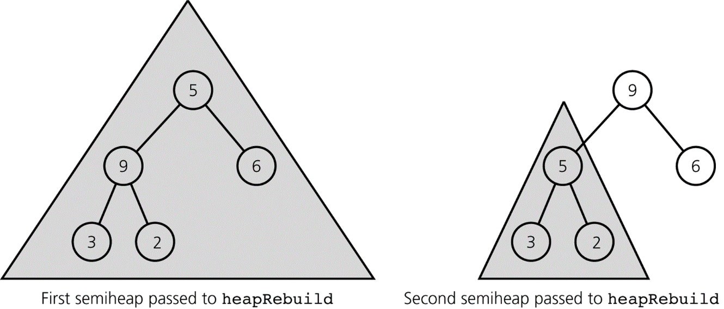
Sift down restores heap order
Swap with the larger child until the parent is large enough or reaches a leaf.
At most floor(log2(n)) levels. Sift down takes O(log n) worst-case.
Java: HeapDemo.java
Original diagram: © 2011 Pearson Addison-Wesley
16
Notes:
Adapted from the supplied Lecture11-PQ.pptx. Original Pearson material: © 2011 Pearson Addison-Wesley. All rights reserved.
Analysis assumes n stored items, O(1) comparisons, and O(1) array access. Worst-case bounds unless labeled otherwise.
Ask students to connect the displayed representation or trace with the heap invariant and the operation cost. Use HeapDemo to compare the illustrated sequence with level-order array values.
Local Java: HeapDemo.java.

Slide 17
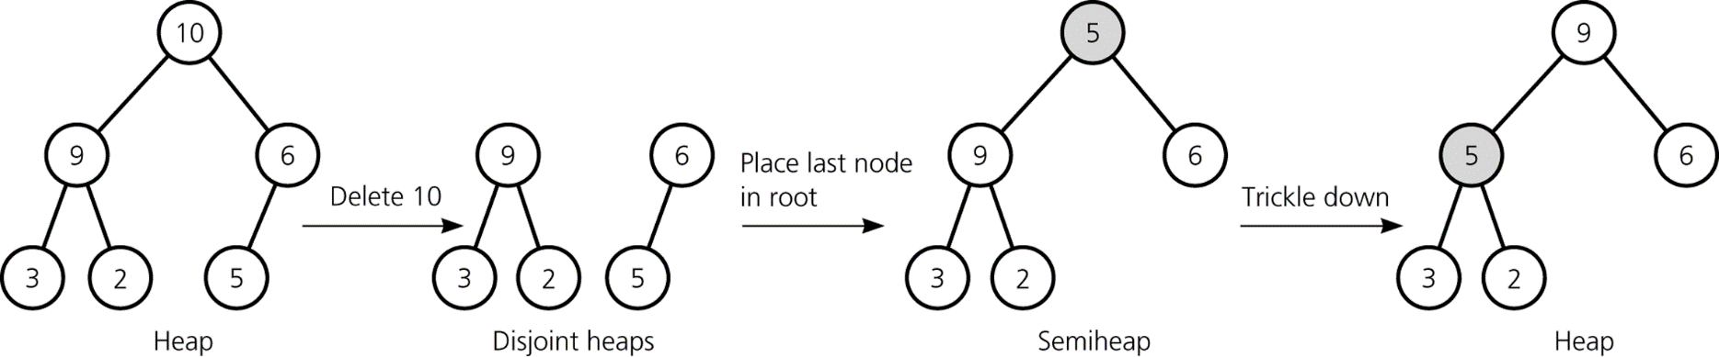
Deletion: the complete sequence
Save root, replace it with the last item, and sift down.
The complete shape stays intact because only the last node disappears.
Remove root: O(log n) worst-case, O(1) best-case.
Java: HeapDemo.java
Original diagram: © 2011 Pearson Addison-Wesley
17
Notes:
Adapted from the supplied Lecture11-PQ.pptx. Original Pearson material: © 2011 Pearson Addison-Wesley. All rights reserved.
Analysis assumes n stored items, O(1) comparisons, and O(1) array access. Worst-case bounds unless labeled otherwise.
Ask students to connect the displayed representation or trace with the heap invariant and the operation cost. Use HeapDemo to compare the illustrated sequence with level-order array values.
Local Java: HeapDemo.java.

Slide 18
Sift down: iterative Java
Both child subtrees must already satisfy max-heap order.
private void heapRebuild(int root) {
int n = list.size();
while (root < n / 2) {
int child = 2 * root + 1;
if (child + 1 < n &&
list.get(child + 1).compareTo(list.get(child)) > 0)
child++;
if (list.get(root).compareTo(list.get(child)) >= 0)
break;
Collections.swap(list, root, child);
root = child;
}
}
Time O(log n). Extra space O(1), versus O(log n) for recursive calls.
Java: MaxHeap.java
18
Notes:
Adapted from the supplied Lecture11-PQ.pptx. Original Pearson material: © 2011 Pearson Addison-Wesley. All rights reserved.
Analysis assumes n stored items, O(1) comparisons, and O(1) array access. Worst-case bounds unless labeled otherwise.
The full MaxHeap declares private ArrayList<T> list and imports Collections. The loop guard root < n / 2 means this node has a left child; it also avoids evaluating an overflowing child-index expression for a very large leaf index. With this guard, 2 * root + 1 is safe. The right-child check handles a final parent with only a left child. Sift down chooses the larger child, then stops on equality.
Local Java: MaxHeap.java.

Slide 19
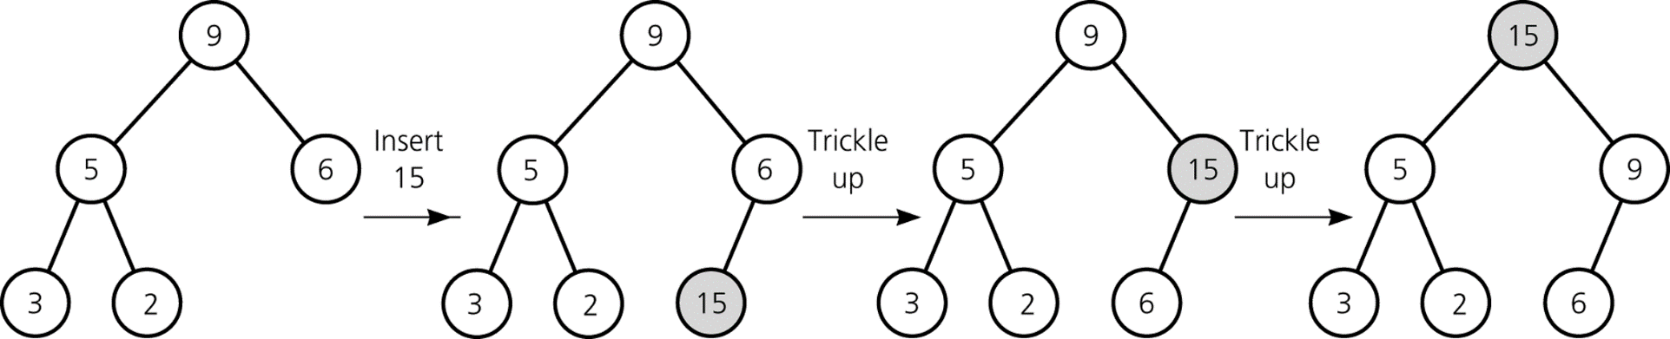
Insertion: append, then sift up
Append at the next free position to preserve the complete shape.
Compare the new item with its parent and swap while the item is larger.
Heap repair takes O(log n) worst-case and O(1) best-case.
Java: HeapDemo.java
Original diagram: © 2011 Pearson Addison-Wesley
19
Notes:
Adapted from the supplied Lecture11-PQ.pptx. Original Pearson material: © 2011 Pearson Addison-Wesley. All rights reserved.
Analysis assumes n stored items, O(1) comparisons, and O(1) array access. Worst-case bounds unless labeled otherwise.
Ask students to connect the displayed representation or trace with the heap invariant and the operation cost. Use HeapDemo to compare the illustrated sequence with level-order array values.
Local Java: HeapDemo.java.

Slide 20
Sift up: Java implementation
The loop condition stops before trying to move above the root.
public void add(T newItem) {
list.add(Objects.requireNonNull(newItem, "newItem"));
int i = list.size() - 1;
while (i > 0) {
int parent = (i - 1) / 2;
if (list.get(i).compareTo(list.get(parent)) <= 0)
break;
Collections.swap(list, i, parent);
i = parent;
}
}
O(log n) amortized with ArrayList. A resizing insertion can take O(n).
Java: MaxHeap.java
20
Notes:
Adapted from the supplied Lecture11-PQ.pptx. Original Pearson material: © 2011 Pearson Addison-Wesley. All rights reserved.
Analysis assumes n stored items, O(1) comparisons, and O(1) array access. Worst-case bounds unless labeled otherwise.
This is MaxHeap.add, whose return type is void. The custom priority queue adapter has boolean add and returns true after this heap insertion. Null is rejected before mutation. Equal items do not swap unnecessarily; that does not make the overall priority queue stable.
Local Java: MaxHeap.java.

Slide 21
Insertion example: 3, 5, 1, 19, 11, 22
Begin with an empty max-heap. Each highlighted value has just been inserted.
Six insertions here. In general, n successive insertions cost O(n log n).
Java: HeapDemo.java
Original diagram: © 2011 Pearson Addison-Wesley
21
Notes:
Adapted from the supplied Lecture11-PQ.pptx. Original Pearson material: © 2011 Pearson Addison-Wesley. All rights reserved.
Analysis assumes n stored items, O(1) comparisons, and O(1) array access. Worst-case bounds unless labeled otherwise.
HeapDemo reproduces the six insertions and prints [22, 11, 19, 3, 5, 1]. The source diagram shows the same level-order arrangement. The root is the maximum, but siblings have no required relative ordering.
Local Java: HeapDemo.java.

Slide 22
Insertion example: add 88
Append 88, swap with 19, then swap with 22.
Two swaps in this example. At most the tree height in general.
Java: HeapDemo.java
Original diagram: © 2011 Pearson Addison-Wesley
22
Notes:
Adapted from the supplied Lecture11-PQ.pptx. Original Pearson material: © 2011 Pearson Addison-Wesley. All rights reserved.
Analysis assumes n stored items, O(1) comparisons, and O(1) array access. Worst-case bounds unless labeled otherwise.
After inserting 88, the level-order array is [88, 11, 22, 3, 5, 1, 19]. The path to the root contains the two swaps described by the slide.
Local Java: HeapDemo.java.

Slide 23
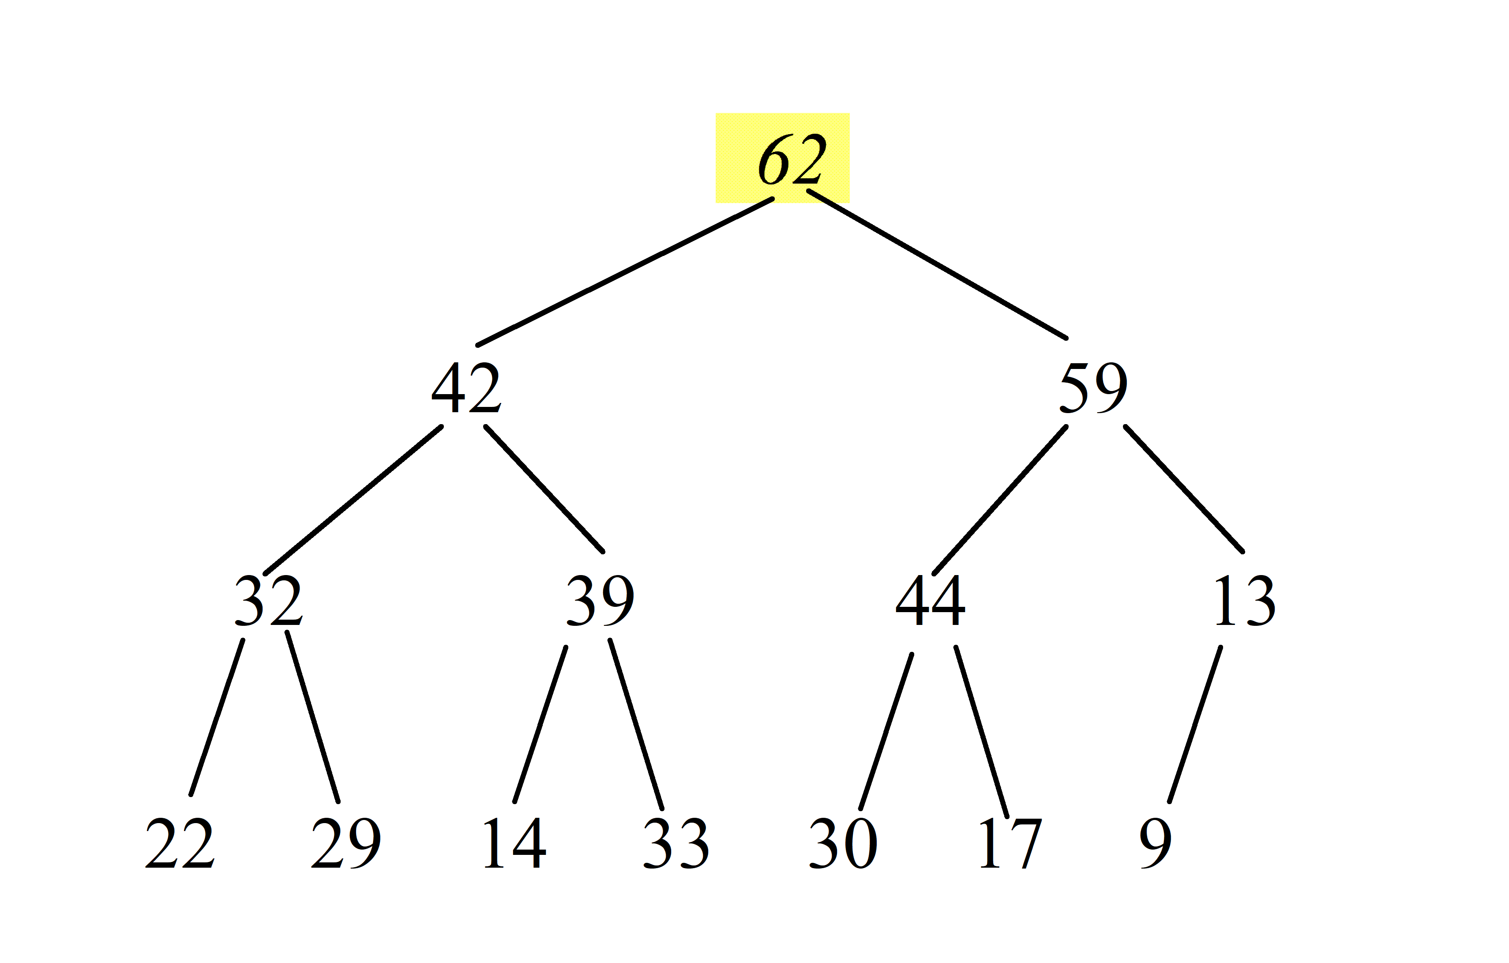
Deletion example: remove 62
Save 62 as the return value. The last node contains 9.
Finding the maximum and locating the last item each take O(1).
Java: HeapDemo.java
Original diagram: © 2011 Pearson Addison-Wesley
23
Notes:
Adapted from the supplied Lecture11-PQ.pptx. Original Pearson material: © 2011 Pearson Addison-Wesley. All rights reserved.
Analysis assumes n stored items, O(1) comparisons, and O(1) array access. Worst-case bounds unless labeled otherwise.
HeapDemo builds the displayed 14-item heap from [62,42,59,32,39,44,13,22,29,14,33,30,17,9]. remove returns 62. The saved result must not be overwritten by repair.
Local Java: HeapDemo.java.

Slide 24
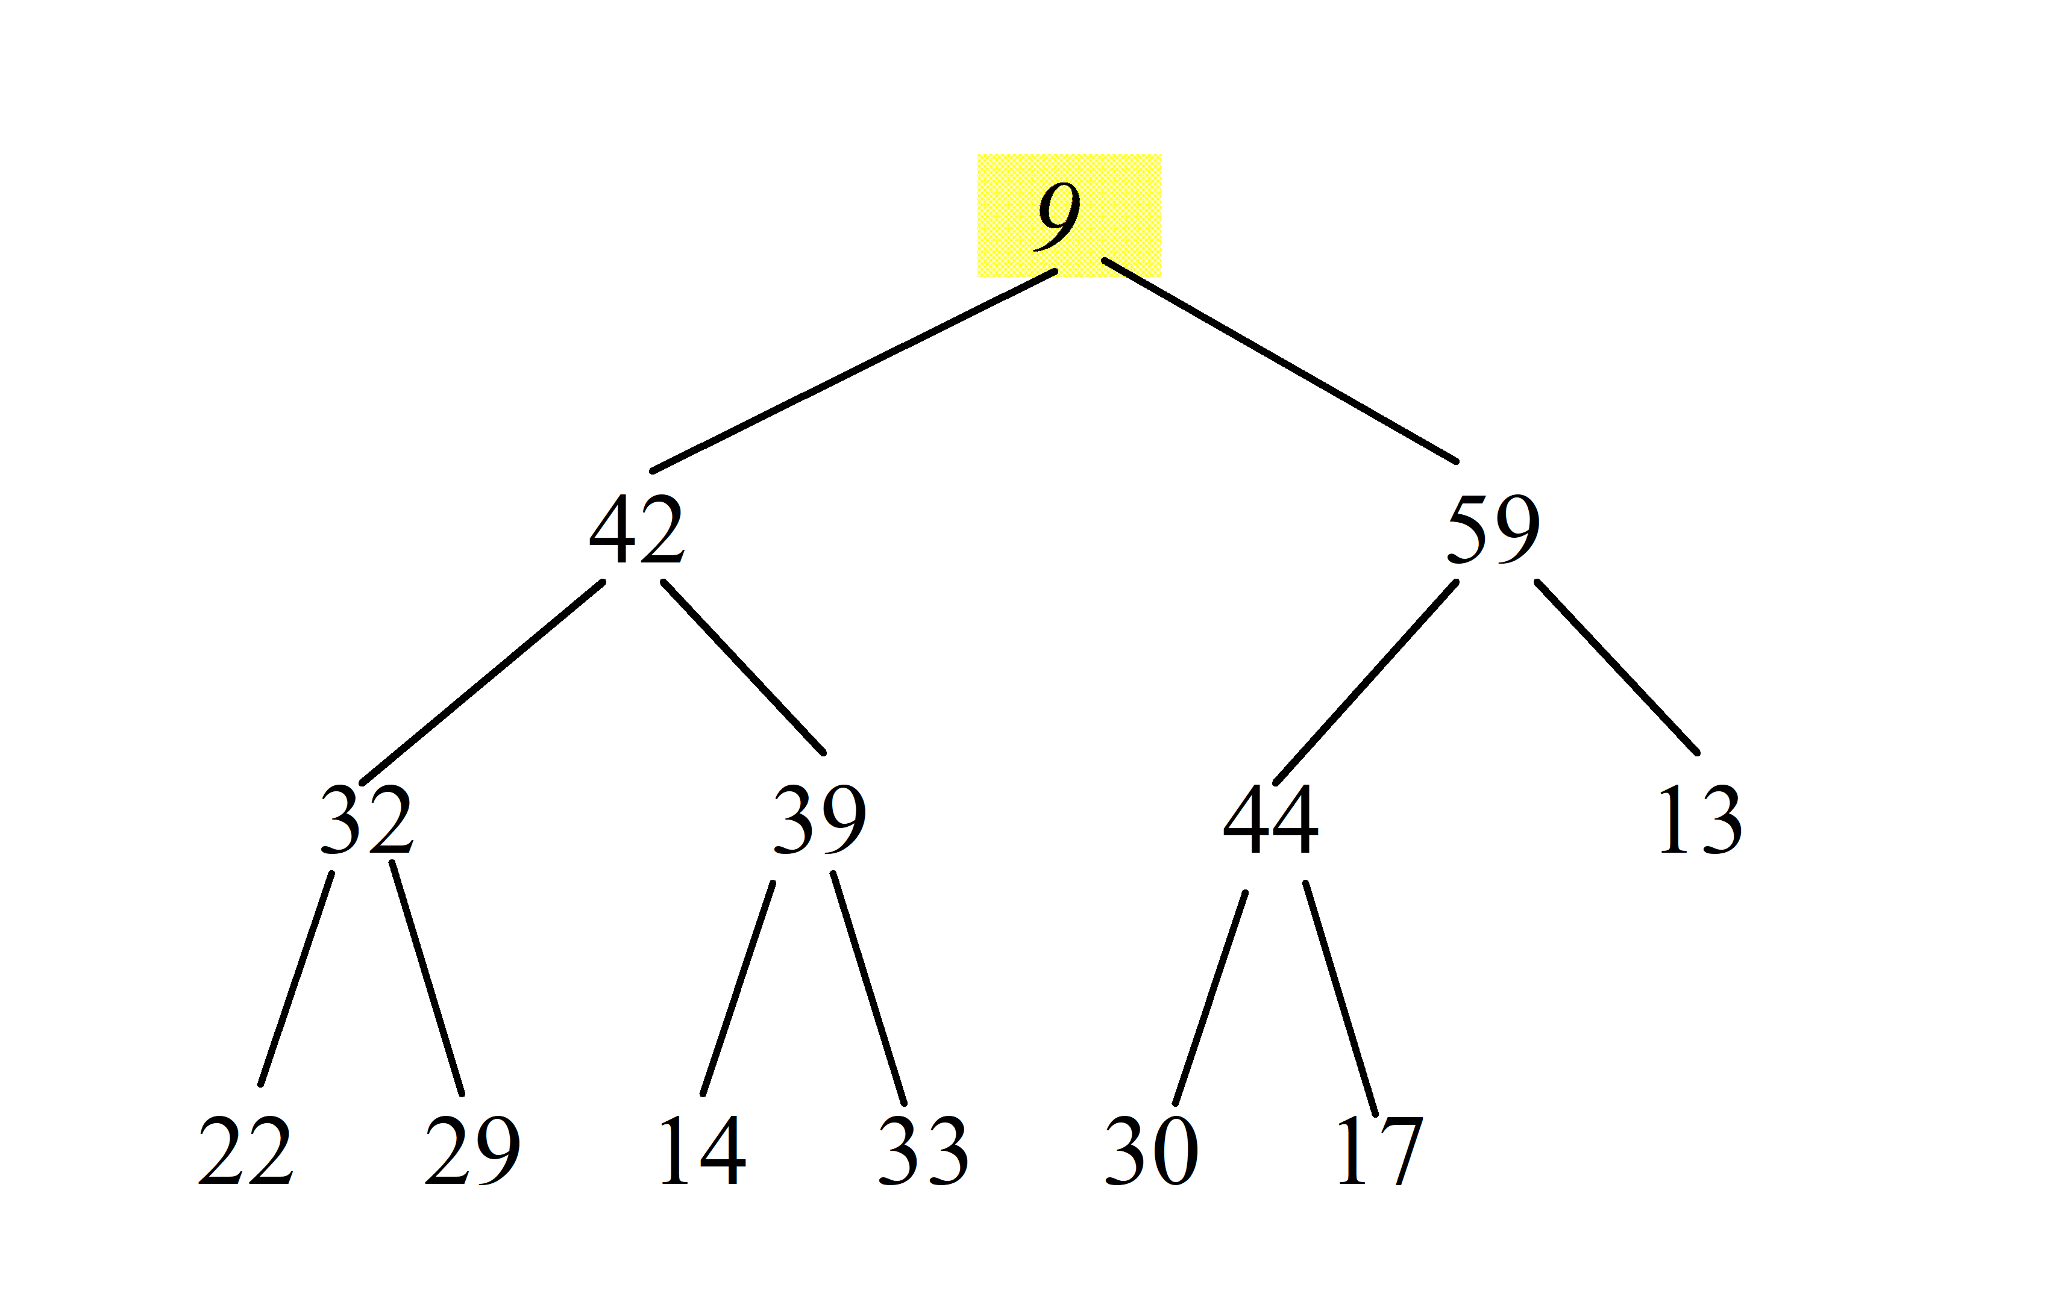
Deletion example: move 9 to the root
Remove the final node after moving its value.
The shape is complete. The root violates max-heap order.
Java: HeapDemo.java
Original diagram: © 2011 Pearson Addison-Wesley
24
Notes:
Adapted from the supplied Lecture11-PQ.pptx. Original Pearson material: © 2011 Pearson Addison-Wesley. All rights reserved.
Analysis assumes n stored items, O(1) comparisons, and O(1) array access. Worst-case bounds unless labeled otherwise.
Ask students to connect the displayed representation or trace with the heap invariant and the operation cost. Use HeapDemo to compare the illustrated sequence with level-order array values.
Local Java: HeapDemo.java.

Slide 25
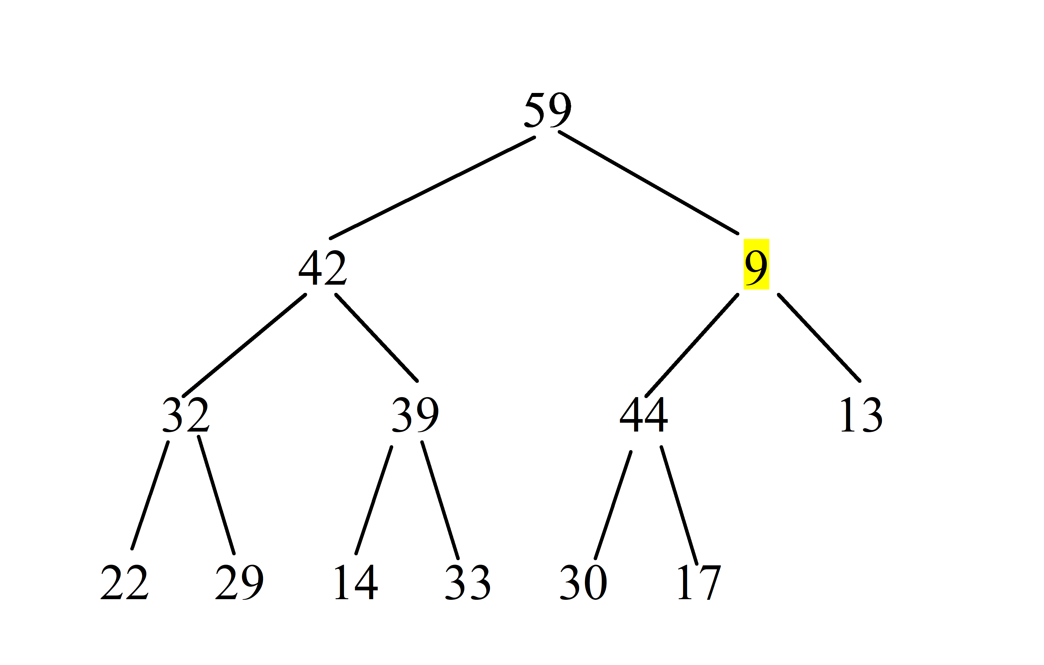
Deletion example: swap 9 with 59
59 is the larger of the root’s children, 42 and 59.
One sift-down step costs O(1). Continue from the new position of 9.
Java: HeapDemo.java
Original diagram: © 2011 Pearson Addison-Wesley
25
Notes:
Adapted from the supplied Lecture11-PQ.pptx. Original Pearson material: © 2011 Pearson Addison-Wesley. All rights reserved.
Analysis assumes n stored items, O(1) comparisons, and O(1) array access. Worst-case bounds unless labeled otherwise.
Ask students to connect the displayed representation or trace with the heap invariant and the operation cost. Use HeapDemo to compare the illustrated sequence with level-order array values.
Local Java: HeapDemo.java.

Slide 26
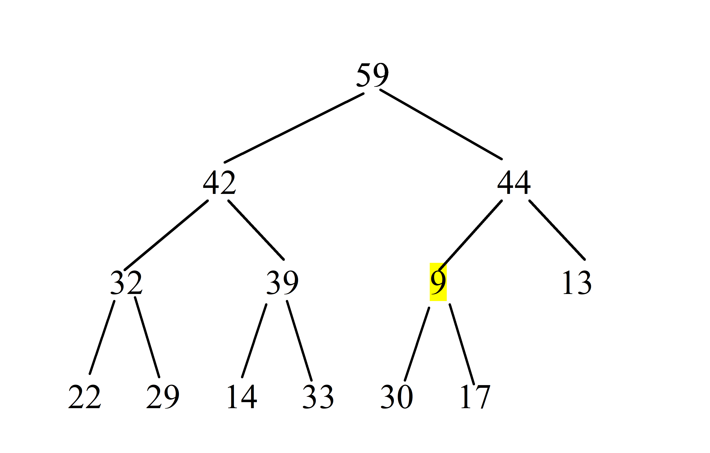
Deletion example: swap 9 with 44
44 is the larger of 9’s children, 44 and 13.
The possible violation moves down one level after each swap.
Java: HeapDemo.java
Original diagram: © 2011 Pearson Addison-Wesley
26
Notes:
Adapted from the supplied Lecture11-PQ.pptx. Original Pearson material: © 2011 Pearson Addison-Wesley. All rights reserved.
Analysis assumes n stored items, O(1) comparisons, and O(1) array access. Worst-case bounds unless labeled otherwise.
Ask students to connect the displayed representation or trace with the heap invariant and the operation cost. Use HeapDemo to compare the illustrated sequence with level-order array values.
Local Java: HeapDemo.java.

Slide 27
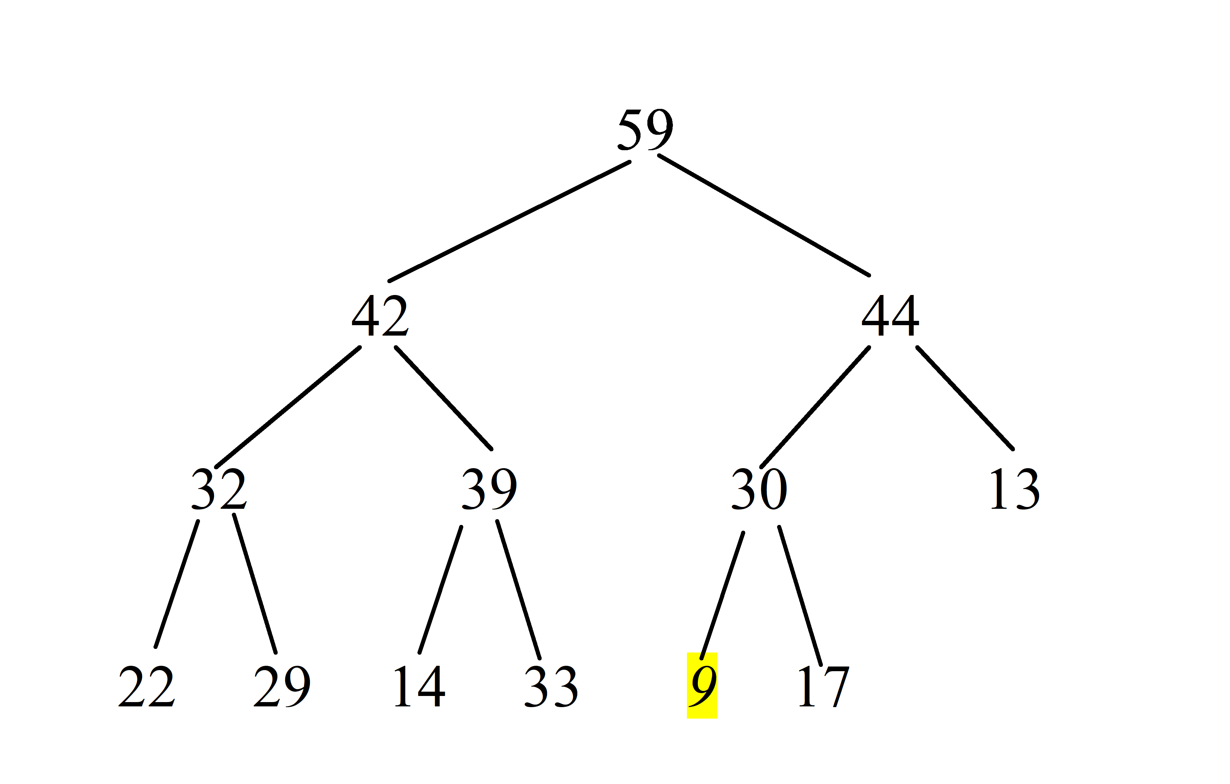
Deletion example: swap 9 with 30
30 is the larger child. After the swap, 9 reaches a leaf.
Three swaps restore the heap. General worst-case time: O(log n).
Java: HeapDemo.java
Original diagram: © 2011 Pearson Addison-Wesley
27
Notes:
Adapted from the supplied Lecture11-PQ.pptx. Original Pearson material: © 2011 Pearson Addison-Wesley. All rights reserved.
Analysis assumes n stored items, O(1) comparisons, and O(1) array access. Worst-case bounds unless labeled otherwise.
After removing 62 and repairing, HeapDemo prints [59,42,44,32,39,30,13,22,29,14,33,9,17]. The three downward swaps match the diagram. The remaining heap has 13 items.
Local Java: HeapDemo.java.

Slide 28
Building a heap from n items
Bottom-up construction is faster than inserting every item separately.
for (int i = list.size() / 2 - 1; i >= 0; i--)
heapRebuild(i);
Leaves already satisfy heap order. Start at the last internal node.
Most nodes are near the leaves and move only a short distance.
Total work: n/4 + 2n/8 + 3n/16 + … = O(n).
Bottom-up build: O(n). Repeated insertion: O(n log n) worst-case.
Java: MaxHeap.java
Java: HeapDemo.java
28
Notes:
Adapted from the supplied Lecture11-PQ.pptx. Original Pearson material: © 2011 Pearson Addison-Wesley. All rights reserved.
Analysis assumes n stored items, O(1) comparisons, and O(1) array access. Worst-case bounds unless labeled otherwise.
The collection constructor copies and checks every entry, then runs the displayed loop. Each child subtree has already been repaired before its parent. This is bottom-up O(n) construction, not n successive calls to add. The linked source uses the overflow-safe sift-down guard from slide 18.
Local Java: MaxHeap.java, HeapDemo.java.

Slide 29
A heap-backed priority queue
Use the priority as the comparison key. Reverse comparisons for a min-heap.
Priority queue operation | Heap action | Time
add(item) | Append and sift up | O(log n)*
peek() | Read index 0 | O(1)
remove() | Replace root, sift down | O(log n)
size() / isEmpty() | Read stored count | O(1)
clear() | Release n references | O(n)
*Amortized with geometric array growth. A resizing insertion can take O(n).
Java: MaxPriorityQueue.java
Java: MinPriorityQueue.java
Java: TestPQ.java
29
Notes:
Adapted from the supplied Lecture11-PQ.pptx. Original Pearson material: © 2011 Pearson Addison-Wesley. All rights reserved.
Analysis assumes n stored items, O(1) comparisons, and O(1) array access. Worst-case bounds unless labeled otherwise.
Both adapters implement PriorityQueueInterface<T>. They hide the heap and reject null. Empty remove and peek return null. clear removes all references in O(n); neither removal nor clear shrinks the array capacity here. TestPQ drains maximum and minimum queues to show the chosen ordering.
Local Java: MaxPriorityQueue.java, MinPriorityQueue.java, TestPQ.java.

Slide 30
Heapsort
For ascending order, use a max-heap within the input array.
1. Build a max-heap in the array: O(n).
2. Swap the root with the last item in the active heap.
3. Shrink the active heap by one and sift down the new root.
4. Repeat for n − 1 removals: O(n log n) total.
Worst-case O(n log n). Iterative in-place heapsort uses O(1) extra space.
Java: HeapSort.java
Java: HeapSortTest.java
30
Notes:
Adapted from the supplied Lecture11-PQ.pptx. Original Pearson material: © 2011 Pearson Addison-Wesley. All rights reserved.
Analysis assumes n stored items, O(1) comparisons, and O(1) array access. Worst-case bounds unless labeled otherwise.
HeapSort.sort(int[]) implements the slide algorithm directly within the input array. Its iterative siftDown uses an exclusive active-end bound. The sorted suffix stays outside the heap. This implementation uses O(1) auxiliary space and is unstable. HeapSortTest includes negative and duplicate values.
Local Java: HeapSort.java, HeapSortTest.java.

Slide 31
Heapsort and other comparison sorts
Properties depend on the implementation. These describe common array versions.
Algorithm | Worst-case time | Extra space / stability
Heapsort | O(n log n) | O(1) / unstable
Mergesort | O(n log n) | O(n) / stable
Quicksort | O(n²) | Typically O(log n) stack / unstable
Quicksort has expected O(n log n) time with randomized pivots.
A heap array has local order. Removing all roots produces sorted order.
Java: HeapSortTest.java
31
Notes:
Adapted from the supplied Lecture11-PQ.pptx. Original Pearson material: © 2011 Pearson Addison-Wesley. All rights reserved.
Analysis assumes n stored items, O(1) comparisons, and O(1) array access. Worst-case bounds unless labeled otherwise.
The linked test demonstrates the in-place ascending heapsort. Ordinary recursive quicksort can use O(n) stack space on a worst-case recursion chain; O(log n) describes typical balanced recursion. Implementations that recurse on the smaller partition can bound stack depth separately from worst-case running time.
Local Java: HeapSortTest.java.

Slide 32
Java’s PriorityQueue
Natural ordering puts the smallest element at the head. A comparator can reverse it.
Methods | Behavior | Time
add(e), offer(e) | Insert an item | O(log n)*
poll(), remove() | Remove head | O(log n)
peek(), element() | Read head | O(1)
contains(o), remove(o) | Find an arbitrary item | O(n)
size(), isEmpty() | Read count | O(1)
clear() | Release references | O(n)
poll / peek return null when empty. remove() / element() throw.
*Heap work is O(log n). Array growth can make one insertion O(n).
Java: JavaPriorityQueueDemo.java
Java: StablePriorityQueueDemo.java
32
Notes:
Adapted from the supplied Lecture11-PQ.pptx. Original Pearson material: © 2011 Pearson Addison-Wesley. All rights reserved.
Analysis assumes n stored items, O(1) comparisons, and O(1) array access. Worst-case bounds unless labeled otherwise.
JavaPriorityQueueDemo uses natural-order and reverse-order queues. Repeated poll produces priority order; iterator order and toString output must not be assumed sorted. Null entries are prohibited. StablePriorityQueueDemo explicitly orders by priority and then arrival sequence. Oracle Java SE 17 PriorityQueue API: https://docs.oracle.com/en/java/javase/17/docs/api/java.base/java/util/PriorityQueue.html . OpenJDK 17 implementation: https://github.com/openjdk/jdk17u/blob/master/src/java.base/share/classes/java/util/PriorityQueue.java . Array growth can make an individual insertion linear even though heap repair is logarithmic.
Local Java: JavaPriorityQueueDemo.java, StablePriorityQueueDemo.java.

