Slide 1
Linked Lists

Slide 2
Preliminaries
Options for implementing an ADT (List)
Array
Has a fixed size
Data must be shifted during insertions and deletions
Linked list
Is able to grow in size as needed
Does not require the shifting of items during insertions and deletions
Notes:
Since MyArrayList is implemented using an array, the methods get(int index) and set(int index, Object o) for accessing and modifying an element through an index and the add(Object o) for adding an element at the end of the list are efficient. However, the methods add(int index, Object o) and remove(int index) are inefficient because it requires shifting potentially a large number of elements. You can use a linked structure to implement a list to improve efficiency for adding and removing an element anywhere in a list.

Slide 3
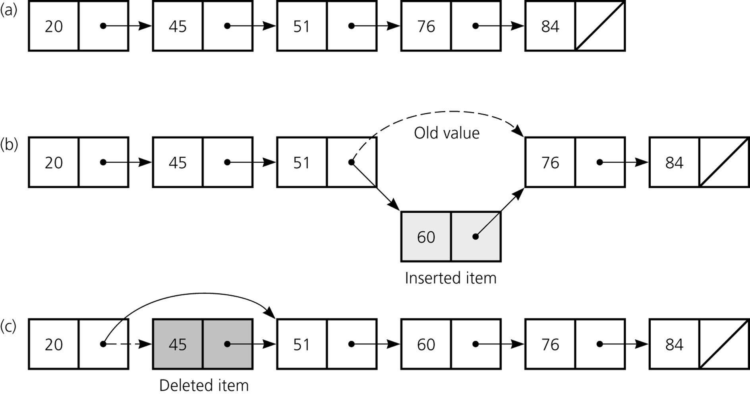
Preliminaries
a) A linked list of integers; b) insertion; c) deletion

Slide 4
Object References
A reference variable
Contains the location of an object
Example
Integer intRef;
intRef = new Integer(5);
As a data field of a class
Has the default value null
A local reference variable to a method
Does not have a default value

Slide 5
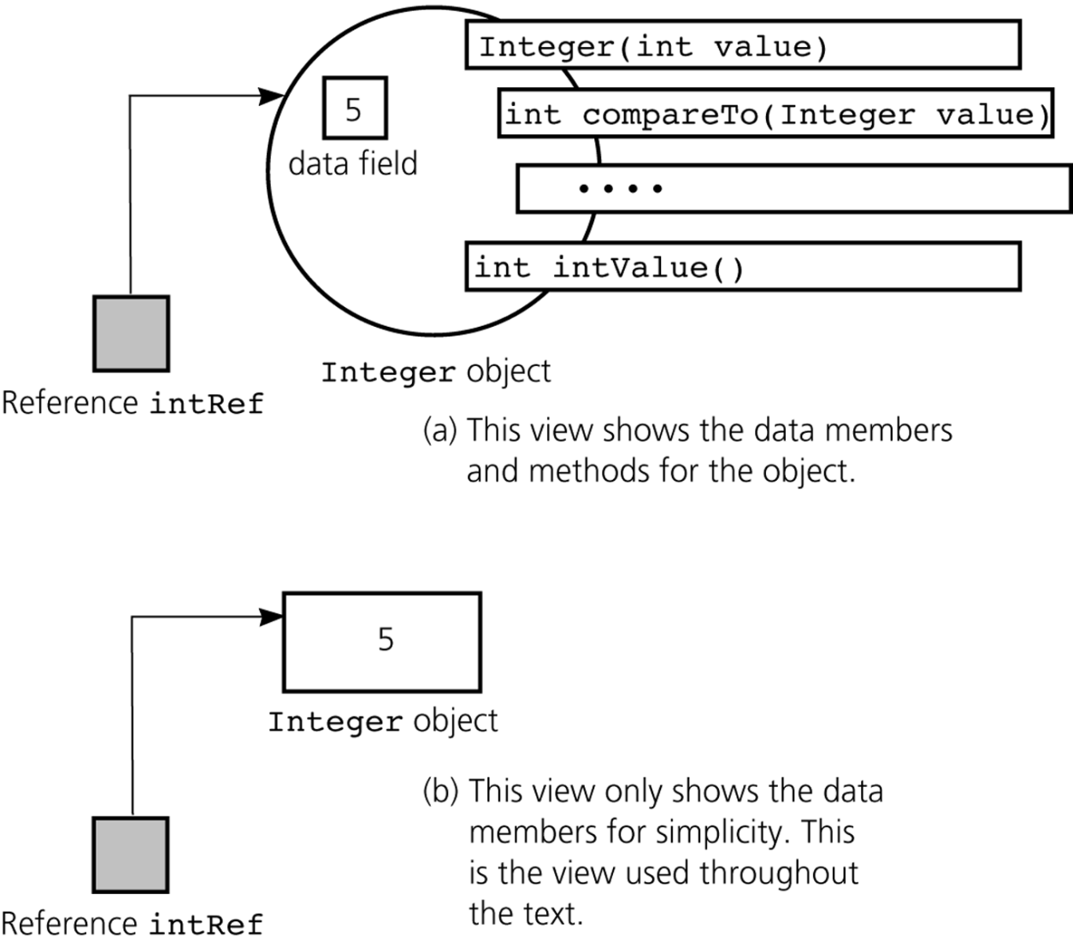
Object References
A reference to an Integer object

Slide 6
Object References
When one reference variable is assigned to another reference variable, both references then refer to the same object
Integer p, q;
p = new Integer(6);
q = p;
A reference variable that no longer references any object is marked for garbage collection

Slide 7
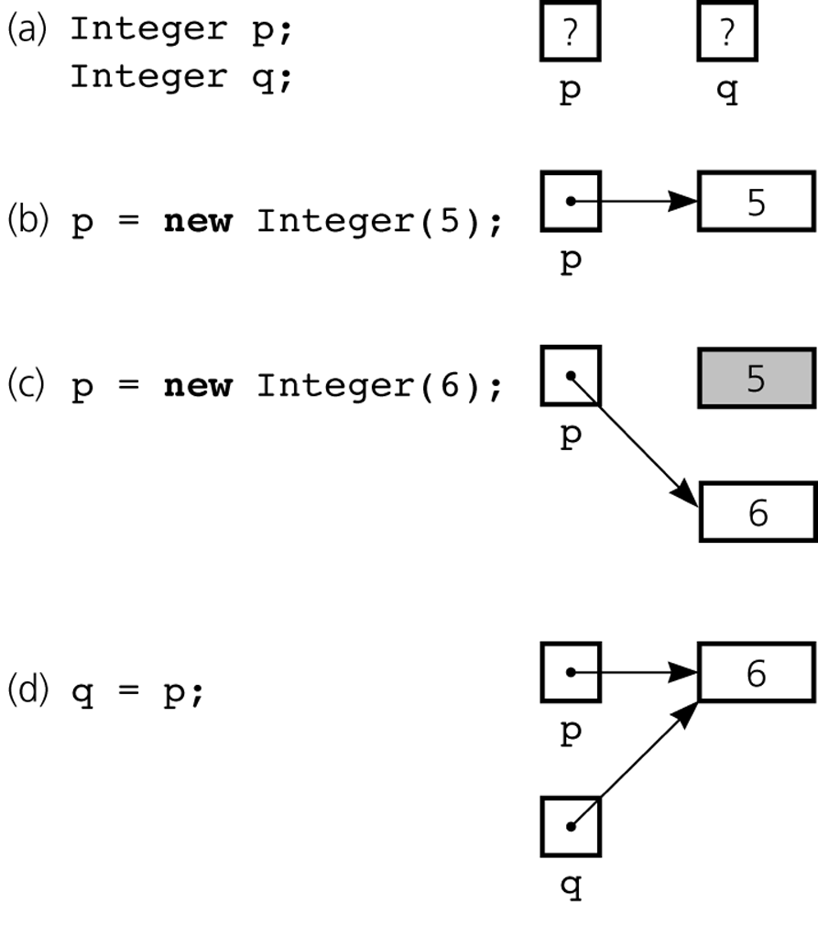
Object References
Figure 5-3a-d
a) Declaring reference variables; b) allocating an object; c) allocating another object, with the dereferenced object marked for garbage collection

Slide 8
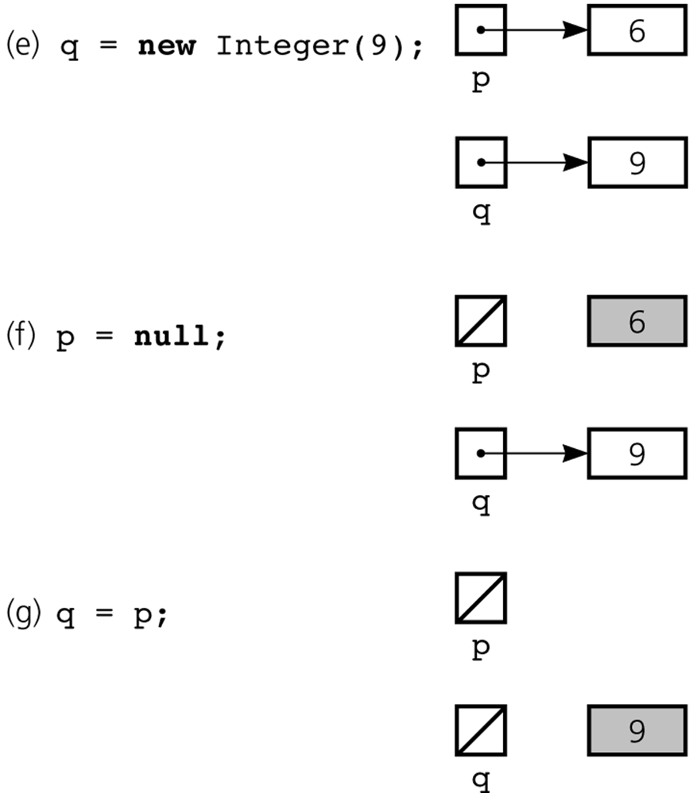
Object References
Figure 5-3e-g
e) allocating an object; f) assigning null to a reference variable; g) assigning a reference with a null value

Slide 9
Object References
An array of objects
Is actually an array of references to the objects
Example
Integer[] scores = new Integer[30];
Instantiating Integer objects for each array reference
scores[0] = new Integer(7);
scores[1] = new Integer(9); // and so on …

Slide 10
Object References
Equality operators (== and !=)
Compare the values of the reference variables, not the objects that they reference
equals method
Compares objects field by field
When an object is passed to a method as an argument, the reference to the object is copied to the method’s formal parameter
Reference-based ADT implementations and data structures use Java references

Slide 11
Resizable Arrays
The number of references in a Java array is of fixed size
Resizable array
An array that grows and shrinks as the program executes
An illusion that is created by using an allocate and copy strategy with fixed-size arrays
java.util.Vector class
Uses a similar technique to implement a growable array of objects

Slide 12
Nodes in Linked Lists
A linked list consists of nodes. Each node contains an element, and each node is linked to its next neighbor. Thus a node can be defined as a class, as follows:
class Node<E> {
E element;
Node<E> next;
public Node(E o) {
element = o;
}
}
Notes:
Access is package-private

Slide 13
Adding Three Nodes
The variable head refers to the first node in the list, and the variable tail refers to the last node in the list. If the list is empty, both are null. For example, you can create three nodes to store three strings in a list, as follows:
Step 1: Declare head and tail:

Slide 14
Traversing All Elements in the List
Each node contains the element and a data field named next that points to the next node. If the node is the last in the list, its pointer data field next contains the value null. You can use this property to detect the last node. For example, you may write the following loop to traverse all the nodes in the list.
Node<E> current = head;
while (current != null) {
System.out.println(current.element);
current = current.next;
}

Slide 15
MyLinkedList

Slide 16
Implementing addFirst(E e)

Slide 17
Implementing addLast(E e)

Slide 18
Implementing add(int index, E e)

Slide 19
Implementing removeFirst()

Slide 20
Implementing removeLast()

Slide 21
Implementing remove(int index)

Slide 22
Comparing Array-Based and Referenced-Based Implementations
Size
Array-based
Fixed size
Resizable array
Access time
Array-based
Reference-based
Insertion and deletions
Array-based
Reference-based

Slide 23
Linked List Efficiency
Insertion and Deletion from the beginning are very fast. Efficiency is O(1).
Finding, deleting or inserting next to a specific node requires searching through the list. This required O(N) comparisons.
Still faster than arrays because no shifting required.
Expandable , initial size determination is not necessary.

Slide 24
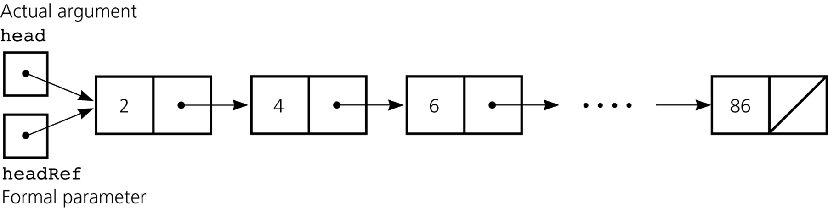
Passing a Linked List to a Method
A method with access to a linked list’s head reference has access to the entire list
When head is an actual argument to a method, its value is copied into the corresponding formal parameter

Slide 25
Processing Linked Lists Recursively
Traversal
Recursive strategy to display a list
Write the first node of the list
Write the list minus its first node
Recursive strategies to display a list backward
Notes:
public void printList()
{
writeList(head);
}
private void writeList(Node<E> nextNode)
{
if (nextNode != null)
{
System.out.println(nextNode.element);
writeList(nextNode.next);
}
}

Slide 26
Circular Linked Lists
A circular, singly linked list is like a singly linked list, except that the pointer of the last node points back to the first node.

Slide 27
Doubly Linked Lists
A doubly linked list contains the nodes with two pointers. One points to the next node and the other points to the previous node. These two pointers are conveniently called a forward pointer and a backward pointer. So, a doubly linked list can be traversed forward and backward.

Slide 28
Implementing addFirst(E e)
e
next
previous
newNode

Slide 29
Implementing removeFirst(E e)
newNode

Slide 30
Implementing addLast(E e)
e
next
previous
newNode

Slide 31
Implementing removeLast(E e)
newNode

Slide 32
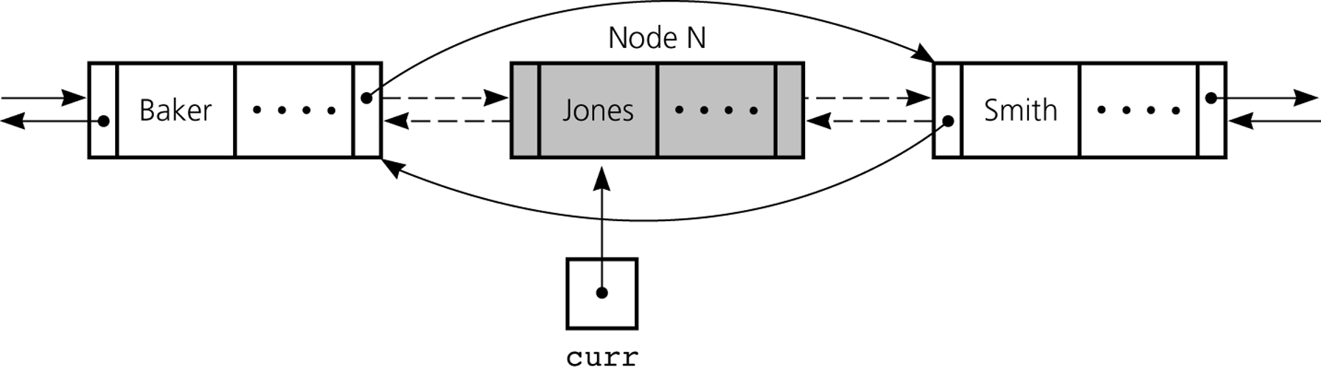
Doubly Linked List
To delete the node that curr references
Reference changes for deletion

Slide 33
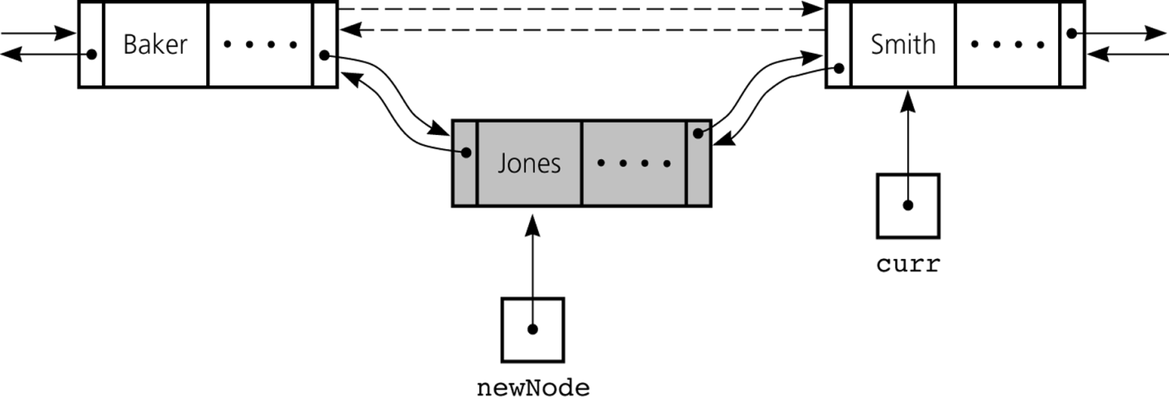
Doubly Linked List
To insert a new node that newNode references before the node referenced by curr
Reference changes for insertion

Slide 34
Circular Doubly Linked Lists
A circular, doubly linked list is doubly linked list, except that the forward pointer of the last node points to the first node and the backward pointer of the first pointer points to the last node.

Slide 35
JCF - LinkedList
LinkedList class is concrete implementation of the List interface.
If your application requires the insertion or deletion of elements from any place in the list, you should choose LinkedList.

Slide 36
java.util.LinkedList

Slide 37
Time Complexity for ArrayList and LinkedList

