Slide 1
Recursion

Slide 2
Recursive Algorithm
Recursion
An extremely powerful problem-solving technique
Breaks a problem in smaller identical problems
Base Case
An alternative to iteration
An iterative solution involves loops

Slide 3
What Is Recursion?
Consider hiring a contractor to build
He hires a subcontractor for a portion of the job
That subcontractor hires a sub-subcontractor to do a smaller portion of job
The last sub-sub- … subcontractor finishes
Each one finishes and reports “done” up the line

Slide 4
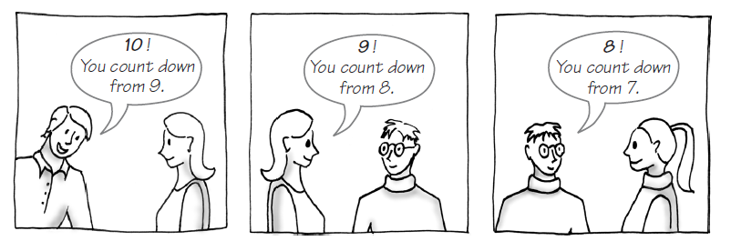
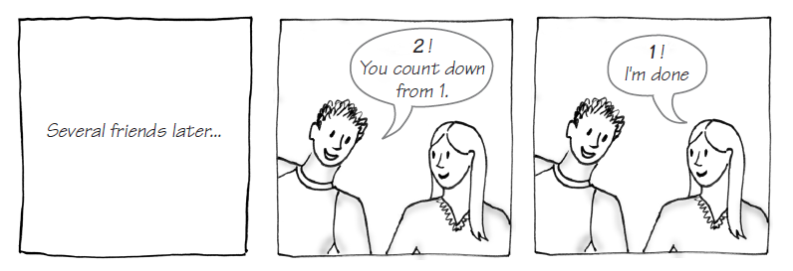
Example: The Countdown

Slide 5
Characteristics of Recursion
All recursive methods have the following characteristics:
One or more base cases (the simplest case) are used to stop recursion.
Every recursive call reduces the original problem, bringing it increasingly closer to a base case until it becomes that case.

Slide 6
Example: The Countdown
countdown(1) = print 1
countdown(n) = {
print n
countdown(n-1)
Recursive Java method to do countdown.

Slide 7
A Recursive Valued Method: The Factorial of n
A recursive definition of factorial(n)
factorial(n) = 1 if n = 0
n * factorial(n-1) if n > 0
A recurrence relation
A mathematical formula that generates the terms in a sequence from previous terms
Example
factorial(n) = n * [(n-1) * (n-2) * … * 1]
= n * factorial(n-1)
Notes:
public static int factorial(int n) { if (n==0) return 1; else { return n*factorial(n-1); } }

Slide 8
A Recursive void Method: Writing a String Backward
Problem
Given a string of characters, write it in reverse order
Recursive solution
Each recursive step of the solution diminishes by 1 the length of the string to be written backward
Base case
Write the empty string backward

Slide 9
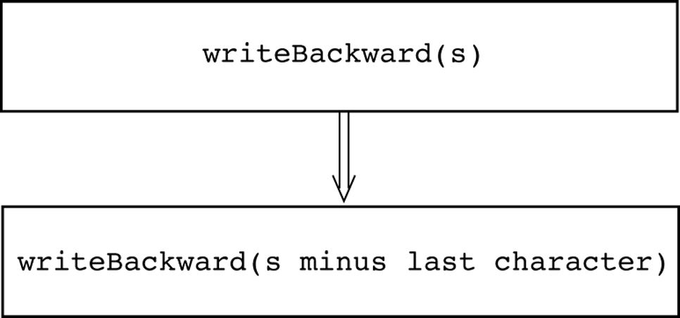
A Recursive void Method: Writing a String Backward

Slide 10
Multiplying Rabbits (The Fibonacci Sequence)
Problem
How many pairs of rabbits are alive in month n?
Recurrence relation
fib(n) = fib(n-1) + fib(n-2)
Fib series:
indices:
0 | 1 | 1 | 2 | 3 | 5 | 8 | 13 | 21 | 34 | 55 | 89
0 | 1 | 2 | 3 | 4 | 5 | 6 | 7 | 8 | 9 | 10 | 11

Slide 11
Multiplying Rabbits (The Fibonacci Sequence)
Base cases
fib(1), fib(0)
Recursive definition
fib(n) = if n==0 → 0 , if n==1 → 1
fib(n-1) + fib(n-2) if n > 2
Fibonacci sequence
The series of numbers fib(0), fib(1), fib(2), and so on

Slide 12
Palindrome
a word, phrase, or sequence that reads the same backward as forward.
e.g. madam or nurses run.
Iterate solution
Recursive solution

Slide 13
Binary Search
A high-level binary search
if (anArray is of size 1) {
Determine if anArray’s item is equal to value
}
else {
Find the midpoint of anArray
Determine which half of anArray contains value
if (value is in the first half of anArray) {
binarySearch (first half of anArray, value)
}
else {
binarySearch(second half of anArray, value)
} // end if
} // end if

Slide 14
Tower of Hanoi
There are n disks labeled 1, 2, 3, . . ., n, and three towers labeled A, B, and C.
No disk can be on top of a smaller disk at any time.
All the disks are initially placed on tower A.
Only one disk can be moved at a time, and it must be the top disk on the tower.

Slide 15
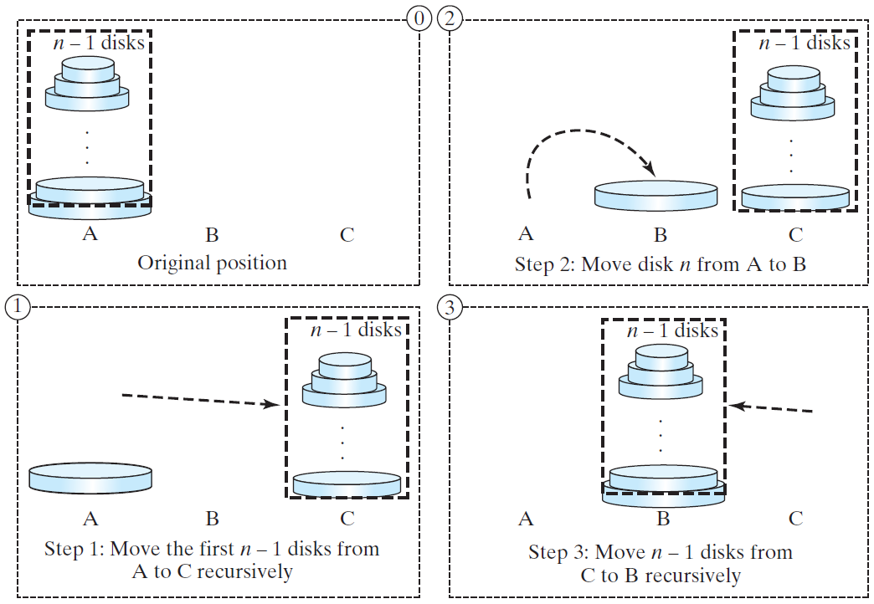
Solution to Tower of Hanoi
The Tower of Hanoi problem can be decomposed into three subproblems.

Slide 16
The Towers of Hanoi
Tower oh Hanoi
Animation
Pseudocode solution
solveTowers(count, source, destination, spare)
if (count is 1) {
Move a disk directly from source to destination
}
else {
solveTowers(count-1, source, spare, destination)
solveTowers(1, source, destination, spare)
solveTowers(count-1, spare, destination, source)
} //end if
TowerOfHanoi.java

Slide 17
Exercise: GCD
gcd(2, 3) = 1
gcd(2, 10) = 2
gcd(25, 35) = 5
gcd(27, 18) = 9
gcd(m, n)
Approach 1: Brute-force, start from min(n, m) down to 1, to check if a number is common divisor for both m and n, if so, it is the greatest common divisor.
Approach 2: Euclid’s algorithm
Approach 3: Recursive method

Slide 18
Approach 2: Euclid’s algorithm
// Get absolute value of m and n;
t1 = Math.abs(m); t2 = Math.abs(n);
// r is the remainder of t1 divided by t2;
r = t1 % t2;
while (r != 0) {
t1 = t2;
t2 = r;
r = t1 % t2;
}
// When r is 0, t2 is the greatest common
// divisor between t1 and t2
return t2;

Slide 19
Approach 3: Recursive Method
gcd(m, n) = n if m % n = 0;
gcd(m, n) = gcd(n, m % n); otherwise;

