Slide 1
Recursion
COMP 182 Lecture 04
Recursive methods in Java
Tracing calls, proving termination, and comparing costs
01
Notes:
This lecture covers recursive methods in Java. Ask students to distinguish a base case, a smaller recursive subproblem, and the work waiting for a returned result. The companion Java folder contains complete runnable classes. Keep that folder beside this PowerPoint so the relative Java links continue to work. To print a slide with its teaching notes, choose File > Print > Notes Pages. The separate PDF contains slides only. The course website lists recursion as Lecture 4.

Slide 2
A directory contains smaller directories
To find a word in every file, apply the same search to each subdirectory.
Entry | Work to perform
notes.txt | Search this file
lectures/ | Search every entry inside this directory
projects/ | Search every entry inside this directory
An empty directory | Return immediately
The task stays the same while the directory being searched becomes smaller.
02
Notes:
A directory search is the same task applied to each subdirectory. An empty directory needs no further recursive calls. Ask students to identify what gets smaller: the remaining subtree, rather than necessarily a numeric variable. In a real file-system traversal, define symbolic-link and permission-error behavior before following directories. This slide gives a conceptual example, rather than Java file-system code.

Slide 3
The structure of a recursive algorithm
A method solves a smaller instance of its own problem.
Part | Question it answers
Input contract | Which inputs are valid?
Base case | When can the method finish without another call?
Recursive step | Which smaller instance should it solve?
Result or action | How does this call use the smaller result?
A correct recursive call must move toward a reachable base case.
03
Notes:
Identify four parts before writing code: the input contract, base case, recursive step, and result or action. Ask students which part proves that the calls eventually stop. A base case alone is insufficient unless every valid recursive path reaches it. Compare a countdown with binary search: each shrinks a different quantity.

Slide 4
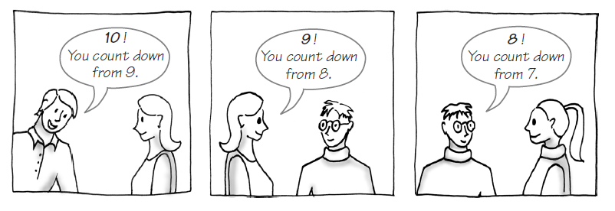
Delegating a smaller countdown
Each person prints one number and asks someone else to continue.
Repeated task: print n. Smaller problem: count down from n − 1.
Java: Countdown.java
04
Notes:
Use the delegation cartoon to describe separate method invocations. Each person performs one action and delegates a smaller task. Ask students what must be remembered while waiting for the delegate. The caller resumes at the statement following the recursive call. The cartoon starts at 10; the worked trace later starts at 3. Local Java: Countdown.java.

Slide 5
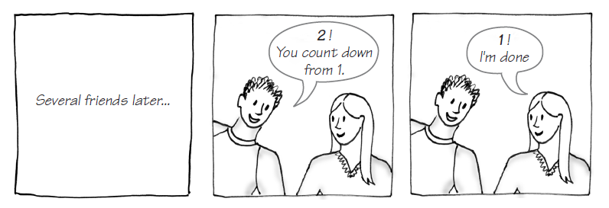
The countdown reaches its base case
The person handling 1 finishes without passing the task to another person.
At n = 1, print 1 and return without another recursive call.
Java: Countdown.java
05
Notes:
The delegate handling 1 prints 1 and returns. There is no delegate for 0 under this countdown contract. Contrast this with another valid design whose base case is n <= 0 and which prints before reaching zero. A solution must use one consistent input contract and stopping rule. Local Java: Countdown.java.

Slide 6
Countdown calls and returns
For countdown(3), each call handles one number and delegates the rest.
Call | Action | Next step
countdown(3) | Print 3 | Call countdown(2)
countdown(2) | Print 2 | Call countdown(1)
countdown(1) | Print 1 | Return without another call
Return order: countdown(1), countdown(2), countdown(3)
Each call keeps its place until the smaller call finishes.
Java: Countdown.java
06
Notes:
Trace countdown(3): print 3, print 2, print 1. The returns then complete in order 1, 2, 3. Ask students whether anything prints during the return phase in this method. It does not. If a print statement were placed after the recursive call, the visible order would change. Local Java: Countdown.java.

Slide 7
Why recursion terminates
The base case and progress rule must work together for every valid input.
Example | Quantity that gets smaller | Stopping condition
Countdown | Positive value n | n = 1
Binary search | Search interval length | Interval is empty
Hanoi | Number of disks | n = 0
Euclid’s GCD | Second nonnegative argument | Second argument is 0
A base case does not help if the recursive step never reaches it.
Java: Countdown.java
07
Notes:
Ask students to name the progress measure in each row. Countdown decreases a positive integer; binary search decreases an interval length; Hanoi decreases the number of disks; Euclid eventually makes the second nonnegative argument zero. Euclid may first swap an unordered positive pair, so the second argument need not decrease on the very first call. Local Java: Countdown.java.

Slide 8
Countdown in Java
Input: n ≥ 1. The method prints n down through 1.
static void countdown(int n) {
if (n < 1) throw new IllegalArgumentException();
if (n == 1) {
System.out.println(1);
return;
}
System.out.println(n);
countdown(n - 1);
}
Time O(n). Maximum call-stack space O(n).
Java: Countdown.java
08
Notes:
The driver defaults to countdown(3), printing 3, 2, 1 on separate lines. The guard rejects n below 1. The n == 1 branch returns immediately. Every other valid call passes n - 1. There are n calls, constant work per call, and O(n) maximum call-stack space. A large valid n may still exceed the available stack. Local Java: Countdown.java.

Slide 9
Factorial returns a value
0! = 1. For n > 0, n! = n × (n − 1)!
static long factorial(int n) {
if (n < 0 || n > 20)
throw new IllegalArgumentException();
if (n == 0) return 1;
return n * factorial(n - 1);
}
factorial(4) = 4 × 3 × 2 × 1 × 1 = 24
Time O(n). Stack O(n). The pending multiplication happens on return.
Java: Factorial.java
09
Notes:
The driver prints 24 for factorial(4). The base value factorial(0) is 1. Each caller waits to multiply by the smaller result, so multiplication finishes during returns. long holds 20! but not 21!; the method rejects values outside 0 through 20. Ask students to trace factorial(0), factorial(1), and factorial(4). Local Java: Factorial.java.

Slide 10
Writing a string backward
Print the last remaining character, then handle the shorter prefix.
Call index i | Printed character | Remaining prefix
3 | E | COD
2 | D | CO
1 | O | C
0 | C | Empty
−1 | Nothing | Base case
writeBackward("CODE", 3) prints EDOC.
Java: ReversePrint.java
10
Notes:
For CODE, the starting index is 3. Print E, D, O, and C, then stop when the index becomes -1. The table records the last remaining index before each call. Passing indexes avoids allocating a new substring at every step. Each call still consumes stack space. Local Java: ReversePrint.java.

Slide 11
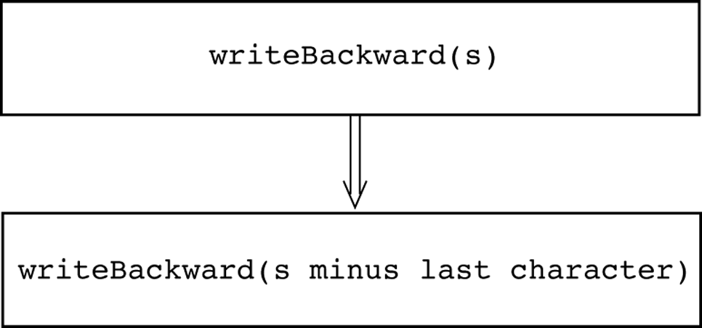
A smaller prefix without copying substrings
The index marks the last character still to be printed.
static void writeBackward(String s, int i) {
if (i < 0) return;
System.out.print(s.charAt(i));
writeBackward(s, i - 1);
}
Call: writeBackward(s, s.length() - 1);
For n characters: O(n) time and O(n) call-stack space.
Java: ReversePrint.java
11
Notes:
The driver calls writeBackward(s, s.length() - 1) and then prints a newline. Empty text starts at -1 and prints no characters. The helper assumes a non-null String and a valid starting index or the empty interval. It reverses UTF-16 char units; it is not a general reversal of Unicode grapheme clusters. Use ordinary ASCII text for the classroom trace. Local Java: ReversePrint.java.

Slide 12
Fibonacci numbers
Each value after the first two is the sum of its two predecessors.
F(0) = 0 F(1) = 1
F(n) = F(n − 1) + F(n − 2), for n ≥ 2
n | 0 | 1 | 2 | 3 | 4 | 5 | 6 | 7 | 8 | 9 | 10 | 11
F(n) | 0 | 1 | 1 | 2 | 3 | 5 | 8 | 13 | 21 | 34 | 55 | 89
Two base cases are necessary: F(0) and F(1).
Java: Fibonacci.java
12
Notes:
Define both Fibonacci base values before tracing the recurrence. Ask for F(2), F(3), and F(5): the answers are 1, 2, and 5. The displayed table uses the convention F(0)=0 and F(1)=1. A recurrence describes the result without specifying whether an implementation reuses intermediate results. Local Java: Fibonacci.java.

Slide 13
Naive Fibonacci repeats subproblems
The method is short, but the same smaller values are computed many times.
static long fib(int n) {
if (n < 0 || n > 92)
throw new IllegalArgumentException();
if (n < 2) return n;
return fib(n - 1) + fib(n - 2);
}
fib(5) computes fib(3) twice.
Memoization stores earlier results.
Memoized or iterative time: O(n).
Use n ≤ 10 for tracing. long stores values through F(92).
Naive time O(2ⁿ), an upper bound. Maximum stack depth O(n).
Java: Fibonacci.java
13
Notes:
The default driver prints fib(10), which is 55. Trace only small n; the naive implementation repeats subproblems and becomes impractical long before the long numeric limit of F(92). O(2^n) is an upper bound on time; the maximum simultaneous call depth is O(n). Memoization or iteration can avoid repeated computation, but their implementations are not shown in this deck. Local Java: Fibonacci.java.

Slide 14
A palindrome compares matching ends
Assume the input already has the case and spacing you want to compare.
static boolean isPalindrome(String s,
int left, int right) {
if (left >= right) return true;
return s.charAt(left) == s.charAt(right)
&& isPalindrome(s, left + 1, right - 1);
}
"madam" gives true. "robot" gives false.
Each call removes two characters from consideration. Worst case O(n).
Java: Palindrome.java
14
Notes:
The default driver checks madam and prints true. robot prints false. Empty and one-character strings return true. The left >= right base case handles even and odd lengths. A mismatch short-circuits &&, so no smaller call is made on that path. Compare exact case and spacing, as stated by the slide contract. Local Java: Palindrome.java.

Slide 15
Recursive binary search
Sorted array: [3, 8, 12, 17, 24, 31, 40]. Target: 24.
static int binarySearch(int[] a, int target,
int low, int high) {
if (low > high) return -1;
int mid = low + (high - low) / 2;
if (a[mid] == target) return mid;
if (target < a[mid])
return binarySearch(a, target, low, mid - 1);
return binarySearch(a, target, mid + 1, high);
}
low | high | mid | a[mid]
0 | 6 | 3 | 17
4 | 6 | 5 | 31
4 | 4 | 4 | 24
Target 24: found at index 4
Call: binarySearch(a, 24, 0, a.length - 1);
Worst-case time O(log n). Recursive stack O(log n).
Java: RecursiveBinarySearch.java
15
Notes:
The array must already be in ascending order. Search for 24 in indexes 0 through 6: inspect index 3 (17), index 5 (31), then index 4 (24). The returned index is 4. An empty range returns -1 before reading an element. The midpoint formula avoids adding low and high directly. Duplicate keys may return any matching index. Local Java: RecursiveBinarySearch.java.

Slide 16
The Tower of Hanoi
Move n disks from peg A to peg B, using peg C as spare storage.
All disks start on A, with the smallest disk on top.
Move only one disk at a time.
Only the top disk on a peg may move.
A larger disk may never sit on a smaller disk.
Question: how many moves are necessary for three disks?
Java: TowerOfHanoi.java
16
Notes:
For three disks the minimum move count is seven. Ask students to describe the rules before discussing code: one top disk per move and no larger disk on a smaller one. The algorithm must first clear the largest disk. The n=0 case is a valid empty transfer with no printed moves. Local Java: TowerOfHanoi.java.

Slide 17
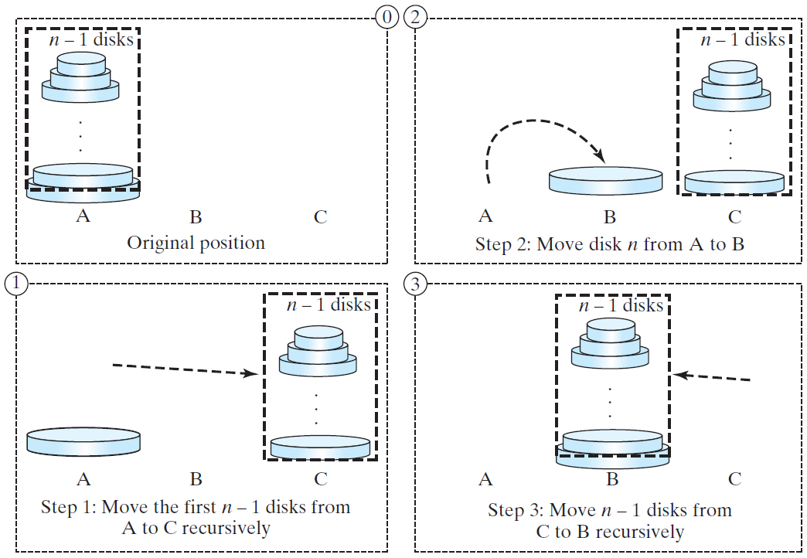
Hanoi: clear the largest disk
Move the n − 1 smaller disks from A to C, using B as spare storage.
The largest disk stays on A until every smaller disk has moved away.
Java: TowerOfHanoi.java
17
Notes:
Treat the n-1 smaller disks as one recursive subproblem. Move them from the source peg to the spare peg, using the destination as temporary storage. The largest disk stays at the source during this step. Ask students to name the source, destination, and spare in the first recursive call. Local Java: TowerOfHanoi.java.

Slide 18
Hanoi: move disk n and finish
Move the largest disk to B, then transfer the n − 1 smaller disks from C to B.
Two recursive transfers surround one direct move of the largest disk.
Java: TowerOfHanoi.java
18
Notes:
After clearing the largest disk, move it once to the destination. Then recursively move the smaller tower from the spare to the destination, using the original source as temporary storage. The two recursive calls exchange peg roles. Emphasize that every recursive transfer must obey the same disk rules. Local Java: TowerOfHanoi.java.

Slide 19
Hanoi in Java
Call hanoi(3, 'A', 'B', 'C'). The n = 0 case makes no moves.
static void hanoi(int n, char from,
char to, char spare) {
if (n < 0) throw new IllegalArgumentException();
if (n == 0) return;
hanoi(n - 1, from, spare, to);
System.out.println(from + " to " + to);
hanoi(n - 1, spare, to, from);
}
Moves: M(n) = 2M(n − 1) + 1 = 2ⁿ − 1
Time O(2ⁿ). Maximum call-stack space O(n).
Java: TowerOfHanoi.java
19
Notes:
The default driver prints seven legal moves for three disks, from A to B using C. Zero disks print no moves; negative n is rejected. For n>0, two transfers of n-1 disks surround one direct move. M(0)=0 gives M(n)=2^n-1. The output and time grow exponentially, but maximum simultaneous call-stack depth is O(n). Use three distinct peg labels. Local Java: TowerOfHanoi.java.

Slide 20
Greatest common divisor
Euclid’s algorithm can be written with a loop or with recursion.
Inputs | GCD
2 and 3 | 1
2 and 10 | 2
25 and 35 | 5
27 and 18 | 9
0 and 18 | 18
Brute-force candidate scan: O(min(a, b)) for positive inputs.
Euclid uses gcd(a, b) = gcd(b, a mod b), while b > 0.
Java: GcdIterative.java
Java: GcdRecursive.java
20
Notes:
Compare candidate scanning with Euclid. The examples include gcd(27,18)=9 and gcd(0,18)=18. The accompanying two drivers accept signed int inputs, convert to nonnegative long magnitudes, and define gcd(0,0)=0. This explicit convention makes the zero pair predictable even though it is not a positive greatest divisor in the usual mathematical definition. Local Java: GcdIterative.java, GcdRecursive.java.

Slide 21
Euclid with a loop
Check b before computing a remainder, so zero inputs are safe.
static long gcdIter(int m, int n) {
long a = Math.abs((long) m);
long b = Math.abs((long) n);
while (b != 0) {
long remainder = a % b;
a = b;
b = remainder;
}
return a;
}
Positive inputs: O(log min(a, b)) time. Auxiliary space O(1).
Java: GcdIterative.java
21
Notes:
The default driver prints 9. Convert int to long before Math.abs so Integer.MIN_VALUE becomes the representable magnitude 2147483648. Check b != 0 before computing a % b. At each loop step, gcd(a,b) equals gcd(b,a%b). Test negative inputs, one zero, both zeros, and the minimum int value. The loop uses constant auxiliary space. Local Java: GcdIterative.java.

Slide 22
Euclid with recursion
The second argument shrinks to zero. The first argument is then the GCD.
static long gcd(int m, int n) {
return gcdPositive(Math.abs((long) m),
Math.abs((long) n));
}
static long gcdPositive(long a, long b) {
if (b == 0) return a;
return gcdPositive(b, a % b);
}
a | b | a mod b
27 | 18 | 9
18 | 9 | 0
9 | 0 | Stop
gcd(27, 18) returns 9
Positive inputs: O(log min(a, b)) time and recursive stack space.
Java: GcdRecursive.java
22
Notes:
The default driver prints 9. The public-facing wrapper handles signed int magnitudes using long; the helper receives nonnegative values. With b positive, the remainder is smaller than b. If the starting magnitudes are in reverse order, one initial swap-like step can occur before strict decrease. When b is zero, return a. Compare results against the iterative implementation. Local Java: GcdRecursive.java.

Slide 23
When recursion matches the problem
Recursion is useful when the problem already has a recursive structure.
Problem | Smaller problem | Work in this call
Directory search | Each subdirectory | Process files and subdirectories
Factorial | Factorial of n − 1 | Multiply the returned result by n
Binary search | One half of the interval | Compare and select that half
Hanoi | Transfer n − 1 disks | Move the largest disk between calls
Choose recursion when its structure makes the algorithm easier to reason about.
23
Notes:
Discuss when recursion makes an algorithm easier to explain: a directory tree, a smaller factorial, a half-sized search interval, or a smaller disk transfer. A recursive definition does not guarantee an efficient implementation, as naive Fibonacci shows. An iterative version may use less auxiliary stack space.

Slide 24
Time and call-stack costs
Worst-case bounds for the examples in this lecture.
Algorithm | Time | Call-stack space
Countdown / factorial | O(n) | O(n)
String reversal / palindrome | O(n) | O(n)
Binary search | O(log n) | O(log n)
Naive Fibonacci | O(2ⁿ), upper bound | O(n)
Hanoi | O(2ⁿ) | O(n)
Recursive Euclid (a, b > 0) | O(log min(a, b)) | O(log min(a, b))
Deep recursion can exhaust the stack. Repeated subproblems can waste time.
24
Notes:
All bounds describe worst cases in the unit-cost model for the displayed fixed-width operations. String reversal and palindrome use indexes, avoiding repeated substring copies. Recursive binary search uses logarithmic depth. The Fibonacci time entry is an upper bound. Euclid bounds in the table assume positive inputs; zero cases finish immediately or after one additional step. Java does not guarantee tail-call elimination.

Slide 25
A checklist for correct recursion
Use the input contract, stopping rule, and progress measure to check a solution.
State the valid inputs and handle boundary cases.
Make the base case explicit and reachable.
Show why every recursive call makes progress.
Use the recursive result and account for stack depth.
Quick checks: factorial(0), an empty binary search, Hanoi with 3 disks, gcd(27, 18)
Trace one small input through both the calls and the returns.
25
Notes:
Use the checklist to review one method in pairs. Quick-check answers: factorial(0)=1; binary search on an empty range returns -1; three Hanoi disks need seven moves; gcd(27,18)=9. Ask for an example with a reachable base case and one with a recursive step that misses it. Distinguish the mathematical input contract from practical stack-depth and output-size limits.

