Slide 1
Binary Search Trees
12
Structure, algorithms, and the cost of height
5
15
A lesson in ordered data structures
2
9
20
7
10
17
30
01

Slide 2
Learning objectives
Explain the BST ordering rule and tree terminology.
Trace search, insertion, deletion, and traversal.
Read and implement a generic Java BST.
Relate operation cost to the height of the tree.
02

Slide 3
Why an ordered tree?
Structure | Search by key | Insert / delete
Sorted array | O(log n) | O(n) shifting
Linked list | O(n) | O(n) to locate
BST | O(h + 1) | O(h + 1)
A short tree can support fast search and updates.
03
Notes:
Array costs assume sorted arrays and arbitrary insertion positions. Linked-list updates are O(1) only when the required location and predecessor are already available. BST operations take O(h+1). Source: https://algs4.cs.princeton.edu/32bst/

Slide 4
Trees and rooted trees
An undirected tree is a connected graph with no cycles.
A forest is an acyclic graph that may be disconnected.
A tree with n nodes has n − 1 edges and exactly one
simple path between any two nodes.
Choosing a root defines parent–child relationships.
04

Slide 5
Tree terminology
Root: A has no parent.
Leaf: E has no children.
Internal node: B has children.
Ancestors of J: F, B, A.
Subtree at F: F, I, J, K.
A
B
C
D
E
F
G
H
I
J
K
05
Notes:
Diagram adapted from supplied slide 11. A subtree includes its root and all descendants.

Slide 6
Binary trees and binary search trees
A binary tree gives each node at most two children,
identified as left and right. Either child may be absent.
A binary search tree adds an ordering rule:
every key in the left subtree is smaller, and every key
in the right subtree is larger.
Both subtrees obey the same rule.
This lesson uses unique keys and rejects duplicates.
06

Slide 7
Depth, level, and height
Depth counts edges from the root.
Root 30 has depth 0.
Node 40 has depth 3.
Height is the maximum depth.
This tree has height 3 and 4 levels.
Empty tree: height −1.
Single node: height 0.
30
20
70
10
50
90
40
60
07
Notes:
Convention: count edges. Empty-tree height is −1, leaf height is 0, root depth is 0. Level equals depth in this lesson. The original mixes edge and node counts.

Slide 8
Full, perfect, complete, and balanced
Term | Definition used in this lesson
Full (proper) | Every node has 0 or 2 children
Perfect | Full, with all leaves at the same depth
Complete | Every level fills, except possibly the last, which fills from left to right
Height-balanced | At every node, subtree heights differ by at most 1
Every perfect tree is complete. Every complete tree is height-balanced.
08
Notes:
Terminology varies between textbooks. This lesson uses full/proper for zero or two children and perfect for all leaves at one depth. Height-balanced means the AVL local height condition, without teaching rotations here.

Slide 9
The BST ordering rule applies to every descendant
At root 12:
all left keys are less than 12,
all right keys are greater than 12.
At node 15:
all right keys are greater than 15.
A parent–child check alone
cannot validate a whole BST.
12
5
15
2
9
20
7
10
17
30
09
Notes:
Diagram adapted from supplied slide 41. This consistent example has root 12.

Slide 10
Checkpoint: which drawing is a valid BST?
5
8
4
8
5
11
1
7
11
2
7
6
10
18
3
4
15
20
21
For each node, carry the lower and upper bounds from its ancestors.
10
Notes:
Answer: the left tree is a BST. The right drawing is invalid: node 5 has three children, and node 10 has descendant 15, which exceeds ancestor 11, and 21 is left of 20. More simply identify any one violation. Diagram adapted from supplied slide 29.

Slide 11
A linked representation in Java
class Node<E> {
E key;
Node<E> left, right;
Node(E key) { this.key = key; }
}
class BST<E extends Comparable<? super E>> {
private Node<E> root;
private int size;
// Methods follow.
}
A missing child uses null. The tree stores a root reference and a size.
11
Notes:
All Java examples use ordering equality (compareTo == 0). Non-null keys are required. Source: https://docs.oracle.com/en/java/javase/18/docs/api/java.base/java/lang/Comparable.html

Slide 12
The Tree interface and BST implementation
interface Tree<E> extends Iterable<E> {
boolean contains(E key);
boolean insert(E key);
boolean delete(E key);
int size();
}
BST<E> implements Tree<E>.
insert returns false for a duplicate key.
delete returns false when the key is absent.
Use compareTo consistently for less than, greater than, and equality.
12

Slide 13
Search follows one path
Search for 10
10 < 12: go left.
10 > 5: go right.
10 > 9: go right.
10 = 10: found.
A null child ends an
unsuccessful search.
12
5
15
2
9
20
7
10
17
30
13
Notes:
Diagram adapted from supplied slide 41. Search 10 visits 12, 5, 9, 10. Search 8 visits 12, 5, 9, 7, then null.

Slide 14
Iterative search
public boolean contains(E key) {
Objects.requireNonNull(key);
Node<E> x = root;
while (x != null) {
int cmp = key.compareTo(x.key);
if (cmp < 0) x = x.left;
else if (cmp > 0) x = x.right;
else return true;
}
return false;
}
Time O(h + 1). Extra space O(1). Import java.util.Objects.
14

Slide 15
Recursive search
private boolean contains(Node<E> x, E key) {
if (x == null) return false;
int cmp = key.compareTo(x.key);
if (cmp < 0) return contains(x.left, key);
if (cmp > 0) return contains(x.right, key);
return true;
}
The public method checks the key, then calls contains(root, key).
Time O(h + 1). Call stack O(h + 1).
15

Slide 16
Insertion attaches a new leaf
Search for the new key.
If an equal key exists, return false.
Otherwise, attach a new node
at the first missing child link.
An empty tree gets a new root.
12
5
15
2
9
13
20
7
10
17
30
8
31
16
Notes:
Source diagrams adapted from supplied slide 43. Existing nodes retain their positions in the ordering. New nodes 13, 8, 31 appear in that source example.

Slide 17
Worked insertion: key 13
Compare with 12: 13 is larger.
Compare with 15: 13 is smaller.
The left link of 15 is empty.
Attach node 13 there.
The BST ordering rule still holds.
12
5
15
2
9
13
20
7
10
17
30
17
Notes:
This compact trace replaces the source deck’s 20-slide trace of insertion 101. Diagram adapted from supplied slide 43; later insertions 8 and 31 are omitted.

Slide 18
Iterative insertion
public boolean insert(E key) {
Objects.requireNonNull(key);
Node<E> parent = null, x = root;
int cmp = 0;
while (x != null) {
parent = x;
cmp = key.compareTo(x.key);
if (cmp == 0) return false;
x = cmp < 0 ? x.left : x.right;
}
Node<E> node = new Node<>(key);
if (parent == null) root = node;
else if (cmp < 0) parent.left = node;
else parent.right = node;
size++;
return true;
}
18

Slide 19
An expression tree is a binary tree
Expression:
2 × (a − 1) + 3 × b
Internal nodes hold operators.
Leaves hold operands.
The shape captures evaluation
order rather than key ordering.
+
×
×
2
-
3
b
a
1
19
Notes:
Diagram adapted from supplied slide 19. Operator nodes are internal, operands are leaves. This is a binary tree but not a BST over the displayed symbols.

Slide 20
Traversal visits every node once
Depth-first search follows a branch
before returning to other branches.
Preorder: node, left, right.
Inorder: left, node, right.
Postorder: left, right, node.
Breadth-first search visits nodes
one level at a time.
30
20
70
10
50
90
40
60
20

Slide 21
Traversal orders on the same tree
30
Preorder
30, 20, 10, 70, 50, 40, 60, 90
Inorder
10, 20, 30, 40, 50, 60, 70, 90
Postorder
10, 20, 40, 60, 50, 90, 70, 30
20
70
10
50
90
40
60
Inorder traversal of a BST lists its keys in sorted order.
21
Notes:
Diagram adapted from supplied slide 36. Inorder yields sorted keys because the input is a BST.

Slide 22
Recursive depth-first traversal
void inorder(Node<E> x) {
if (x == null) return;
inorder(x.left);
visit(x.key);
inorder(x.right);
}
Preorder moves visit before both recursive calls.
Postorder moves visit after both recursive calls.
visit is the action to perform on a key, such as printing it.
All three take O(n) time and O(h + 1) stack space.
22

Slide 23
Breadth-first traversal uses a queue
void levelOrder() {
if (root == null) return;
Queue<Node<E>> q = new ArrayDeque<>();
q.add(root);
while (!q.isEmpty()) {
Node<E> x = q.remove();
visit(x.key);
if (x.left != null) q.add(x.left);
if (x.right != null) q.add(x.right);
}
}
Time O(n). Queue space O(w), where w is the maximum level width.
23
Notes:
Queue code assumes import java.util.Queue and java.util.ArrayDeque. Output for the tree on slide 21 is 30, 20, 70, 10, 50, 90, 40, 60.

Slide 24
Checkpoint: traversal and successor
Write the inorder, preorder,
and postorder sequences.
Which key follows 30
in inorder traversal?
Explain why that key
is the inorder successor.
30
20
70
10
50
90
40
60
24
Notes:
Answers: inorder 10,20,30,40,50,60,70,90. Preorder 30,20,10,70,50,40,60,90. Postorder 10,20,40,60,50,90,70,30. Inorder successor of 30 is 40.

Slide 25
Predecessor and successor
For root 12:
Predecessor = 10
Largest key in the left subtree.
Successor = 15
Smallest key in the right subtree.
The maximum follows right links.
The minimum follows left links.
12
5
15
2
9
20
7
10
17
30
25
Notes:
For a node with a left subtree, predecessor is the maximum key there. With no left subtree, walk toward the nearest smaller ancestor. The successor is symmetric. Diagram adapted from supplied slide 41.

Slide 26
Deletion has three structural cases
Children | Repair after finding the node
0 | Remove the parent’s child link
1 | Connect the parent directly to the child
2 | Copy the successor key, then remove the successor from the right subtree
Deleting the root can change root. An absent key leaves size unchanged.
26

Slide 27
One child: deletion reconnects the subtree
Before: delete 15
After: 12 links to 20
12
12
5
15
5
20
2
9
20
2
9
30
7
10
30
7
10
A leaf uses the same reconnection idea with a null replacement.
27
Notes:
Diagram adapted from supplied slide 69. Node 15 has one child, node 20. The title in the original calls this Case 1 despite an earlier no-left-child description. This slide labels the structure explicitly.

Slide 28
Two children: deletion uses a neighboring key
Delete 12 using its successor.
1. Find the minimum in the right
subtree: key 15.
2. Copy 15 into the root.
3. Remove the original node 15,
reconnecting its child 20.
The predecessor is an equally
valid alternative.
12
5
15
2
9
20
7
10
17
30
28
Notes:
Diagram adapted from supplied slide 41. This lesson implements successor deletion. The source also teaches predecessor deletion. Both preserve ordering. For root 12, successor is 15, which has right child 20.

Slide 29
Recursive deletion preserves the BST rule
private Node<E> delete(Node<E> x, E key) {
if (x == null) return null;
int cmp = key.compareTo(x.key);
if (cmp < 0) x.left = delete(x.left, key);
else if (cmp > 0) x.right = delete(x.right, key);
else {
if (x.left == null) return x.right;
if (x.right == null) return x.left;
x.key = min(x.right).key;
x.right = deleteMin(x.right);
}
return x;
}
Each call reconnects the returned subtree root to its parent.
29
Notes:
The helper returns the new root of the subtree. It relies on min and deleteMin shown next. Source for the successor strategy: https://algs4.cs.princeton.edu/32bst/

Slide 30
Successor helpers
private Node<E> min(Node<E> x) {
while (x.left != null) x = x.left;
return x;
}
private Node<E> deleteMin(Node<E> x) {
if (x.left == null) return x.right;
x.left = deleteMin(x.left);
return x;
}
The successor has no left child. It may have a right child to reconnect.
30

Slide 31
The public deletion method
public boolean delete(E key) {
Objects.requireNonNull(key);
if (!contains(key)) return false;
root = delete(root, key);
size--;
return true;
}
The preliminary search keeps size bookkeeping simple.
A later optimization can combine search and deletion.
Both versions take O(h + 1) time.
31

Slide 32
An inorder iterator
An iterator exposes hasNext() and next().
A lazy inorder iterator keeps a stack of ancestors.
Initially, push the path from root to the leftmost node.
On next(), pop a node and return its key.
Push the leftmost path in that node’s right subtree.
Across n calls, total time is O(n) with O(h + 1) stack space.
Exercise: handle an exhausted iterator with NoSuchElementException.
32

Slide 33
Height determines operation cost
Operation | General BST | If height is O(log n)
Search, insert, delete | O(h + 1) | O(log n)
Minimum, maximum | O(h + 1) | O(log n)
Full traversal | O(n) | O(n)
Sorted insertion can create a chain with height n − 1.
A balanced search tree controls height as the data changes.
33
Notes:
Source: https://algs4.cs.princeton.edu/32bst/ . Expected logarithmic height assumes a BST built from distinct keys inserted in random order. Arbitrary unbalanced update histories carry no logarithmic guarantee.

Slide 34
binary tree time complexity
It is obvious that the time complexity for the inorder, preorder, and postorder is O(n), since each node is traversed only once. The time complexity for search, insertion and deletion is the height of the tree. In the worst case, the height of the tree is O(n).

Slide 35
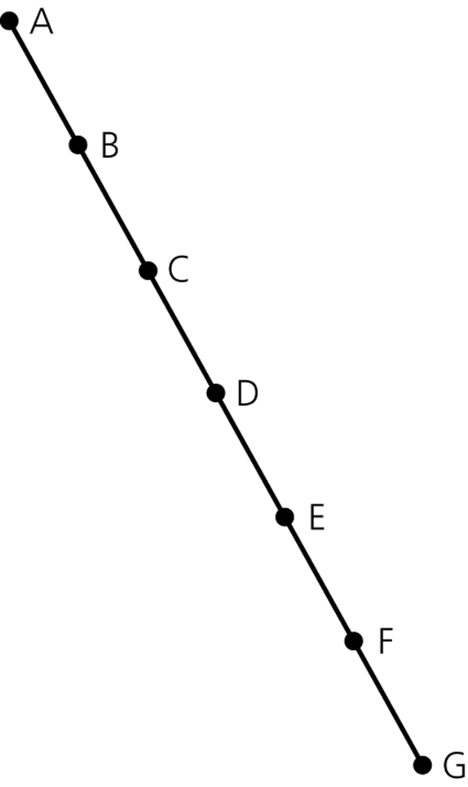
The Efficiency of Binary Search Tree Operations
The maximum number of comparisons for a retrieval, insertion, or deletion is the height of the tree
The maximum and minimum heights of a binary search tree
  n is the maximum height of a binary tree with n nodes
A maximum-height binary tree with seven nodes

Slide 36
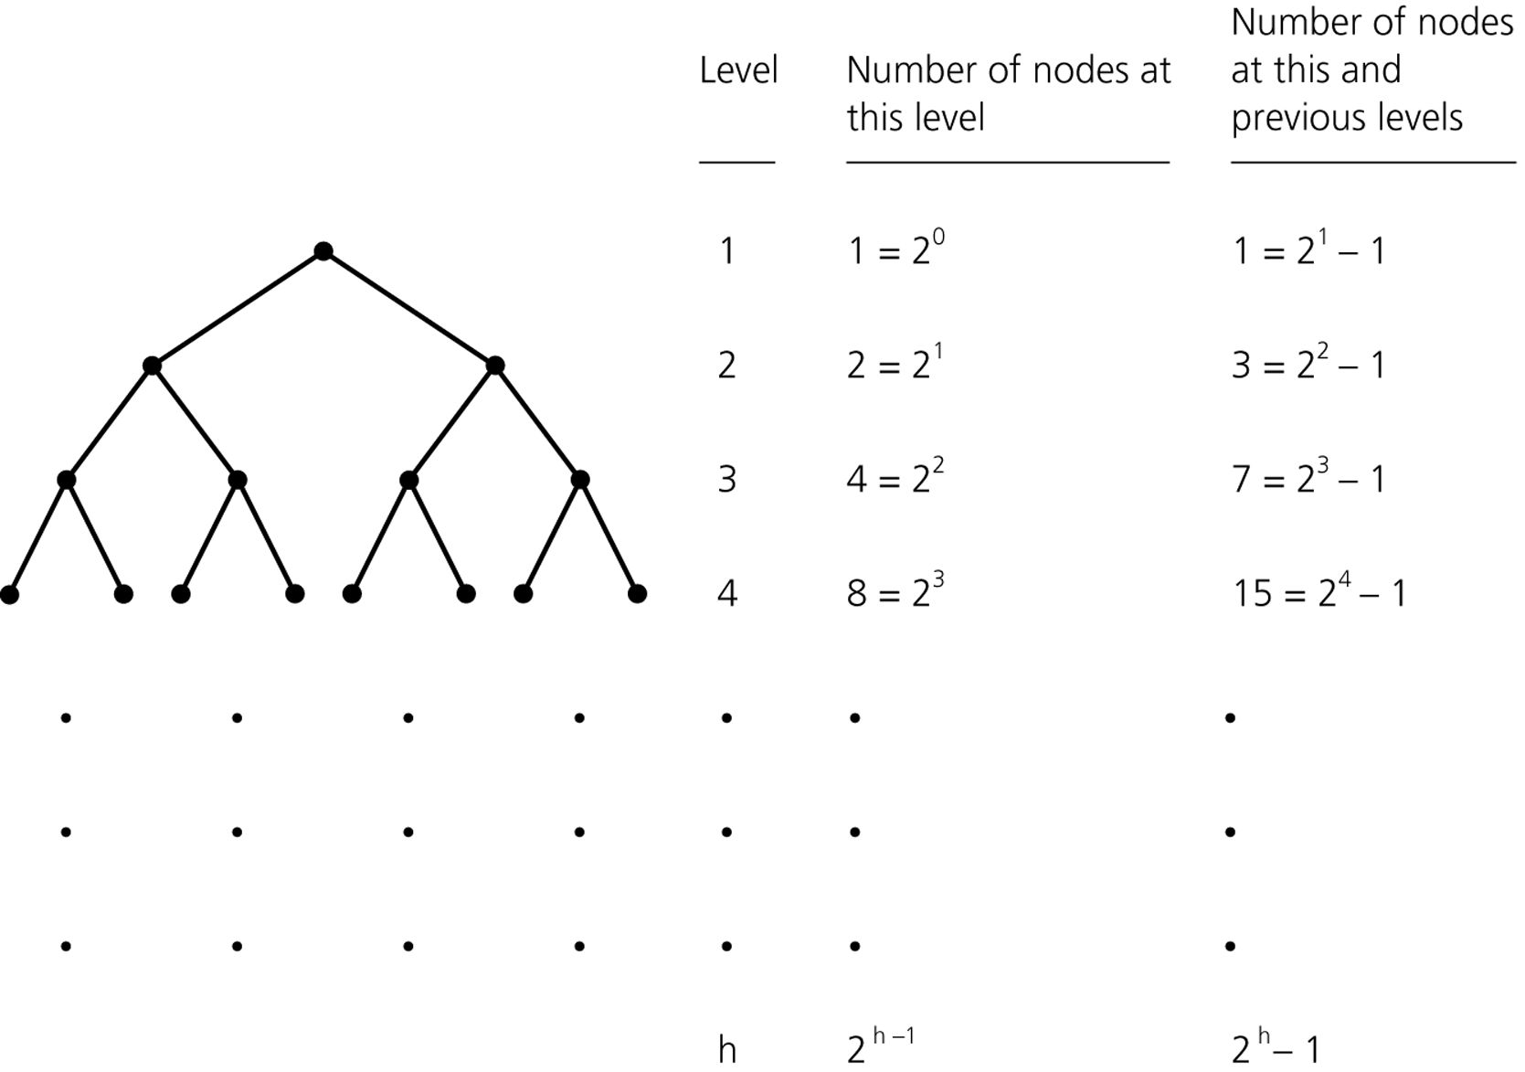
Height bounds with an edge count
For height h ≥ 0, the maximum node count is
2^(h + 1) − 1
For n ≥ 1 nodes, height satisfies
ceil(log₂(n + 1)) − 1 ≤ h ≤ n − 1
A perfect tree attains the maximum node count for its height.
34
Notes:
For n >= 1, minimum height is ceil(log2(n+1)) - 1 and maximum height is n - 1. Maximum nodes for height h>=0 is 2^(h+1)-1. These differ by one from formulas that count levels.

Slide 37
Treesort
Insert the input keys into a BST.
Then emit keys in inorder.
Expected time with random insertion order: O(n log n).
Worst case for an unbalanced tree: O(n²).
A set-style BST discards duplicates. A sorting implementation
must retain equal keys, for example with a count per node.
35
Notes:
A set-style BST rejects duplicate keys. To preserve duplicates for sorting, store counts at nodes or buckets of equal-key records. Expected O(n log n) assumes distinct keys inserted in random order. Source: https://algs4.cs.princeton.edu/32bst/

Slide 38
Review problems
1. What is the maximum node count with 8 levels?
2. For 2011 nodes, what are the minimum and
maximum numbers of levels?
3. With exactly 10 levels, what are the minimum
and maximum numbers of leaves?
4. Why can sorted insertion make a BST slow?
36
Notes:
Allow students time before revealing the next slide. A level count is h+1 for nonempty trees.

Slide 39
Review answers
1. 2⁸ − 1 = 255 nodes.
2. Minimum: ceil(log₂ 2012) = 11 levels.
Maximum: 2011 levels, a chain.
3. Minimum: 1 leaf. Maximum: 2⁹ = 512 leaves.
4. Each key can extend the same branch, creating
height n − 1 and linear search paths.
37

Slide 40
Further practice
Implement iterative inorder traversal with an explicit stack.
Compute height using a queue and one level at a time.
Validate a BST using lower and upper bounds.
Compare sorted insertion with random insertion.
Explain how changing a stored key could break ordering.
A BST’s ordering rule gives the algorithm. Its shape determines the cost.
38

