Slide 1
CMPSCI 282
Advanced Data Structures

Slide 2
Overall Goal of COMP182
At the end of COMP182, you should have basic skills to approach a reasonably complex problem and ask design questions first:
What entities/objects would be appropriate to model this problem?
How would these objects interact to solve the problem?
What data structure would be the most appropriate or efficient to use?
Fundamentally different problem-solving approach:
Bottom-up
“Smart data structure and dumb code work a lot better than the other way around”.

Slide 3
Overall Goal of COMP182
By the end of COMP282, you should be able to approach a reasonably complex problem and ask design questions first:
What entities/objects would be appropriate to model this problem?
How would these objects interact to solve the problem?
What data structure would be the most appropriate or efficient to use?
Main memory structures: hash tables, trees.
Architectural foundations for files.
Large-scale sorting.
Hash-based persistent structures.
Indexed files.
Introduction to databases.

Slide 4
Data Structures & Algorithms
A data structure is an arrangement of data in a computer’s memory (or sometimes on a disk)
Algorithms are step by step instructions used to manipulate the data in given structure in various ways.
Notes:
Example of DS: arrays, linked list, Stack, binary trees, hash tables
Example of algorithms: sorting arrays, binary search, infix to postfix

Slide 5
Introduction
Rare to deal with only one instance
Often need to deal with collections of objects
Cannot always anticipate how many things we might need to deal with
Languages usually provide support for arrays
In Java:
int n = 10;
int[] arr = new int[n];

Slide 6
Problems With Arrays
Once created, capacity is fixed
Cannot dynamically change its size (without rebuilding/copying)
May not need entire capacity at certain points
Must manually handle the organization
Must have prior knowledge of the size before you create it

Slide 7
Better Solution: A List
Better Solution: A List ADT (Abstract Data Type)
You don’t have to be worry about lower-level details
Ex: when you use it, you just add the elements, you don’t care how many elements are already there, this is the detail that we have to take care of it in class (abstract the details inside the class)
Core Functionality (4 basic operations on any collection of data):
Adding elements
Retrieving elements
Removing elements
Automatic resizing
Notes:
Data abstraction
Focuses of the operations of data, not on the implementation of the operations
Abstract data type (ADT)
A collection of data and a set of operations on the data
An ADT’s operations can be used without knowing how the operations are implemented, if:
the operations’ specifications are known
Data structure
A construct that can be defined within a programming language to store a collection of data

Slide 8
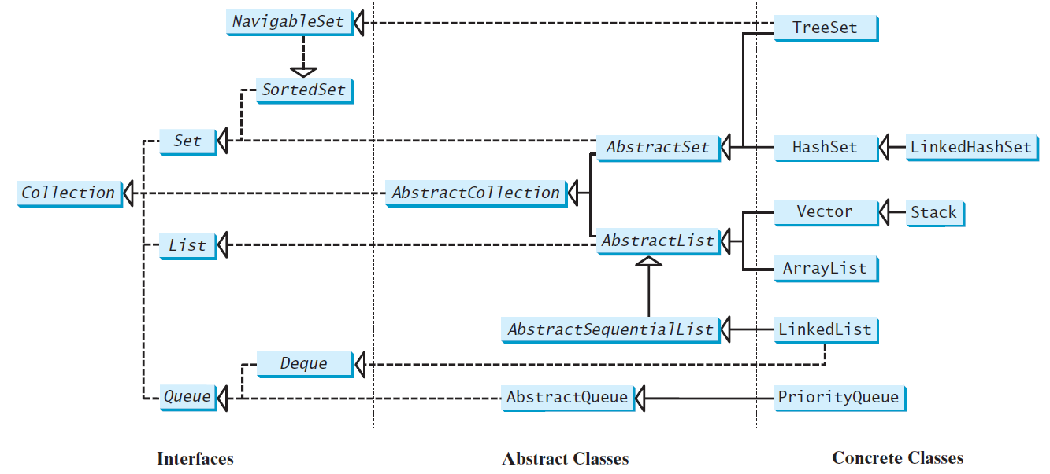
Java Collection Framework hierarchy, cont.
Set and List are subinterfaces of Collection.

Slide 9
ArrayList
The ArrayList class is concrete implementation of the List interface.
Supports random access through an index without inserting or removing elements from any place other than the end.
A list can grow or shrink dynamically.
An array is fixed once it is created. If your application does not require insertion or deletion of elements, the most efficient data structure is the array.

Slide 10
java.util.ArrayList

Slide 11
The ArrayList Class
You can create an array to store objects. But the array’s size is fixed once the array is created. Java provides the ArrayList class that can be used to store an unlimited number of objects.

Slide 12
Generic Type
ArrayList is known as a generic class with a generic type E. You can specify a concrete type to replace E when creating an ArrayList. For example, the following statement creates an ArrayList and assigns its reference to variable cities. This ArrayList object can be used to store strings.
ArrayList<String> cities = new ArrayList<String>();
ArrayList<String> cities = new ArrayList<>();

Slide 13
Differences and Similarities between Arrays and ArrayList

Slide 14
Linked List
Options for implementing an ADT (List)
Array
Has a fixed size
Data must be shifted during insertions and deletions
Linked list
Is able to grow in size as needed
Does not require the shifting of items during insertions and deletions
Notes:
Since MyArrayList is implemented using an array, the methods get(int index) and set(int index, Object o) for accessing and modifying an element through an index and the add(Object o) for adding an element at the end of the list are efficient. However, the methods add(int index, Object o) and remove(int index) are inefficient because it requires shifting potentially a large number of elements. You can use a linked structure to implement a list to improve efficiency for adding and removing an element anywhere in a list.

Slide 15
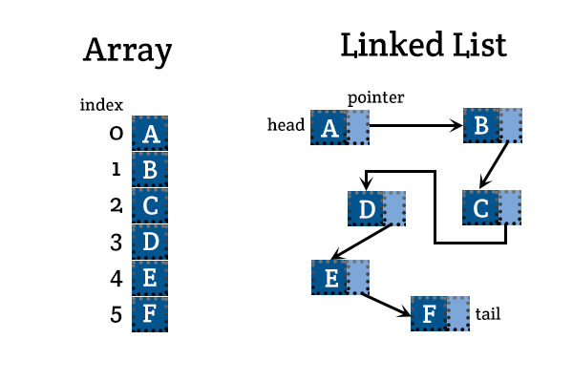

Slide 16
Object References
A reference variable
Contains the location of an object
Example
Integer intRef;
intRef = new Integer(5);
As a data field of a class
Has the default value null
A local reference variable to a method
Does not have a default value

Slide 17
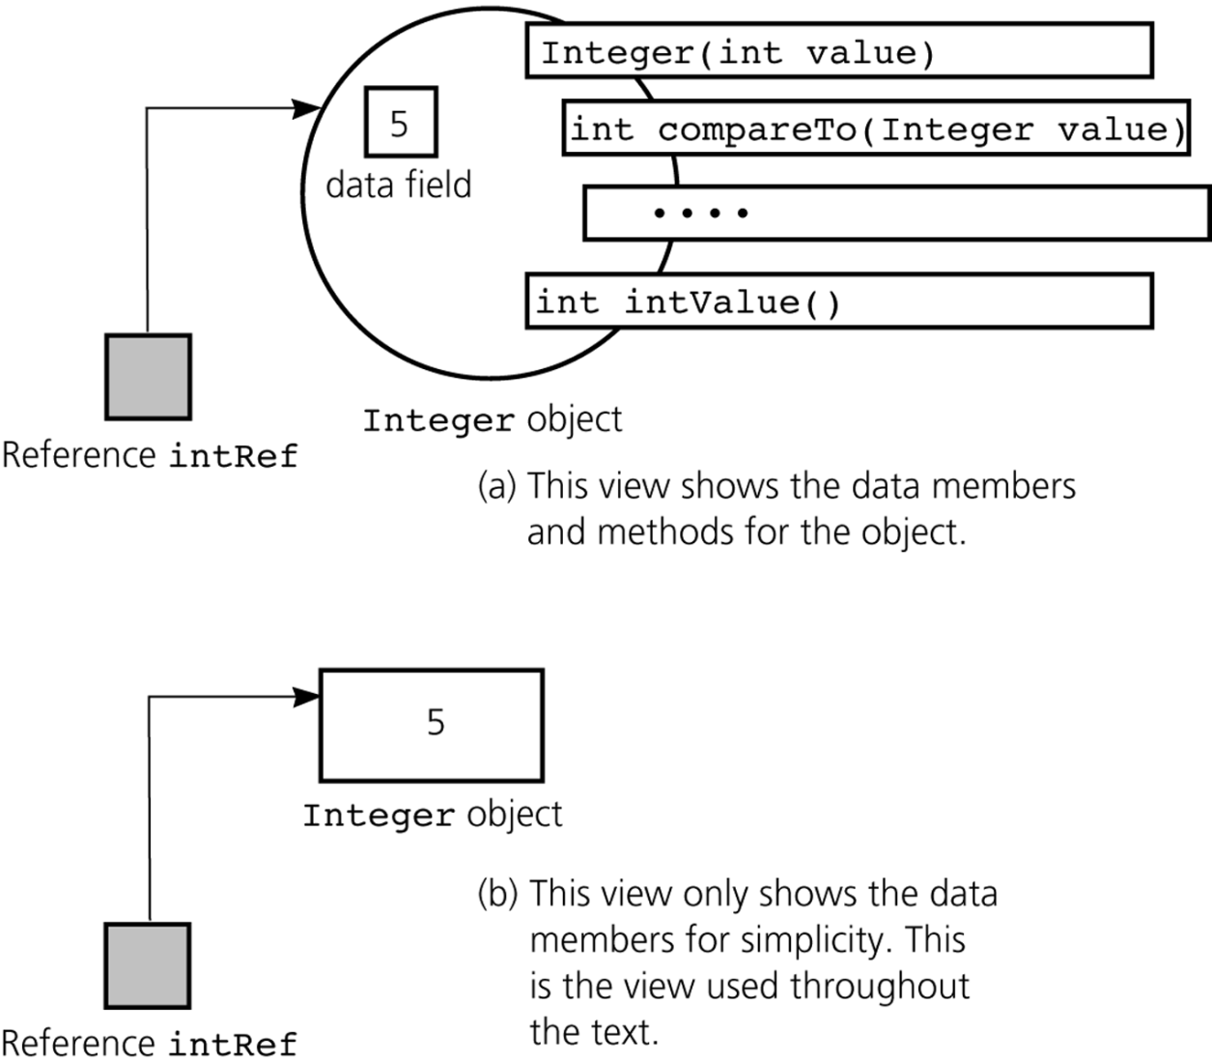
Object References
A reference to an Integer object

Slide 18
Object References
When one reference variable is assigned to another reference variable, both references then refer to the same object
Integer p, q;
p = new Integer(6);
q = p;
A reference variable that no longer references any object is marked for garbage collection

Slide 19
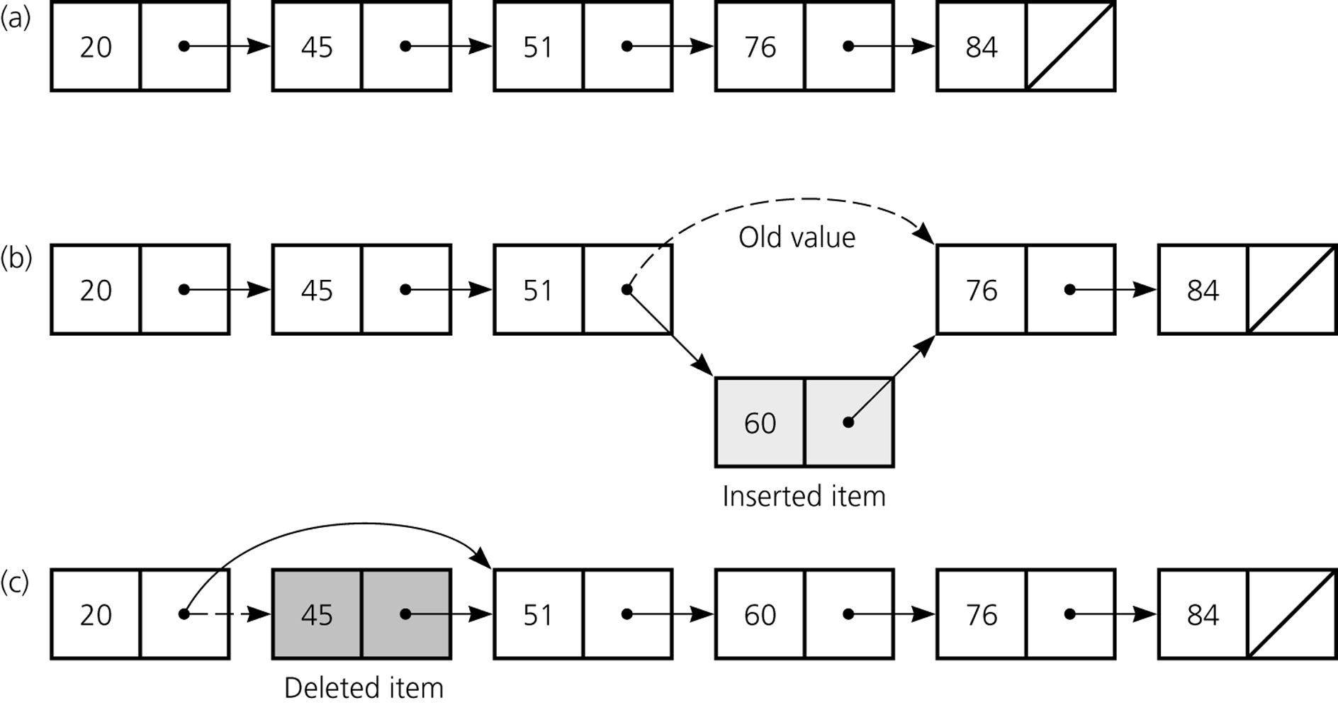
Preliminaries
a) A linked list of integers; b) insertion; c) deletion

Slide 20
Nodes in Linked Lists
A linked list consists of nodes. Each node contains an element, and each node is linked to its next neighbor. Thus a node can be defined as a class, as follows:
class Node<E> {
E element;
Node<E> next;
public Node(E o) {
element = o;
}
}
Notes:
Access is package-private

Slide 21
Adding Three Nodes
The variable head refers to the first node in the list, and the variable tail refers to the last node in the list. If the list is empty, both are null. For example, you can create three nodes to store three strings in a list, as follows:
Step 1: Declare head and tail:

Slide 22
MyLinkedList

Slide 23
Traversing All Elements in the List
Each node contains the element and a data field named next that points to the next node. If the node is the last in the list, its pointer data field next contains the value null. You can use this property to detect the last node. For example, you may write the following loop to traverse all the nodes in the list.
Node<E> current = head;
while (current != null) {
System.out.println(current.element);
current = current.next;
}

Slide 24
Implementing addFirst(E e)
Notes:
public void addFirst(E e) {
Node<E> newNode = new Node<>(e);
newNode.next = head;
head = newNode;
size++;
if (tail == null)
tail = head;
}

Slide 25
Implementing addLast(E e)
Notes:
public void addLast(E e) {
if (tail == null) {
head = tail = new Node<>(e);
}
else {
tail.next = new Node<>(e);
tail = tail.next;
}
size++;
}

Slide 26
Implementing add(int index, E e)
Notes:
public void add(int index, E e) {
if (index == 0) addFirst(e);
else if (index >= size) addLast(e);
else {
Node<E> current = head;
for (int i = 1; i < index; i++)
current = current.next;
Node<E> temp = current.next;
current.next = new Node<>(e);
(current.next).next = temp;
size++;
}
}

Slide 27
Implementing removeFirst()
Notes:
public E removeFirst() {
if (size == 0) return null;
else {
Node<E> temp = head;
head = head.next;
size--;
if (head == null) tail = null;
return temp.element;
}
}

Slide 28
Implementing removeLast()
Notes:
public E removeLast() {
if (size == 0) return null;
else if (size == 1)
{
Node<E> temp = head;
head = tail = null;
size = 0;
return temp.element;
}
else
{
Node<E> current = head;
for (int i = 0; i < size - 2; i++)
current = current.next;
Node temp = tail;
tail = current;
tail.next = null;
size--;
return temp.element;
}
}

Slide 29
Implementing remove(int index)
Notes:
public E remove(int index) {
if (index < 0 || index >= size) return null;
else if (index == 0) return removeFirst();
else if (index == size - 1) return removeLast();
else {
Node<E> previous = head;
for (int i = 1; i < index; i++) {
previous = previous.next;
}
Node<E> current = previous.next;
previous.next = current.next;
size--;
return current.element;
}
}

Slide 30
Circular Linked Lists
A circular, singly linked list is like a singly linked list, except that the pointer of the last node points back to the first node.

Slide 31
Doubly Linked Lists
A doubly linked list contains the nodes with two pointers. One points to the next node and the other points to the previous node. These two pointers are conveniently called a forward pointer and a backward pointer. So, a doubly linked list can be traversed forward and backward.

Slide 32
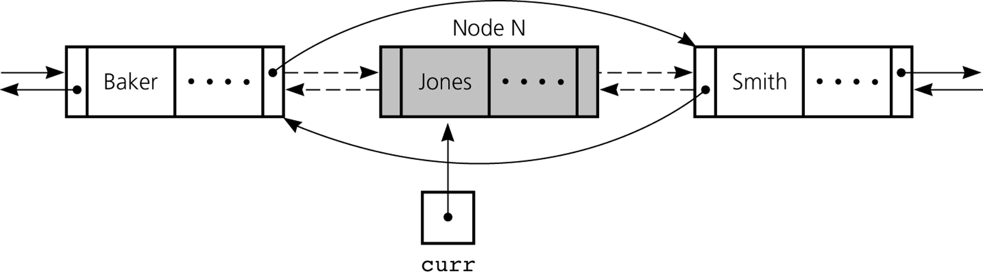
Doubly Linked List
To delete the node that curr references
Reference changes for deletion

Slide 33
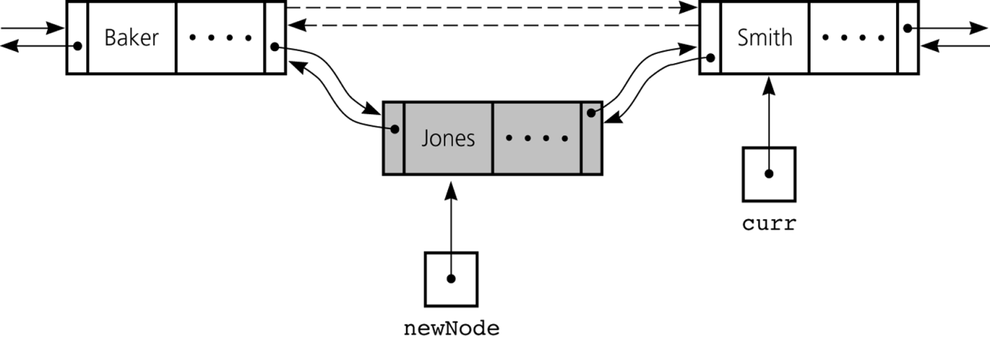
Doubly Linked List
To insert a new node that newNode references before the node referenced by curr
Reference changes for insertion

Slide 34
Circular Doubly Linked Lists
A circular, doubly linked list is doubly linked list, except that the forward pointer of the last node points to the first node and the backward pointer of the first pointer points to the last node.

Slide 35
JCF - LinkedList
LinkedList class is concrete implementation of the List interface.
If your application requires the insertion or deletion of elements from any place in the list, you should choose LinkedList.

Slide 36
java.util.LinkedList

Slide 37
Time Complexity for ArrayList and LinkedList

Slide 38
Stacks

Slide 39
Introduction
Collection data structures such as lists are typically unstructured.
A list, whether array based, a linked list, simply hold elements in an ordered manner.
That is, there is a notion of a first element, second element, etc.
However, that ordering is not necessarily structured, it is simply the order in which the elements were added to the collection.
In contrast, you can impose a structured ordering by sorting a list
Sorting a list, however, does not give the data structure itself any more structure.
The interface would still allow a user to insert or rearrange the elements so that they are no longer sorted.

Slide 40
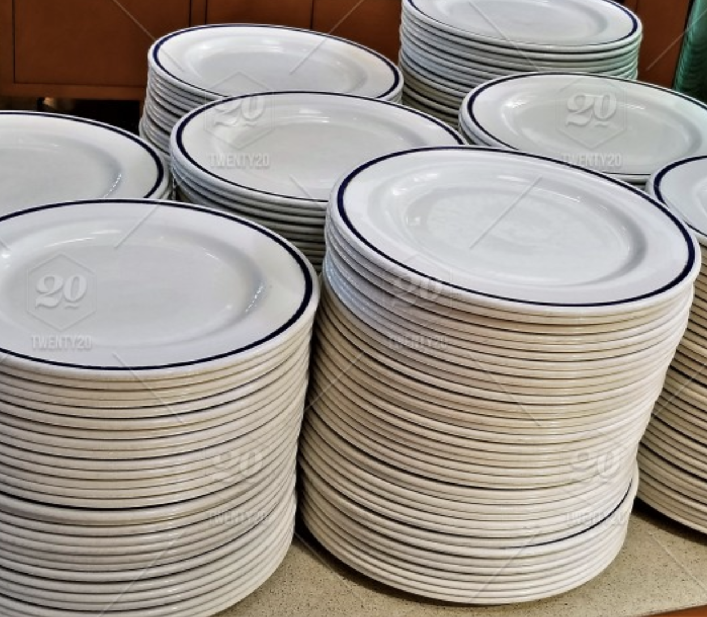
Stacks
A stack is a data structure that stores elements in a last-in, first-out (or Last-In First-Out (LIFO) manner.
That is, the last element to be inserted into a stack is the first element that will come out of the stack.
The last dish that we added to the stack will be the first dish that we take of the stack.

Slide 41
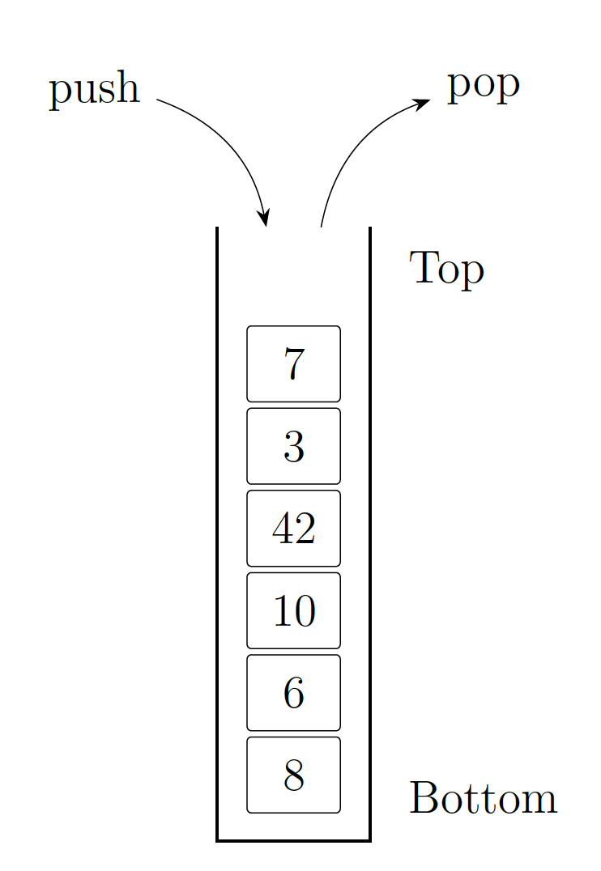
Visualization

Slide 42
Stack
ADT stack operations
Create an empty stack
Determine whether a stack is empty
Add a new item to the stack
Remove from the stack the item that was added most recently
Remove all the items from the stack
Retrieve from the stack the item that was added most recently

Slide 43
In Practice
Don’t roll your own!
You generally do not want to implement your own stack, queue, etc.
JCF contains an implementation of a stack class called Stack (generic)
Derived from Vector
Includes methods: peek, pop, push, and search
search returns the 1-based position of an object on the stack

Slide 44
Simple Applications of the ADT Stack: Checking for Balanced Braces
A stack can be used to verify whether a program contains balanced braces
An example of balanced braces
abc{defg{ijk}{l{mn}}op}qr
An example of unbalanced braces
abc{def}}{ghij{kl}m
Notes:
Requirements for balanced braces
Each time you encounter a “}”, it matches an already encountered “{”
When you reach the end of the string, you have matched each “{”

Slide 45
Application: Algebraic Expressions
When the ADT stack is used to solve a problem, the use of the ADT’s operations should not depend on its implementation
Convert the infix expression to postfix form
Evaluate the postfix expression

Slide 46
Evaluating Postfix Expressions
A postfix calculator
Requires you to enter postfix expressions
Example: 2, 3, 4, +, *
When an operand is entered, the calculator
Pushes it onto a stack
When an operator is entered, the calculator
Applies it to the top two operands of the stack
Pops the operands from the stack
Pushes the result of the operation on the stack

Slide 47
Converting Infix Expressions to Equivalent Postfix Expressions
An infix expression can be evaluated by first being converted into an equivalent postfix expression
Facts about converting from infix to postfix
Operands always stay in the same order with respect to one another
An operator will move only “to the right” with respect to the operands
All parentheses are removed

Slide 48
Queues

Slide 49
Queues
A similar data structure is a queue which provides a First-In First-Out (FIFO) ordering of elements.
As its name suggests, a queue can be thought of as a line.
Elements enter the queue at one end (the “end” of the line) and are removed from the other end (the “front” of the line). Thus, the first element to enter a queue is the first element to be removed from the queue.

Slide 50
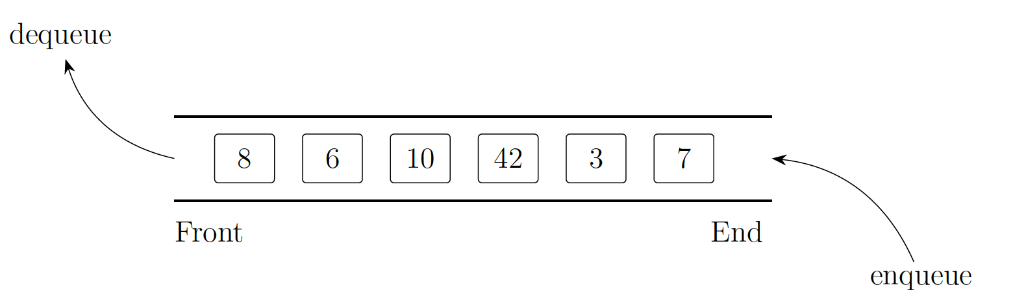
Core Functionality
The two core operations in a queue are:
enqueue which adds an element to the queue at its end
dequeue which removes the element at the front of the queue

Slide 51
The Java Collections Framework Interface Queue
JCF has a queue interface called Queue
Derived from interface Collection
Adds methods:
element: retrieves, but does not remove head
offer: inserts element into queue
peek: retrieves, but does not remove head
poll: retrieves and removes head
remove: retrieves and removes head

Slide 52
In Practice
Don’t roll your own!
You generally do not want to implement your own stack, queue, etc.
Java:
Deque <T> (“deck”): allows both insert and remove operations from both ends (”double ended queue)
It can either be used as a queue(first-in-first-out/FIFO) or as a stack(last-in-first-out/LIFO).

