Slide 1
Lecture 1
Review of COMP 110

Slide 2
Arrays
Array is a data structure that represents a collection of the same types of data.
Passing arrays to methods
Returning an array from a method
Searching arrays

Slide 3
Single-Dimensional Arrays

Slide 4
Objectives
To describe why arrays are necessary in programming
To declare array reference variables and create arrays
To obtain array size using arrayRefVar.length and know default values in an array
To access array elements using indexes
To declare, create, and initialize an array using an array initializer
To program common array operations (displaying arrays, summing all elements, finding the minimum and maximum elements, random shuffling, and shifting elements)
To simplify programming using the foreach loops

Slide 5
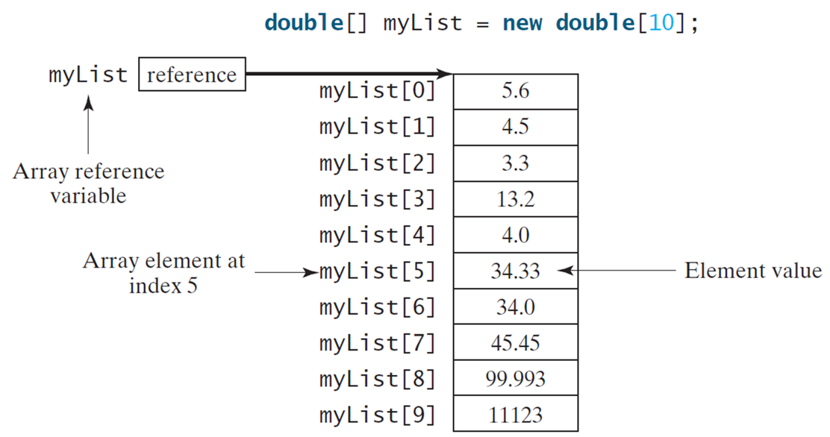
Introducing Arrays
Array is a data structure that represents a collection of the same types of data.
Notes:
The list of arrays is labeled as Array element at index 5. My list is labeled as Array reference variable, with an Element value against each array variable.
Array list, Element value
my list open bracket 0 close bracket, 5.6
my list open bracket 1 close bracket, 4.5
my list open bracket 2 close bracket, 3.3
my list open bracket 3 close bracket, 13.2
my list open bracket 4 close bracket, 4.0
my list open bracket 5 close bracket, 34.33
my list open bracket 6 close bracket, 34.0
my list open bracket 7 close bracket, 45.45
my list open bracket 8 close bracket, 99.993
my list open bracket 9 close bracket, 11123

Slide 6
Array Initializers
Declaring, creating, initializing in one step:
double[] myList = {1.9, 2.9, 3.4, 3.5};
This shorthand syntax must be in one statement.

Slide 7
Processing Arrays
See the examples in the text.
(Initializing arrays with input values)
(Initializing arrays with random values)
(Printing arrays)
(Summing all elements)
(Finding the largest element)
(Finding the smallest index of the largest element)
(Random shuffling)
(Shifting elements) - left

Slide 8
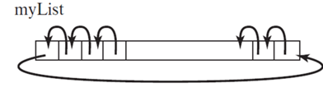
Shifting Elements – shift left

Slide 9
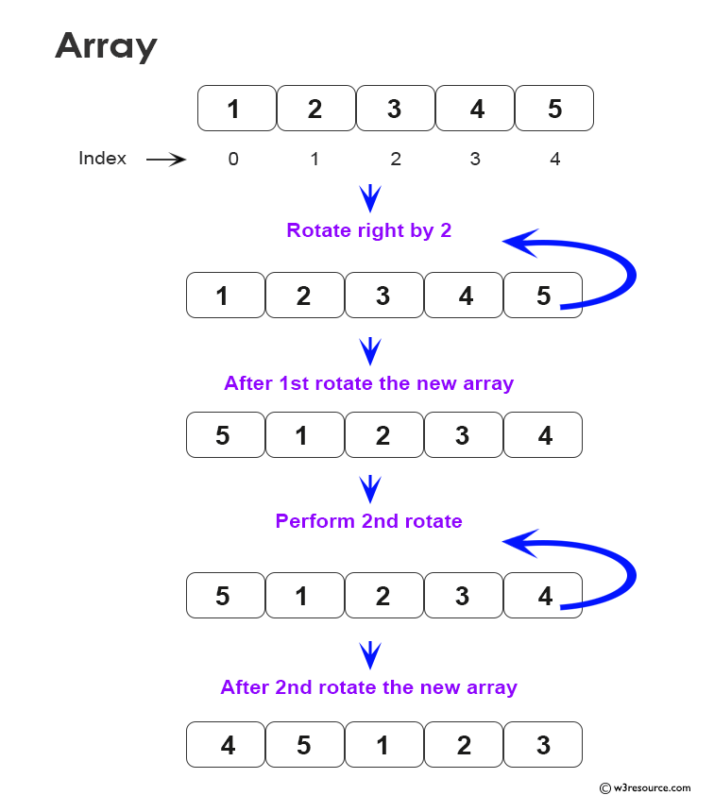
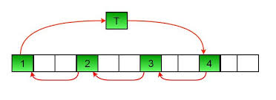
Shifting Elements – shift right

Slide 10
Enhanced for Loop (for-each loop)
J D K 1.5 introduced a new for loop that enables you to traverse the complete array sequentially without using an index variable. For example, the following code displays all elements in the array myList:
for (double value: myList)
System.out.println(value);
In general, the syntax is
for (elementType value: arrayRefVar) {
// Process the value
}
You still have to use an index variable if you wish to traverse the array in a different order or change the elements in the array.

Slide 11
Problem: Deck of Cards (1 of 4)
The problem is to write a program that picks four cards randomly from a deck of 52 cards. All the cards can be represented using an array named deck, filled with initial values 0 to 51, as follows:
int[] deck = new int[52];
// Initialize cards
for (int i = 0; i < deck.length; i++)
deck[i] = i;
DeckOfCards
Notes:
DeckOfCards: https://liveexample.pearsoncmg.com/html/DeckOfCards.html

Slide 12
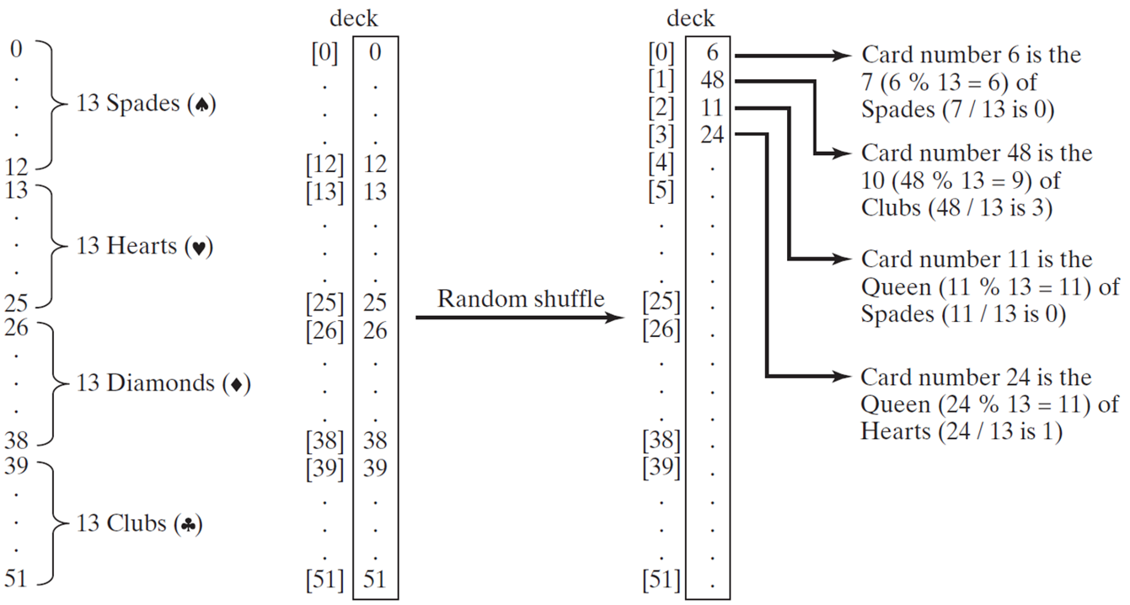
Problem: Deck of Cards (2 of 4)
Notes:
The first column shows 0, vertical ellipses, 12 combined together as 13 spades. The column further goes down to 13, vertical ellipses, 25, combined together as 13 hearts. Going down further the column to 26, vertical ellipses, 38, combined together as 13 diamonds. The last part of this column is from 39, vertical ellipses to 51, combined together as 13 clubs.
The second column shows deck as open bracket 0 close bracket, 0, vertical ellipses, open bracket 12, 12, open bracket 13 close bracket, vertical ellipses, open bracket 25 close bracket, 25, open bracket 26 close bracket, vertical ellipses, open bracket 38 close bracket, open bracket 39 close bracket, vertical ellipses open bracket 51 close bracket.
The third column shows a deck
open bracket 0 close bracket, 6, labeled with Card number 6 is the 7 open parenthesis 6 % 13 = 6 close parenthesis of spades open parenthesis 7 over 13 is 0.
Open bracket 1 close bracket, 48, labeled as Card number 48 is the 10 open parenthesis 48 % 13 = 9 close parenthesis of clubs open parenthesis 48 over 13 is 3 close parenthesis.
Open bracket 2 close bracket, 11 is labeled as Card number 11 is the queen open parenthesis 11 % 13 = 11 close parenthesis of spades open parenthesis 11 over 13 is 0 close parenthesis.
open parenthesis 3 close parenthesis, 24 is labeled as Card number 24 is the queen open parenthesis 24 % 13 = 11 close parenthesis of hearts open parenthesis 24 over 13 is 1 close parenthesis.
Vertical ellipses.
An arrow points from second column to third column. The arrow is labeled as Random shuffle.

Slide 13
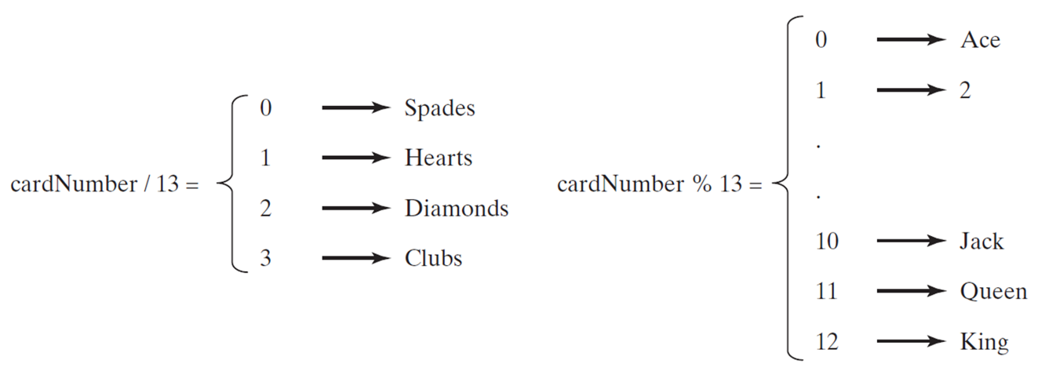
Problem: Deck of Cards (3 of 4)
DeckOfCards
Notes:
DeckOfCards: https://liveexample.pearsoncmg.com/html/DeckOfCards.html

Slide 14
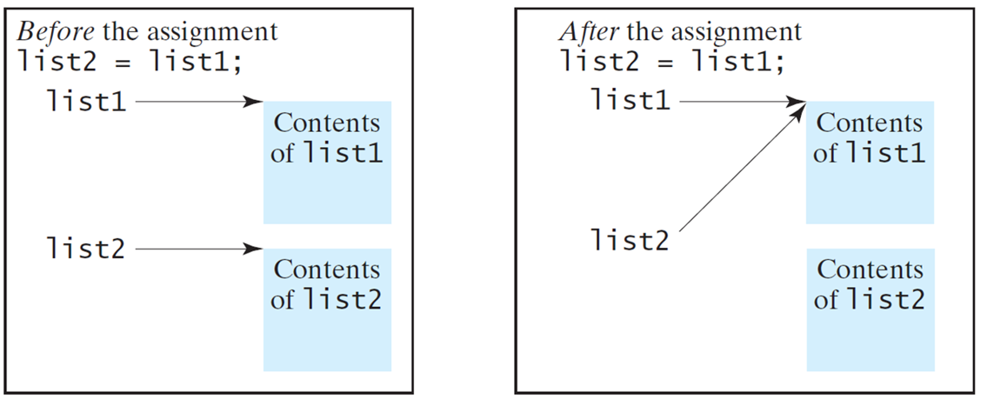
Copying Arrays (1 of 2)
Often, in a program, you need to duplicate an array or a part of an array. In such cases you could attempt to use the assignment statement (=), as follows:
list2 = list1;

Slide 15
Copying Arrays (2 of 2)
Using a loop:
int[] sourceArray = {2, 3, 1, 5, 10};
int[] targetArray = new int[sourceArray.length];
for (int i = 0; i < sourceArrays.length; i++)
targetArray[i] = sourceArray[i];

Slide 16
The arraycopy Utility
arraycopy(sourceArray, src_pos, targetArray, tar_pos, length);
Example:
System.arraycopy(sourceArray, 0, targetArray, 0, sourceArray.length);

Slide 17
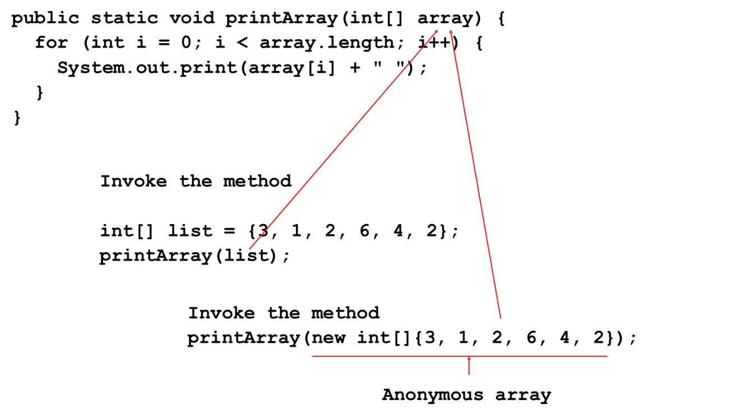
Passing Arrays to Methods
Notes:
Public static void print Array open parenthesis int open and close brackets array close parenthesis open brace for open parenthesis int i = 0; i less than array. Length; i plus plus close parenthesis open brace System.out.print open parenthesis array open bracket i close bracket plus open double quotes close double quotes close parenthesis;
Invoke the method
int open and close brackets list = open brace 3, 1, 2, 6, 4, 2 close brace; print Array open parenthesis list close parenthesis. Invoke the method print Array open parenthesis new int open and close brackets open brace 3, 1, 2, 6, 4, 2 close brace close parenthesis. The numbers are labeled as Anonymous array. array in the first line is connected to print Array open parenthesis list close parenthesis. Array in the first line is also connected to anonymous array in the last line.

Slide 18
Pass by Value
Java uses pass by value to pass arguments to a method. There are important differences between passing a value of variables of primitive data types and passing arrays.
For a parameter of a primitive type value, the actual value is passed. Changing the value of the local parameter inside the method does not affect the value of the variable outside the method.
For a parameter of an array type, the value of the parameter contains a reference to an array; this reference is passed to the method. Any changes to the array that occur inside the method body will affect the original array that was passed as the argument.

Slide 19
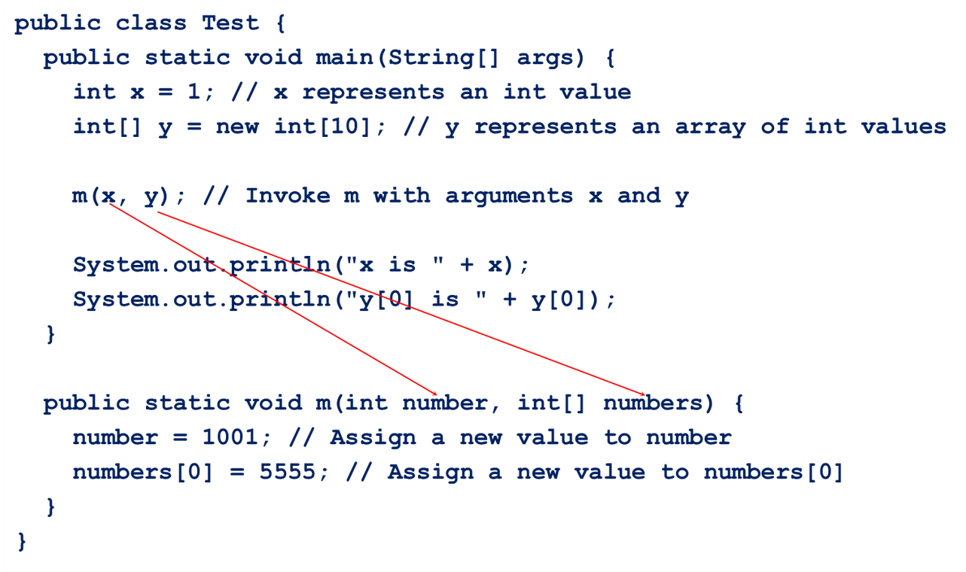
Simple Example

Slide 20
Multidimensional Arrays

Slide 21
Motivations (1 of 2)
Thus far, you have used one-dimensional arrays to model linear collections of elements. You can use a two-dimensional array to represent a matrix or a table. For example, the following table that describes the distances between the cities can be represented using a two-dimensional array.
Distance Table (in miles)
Blank | Chicago | Boston | New York | Atlanta | Miami | Dallas | Houston
Chicago | 0 | 983 | 787 | 714 | 1375 | 967 | 1087
Boston | 983 | 0 | 214 | 1102 | 1763 | 1723 | 1842
New York | 787 | 214 | 0 | 888 | 1549 | 1548 | 1627
Atlanta | 714 | 1102 | 888 | 0 | 661 | 781 | 810
Miami | 1375 | 1763 | 1549 | 661 | 0 | 1426 | 1187
Dallas | 967 | 1723 | 1548 | 781 | 1426 | 0 | 239
Houston | 1087 | 1842 | 1627 | 810 | 1187 | 239 | 0

Slide 22
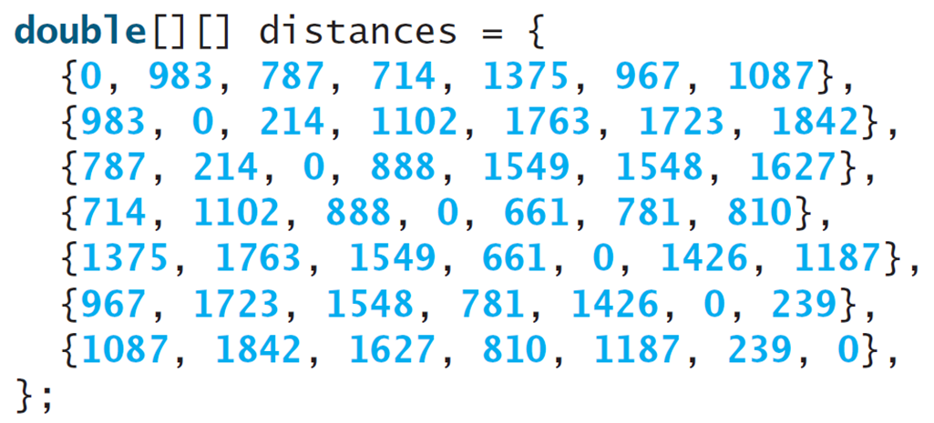
Motivations (2 of 2)
Notes:
Line 1, indicates double open braces close braces open braces close braces distance equal to open braces. Line 2, open braces 0, 983, 787, 714, 1375, 967, 1087 close braces comma. Line 3, open braces 983, 0, 214, 1102, 1763, 1723, 1842 close braces comma. Line 4, open braces 787, 214, 0, 888, 1549, 1548, 1627 close braces comma. Line 5, open braces 714, 1102, 888, 1549, 1548, 1627 close braces comma. Line 6, open braces 1375, 1763, 1549, 661, 781, 810 close braces comma. Line 7, open braces 967, 1723, 1548, 781, 1426, 0, 239 close braces comma. Line 8, open braces 1087, 1842, 1627, 810, 1187, 239, 0 close braces comma. Line 9, close braces semicolon.

Slide 23
Objectives
To give examples of representing data using two-dimensional arrays.
To declare variables for two-dimensional arrays, create arrays, and access array elements in a two-dimensional array using row and column indexes.
To program common operations for two-dimensional arrays (displaying arrays, summing all elements, finding the minimum and maximum elements, and random shuffling).
To pass two-dimensional arrays to methods.

Slide 24
Declare/Create Two-dimensional Arrays
// Declare array ref var
dataType[][] refVar;
// Create array and assign its reference to variable
refVar = new dataType[10][10];
// Combine declaration and creation in one statement
dataType[][] refVar = new dataType[10][10];
// Alternative syntax
dataType refVar[][] = new dataType[10][10];

Slide 25
Declaring Variables of Two-dimensional Arrays and Creating Two-dimensional Arrays
int[][] matrix = new int[10][10];
or
int matrix[][] = new int[10][10];
matrix[0][0] = 3;
for (int i = 0; i < matrix.length; i++)
for (int j = 0; j < matrix[i].length; j++)
matrix[i][j] = (int)(Math.random() * 1000);
double[][] x;

Slide 26
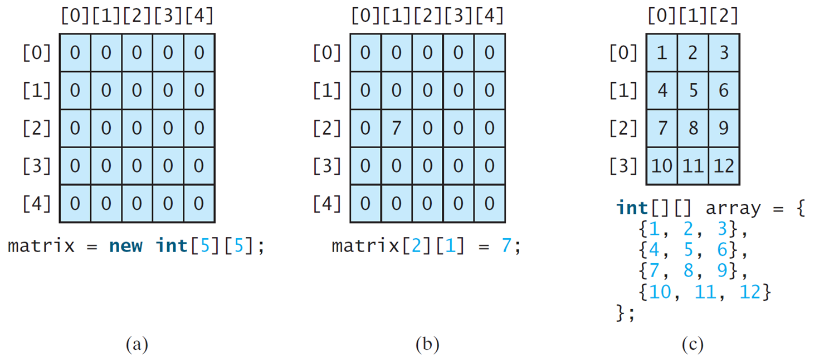
Two-dimensional Array Illustration
matrix.length? 5
matrix[0].length? 5
array.length? 4
array[0].length? 3
Notes:
(a) A 5 by 5 array with columns and rows numbered 0 to 4. Each element in the array is 0. The text reads, matrix = new int 5 by 5.
(b) A 5 by 5 array with columns and rows numbered 0 to 4. Each element in the array is 0. The text reads, matrix 2 by 1 = 7.
(c) A 4 by 3 array with columns numbered 0 to 2 and rows numbered 0 to 3. The row entries are as follows.
Row 0. 1, 2, 3.
Row 1. 4, 5, 6.
Row 2. 7, 8, 9.
Row 3. 10, 11, 12.
The text reads, int left bracket right bracket, left bracket right bracket array = left brace
Left brace 1, 2, 3 right brace
Left brace 4, 5, 6 right brace
Left brace 7, 8, 9 right brace
Left brace 10, 11, 12 right brace
Right brace.

Slide 27
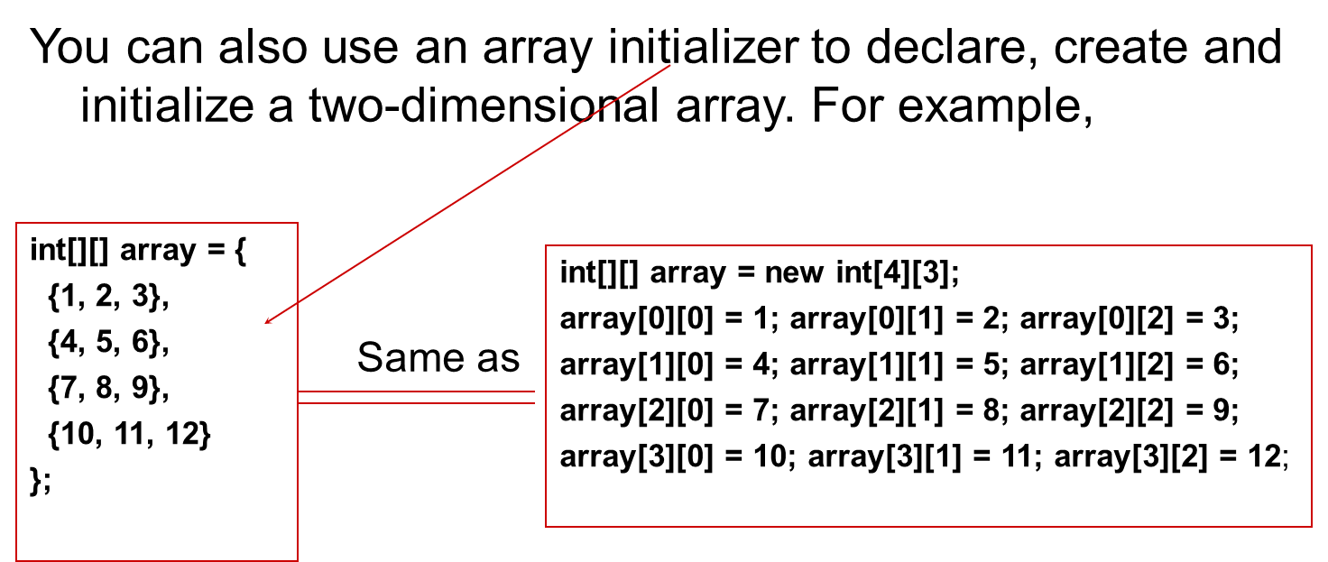
Declaring, Creating, and Initializing Using Shorthand Notations
Notes:
The computer code consists 6 lines. Line 1, indicates i n t open braces close braces open braces close braces array equal to open braces. Line 2, open braces 1, 2, 3 close braces comma. Line 3, open braces 4, 5, 6 close braces comma. Line 4, open braces 7, 8, 9 close braces comma. Line 5, open braces 10, 11, 12 close braces. Line 6, close braces semicolon. A right side text box also shows the Two-dimensional Arrays. The computer code consists 5 lines. Line 1, indicates i n t open braces close braces open braces close braces array equal to new i n t open braces four close braces open braces three close braces semicolon. Line 2, array open braces zero close braces open braces zero close braces equal to one semicolon array open braces zero close braces open braces one close braces equal to two semicolon array open braces zero close braces open braces two close braces equal to three semicolon. Line 3, array open braces one close braces open braces zero close braces equal to four semicolon array open braces one close braces open braces one close braces equal to five semicolon array open braces one close braces open braces two close braces equal to six semicolon. Line 4, array open braces two close braces open braces zero close braces equal to seven semicolon array open braces two close braces open braces one close braces equal to eight semicolon array open braces two close braces open braces two close braces equal to nine semicolon. Line 5, array open braces three close braces open braces zero close braces equal to ten semicolon array open braces three close braces open braces one close braces equal to eleven semicolon array open braces three close braces open braces two close braces equal to twelve semicolon.

Slide 28
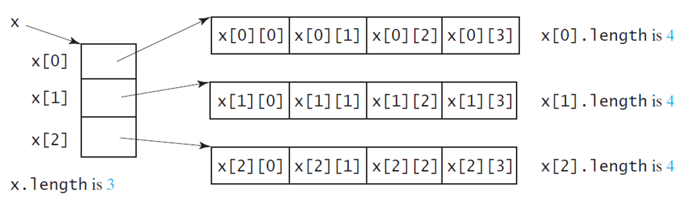
Lengths of Two-dimensional Arrays (1 of 2)
int[][] x = new int[3][4];
Notes:
The boxes are labeled, x 0, x 1, and x 2. The text at the bottom reads, x dot length is 3.
The first box contains four arrays as x 0 by 0, x 0 by 1, x 0 by 2, and x 0 by 3. The text reads, x 0 dot length is 4.
The second box contains four arrays as x 1 by 0, x 1 by 1, x 1 by 2, and x 1 by 3. The text reads, x 1 dot length is 4.
The third box contains four arrays as x 2 by 0, x 2 by 1, x 2 by 2, and x 2 by 3. The text reads, x 2 dot length is 4.

Slide 29
Lengths of Two-dimensional Arrays (2 of 2)
int[][] array = {
{1, 2, 3},
{4, 5, 6},
{7, 8, 9},
{10, 11, 12}
};
array.length
array[0].length
array[1].length
array[2].length
array[3].length
array[4].length ArrayIndexOutOfBoundsException

Slide 30
Ragged Arrays (1 of 2)
Each row in a two-dimensional array is itself an array. So, the rows can have different lengths. Such an array is known as a ragged array. For example,
int[][] matrix = {
{1, 2, 3, 4, 5},
{2, 3, 4, 5},
{3, 4, 5},
{4, 5},
{5}
};
matrix.length is 5
matrix[0].length is 5
matrix[1].length is 4
matrix[2].length is 3
matrix[3].length is 2
matrix[4].length is 1

Slide 31
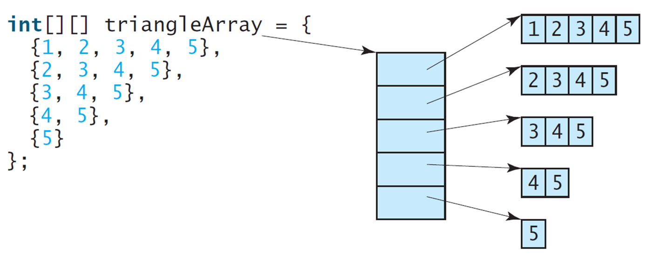
Ragged Arrays (2 of 2)
Notes:
Left brace 1, 2, 3, 4, 5 right brace,
Left brace 2, 3, 4, 5 right brace,
Left brace 3, 4, 5 right brace,
Left brace 4, 5 right brace,
Left brace 5 right brace
right brace
An arrow from triangleArray point to a column with five boxes. The top box contains numbers from 1 to 5, the second box contains numbers from 2 to 5, the third box contains numbers from 3 to 5, the fourth box contains numbers from 4 to 5, and the fifth box contains number 5.

Slide 32
Processing Two-Dimensional Arrays
See the examples in the text.
(Initializing arrays with input values)
(Printing arrays)
(Summing all elements)
(Summing all elements by column)
(Summing all elements by row)
(Random shuffling)
(Which row has the largest sum)
(Finding the smallest index of the largest element)

Slide 33
Passing Tow-Dimensional Arrays to Methods
PassTwoDimensionalArray
Notes:
PassTwoDimensionalArray: https://liveexample.pearsoncmg.com/html/PassTwoDimensionalArray.html

Slide 34
Exception-Handling Overview
Show runtime error
Quotient
Fix it using an if statement
QuotientWithIf
With a method
QuotientWithMethod

Slide 35
Exception Advantages
QuotientWithException
Now you see the advantages of using exception handling. It enables a method to throw an exception to its caller. Without this capability, a method must handle the exception or terminate the program.

Slide 36
Handling InputMismatchException
InputMismatchExceptionDemo
By handling InputMismatchException, your program will continuously read an input until it is correct.

Slide 37
Exception Types

Slide 38
Input
the Scanner class
int nextValue;
int sum=0;
Scanner kbInput = new Scanner(System.in);
nextValue = kbInput.nextInt();
while (nextValue > 0) {
sum += nextValue;
nextValue = kbInput.nextInt();
} // end while
kbInput.close();

Slide 39
Input
The Scanner class (continued)
More useful next methods
String next();
boolean nextBoolean();
double nextDouble();
float nextFloat();
int nextInt();
String nextLine();
long nextLong();
short nextShort();

Slide 40
Output
Methods print and println
Write character strings, primitive types, and objects to System.out
println terminates a line of output so next one starts on the next line
When an object is used with these methods
Return value of object’s toString method is displayed
You usually override this method with your own implementation
Problem
Lack of formatting abilities

Slide 41
Formatting Output
Use the printf statement.
System.out.printf(format, items);
Where format is a string that may consist of substrings and format specifiers. A format specifier specifies how an item should be displayed. An item may be a numeric value, character, boolean value, or a string. Each specifier begins with a percent sign.
% [flags] [width] [.precision] conversion-character ( square brackets denote optional parameters )

Slide 42
Frequently-Used Specifiers
Specifier Output Example
%b a boolean value true or false
%c a character 'a'
%d a decimal integer 200
%f a floating-point number 45.460000
%e a number in standard scientific notation 4.556000e+01
%s a string "Java is cool"

Slide 43
Frequently-Used Flags
: left-justify ( default is to right-justify )
+ : output a plus ( + ) or minus ( - ) sign for a numerical value
0 : forces numerical values to be zero-padded ( default is blank padding )
, : comma grouping separator (for numbers > 1000)
: space will display a minus sign if the number is negative or a space if it is positive

Slide 44
Width: Specifies the field width for outputting the argument and represents the minimum number of characters to be written to the output. Include space for expected commas and a decimal point in the determination of the width for numerical values.
Precision: Used to restrict the output depending on the conversion. It specifies the number of digits of precision when outputting floating-point values or the length of a substring to extract from a String. Numbers are rounded to the specified precision.

Slide 45
FormatDemo
The example gives a program that uses printf to display a table.
FormatDemo

Slide 46
The File Class
The File class is intended to provide an abstraction that deals with most of the machine-dependent complexities of files and path names in a machine-independent fashion. The filename is a string. The File class is a wrapper class for the file name and its directory path.

Slide 47
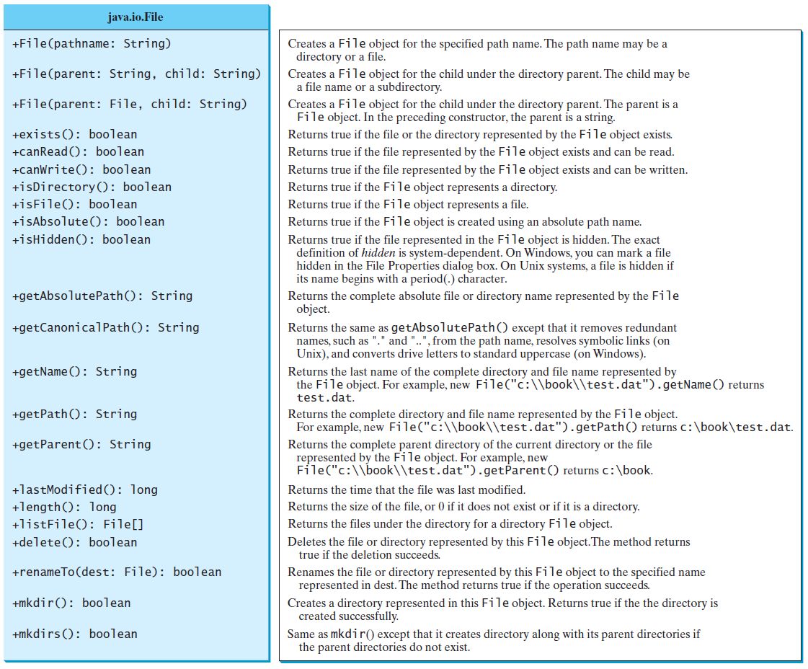
Obtaining file properties and manipulating file

Slide 48
Text I/O
A File object encapsulates the properties of a file or a path, but does not contain the methods for reading/writing data from/to a file. In order to perform I/O, you need to create objects using appropriate Java I/O classes. The objects contain the methods for reading/writing data from/to a file. This section introduces how to read/write strings and numeric values from/to a text file using the Scanner and PrintWriter classes.

Slide 49
Writing Data Using PrintWriter
WriteData

Slide 50
Try-with-resources
Programmers often forget to close the file. JDK 7 provides the followings new try-with-resources syntax that automatically closes the files.
try (declare and create resources) {
Use the resource to process the file;
}
WriteDataWithAutoClose

Slide 51
Reading Data Using Scanner
ReadData

Slide 52
Problem: Replacing Text
Write a class named ReplaceText that replaces a string in a text file with a new string. The filename and strings are passed as command-line arguments as follows:
java ReplaceText sourceFile targetFile oldString newString
For example, invoking
java ReplaceText FormatString.java t.txt StringBuilder StringBuffer
replaces all the occurrences of StringBuilder by StringBuffer in FormatString.java and saves the new file in t.txt.
ReplaceText

