Slide 1
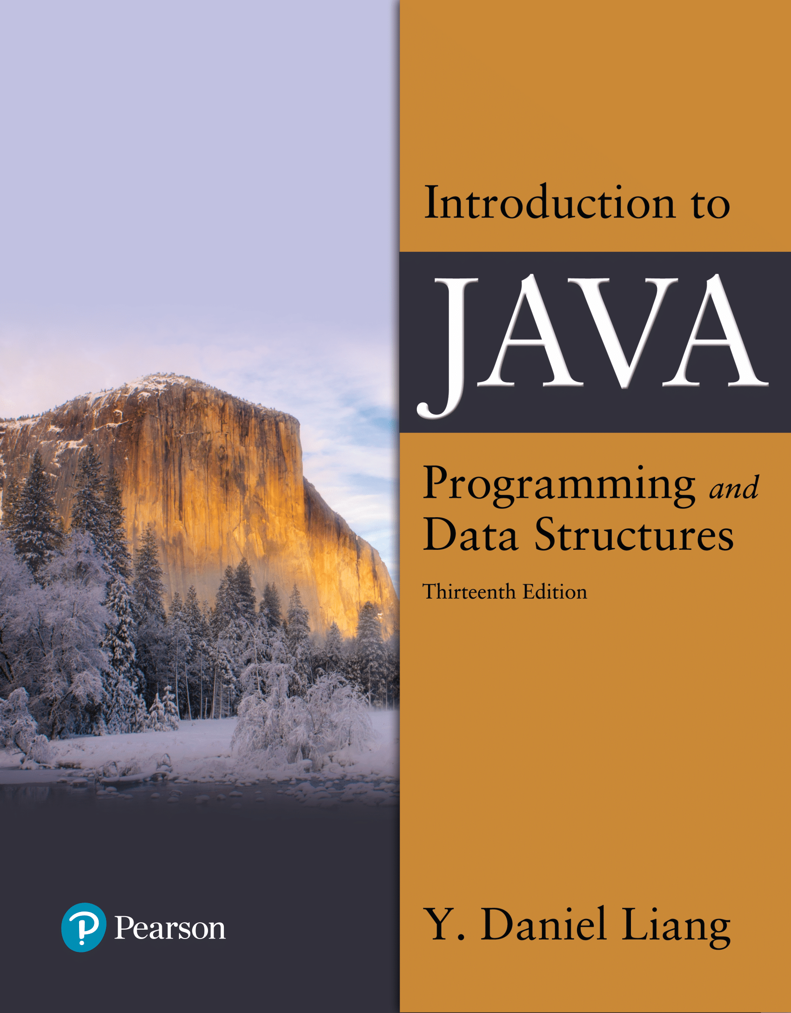

Introduction to Java Programming and Data Structures
Thirteenth Edition
Chapter 11
Inheritance and Polymorphism
Copyright © 2024 Pearson Education, Inc. All Rights Reserved
Notes:
If this PowerPoint presentation contains mathematical equations, you may need to check that your computer has the following installed:
1) MathType Plugin
2) Math Player (free versions available)
3) NVDA Reader (free versions available)
Slides in this presentation contain hyperlinks. JAWS users should be able to get a list of links by using INSERT+F7

Slide 2
Motivations
Suppose you will define classes to model circles, rectangles, and triangles. These classes have many common features. What is the best way to design these classes so to avoid redundancy? The answer is to use inheritance.

Slide 3
Objectives (1 of 2)
11.1 To define a subclass from a superclass through inheritance (§11.2).
11.2 To invoke the superclass’s constructors and methods using the super keyword (§11.3).
11.3 To override instance methods in the subclass (§11.4).
11.4 To distinguish differences between overriding and overloading (§11.5).
11.5 To explore the toString()method in the Object class (§11.6).
11.6 To discover polymorphism and dynamic binding (§§11.7–11.8).
11.7 To describe casting and explain why explicit downcasting is necessary (§11.9).

Slide 4
Objectives (2 of 2)
11.8 To explore the equals method in the Object class (§11.10).
11.9 To store, retrieve, and manipulate objects in an ArrayList (§11.11).
11.10 To construct an array list from an array, to sort and shuffle a list, and to obtain max and min element from a list (§11.12).
11.11 To implement a Stack class using ArrayList (§11.13).
11.12 To enable data and methods in a superclass accessible from subclasses using the protected visibility modifier (§11.14).
11.13 To prevent class extending and method overriding using the final modifier (§11.14).
11.14 To automatically generate boilerplate code using Lombok (§11.16).

Slide 5
What is Inheritance? Generalization vs. Specialization
Real-life objects are typically specialized versions of other more general objects.
The term “Geometric Objects” describes a very general type of Geometric Objects with numerous characteristics.
Circles and Rectangles are Geometric Objects
They share the general characteristics of an Geometric Objects (color, filled, date created) .
However, they have special characteristics of their own.
Circles have a radius
Rectangles have height and width.
Circles and Rectangles are specialized versions of an Geometric Objects .

Slide 6
Inheritance
GeometricObject
Contains those attributes and methods that are shared by all Geometric Objects.
Circle
Rectangle
Contains those attributes and methods that are specific to a Rectangle.
Contains those attributes and methods that specific to a Circle.
Notes:
We can extend the capabilities of a class.
Inheritance involves a superclass and a subclass.
The superclass is the general class and
the subclass is the specialized class.
The subclass is based on, or extended from, the superclass.
Superclasses are also called base classes, and
subclasses are also called derived classes.
The relationship of classes can be thought of as parent classes and child classes.

Slide 7
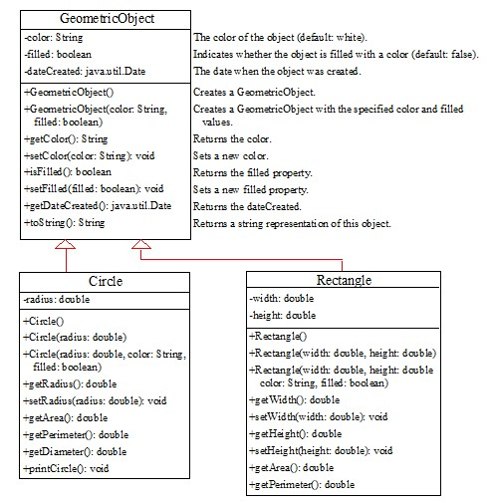
Superclasses and Subclasses
GeometricObject
Circle
Rectangle
TestCircleRectangle
Notes:
It has 3 rows. Row 1, shows the Geometric Object. Row 2, shows the coding and it has 3 lines. Line 1, minus color colon String. Line 2, minus filled colon Boolean. Line 3, minus data C related colon java period util period Date. Row 3, shows the coding and it has 9 lines. Line 1, plus Geometric Object open parenthesis close parenthesis. Line 2, plus Geometric Object open parenthesis color colon String comma. Line 3, filled colon Boolean close parenthesis. Line 4, plus get Color open parenthesis close parenthesis colon String. Line 5, plus set Color open parenthesis color colon String close parenthesis colon void. Line 6, plus is Filled open parenthesis close parenthesis colon Boolean. Line 7, plus set Filled open parenthesis filled colon Boolean close parenthesis colon void. Line 8, plus get Date C related open parenthesis close parenthesis colon java period util period Date. Line 9, plus to String open parenthesis close parenthesis colon String. A left downward side computer code shows the coding and it is divided in 3 rows. Row 1, shows the Circle. Row 2, shows the minus radius colon double. Row 3, has 10 lines. Line 1, plus Circle open parenthesis close parenthesis. Line 2, plus Circle open parenthesis radius colon double close parenthesis. Line 3, plus Circle open parenthesis radius colon double comma color colon String comma. Line 4, filled colon Boolean close parenthesis. Line 5, plus get Radius open parenthesis close parenthesis colon double. Line 6, plus set Radius open parenthesis radius colon double close parenthesis colon void. Line 7, get Area open parenthesis close parenthesis colon double. Line 8, plus get Perimeter open parenthesis close parenthesis colon double. Line 9, plus get Diameter open parenthesis close parenthesis colon double. Line 10, plus print Circle open parenthesis close parenthesis colon void. A right downward side computer code shows the coding and it has 3 rows. Row 1, shows the Rectangle. Row 2, shows the coding for 2 lines. Line 1, minus width colon double. Line 2, minus height colon double. Row 3, also shows the coding for 10 lines. Line 1, plus Rectangle open parenthesis close parenthesis. Line 2, plus Rectangle open parenthesis width colon double comma height colon double close parenthesis. Line 4, color colon String comma filled colon Boolean close parenthesis. Line 5, plus get Width open parenthesis close parenthesis colon double. Line 6, plus set Width open parenthesis width colon double close parenthesis colon void. Line 7, get Height open parenthesis close parenthesis colon double. Line 8, plus set Height open parenthesis height colon double close parenthesis colon void. Line 9, plus get Area open parenthesis close parenthesis colon double. Line 10, plus get Perimeter open parenthesis close parenthesis colon double.
GeometricObject: https://liveexample.pearsoncmg.com/html/SimpleGeometricObject.html
Circle: https://liveexample.pearsoncmg.com/html/CircleFromSimpleGeometricObject.html
Rectangle: https://liveexample.pearsoncmg.com/html/RectangleFromSimpleGeometricObject.html
TestCircleRectangle: https://liveexample.pearsoncmg.com/html/TestCircleRectangle.html

Slide 8
Are Superclass’s Constructor Inherited?
No. They are not inherited.
They are invoked explicitly or implicitly.
Explicitly using the super keyword.
A constructor is used to construct an instance of a class. Unlike properties and methods, a superclass's constructors are not inherited in the subclass. They can only be invoked from the subclasses' constructors, using the keyword super. If the keyword super is not explicitly used, the superclass's no-arg constructor is automatically invoked.

Slide 9
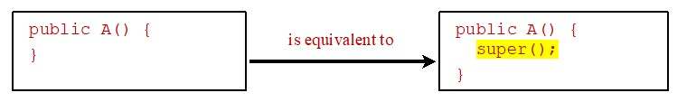
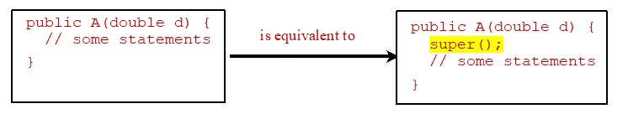
Superclass’s Constructor Is Always Invoked
A constructor may invoke an overloaded constructor or its superclass’s constructor. If none of them is invoked explicitly, the compiler puts super() as the first statement in the constructor. For example,
Notes:
It has 2 lines. Line 1, public A open parenthesis close parenthesis open braces. Line 2, close braces. And this is equivalent to right upward side box. A right upward side box shows the coding for 3 lines. Line 1, public A open parenthesis close parenthesis open braces. Line 2, super open parenthesis close parenthesis semicolon. Line 3, close braces.
Line 1, public A open parenthesis double d close parenthesis open braces. Line 2, slash forward slash forward some statements. Line 3, close braces. And this is equivalent to right downward side computer code. A right downward side computer code shows the coding for 4 lines. Line 1, public A open parenthesis double d close parenthesis open braces. Line 2, super open parenthesis close parenthesis semicolon. Line 3, slash forward slash forward some statements. Line 4, close braces.

Slide 10
Using the Keyword super
The keyword super refers to the superclass of the class in which super appears. This keyword can be used in two ways:
To call a superclass constructor
To call a superclass method

Slide 11
Caution
You must use the keyword super to call the superclass constructor. Invoking a superclass constructor’s name in a subclass causes a syntax error. Java requires that the statement that uses the keyword super appear first in the constructor.

Slide 12
Constructor Chaining (1 of 2)
Constructing an instance of a class invokes all the superclasses’ constructors along the inheritance chain. This is known as constructor chaining.
public class Faculty extends Employee {
public static void main(String[] args) {
new Faculty();
}
public Faculty() {
System.out.println("(4) Faculty's no-arg constructor is invoked");
}
}
class Employee extends Person {
public Employee() {

Slide 13
Constructor Chaining (2 of 2)
this("(2) Invoke Employee’s overloaded constructor");
System.out.println("(3) Employee's no-arg constructor is invoked");
}
public Employee(String s) {
System.out.println(s);
}
}
class Person {
public Person() {
System.out.println("(1) Person's no-arg constructor is invoked");
}
}

Slide 14
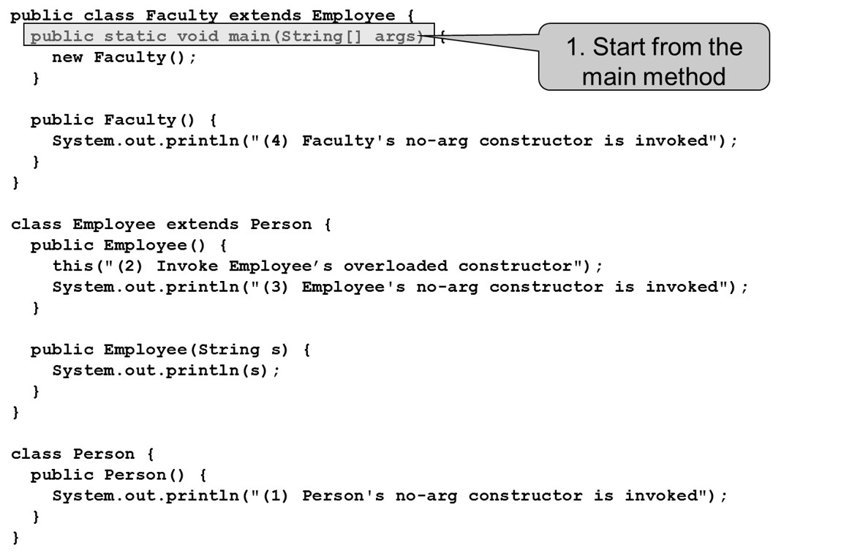
Trace Execution (1 of 9)
Notes:
It has 26 lines. Line 1, public class Faculty extends Employee open braces. Line 2, public static void main open parenthesis String open parenthesis close parenthesis args close parenthesis open braces and this line shows the Start from the main method. Line 3, new Faculty open parenthesis close parenthesis semicolon. Line 4, close braces. Line 5, Blank. Line 6, public Faculty open parenthesis close parenthesis open braces. Line 7, System period out period print ln open parenthesis double quote open parenthesis 4 close parenthesis Faculty's no hyphen arg constructor is invoked double quote close parenthesis semicolon. Line 8, close braces. Line 9, close braces. Line 10, blank. Line 11, class Employee extends Person open braces. Line 12, public employee open parenthesis close parenthesis open braces. Line 13, this open parenthesis double quote open parenthesis 2 close parenthesis Invoke Employee's overloaded constructor double quote close parenthesis semicolon. Line 14, System period out period print ln open parenthesis double quote open parenthesis 3 close parenthesis Employee's no hyphen arg constructor is invoked double quote close parenthesis semicolon. Line 15, close braces. Line 16, blank. Line 17, public Employee open parenthesis String s close parenthesis open braces. Line 18, System period out period print ln open parenthesis s close parenthesis semicolon. Line 19, close braces. Line 20, close braces. Line 21, blank. Line 22, class Person open braces. Line 23, public Person open parenthesis close parenthesis open braces. Line 24, System period out period print ln open parenthesis double quote open parenthesis 1 close parenthesis Person's no hyphen arg constructor is invoked double quote close parenthesis semicolon. Line 25, close braces. Line 26, close braces.

Slide 15
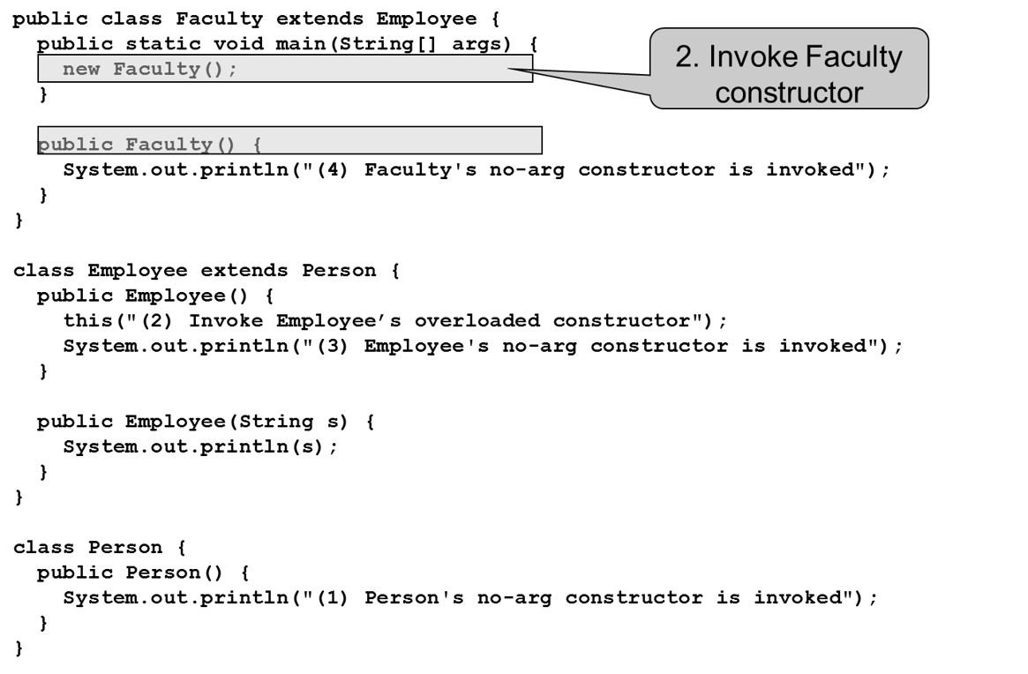
Trace Execution (2 of 9)
Notes:
It has 26 lines. Line 1, public class Faculty extends Employee open braces. Line 2, public static void main open parenthesis String open parenthesis close parenthesis args close parenthesis open braces. Line 3, new Faculty open parenthesis close parenthesis semicolon and this line shows the Invoke Faculty constructor. Line 4, close braces. Line 5, Blank. Line 6, public Faculty open parenthesis close parenthesis open braces. Line 7, System period out period print ln open parenthesis double quote open parenthesis 4 close parenthesis Faculty's no hyphen arg constructor is invoked double quote close parenthesis semicolon. Line 8, close braces. Line 9, close braces. Line 10, blank. Line 11, class Employee extends Person open braces. Line 12, public employee open parenthesis close parenthesis open braces. Line 13, this open parenthesis double quote open parenthesis 2 close parenthesis Invoke Employee's overloaded constructor double quote close parenthesis semicolon. Line 14, System period out period print ln open parenthesis double quote open parenthesis 3 close parenthesis Employee's no hyphen arg constructor is invoked double quote close parenthesis semicolon. Line 15, close braces. Line 16, blank. Line 17, public Employee open parenthesis String s close parenthesis open braces. Line 18, System period out period print ln open parenthesis s close parenthesis semicolon. Line 19, close braces. Line 20, close braces. Line 21, blank. Line 22, class Person open braces. Line 23, public Person open parenthesis close parenthesis open braces. Line 24, System period out period print ln open parenthesis double quote open parenthesis 1 close parenthesis Person's no hyphen arg constructor is invoked double quote close parenthesis semicolon. Line 25, close braces. Line 26, close braces.

Slide 16
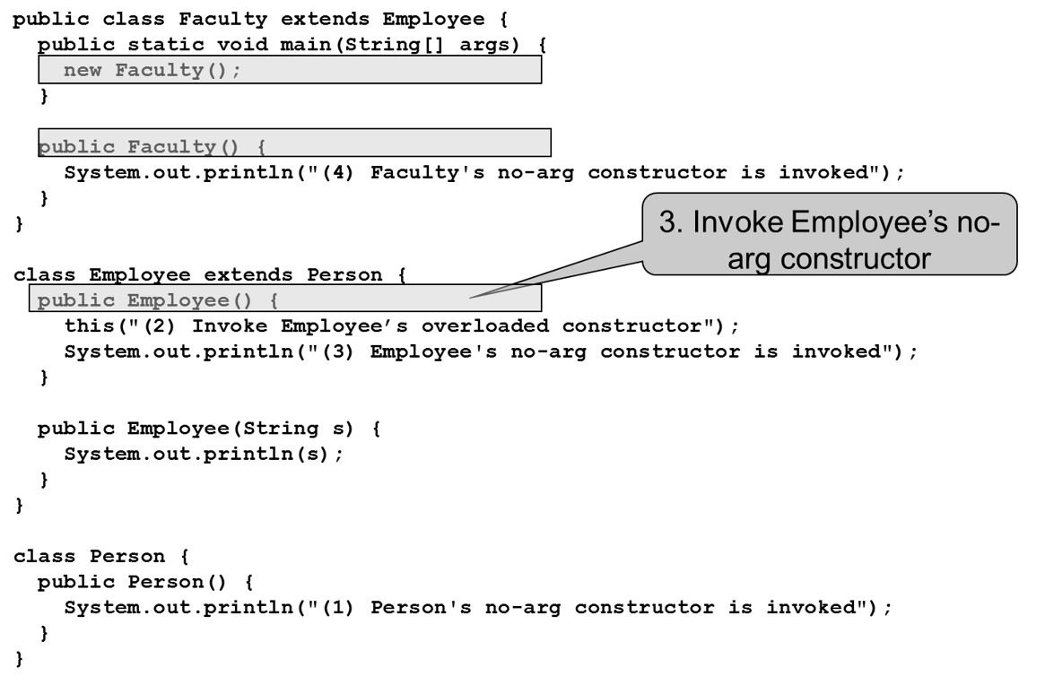
Trace Execution (3 of 9)
Notes:
It has 26 lines. Line 1, public class Faculty extends Employee open braces. Line 2, public static void main open parenthesis String open parenthesis close parenthesis args close parenthesis open braces. Line 3, new Faculty open parenthesis close parenthesis semicolon. Line 4, close braces. Line 5, Blank. Line 6, public Faculty open parenthesis close parenthesis open braces. Line 7, System period out period print ln open parenthesis double quote open parenthesis 4 close parenthesis Faculty's no hyphen arg constructor is invoked double quote close parenthesis semicolon. Line 8, close braces. Line 9, close braces. Line 10, blank. Line 11, class Employee extends Person open braces. Line 12, public employee open parenthesis close parenthesis open braces and this line shows the Invoke Employee's no hyphen arg constructor. Line 13, this open parenthesis double quote open parenthesis 2 close parenthesis Invoke Employee's overloaded constructor double quote close parenthesis semicolon. Line 14, System period out period print ln open parenthesis double quote open parenthesis 3 close parenthesis Employee's no hyphen arg constructor is invoked double quote close parenthesis semicolon. Line 15, close braces. Line 16, blank. Line 17, public Employee open parenthesis String s close parenthesis open braces. Line 18, System period out period print ln open parenthesis s close parenthesis semicolon. Line 19, close braces. Line 20, close braces. Line 21, blank. Line 22, class Person open braces. Line 23, public Person open parenthesis close parenthesis open braces. Line 24, System period out period print ln open parenthesis double quote open parenthesis 1 close parenthesis Person's no hyphen arg constructor is invoked double quote close parenthesis semicolon. Line 25, close braces. Line 26, close braces.

Slide 17
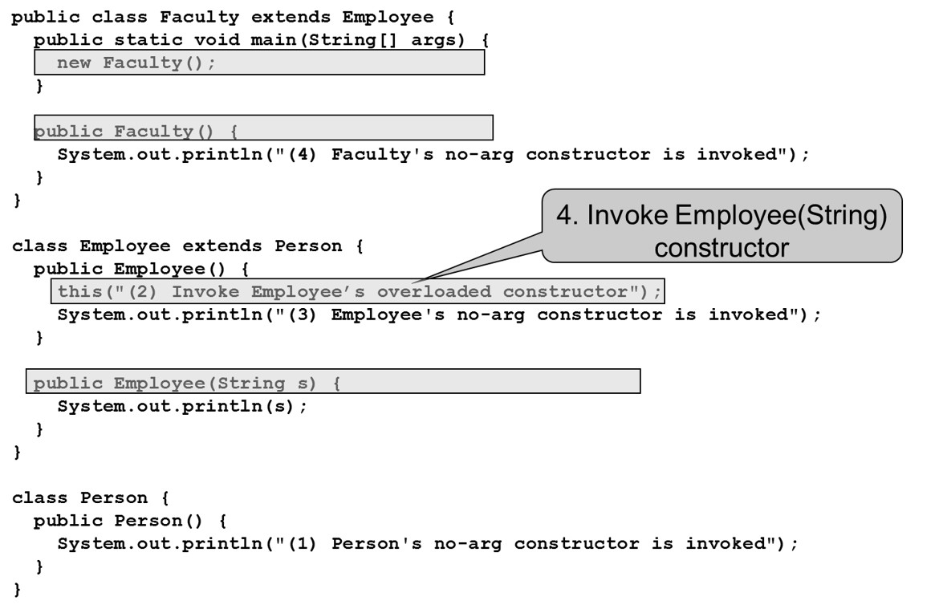
Trace Execution (4 of 9)
Notes:
It has 26 lines. Line 1, public class Faculty extends Employee open braces. Line 2, public static void main open parenthesis String open parenthesis close parenthesis args close parenthesis open braces. Line 3, new Faculty open parenthesis close parenthesis semicolon. Line 4, close braces. Line 5, Blank. Line 6, public Faculty open parenthesis close parenthesis open braces. Line 7, System period out period print ln open parenthesis double quote open parenthesis 4 close parenthesis Faculty's no hyphen arg constructor is invoked double quote close parenthesis semicolon. Line 8, close braces. Line 9, close braces. Line 10, blank. Line 11, class Employee extends Person open braces. Line 12, public employee open parenthesis close parenthesis open braces. Line 13, this open parenthesis double quote open parenthesis 2 close parenthesis Invoke Employee's overloaded constructor double quote close parenthesis semicolon and this line shows the Invoke Employee open parenthesis String close parenthesis constructor. Line 14, System period out period print ln open parenthesis double quote open parenthesis 3 close parenthesis Employee's no hyphen arg constructor is invoked double quote close parenthesis semicolon. Line 15, close braces. Line 16, blank. Line 17, public Employee open parenthesis String s close parenthesis open braces. Line 18, System period out period print ln open parenthesis s close parenthesis semicolon. Line 19, close braces. Line 20, close braces. Line 21, blank. Line 22, class Person open braces. Line 23, public Person open parenthesis close parenthesis open braces. Line 24, System period out period print ln open parenthesis double quote open parenthesis 1 close parenthesis Person's no hyphen arg constructor is invoked double quote close parenthesis semicolon. Line 25, close braces. Line 26, close braces.

Slide 18
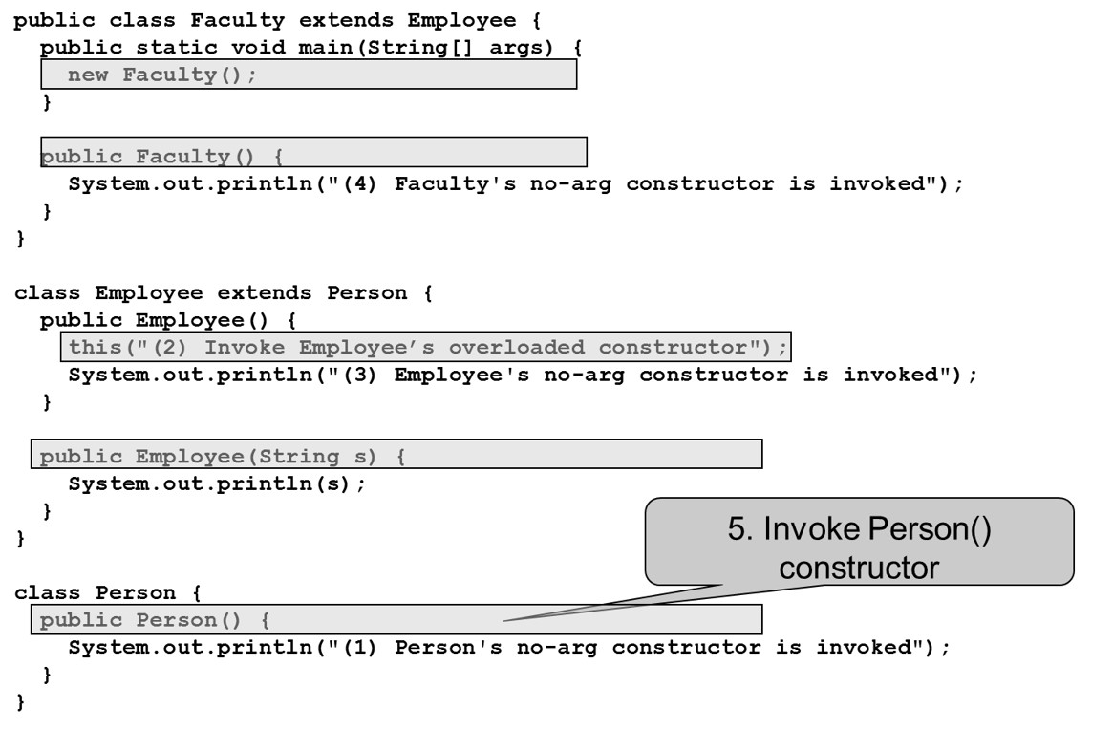
Trace Execution (5 of 9)
Notes:
It has 26 lines. Line 1, public class Faculty extends Employee open braces. Line 2, public static void main open parenthesis String open parenthesis close parenthesis args close parenthesis open braces. Line 3, new Faculty open parenthesis close parenthesis semicolon. Line 4, close braces. Line 5, Blank. Line 6, public Faculty open parenthesis close parenthesis open braces. Line 7, System period out period print ln open parenthesis double quote open parenthesis 4 close parenthesis Faculty's no hyphen arg constructor is invoked double quote close parenthesis semicolon. Line 8, close braces. Line 9, close braces. Line 10, blank. Line 11, class Employee extends Person open braces. Line 12, public employee open parenthesis close parenthesis open braces. Line 13, this open parenthesis double quote open parenthesis 2 close parenthesis Invoke Employee's overloaded constructor double quote close parenthesis semicolon. Line 14, System period out period print ln open parenthesis double quote open parenthesis 3 close parenthesis Employee's no hyphen arg constructor is invoked double quote close parenthesis semicolon. Line 15, close braces. Line 16, blank. Line 17, public Employee open parenthesis String s close parenthesis open braces. Line 18, System period out period print ln open parenthesis s close parenthesis semicolon. Line 19, close braces. Line 20, close braces. Line 21, blank. Line 22, class Person open braces. Line 23, public Person open parenthesis close parenthesis open braces and this line shows the Invoke Person open parenthesis close parenthesis constructor. Line 24, System period out period print ln open parenthesis double quote open parenthesis 1 close parenthesis Person's no hyphen arg constructor is invoked double quote close parenthesis semicolon. Line 25, close braces. Line 26, close braces.

Slide 19
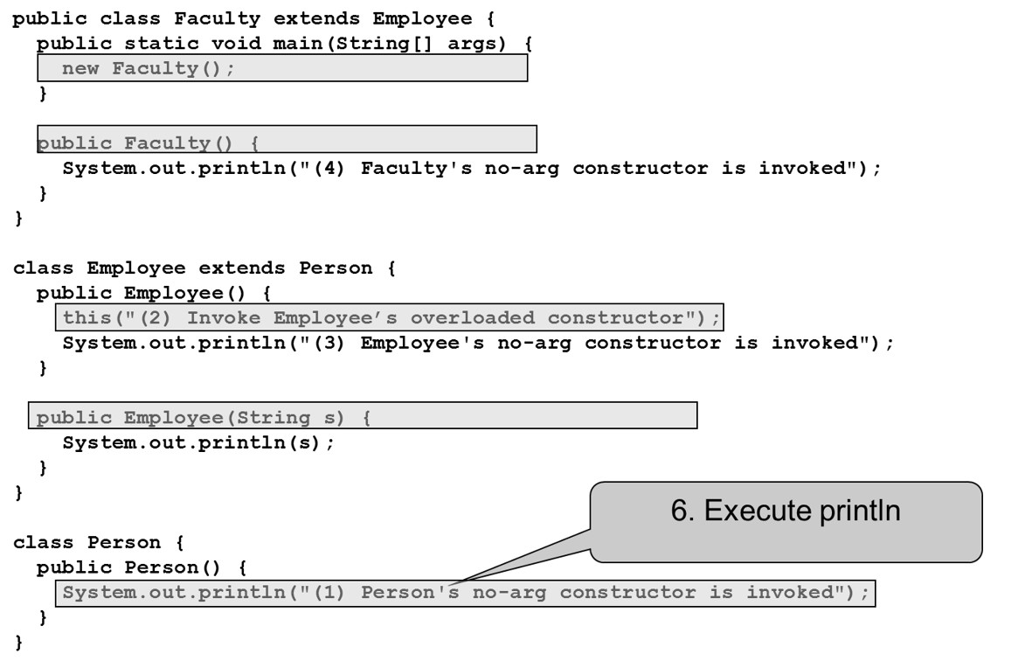
Trace Execution (6 of 9)
Notes:
It has 26 lines. Line 1, public class Faculty extends Employee open braces. Line 2, public static void main open parenthesis String open parenthesis close parenthesis args close parenthesis open braces. Line 3, new Faculty open parenthesis close parenthesis semicolon. Line 4, close braces. Line 5, Blank. Line 6, public Faculty open parenthesis close parenthesis open braces. Line 7, System period out period print ln open parenthesis double quote open parenthesis 4 close parenthesis Faculty's no hyphen arg constructor is invoked double quote close parenthesis semicolon. Line 8, close braces. Line 9, close braces. Line 10, blank. Line 11, class Employee extends Person open braces. Line 12, public employee open parenthesis close parenthesis open braces. Line 13, this open parenthesis double quote open parenthesis 2 close parenthesis Invoke Employee's overloaded constructor double quote close parenthesis semicolon. Line 14, System period out period print ln open parenthesis double quote open parenthesis 3 close parenthesis Employee's no hyphen arg constructor is invoked double quote close parenthesis semicolon. Line 15, close braces. Line 16, blank. Line 17, public Employee open parenthesis String s close parenthesis open braces. Line 18, System period out period print ln open parenthesis s close parenthesis semicolon. Line 19, close braces. Line 20, close braces. Line 21, blank. Line 22, class Person open braces. Line 23, public Person open parenthesis close parenthesis open braces. Line 24, System period out period print ln open parenthesis double quote open parenthesis 1 close parenthesis Person's no hyphen arg constructor is invoked double quote close parenthesis semicolon and this line shows the Execute print ln. Line 25, close braces. Line 26, close braces.

Slide 20
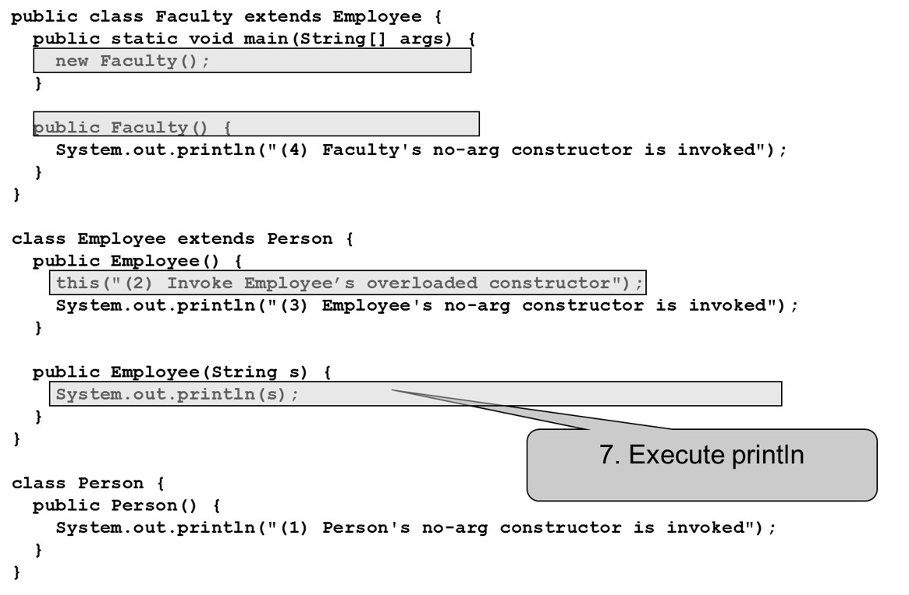
Trace Execution (7 of 9)
Notes:
It has 26 lines. Line 1, public class Faculty extends Employee open braces. Line 2, public static void main open parenthesis String open parenthesis close parenthesis args close parenthesis open braces. Line 3, new Faculty open parenthesis close parenthesis semicolon. Line 4, close braces. Line 5, Blank. Line 6, public Faculty open parenthesis close parenthesis open braces. Line 7, System period out period print ln open parenthesis double quote open parenthesis 4 close parenthesis Faculty's no hyphen arg constructor is invoked double quote close parenthesis semicolon. Line 8, close braces. Line 9, close braces. Line 10, blank. Line 11, class Employee extends Person open braces. Line 12, public employee open parenthesis close parenthesis open braces. Line 13, this open parenthesis double quote open parenthesis 2 close parenthesis Invoke Employee's overloaded constructor double quote close parenthesis semicolon. Line 14, System period out period print ln open parenthesis double quote open parenthesis 3 close parenthesis Employee's no hyphen arg constructor is invoked double quote close parenthesis semicolon. Line 15, close braces. Line 16, blank. Line 17, public Employee open parenthesis String s close parenthesis open braces. Line 18, System period out period print ln open parenthesis s close parenthesis semicolon and this line shows the Execute print ln. Line 19, close braces. Line 20, close braces. Line 21, blank. Line 22, class Person open braces. Line 23, public Person open parenthesis close parenthesis open braces. Line 24, System period out period print ln open parenthesis double quote open parenthesis 1 close parenthesis Person's no hyphen arg constructor is invoked double quote close parenthesis semicolon. Line 25, close braces. Line 26, close braces.

Slide 21
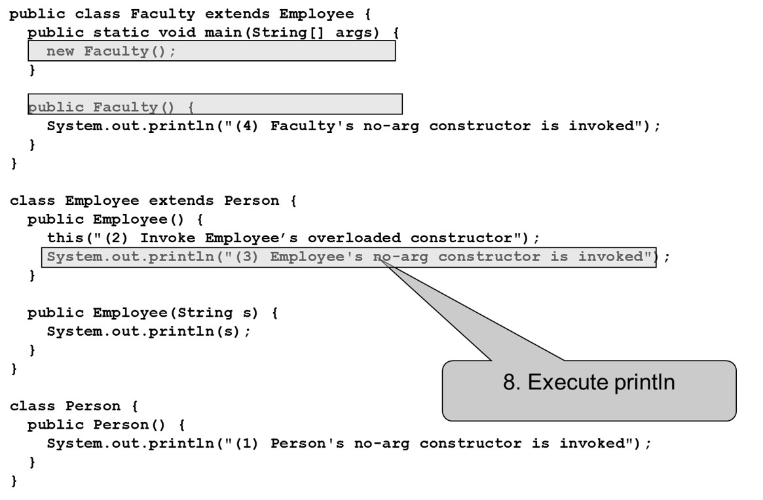
Trace Execution (8 of 9)
Notes:
The computer code has 26 lines. Line 1, public class Faculty extends Employee open braces. Line 2, public static void main open parenthesis String open parenthesis close parenthesis args close parenthesis open braces. Line 3, new Faculty open parenthesis close parenthesis semicolon. Line 4, close braces. Line 5, Blank. Line 6, public Faculty open parenthesis close parenthesis open braces. Line 7, System period out period print ln open parenthesis double quote open parenthesis 4 close parenthesis Faculty's no hyphen arg constructor is invoked double quote close parenthesis semicolon. Line 8, close braces. Line 9, close braces. Line 10, blank. Line 11, class Employee extends Person open braces. Line 12, public employee open parenthesis close parenthesis open braces. Line 13, this open parenthesis double quote open parenthesis 2 close parenthesis Invoke Employee's overloaded constructor double quote close parenthesis semicolon. Line 14, System period out period print ln open parenthesis double quote open parenthesis 3 close parenthesis Employee's no hyphen arg constructor is invoked double quote close parenthesis semicolon and this line shows the Execute print ln. Line 15, close braces. Line 16, blank. Line 17, public Employee open parenthesis String s close parenthesis open braces. Line 18, System period out period print ln open parenthesis s close parenthesis semicolon. Line 19, close braces. Line 20, close braces. Line 21, blank. Line 22, class Person open braces. Line 23, public Person open parenthesis close parenthesis open braces. Line 24, System period out period print ln open parenthesis double quote open parenthesis 1 close parenthesis Person's no hyphen arg constructor is invoked double quote close parenthesis semicolon. Line 25, close braces. Line 26, close braces.

Slide 22
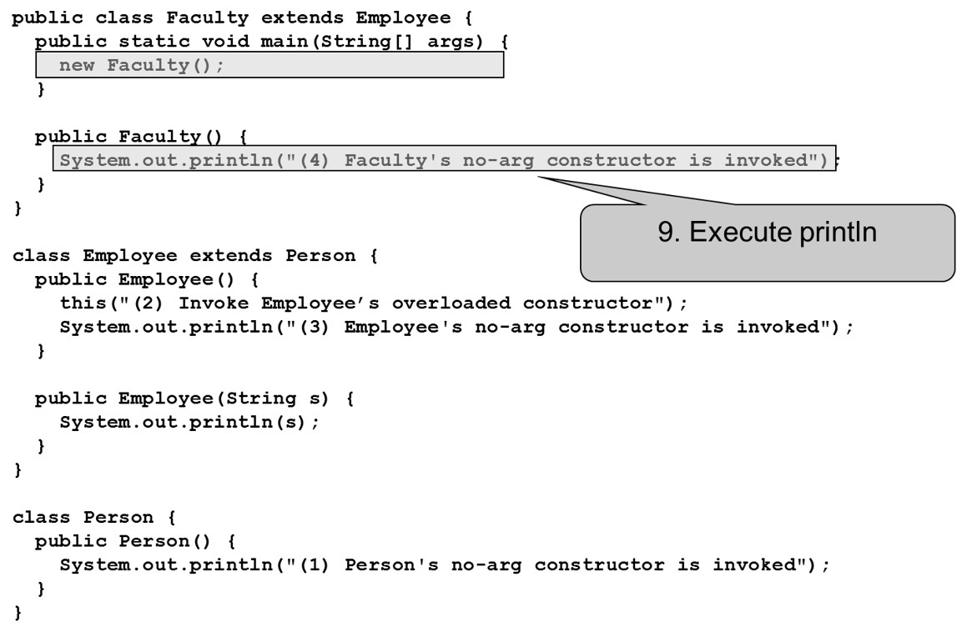
Trace Execution (9 of 9)
Notes:
The computer code has 26 lines. Line 1, public class Faculty extends Employee open braces. Line 2, public static void main open parenthesis String open parenthesis close parenthesis args close parenthesis open braces. Line 3, new Faculty open parenthesis close parenthesis semicolon. Line 4, close braces. Line 5, Blank. Line 6, public Faculty open parenthesis close parenthesis open braces. Line 7, System period out period print ln open parenthesis double quote open parenthesis 4 close parenthesis Faculty's no hyphen arg constructor is invoked double quote close parenthesis semicolon and this line shows the Execute print ln. Line 8, close braces. Line 9, close braces. Line 10, blank. Line 11, class Employee extends Person open braces. Line 12, public employee open parenthesis close parenthesis open braces. Line 13, this open parenthesis double quote open parenthesis 2 close parenthesis Invoke Employee's overloaded constructor double quote close parenthesis semicolon. Line 14, System period out period print ln open parenthesis double quote open parenthesis 3 close parenthesis Employee's no hyphen arg constructor is invoked double quote close parenthesis semicolon. Line 15, close braces. Line 16, blank. Line 17, public Employee open parenthesis String s close parenthesis open braces. Line 18, System period out period print ln open parenthesis s close parenthesis semicolon. Line 19, close braces. Line 20, close braces. Line 21, blank. Line 22, class Person open braces. Line 23, public Person open parenthesis close parenthesis open braces. Line 24, System period out period print ln open parenthesis double quote open parenthesis 1 close parenthesis Person's no hyphen arg constructor is invoked double quote close parenthesis semicolon. Line 25, close braces. Line 26, close braces.

Slide 23
Example on the Impact of a Superclass Without no-arg Constructor
Find out the errors in the program:
public class Apple extends Fruit {
}
class Fruit {
public Fruit(String name) {
System.out.println("Fruit's constructor is
invoked");
}
}

Slide 24
Defining a Subclass
A subclass inherits from a superclass. You can also:
Add new properties
Add new methods
Override the methods of the superclass

Slide 25
Calling Superclass Methods
You could rewrite the printCircle() method in the Circle class as follows:
public void printCircle() {
System.out.println("The circle is created " +
super.getDateCreated() + " and the radius is " + radius);
}

Slide 26
Check Point
What is the ouput of running the class C in (a)?
What problem arises in compiling the program in (b)?
class A { public A() { System.out.println( "A's no-arg constructor is invoked"); } }
class B extends A { }
public class C { public static void main(String[] args) { B b = new B(); } }
class A { public A(int x) { } } class B extends A { public B() { } } public class C { public static void main(String[] args) { B b = new B(); } }
a
b
Notes:
a. A’s no-arg constructor is invoked
b. The default constructor of B attempts to invoke the default of constructor of A, but class A's default constructor is not defined.

Slide 27
Overriding Methods in the Superclass
A subclass inherits methods from a superclass. Sometimes it is necessary for the subclass to modify the implementation of a method defined in the superclass. This is referred to as method overriding.
public class Circle extends GeometricObject {
// Other methods are omitted
/** Override the toString method defined in
GeometricObject */
public String toString() {
return super.toString() + "\nradius is " + radius;
}
}

Slide 28
Note (1 of 4)
An instance method can be overridden only if it is accessible. Thus a private method cannot be overridden, because it is not accessible outside its own class. If a method defined in a subclass is private in its superclass, the two methods are completely unrelated.

Slide 29
Note (2 of 4)
Like an instance method, a static method can be inherited. However, a static method cannot be overridden. If a static method defined in the superclass is redefined in a subclass, the method defined in the superclass is hidden.

Slide 30
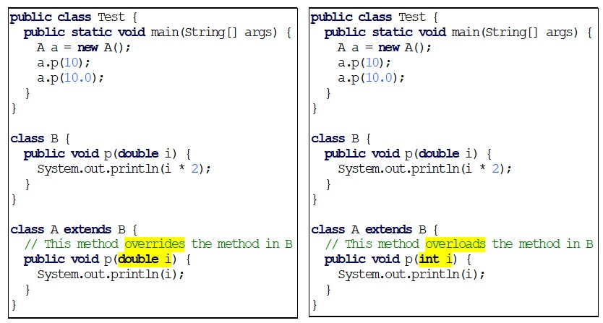
Overriding versus Overloading
Notes:
The computer code has 18 lines. Line 1, public class Test open braces. Line 2, public static void main open parenthesis String open parenthesis close parenthesis args close parenthesis open braces. Line 3, A a equal to new A open parenthesis close parenthesis semicolon. Line 4, a period p open parenthesis 10 close parenthesis semicolon. Line 5, a period p open parenthesis 10.0 close parenthesis semicolon. Line 6 close braces. Line 7, close braces. Line 8, class B open braces. Line 9, public void p open parenthesis double i close parenthesis open braces. Line 10, System period out period print ln open parenthesis i address 2 close parenthesis semicolon. Line 11, close braces. Line 12, close braces. Line 13, class A extends B open braces. Line 13, slash forward slash forward This method overrides the method in B. Line 14, public void p open parenthesis double i close parenthesis open braces. Line 15, System period out period print ln open parenthesis i close parenthesis semicolon. Line 16, close braces. Line 17, close braces. A right side computer code shows the Overriding vs. Overloading. The computer code has 18 lines. Line 1, public class Test open braces. Line 2, public static void main open parenthesis String open parenthesis close parenthesis args close parenthesis open braces. Line 3, A a equal to new A open parenthesis close parenthesis semicolon. Line 4, a period p open parenthesis 10 close parenthesis semicolon. Line 5, a period p open parenthesis 10.0 close parenthesis semicolon. Line 6 close braces. Line 7, close braces. Line 8, class B open braces. Line 9, public void p open parenthesis double i close parenthesis open braces. Line 10, System period out period print ln open parenthesis i address 2 close parenthesis semicolon. Line 11, close braces. Line 12, close braces. Line 13, class A extends B open braces. Line 13, slash forward slash forward This method overloads the method in B. Line 14, public void p open parenthesis print i close parenthesis open braces. Line 15, System period out period print ln open parenthesis i close parenthesis semicolon. Line 16, close braces. Line 17, close braces.

Slide 31
public class Circle { private double radius; public Circle(double radius) { radius = radius; } public double getRadius() { return radius; } public double getArea() { return radius * radius * Math.PI; } }
class B extends Circle { private double length; B(double radius, double length) { Circle(radius); length = length; } @Override public double getArea() { return getArea() * length; } }

Slide 32
Check Point
If a method in a subclass has the same signature as a method in its superclass with the same return type, is the method overridden or overloaded?
If a method in a subclass has the same signature as a method in its superclass with a different return type, will this be a problem?
If a method in a subclass has the same name as a method in its superclass with different parameter types, is the method overridden or overloaded?

Slide 33

The Object Class and Its Methods
Every class in Java is descended from the java.lang.Object class. If no inheritance is specified when a class is defined, the superclass of the class is Object.
Notes:
The computer code has 3 lines. Line 1, public class Circle open braces. Line 2, period period period. Line 3, close braces and this box is equivalent to right hand side text box. A right side computer code shows the Object Class. The computer code has 3 lines. Line 1, public class Circle extends Object open braces. Line 2, period period period. Line 3, close braces.

Slide 34
The toString() Method in Object
The toString() method returns a string representation of the object. The default implementation returns a string consisting of a class name of which the object is an instance, the at sign (@), and a number representing this object.
Loan loan = new Loan();
System.out.println(loan.toString());
The code displays something like Loan@15037e5 . This message is not very helpful or informative. Usually you should override the toString method so that it returns a digestible string representation of the object.

Slide 35
Polymorphism
Polymorphism means that a variable of a supertype can refer to a subtype object.
A class defines a type. A type defined by a subclass is called a subtype, and a type defined by its superclass is called a supertype. Therefore, you can say that Circle is a subtype of GeometricObject and GeometricObject is a supertype for Circle.
PolymorphismDemo
Notes:
PolymorphismDemo: https://liveexample.pearsoncmg.com/html/PolymorphismDemo.html

Slide 36
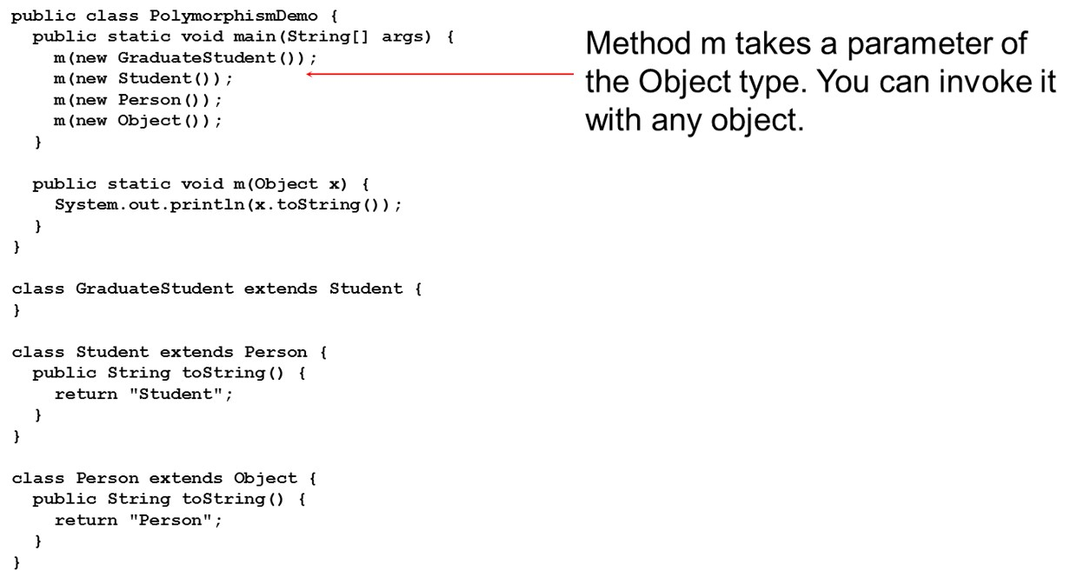
Polymorphism, Dynamic Binding and Generic Programming (1 of 2)
DynamicBindingDemo
Notes:
The computer code has 23 lines. Line 1, public class Polymorphism Demo open braces. Line 2, public static void main open parenthesis String open parenthesis close parenthesis args close parenthesis open braces. Line 3, m open parenthesis new Graduate open parenthesis close parenthesis close parenthesis semicolon. Line 4, m open parenthesis new Student open parenthesis close parenthesis close parenthesis semicolon. Line 5, m open parenthesis new Person open parenthesis close parenthesis close parenthesis semicolon. Line 6, m open parenthesis new Object open parenthesis close parenthesis open parenthesis semicolon. Line 7, close braces. Line 8, public static void m open parenthesis Object x close parenthesis open braces. Line 9, System period out period print ln open parenthesis x period to String open parenthesis close parenthesis close parenthesis semicolon. Line 10, close braces. Line 11, close braces. Line 12 class Graduate Student extends Student open braces. Line 13, close braces. Line 14, class Student extends Person open braces. Line 15, public String to String open parenthesis close parenthesis open braces. Line 16, return double quote Student double quote semicolon. Line 17, close braces. Line 18, close braces. Line 19, class Person extends Object open braces. Line 19, public String to String open parenthesis close parenthesis open braces. Lime 20, return double quote Person double quote semicolon. Line 21, close braces. Line 22, close braces.
DynamicBindingDemo: https://liveexample.pearsoncmg.com/html/DynamicBindingDemo.html

Slide 37
Polymorphism, Dynamic Binding and Generic Programming (2 of 2)
An object of a subtype can be used wherever its supertype value is required. This feature is known as polymorphism.
When the method m(Object x) is executed, the argument x’s toString method is invoked. x may be an instance of GraduateStudent, Student, Person, or Object. Classes GraduateStudent, Student, Person, and Object have their own implementation of the toString method. Which implementation is used will be determined dynamically by the Java Virtual Machine at runtime. This capability is known as dynamic binding.

Slide 38
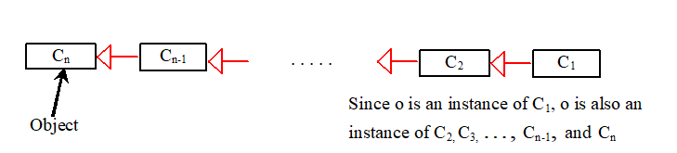
Dynamic Binding
Dynamic binding works as follows: Suppose an object o is an instance of
classes
where
is a subclass of
is a subclass of
is a subclass of
That is,
is the most
general class, and
is the most specific class. In Java,
is the Object
class. If o invokes a method p, the J V M searches the implementation for the
method p in
in this order, until it is found. Once an
implementation is found, the search stops and the first-found implementation is invoked.
Notes:
1st box is for C(n) and it signifies Object. 2nd box is for C(n-1) and it makes an arrow forward to represent the 1st box that is for C(n). 3rd box is for C(2) and it's also makes an arrow forward to represent the forward series. 4th box is for C(1) and it's also makes an arrow forward to represent the Box 3rd which is for C(1).

Slide 39
Method Matching versus Binding
Matching a method signature and binding a method implementation are two issues. The compiler finds a matching method according to parameter type, number of parameters, and order of the parameters at compilation time. A method may be implemented in several subclasses. The Java Virtual Machine dynamically binds the implementation of the method at runtime.

Slide 40
Check Point
What is wrong in the following code
public class Test { public static void main(String[] args) { Integer[] list1 = {12, 24, 55, 1}; Double[] list2 = {12.4, 24.0, 55.2, 1.0}; int[] list3 = {1, 2, 3}; printArray(list1); printArray(list2); printArray(list3); } public static void printArray(Object[] list) { for (Object o: list) System.out.print(o + " "); System.out.println(); } }
Notes:
printArray(list3) → error: int[] array can not be assigned to Object[]

Slide 41
What is the output of the following code:
public class Test { public static void main(String[] args) { new Person().printPerson(); new Student().printPerson(); } } class Student extends Person { @Override public String getInfo() { return "Student"; } } class Person { public String getInfo() { return "Person"; } public void printPerson() { System.out.println(getInfo()); } }
public class Test { public static void main(String[] args) { new Person().printPerson(); new Student().printPerson(); } } class Student extends Person { private String getInfo() { return "Student"; } } class Person { private String getInfo() { return "Person"; } public void printPerson() { System.out.println(getInfo()); } }
a
b
Notes:
Person student
Person person

Slide 42
Generic Programming (1 of 2)
public class PolymorphismDemo {
public static void main(String[] args) {
m(new GraduateStudent());
m(new Student());
m(new Person());
m(new Object());
}
public static void m(Object x) {
System.out.println(x.toString());
}
}
class GraduateStudent extends Student {
}
class Student extends Person {
public String toString() {
return "Student";
}
}
class Person extends Object {
public String toString() {
return "Person";
}
}

Slide 43
Generic Programming (2 of 2)
Polymorphism allows methods to be used generically for a wide range of object arguments. This is known as generic programming. If a method’s parameter type is a superclass (e.g., Object), you may pass an object to this method of any of the parameter’s subclasses (e.g., Student or String). When an object (e.g., a Student object or a String object) is used in the method, the particular implementation of the method of the object that is invoked (e.g., toString) is determined dynamically.

Slide 44
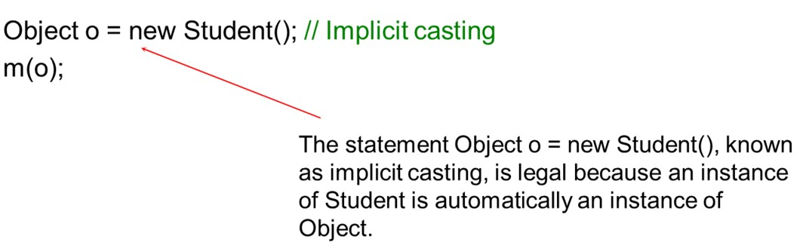
Casting Objects
You have already used the casting operator to convert variables of one primitive type to another. Casting can also be used to convert an object of one class type to another within an inheritance hierarchy. In the preceding section, the statement
m(new Student());
assigns the object new Student() to a parameter of the Object type. This statement is equivalent to:
Notes:
Object o = new Student left parenthesis left parenthesis is labeled, the statement Object o = new Student left parenthesis left parenthesis, known as implicit casting, is legal because an instance of Student is automatically an instance of Object.

Slide 45
Why Casting Is Necessary?
Suppose you want to assign the object reference o to a variable of the Student type using the following statement:
Student b = o;
A compile error would occur. Why does the statement Object o = new Student() work and the statement Student b = o doesn’t? This is because a Student object is always an instance of Object, but an Object is not necessarily an instance of Student. Even though you can see that o is really a Student object, the compiler is not so clever to know it. To tell the compiler that o is a Student object, use an explicit casting. The syntax is similar to the one used for casting among primitive data types. Enclose the target object type in parentheses and place it before the object to be cast, as follows:
Student b = (Student)o; // Explicit casting

Slide 46
Casting From Superclass to Subclass
Explicit casting must be used when casting an object from a superclass to a subclass. This type of casting may not always succeed.
Apple x = (Apple)fruit;
Orange x = (Orange)fruit;

Slide 47
The instanceof Operator
Use the instanceof operator to test whether an object is an instance of a class:
Object myObject = new Circle();
... // Some lines of code
/** Perform casting if myObject is an instance of Circle */
if (myObject instanceof Circle) {
System.out.println("The circle diameter is " +
((Circle)myObject).getDiameter());
...
}

Slide 48
Java 16 instanceof Pattern Matching
When using the if statement to test if an object is an instance of a class, you can specify a binding variable. If the result of the instanceof operator is true, then the object being tested is assigned to the binding variable. This new syntax, known as instanceof pattern matching, became a standard feature since Java 16. You can simplify the code in lines 15-24 using this new feature as follows:

Slide 49
Java 16 New Features on instanceof
if (myObject instanceof Circle circle) {
System.out.println("The circle area is " +
circle.getArea());
System.out.println("The circle diameter is " +
circle.getDiameter());
}
else if (myObject instanceof Rectangle rectangle) {
System.out.println("The rectangle area is " +
rectangle.getArea());
}

Slide 50
Tip
To help understand casting, you may also consider the analogy of fruit, apple, and orange with the Fruit class as the superclass for Apple and Orange. An apple is a fruit, so you can always safely assign an instance of Apple to a variable for Fruit. However, a fruit is not necessarily an apple, so you have to use explicit casting to assign an instance of Fruit to a variable of Apple.

Slide 51
Example: Demonstrating Polymorphism and Casting
This example creates two geometric objects: a circle, and a rectangle, invokes the displayGeometricObject method to display the objects. The displayGeometricObject displays the area and diameter if the object is a circle, and displays area if the object is a rectangle.
CastingDemo
Notes:
CastingDemo: https://liveexample.pearsoncmg.com/html/CastingDemo.html

Slide 52
The equals Method
The equals() method compares the contents of two objects. The default implementation of the equals method in the Object class is as follows:
public boolean equals(Object obj){
return this == obj;
}
For example, the equals method is overridden in the Circle class.
public boolean equals(Object o) {
if (o instanceof Circle) {
return radius ==((Circle)o).radius;
}
else
return false;
}

Slide 53
Note (3 of 4)
The == comparison operator is used for comparing two primitive data type values or for determining whether two objects have the same references. The equals method is intended to test whether two objects have the same contents, provided that the method is modified in the defining class of the objects. The == operator is stronger than the equals method, in that the == operator checks whether the two reference variables refer to the same object.

Slide 54
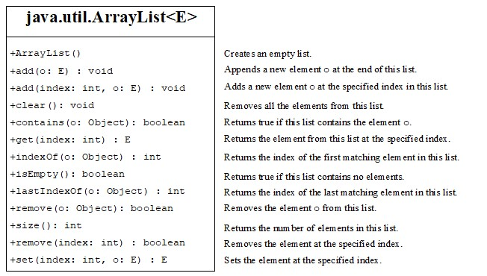
The ArrayList Class
You can create an array to store objects. But the array’s size is fixed once the array is created. Java provides the ArrayList class that can be used to store an unlimited number of objects.
Notes:
The computer code has 2 rows. Row 1, shows the java period util period Array List less than E greater than. Row 2, has 13 lines. Line 1, plus Array List open parenthesis close parenthesis. Line 2, plus add open parenthesis o colon E close parenthesis colon void. Line 3, plus add open parenthesis index colon int comma o colon E close parenthesis colon void. Line 4, plus clear open parenthesis close parenthesis colon void. Line 5, plus contains open parenthesis o colon Object close parenthesis colon Boolean. Line 6, plus get open parenthesis index colon int close parenthesis int. Line 7, plus index Of open parenthesis o colon Object close parenthesis colon int. Line 8, plus is Empty open parenthesis close parenthesis colon Boolean. Line 9, plus last Index Of open parenthesis o colon Object close parenthesis colon int. Line 10, plus remove open parenthesis o colon Object close parenthesis colon Boolean. Line 11, plus size open parenthesis close parenthesis colon int. Line 12, plus remove open parenthesis index colon int close parenthesis colon Boolean. Line 13, plus set open parenthesis index colon int comma o colon E close parenthesis colon E.

Slide 55
Generic Type
ArrayList is known as a generic class with a generic type E. You can specify a concrete type to replace E when creating an ArrayList. For example, the following statement creates an ArrayList and assigns its reference to variable cities. This ArrayList object can be used to store strings.
ArrayList<String> cities = new ArrayList<String>();
ArrayList<String> cities = new ArrayList<>();
TestArrayList
Notes:
TestArrayList: https://liveexample.pearsoncmg.com/html/TestArrayList.html

Slide 56
Differences and Similarities Between Arrays and ArrayList
Operation | Array | ArrayList
Creating an array/ArrayList | String[] a = new String[10] | ArrayList<String> list = new ArrayList<>();
Accessing an element | a[index] | list.get(index);
Updating an element | a[index] = "London"; | list.set(index, "London");
Returning size | a.length | list.size();
Adding a new element | Blank | list.add("London");
Inserting a new element | Blank | list.add(index, "London");
Removing an element | Blank | list.remove(index);
Removing an element | Blank | list.remove(Object);
Removing all elements | Blank | list.clear();
DistinctNumbers
Notes:
DistinctNumbers: https://liveexample.pearsoncmg.com/html/DistinctNumbers.html

Slide 57
Array Lists From/to Arrays
Creating an ArrayList from an array of objects:
String[] array = {"red", "green", "blue"};
ArrayList<String> list = new ArrayList<>(Arrays.asList(array));
Creating an array of objects from an ArrayList:
String[] array1 = new String[list.size()];
list.toArray(array1);

Slide 58
max and min in an Array List
String[] array = {"red", "green", "blue"};
System.out.pritnln(java.util.Collections.max(
new ArrayList<String>(Arrays.asList(array)));
String[] array = {"red", "green", "blue"};
System.out.pritnln(java.util.Collections.min(
new ArrayList<String>(Arrays.asList(array)));

Slide 59
Shuffling an Array List
Integer[] array = {3, 5, 95, 4, 15, 34, 3, 6, 5};
ArrayList<Integer> list = new
ArrayList<>(Arrays.asList(array));
java.util.Collections.shuffle(list);
System.out.println(list);

Slide 60
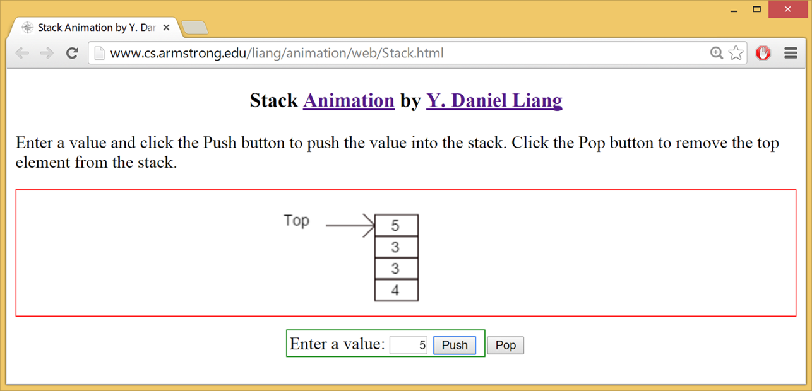
Stack Animation
https://liveexample.pearsoncmg.com/dsanimation/StackeBook.html
Notes:
https://liveexample.pearsoncmg.com/dsanimation/StackeBook.html

Slide 61
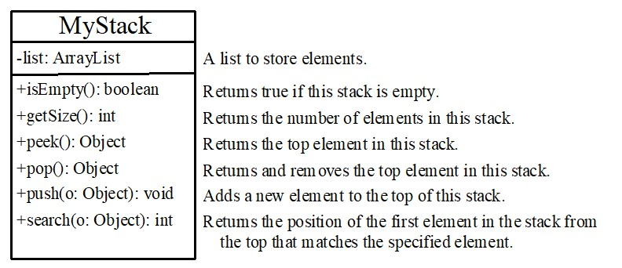
The MyStack Classes
A stack to hold objects.
MyStack
Notes:
MyStack: https://liveexample.pearsoncmg.com/html/MyStack.html
It has 3 rows. Row 1, shows the My Stack. Row 2, shows the one line coding that is minus list colon Array List. Row 3, shows the coding for 6 lines. Line 1, plus is Empty open parenthesis close parenthesis colon Boolean. Line 2, plus get Size open parenthesis close parenthesis colon int. Line 3, plus peek open parenthesis close parenthesis colon Object. Line 4, plus pop open parenthesis close parenthesis colon Object. Line 5, plus push open parenthesis o colon Object close parenthesis colon void. Line 6, plus search open parenthesis o colon Object close parenthesis colon int.

Slide 62
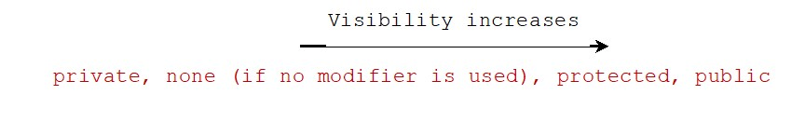
The protected Modifier
The protected modifier can be applied on data and methods in a class. A protected data or a protected method in a public class can be accessed by any class in the same package or its subclasses, even if the subclasses are in a different package.
private, default, protected, public

Slide 63
Accessibility Summary
Modifier on members in a class | Accessed from the same class | Accessed from the same package | Accessed from a subclass | Accessed from a different package
public | sign | sign | sign | sign
protected | sign | sign | sign | Blank
default | sign | sign | Blank | Blank
private | sign | Blank | Blank | Blank

Slide 64
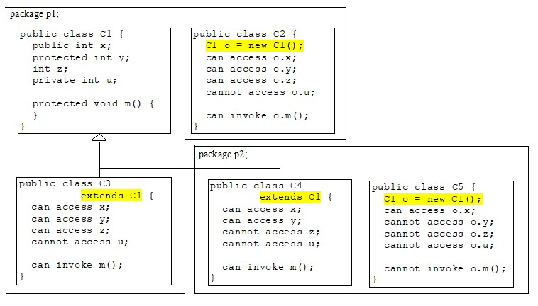
Visibility Modifiers
Notes:
It has divided into 2 parts that is package p1 and package p2. In the package p1 there are 3 boxes. Box 1,shows the coding for 8 lines. Line 1, public class C1 open braces. Line 2, public int x semicolon. Line 3, protected int y semicolon. Line 4, int z semicolon. Line 5, private int u semicolon. Line 6, protected void m open parenthesis close parenthesis open braces. Line 7, close braces. Line 8, close braces. Box 2, also shows the coding for 8 lines. Line 1, public class C2 open braces. Line 2, C1 o equal to new C1 open parenthesis close parenthesis semicolon. Line 3, can access o period x semicolon. Line 4, can access o period y semicolon. Line 5, can access o period z semicolon. Line 6, cannot access o period u semicolon. Line 7, can invoke o period m open parenthesis close parenthesis semicolon. Line 8, close braces. Box 3, also shows the coding for 8 lines. Line 1, public class C3. Line 2, extends C1 open braces. Line 3, can access x semicolon. Line 4, can access y semicolon. Lime 5, can access z semicolon. Line 6, cannot access u semicolon. Line 7, can invoke m open parenthesis close parenthesis semicolon. Line 8, close braces and this box makes an arrow which represent the Box 1 of package p1 and Box 1 of package p2. Now, in the package p2 has 2 boxes. Box 1, shows the coding for 8 lines. Line 1, public class C4. Line 2, extends C1 open braces. Line 3, can access x semicolon. Line 4, can access y semicolon. Line 5, cannot access z semicolon. Line 6, cannot access u semicolon. Line 7, can invoke m open parenthesis close parenthesis semicolon. Line 8, close braces. Box 2, also shows the coding for 8 lines. Line 1, public class C5 open braces. Line 2, C1 o equal to new C1 open parenthesis close parenthesis semicolon. Line 3, can access o period x semicolon. Line 4, cannot access o period y semicolon. Line 5, cannot access o period z semicolon. Line 6, cannot access o period u semicolon. Line 7, cannot invoke o period m open parenthesis close parenthesis semicolon. Line 8, close braces.

Slide 65
A Subclass Cannot Weaken the Accessibility
A subclass may override a protected method in its superclass and change its visibility to public. However, a subclass cannot weaken the accessibility of a method defined in the superclass. For example, if a method is defined as public in the superclass, it must be defined as public in the subclass.

Slide 66
Note (4 of 4)
The modifiers are used on classes and class members (data and methods), except that the final modifier can also be used on local variables in a method. A final local variable is a constant inside a method.

Slide 67
The final Modifier
The final class cannot be extended:
final class Math {
...
}
The final variable is a constant:
final static double PI = 3.14159;
The final method cannot be overridden by its subclasses.

