Slide 1
Sets and Maps

Slide 2
Motivations
The “No-Fly” list is a list, created and maintained by the U.S. government’s Terrorist Screening Center, of people who are not permitted to board a commercial aircraft for travel in or out of the United States. Suppose we need to write a program that checks whether a person is on the No-Fly list. You can use a list to store names in the No-Fly list. However, a more efficient data structure for this application is a set.
Suppose your program also needs to store detailed information about terrorists in the No-Fly list. The detailed information such as gender, height, weight, and nationality can be retrieved using the name as the key. A map is an efficient data structure for such a task.

Slide 3
Set abstract data type
A set is a collection of distinct elements. A set add operation adds an element to the set, provided an equal element doesn't already exist in the set. A set is an unordered collection. Ex: The set with integers 3, 7, and 9 is equivalent to the set with integers 9, 3 and 7.
A multiset (also known as a bag) is a set-like container that allows duplicates.

Slide 4
1
Which of the following is not a valid set?
{ 78, 32, 46, 57, 82 }
{ 34, 8, 92 }
{ 78, 28, 91, 28, 15 }
Correct
A set does not contain duplicates. { 78, 28, 91, 28, 15 } contains 28 twice and is therefore not a valid set.

Slide 5
Elements keys
Elements may be:
Primitive data type (wrapped as an object)
Strings
Objects (distinguish elements based on an element’s key value)

Slide 6
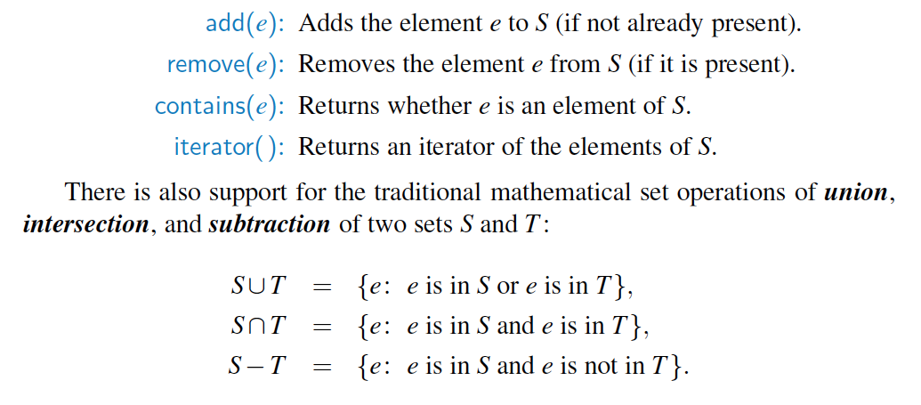
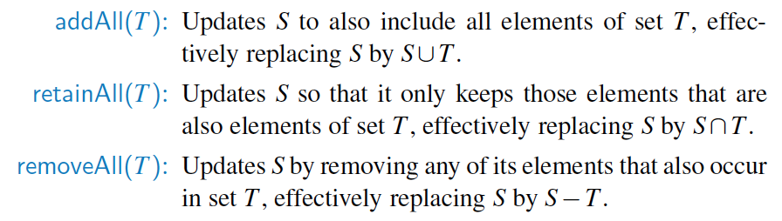
Set ADT

Slide 7
Set operations
The union of sets X and Y, denoted as X ∪ Y, is a set that contains every element from X, every element from Y, and no additional elements.
Ex: { 54, 19, 75 } ∪ { 75, 12 } = { 12, 19, 54, 75 }.
The intersection of sets X and Y, denoted as X ∩ Y, is a set that contains every element that is in both X and Y, and no additional elements.
Ex: { 54, 19, 75 } ∩ { 75, 12 } = { 75 }.
The difference of sets X and Y, denoted as X \ Y, is a set that contains every element that is in X but not in Y, and no additional elements.
Ex: { 54, 19, 75 } \ { 75, 12 } = { 54, 19 }.
The union and intersection operations are commutative, so X ∪ Y = Y ∪ X and X ∩ Y = Y ∩ X. The difference operation is not commutative.
Notes:
setUnion(set1, set2) {
result = Create new, empty set
for each (element in set1) {
Add element to result
}
for each (element in set2)
{
Add element to result
}
return result
}
setIntersection(set1, set2)
{
result = Create new, empty set
for each (element in set1)
{
if (setSearch(set2, element⇢key) != null)
{
Add element to result
}
}
return result
}
setDifference(set1, set2) {
result = Create new, empty set
for each (element in set1) {
if (SetSearch(set2, element⇢key) == null) {
Add element to result
}
}
return result
}

Slide 8
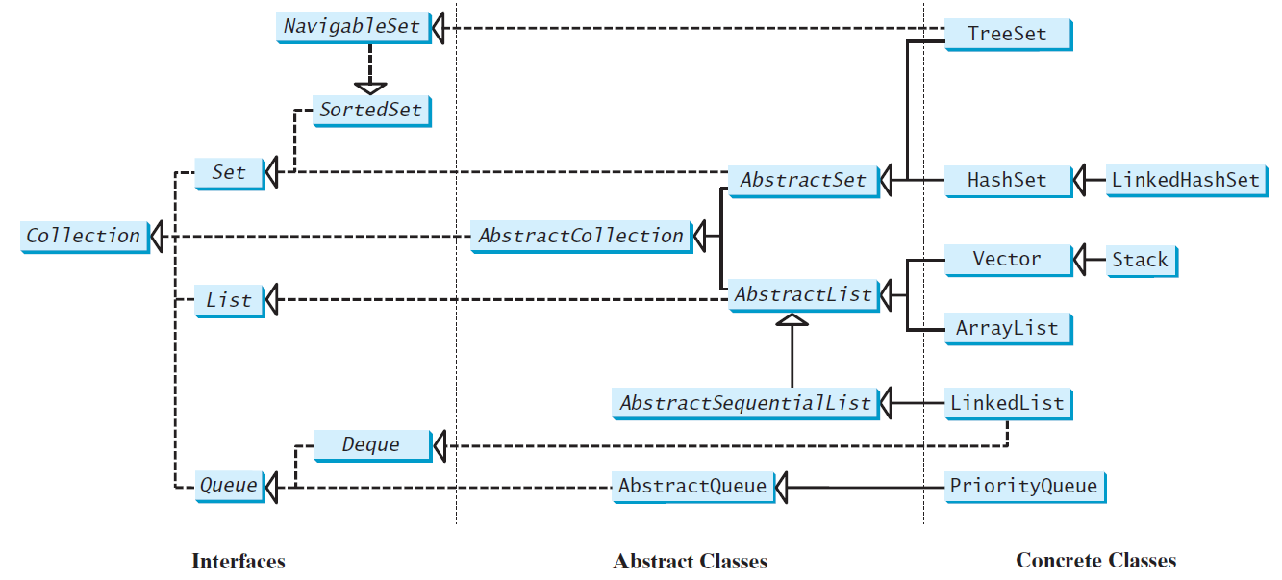
Review of Java Collection Framework hierarchy
Set and List are subinterfaces of Collection.
Notes:
The Set interface extends the Collection interface.
It does not introduce new methods or constants, but it stipulates that an instance of Set contains no duplicate elements.
The concrete classes that implement Set must ensure that no duplicate elements can be added to the set.
That is no two elements e1 and e2 can be in the set such that e1.equals(e2) is true.

Slide 9
The HashSet Class
The HashSet class is a concrete class that implements Set. It can be used to store duplicate-free elements. For efficiency, objects added to a hash set need to implement the hashCode method in a manner that properly disperses the hash code.

Slide 10
Example: Using HashSet and Iterator
This example creates a hash set filled with strings, and uses an iterator to traverse the elements in the list.
TestHashSet
Notes:
You can simplify the code in Lines 19-21 using a JDK 1.5 enhanced for loop without using an iterator, as follows:
for (Object element: set)
System.out.print(element.toString() + " ");

Slide 11
Example: Using LinkedHashSet
This example creates a hash set filled with strings, and uses an iterator to traverse the elements in the list.
TestLinkedHashSet

Slide 12
The SortedSet Interface and the TreeSet Class (
SortedSet is a subinterface of Set, which guarantees that the elements in the set are sorted. TreeSet is a concrete class that implements the SortedSet interface. You can use an iterator to traverse the elements in the sorted order. The elements can be sorted in two ways.
TestTreeSetSet

Slide 13
Case Study: Counting Keywords
This section presents an application that counts the number of the keywords in a Java source file.
CountKeywords

Slide 14
Maps

Slide 15

Dictionaries
When you want to look up …
The meaning of a word
An address
A phone number
A contact on your phone
These can be implemented in an ADT Dictionary
Notes:
Synonyms for ADT Dictionary
Map
Table
Associative array
An entry in the dictionary contains
Keyword, search key
Value

Slide 16
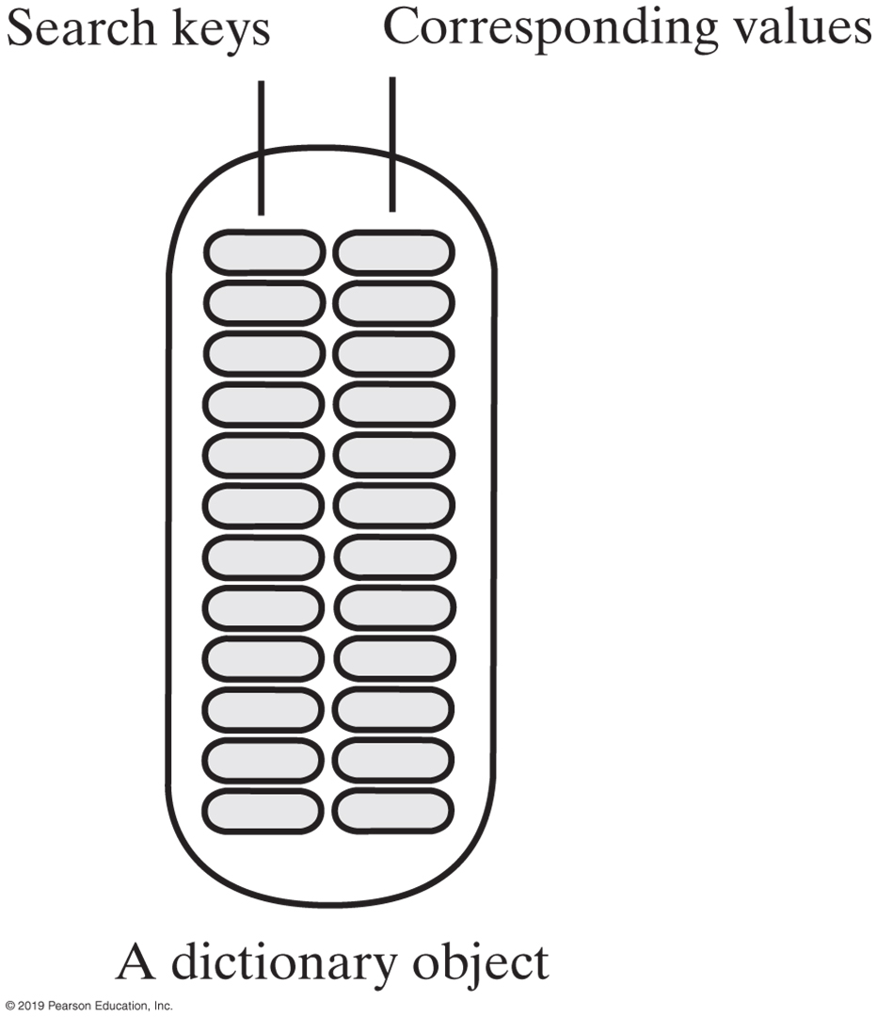
Specifications for the ADT Dictionary
Dictionary Data
Collection of pairs (k, v) of objects k and v,
k is the search key
v is the corresponding value
Number of pairs in the collection
Notes:
Map is a container object that stores a collection of key/value pairs.
It enables fast retrieval, deletion, and updating of the pair using key
Keys are like indexes
In list indexes are integers
In map key can be any object

Slide 17
Maps
A map models a searchable collection of key-value entries
The main operations of a map are for searching, inserting, and deleting items
Multiple entries with the same key are not allowed
Applications:
address book
student-record database

Slide 18
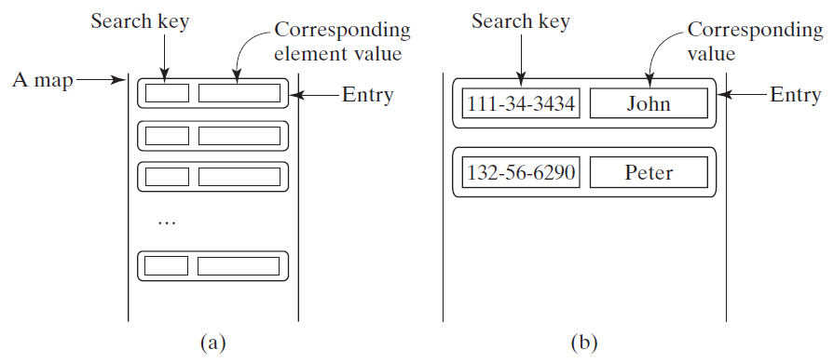
The Map Interface
The Map interface maps keys to the elements. The keys are like indexes. In List, the indexes are integer. In Map, the keys can be any objects.

Slide 19
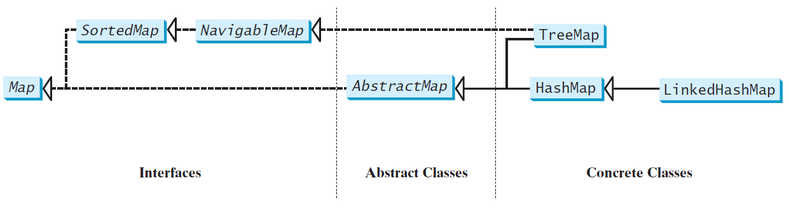
Map Interface and Class Hierarchy
An instance of Map represents a group of objects, each of which is associated with a key. You can get the object from a map using a key, and you have to use a key to put the object into the map.
Notes:
There are three types of maps:
HashMap, LinkedHashMap, and TreeMap.
Common features of the three are defined in the Map interface
Figure shows heir relationship

Slide 20
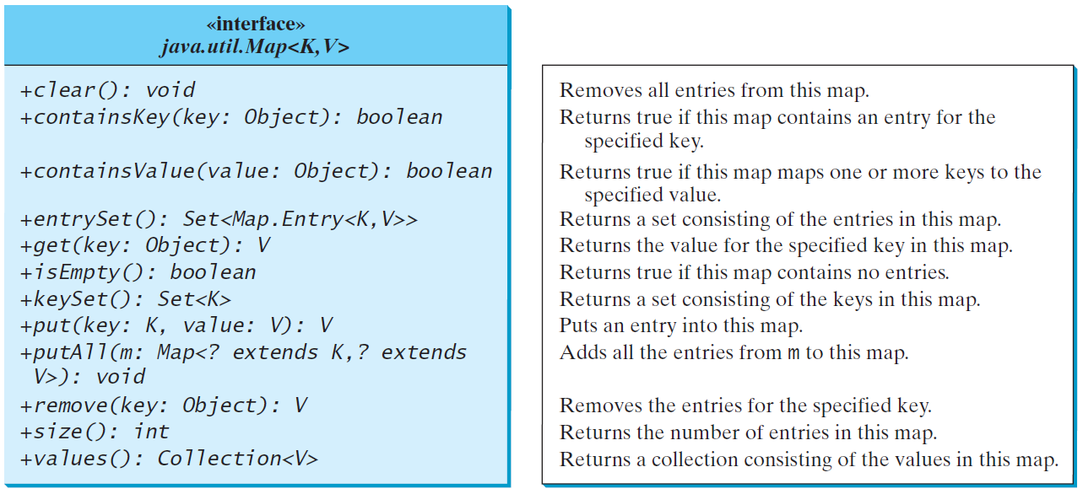
The Map Interface UML Diagram
Notes:
Map interface provides the methods for
Querying, updating, and getting a collection of values and a set of keys.
Update methods (clear, put, putAll, remove)
Query methods (containKey, containsValue, isEmpt, size)

Slide 21
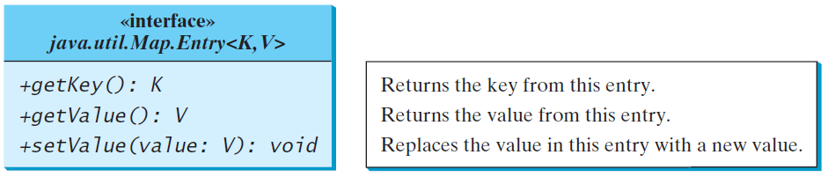
Entry
Notes:
Map.Entry interface operates on an entry in the map
Java 8 added a default forEach method in the Map interface

Slide 22
HashMap and TreeMap
The HashMap and TreeMap classes are two concrete implementations of the Map interface. The HashMap class is efficient for locating a value, inserting a mapping, and deleting a mapping. The TreeMap class, implementing SortedMap, is efficient for traversing the keys in a sorted order.

Slide 23
Example: Using HashMap and TreeMap
This example creates a hash map that maps borrowers to mortgages. The program first creates a hash map with the borrower’s name as its key and mortgage as its value. The program then creates a tree map from the hash map, and displays the mappings in ascending order of the keys.
TestMap

Slide 24
Case Study: Counting the Occurrences of Words in a Text
This program counts the occurrences of words in a text and displays the words and their occurrences in ascending order of the words. The program uses a hash map to store a pair consisting of a word and its count. For each word, check whether it is already a key in the map. If not, add the key and value 1 to the map. Otherwise, increase the value for the word (key) by 1 in the map. To sort the map, convert it to a tree map.
CountOccurrenceOfWords

