Slide 1
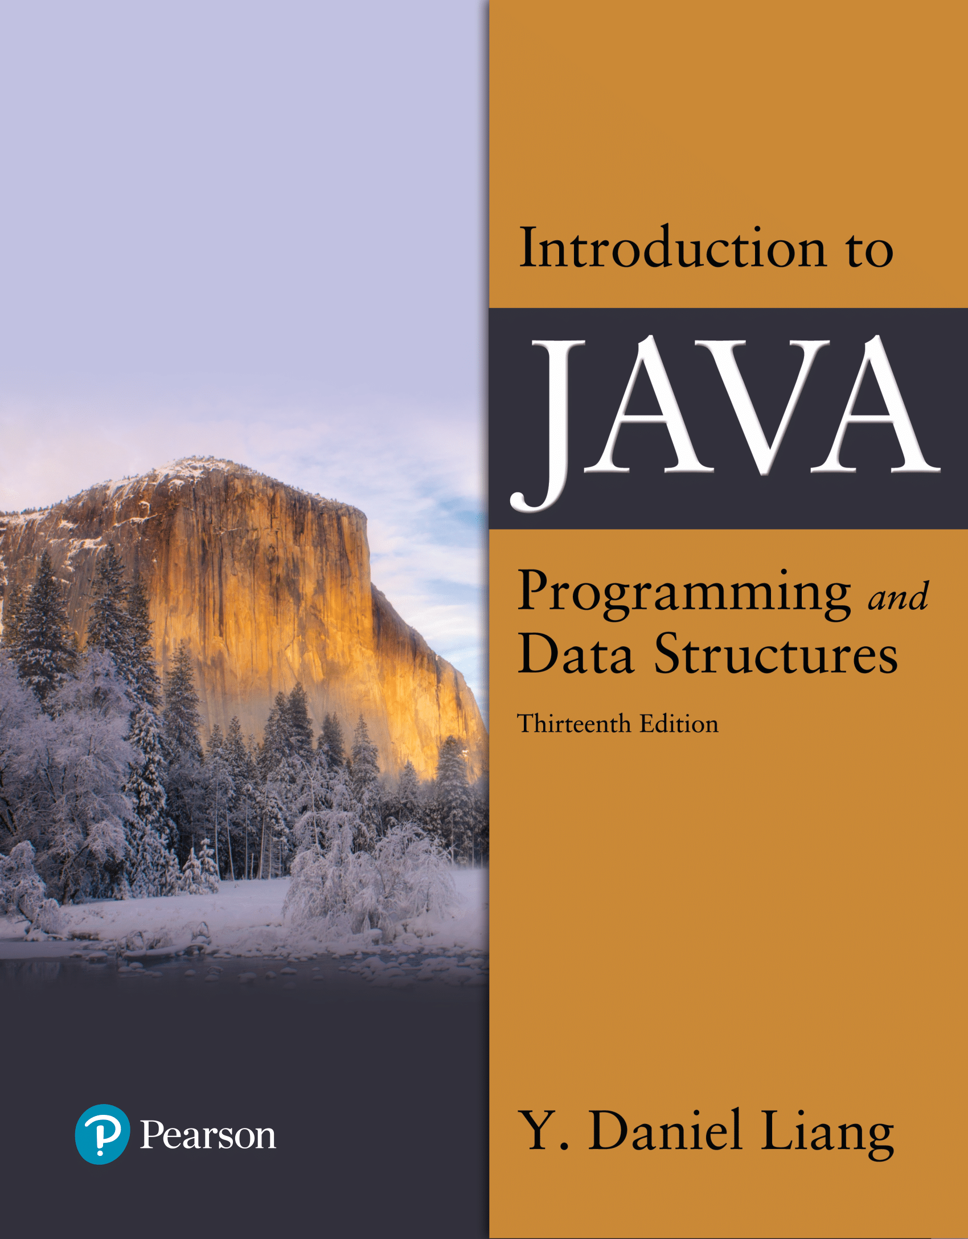

Introduction to Java Programming and Data Structures
Thirteenth Edition
Chapter 10
Thinking in Objects
Copyright © 2024 Pearson Education, Inc. All Rights Reserved
Notes:
If this PowerPoint presentation contains mathematical equations, you may need to check that your computer has the following installed:
1) MathType Plugin
2) Math Player (free versions available)
3) NVDA Reader (free versions available)
Slides in this presentation contain hyperlinks. JAWS users should be able to get a list of links by using INSERT+F7

Slide 2
Review: Objects and Classes Money Class
A Money object can be represented by the following UML:
Money
dollars : int cents : int (Must be 0 to 99)
+ Money() // default value 0.0 + Money(dollar : int, cent : int) + getDollars() : int + setDollars(dollar : int) : void + getCents() : int + SetCents(cent : int) : void + add(m : Money) : Money + subtract(m : Money) : Money // return null if m is greater than this object + equals(m : Money) : Boolean + compareTo(m : Money) : int + printList(list : Money[] , n : int) : void // print n values per line separated by 1 blank space + selectionSort(list : Money[]) : void // sort Money array using selection sort + max(list : Money[] ) : Money // return the largest Money object + toString() : String // format is: $#.##
Notes:
Implement the class.

Slide 3
Motivations
You see the advantages of object-oriented programming from the preceding chapter. This chapter will demonstrate how to solve problems using the object-oriented paradigm.

Slide 4
Class Abstraction and Encapsulation
Class abstraction means to separate class implementation from the use of the class. The creator of the class provides a description of the class and let the user know how the class can be used. The user of the class does not need to know how the class is implemented. The detail of implementation is encapsulated and hidden from the user.
Notes:
Next to this box is a box with text, class contacts (Signatures of public methods and public constants). There is a two way arrow between this box and a box to the right. The text in the box on the right reads, clients use the class through the contact of the class.

Slide 5
Object-Oriented Thinking
Chapters 1-8 introduced fundamental programming techniques for problem solving using loops, methods, and arrays. The studies of these techniques lay a solid foundation for object-oriented programming. Classes provide more flexibility and modularity for building reusable software. This section improves the solution for a problem introduced in Chapter 3 using the object-oriented approach. From the improvements, you will gain the insight on the differences between the procedural programming and object-oriented programming and see the benefits of developing reusable code using objects and classes.

Slide 6
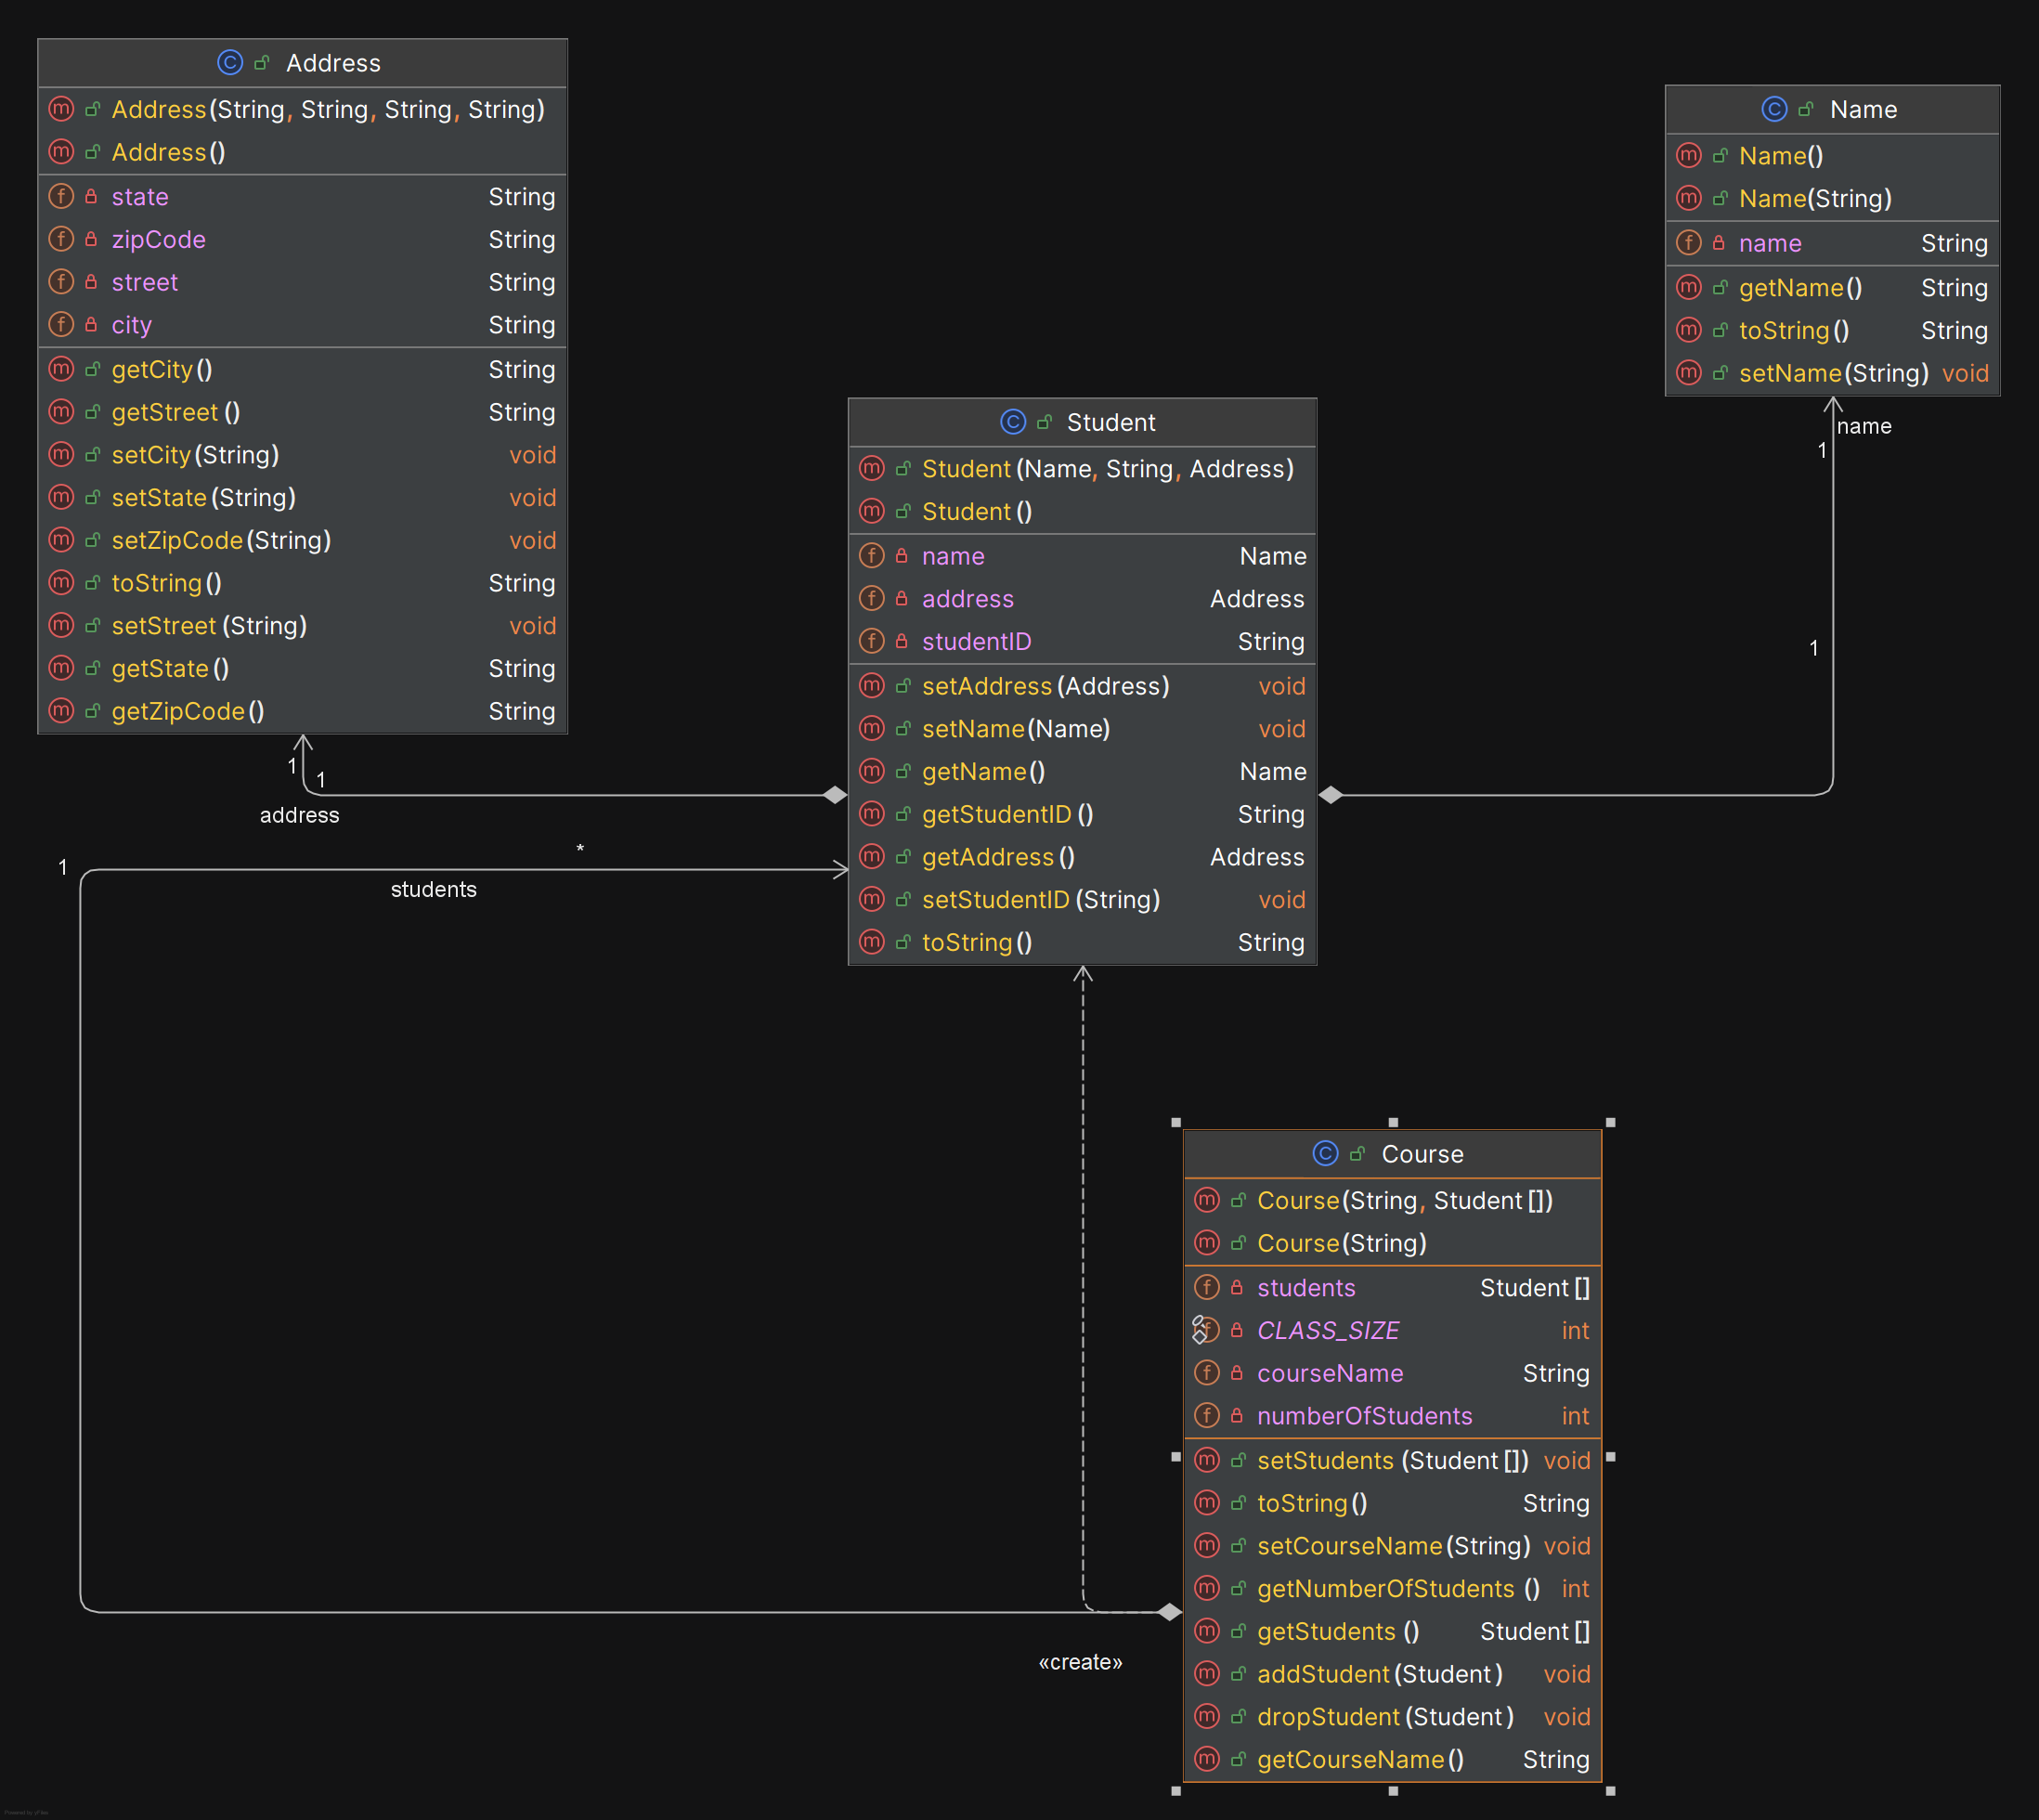
Course UML

Slide 7
Example: The StackOfIntegers Class
TestStackOfIntegers
Notes:
Row 1. elements colon int left bracket right bracket. An array to store integers in the stack.
Row 2. size colon int. The number of integers in the stack.
Row 3. +StackOfIntegers left parenthesis right parenthesis. Constructs an empty stack with a default capacity of 16.
Row 4. +StackOflntegers left parenthesis capacity colon int right parenthesis. Constructs an empty stack with a specified capacity.
Row 5. +empty left parenthesis right parenthesis colon Boolean. Returns true if the stack is empty.
Row 6. +peek left parenthesis right parenthesis colon int. Returns the integer at the top of the stack without removing it from the stack.
Row 7. +push left parenthesis value colon int right parenthesis colon int. Stores an integer into the top of the stack.
Row 8. +pop left parenthesis right parenthesis colon int. Removes the integer at the top of the stack and returns it.
Row 9. +getSize left parenthesis right parenthesis colon int. Returns the number of elements in the stack.
TestStackOfIntegers: https://liveexample.pearsoncmg.com/html/TestStackOfIntegers.html

Slide 8
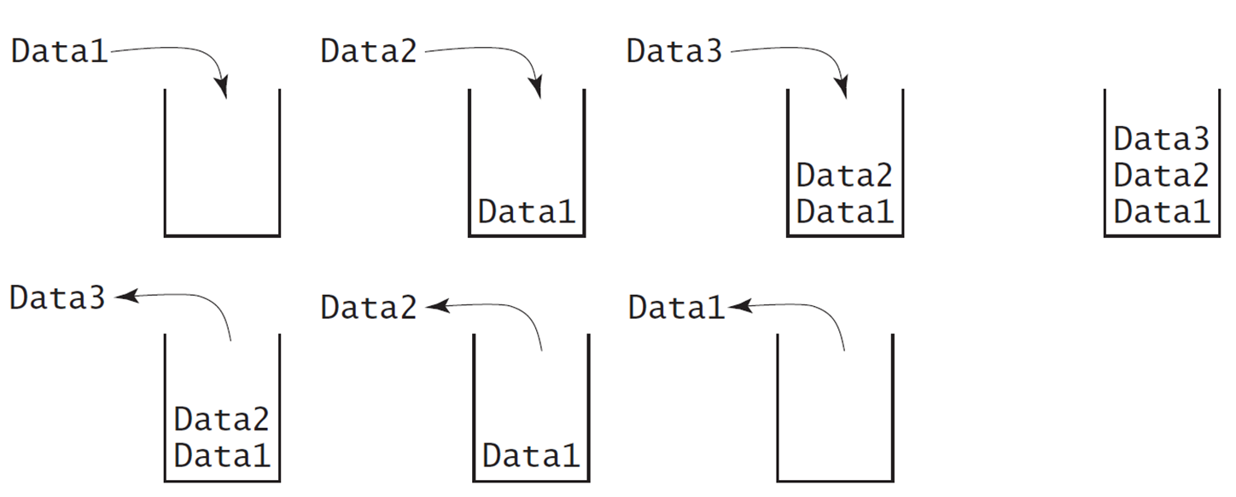
Designing the StackOfIntegers Class

Slide 9
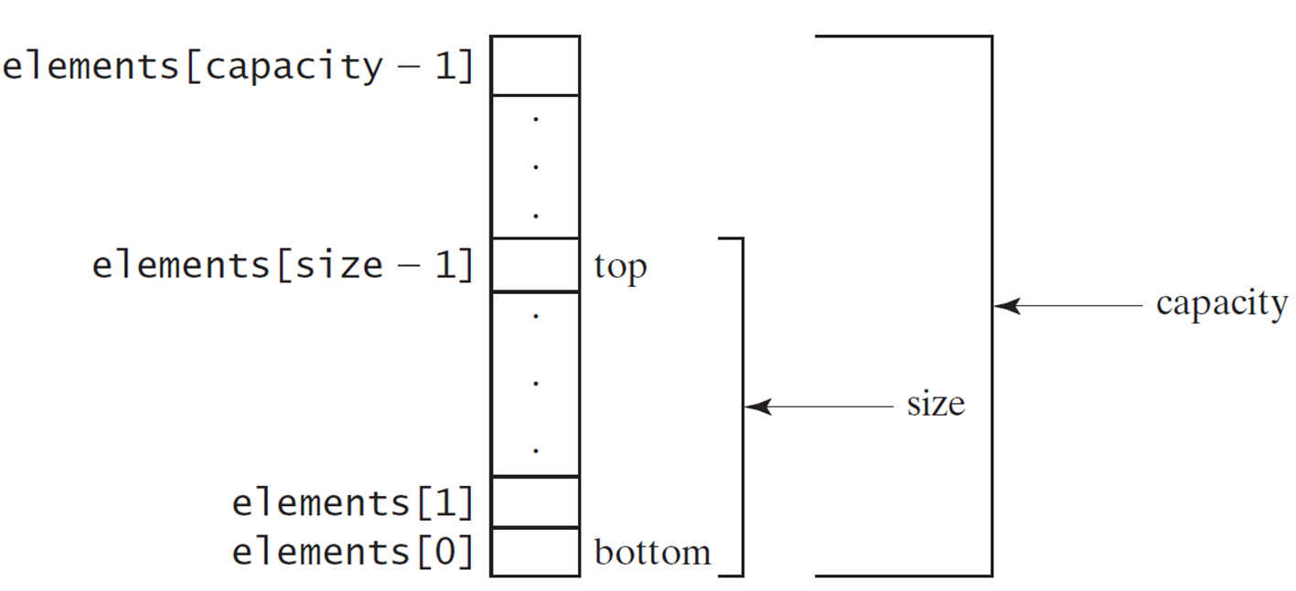
Implementing StackOfIntegers Class
StackOfIntegers
Notes:
The box elements array for size minus 1 is labeled, top and last box is labeled, bottom. The boxes from the box labeled, top to box labeled, bottom are labeled, size. The whole vertical column is labeled, capacity.
StackOfIntegers: https://liveexample.pearsoncmg.com/html/StackOfIntegers.html

Slide 10
Wrapper Classes
Boolean
Character
Short
Byte
Integer
Long
Float
Double
Note: (1) The wrapper classes do not have no-arg constructors. (2) The instances of all wrapper classes are immutable, i.e., their internal values cannot be changed once the objects are created.

Slide 11
The Integer and Double Classes
Notes:
The computer code is divided into 2 boxes. The left box shows the java period lang period Integer. The computer code has of 14 lines.
Line1, minus value colon int
Line 2, plus MAX_VALUE colon int
Line 3, plus MIN_VALUE colon int
Line 4, plus Integer open parenthesis value colon int close parenthesis
Line 5, plus Integer open parenthesiss colon String close parenthesis
Line 6, plus byte Value open parenthesis close parenthesis colon byte
Line 7, plus short Value open parenthesis close parenthesis colon short
Line 8, plus intValue open parenthesis close parenthesis colon int
Line 9, plus longValue open parenthesis close parenthesis colon long
Line 10, plus float Value open parenthesis close parenthesis colon float
Line 11, plus double Value open parenthesis close parenthesis colon double
Line 12, plus compare To open parenthesis colon Integer close parenthesis colon int
Line 13, plus to String open parenthesis close parenthesis colon String
Line 14, plus value Of open parenthesis colon String close parenthesis colon Integer
Line 15, plus value Of open parenthesis colon String, radix colon int close parenthesis colon Integer
Line 16, plus parseInt open parenthesis colon String close parenthesis colon int
Line 17, plus parseInt open parenthesis colon String, radix colon int close parenthesis colon int
The Right box shows java period lang period Double.
The computer code has of 17 lines.
Line1, minus value colon double
Line 2, plus MAX_VALUE colon double
Line 3, plus MIN_VALUE colon double
Line 4, plus Double open parenthesis value colon double close parenthesis
Line 5, plus Double open parenthesis colon String close parenthesis
Line 6, plus byte Value open parenthesis close parenthesis colon byte
Line 7, plus short Value open parenthesis close parenthesis colon short
Line 8, plus intValue open parenthesis close parenthesis colon int
Line 9, plus longValue open parenthesis close parenthesis colon long
Line 10, plus float Value open parenthesis close parenthesis colon float
Line 11, plus double Value open parenthesis close parenthesis colon double
Line 12, plus compare To open parenthesis colon Double close parenthesis colon into
Line 13, plus to String open parenthesis close parenthesis colon String
Line 14, plus value Of open parenthesis colon String close parenthesis colon Double
Line 15, plus value Of open parenthesis colon String, radix colon int close parenthesis colon Double
Line 16, plus parse Double open parenthesis colon String close parenthesis colon double
Line 17, plus parse Double open parenthesis colon String, radix colon int close parenthesis colon double

Slide 12
The Static valueOf Methods
The numeric wrapper classes have a useful class method, valueOf(String s). This method creates a new object initialized to the value represented by the specified string. For example:
Double doubleObject = Double.valueOf("12.4");
Integer integerObject = Integer.valueOf("12");

Slide 13

Automatic Conversion Between Primitive Types and Wrapper Class Types
J D K 1.5 allows primitive type and wrapper classes to be converted automatically. For example, the following statement in (a) can be simplified as in (b):
Notes:
The left computer code shows the coding of Integer open bracket close bracket int Array equals to open braces new Integer open parenthesis 2 close parenthesis comma new Integer open parenthesis 4 close parenthesis, new Integer open parenthesis3 close parenthesis close braces semicolon which is equivalent to right computer code that shows the Integer open bracket close bracket int Array equals to open braces 2, 4, 3 close braces semicolon are New JDK 1.5 boxing.
System.out.prinln left parenthesis intArray left bracket 0 right bracket + intArray left bracket 1 right bracket + intArray left bracket 2 right bracket. The arrays are together labeled, unboxing.

Slide 14
The String Class
Constructing a String:
String message = "Welcome to Java“;
String message = new String("Welcome to Java“);
String s = new String();
Obtaining String length and Retrieving Individual Characters in a string
String Concatenation (concat)
Substrings (substring(index), substring(start, end))
Comparisons (equals, compareTo)
String Conversions
Finding a Character or a Substring in a String
Conversions between Strings and Arrays
Converting Characters and Numeric Values to Strings

Slide 15
Constructing Strings
String newString = new String(stringLiteral);
String message = new String("Welcome to Java");
Since strings are used frequently, Java provides a shorthand initializer for creating a string:
String message = "Welcome to Java";

Slide 16
Strings Are Immutable
A String object is immutable; its contents cannot be changed. Does the following code change the contents of the string?
String s = "Java";
s = "HTML";

Slide 17
Interned Strings
display
s1 == s is false
s1 == s3 is true
A new object is created if you use the new operator.
If you use the string initializer, no new object is created if the interned object is already created.
Notes:
Since strings are immutable and are frequently used, to improve efficiency and save memory,
the J V M uses a unique instance for string literals with the same character sequence. Such an instance is called interned. For example, the following statements:

Slide 18
Replacing and Splitting Strings (1 of 2)

Slide 19
Splitting a String
String[] tokens = "Java#HTML#Perl".split("#");
for (int i = 0; i < tokens.length; i++)
System.out.print(tokens[i] + " ");
displays
Java H T M L Perl

Slide 20
Matching, Replacing and Splitting by Patterns (1 of 3)
You can match, replace, or split a string by specifying a pattern. This is an extremely useful and powerful feature, commonly known as regular expression. Regular expression is complex to beginning students. For this reason, two simple patterns are used in this section. Please
refer to Supplement
“Regular Expressions,” for further
studies.
"Java".matches("Java");
"Java".equals("Java");
"Java is fun".matches("Java.*");
"Java is cool".matches("Java.*");

Slide 21
Matching, Replacing and Splitting by Patterns (2 of 3)
The replaceAll, replaceFirst, and split methods can be used with a regular expression. For example, the following statement returns a new string that replaces $, +, or # in "a+b$#c" by the string NNN.
String s = "a+b$#c".replaceAll("[$+#]", "NNN");
System.out.println(s);
Here the regular expression [$+#] specifies a pattern that matches $, +, or #. So, the output is aNNNbNNNNNNc.

Slide 22
Matching, Replacing and Splitting by Patterns (3 of 3)
The following statement splits the string into an array of strings delimited by some punctuation marks.
String[] tokens = "Java,C?C#,C++".split("[.,:;?]");
for (int i = 0; i < tokens.length; i++)
System.out.println(tokens[i]);

Slide 23
StringBuilder
The StringBuilder class is an alternative to the String class. In general, a StringBuilder can be used wherever a string is used. StringBuilder is more flexible than String. You can add, insert, or append new contents into a string buffer, whereas the value of a String object is fixed once the string is created.

Slide 24
StringBuilder Constructors
Notes:
Row 1. +StringBuilder left parenthesis right parenthesis. Constructs an empty string builder with capacity 16.
Row 2. +StringBuilder left parenthesis capacity colon int right parenthesis. Constructs a string builder with the specified capacity.
Row 3. +StringBuilder left parenthesis S colon String right parenthesis. Construcyts a string builder with the specified string.

Slide 25
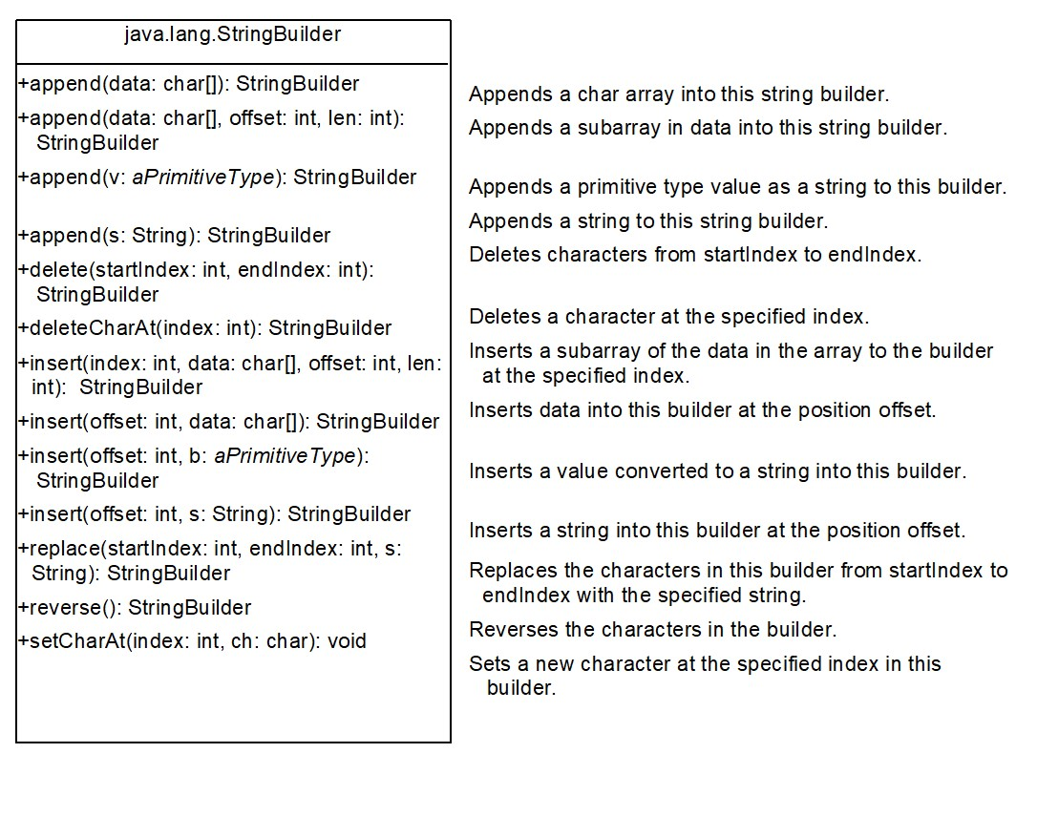
Modifying Strings in the Builder
Notes:
Row 1. +append left parenthesis data colon char left bracket right bracket right parenthesis colon StringBuilder. Appends a char array into this string builder.
Row 2. +append left parenthesis data colon char left bracket right bracket, offset colon int, len colon int right parenthesis colon StringBuilder. Appends a subarray in data into this string builder.
Row 3. +append left parenthesis v colon aPrimitiveType right parenthesis colon String Builder. Appends a primitive type value as a string to this builder.
Row 4. +append left parenthesis s colon String right parenthesis colon StringBuilder. Appends a string to this string builder.
Row 5. +delete left parenthesis startIndex colon int, endlndex colon int right parenthesis colon StringBuilder. Deletes characters from startlndex to endlndex.
Row 6. +deleteCharAt left parenthesis index colon int right parenthesis colon StringBuilder. Deletes a character at the specified index.
Row 7. +insert left parenthesis index colon int, data colon char left bracket right bracket, offset colon int, len colon int right parenthesis colon StringBuilder. Inserts a subarray of the data in the array to the builder at the specified index.
Row 8. +insert left parenthesis offset colon int, data colon char left bracket right bracket right parenthesis colon StringBuilder. Inserts data into this builder at the position offset.
Row 9. +insert left parenthesis offset colon int, b colon aPrimitiveType right parenthesis colon StringBuilder. Inserts a value converted to a string into this builder.
Row 10. +insert left parenthesis offset colon int, s colon String right parenthesis colon StringBuilder. Inserts a string into this builder at the position offset.
Row 11. +replace left parenthesis startlndex colon int, endlndex colon int, s colon String right parenthesis colon StringBuilder. Replaces the characters in this builder from startlndex to endlndex with the specified string.
Row 12. +reverse left parenthesis right parenthesis colon StringBuilder. Reverses the characters in the builder.
Row 13. +setCharAt left parenthesis index colon int, ch colon char right parenthesis colon void. Sets a new character at the specified index in this builder.

Slide 26
Examples
StringBuilder s = new StringBuilder(); s.append("Welcome to Java"); System.out.println(s.toString()); s.insert(11,"C++ and "); System.out.println(s.toString()); s.deleteCharAt(1); System.out.println(s.toString()); s.insert(1,"e"); System.out.println(s.toString()); s.replace(11,14,"CPP"); System.out.println(s.toString()); System.out.println(s.reverse());

Slide 27
The toString, capacity, length, setLength, and charAt Methods
Notes:
Row 1. +toString left parenthesis right parenthesis colon String. Returns a string object from the string builder.
Row 2. +capacity left parenthesis right parenthesis colon int. Returns the capacity of this string builder.
Row 3. +charAt left parenthesis index colon int right parenthesis colon char. Returns the character at the specified index.
Row 4. +length left parenthesis right parenthesis colon int. Returns the number of characters in this builder.
Row 5. +setLength left parenthesis newLength colon int right parenthesis colon void. Sets a new length in this builder.
Row 6. +substring left parenthesis startlndex colon int right parenthesis colon String. Returns a substring starting at startlndex.
Row 7. +substring left parenthesis startlndex colon int, endlndex colon int right parenthesis colon String. Returns a substring from startlndex to endlndex 1.
Row 8. +trimToSize left parenthesis right parenthesis colon void. Reduces the storage size used for the string builder.

Slide 28
Problem: Checking Palindromes Ignoring Non-alphanumeric Characters
This example gives a program that counts the number of occurrence of each letter in a string. Assume the letters are not case-sensitive.
PalindromeIgnoreNonAlphanumeric
Notes:
PalindromeIgnoreNonAlphanumeric: https://liveexample.pearsoncmg.com/html/PalindromeIgnoreNonAlphanumeric.html

Slide 29
Regular Expressions
A regular expression (abbreviated regex) is a string that describes a pattern for matching a set of strings. Regular expression is a powerful tool for string manipulations. You can use regular expressions for matching, replacing, and splitting strings.

Slide 30
Matching Strings
"Java".matches("Java");
"Java".equals("Java");
"Java is fun".matches("Java.*")
"Java is cool".matches("Java.*")
"Java is powerful".matches("Java.*")

Slide 31
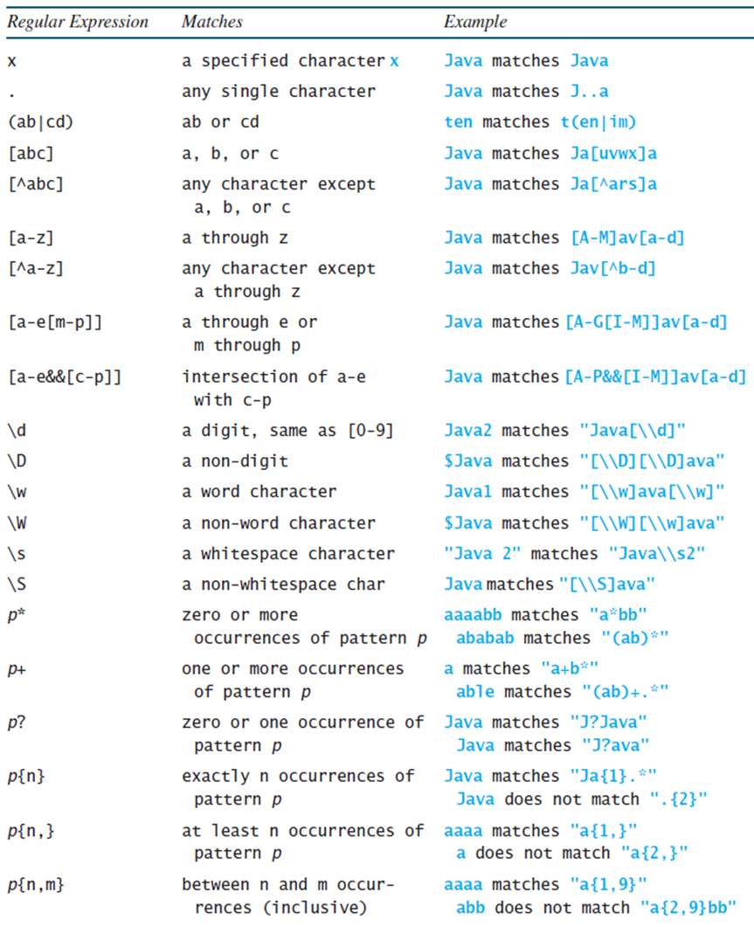
Regular Expression Syntax
Notes:
The row entries are as follows.
Row 1. X, a specified character x, Java matches Java.
Row 2. dot, any single character, Java matches J dot dot a.
Row 3. Left parenthesis ab vertical line cd right parenthesis, ab or cd, ten matches t left parenthesis en vertical line im right parenthesis.
Row 4. Left parenthesis a b c right parenthesis, a, b. or c, Java matches Ja left bracket uvwx right bracket a.
Row 5. Left bracket cap a b c right bracket, any character except a, b, or c, Java matches la left bracket cap a r s right bracket a
Row 6. Left bracket a to z right bracket, a through z, Java matches left bracket A to M right bracket a v left bracket a to d right bracket
Row 7. Left bracket cap a to z, any character except a through z, Java matches Jav left bracket cap b to d right bracket
Row 8. left bracket a to e left bracket m to p right bracket, right bracket, a through e or m through p, Java matches left bracket A to G left bracket I to M right bracket a v left bracket a to d right bracket
Row 9. left bracket a to e and and left bracket c to p right bracket, right bracket, intersection of a to e with c to p, Java matches left bracket A to P and and left bracket I to M a v left bracket a to d right bracket.
Row 10. Backslash slash lowercase d, a digit, same as left bracket 0 to 9 right bracket, Java2 matches double quotation marks Java left bracket backslash backslash lowercase d right bracket double quotation marks.
Row 11. Backslash slash uppercase d, a non digit, Java matches double quotation marks left bracket backslash, backslash uppercase D right bracket left bracket backslash, backslash uppercase D right bracket left bracket uppercase D right bracket ava double quotation marks.
Row 12. backslash lowercase w, a word character, Java matches double quotation marks left bracket backslash backslash w right bracket ava left bracket backslash, backslash, w right bracket double quotation marks.
Row 13. backslash uppercase W, a non word character, Java matches double quotation marks left bracket backslash backslash W left bracket backslash backslash W right bracket ava double quotation marks.
Row 14. backslash lowercase s, a whitespace character, double quotation marks Java 2 double quotation marks matches double quotation marks Java backslash backslash s2 double quotation marks.
Row 15. backslash uppercase S, a non whitespace char, Java matches double quotation marks left bracket backslash backslash S right bracket ava double quotation marks.
Row 16. p asterisk, zero or more occurrences of pattern p, aaaabb matches double quotation marks a asterisk bb double quotation marks, ababab matches double quotation marks left bracket ab right bracket double quotation marks
Row 17. p+, one or more occurrences of pattern p, a matches double quotation marks a + b asterisk double quotation marks, able matches double quotation marks left bracket ab right bracket + double quotation marks
Row 18. p left brace n right brace, zero or one occurrence of pattern p, Java matches double quotation marks Ja left brace 1 right brace. double quotation marks
Row 19. P left brace n, right brace, exactly n occurrences of pattern p, aaaa matches double quotation marks a left brace 1 right brace double quotation marks, a does not match double quotation marks a left brace 2, right brace double quotation marks.
Row 20. p left brace n, m right brace, at least n occurrences of pattern p between n and m occurrences (inclusive), aaaa matches double quotation marks a left brace 1, 9 right brace double quotation marks, abb does not match double quotation marks a left brace 2, 9 right brace bb double quotation marks.

Slide 32
Replacing and Splitting Strings (2 of 2)
Notes:
Row 1. +matches left parenthesis regex colon String right parenthesis colon Boolean. Returns true if this string matches the pattern.
Row 2. +replaceAll left parenthesis regex colon String, replacement colon String right parenthesis colon String. Returns a new string that replaces all matching substrings with the replacement.
Row 3. +replaceFirst left parenthesis regex colon String, replacement colon String right parenthesis colon String. Returns a new string that replaces the first matching substring with the replacement.
Row 4. +split left parenthesis regex colon String right parenthesis colon String. Returns an array of strings consisting of the substrings split by the matches.

Slide 33
Examples (4 of 4)
// replace v followed by any word char. With “wi”
String s = "Java Java Java".replaceAll("v\\w", "wi") ;
S → “Jawi Jawi Jawi”
String s = "Java Java Java".replaceFirst("v\\w", "wi") ;
S → “Jawi Java Java”
String[] s = "Java1HTML2Perl".split("\\d");
https://docs.oracle.com/javase/8/docs/api/java/util/regex/Pattern.html

