Slide 1
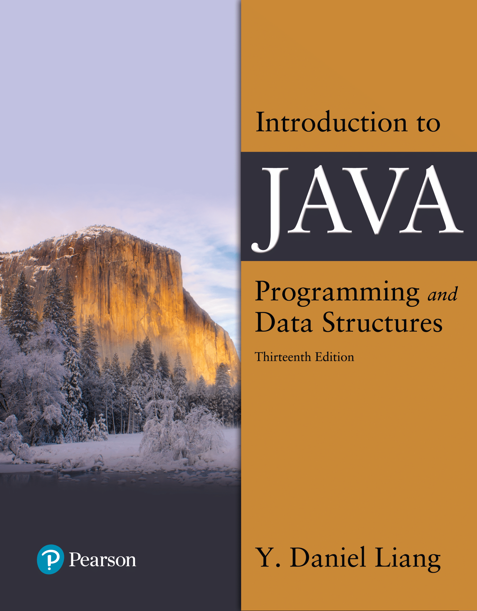

Introduction to Java Programming and Data Structures
Thirteenth Edition
Chapter 2
Elementary Programming
Copyright © 2024 Pearson Education, Inc. All Rights Reserved
Notes:
If this PowerPoint presentation contains mathematical equations, you may need to check that your computer has the following installed:
1) MathType Plugin
2) Math Player (free versions available)
3) NVDA Reader (free versions available)
Slides in this presentation contain hyperlinks. JAWS users should be able to get a list of links by using INSERT+F7

Slide 2
Motivations
In the preceding chapter, you learned how to create, compile, and run a Java program. Starting from this chapter, you will learn how to solve practical problems programmatically. Through these problems, you will learn Java primitive data types and related subjects, such as variables, constants, data types, operators, expressions, and input and output.

Slide 3
Introducing Programming with an Example
Listing 2.1 Computing the Area of a Circle
Write a program to calculate the area of a circle with radius 20.
Problem Solving
Analyze the problem
input/output
Design Solution
Algorithm
Coding
Program
Testing
Syntax error, run-time error, logical error

Slide 4
Algorithms
Any computing problem can be solved by executing a series of actions in a specific order.
An algorithm is a procedure for solving a problem in terms of
the actions to execute and
the order in which these actions execute
Specifying the order in which statements (actions) execute in a program is called program control.

Slide 5
Write a program to calculate area of a circle with radius 20.
Pseudocode is an informal language that helps you develop algorithms without having to worry about the strict details of Java language syntax.
Flowchart uses diagrams and arrow lines to show flow of the statements.

Slide 6
Control Structures
Any problem can be solved using 4 types of Control Structures
Sequential execution: Statements in a program execute one after the other in the order in which they are written.
Selection Structure: Enables you to specify which statement to execute based on a decision.
iteration structure: Enables you to repeat execution of set of statements.
Subprogram Structure: Enables you to break large problems to sub problems. By solving sub problems, you solve the entire problem

Slide 7
Sample Java Application Template
This is the method header
for the main method. The
main method is where a Java
application begins.
// This is a simple Java program.
public class Simple { }
public static void main(String[] args) {
}
This area is the body of the main method.
All of the actions to be completed during
the main method will be between these curly braces.

Slide 8
Identifiers
An identifier is a sequence of characters that consist of letters, digits, underscores (_), and dollar signs ($).
An identifier must start with a letter, an underscore (_), or a dollar sign ($). It cannot start with a digit.
An identifier cannot be a reserved word. (See Appendix A, “Java Keywords,” for a list of reserved words).
An identifier cannot be true, false, or null.
An identifier can be of any length.

Slide 9

Variables
Related to variables in math
A named “box” you can put a value in
x = 10 same as in math:
y = x + 1
11
10
x
y

Slide 10
Memory Concepts Variables
Variables
Every variable has a name, a type, a size (in bytes) and a value.
When a new value is placed into a variable, the new value replaces the previous value (if any)
The previous value is lost, so this process is said to be destructive.
Every variable must be declared before it can be used
Syntax
type name [= value ];
Notes:
A variable is a named storage location in the computer’s memory.
A literal is a value that is written into the code of a program.
Programmers determine the number and type of variables a program will need.
int x; // Declare x to be an
// integer variable;
double radius; // Declare radius to
// be a double variable;
char a; // Declare a to be a
// character variable;

Slide 11
Declaring Variables
int x; // Declare x to be an
// integer variable;
double radius; // Declare radius to
// be a double variable;
char a; // Declare a to be a
// character variable;
x
radius
a

Slide 12
Assignment Statements
x = 1; // Assign 1 to x;
radius = 1.0; // Assign 1.0 to radius;
Char a = 'A'; // Assign 'A' to a;
1
a
1.0
radius
A
a

Slide 13
Declaring and Initializing in One Step
int x = 1;
double d = 1.4;

Slide 14
Named Constants
final datatype CONSTANTNAME = VALUE;
final double PI = 3.14159;
final int SIZE = 3;

Slide 15
Naming Conventions (1 of 2)
Choose meaningful and descriptive names.
Variables and method names:
Use lowercase. If the name consists of several words, concatenate all in one, use lowercase for the first word, and capitalize the first letter of each subsequent word in the name. For example, the variables radius and area, and the method computeArea.

Slide 16
Naming Conventions (2 of 2)
Class names:
Capitalize the first letter of each word in the name. For example, the class name ComputeArea.
Constants:
Capitalize all letters in constants, and use underscores to connect words. For example, the constant PI and MAX_VALUE

Slide 17
Numerical Data Types

Slide 18
Opening Problem
Listing 2.1 Computing the Area of a Circle
This program computes the area of the circle with radius 20.
ComputeArea
radius = 20
area = radius * radius * 3.14159
Print area
Notes:
ComputeArea: https://liveexample.pearsoncmg.com/html/ComputeArea.html

Slide 19
Reading Numbers from the Keyboard
Scanner input = new Scanner(System.in);
int value = input.nextInt();

Slide 20
Opening Problem (interactive)
This program computes the area of the circle with a given radius.
Input radius
area = radius * radius * 3.14159
Print area
Notes:
ComputeArea: https://liveexample.pearsoncmg.com/html/ComputeArea.html

Slide 21
Calculate Gross Pay
Given hours worked and pay rate, calculate and print gross pay.
Analyze the problem (input/output)
Algorithm
Coding
Testing

Slide 22
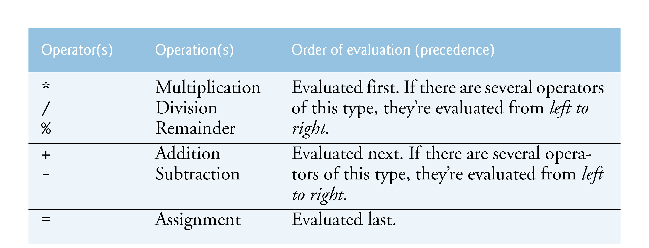
Arithmetic Operators
Notes:
Rules of operator precedence
Multiplication, division and remainder operations are applied first.
If an expression contains several such operations, they are applied from left to right.
Multiplication, division and remainder operators have the same level of precedence.
Addition and subtraction operations are applied next.
If an expression contains several such operations, the operators are applied from left to right.
Addition and subtraction operators have the same level of precedence.
When we say that operators are applied from left to right, we are referring to their associativity.
Some operators associate from right to left.

Slide 23
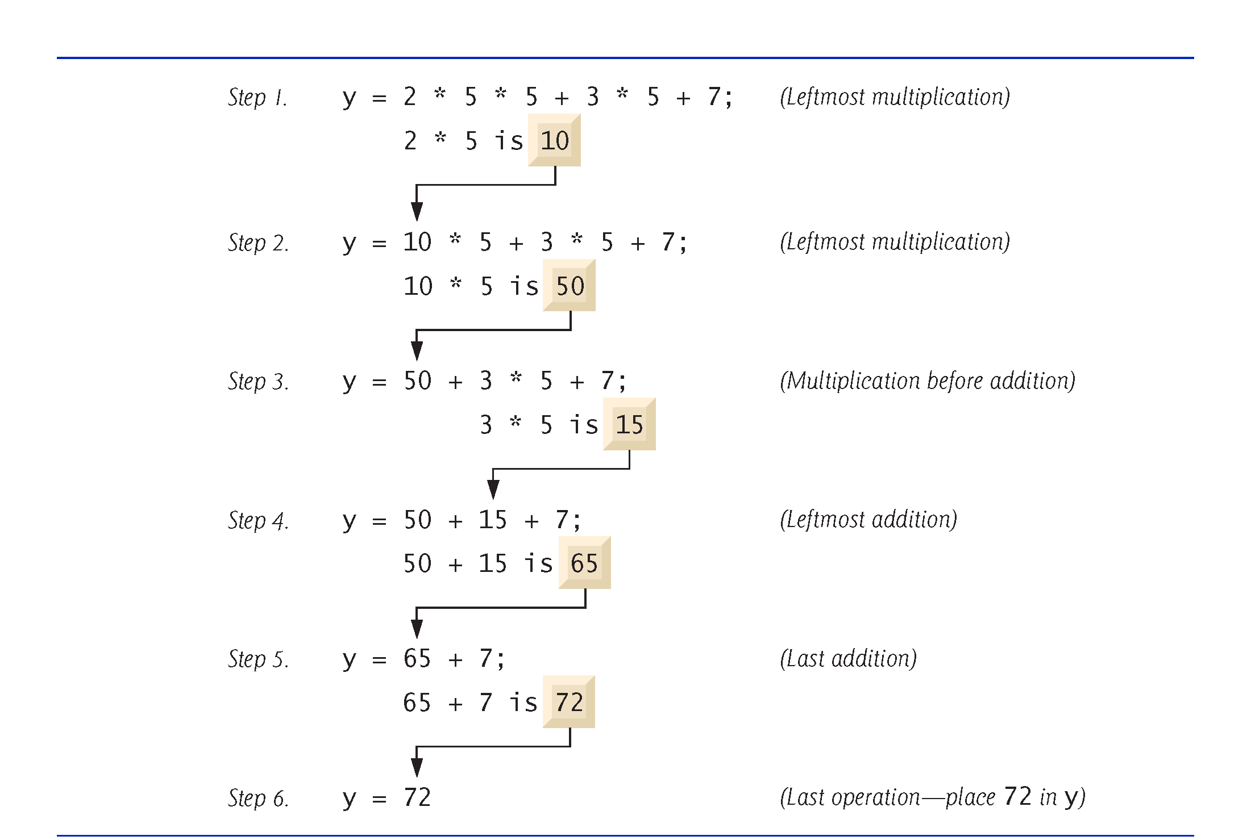

Slide 24
NOTE
Calculations involving floating-point numbers are approximated because these numbers are not stored with complete accuracy. For example,
System.out.println(1.0 - 0.1 - 0.1 - 0.1 - 0.1 - 0.1);
displays 0.5000000000000001, not 0.5, and
System.out.println(1.0 - 0.9);
displays 0.09999999999999998, not 0.1. Integers are stored precisely. Therefore, calculations with integers yield a precise integer result.

Slide 25
Number Literals
A literal is a constant value that appears directly in the program. For example, 34, 1,000,000, and 5.0 are literals in the following statements:
int i = 34;
long x = 1000000;
double d = 5.0;

Slide 26
Arithmetic Expressions
is translated to
(3+4*x)/5 – 10*(y-5)*(a+b+c)/x + 9*(4/x + (9+x)/y)

Slide 27
Problem: Converting Temperatures
Write a program that converts a Fahrenheit degree to Celsius using the formula:
Note: you have to write
celsius = (5.0 / 9) * (fahrenheit – 32)

Slide 28
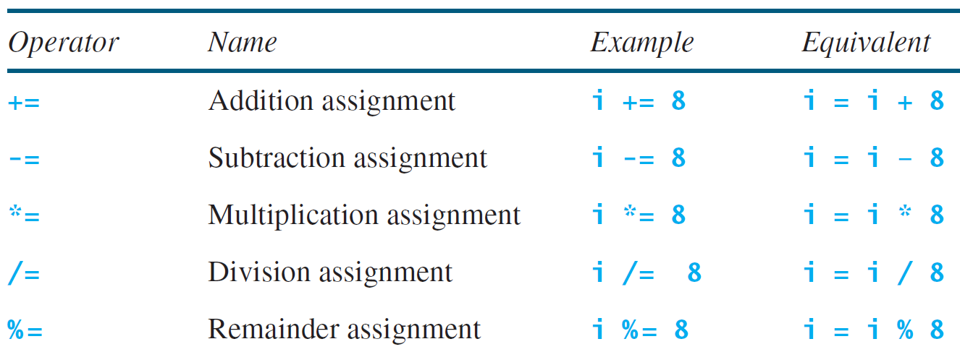
Augmented Assignment Operators

Slide 29
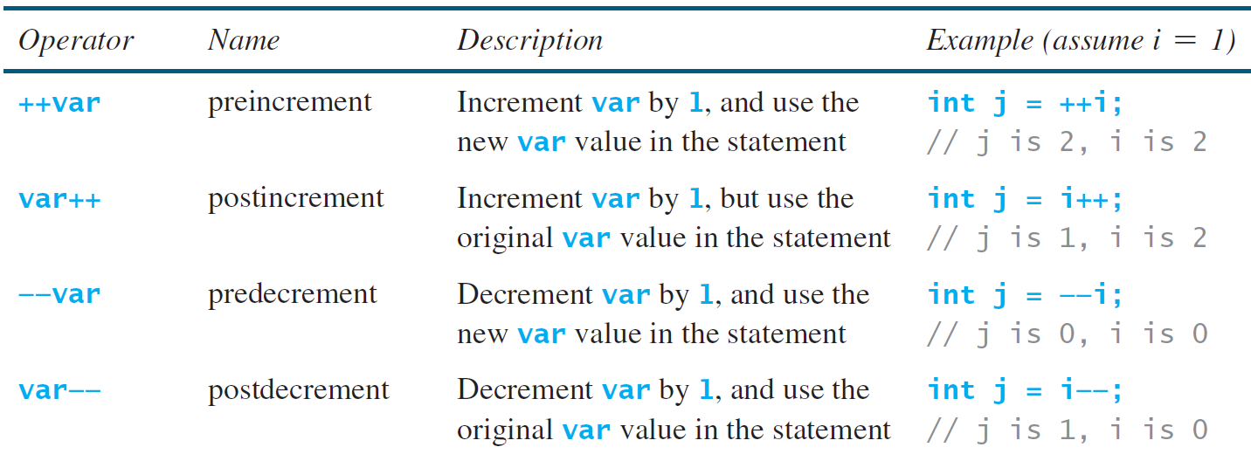
Increment and Decrement Operators

Slide 30
Increment and Decrement Operators, cont.

Slide 31
Numeric Type Conversion
Consider the following statements:
byte i = 100;
long k = i * 3 + 4;
double d = i * 3.1 + k / 2;

Slide 32
Conversion Rules
When performing a binary operation involving two operands of different types, Java automatically converts the operand based on the following rules:
1. If one of the operands is double, the other is converted into double.
2. Otherwise, if one of the operands is float, the other is converted into float.
3. Otherwise, if one of the operands is long, the other is converted into long.
4. Otherwise, both operands are converted into int.

Slide 33
Type Casting
Implicit casting
double d = 3; (type widening)
Explicit casting
int i = (int)3.0; (type narrowing)
int i = (int)3.9; (Fraction part is truncated)
What is wrong? int x = 5 / 2.0;

Slide 34
Casting in an Augmented Expression
In Java, an augmented expression of the form x1 op= x2 is implemented as x1 = (T)(x1 op x2), where T is the type for x1. Therefore, the following code is correct.
int sum = 0;
sum += 4.5; // sum becomes 4 after this statement
sum += 4.5 is equivalent to sum = (int)(sum + 4.5).

Slide 35
Problem: Keeping Two Digits After Decimal Points
Write a program that displays the sales tax with two digits after the decimal point.

Slide 36
Problem: Computing Loan Payments
This program lets the user enter the interest rate, number of years, and loan amount, and computes monthly payment and total payment.

Slide 37
Problem: Monetary Units
This program lets the user enter the amount in decimal representing dollars and cents and output a report listing the monetary equivalent in single dollars, quarters, dimes, nickels, and pennies. Your program should report maximum number of dollars, then the maximum number of quarters, and so on, in this order.

Slide 38
Common Error 1: Undeclared/Uninitialized Variables and Unused Variables
double interestRate = 0.05;
double interest = interestrate * 45;

Slide 39
Common Error 2: Integer Overflow
int value = 2147483647 + 1;
// value will actually be

Slide 40
Common Error 3: Round-off Errors
System.out.println(1.0 - 0.1 - 0.1 - 0.1 - 0.1 - 0.1);
System.out.println(1.0 - 0.9);

Slide 41
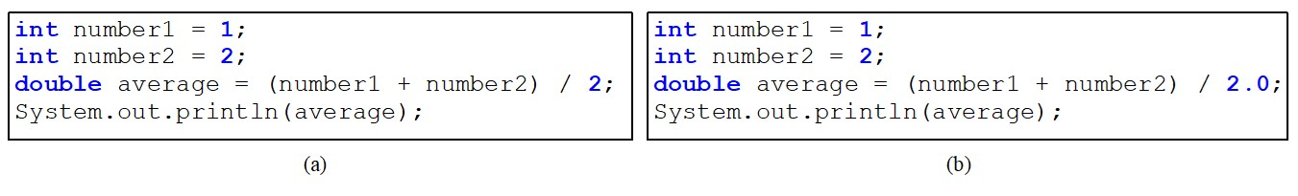
Common Error 4: Unintended Integer Division
Notes:
(a) int number 1 = 1 semi colon
(a) int number 12 = 2 semi colon
double average = left parenthesis number 1 + number 2 right parenthesis over 2 semi colon
System.out.println left parenthesis average right parenthesis semi colon
(b) int number 1 = 1 semi colon
(a) int number 12 = 2 semi colon
double average = left parenthesis number 1 + number 2 right parenthesis over 2.0 semi colon
System.out.println left parenthesis average right parenthesis semi colon

Slide 42
Common Pitfall 1: Redundant Input Objects
Scanner input = new Scanner(System.in);
System.out.print("Enter an integer: ");
int v1 = input.nextInt();
Scanner input1 = new Scanner(System.in);
System.out.print("Enter a double value: ");
double v2 = input1.nextDouble();

