Slide 1
Priority Queues

Slide 2
The ADT Priority Queue: A Variation of the ADT Table
Consider how hospital assign a priority to each patient at ER.
ADT PQ organizes objects according to their priorities.
Definition of “Priority” depends on nature of the items. The queue.
The first item removed is the one having the highest priority value
Notes:
A regular queue is a first-in and first-out data structure.
Elements are appended to the end of the queue and are removed from the beginning of the queue.
In a priority queue, elements are assigned with priorities.
When accessing elements, the element with the highest priority is removed first.
A priority queue has a largest-in, first-out behavior.
- OS schedule execution of programs based on their priority
- Patients at ER are treated based on their emergency. They are seen based on their priority. PQ is used

Slide 3
ADT Priority Queue
/** An interface for the ADT priority queue. */
public interface PriorityQueueInterface<T extends Comparable<? super T>>
{
/** Adds a new entry to this priority queue.
@param newEntry An object to be added. */
public void add(T newEntry);
/** Removes and returns the entry having the highest priority.
@return Either the object having the highest priority or, if the
priority queue is empty before the operation, null. */
public T remove();
/** Retrieves the entry having the highest priority.
@return Either the object having the highest priority or, if the
priority queue is empty, null. */
public T peek();
/** Detects whether this priority queue is empty.
@return True if the priority queue is empty, or false otherwise. */
public boolean isEmpty();
/** Gets the size of this priority queue.
@return The number of entries currently in the priority queue. */
public int getSize();
/** Removes all entries from this priority queue. */
public void clear();
} // end PriorityQueueInterface

Slide 4
The ADT Priority Queue: A Variation of the ADT Table
Possible implementations
Sorted linear implementations
Appropriate if the number of items in the priority queue is small
Array-based implementation
Maintains the items sorted in ascending order of priority value
Reference-based implementation
Maintains the items sorted in descending order of priority value

Slide 5
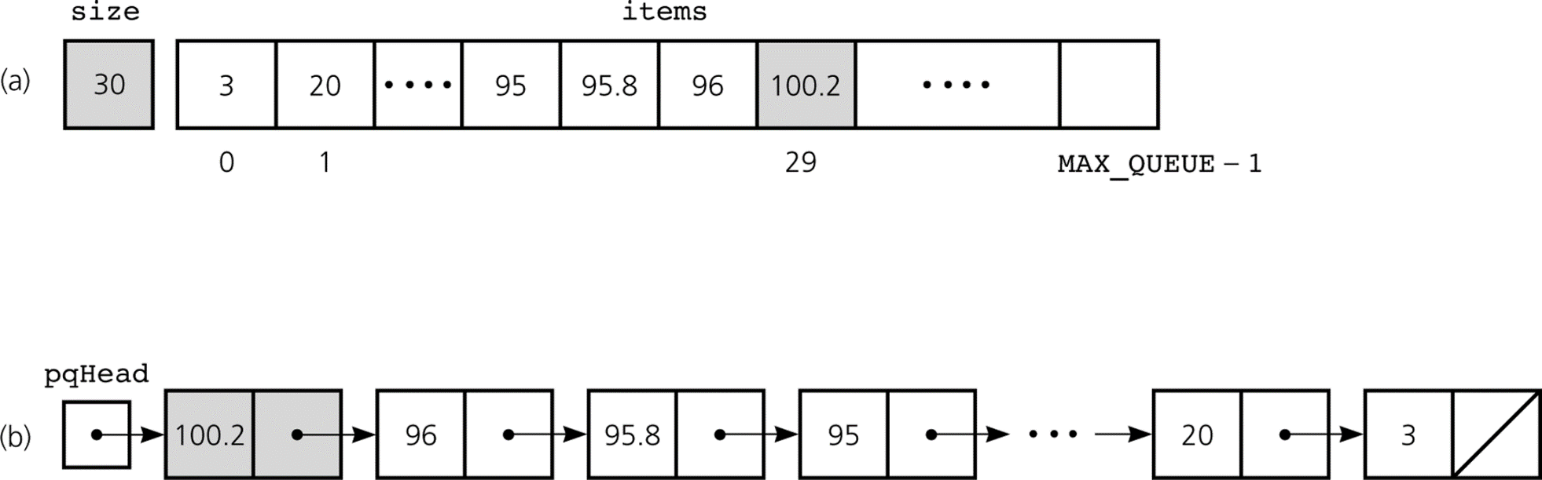
The ADT Max Priority Queue:
Remove operation
(array base from items[size-1] and Size--)
(ref based delete at pqHead)
Insert operation – find insertion point
(array base: use binary search, then shift element to right)
(ref base: linear search to find insertion point, then adjust pointers)
Some implementations of the ADT priority queue: a) array based; b) reference based
Notes:
Dequeue() operation (array based from items[size-1] and size-- , reference based (delete at pqHead)
Enqueue() operation however must find the insertion point (array based use binary search to find insertion point, then shift elements to open room)
Reference based (linear search to find insertion point)

Slide 6
The ADT Min Priority Queue:
size
30
100 | 96 | 95 | … | 20 | 3
0 | 1 |  | 29
MAX_SIZE-1
head
3
20
……
100
Some implementations of the ADT priority queue: a) array based; b) reference based
Notes:
Dequeue() operation (array based from items[size-1] and size-- , reference based (delete at pqHead)
Enqueue() operation however must find the insertion point (array based use binary search to find insertion point, then shift elements to open room)
Reference based (linear search to find insertion point)

Slide 7
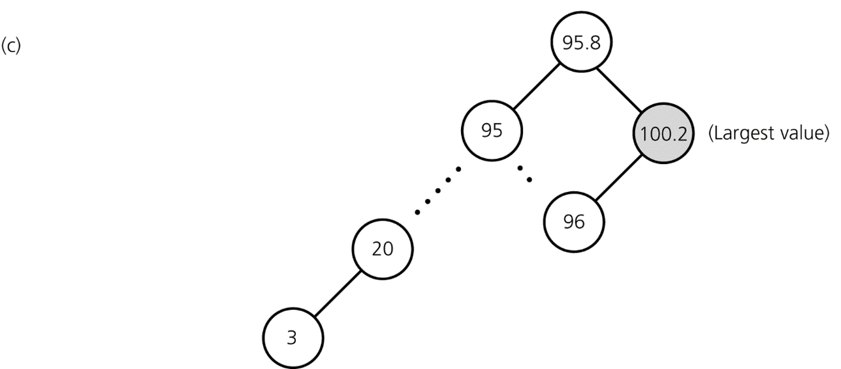
The ADT Priority Queue: A Variation of the ADT Table
Possible implementations (Continued)
Binary search tree implementation
Appropriate for any priority queue
Insertion is same as BST
Deletion: largest value is the
Rightmost child.
Some implementations of the ADT priority queue: c) binary search tree
Notes:
INSERTION IS SAME AS BEFORE
DELETE (LARGEST VALUE IS THE RIGHTMOST CHILD). FOLLOW RIGHT CHILD UNTIL NULL

Slide 8
Heaps
Heap is a useful data structure for designing efficient sorting algorithms and priority queues.
A heap is a complete binary tree
That is empty
or
Whose root contains a search key greater than or equal to the search key in each of its children, and
Whose root has heaps as its subtrees

Slide 9
Complete Binary Tree
A binary tree is complete if every level of the tree is full except that the last level may not be full and all the leaves on the last level are placed left-most. For example, in the following figure, the binary trees in (a) and (b) are complete, but the binary trees in (c) and (d) are not complete. Further, the binary tree in (a) is a heap, but the binary tree in (b) is not a heap, because the root (39) is less than its right child (42).
(a)
(b)
( c )
(d)

Slide 10
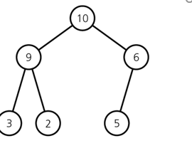
Heaps
Maxheap
A heap in which the root contains the item with the largest search key
Minheap
A heap in which the root contains the item with the smallest search key
2
5
6
9
7

Slide 11
Heaps
Pseudocode for the operations of the ADT heap
Heap()
// Creates an empty heap.
isEmpty()
// Determines whether a heap is empty.
add(newItem)
// Inserts newItem into a heap.
remove()
// Retrieves and then deletes a heap’s root
// item. This item has the largest search key.

Slide 12
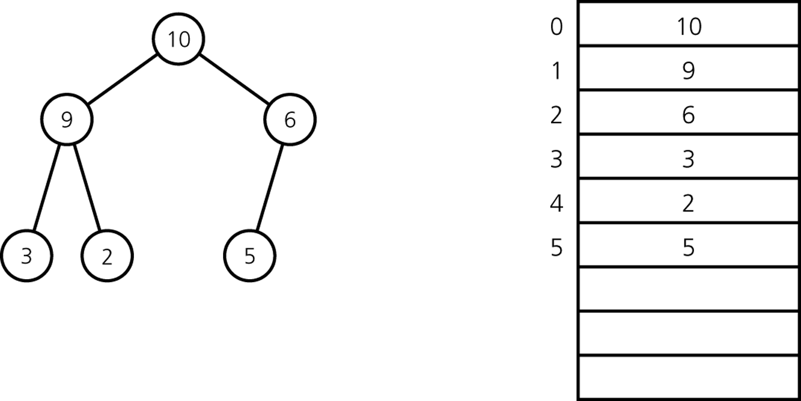
Heaps: An Array-based Implementation of a Heap
Data fields
List: an ArrayList of heap items
private ArrayList<T> list; // array of list items
A heap with its array representation
Left child index: 2i+1
Right child index: 2i+2

Slide 13
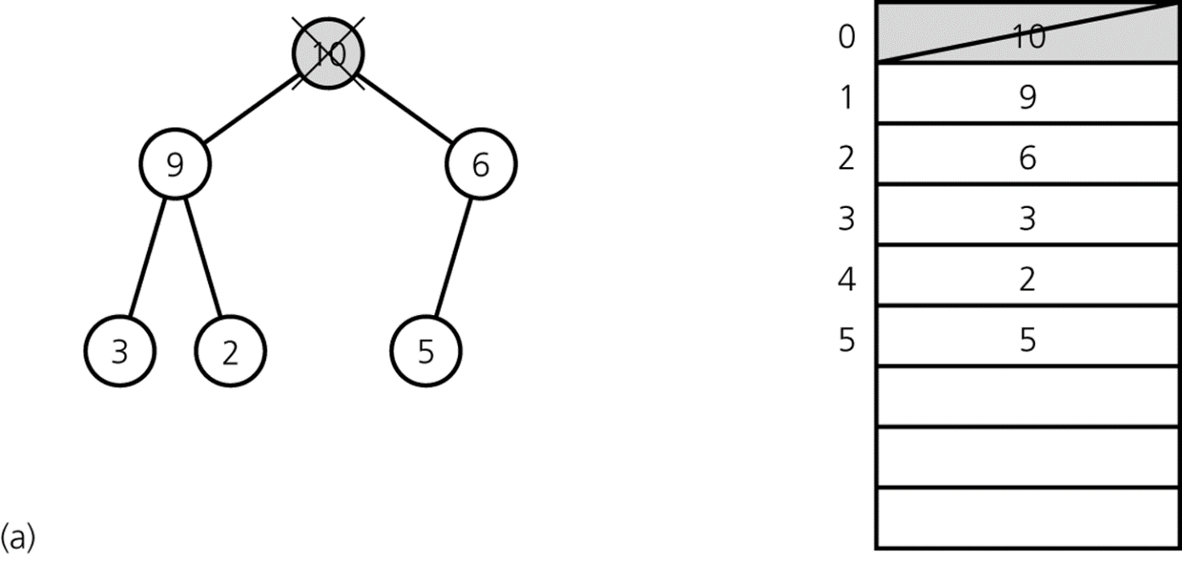
Heaps: heapDelete
Step 1: Return the item in the root
Results in disjoint heaps
a) Disjoint heaps

Slide 14
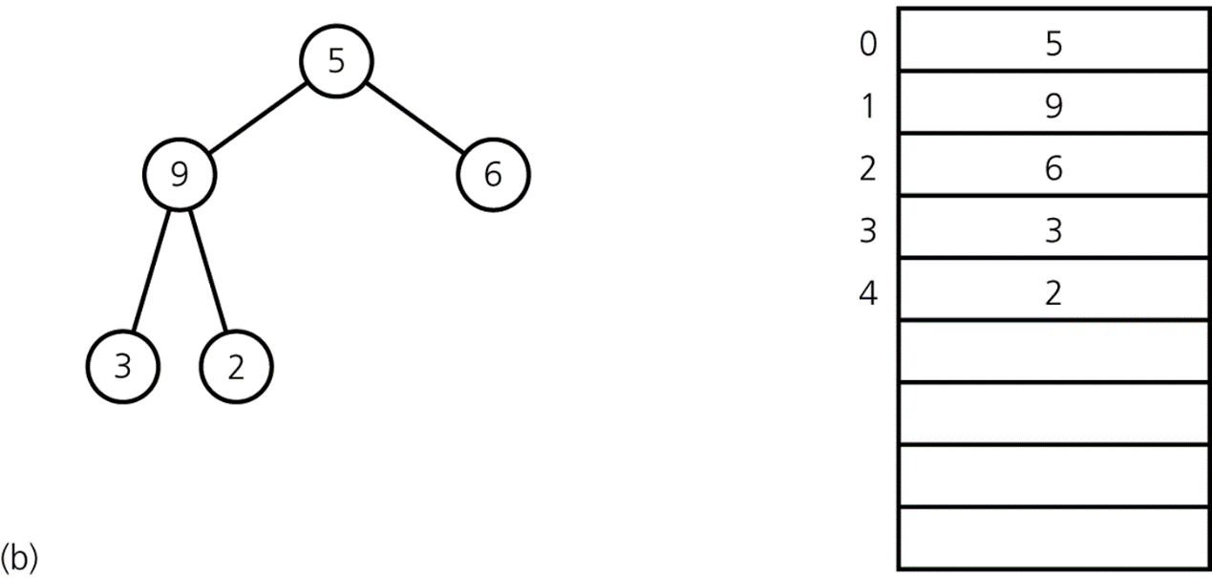
Heaps: heapDelete
Step 2: Copy the item from the last node into the root
Results in a semiheap
b) a semiheap

Slide 15
Heaps: heapDelete
SemiHeap
0 | 5
1 | 9
2 | 6
3 | 3
4 | 2

Slide 16
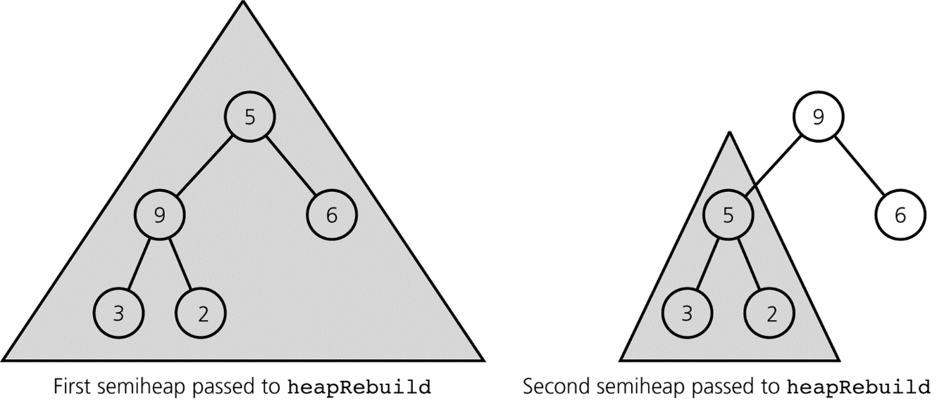
Heaps: heapDelete
Step 3: Transform the semiheap back into a heap
Performed by the recursive algorithm heapRebuild
5
9
6
3
2
9
5
6
3
2
Recursive calls to heapRebuild

Slide 17
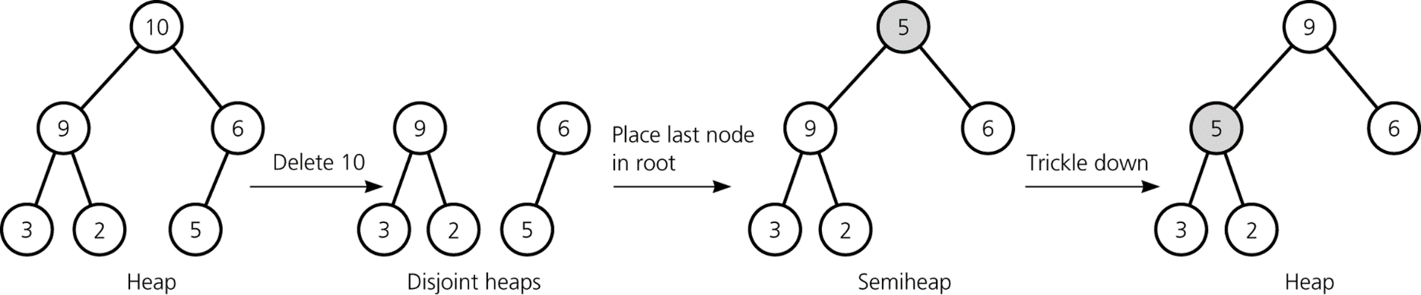
Heaps: heapDelete
Efficiency
heapDelete is O(log n)
Deletion from a heap

Slide 18
Heaps: heapRebuild
protected void heapRebuild(int root) { // if the root is not a leaf and the root's search key // is less than the larger of the search keys in the // root's children // index of root's left child, if any int child = 2 * root + 1; if (child < list.size() ) { // root is not a leaf, so it has a left child // index of root's right child, if any int rightChild = child + 1; // if root has a right child, find larger child if (( rightChild < list.size()) && list.get(rightChild).compareTo(list.get(child)) > 0) { child = rightChild; // index of larger child } // if the root's value is smaller than the value in the larger // child, swap values if (list.get(root).compareTo(list.get(child)) < 0) { T temp = list.get(root); list.set(root,list.get(child)); list.set(child, temp); // transform the new subtree into a heap heapRebuild(child); } // end if } // end if // if root is a leaf, do nothing } // end rebuild

Slide 19
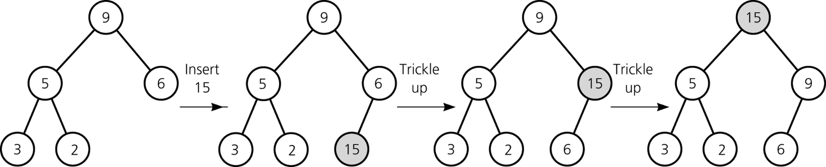
Heaps: heapInsert
9
5
6
3
2
15
9
5
15
3
2
6
15
5
9
3
2
6
Strategy
Insert newItem into the bottom of the tree
Trickle new item up to appropriate spot in the tree
Efficiency: O(log n)
Heap class
Represents an array-based implementation of the ADT heap
9
5
6
3
2
Insertion into a heap

Slide 20
Heaps: heapInsert
public void add(T newItem) { // adds an item into a heap // Precondition: newItem is the item to be added // Postcondition: newItem is added in proper
//location in the heap // trickle new item up to its proper position list.add(newItem); // Append to the heap
// The index of the last node int currentIndex = list.size() - 1; int parentIndex = (currentIndex - 1) / 2; while (currentIndex >= 0 && list.get(currentIndex).compareTo(list.get(parentIndex)) > 0 ) { // Swap list[currentIndex] and list[parentIndex] T temp = list.get(currentIndex); list.set(currentIndex, list.get(parentIndex)); list.set(parentIndex, temp); currentIndex = parentIndex; parentIndex = (currentIndex - 1) / 2; } // end while
9
5
6
3
2
9
5
6
3
2
15
9
5
15
3
2
6
15
5
9
3
2
6

Slide 21
Adding Elements to the Heap
Adding 3, 5, 1, 19, 11, and 22 to a heap, initially empty

Slide 22
Rebuild the heap after adding a new node
Adding 88 to the heap

Slide 23
Removing the Root and Rebuild the Tree
Removing root 62 from the heap

Slide 24
Removing the Root and Rebuild the Tree
Move 9 to root

Slide 25
Removing the Root and Rebuild the Tree
Swap 9 with 59

Slide 26
Removing the Root and Rebuild the Tree
Swap 9 with 44

Slide 27
Removing the Root and Rebuild the Tree
Swap 9 with 30

Slide 28
The Heap Class
Pseudocode for the operations of the ADT heap
Heap()
// Creates an empty heap.
isEmpty()
// Determines whether a heap is empty.
add(newItem)
// Inserts newItem into a heap.
remove()
// Retrieves and then deletes a heap’s root
// item. This item has the largest search key.
Heap

Slide 29
A Heap Implementation of the ADT Priority Queue
Priority-queue operations and heap operations are analogous
The priority value in a priority-queue corresponds to a heap item’s search key
PriorityQueue class
Has an instance of the Heap class as its data field

Slide 30
Heapsort
Strategy
Transforms the array into a heap
Removes from the heap element by element and add to your array.
Efficiency
Compared to mergesort
Both heapsort and mergesort are O(n * log n) in both the worst and average cases
Advantage over mergesort
Heapsort does not require a second array
Compared to quicksort
Quicksort is the preferred sorting method

Slide 31
Heap Sort
HeapSort

Slide 32
Java Class Library: The Class PriorityQueue
Basic constructors and methods PriorityQueue
add
offer
remove
poll
element
peek
isEmpty, clear, size

