Slide 1
Sets and Maps

Slide 2
Motivations
The “No-Fly” list is a list, created and maintained by the U.S. government’s Terrorist Screening Center, of people who are not permitted to board a commercial aircraft for travel in or out of the United States. Suppose we need to write a program that checks whether a person is on the No-Fly list. You can use a list to store names in the No-Fly list. However, a more efficient data structure for this application is a set.
Suppose your program also needs to store detailed information about terrorists in the No-Fly list. The detailed information such as gender, height, weight, and nationality can be retrieved using the name as the key. A map is an efficient data structure for such a task.

Slide 3
Set abstract data type
A set is a collection of distinct elements. A set add operation adds an element to the set, provided an equal element doesn't already exist in the set. A set is an unordered collection. Ex: The set with integers 3, 7, and 9 is equivalent to the set with integers 9, 3 and 7.
A multiset (also known as a bag) is a set-like container that allows duplicates.

Slide 4
1
Which of the following is not a valid set?
{ 78, 32, 46, 57, 82 }
{ 34, 8, 92 }
{ 78, 28, 91, 28, 15 }
Correct
A set does not contain duplicates. { 78, 28, 91, 28, 15 } contains 28 twice and is therefore not a valid set.

Slide 5
Elements keys
Elements may be:
Primitive data type (wrapped as an object)
Strings
Objects (distinguish elements based on an element’s key value)

Slide 6
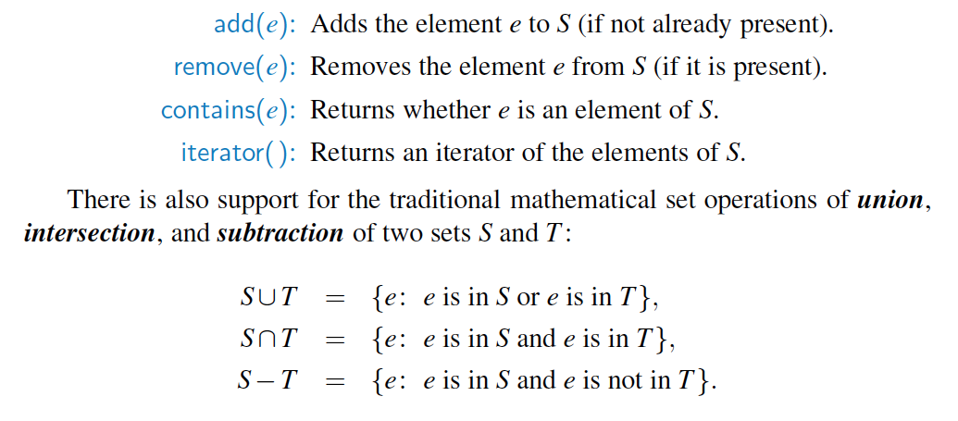
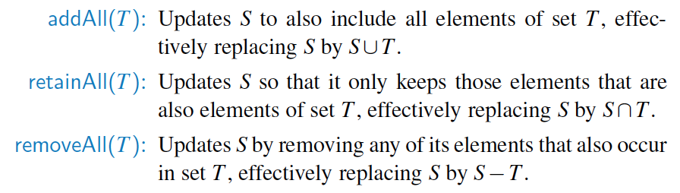
Set ADT

Slide 7
Set operations
The union of sets X and Y, denoted as X ∪ Y, is a set that contains every element from X, every element from Y, and no additional elements.
Ex: { 54, 19, 75 } ∪ { 75, 12 } = { 12, 19, 54, 75 }.
The intersection of sets X and Y, denoted as X ∩ Y, is a set that contains every element that is in both X and Y, and no additional elements.
Ex: { 54, 19, 75 } ∩ { 75, 12 } = { 75 }.
The difference of sets X and Y, denoted as X \ Y, is a set that contains every element that is in X but not in Y, and no additional elements.
Ex: { 54, 19, 75 } \ { 75, 12 } = { 54, 19 }.
The union and intersection operations are commutative, so X ∪ Y = Y ∪ X and X ∩ Y = Y ∩ X. The difference operation is not commutative.
Notes:
setUnion(set1, set2) {
result = Create new, empty set
for each (element in set1) {
Add element to result
}
for each (element in set2)
{
Add element to result
}
return result
}
setIntersection(set1, set2)
{
result = Create new, empty set
for each (element in set1)
{
if (setSearch(set2, element⇢key) != null)
{
Add element to result
}
}
return result
}
setDifference(set1, set2) {
result = Create new, empty set
for each (element in set1) {
if (SetSearch(set2, element⇢key) == null) {
Add element to result
}
}
return result
}

Slide 8
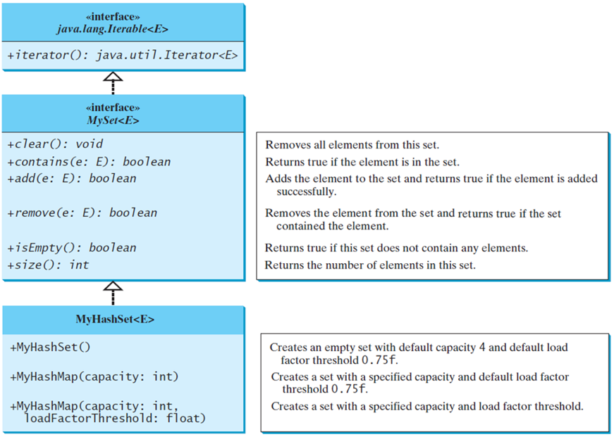
Implementing Set Using Hashing
MySet
MyHashSet
TestMyHashSet
Notes:
MySet less than symbol E greater than symbol which leads to the interface java.lang.lterable less than symbol E greater than symbol.
The codes for each are as follows.
java.lang.lterable less than symbol E greater than symbol.
+iterator left parenthesis right parenthesis colon java.util.Iterator less than symbol E greater than symbol.
Interface, MySet less than symbol E greater than symbol
+clear left parenthesis right parenthesis colon void. Removes all elements from this set.
+contains left parenthesis ecolon E right parenthesis colon Boolean. Returns true if the element is in the set.
+add left parenthesis ecolon E right parenthesis colon Boolean. Adds the element to the set and returns true if the element is added successfully.
+remove left parenthesis e colon E right parenthesis colon Boolean. Removes the element from the set and returns true if the set contained the element.
+isEmpty left parenthesis right parenthesis colon Boolean. Returns true if this set does not contain any elements.
+sizeOcolon int. Returns the number of elements in this set.
MyHashSet less than symbol E greater than symbol.
+MyHashSet left parenthesis right parenthesis. Creates an empty set with default capacity 4 and default load factor threshold 0.75f.
+MyHashMap left parenthesis capacity colon int right parenthesis. Creates a set with a specified capacity and default load factor threshold 0.75f.
+MyHashMap left parenthesis capacitycolon int, loadFactorThreshold colon float right parenthesis. Creates a set with a specified capacity and load factor threshold.
MySet: https://liveexample.pearsoncmg.com/html/MySet.html
MyHashSet: https://liveexample.pearsoncmg.com/html/MyHashSet.html
TestMyHashSet: https://liveexample.pearsoncmg.com/html/TestMyHashSet.html

Slide 9
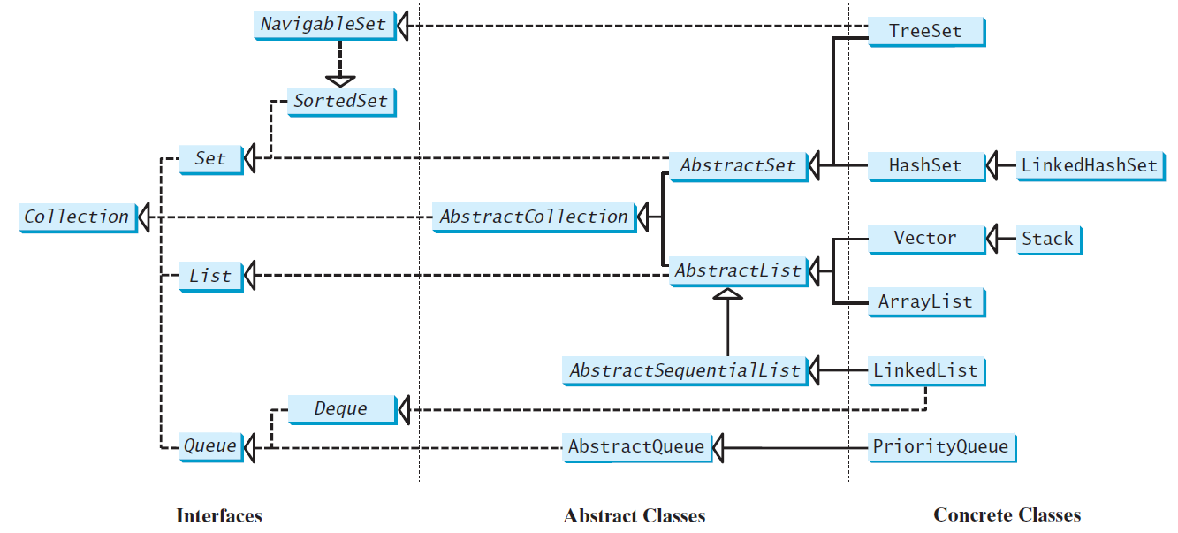
Review of Java Collection Framework hierarchy
Set and List are subinterfaces of Collection.
Notes:
The Set interface extends the Collection interface.
It does not introduce new methods or constants, but it stipulates that an instance of Set contains no duplicate elements.
The concrete classes that implement Set must ensure that no duplicate elements can be added to the set.
That is no two elements e1 and e2 can be in the set such that e1.equals(e2) is true.

Slide 10
The HashSet Class
The HashSet class is a concrete class that implements Set. It can be used to store duplicate-free elements. For efficiency, objects added to a hash set need to implement the hashCode method in a manner that properly disperses the hash code.

Slide 11
Example: Using HashSet and Iterator
This example creates a hash set filled with strings, and uses an iterator to traverse the elements in the list.
TestHashSet
Notes:
You can simplify the code in Lines 19-21 using a JDK 1.5 enhanced for loop without using an iterator, as follows:
for (Object element: set)
System.out.print(element.toString() + " ");

Slide 12
Example: Using LinkedHashSet
This example creates a hash set filled with strings, and uses an iterator to traverse the elements in the list.
TestLinkedHashSet

Slide 13
The SortedSet Interface and the TreeSet Class (
SortedSet is a subinterface of Set, which guarantees that the elements in the set are sorted. TreeSet is a concrete class that implements the SortedSet interface. You can use an iterator to traverse the elements in the sorted order. The elements can be sorted in two ways.
TestTreeSetSet

Slide 14
Case Study: Counting Keywords
This section presents an application that counts the number of the keywords in a Java source file.
CountKeywords

Slide 15
Maps

Slide 16

Dictionaries
When you want to look up …
The meaning of a word
An address
A phone number
A contact on your phone
These can be implemented in an ADT Dictionary
Notes:
Synonyms for ADT Dictionary
Map
Table
Associative array
An entry in the dictionary contains
Keyword, search key
Value

Slide 17
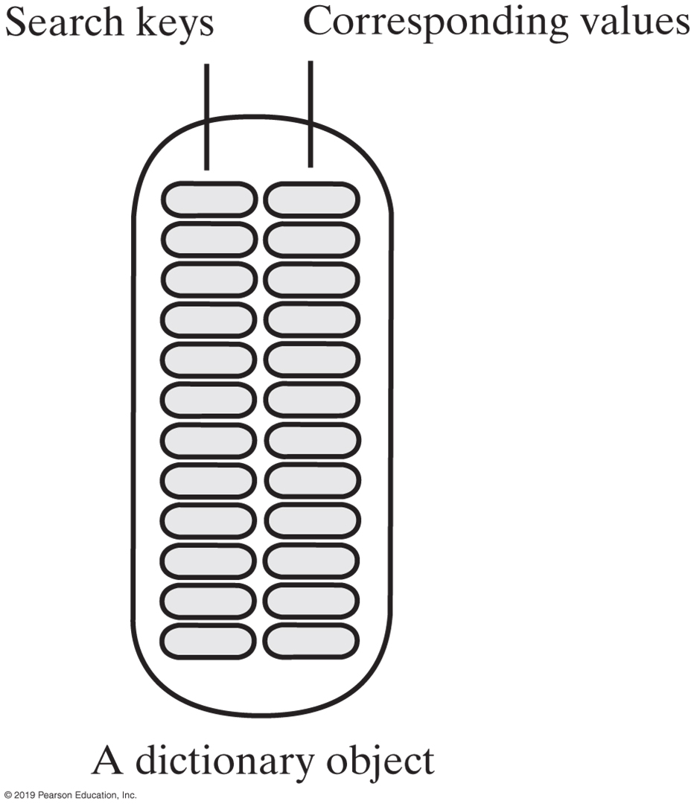
Specifications for the ADT Dictionary
Dictionary Data
Collection of pairs (k, v) of objects k and v,
k is the search key
v is the corresponding value
Number of pairs in the collection
Notes:
Map is a container object that stores a collection of key/value pairs.
It enables fast retrieval, deletion, and updating of the pair using key
Keys are like indexes
In list indexes are integers
In map key can be any object

Slide 18
Maps
A map models a searchable collection of key-value entries
The main operations of a map are for searching, inserting, and deleting items
Multiple entries with the same key are not allowed
Applications:
address book
student-record database

Slide 19
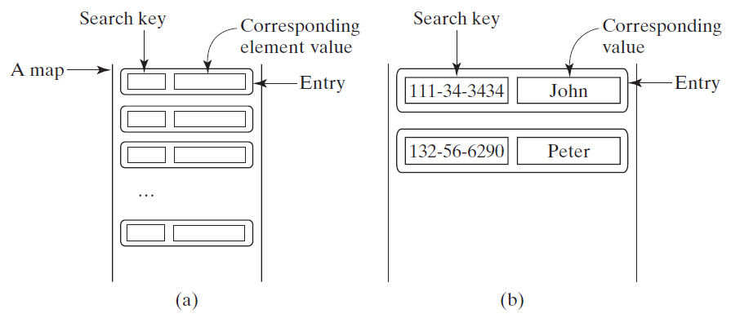
The Map Interface
The Map interface maps keys to the elements. The keys are like indexes. In List, the indexes are integer. In Map, the keys can be any objects.

Slide 20
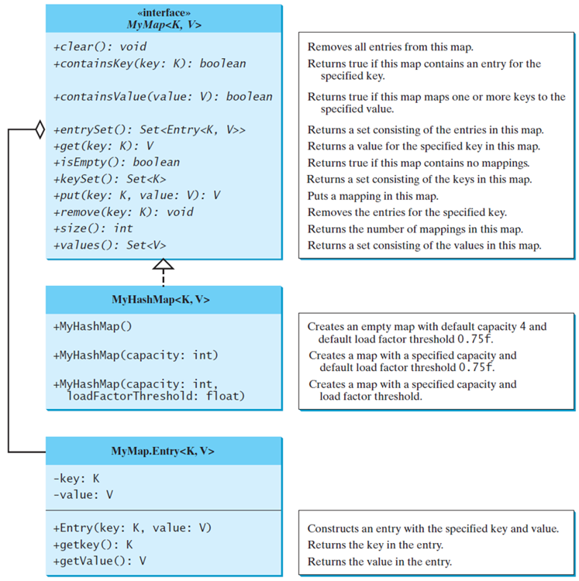
Implementing Map Using Hashing
MyMap
MyHashMap
TestMyHashMap
Notes:
Entry less than symbol K, V greater than symbol and MyHashMap less than symbol K, V greater than symbol leading to the interface MyMap less than symbol K, V greater than symbol, each with the codes and description as follows.
Interface, MyMap less than symbol K, V greater than symbol.
+clear left parenthesis right parenthesis semi colon void. Removes all entries from this map.
+containsKey left parenthesis key colon K right parenthesis colon Boolean. Returns true if this map contains an entry for the specified key.
+containsVOue left parenthesis value colon V right parenthesis colon Boolean. Returns true if this map maps one or more keys to the specified value.
+entrySet left parenthesis right parenthesis colon Set less than symbol Entry less than symbol K, V greater than symbol, greater than symbol. Returns a set consisting of the entries in this map.
+get left parenthesis key colon K right parenthesis colon V. Returns a value for the specified key in this map.
+isEmpty left parenthesis right parenthesis colon Boolean. Returns true if this map contains no mappings.
+keyset left parenthesis right parenthesis colon Set less than symbol K greater than symbol. Returns a set consisting of the keys in this map.
+put left parenthesis key colon K, value colon V right parenthesis colon V. Puts a mapping in this map.
+remove left parenthesis key colon K right parenthesis colon void. Removes the entries for the specified key.
+size left parenthesis right parenthesis colon int. Returns the number of mappings in this map.
+values left parenthesis right parenthesis colon Set less than symbol V greater than symbol. Returns a set consisting of the values in this map.
May HashMap less than symbol K, V greater than symbol.
+MyHashMap left parenthesis right parenthesis. Creates an empty map with default capacity 4 and default load factor threshold 0.75f.
+MyHashMap left parenthesis capacity colon int right parenthesis. Creates a map with a specified capacity and default load factor threshold 0. 75f.
+MyHashMap left parenthesis capacity colon int, loadFactorThreshold colon float right parenthesis. Creates a map with a specified capacity and load factor threshold.
MyMapEntry less than symbol K, V greater than symbol.
Hyphen key colon K.
Hyphen value colon V.
+Entry left parenthesis key colon K, value colon V right parenthesis. Constructs an entry with the specified key and value.
+getkey left parenthesis right parenthesis colon K. Returns the key in the entry.
+getValue left parenthesis right parenthesis colon V. Returns the value in the entry.
MyMap: https://liveexample.pearsoncmg.com/html/MyMap.html
MyHashMap: https://liveexample.pearsoncmg.com/html/MyHashMap.html
TestMyHashMap: https://liveexample.pearsoncmg.com/html/TestMyHashMap.html

Slide 21
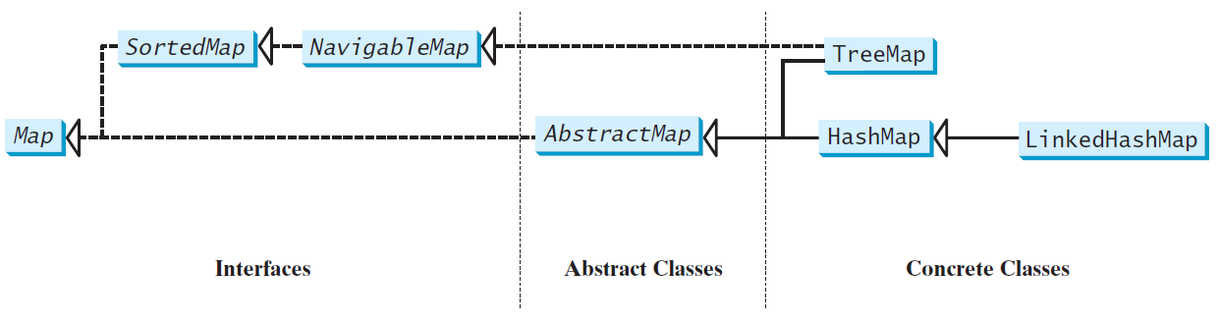
Map Interface and Class Hierarchy
An instance of Map represents a group of objects, each of which is associated with a key. You can get the object from a map using a key, and you have to use a key to put the object into the map.
Notes:
There are three types of maps:
HashMap, LinkedHashMap, and TreeMap.
Common features of the three are defined in the Map interface
Figure shows heir relationship

Slide 22
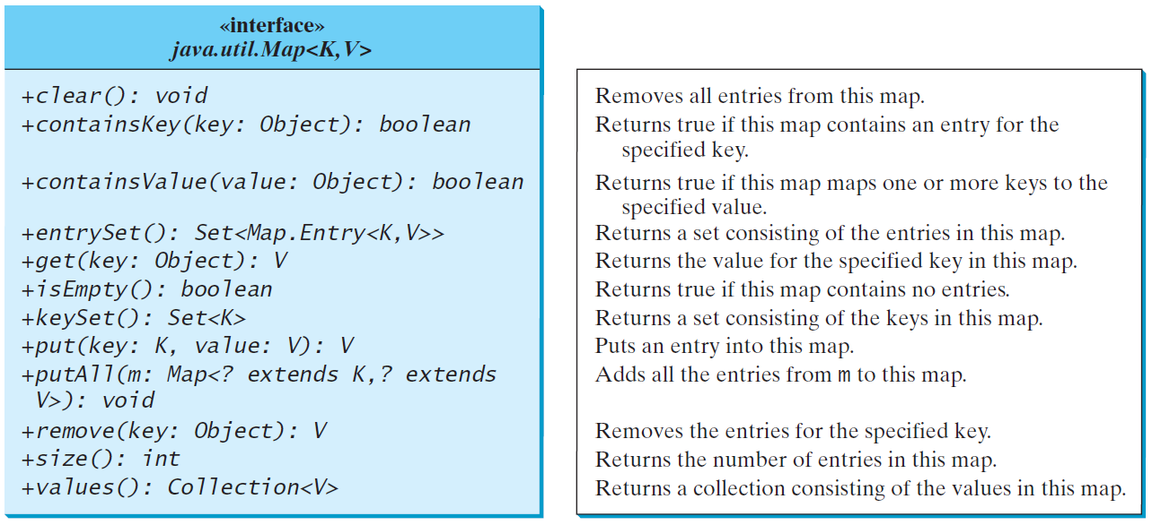
The Map Interface UML Diagram
Notes:
Map interface provides the methods for
Querying, updating, and getting a collection of values and a set of keys.
Update methods (clear, put, putAll, remove)
Query methods (containKey, containsValue, isEmpt, size)

Slide 23
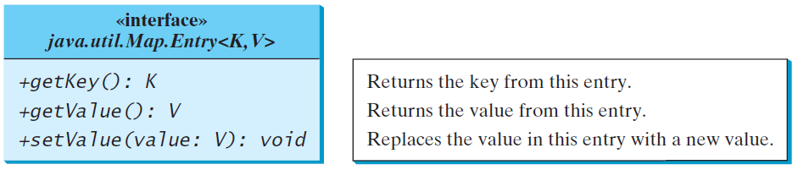
Entry
Notes:
Map.Entry interface operates on an entry in the map
Java 8 added a default forEach method in the Map interface

Slide 24
HashMap and TreeMap
The HashMap and TreeMap classes are two concrete implementations of the Map interface. The HashMap class is efficient for locating a value, inserting a mapping, and deleting a mapping. The TreeMap class, implementing SortedMap, is efficient for traversing the keys in a sorted order.

Slide 25
Example: Using HashMap and TreeMap
This example creates a hash map that maps borrowers to mortgages. The program first creates a hash map with the borrower’s name as its key and mortgage as its value. The program then creates a tree map from the hash map, and displays the mappings in ascending order of the keys.
TestMap

Slide 26
Case Study: Counting the Occurrences of Words in a Text
This program counts the occurrences of words in a text and displays the words and their occurrences in ascending order of the words. The program uses a hash map to store a pair consisting of a word and its count. For each word, check whether it is already a key in the map. If not, add the key and value 1 to the map. Otherwise, increase the value for the word (key) by 1 in the map. To sort the map, convert it to a tree map.
CountOccurrenceOfWords

