Slide 1
Searching and Algorithms Analysis

Slide 2
Executing Time
Suppose two algorithms perform the same task such as search (linear search vs. binary search). Which one is better? One possible approach to answer this question is to implement these algorithms in Java and run the programs to get execution time. But there are two problems for this approach:
First, there are many tasks running concurrently on a computer. The execution time of a particular program is dependent on the system load.
Second, the execution time is dependent on specific input. Consider linear search and binary search for example. If an element to be searched happens to be the first in the list, linear search will find the element quicker than binary search.

Slide 3
Growth Rate
Analyze algorithms independent of computers and specific input.
This approach approximates the effect of a change on the size of the input.
How fast an algorithm’s execution time increases as the input size increases.
Compare two algorithms by examining their growth rates.

Slide 4
Ignoring Multiplicative Constants
The linear search algorithm requires n comparisons in the worst-case and n/2 comparisons in the average-case. Using the Big O notation, both cases require O(n) time. The multiplicative constant (1/2) can be omitted. Algorithm analysis is focused on growth rate. The multiplicative constants have no impact on growth rates. The growth rate for n/2 or 100n is the same as n, i.e., O(n) = O(n/2) = O(100n).

Slide 5
Ignoring Non-Dominating Terms
Consider the algorithm for finding the maximum number in an array of n elements. If n is 2, it takes one comparison to find the maximum number. If n is 3, it takes two comparisons to find the maximum number. In general, it takes n-1 times of comparisons to find maximum number in a list of n elements. Algorithm analysis is for large input size. If the input size is small, there is no significance to estimate an algorithm’s efficiency. As n grows larger, the n part in the expression n-1 dominates the complexity. The Big O notation allows you to ignore the non-dominating part (e.g., -1 in the expression n-1) and highlight the important part (e.g., n in the expression n-1). So, the complexity of this algorithm is O(n).

Slide 6
Useful Mathematic Summations

Slide 7
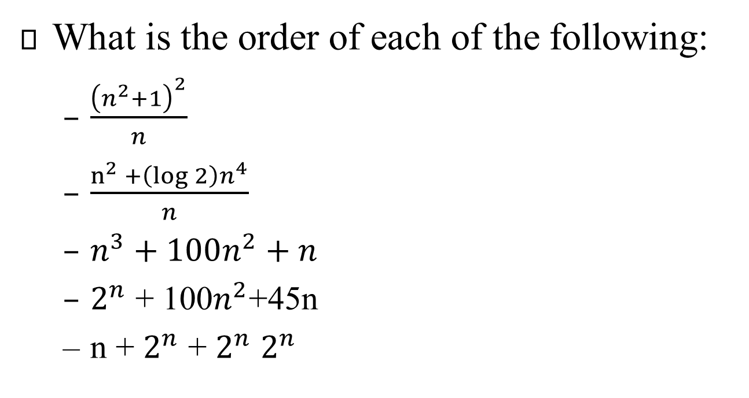
Check Point
What is the order of each of the following:
$\frac{{\left(n^{2}+1\right)}^{2}}{n}$
$\frac{n^{2}{+\left(\log{2}\right)n^{4}}}{n}$
$n^{3}+100n^{2}+n$
$2^{n}$ + 100$n^{2}$+45n
n + $2^{n}$ + $2^{n}$ $2^{n}$

Slide 8
Examples: Determining Big-O
Repetition
Sequence
Selection
Logarithm

Slide 9
Repetition: Simple Loops
for (i = 1; i <= n; i++) {
k = k + 5;
}
executed
n times
constant time
Time Complexity
T(n) = (a constant c) * n = cn = O(n)
Ignore multiplicative constants (e.g., “c”).

Slide 10
Repetition: Nested Loops
for (i = 1; i <= n; i++) {
for (j = 1; j <= n; j++) {
k = k + i + j;
}
}
executed
n times
inner loop
executed
n times
constant time
Time Complexity
T(n) = (a constant c) * n * n = cn² = O(n²)
Ignore multiplicative constants (e.g., “c”).

Slide 11
Repetition: Nested Loops
for (i = 1; i <= n; i++) {
for (j = 1; j <= 20; j++) {
k = k + i + j;
}
}
executed
n times
inner loop
executed
20 times
constant time
Time Complexity
T(n) = 20 * c * n = O(n)
Ignore multiplicative constants (e.g., 20*c)

Slide 12
Sequence
for (j = 1; j <= 10; j++) {
k = k + 4;
}
executed
10 times
for (i = 1; i <= n; i++) {
for (j = 1; j <= 20; j++) {
k = k + i + j;
}
}
executed
n times
inner loop
executed
20 times
Time Complexity
T(n) = c *10 + 20 * c * n = O(n)

Slide 13
Selection
O(n)
if (list.contains(e)) {
System.out.println(e);
}
else
for (Object t: list) {
System.out.println(t);
}
Let n be
list.size().
Executed
n times.
Time Complexity
T(n) = test time + worst-case (if, else)
= O(n) + O(n)
= O(n)

Slide 14
Logarithm: Analyzing Binary Search
The binary search algorithm presented in Lecture, BinarySearch.java, searches a key in a sorted array. Each iteration in the algorithm contains a fixed number of operations, denoted by c. Let T(n) denote the time complexity for a binary search on a list of n elements. Without loss of generality, assume n is a power of 2 and k=log n. Since binary search eliminates half of the input after two comparisons,
Notes:
Logarithmic Time
Ignoring constants and smaller terms, the complexity of the binary search algorithm is O(logn). An algorithm with the O(logn) time complexity is called a logarithmic algorithm. The base of the log is 2, but the base does not affect a logarithmic growth rate, so it can be omitted. The logarithmic algorithm grows slowly as the problem size increases. If you square the input size, you only double the time for the algorithm.

Slide 15
Check Point
Count the number of iterations in the following loops:
int cnt = 1; b) int cnt = 15;
while ( cnt < 30 ) while ( cnt < 30 )
cnt = cnt * 2; cnt = cnt * 3;
c) int cnt = 1; b) int cnt = 15;
while ( cnt < n ) while ( cnt < n )
cnt = cnt * 2; cnt = cnt * 3;

Slide 16
Check Point
Use the Big O notation to estimate the time complexity of the following methods:
public static void m(int n)
{
for( int i=0; i<n; ++i){
System.out.println(Math.random());
}
}
public static void m(int n)
{
for( int i=0; i<n; ++i){
for(int j=0; j<i; ++j)
System.out.println(Math.random());
}
}

Slide 17
Check Point
(c) public static void mC(int[] m) {
for (int i = 0; i < m.length; i++) {
System.out.print(m[i]);
}
for (int i = m.length - 1; i >= 0; ) {
System.out.print(m[i]); i--; }
}
(d) public static void mD(int[] m) {
for (int i = 0; i < m.length; i++) {
for (int j = 0; j < i; j++)
System.out.print(m[i] * m[j]);
}
}

Slide 18
Comparing Common Growth Functions
Constant time
Logarithmic time
Linear time
Log-linear time
Quadratic time
Cubic time
Exponential time

Slide 19
Comparing Common Growth Functions

Slide 20
Analyzing Tower of Hanoi
The Tower of Hanoi problem presented in Listing 18.7, TowerOfHanoi.java, moves n disks from tower A to tower B with the assistance of tower C recursively as follows:
Move the first n – 1 disks from A to C with the assistance of tower B.
Move disk n from A to B.
Move n - 1 disks from C to B with the assistance of tower A.
Let T(n) denote the complexity for the algorithm that moves disks and c denote the constant time to move one disk, i.e., T(1) is c. So,

Slide 21
Case Study: Fibonacci Numbers
/** The method for finding the Fibonacci number */
public static long fib(long index) {
if (index == 0) // Base case
return 0;
else if (index == 1) // Base case
return 1;
else // Reduction and recursive calls
return fib(index - 1) + fib(index - 2);
}

Slide 22
Case Study: Non-recursive version of Fibonacci Numbers
public static long fib(long n) {
long f0 = 0; // For fib(0)
long f1 = 1; // For fib(1)
long f2 = 1; // For fib(2)
if (n == 0)
return f0;
else if (n == 1)
return f1;
else if (n == 2)
return f2;
for (int i = 3; i <= n; i++) {
f0 = f1;
f1 = f2;
f2 = f0 + f1;
}
return f2;
}
Notes:
Obviously, the complexity of this new algorithm is O(n) . This is a tremendous improvement over the recursive algorithm.

Slide 23
Case Study: GCD Algorithms Version 1
public static int gcd(int m, int n) {
int gcd = 1;
for (int k = 2; k <= m && k <= n; k++) {
if (m % k == 0 && n % k == 0)
gcd = k;
}
return gcd;
}

Slide 24
Case Study: GCD Algorithms Version 2
for (int k = n; k >= 1; k--) {
if (m % k == 0 && n % k == 0) {
gcd = k;
break;
}
}

Slide 25
Euclid’s Algorithm Implementation
public static int gcd(int m, int n) {
if (m % n == 0)
return n;
else
return gcd(n, m % n);
}

