Slide 1
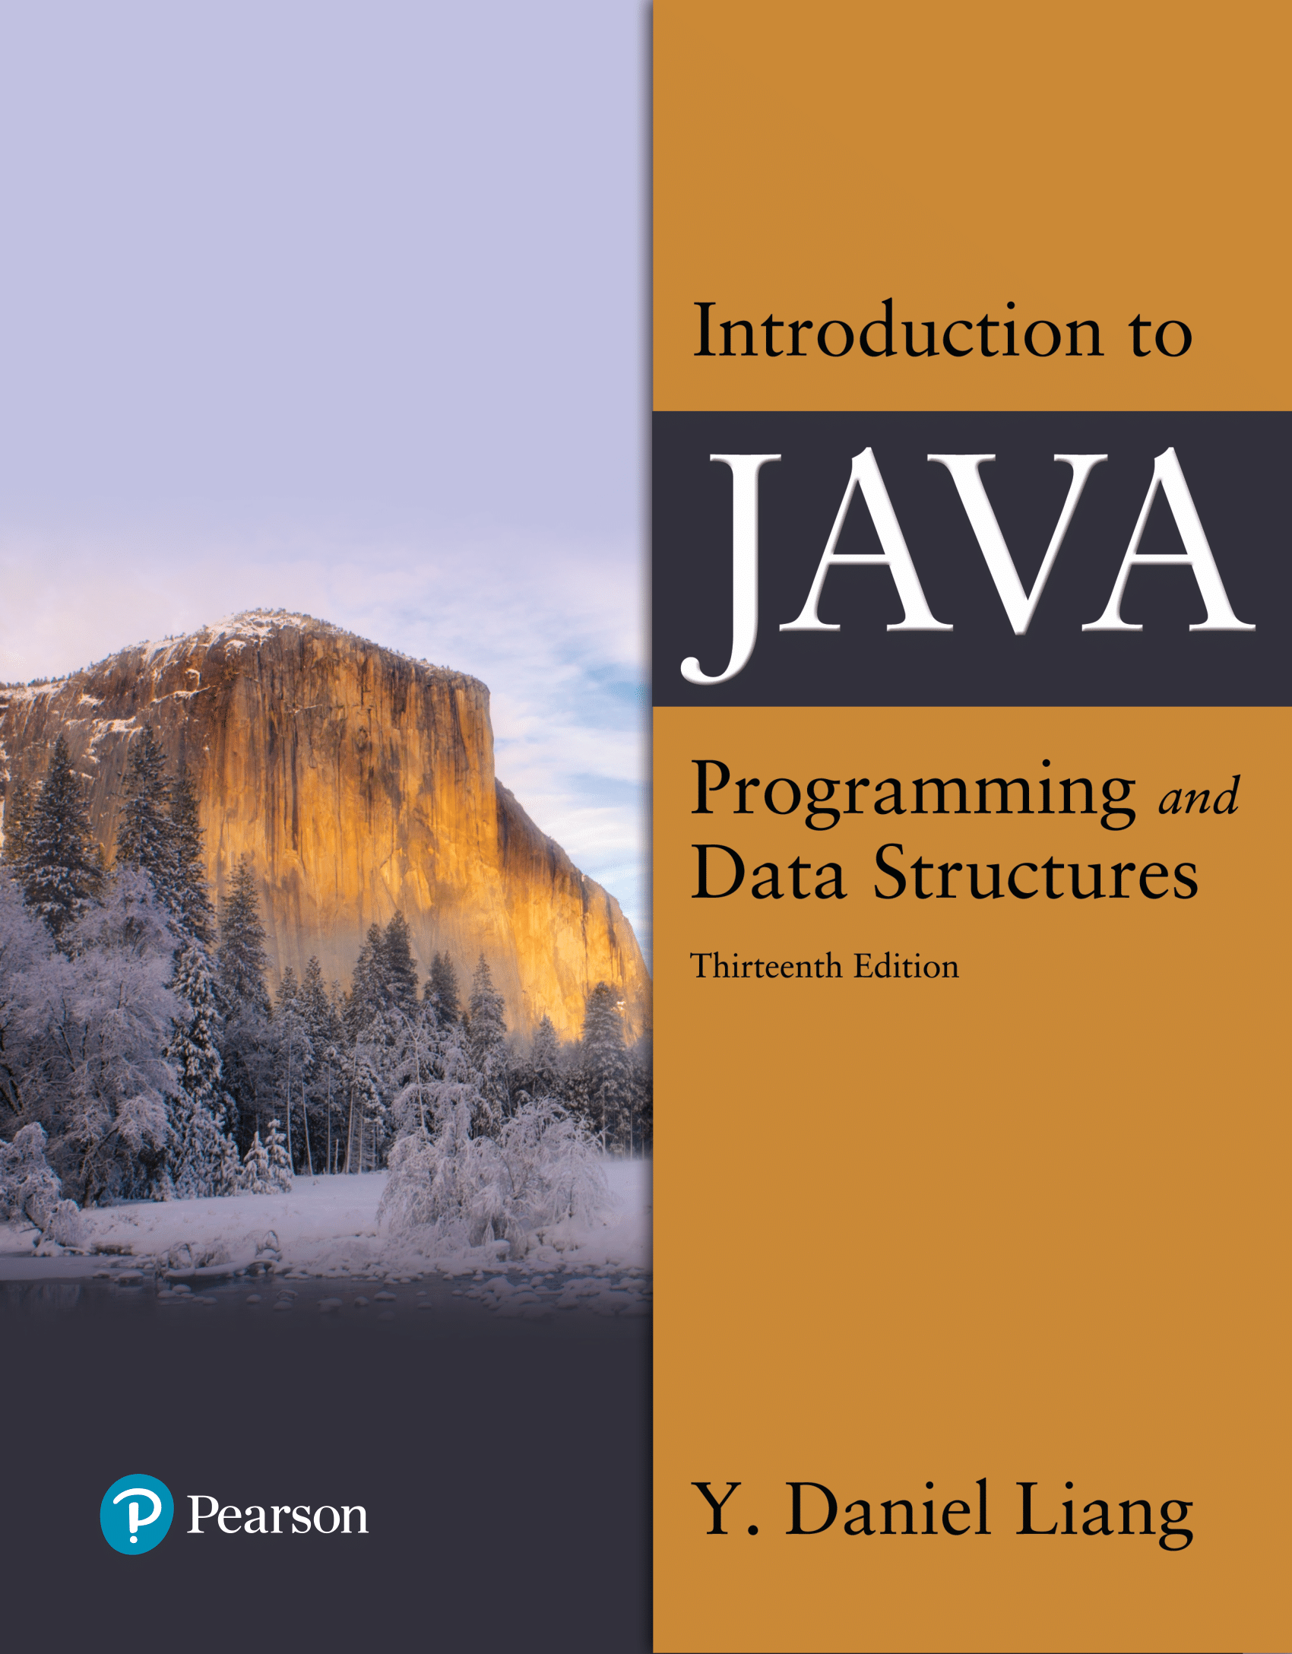

Introduction to Java Programming and Data Structures
Thirteenth Edition
Chapter 1
Introduction to Computers, Programs, and Java
Bahram Zartoshty
Email: Bahram.zartoshty@csun.edu
Copyright © 2024 Pearson Education, Inc. All Rights Reserved
Notes:
If this PowerPoint presentation contains mathematical equations, you may need to check that your computer has the following installed:
1) MathType Plugin
2) Math Player (free versions available)
3) NVDA Reader (free versions available)
Slides in this presentation contain hyperlinks. JAWS users should be able to get a list of links by using INSERT+F7

Slide 2
COMP 110/L Chapter 1
Bahram Zartoshty

Slide 3
Objectives
To understand computer basics, programs, and operating systems (§§1.2–1.4).
To understand the meaning of Java language specification, A P I, J D K, and I D E (§1.6).
To write a simple Java program (§1.7).
To display output on the console (§1.7).
To explain the basic syntax of a Java program (§1.7).
To create, compile, and run Java programs (§1.8).
To use sound Java programming style and document programs properly (§1.9).
To explain the differences between syntax errors, runtime errors, and logic errors (§1.10).
develop Java programs using NetBeans (§1.11).

Slide 4
What is Computer Science?
The fundamental core of Computer Science is problem solving.
Computers do not solve problems, you do
Computers are dumb!
It is up to you, the user, to approach a complex problem, study it, understand it, and develop a solution to it.
Computers only automate solutions

Slide 5
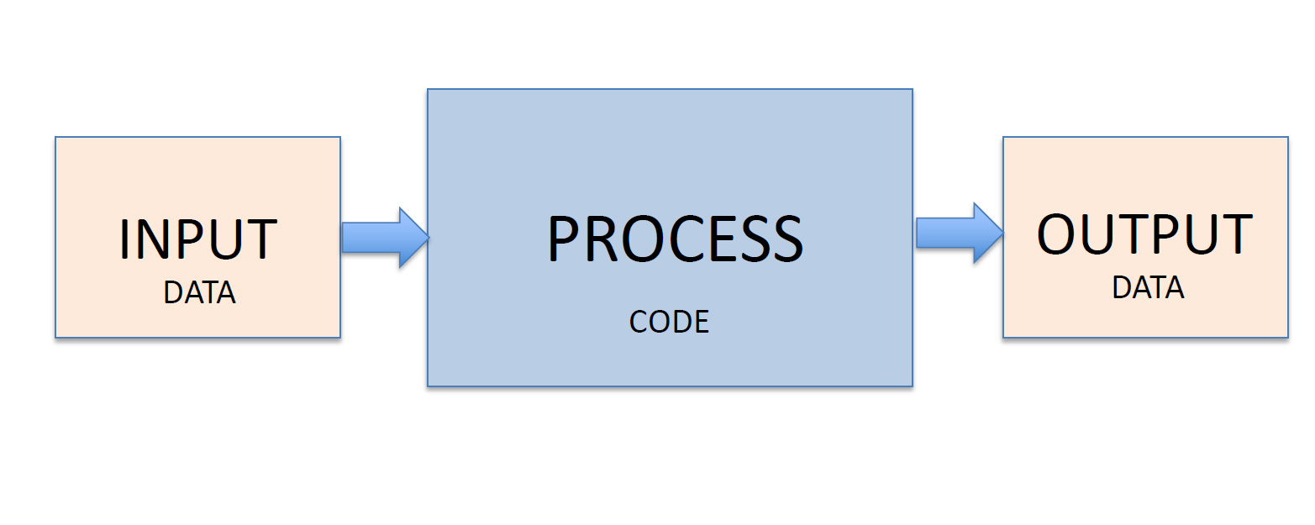
Computer System (IPO Model)

Slide 6
Computer Programs
A computer program is a sequence of instructions in a programming language that a computer can execute or interpret.
Java Programming Language
Object oriented Programming Language
Software
Set of programs that tell computer how to solve specific problem

Slide 7
Hardware
Physical Components
A computer consists of a CPU, memory, hard disk, floppy disk, monitor, printer, and communication devices.
Notes:
Click for zybook

Slide 8
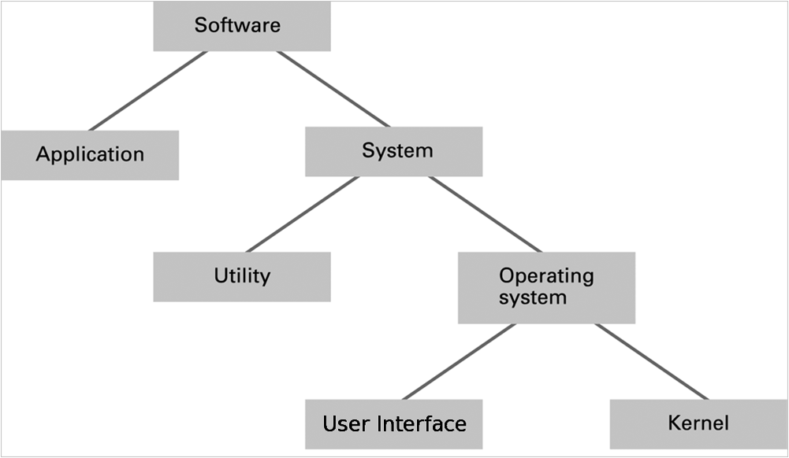
Software classification

Slide 9
Operating System Components
User Interface: Communicates with users
Text based (Shell)
Graphical user interface (GUI)
Kernel: Performs basic required functions
File manager
Device drivers
Memory manager
Scheduler and dispatcher

Slide 10
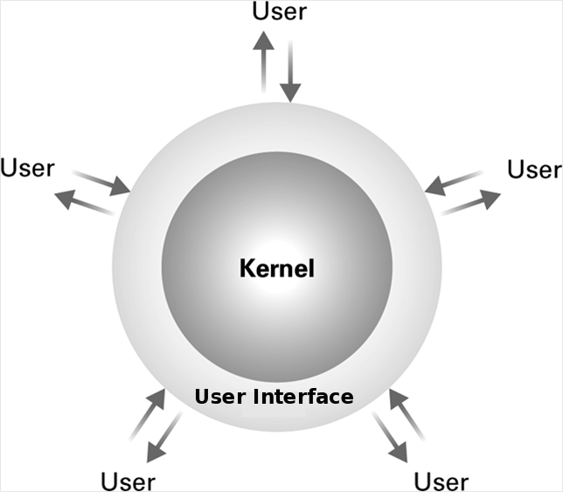
The user interface act as an intermediary between users and the operating system kernel

Slide 11
Computational Thinking
Algorithm
A process or set of rules to be followed in calculations or other problem-solving operations, especially by a computer

Slide 12
Programming languages are a lot like human languages in that they have syntax rules (grammar of the language) and semantics (meaning of the statement).

Slide 13


Syntax (Grammar)
Lisa goes to school.
Goes Lisa school to.

Slide 14


Semantics
Defines what valid sentences mean
Lisa goes to the school.

Slide 15
Programming Languages
Machine Language Assembly Language High-Level Language
Any computer can directly understand only its own machine language, defined by its hardware design.
Generally consist of strings of numbers (ultimately reduced to 1s and 0s) that instruct computers to perform their most elementary operations one at a time.
Machine dependent—a particular ma-chine language can be used on only one type of computer.
For example, to add two numbers, you might write an instruction in binary like this:
1101101010011010

Slide 16
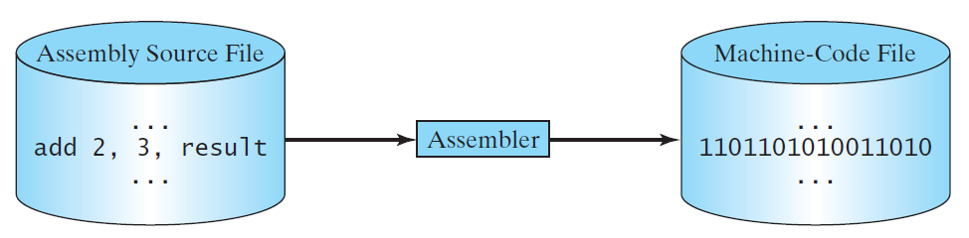
Programming Languages
Machine Language Assembly Language High-Level Language
Assembly languages were developed to make programming easy.
English-like abbreviations that represent elementary operations formed the basis of assembly languages.
Translator programs called assemblers convert early assembly-language programs to machine language.
For example, to add two numbers, you might write an instruction in assembly code like this:
ADDF3 R1, R2, R3

Slide 17
Programming Languages
Machine Language Assembly Language High-Level Language
The high-level languages are English-like and easy to learn and program.
Single statements accomplish substantial tasks.
A Java program to calculate the area of a circle might contain a single statement such as
area = radius * radius * Math.PI;
High-Level programs must be converted to Machine Language.

Slide 18

Java Assignment Statement syntax
area = radius * radius * Math.PI;
radius * radius * Math.PI = area;
area = radius * radius * Math.PI

Slide 19
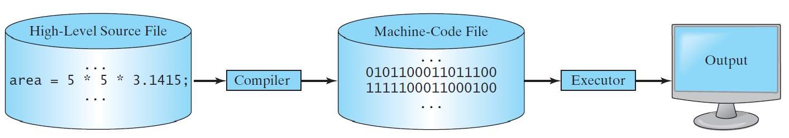
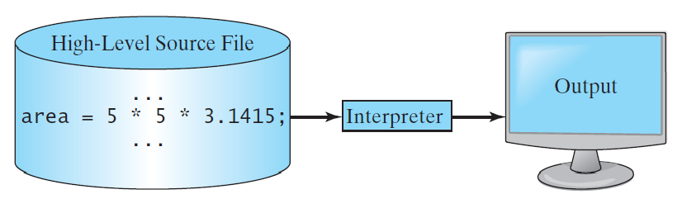
Interpreting/Compiling Source Code
Computer Program: (Source code / Source Program)
Compiling/Interpreting: (Object Code / Byte Code)
Notes:
A program written in a high-level language is called a source program or source code.
Because a computer cannot understand a source program, a source program must be translated into machine code for execution.

Slide 20
Java (Cont.)
Java Class Libraries
Rich collections of existing classes and methods
Also known as the Java APIs (Application Programming Interfaces).

Slide 21
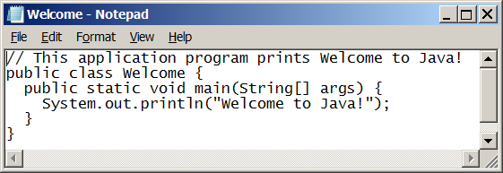
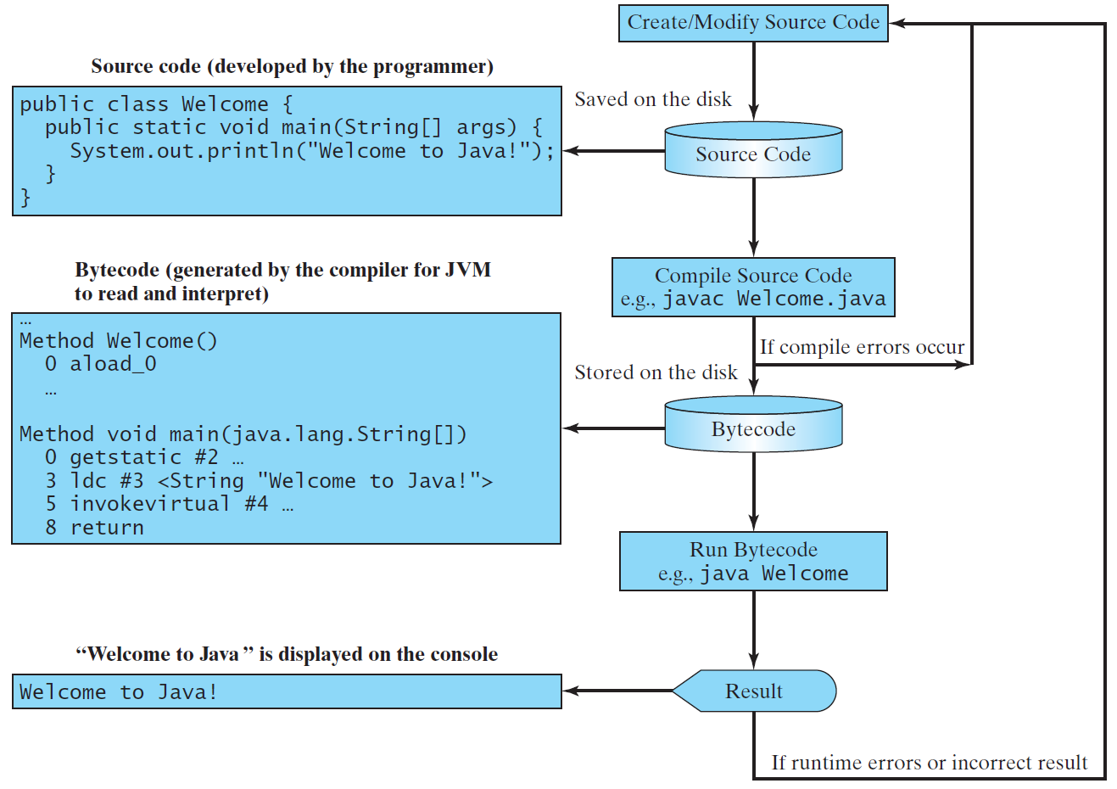
Java Development Environment
Edit → Compile → Load → Verify → Execute

Slide 22
Java SE Development Kit (JDK)
The JDK is a development environment for building applications, applets, and components using the Java programming language.
The JDK includes tools useful for developing and testing programs written in the Java programming language and running on the Java platform.
Java SE Development Kit

Slide 23
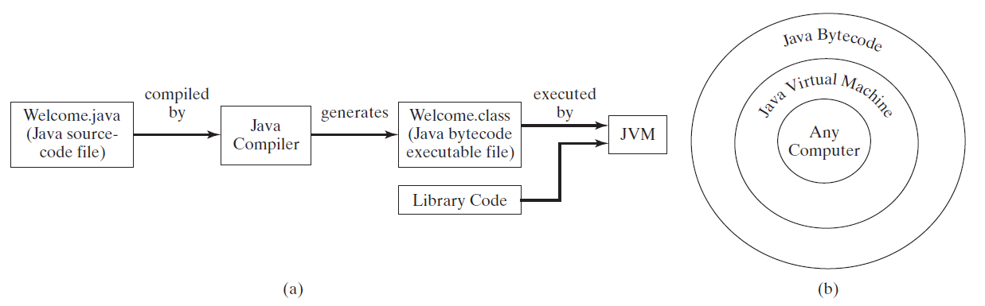
Java Development Environment (Cont.)
Bytecodes are portable (platform independent)
The JVM is invoked by the java command.
java Welcome
The JVM places the program in memory to execute it. (loading .class file)
As the classes are loaded, the bytecode verifier examines their bytecodes
Ensures that they’re valid and do not violate Java’s security restrictions.
The JVM executes the program’s bytecodes.

Slide 24
Your First Program in Java: Printing a Line of Text
Java application
A computer program that executes when you use the java command to launch the Java Virtual Machine (JVM).
/* File: Welcome.java
This program prints Welcome to Java!
*/
public class Welcome {
public static void main(String[] args) {
System.out.println( "Welcome to Java!” );
} // end main method
} // end class Welcome

Slide 25
Programming Style and Documentation
Appropriate Comments
Naming Conventions
Proper Indentation and Spacing Lines
Block Styles

Slide 26
Programming Errors
Syntax Errors
Detected by the compiler
Runtime Errors
Causes the program to abort
Logic Errors
Produces incorrect result

Slide 27
Syntax Errors
public class Welcome {
public static main(String[] args) {
System.out.println("Welcome to Java);
}
}

Slide 28
Runtime Errors
public class Welcome {
public static void main(String[] args) {
System.out.println(1 / 0);
}
}

Slide 29
Logic Errors
public class Circle {
public static void main(String[] args) {
System.out.print(“Area of a circle with radius 5 is “);
System.out.println( 5 * Math.PI );
}
}

