Slide 1
Multidimensional Arrays

Slide 2
Motivations (1 of 2)
Thus far, you have used one-dimensional arrays to model linear collections of elements. You can use a two-dimensional array to represent a matrix or a table. For example, the following table that describes the distances between the cities can be represented using a two-dimensional array.
Distance Table (in miles)
Blank | Chicago | Boston | New York | Atlanta | Miami | Dallas | Houston
Chicago | 0 | 983 | 787 | 714 | 1375 | 967 | 1087
Boston | 983 | 0 | 214 | 1102 | 1763 | 1723 | 1842
New York | 787 | 214 | 0 | 888 | 1549 | 1548 | 1627
Atlanta | 714 | 1102 | 888 | 0 | 661 | 781 | 810
Miami | 1375 | 1763 | 1549 | 661 | 0 | 1426 | 1187
Dallas | 967 | 1723 | 1548 | 781 | 1426 | 0 | 239
Houston | 1087 | 1842 | 1627 | 810 | 1187 | 239 | 0

Slide 3
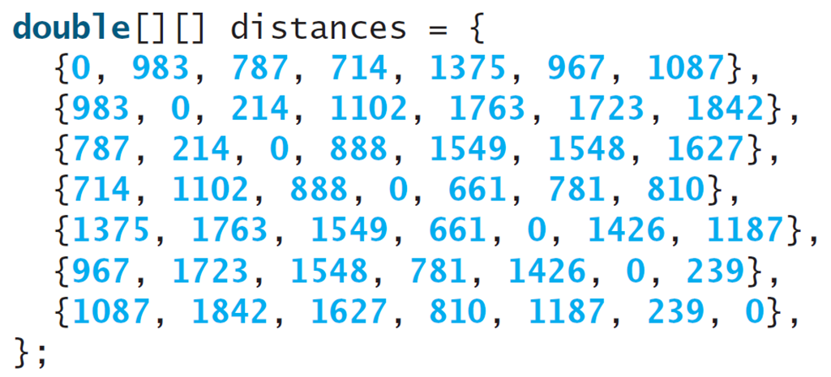
Motivations (2 of 2)
Notes:
Line 1, indicates double open braces close braces open braces close braces distance equal to open braces. Line 2, open braces 0, 983, 787, 714, 1375, 967, 1087 close braces comma. Line 3, open braces 983, 0, 214, 1102, 1763, 1723, 1842 close braces comma. Line 4, open braces 787, 214, 0, 888, 1549, 1548, 1627 close braces comma. Line 5, open braces 714, 1102, 888, 1549, 1548, 1627 close braces comma. Line 6, open braces 1375, 1763, 1549, 661, 781, 810 close braces comma. Line 7, open braces 967, 1723, 1548, 781, 1426, 0, 239 close braces comma. Line 8, open braces 1087, 1842, 1627, 810, 1187, 239, 0 close braces comma. Line 9, close braces semicolon.

Slide 4
Objectives (1 of 2)
8.1 To give examples of representing data using two-dimensional arrays (§8.1).
8.2 To declare variables for two-dimensional arrays, create arrays, and access array elements in a two-dimensional array using row and column indexes (§8.2).
8.3 To program common operations for two-dimensional arrays (displaying arrays, summing all elements, finding the minimum and maximum elements, and random shuffling) (§8.3).
8.4 To pass two-dimensional arrays to methods (§8.4).

Slide 5
Declare/Create Two-dimensional Arrays
// Declare array ref var
dataType[][] refVar;
// Create array and assign its reference to variable
refVar = new dataType[10][10];
// Combine declaration and creation in one statement
dataType[][] refVar = new dataType[10][10];
// Alternative syntax
dataType refVar[][] = new dataType[10][10];

Slide 6
Declaring Variables of Two-dimensional Arrays and Creating Two-dimensional Arrays
int[][] matrix = new int[10][10];
or
int matrix[][] = new int[10][10];
matrix[0][0] = 3;
for (int i = 0; i < matrix.length; i++)
for (int j = 0; j < matrix[i].length; j++)
matrix[i][j] = (int)(Math.random() * 1000);
double[][] x;

Slide 7
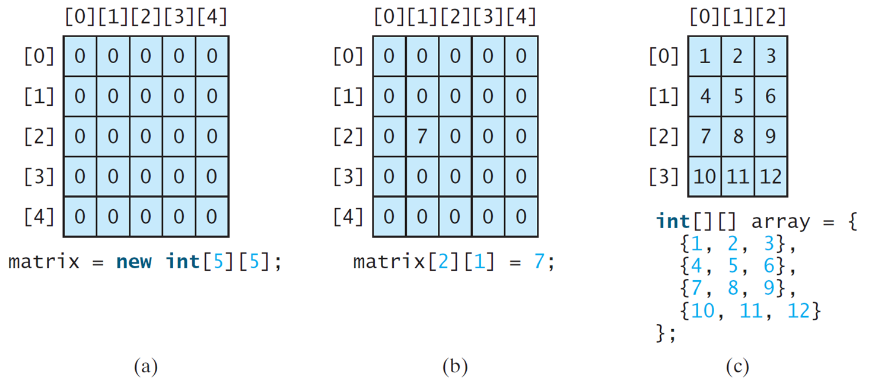
Two-dimensional Array Illustration
matrix.length? 5
matrix[0].length? 5
array.length? 4
array[0].length? 3
Notes:
(a) A 5 by 5 array with columns and rows numbered 0 to 4. Each element in the array is 0. The text reads, matrix = new int 5 by 5.
(b) A 5 by 5 array with columns and rows numbered 0 to 4. Each element in the array is 0. The text reads, matrix 2 by 1 = 7.
(c) A 4 by 3 array with columns numbered 0 to 2 and rows numbered 0 to 3. The row entries are as follows.
Row 0. 1, 2, 3.
Row 1. 4, 5, 6.
Row 2. 7, 8, 9.
Row 3. 10, 11, 12.
The text reads, int left bracket right bracket, left bracket right bracket array = left brace
Left brace 1, 2, 3 right brace
Left brace 4, 5, 6 right brace
Left brace 7, 8, 9 right brace
Left brace 10, 11, 12 right brace
Right brace.

Slide 8
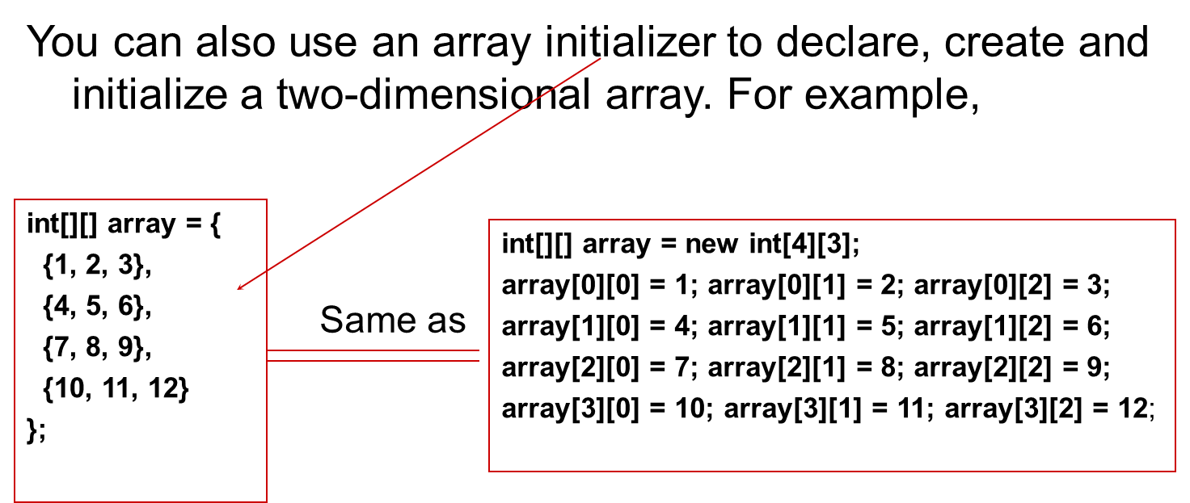
Declaring, Creating, and Initializing Using Shorthand Notations
Notes:
The computer code consists 6 lines. Line 1, indicates i n t open braces close braces open braces close braces array equal to open braces. Line 2, open braces 1, 2, 3 close braces comma. Line 3, open braces 4, 5, 6 close braces comma. Line 4, open braces 7, 8, 9 close braces comma. Line 5, open braces 10, 11, 12 close braces. Line 6, close braces semicolon. A right side text box also shows the Two-dimensional Arrays. The computer code consists 5 lines. Line 1, indicates i n t open braces close braces open braces close braces array equal to new i n t open braces four close braces open braces three close braces semicolon. Line 2, array open braces zero close braces open braces zero close braces equal to one semicolon array open braces zero close braces open braces one close braces equal to two semicolon array open braces zero close braces open braces two close braces equal to three semicolon. Line 3, array open braces one close braces open braces zero close braces equal to four semicolon array open braces one close braces open braces one close braces equal to five semicolon array open braces one close braces open braces two close braces equal to six semicolon. Line 4, array open braces two close braces open braces zero close braces equal to seven semicolon array open braces two close braces open braces one close braces equal to eight semicolon array open braces two close braces open braces two close braces equal to nine semicolon. Line 5, array open braces three close braces open braces zero close braces equal to ten semicolon array open braces three close braces open braces one close braces equal to eleven semicolon array open braces three close braces open braces two close braces equal to twelve semicolon.

Slide 9
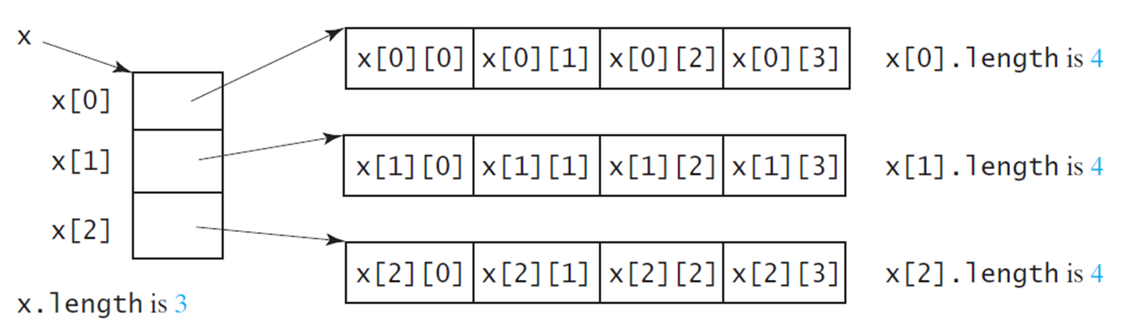
Lengths of Two-dimensional Arrays (1 of 2)
int[][] x = new int[3][4];
Notes:
The boxes are labeled, x 0, x 1, and x 2. The text at the bottom reads, x dot length is 3.
The first box contains four arrays as x 0 by 0, x 0 by 1, x 0 by 2, and x 0 by 3. The text reads, x 0 dot length is 4.
The second box contains four arrays as x 1 by 0, x 1 by 1, x 1 by 2, and x 1 by 3. The text reads, x 1 dot length is 4.
The third box contains four arrays as x 2 by 0, x 2 by 1, x 2 by 2, and x 2 by 3. The text reads, x 2 dot length is 4.

Slide 10
Lengths of Two-dimensional Arrays (2 of 2)
int[][] array = {
{1, 2, 3},
{4, 5, 6},
{7, 8, 9},
{10, 11, 12}
};
array.length
array[0].length
array[1].length
array[2].length
array[3].length
array[4].length ArrayIndexOutOfBoundsException

Slide 11
Ragged Arrays (1 of 2)
Each row in a two-dimensional array is itself an array. So, the rows can have different lengths. Such an array is known as a ragged array. For example,
int[][] matrix = {
{1, 2, 3, 4, 5},
{2, 3, 4, 5},
{3, 4, 5},
{4, 5},
{5}
};
matrix.length is 5
matrix[0].length is 5
matrix[1].length is 4
matrix[2].length is 3
matrix[3].length is 2
matrix[4].length is 1

Slide 12
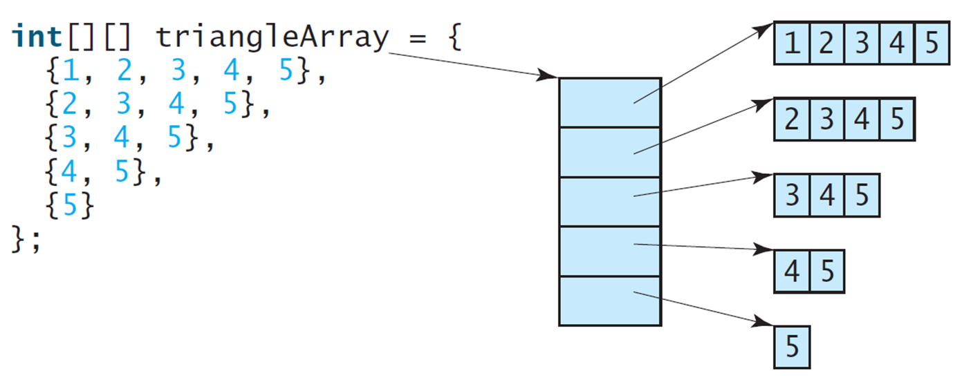
Ragged Arrays (2 of 2)
Notes:
Left brace 1, 2, 3, 4, 5 right brace,
Left brace 2, 3, 4, 5 right brace,
Left brace 3, 4, 5 right brace,
Left brace 4, 5 right brace,
Left brace 5 right brace
right brace
An arrow from triangleArray point to a column with five boxes. The top box contains numbers from 1 to 5, the second box contains numbers from 2 to 5, the third box contains numbers from 3 to 5, the fourth box contains numbers from 4 to 5, and the fifth box contains number 5.

Slide 13
Processing Two-Dimensional Arrays
See the examples in the text.
(Initializing arrays with random/input values)
(Printing arrays)
(Summing all elements)
(Summing all elements by column)
(Summing all elements by row)
(Which row has the largest sum)
(Finding the smallest index of the largest element)
(Random shuffling)

Slide 14
Passing Tow-Dimensional Arrays to Methods
PassTwoDimensionalArray
Notes:
PassTwoDimensionalArray: https://liveexample.pearsoncmg.com/html/PassTwoDimensionalArray.html

