Slide 1
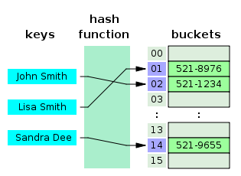
Hashing

Slide 2
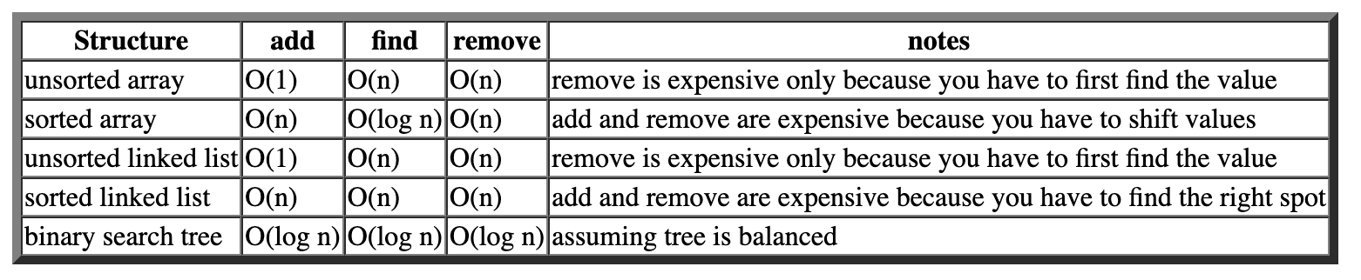
So Far
Obviously the well-behaved structure here is the binary search tree because everything becomes O(log n).
That's why the Java class libraries include tree implementations of sets and maps.
But it turns out you can do even better. With a structure known as a hash table, you can get O(1) for each of these operations.

Slide 3
Objectives
Basic Concept
Hash Functions
Collision Resolution
Runtimes
Notes:
To understand what hashing is and for what hashing is used.
To obtain the hash code for an object and design the hash function to map a key to an index.
To handle collisions using open addressing.
To know the differences among linear probing, quadratic probing, and double hashing.
To handle collisions using separate chaining.
To understand the load factor and the need for rehashing.

Slide 4
Why Hashing?
The preceding chapters introduced search trees. An element
can be found in
time in a well-balanced search tree.
Is there a more efficient way to search for an element in a container? This chapter introduces a technique called hashing. You can use hashing to implement a map or a set
to search, insert, and delete an element in

Slide 5
Introduction
Suppose there is a set of data M
There is a set of data that we actually care about storing D, where D << M
What is our ideal data structure?
The operation should run in O(1) time
What are some difficulties with this?
Notes:
Any data we might want to store is a member of this set. For example, M might be the set of all strings
For an English Dictionary, D might be the set of English words
The data structure should use O(D) memory
No extra memory is allocated
Accesses should be as fast as possible
Need to know the size of D in advance or lose memory to pointer overhead

Slide 6
Hashing
Memory: The Hash Table
Consider an array of size c * D
Each index in the array corresponds to some element in M that we want to store.
The data in D does not need any particular ordering

Slide 7











THE HASH TABLE
How can we do this?
M
D

Slide 8




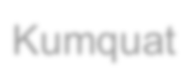
THE HASH TABLE
What is the problem here?
M
Apple
Pear
Orange
Durian
Kumquat
D

Slide 9
THE HASH TABLE
What is the problem here?
Takes O(D) time to find the word in the list!
M
Apple
Pear
Orange
Durian
Kumquat
D

Slide 10
THE HASH TABLE
What is the problem here?
Takes O(D) time to find the word in the list
Same problem with sorted arrays!
M
Apple
Durian
Kumquat
Orange
Pear
D

Slide 11
THE HASH TABLE
What is another solution?
M
Apple
Pear
Orange
Durian
Kumquat
D

Slide 12
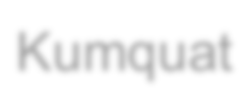



THE HASH TABLE
What is another solution?
Random mapping
M
Kumquat
Pear
Durian
Apple
Orange
D
Notes:
Can’t retrieve the random variable, O(D) search!

Slide 13


THE HASH TABLE
What about a pseudo-random mapping?
Kumquat Pear
D
h(x)
M
Durian
Apple
Orange
Notes:
This is “the hash function”

Slide 14
Map
A map is a data structure that stores entries. Each entry contains two parts: key and value. The key is also called a search key, which is used to search for the corresponding value. For example, a dictionary can be stored in a map, where the words are the keys and the definitions of the words are the values.
A map is also called a dictionary, a hash table, or an associative array. The new trend is to use the term map.
<key,value>
Map key to an index in HashTable

Slide 15
Hash Tables
hash table
0
 | ⁞
size -1
A hash table is an array of some fixed size
Basic idea:
The goal:
Aim for constant-time find, insert, and delete "on average" under reasonable assumptions
hash function:
index = h(key)
key space (e.g., integers, strings)

Slide 16
What Is Hashing?
If you know the index of an element in the array, you can retrieve
the element using the index in
time. So, can we store the
values in an array and use the key as the index to find the value? The answer is yes if you can map a key to an index.
The array that stores the values is called a hash table. The function that maps a key to an index in the hash table is called a hash function.
Hashing is a technique that retrieves the value using the index obtained from key without performing a search.

Slide 17
More General Kinds of Keys
But what should we do if our keys are not integers in the range from 0 to N – 1?
Use a hash function to map general keys to corresponding indices in a table.
For instance, the last four digits of a Social Security number.
0
∅
1
025-612-0001
2
981-101-0002
3
∅
4
451-229-0004
…

Slide 18
Hashing
A technique that determines an index into a table using only an entry’s search key
Hash function
Takes a search key and produces the integer index of an element in the hash table
Search key is mapped, or hashed, to the index
hashTable
0
Table_size-1
index = hash(key)

Slide 19
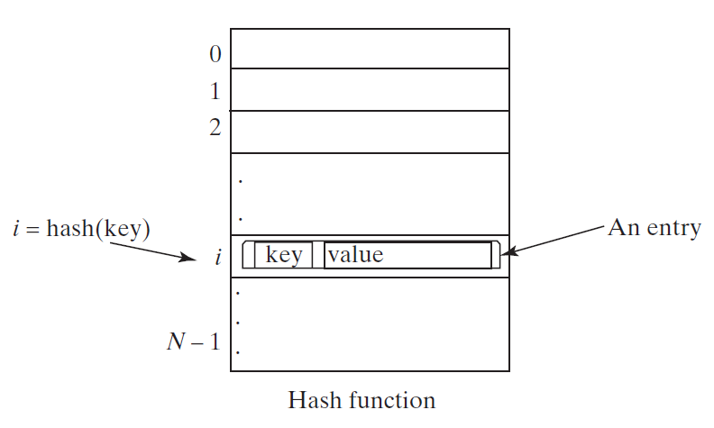
Hash Function and Hash Codes
A typical hash function:
first converts a search key to an integer value called a hash code,
Compresses the hash code into an index to the hash table.

Slide 20
Ideal Hashing
Simple algorithms for the dictionary operations that add and retrieve
put(k, v):
insert entry (k, v) into the map M; if key k is not already in M,
then return null; else, return old value associated with k
get(k): if the map M has an entry with key k, return its associated value; else, return null

Slide 21
Hash Functions and Hash Tables
A hash function h maps keys of a given type to integers in a fixed interval [0, N − 1]
Example: h(x) = x mod N is a hash function for integer keys
The integer h(x) is called the hash value of key x
A hash table for a given key type consists of
Hash function h
Array (called table) of size N
When implementing a map with a hash table, the goal is to store item (k, o) at index i = h(k)

Slide 22
Typical Hashing
Typical hash functions perform two steps:
Convert search key to an integer
Called the hash code.
Compress hash code into the range of indices for hash table.
Algorithm getHashIndex(phoneNumber)
// Returns an index to an array of tableSize elements.
i = last four digits of phoneNumber
return i % tableSize
(800)555-1234
hashCode
Index (0..table_size-1)

Slide 23










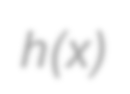













HASH EXAMPLE
Let’s consider an example. We want to save 10 numbers from all possible Java ints
What is a simple hash function?
ints
0
1
2
3
4
5
6
7
8
9
h(x)

Slide 24
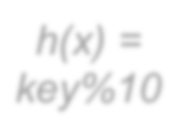
HASH EXAMPLE
Let’s consider an example. We want to save 10 numbers from all possible Java ints
What is a simple hash function?
ints
0
1
2
3
4
5
6
7
8
9
h(x) = key%10

Slide 25
HASH EXAMPLE
Let’s insert(519) table
ints
0
1
2
3
4
5
6
7
8
9
h(x) = key%10

Slide 26
HASH EXAMPLE
Let’s insert(519) table
Where does it go?
ints
0
1
2
3
4
5
6
7
8
9
h(x) = key%10

Slide 27
HASH EXAMPLE
Let’s insert(519) table
Where does it go?
519%10 =
ints
0
1
2
3
4
5
6
7
8
9
h(x) = key%10

Slide 28



HASH EXAMPLE
Let’s insert(519) table
Where does it go?
519%10 = 9
0
1
2
519
h(x) = key%10
3
4
5
6
7
8
9: 519

Slide 29
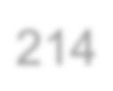

HASH EXAMPLE
Insert(214)
214
0
1
2
519
h(x) = key%10
3
4
5
6
7
8
9: 519

Slide 30

HASH EXAMPLE
Insert(214)
214
0
1
2
519
h(x) = key%10
3
4: 214
5
6
7
8
9: 519

Slide 31


HASH EXAMPLE
insert(1001)
214
0
1
2
519
h(x) = key%10
3
1001
4: 214
5
6
7
8
9: 519

Slide 32

HASH EXAMPLE
insert(1001)
214
0
1: 1001
2
519
h(x) = key%10
3
1001
4: 214
5
6
7
8
9: 519

Slide 33
HASH EXAMPLE
Is there a problem here?
214
0
1: 1001
2
519
h(x) = key%10
3
1001
4: 214
5
6
7
8
9: 519

Slide 34
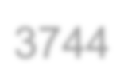

HASH EXAMPLE
Is there a problem here?
insert(3744)
214
0
1: 1001
2
519
h(x) = key%10
3
4: 214
1001
5
6
3744
7
8
9: 519

Slide 35
HASH EXAMPLE
Is there a problem here?
insert(3744)
214
0
1: 1001
2
519
h(x) = key%10
3
4: 214
1001
5
6
3744
7
8
9: 519

Slide 36
HASH EXAMPLE
Is there a problem here?
insert(3744)
This is called a collision!
214
0
1: 1001
2
519
h(x) = key%10
3
4: 214
1001
5
6
3744
7
8
9: 519

Slide 37
Hashing
A perfect hash function
Maps each search key into a unique location of the hash table
Possible if all the search keys are known
Collisions
Occur when the hash function maps more than one item into the same array location
Collision-resolution schemes
Assign locations in the hash table to items with different search keys when the items are involved in a collision
Requirements for a hash function
Be easy and fast to compute
Place items evenly throughout the hash table

Slide 38
Computing Hash Codes
Java’s base class Object has a method hashCode that returns an integer hash code
By default returns memory address of the object
A class should define its own version of hashCode
Override: whenever the equals() method is overridden to ensure two equal objects return the same hashcode
Multiple execution of a program with same key should give same integer
Two unequal objects may have the same hashcode, must avoid too many such cases

Slide 39
A hash code for a string
Approach 1:
Using a character’s Unicode integer is common

Slide 40
Approach 2:
Generate a hash code that takes the position of characters into consideration.
Let the hash code be:
s ₀ ∗ b ^{( n − 1 )} + s ₁ ∗ b ^{( n − 2 )} + ⋯ + s _{n − 1} , where s_{i} is s.charAt(i)
The expression is a polyomial for some positive value (b).
Polynomial hash code
(…((s₀ ∗ b+s₁) ∗ b+s₂) ∗ b+⋯+s_{n−2}) ∗ b+s_{n-1}

Slide 41
Hash Code for a Primitive type
If data type is int (32 bits) → Integer.hashCode()
Use the key itself
For byte(8 bits), short(16 bits), char (16 bits):
Cast as int
For long (64 bits)
Casting from long to int (not good idea)
All keys that differ in only the first 32 bits will have the same hash code.
To take the first 32 bits into consideration (folding)
divide the 64 bits into two halves (bit-wise right-shift operator)
perform the exclusive-or operation to combine the two halves
Hash code for long key:
int hashCode = (int)(key ^ (key >> 32));

Slide 42
Other primitive types (Manipulate internal binary representations)
Hash code for float key (32 bits) → Float.hashCode():
Float.floatToIntBits(key) → Float.floatToIntBits(12.2f) → 1094923059
Float.floatToIntBits(2.2f) → 1074580685
Hash code for double key (64 bits) → Double.hashCode():
long bits = Double.doubleToLongBits(key);
int hashCode = (int)(bits ^ (bits >> 32));

Slide 43
What to Hash?
We will focus on two most common things to hash: ints and strings
If you have objects with several fields, it is usually best to hash most of the "identifying fields" to avoid collisions:
class Person { String firstName, middleName, lastName;
Date birthDate;
…
}
An inherent trade-off:
hashing-time vs. collision-avoidance
use these four values
Notes:
If class contains a field that is unique (use it) : SSN

Slide 44
Compressing a Hash Code
Common way to scale an integer
Use Java mod operator %: hashCode % n
Best to use a prime number for n
Prime numbers often give good distribution of hash values
Java API implementation for java.util.Map
n is set to an integer power of 2
Use logical bit-wise and (&) compress the hashCode
Index = hashCode & (n-1) → index will be in range of 0..(n-1)
n=4 , hashCode=11

Slide 45
Resolving Collisions
Collision:
Hash function maps search key into a location in hash table already in use
How to rectify collisions?
Think of a strategy for a few minutes
Possible solutions:
Store in the next available space
Store both in the same space
Try a different hash
Resize the array

Slide 46
Resolving Collisions
Linear probing
Resolves a collision during hashing by examining consecutive locations in hash table
Beginning at original hash index
Find the next available one
Table locations checked make up probe sequence
If probe sequence reaches end of table, go to beginning of table (circular hash table)
Possible problem
Primary clustering

Slide 47
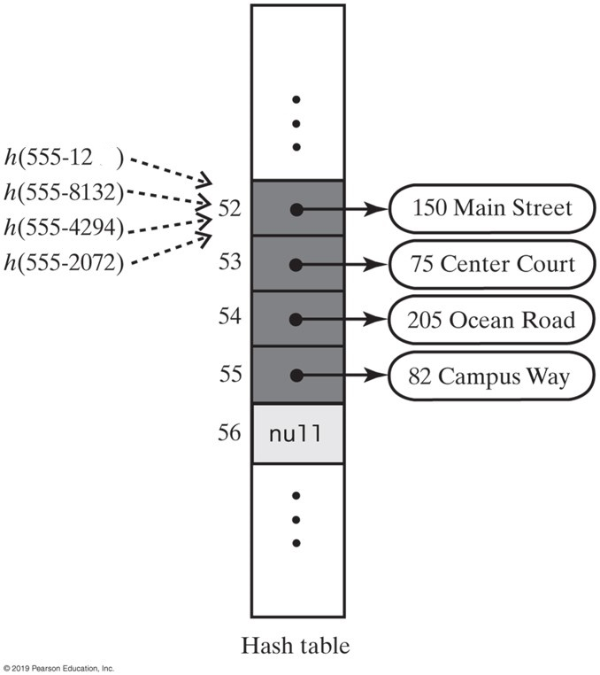
Linear Probing
64
The effect of linear probing after adding four entries whose search keys hash to the same index

Slide 48
Open Addressing: Linear Probing
0
1
2
3
4
5
6
7
8
9
How to deal with collisions?
(h(key) + i) % TableSize for i>=0
If h(key) is already full,
try (h(key) + 1) % TableSize. If full,
try (h(key) + 2) % TableSize. If full,
try (h(key) + 3) % TableSize. If full…
Example: insert 38, 19, 8, 79, 10

Slide 49
Open Addressing: Linear Probing
How to deal with collisions?
(h(key) + i) % TableSize for i>=0
If h(key) is already full,
try (h(key) + 1) % TableSize. If full,
try (h(key) + 2) % TableSize. If full,
try (h(key) + 3) % TableSize. If full…
Example: insert 38, 19, 8, 79, 10
0
1
2
3
4
5
6
7
8 | 38
9

Slide 50
Open Addressing: Linear Probing
0
1
2
3
4
5
6
7
8 | 38
9 | 19
How to deal with collisions?
(h(key) + i) % TableSize for i>=0
If h(key) is already full,
try (h(key) + 1) % TableSize. If full,
try (h(key) + 2) % TableSize. If full,
try (h(key) + 3) % TableSize. If full…
Example: insert 38, 19, 8, 79, 10

Slide 51
Open Addressing: Linear Probing
0 | 8
1
2
3
4
5
6
7
8 | 38
9 | 19
How to deal with collisions?
(h(key) + i) % TableSize for i>=0
If h(key) is already full,
try (h(key) + 1) % TableSize. If full,
try (h(key) + 2) % TableSize. If full,
try (h(key) + 3) % TableSize. If full…
Example: insert 38, 19, 8, 79, 10

Slide 52
Open Addressing: Linear Probing
0 | 8
1 | 79
2
3
4
5
6
7
8 | 38
9 | 19
How to deal with collisions?
(h(key) + i) % TableSize for i>=0
If h(key) is already full,
try (h(key) + 1) % TableSize. If full,
try (h(key) + 2) % TableSize. If full,
try (h(key) + 3) % TableSize. If full…
Example: insert 38, 19, 8, 79, 10

Slide 53
Open Addressing: Linear Probing
0 | 8
1 | 79
2 | 10
3
4
5
6
7
8 | 38
9 | 19
How to deal with collisions?
(h(key) + i) % TableSize for i>=0
If h(key) is already full,
try (h(key) + 1) % TableSize. If full,
try (h(key) + 2) % TableSize. If full,
try (h(key) + 3) % TableSize. If full…
Example: insert 38, 19, 8, 79, 10

Slide 54
Linear Probing : Practice
Insert 44, 4, 16, 28, 21,26 into a table of size 11
0
1
2
3
4
5
6
7
8
9
10

Slide 55

Load factor
The load factor, λ, of a hash table is calculated as
$$λ=\frac{n}{TableSize}$$
where n is the number of items currently in the table

Slide 56
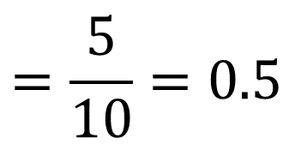
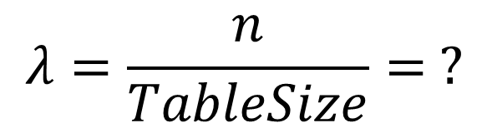
Load Factor?
0 | 8
1 | 79
2 | 10
3
4
5
6
7
8 | 38
9 | 19
Can the load factor when using linear probing ever exceed 1.0?
Nope!!
$$λ=\frac{n}{TableSize}= ?$$
$$=\frac{5}{10}=0.5$$

Slide 57
Open Addressing: Other Operations
insert finds an open table position using a probe function
What about find?
Must use same probe function to "retrace the trail" for the data
Unsuccessful search when reach empty position
Demo
What about delete?
Must use "lazy" deletion. Why?
Marker indicates "data was here, keep on probing"
10 | ✗ | / | 23 | / | / | 16 | ✗ | 26

Slide 58
Open Addressing: Linear Probing
0 | 8
1 | 79
2 | 10
3
4
5
6
7
8 | 38
9 | 19
Now insert 18
What are the problems with this?
Need to go to 8, and then cycle through all of the entries until we get to empty or deleted entry

Slide 59
Open Addressing: Linear Probing
0 | 8
1 | 79
2 | 10
3 | 18
4
5
6
7
8 | 38
9 | 19
18 is placed at index 3.
How do we search for 10?
Need to go to 8, and then cycle through all of the entries until we find the element or find a blank space
What if we need to add something that ends in 8?
It also ends up in this problem area
This is called primary clustering
Notes:
What are the negative effects of clustering?
If the cluster becomes too large, two things happen:
The chances of colliding with the cluster increase
The time it takes to find something in the cluster increases. This isn’t O(1) time!

Slide 60
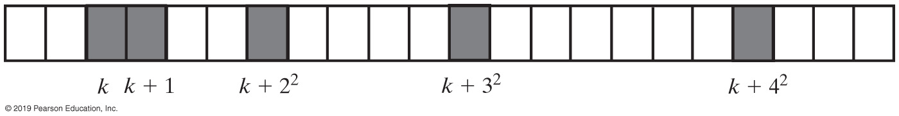
Open Addressing: Quadratic Probing
We can avoid primary clustering by changing the probe function from just i to f(i)
(h(key) + f(i)) % TableSize
For quadratic probing, f(i) = i²: for i>=0
0th probe: (h(key) + 0) % TableSize
1st probe: (h(key) + 1) % TableSize
2nd probe: (h(key) + 4) % TableSize
3rd probe: (h(key) + 9) % TableSize
…
i^{th} probe: (h(key) + i²) % TableSize
Intuition: Probes quickly "leave the neighborhood“

Slide 61
Open Addressing with Quadratic Probing
Linear probing looks at consecutive locations beginning at index k
Quadratic probing:
Considers the locations at indices k + j²
Uses the indices k, k + 1, k + 4, k + 9, …
A probe sequence of length five using quadratic probing
Possible problem:
Secondary clustering: entries that collide with an occupied entry use the same probe sequence

Slide 62
Quadratic Probing Example
TableSize = 10
insert(89)
0
1
2
3
4
5
6
7
8
9

Slide 63
Quadratic Probing Example
TableSize = 10
insert(89)
insert(18)
0
1
2
3
4
5
6
7
8
9 | 89

Slide 64
Quadratic Probing Example
TableSize = 10
insert(89)
insert(18)
insert(49)
0
1
2
3
4
5
6
7
8 | 18
9 | 89

Slide 65
Quadratic Probing Example
TableSize = 10
insert(89)
insert(18)
insert(49)
49 % 10 = 9 collision!
(49 + 1) % 10 = 0
insert(58)
0 | 49
1
2
3
4
5
6
7
8 | 18
9 | 89

Slide 66
Quadratic Probing Example
TableSize = 10
insert(89)
insert(18)
insert(49)
insert(58)
58 % 10 = 8 collision!
(58 + 1) % 10 = 9 collision!
(58 + 4) % 10 = 2
insert(79)
0 | 49
1
2 | 58
3
4
5
6
7
8 | 18
9 | 89

Slide 67
Quadratic Probing Example
TableSize = 10
insert(89)
insert(18)
insert(49)
insert(58)
insert(79)
79 % 10 = 9 collision!
(79 + 1) % 10 = 0 collision!
(79 + 4) % 10 = 3
0 | 49
1
2 | 58
3 | 79
4
5
6
7
8 | 18
9 | 89

Slide 68
Another Quadratic Probing Example
TableSize = 7
Insert:
76 (76 % 7 = 6)
40 (40 % 7 = 5)
48 (48 % 7 = 6)
5 (5 % 7 = 5)
55 (55 % 7 = 6)
47 (47 % 7 = 5)
0
1
2
3
4
5
6

Slide 69
Another Quadratic Probing Example
TableSize = 7
Insert:
76 (76 % 7 = 6)
40 (40 % 7 = 5)
48 (48 % 7 = 6)
5 (5 % 7 = 5)
55 (55 % 7 = 6)
47 (47 % 7 = 5)
0
1
2
3
4
5
6 | 76

Slide 70
Another Quadratic Probing Example
TableSize = 7
Insert:
76 (76 % 7 = 6)
40 (40 % 7 = 5)
48 (48 % 7 = 6)
5 (5 % 7 = 5)
55 (55 % 7 = 6)
47 (47 % 7 = 5)
0
1
2
3
4
5 | 40
6 | 76

Slide 71
Another Quadratic Probing Example
TableSize = 7
Insert:
76 (76 % 7 = 6)
40 (40 % 7 = 5)
48 (48 % 7 = 6)
5 (5 % 7 = 5)
55 (55 % 7 = 6)
47 (47 % 7 = 5)
0 | 48
1
2
3
4
5 | 40
6 | 76

Slide 72
Another Quadratic Probing Example
TableSize = 7
Insert:
(76 % 7 = 6)
(40 % 7 = 5)
48 (48 % 7 = 6)
5 (5 % 7 = 5)
55 (55 % 7 = 6)
47 (47 % 7 = 5)
0 | 48
1
2 | 5
3
4
5 | 40
6 | 76

Slide 73
Another Quadratic Probing Example
TableSize = 7
Insert:
76 (76 % 7 = 6)
40 (40 % 7 = 5)
48 (48 % 7 = 6)
5 (5 % 7 = 5)
55 (55 % 7 = 6)
47 (47 % 7 = 5)
0 | 48
1
2 | 5
3 | 55
4
5 | 40
6 | 76

Slide 74
Another Quadratic Probing Example
TableSize = 7
Insert:
76 (76 % 7 = 6)
40 (40 % 7 = 5)
48 (48 % 7 = 6)
5 (5 % 7 = 5)
55 (55 % 7 = 6)
47 (47 % 7 = 5)
(47 + 1) % 7 = 6 collision!
(47 + 4) % 7 = 2 collision!
(47 + 9) % 7 = 0 collision!
(47 + 16) % 7 = 0 collision!
(47 + 25) % 7 = 2 collision!
0 | 48
1
2 | 5
3 | 55
4
5 | 40
6 | 76
Will we ever get a 1 or 4?!?

Slide 75
Quadtratic Probing : Practice
Insert 44, 4, 16, 28, 21,26 into a table of size 11
0
1
2
3
4
5
6
7
8
9
10

Slide 76
Clustering Reconsidered
Quadratic probing does not suffer from primary clustering as the quadratic nature quickly escapes the neighborhood
But it is no help if keys initially hash the same index
Any 2 keys that hash to the same value will have the same series of moves after that
Called secondary clustering
We can avoid secondary clustering with a probe function that depends on the key: double hashing

Slide 77
Open Addressing: Double Hashing
Idea:
Given two good hash functions h1 and h2, it is very unlikely that for some key, h1(key) == h2(key)
Why not probe using h2(key)?
For double hashing, f(i) = i ⋅ h2(key):
0th probe: (h1(key) + 0 ⋅ h2(key)) % TableSize
1st probe: (h1(key) + 1 ⋅ h2(key)) % TableSize
2nd probe: (h1(key) + 2 ⋅ h2(key)) % TableSize
…
i^{th} probe: (h1(key) + i ⋅ h2(key)) % TableSize
Crucial Detail:
We must make sure that h2(key) cannot be 0
Notes:
Linear probing and quadratic probing add increments to k (initial index) to define a probe sequence
Both are independent of the search key
Double hashing is an open-addressing collision resolution technique that uses 2 different hash functions to compute bucket indices. Using hash functions h1 and h2, a key's index in the table is computed with the formula (ℎ1(key)+i∗ℎ2(key))mod(tableSize). Inserting a key uses the formula, starting with i = 0, to repeatedly search hash table buckets until an empty bucket is found. Each time an empty bucket is not found, i is incremented by 1. Iterating through sequential i values to obtain the desired table index is called the probing sequence.
This is a key-dependent method.

Slide 78
Double Hashing
T = 10 (TableSize)
Hash Functions:
h1(key) = key mod T
h2(key) = 1 + ((key/T) mod (T-1))
0
1
2
3
4
5
6
7
8
9
Insert these values into the hash table in this order. Resolve any collisions with double hashing:
13
28
33
147
43

Slide 79
Double Hashing
T = 10 (TableSize)
Hash Functions:
h1(key) = key mod T
h2(key) = 1 + ((key/T) mod (T-1))
0
1
2
3 | 13
4
5
6
7
8
9
Insert these values into the hash table in this order. Resolve any collisions with double hashing:
13
28
33
147
43

Slide 80
Double Hashing
T = 10 (TableSize)
Hash Functions:
h1(key) = key mod T
h2(key) = 1 + ((key/T) mod (T-1))
0
1
2
3 | 13
4
5
6
7
8 | 28
9
Insert these values into the hash table in this order. Resolve any collisions with double hashing:
13
28
33
147
43

Slide 81
Double Hashing
T = 10 (TableSize)
Hash Functions:
h1(key) = key mod T
h2(key) = 1 + ((key/T) mod (T-1))
0
1
2
3 | 13
4
5
6
7 | 33
8 | 28
9
Insert these values into the hash table in this order. Resolve any collisions with double hashing:
13
28
33 → g(33) = 1 + 3 mod 9 = 4
147
43

Slide 82
Double Hashing
T = 10 (TableSize)
Hash Functions:
h1(key) = key mod T
h2(key) = 1 + ((key/T) mod (T-1))
0
1
2
3 | 13
4
5
6
7 | 33
8 | 28
9 | 147
Insert these values into the hash table in this order. Resolve any collisions with double hashing:
13
28
33
147 → g(147) = 1 + 14 mod 9 = 6
43

Slide 83
Double Hashing
T = 10 (TableSize)
Hash Functions:
h1(key) = key mod T
h2(key) = 1 + ((key/T) mod (T-1))
0
1
2
3 | 13
4
5
6
7 | 33
8 | 28
9 | 147
Insert these values into the hash table in this order. Resolve any collisions with double hashing:
13
28
33
147 → g(147) = 1 + 14 mod 9 = 6
43 → g(43) = 1 + 4 mod 9 = 5
We have a problem:
3 + 0 = 3 3 + 5 = 8 3 + 10 = 13 3 + 15 = 18 3 + 20 = 23

Slide 84
Double Hashing Analysis
Because each probe is "jumping" by g(key) each time, we should ideally "leave the neighborhood" and "go different places from the same initial collision"
But, as in quadratic probing, we could still have a problem where we are not "safe" due to an infinite loop despite room in table
This cannot happen in at least one case:
For primes p and q such that 2 < q < p
h1(key) = key % p
h2(key) = q – (key % q)

Slide 85
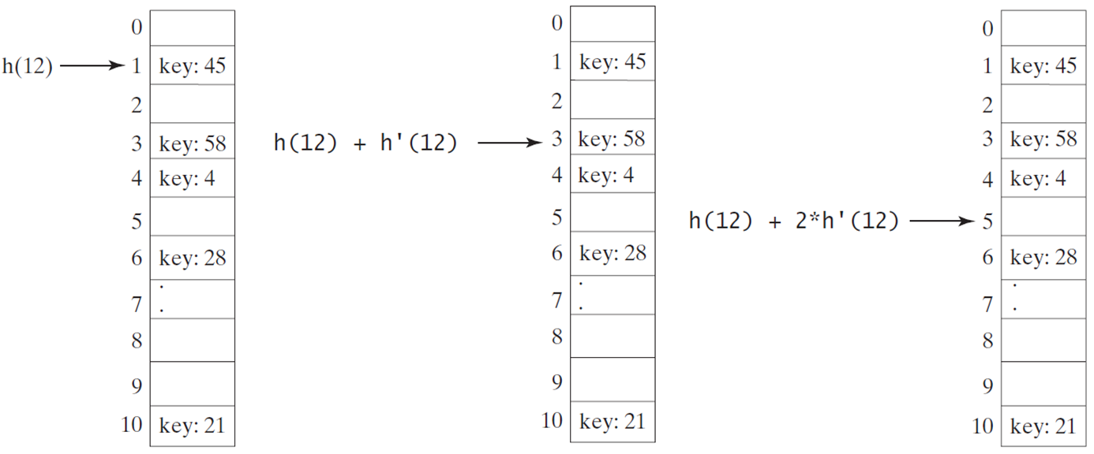

Double Hashing
https://liveexample.pearsoncmg.com/dsanimation/DoubleHashingeBook.html
Double hashing uses a secondary hash function on the keys to determine the increments to avoid the clustering problem.
$$\text{h}\text{’}\left(k\right)=7−\text{k}\text{ \% 7;}$$
Notes:
The text in various sections is as follows.
Section 1. key, 45.
Section 3. key, 58.
Section 4. key, 4.
Section 6. key, 28.
Section 10. key, 21.
All other sections are blank.
Section 1 in the first box is labeled, h left parenthesis 12 right parenthesis. Section 3 in the second box is labeled, h left parenthesis 12 right parenthesis + h dash left parenthesis 12 right parenthesis. Section 5 in the third box is labeled, h left parenthesis 12 right parenthesis + 2 times h dash left parenthesis 12 right parenthesis.

Slide 86
Double Hashing
Double hashing uses a secondary hash function on the keys to determine the increments to avoid the clustering problem.
k = h1(key) = key % table-size
h2(key) = 7 – key % 7;
(table-size=11)
0
1
2
3
4
5
6
7
8
9
10
Insert 44, 4, 16, 28, 21,26 into a table of size 11

Slide 87
Potential Problem with Open Addressing
Recall each location is either occupied, empty, or available
Frequent additions and removals can result in no locations that are null
Thus searching a probe sequence will not work
Consider separate chaining as a solution

Slide 88
Resolving Collisions
Approach 2: Restructuring the hash table
Changes the structure of the hash table so that it can accommodate more than one item in the same location
Buckets
Each location in the hash table is itself an array called a bucket
Separate chaining
Each hash table location is a linked list

Slide 89
Separate Chaining
0 | /
1 | /
2 | /
3 | /
4 | /
5 | /
6 | /
7 | /
8 | /
9 | /
All keys that map to the same table location are kept in a linked list (a.k.a. a "chain" or "bucket")
As easy as it sounds
Example: insert 10, 22, 86, 12, 42 with h(x) = x % 10

Slide 90
Separate Chaining
0
1 | /
2 | /
3 | /
4 | /
5 | /
6 | /
7 | /
8 | /
9 | /
10
/
All keys that map to the same table location are kept in a linked list (a.k.a. a "chain" or "bucket")
As easy as it sounds
Example: insert 10, 22, 86, 12, 42 with h(x) = x % 10

Slide 91
Separate Chaining
0
1 | /
2
3 | /
4 | /
5 | /
6 | /
7 | /
8 | /
9 | /
10
/
All keys that map to the same table location are kept in a linked list (a.k.a. a "chain" or "bucket")
As easy as it sounds
Example: insert 10, 22, 86, 12, 42 with h(x) = x % 10
22
/

Slide 92
Separate Chaining
0
1 | /
2
3 | /
4 | /
5 | /
6
7 | /
8 | /
9 | /
10
/
All keys that map to the same table location are kept in a linked list (a.k.a. a "chain" or "bucket")
As easy as it sounds
Example: insert 10, 22, 86, 12, 42 with h(x) = x % 10
22
/
86
/

Slide 93
Separate Chaining
All keys that map to the same table location are kept in a linked list (a.k.a. a "chain" or "bucket")
As easy as it sounds
Example: insert 10, 22, 86, 12, 42 with h(x) = x % 10
0
1 | /
2
3 | /
4 | /
5 | /
6
7 | /
8 | /
9 | /
10
/
12
22
/
86
/

Slide 94
Separate Chaining
0
1 | /
2
3 | /
4 | /
5 | /
6
7 | /
8 | /
9 | /
10
/
42
12
22
/
All keys that map to the same table location are kept in a linked list (a.k.a. a "chain" or "bucket")
As easy as it sounds
Example: insert 10, 22, 86, 12, 42 with h(x) = x % 10
86
/
Notes:
Thoughts on Separate Chaining
Worst-case time for find?
Linear
But only with really bad luck or bad hash function
Beyond asymptotic complexity, some "data-structure engineering" can improve constant factors
Linked list, array, or a hybrid
Insert at end or beginning of list
Sorting the lists gains and loses performance

Slide 95
Load Factor?
0
1 | /
2
3 | /
4 | /
5 | /
6
7 | /
8 | /
9 | /
10
/
42
12
22
/
86
/
$$λ=\frac{n}{TableSize}= ?$$
$$=\frac{5}{10}=0.5$$

Slide 96
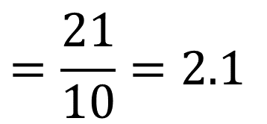
Load Factor?
0
1
2
3
4 | /
5
6
7
8
9
10
/
71
2
31
/
42
12
22
/
63
73
/
75
5
65
95
/
86
/
27
47
88
18
38
98
/
99
/
$$=\frac{21}{10}=2.1$$
$$λ=\frac{n}{TableSize}= ?$$
Notes:
We like to keep λ around 0.75 for separate chaining

Slide 97
Separate Chaining Deletion
0
1 | /
2
3 | /
4 | /
5 | /
6
7 | /
8 | /
9 | /
10
/
42
12
22
/
Not too bad and quite easy
Find in table
Delete from bucket
Similar run-time as insert
86
/

Slide 98
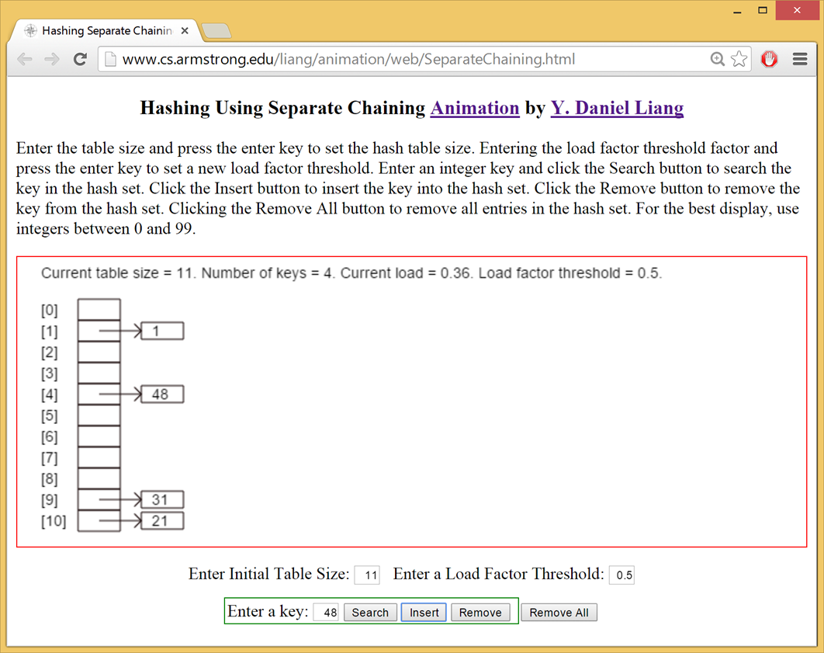
Separate Chaining Animation
https://liveexample.pearsoncmg.com/dsanimation/SeparateChainingeBook.html
Notes:
Daniel Liang
Enter the table size and press the enter key to set the hash table size. Entering the load factor threshold factor and press the enter key to set a new load factor threshold. Enter an integer key and click the Search button to search the key in the hash set. Click the Insert button to insert the key into the hash set. Click the Remove button to remove the key from the hash set. Clicking the Remove All button to remove all entries in the hash set. For the best display, use integers between 0 and 99.
Current table size = 11. Number of keys = 4. Current load, 0.36. Load factor threshold = 0.5.
0, blank. 1, 1. 2, blank. 3, blank. 4, 48. 5, blank. 6, blank. 7, blank. 8, blank. 9, 31. 10, 21.

Slide 99
The Efficiency of Hashing
An analysis of the average-case efficiency of hashing involves the load factor
Load factor α
Ratio of the current number of items in the table to the maximum size of the array table
Measures how full a hash table is
Should not exceed 2/3
Hashing efficiency for a particular search also depends on whether the search is successful
Unsuccessful searches generally require more time than successful searches

Slide 100
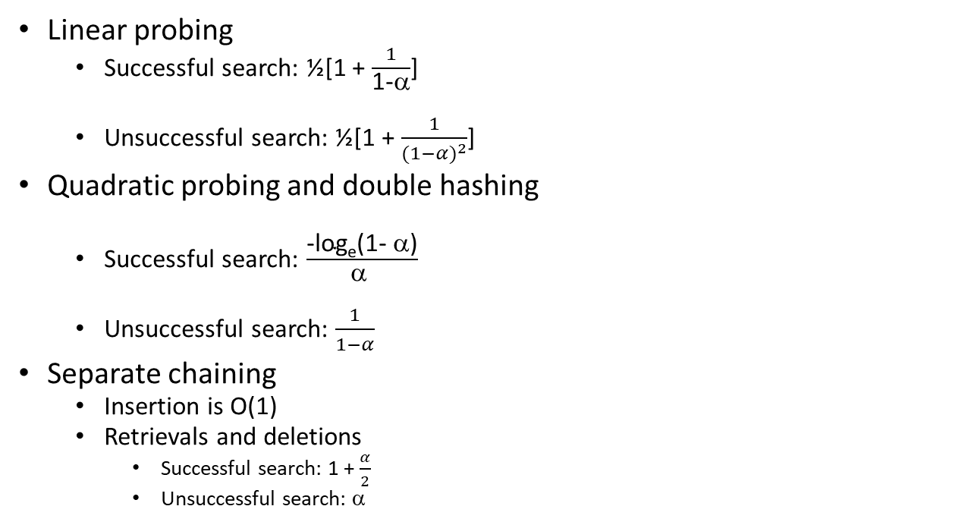
The Efficiency of Hashing
Linear probing
Successful search: ½[1 + $\frac{1}{\text{1−}\text{α}}$]
Unsuccessful search: ½[1 + $\frac{1}{{(1−α)}^{2}}$]
Quadratic probing and double hashing
Successful search: $\frac{\text{−}\text{loge}\text{(1− α)}}{\text{α }}$
Unsuccessful search: $\frac{1}{1−α}$
Separate chaining
Insertion is O(1)
Retrievals and deletions
Successful search: 1 + $\frac{α}{2}$
Unsuccessful search: α

Slide 101
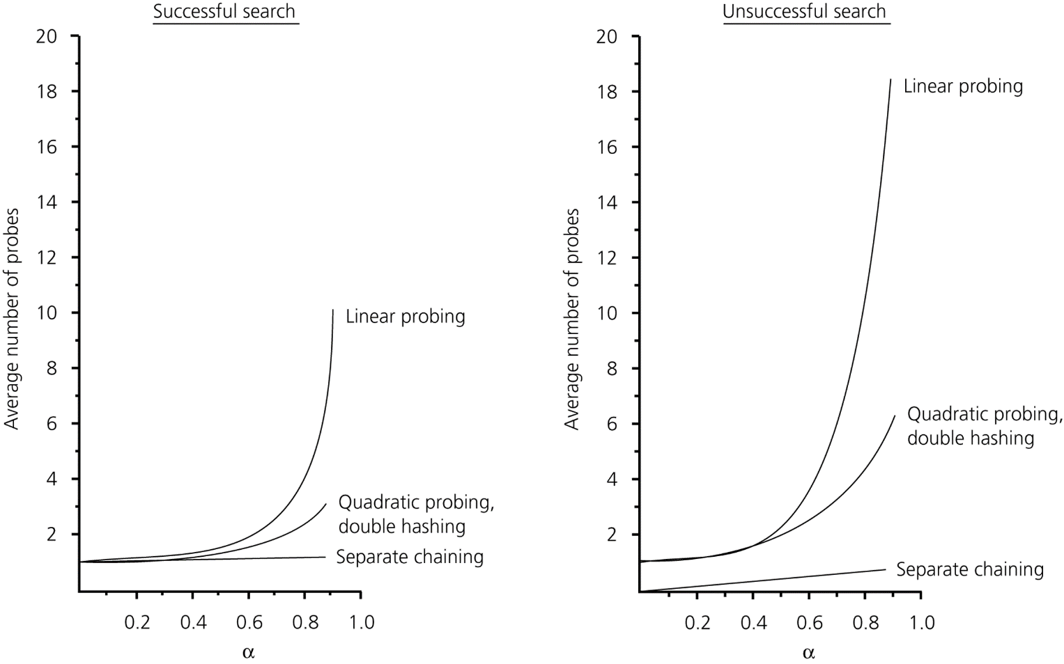
The Efficiency of Hashing
The relative efficiency of four collision-resolution methods

Slide 102
What Constitutes a Good Hash Function
A good hash function should
Be easy and fast to compute (using % or bitwise operators)
Avoid clusters : Scatter the data evenly throughout the hash table
Consider:
key → nine digits , table-size → 40, hashTable[0..39]
H(key) → (first two digits % 40)
Assume keys are unique
60 keys will map to hashTable[0..19]
40 keys will map to hashTable[20..39]
hash code

Slide 103
Java JCF HashMap provides
/** Hash function */
private int hash(int hashCode) {
return supplementalHash(hashCode) & (capacity - 1);
}
/** Ensure the hashing is evenly distributed */
private static int supplementalHash(int h) {
h ^= (h >>> 20) ^ (h >>> 12);
return h ^ (h >>> 7) ^ (h >>> 4);
}
Exclusive OR
Unsigned shift right
For example, both 11100101 & 00000111 and 11001101 & 00000111 yield 00000101. But supplementalHash(11100101) & 00000111 and supplementalHash(11001101) & 00000111 will be different. Using a supplemental function reduces this type of collision.

