Slide 1
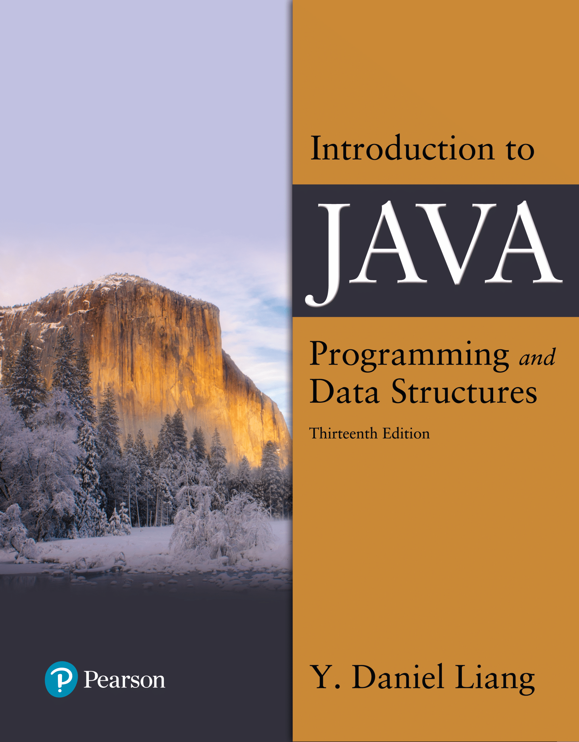

Introduction to Java Programming and Data Structures
Thirteenth Edition
Chapter 6
Methods
Copyright © 2024 Pearson Education, Inc. All Rights Reserved
Notes:
If this PowerPoint presentation contains mathematical equations, you may need to check that your computer has the following installed:
1) MathType Plugin
2) Math Player (free versions available)
3) NVDA Reader (free versions available)
Slides in this presentation contain hyperlinks. JAWS users should be able to get a list of links by using INSERT+F7

Slide 2
Opening Problem
Find the sum of integers from 1 to 10, from 20 to 30, and from 35 to 45, respectively.

Slide 3
Problem (1 of 2)
int sum = 0;
for (int i = 1; i <= 10; i++)
sum += i;
System.out.println("Sum from 1 to 10 is " + sum);
sum = 0;
for (int i = 20; i <= 30; i++)
sum += i;
System.out.println("Sum from 20 to 30 is " + sum);
sum = 0;
for (int i = 35; i <= 45; i++)
sum += i;
System.out.println("Sum from 35 to 45 is " + sum);

Slide 4
Objectives (1 of 2)
6.1 To define methods with formal parameters (§6.2).
6.2 To invoke methods with actual parameters (i.e., arguments) (§6.2).
6.3 To define methods with a return value (§6.3).
6.4 To define methods without a return value (§6.4).
6.5 To pass arguments by value (§6.5).
6.6 To develop reusable code that is modular, easy to read, easy to debug, and easy to maintain (§6.6).
6.7 To write a method that converts hexadecimals to decimals (§6.7).

Slide 5
Objectives (2 of 2)
6.8 To use method overloading and understand ambiguous overloading (§6.8).
6.9 To determine the scope of variables (§6.9).
6.10 To apply the concept of method abstraction in software development (§6.10).
6.11 To design and implement methods using stepwise refinement (§6.11).

Slide 6
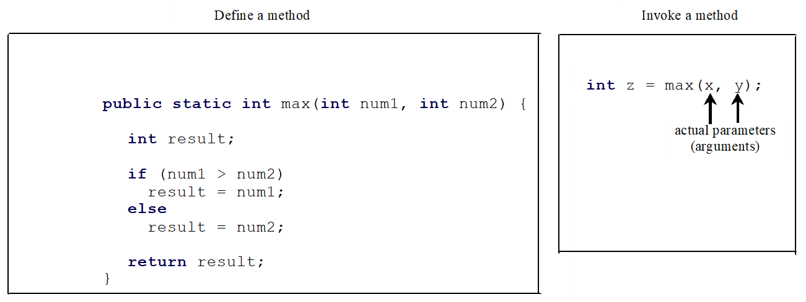
6.1 To define methods with formal parameters (§6.2).
A method is a collection of statements that are grouped together to perform an operation.
Notes:
Define a method
public static int max open parenthesis int num 1, int num 2 close parenthesis open braces int result Semicolon
if open parenthesis num 1 greater than num 2 close parenthesis result = num 1 Semicolon
else
result = num 2 Semicolon
return result Semicolon close braces
Invoke a method.
int z = max open parenthesis x, y close parenthesis Semicolon
x and y are labeled as actual parameters, arguments

Slide 7
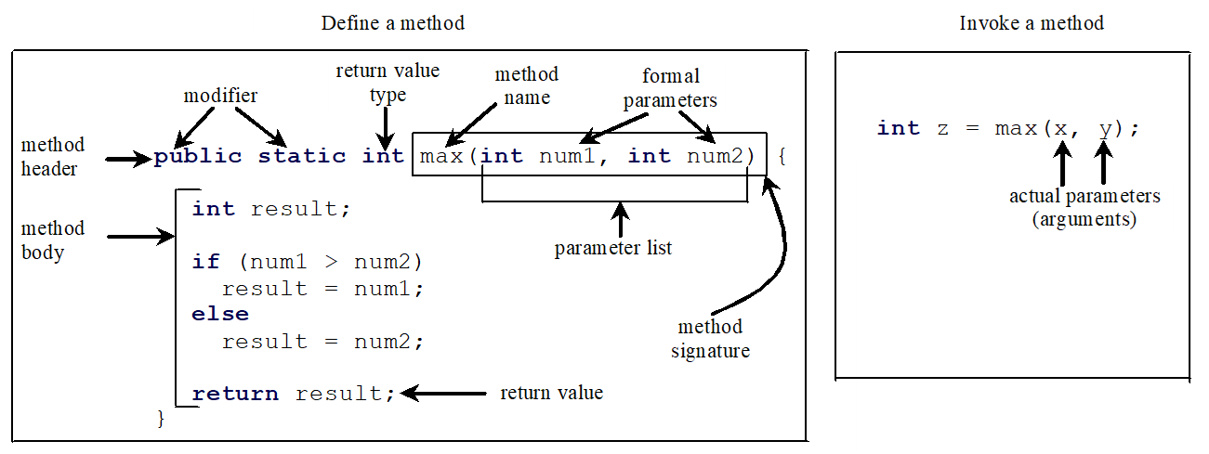
Defining Methods (2 of 2)
A method is a collection of statements that are grouped together to perform an operation.
Notes:
Define a method.
Public static int max open parenthesis num 1, int num 2 close parenthesis open braces int results Semicolon This line is labeled, method header. Public static are labeled, modifier. int is labeled return value type. max is labeled method name. num 1 and num 2 are labeled formal parameters. information within the parenthesis is labeled parameter list. max open parenthesis int num 1, int num 2 close parenthesis is labeled, method signature.
Below is the method body.
if open parenthesis num 1 greater than num 2 close parenthesis result = num 1 Semicolon
else
result = num 2
return result Semicolon It is labeled return value.
Invoke a method.
int z = max open parenthesis x, y close parenthesis Semicolon
x and y are labeled as actual parameters (arguments).

Slide 8
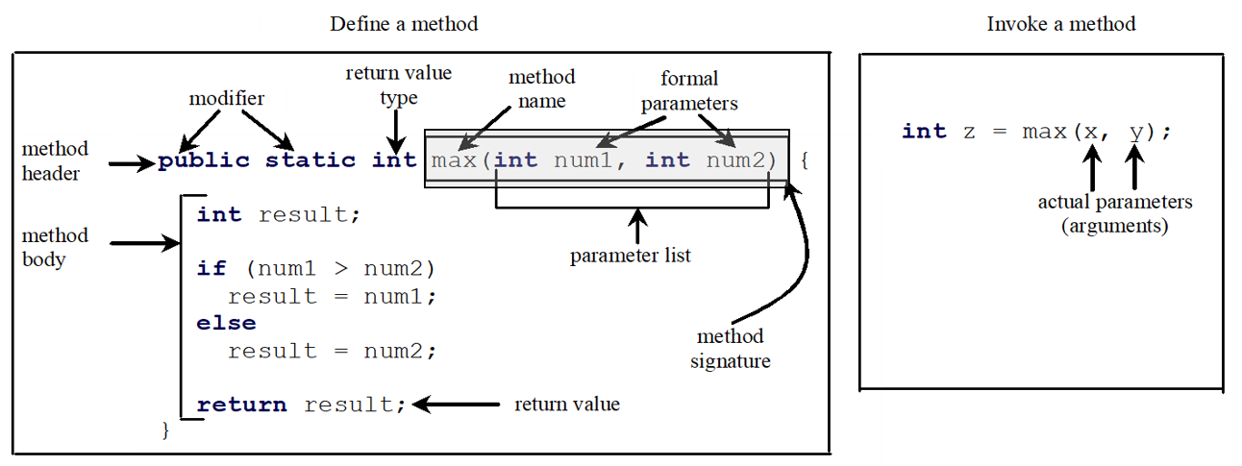
Method Signature
Method signature is the combination of the method name and the parameter list.
Notes:
Define a method.
Public static int max open parenthesis num 1, int num 2 close parenthesis open braces int results Semicolon This line is labeled, method header. Public static are labeled, modifier. int is labeled return value type. max is labeled method name. num 1 and num 2 are labeled formal parameters. information within the parenthesis is labeled parameter list. max open parenthesis int num 1, int num 2 close parenthesis is labeled, method signature.
Below is the method body.
if open parenthesis num 1 greater than num 2 close parenthesis result = num 1 Semicolon
else
result = num 2
return result Semicolon It is labeled return value.
Invoke a method.
int z = max open parenthesis x, y close parenthesis Semicolon
x and y are labeled as actual parameters, arguments.

Slide 9
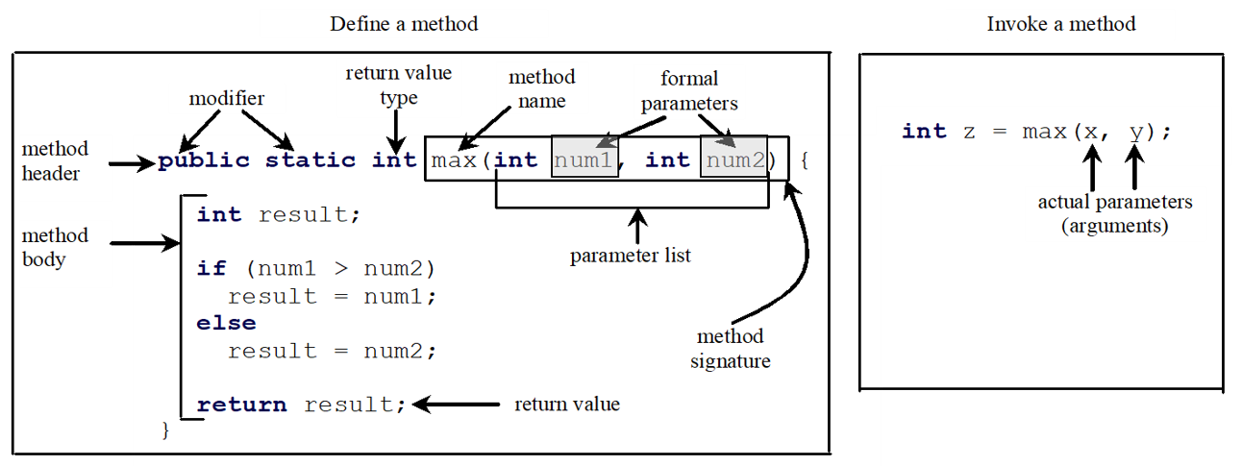
Formal Parameters
The variables defined in the method header are known as formal parameters.
Notes:
Define a method.
Public static int max open parenthesis num 1, int num 2 close parenthesis open braces int results Semicolon This line is labeled, method header. Public static are labeled, modifier. int is labeled return value type. max is labeled method name. num 1 and num 2 are labeled formal parameters. information within the parenthesis is labeled parameter list. max open parenthesis int num 1, int num 2 close parenthesis is labeled, method signature.
Below is the method body.
if open parenthesis num 1 greater than num 2 close parenthesis result = num 1 Semicolon
else
result = num 2
return result Semicolon It is labeled return value.
Invoke a method.
int z = max open parenthesis x, y close parenthesis Semicolon
x and y are labeled as actual parameters, arguments.

Slide 10
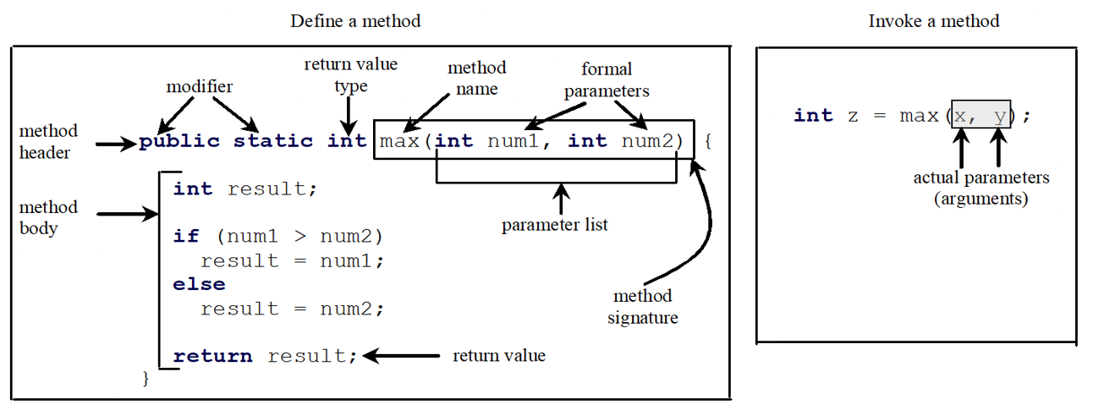
Actual Parameters
When a method is invoked, you pass a value to the parameter. This value is referred to as actual parameter or argument.
Notes:
Define a method.
Public static int max open parenthesis num 1, int num 2 close parenthesis open braces int results Semicolon This line is labeled, method header. Public static are labeled, modifier. int is labeled return value type. max is labeled method name. num 1 and num 2 are labeled formal parameters. information within the parenthesis is labeled parameter list. max open parenthesis int num 1, int num 2 close parenthesis is labeled, method signature.
Below is the method body.
if open parenthesis num 1 greater than num 2 close parenthesis result = num 1 Semicolon
else
result = num 2
return result Semicolon It is labeled return value.
Invoke a method.
int z = max open parenthesis x, y close parenthesis Semicolon
x and y are labeled as actual parameters (arguments).

Slide 11
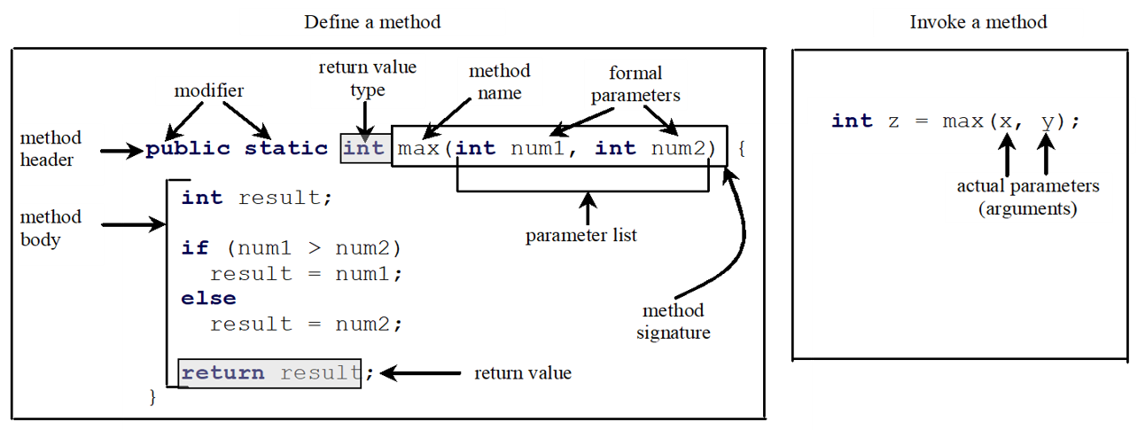
Return Value Type
A method may return a value. The returnValueType is the data type of the value the method returns. If the method does not return a value, the returnValueType is the keyword void. For example, the returnValueType in the main method is void.
Notes:
Define a method.
Public static int max open parenthesis num 1, int num 2 close parenthesis open braces int results Semicolon This line is labeled, method header. Public static are labeled, modifier. int is labeled return value type. max is labeled method name. num 1 and num 2 are labeled formal parameters. information within the parenthesis is labeled parameter list. max open parenthesis int num 1, int num 2 close parenthesis is labeled, method signature.
Below is the method body.
if open parenthesis num 1 greater than num 2 close parenthesis result = num 1 Semicolon
else
result = num 2
return result Semicolon It is labeled return value.
Invoke a method.
int z = max open parenthesis x, y close parenthesis Semicolon
x and y are labeled as actual parameters, arguments.

Slide 12
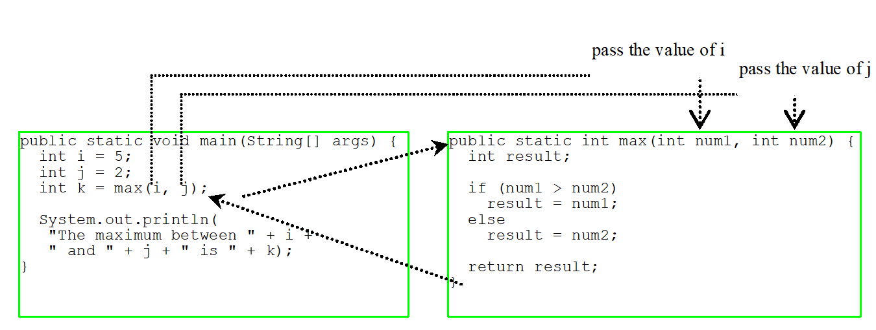
Calling Methods
Testing the max method
This program demonstrates calling a method max to return the largest of the int values
TestMax
TestMax (4 integers)
Notes:
Show Memory stack with TestMax running

Slide 13
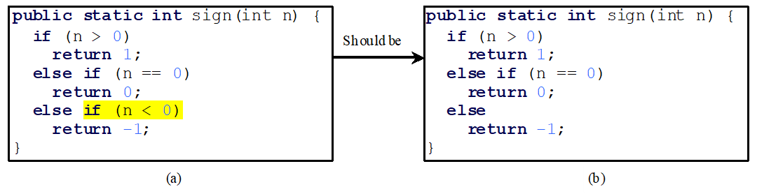
Caution
A return statement is required for a value-returning method. The method shown below in (a) is logically correct, but it has a compilation error because the Java compiler thinks it possible that this method does not return any value.
To fix this problem, delete if (n < 0) in (a), so that the compiler will see a return statement to be reached regardless of how the if statement is evaluated.

Slide 14
Reuse Methods From Other Classes
Note: One of the benefits of methods is for reuse. The max method can be invoked from any class besides TestMax. If you create a new class Test, you can invoke the max method using ClassName.methodName (e.g., TestMax.max).

Slide 15
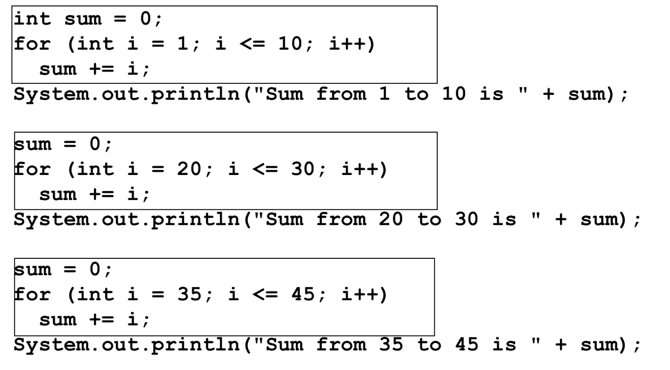
Opening Problem
SumDemo

Slide 16
void Method Example
This type of method does not return a value. The method performs some actions.
Given the test score, find the Letter grade
90-100 → ‘A’
80 – 89 → ‘B’
70 – 79 → ‘C’
60 – 69 → ‘D’
Below 60 → ‘F’
TestVoidMethod
TestReturnGradeMethod
Notes:
TestVoidMethod: https://liveexample.pearsoncmg.com/html/TestVoidMethod.html
TestReturnGradeMethod: https://liveexample.pearsoncmg.com/html/TestReturnGradeMethod.html

Slide 17
Passing Parameters
public static void nPrintln(String message, int n) {
for (int i = 0; i < n; i++)
System.out.println(message);
}
Suppose you invoke the method using
nPrintln(“Welcome to Java”, 5);
What is the output?
Suppose you invoke the method using
nPrintln(“Computer Science”, 15);
What is the output?
Can you invoke the method using
nPrintln(15, “Computer Science”);

Slide 18
Pass by Value (1 of 3)
This program demonstrates passing values to the methods.
1 public class Increment { 2 public static void main(String[] args) { 3 int x = 1; 4 System.out.println("Before the call, x is " + x); 5 increment(x); 6 System.out.println("After the call, x is " + x); 7 8 } 9 10 public static void increment(int x) { 11 x++; 12 System.out.println("n inside the method is " + x); 13 } 14 }
Increment
Notes:
Increment: https://liveexample.pearsoncmg.com/html/Increment.html

Slide 19
Pass by Value (2 of 3)
1 // Given two int values, swap them 2 public class TestPassByValue { 3 public static void main(String[] args){ 4 int num1 = 5; 5 int num2 = 10; 6 System.out.println("Before swap()"); 7 System.out.println("X is " + num1 + " and Y is " + num2); 8 swap(num1,num2); 9 System.out.println("After swap()"); 10 System.out.println("X is " + num1 + " and Y is " + num2); 11 } 12 13 public static void swap(int n1,int n2){ 14 int temp = n1; 15 n1 = n2; 16 n2= temp; 17 } 18 } 19
TestPassByValue
Notes:
TestPassByValue: https://liveexample.pearsoncmg.com/html/TestPassByValue.html

Slide 20
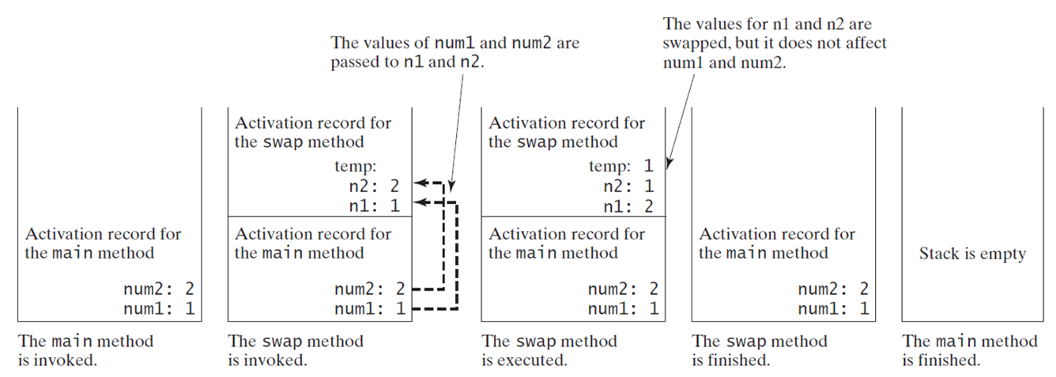
Pass by Value (3 of 3)
Notes:
The main method is invoked. The stack has activation record for the main method, with the code num 2: 2, and num 1: 1.
The swap method is invoked. The stack is divided into two parts. The upper part shows Activation record for the swap method, with temp: blank, n 2: 1, and n 1: 2. The lower part shows Activation record for the main method, with num 2: 2, and num 1: 1. An arrow points from num 2: 2 to n 2: 2. This arrow is labeled as The values of num 1 and num 2 are passed to n 1 and n 2. Another arrow points from num 1: 1 points to n 1: 1.
The swap method is executed. The stack is divided into two parts. The upper part shows Activation record for the swap method, with temp: 1, n 2: 1, and n 1: 2. The values for n 1 and n 2 are swapped, but it does not affect num 1 and num 2. The lower part shows Activation record for the main method, with num 2: 2, and num 1: 5.
The swap method is finished. The stack reads, Activation record for the main method, with num 2: 2, num 1: 1, and i: 5.
The main method is finished. The stack is empty.

Slide 21
Modularizing Code
GCD V2
Methods can be used to reduce redundant coding and enable code reuse. Methods can also be used to modularize code and improve the quality of the program.
1 import java.util.*; 2 public class GCD { 3 public static void main(String[] args) { 4 Scanner in = new Scanner(System.in); 5 int n1 = in.nextInt(); 6 int n2 = in.nextInt(); 7 int gcd = 1; 8 int k = Math.min(n1,n2); 9 while (k>=2) { 10 if(n1%k==0 && n2%k==0) { 11 gcd = k; 12 break; 13 } 14 k--; 15 } 16 System.out.println("GCD is "+gcd); 17 } 18 }
Notes:
GreatestCommonDivisorMethod: https://liveexample.pearsoncmg.com/html/GreatestCommonDivisorMethod.html
PrimeNumberMethod: https://liveexample.pearsoncmg.com/html/PrimeNumberMethod.html

Slide 22
Modularizing Code
PrimeNumberMethod
Methods can be used to reduce redundant coding and enable code reuse. Methods can also be used to modularize code and improve the quality of the program.
1 import java.util.*; 2 public class PrimeNumbers { 3 public static void main(String[] args) { 4 Scanner in = new Scanner(System.in); 5 int count = 0; 6 int num = 2; 7 while(count != 50){ 8 boolean isPrime = true; 9 for(int i=2;i<num;++i) { 10 if(num % i == 0) { 11 isPrime = false; 12 break; 13 } 14 } 15 if(isPrime){ 16 count++; 17 if(count%10!=0) 18 System.out.print(num+" "); 19 else 20 System.out.println(num); 21 22 23 } 24 num++; 25 } 26 } 27 }
Notes:
GreatestCommonDivisorMethod: https://liveexample.pearsoncmg.com/html/GreatestCommonDivisorMethod.html
PrimeNumberMethod: https://liveexample.pearsoncmg.com/html/PrimeNumberMethod.html

Slide 23
Case Study: Converting Hexadecimals to Decimals
Write a method that converts a hexadecimal number into a decimal number.
Hex2Dec
Notes:
A times 16 to the third power + B times 16 to the second power + C times 16 to the first power + D times 16 to the 0 power
= left parenthesis, left parenthesis A times 16 + B right parenthesis times 16 + C right parenthesis times 16 + D
= left parenthesis, left parenthesis 10 times 16 + 11 right parenthesis times 16 + 12 right parenthesis times 16 + 13 = question mark
Hex2Dec: https://liveexample.pearsoncmg.com/html/Hex2Dec.html

Slide 24
Overloading Methods
Overloading the max Method
public static double max(double num1, double num2) {
if (num1 > num2)
return num1;
else
return num2;
}
TestMethodOverloading
Notes:
TestMethodOverloading: https://liveexample.pearsoncmg.com/html/TestMethodOverloading.html

Slide 25
Ambiguous Invocation (1 of 2)
Sometimes there may be two or more possible matches for an invocation of a method, but the compiler cannot determine the most specific match. This is referred to as ambiguous invocation. Ambiguous invocation is a compile error.

Slide 26
Ambiguous Invocation (2 of 2)
public class AmbiguousOverloading {
public static void main(String[] args) {
System.out.println(max(1, 2));
}
public static double max(int num1, double num2) {
if (num1 > num2)
return num1;
else
return num2;
}
public static double max(double num1, int num2) {
if (num1 > num2)
return num1;
else
return num2;
}
}

Slide 27
Scope of Local Variables (1 of 6)
A local variable: a variable defined inside a method.
Scope: the part of the program where the variable can be referenced.
The scope of a local variable starts from its declaration and continues to the end of the block that contains the variable. A local variable must be declared before it can be used.

Slide 28
Scope of Local Variables (2 of 6)
You can declare a local variable with the same name multiple times in different non-nesting blocks in a method, but you cannot declare a local variable twice in nested blocks.

Slide 29
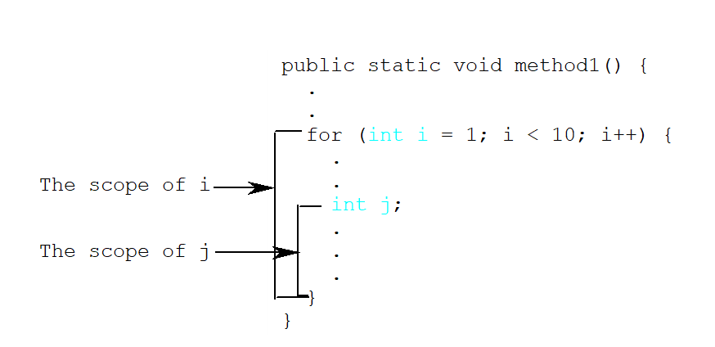
Scope of Local Variables (3 of 6)
A variable declared in the initial action part of a for loop header has its scope in the entire loop. But a variable declared inside a for loop body has its scope limited in the loop body from its declaration and to the end of the block that contains the variable.
Notes:
public static void method 1 open parenthesis close parenthesis open braces, vertical ellipsis.
For open parenthesis int i = 1 Semicolon i less than 10 Semicolon i plus plus close parenthesis open braces, vertical ellipsis.
Int j, vertical ellipsis. open braces open braces.
from int j to open braces, it is under bracket, labeled as The scope of j. From for open parenthesis int i = 1 to open braces, it is under bracket, labeled as, The scope of i.

Slide 30
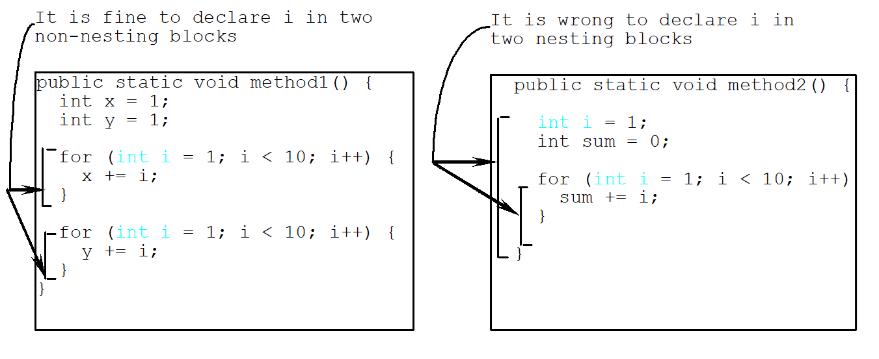
Scope of Local Variables (4 of 6)
Notes:
public static void method open parenthesis close parenthesis open braces int x = 1 Semicolon
int y = 1 Semicolon
for open parenthesis int i = 1 Semicolon I less than 10 Semicolon I plus plus close parenthesis open braces x + = i Semicolon
close braces
for open parenthesis int i = 1 Semicolon I less than 10 Semicolon I plus plus close parenthesis y + = i Semicolon
An arrow labeled, It is fine to declare i in two non-nesting blocks, point to the close braces after x + = i, and y + = i.
public static void method 2 open parenthesis close parenthesis open braces int i = 1 Semicolon
int sum = 0 Semicolon
for open parenthesis int i = 1 Semicolon i less than 10 Semicolon i plus plus close parenthesis sum + = i Semicolon close braces close braces.
Two arrows labeled, It is wrong to declare i in two nesting blocks, point to the region of for open parenthesis int i = 1 Semicolon i less than 10 Semicolon i plus plus close parenthesis sum + = i Semicolon close braces, and the region of int i = 1 till the last close brace.

Slide 31
Scope of Local Variables (5 of 6)
// Fine with no errors
public static void correctMethod() {
int x = 1;
int y = 1;
// i is declared
for (int i = 1; i < 10; i++) {
x += i;
}
// i is declared again
for (int i = 1; i < 10; i++) {
y += i;
}
}

Slide 32
Scope of Local Variables (6 of 6)
// With errors
public static void incorrectMethod() {
int x = 1;
int y = 1;
for (int i = 1; i < 10; i++) {
int x = 0;
x += i;
}
}

Slide 33
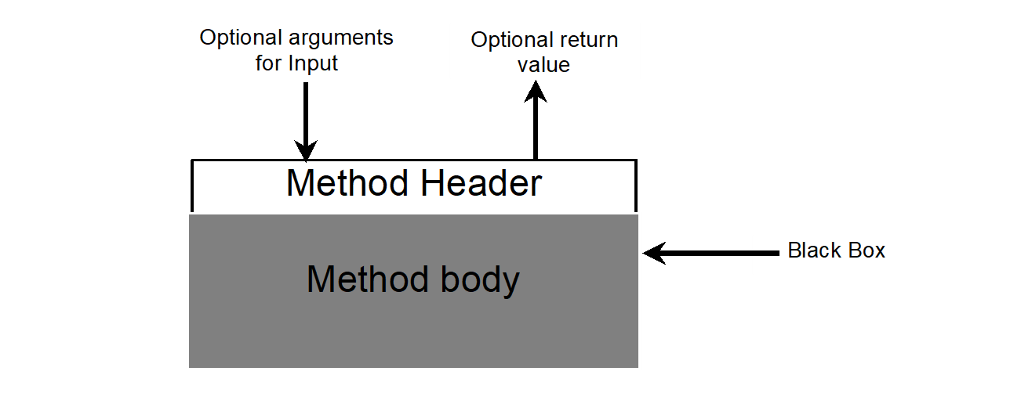
Method Abstraction
You can think of the method body as a black box that contains the detailed implementation for the method.
Notes:
A downward arrow labeled Optional arguments for input, points to Method header. An upward arrow moves up from Method header. This arrow is labeled as Optional return value.

Slide 34
Benefits of Methods
Write a method once and reuse it anywhere.
Information hiding. Hide the implementation from the user.
Reduce complexity.

