Slide 1
Lecture 09
Queue

Slide 2
The Abstract Data Type Queue
A queue
New items enter at the back, or rear, of the queue
Items leave from the front of the queue
First-in, first-out (FIFO) property
The first item inserted into a queue is the first item to leave

Slide 3
The Abstract Data Type Queue
ADT queue operations
Create an empty queue
Determine whether a queue is empty
Add a new item to the queue
Remove from the queue the item that was added earliest
Remove all the items from the queue
Retrieve from the queue the item that was added earliest
Notes:
Queues
Are appropriate for many real-world situations
Example: A line to buy a movie ticket
Have applications in computer science
Example: A request to print a document
A simulation
A study to see how to reduce the wait involved in an application

Slide 4
Simple Applications of the ADT Queue: Reading a String of Characters
A queue can retain characters in the order in which they are typed
Queue queue = new Queue();
while (not end of line) {
Read a new character ch
queue.enqueue(ch)
}
Once the characters are in a queue, the system can process them as necessary

Slide 5
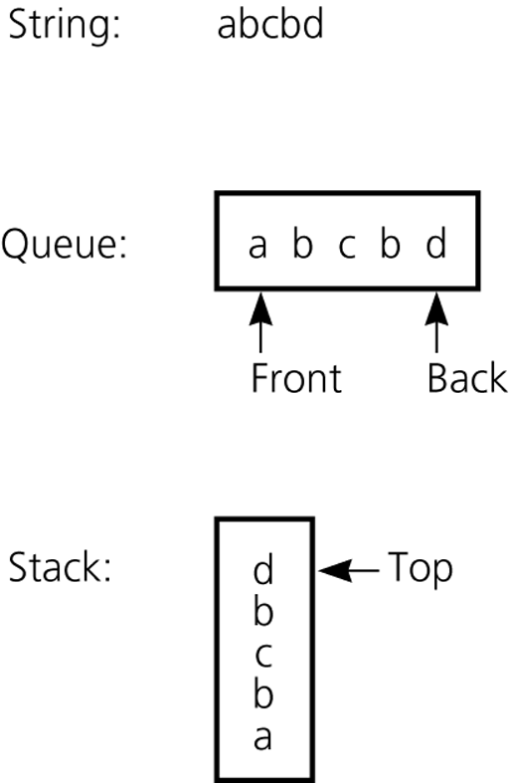
Recognizing Palindromes
A nonrecursive recognition algorithm for palindromes
As you traverse the character string from left to right, insert each character into both a queue and a stack
Compare the characters at the front of the queue and the top of the stack
The results of inserting a string into both a queue and a stack
Notes:
Public Boolean isPalindromString s)
{
create astack
create aqueue
for(int i=0;i<s,length(); ++i)
{
astack.push(s,charAt(i));
aqueue.enqueue(s.charAt(i));
}
Boolean isPal = true;
while (!aqueue.isEmpty() and isPal)
{
ch1= astack.pop();
ch2 = aqueue.dequeue();
if(ch1 != ch2) isPal=false;
}
return isPal;
}

Slide 6
Implementations of the ADT Queue
A queue can have either
An array-based implementation
A reference-based implementation

Slide 7
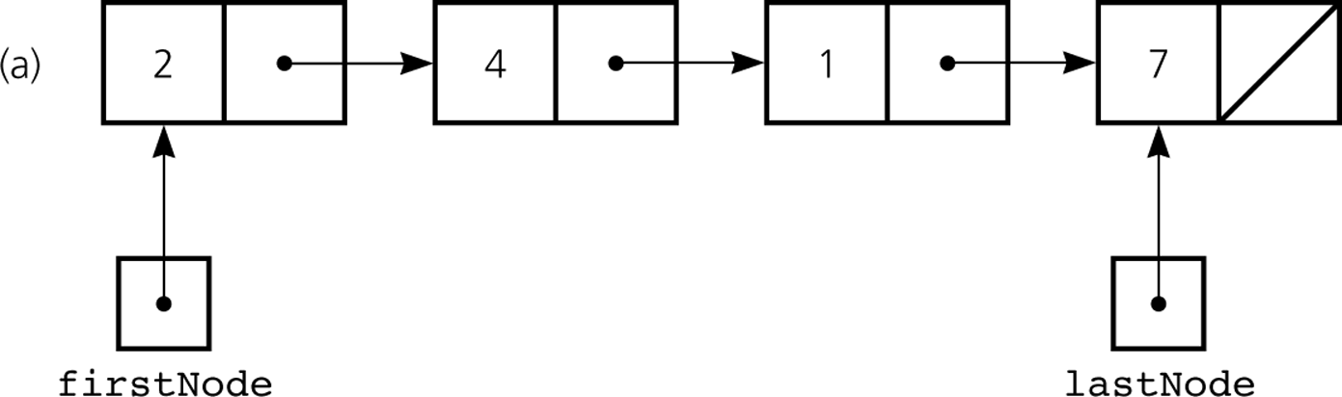
A Reference-Based Implementation
Possible implementations of a queue
A linear linked list with two external references
A reference to the front
A reference to the back
A reference-based implementation of a queue: a) a linear linked list with two external references

Slide 8
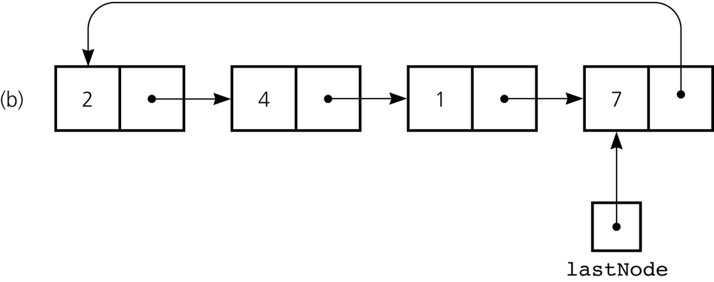
A Reference-Based Implementation
Possible implementations of a queue (Continued)
A circular linked list with one external reference
A reference to the back
A reference-based implementation of a queue: b) a circular linear linked list with one external reference

Slide 9
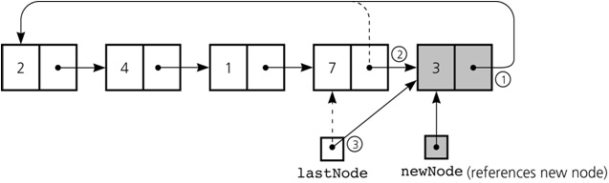
A Reference-Based Implementation
newNode.next = lastNode.next;
lastNode.next = newNode;
lastNode = newNode;
Inserting an item into a nonempty queue

Slide 10
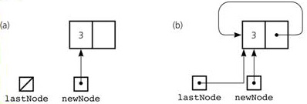
A Reference-Based Implementation
newNode.next = newNode;
lastNode = newNode;
Inserting an item into an empty queue: a) before insertion; b) after insertion

Slide 11
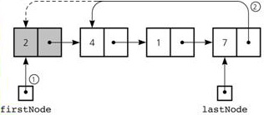
A Reference-Based Implementation
1. firstNode = lastNode.next;
2. lastNode.next = firstNode.next;
Deleting an item from a queue of more than one item

Slide 12
A Reference-Based Implementation
Using inheritance
Using composition

Slide 13
A Reference-Based Implementation
Queue<E>
-list: LinkedList<E>
+enqueue(e: E): void
+dequeue(): E
+getSize(): int
+isEmpty(): boolean
Adds an element to this queue.
Removes an element from this queue.
Returns the number of elements from this queue.
Returns true if queue is empty, otherwise false
GenericQueue

Slide 14
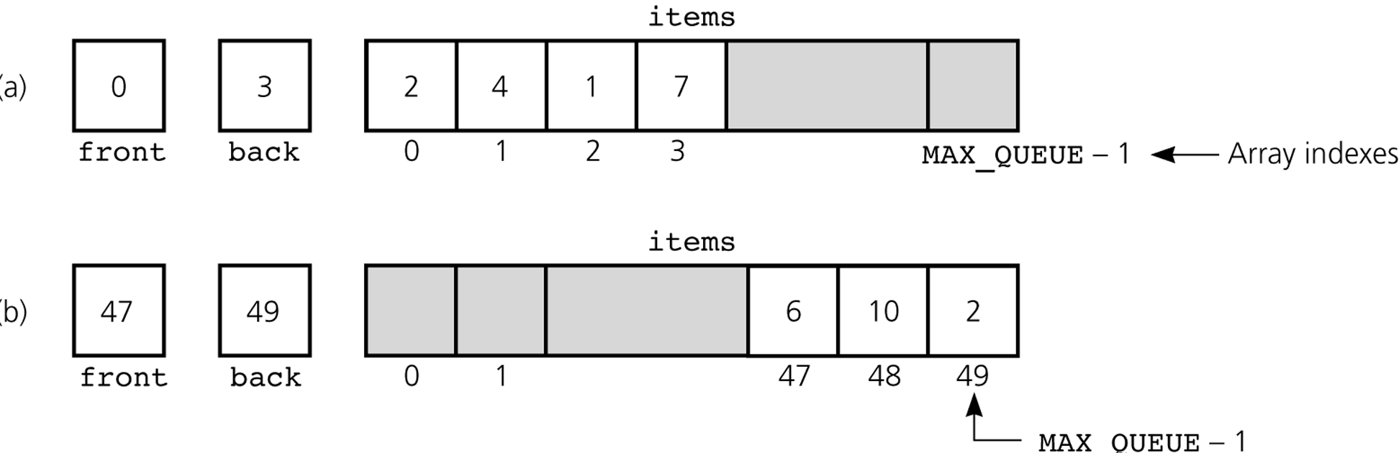
An Array-Based Implementation
a) A naive array-based implementation of a queue; b) rightward drift can cause the queue to appear full

Slide 15
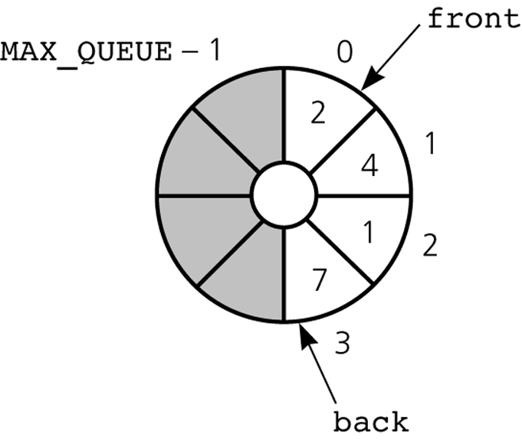
An Array-Based Implementation
A circular array eliminates the problem of rightward drift
A circular implementation of a queue

Slide 16
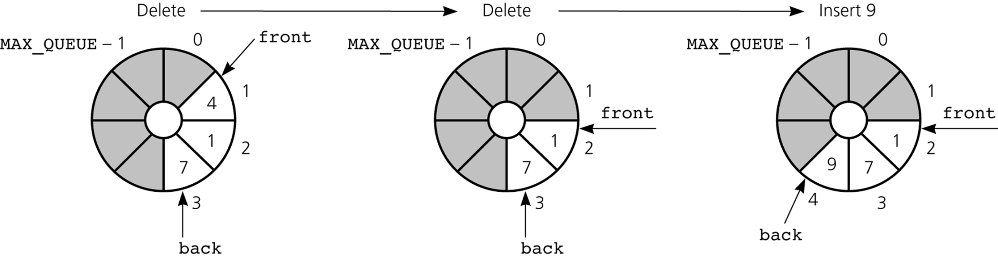
An Array-Based Implementation
The effect of some operations of the queue

Slide 17
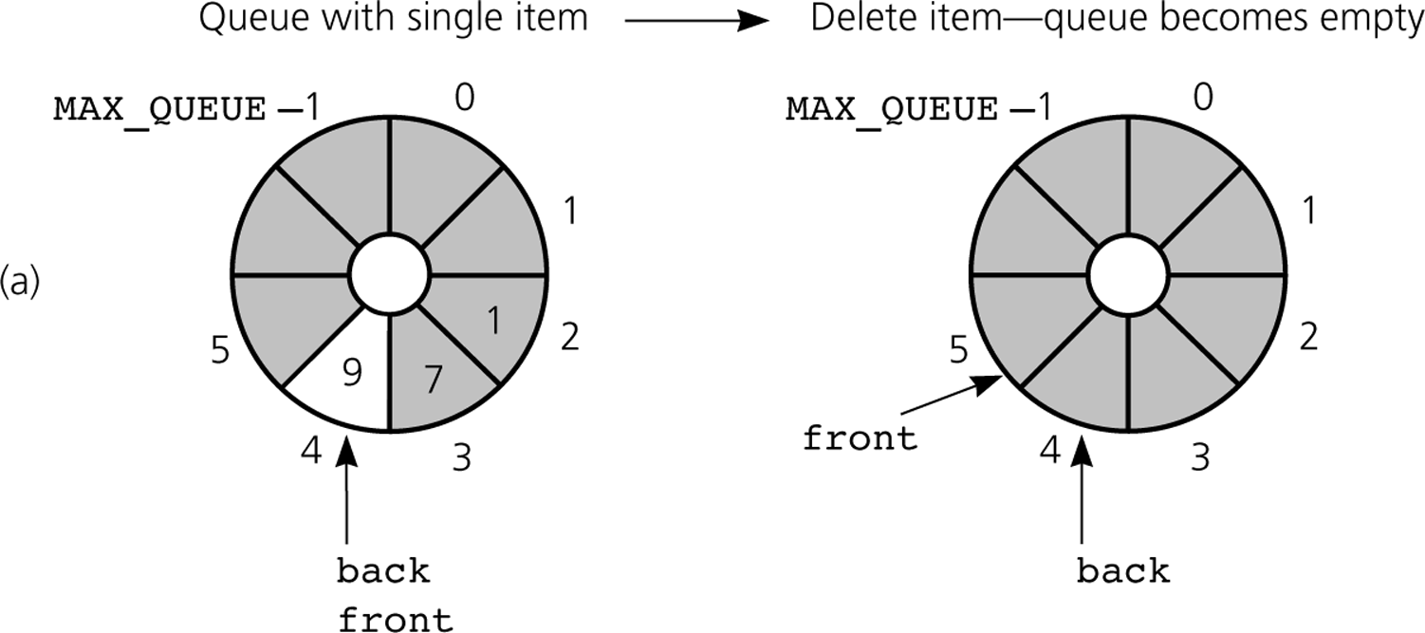
An Array-Based Implementation
a) front passes back when the queue becomes empty

Slide 18
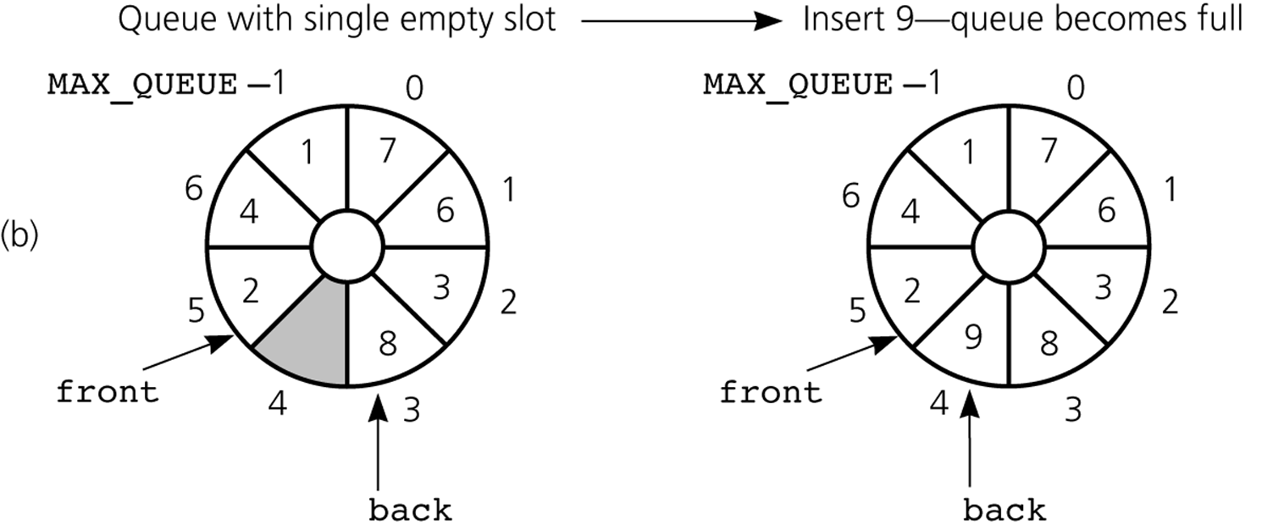
An Array-Based Implementation
b) back catches up to front when the queue becomes full
GenericQueue
TestGenericQueue

Slide 19
The Java Collections Framework Interface Queue
JCF has a queue interface called Queue
Derived from interface Collection
Adds methods:
element: retrieves, but does not remove head
offer: inserts element into queue
peek: retrieves, but does not remove head
poll: retrieves and removes head
remove: retrieves and removes head

