Slide 1
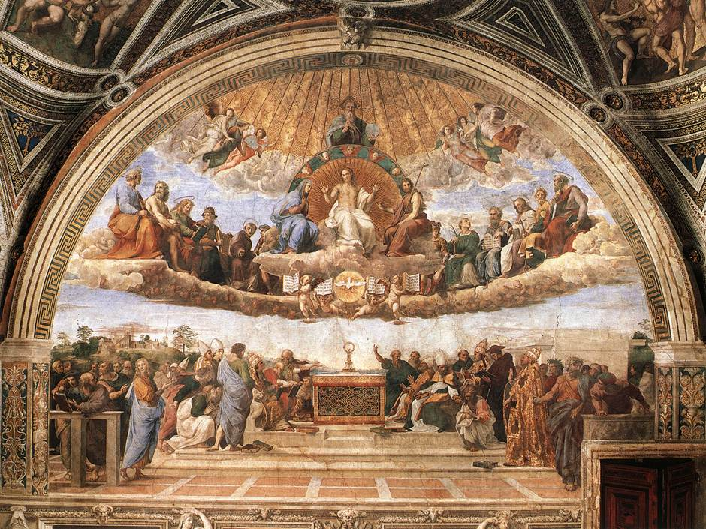
Homeless paintings of the Italian renaissance CS171 final project process book
Ben Zauzmer
Linda Song
Jason Mahr

Slide 2
Table of contents
Initial Project Proposal
Overview and Motivation: Provide an overview of the project goals and the motivation for it. Consider that this will be read by people who did not see your project proposal.
Related Work: Anything that inspired you, such as a paper, a web site, visualizations we discussed in class, etc.
Questions: What questions are you trying to answer? How did these questions evolve over the course of the project? What new questions did you consider in the course of your analysis?
Data: Source, scraping method, cleanup, etc.
Exploratory Data Analysis: What visualizations did you use to initially look at your data? What insights did you gain? How did these insights inform your design?
Design Evolution: What are the different visualizations you considered? Justify the design decisions you made using the perceptual and design principles you learned in the course.
Implementation: Describe the intent and functionality of the interactive visualizations you implemented. Provide clear and well-referenced images showing the key design and interaction elements.
Evaluation: What did you learn about the data by using your visualizations? How did you answer your questions? How well does your visualization work, and how could you further improve it?

Slide 3
Initial project proposal: background & motivation
Ben is taking a class called “Homeless Paintings of the Italian Renaissance.” The goal of the class is to explore a dataset of photos of Italian Renaissance paintings that have been lost to history. The original paintings may have been lost, stolen, destroyed in World War II, mislabeled, or hidden in a private collection. Ideally, we will also find a few of the paintings along the way, though the main goal of this project will be to do cool data visualization projects.
Linda is majoring in CS and minoring in History of Art and Architecture, so she is looking forward to combining her twin interests with this unique and previously unexplored data set. Jason is majoring in CS and is looking to explore how data can be visualized in a meaningful and aesthetically pleasing manner through this project.

Slide 4
Initial project proposal: project objectives
The main goals will be to let users learn more about the distribution of the paintings in the set across many different axes: time, painting location, last known location, artist, last known date, etc. The benefits include a general knowledge of art historical collections, and perhaps insights into finding some of the lost paintings of this collection.

Slide 5
Initial project proposal: data
The data is provided by the Homeless Paintings course, originally encoded by Bernard Berenson’s archive in Italy (in a villa owned by Harvard). The data is split into 11,233 separate json files – one for each painting – which unfortunately are not exactly uniform so some cleaning will be required. The files are online but password protected, but we can get a link with permissions for our TF if necessary.

Slide 6
Initial project proposal: data processing
Mostly, the json files are in two different formats, so we will run a loop through the files to determine the format and then run the appropriate functions to extract data as necessary. We will take dates, locations, artists, and anything else that might be interesting to explore. We expect to use Python to scrape the files (since they are only online), and then write the information into a CSV.

Slide 7
Initial project proposal: visualization
For the dates that paintings were created and then lost, it would be great to create bar charts with brushing. For the locations that paintings were created in and then lost in, we are considering making maps of the world with the paintings plotted on top. For both of these, we would like to have interactive filtering so the user doesn’t have to use the full dataset for each.

Slide 8
Initial project proposal: must-have & optional features
Must-have features:
We need to have visualizations that cover every aspect of the metadata: date, artist, location, etc. Bar charts, line graphs, maps, and 2D plots are all viable options.
Optional features:
There is also potential to do analyses based on the paintings themselves, using aspects such as RGB, saturation, hue, brightness, etc.

Slide 9
Initial project proposal: schedule
Date | Name | Assignment
3/23 | Ben | Scrape and clean data
3/30 | Ben, Linda, Jason | Each create one visualization
4/6 | Ben, Linda, Jason | Each create a second visualization
4/10 | Ben, Linda, Jason | Edit and improve each other’s work

Slide 10
Overview and motivation
To be completed…

Slide 11
Related work
Homework 2 and Homework 4 were influential for our design as baseline templates to start visualizing the large dataset at hand.

Slide 12
questions
The main question that we had with our data set and from our feedback is the question of who would want to access this data and what story it would tell. Currently, our data visualization shows different data points but doesn’t really convey one message or have a certain direction that allows for a directed use of the visualization, so we’re still exploring how to show the data in an interesting and engaging way.

Slide 13
data
From Ben’s Homeless Paintings in the Italian Renaissance class, we have a json data set of paintings that contains the date, artist, geographic location, associated topics (i.e. elements in the painting, such as Jesus, necklace, John the Baptist, etc.), hue/saturation of the photo taken of the painting (which are all in black and white), and notes scribbled on the back of the photo. This was in individual json files per painting, so we used python to scrape the data into one set to work with in the visualization.

Slide 14
Exploratory data analysis
Because we don’t have much of a storyline for the visualization, much of the feedback that we got from Design Studio 4 was to create associations and correlations that could have arisen from the paintings lost/found to make the data more interesting for the average user. Consequently, there are thoughts of possibly comparing the overall history of the Italian Renaissance and its historical main points against the dates of the paintings and when they were lost to see if we can find some correlation that would explain the lost records of the homeless paintings.

Slide 15
Design evolution
The following two images show the initial design sketches that would visualize the paintings in an informative way:

Slide 16
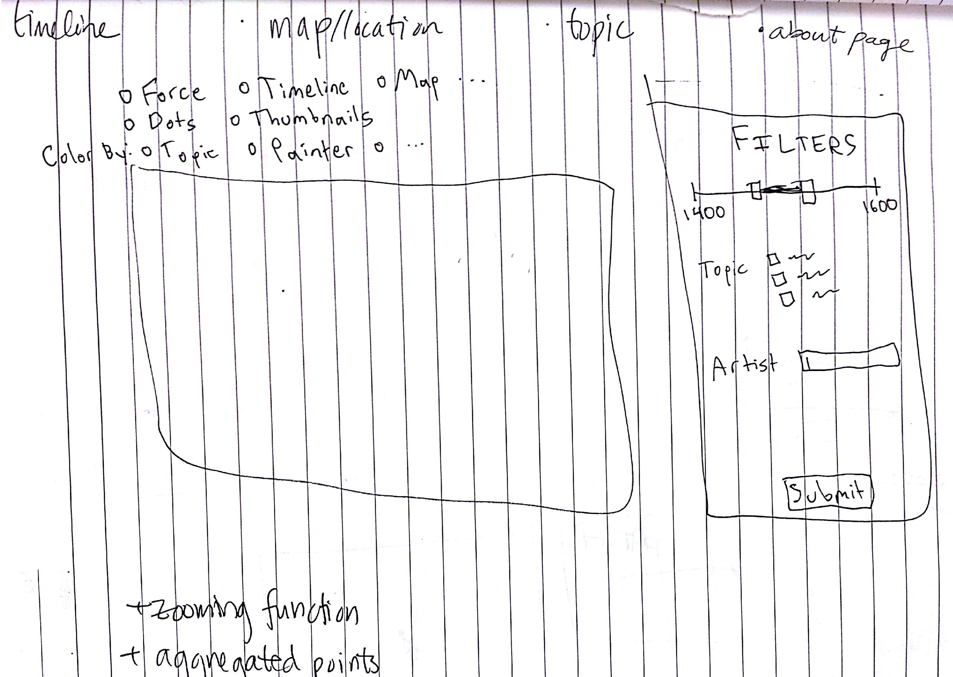
1st idea
Initially, we based our visualization off of the second problem set where we use radio buttons to switch back and forth between different visualizations, ranging from the world map to timeline. The overlapping nodes on the map would aggregate into larger nodes to prevent cluttered usage. There would also be a filtering function where the date of the paintings shown can be adjusted along with the topic and the artist.

Slide 17
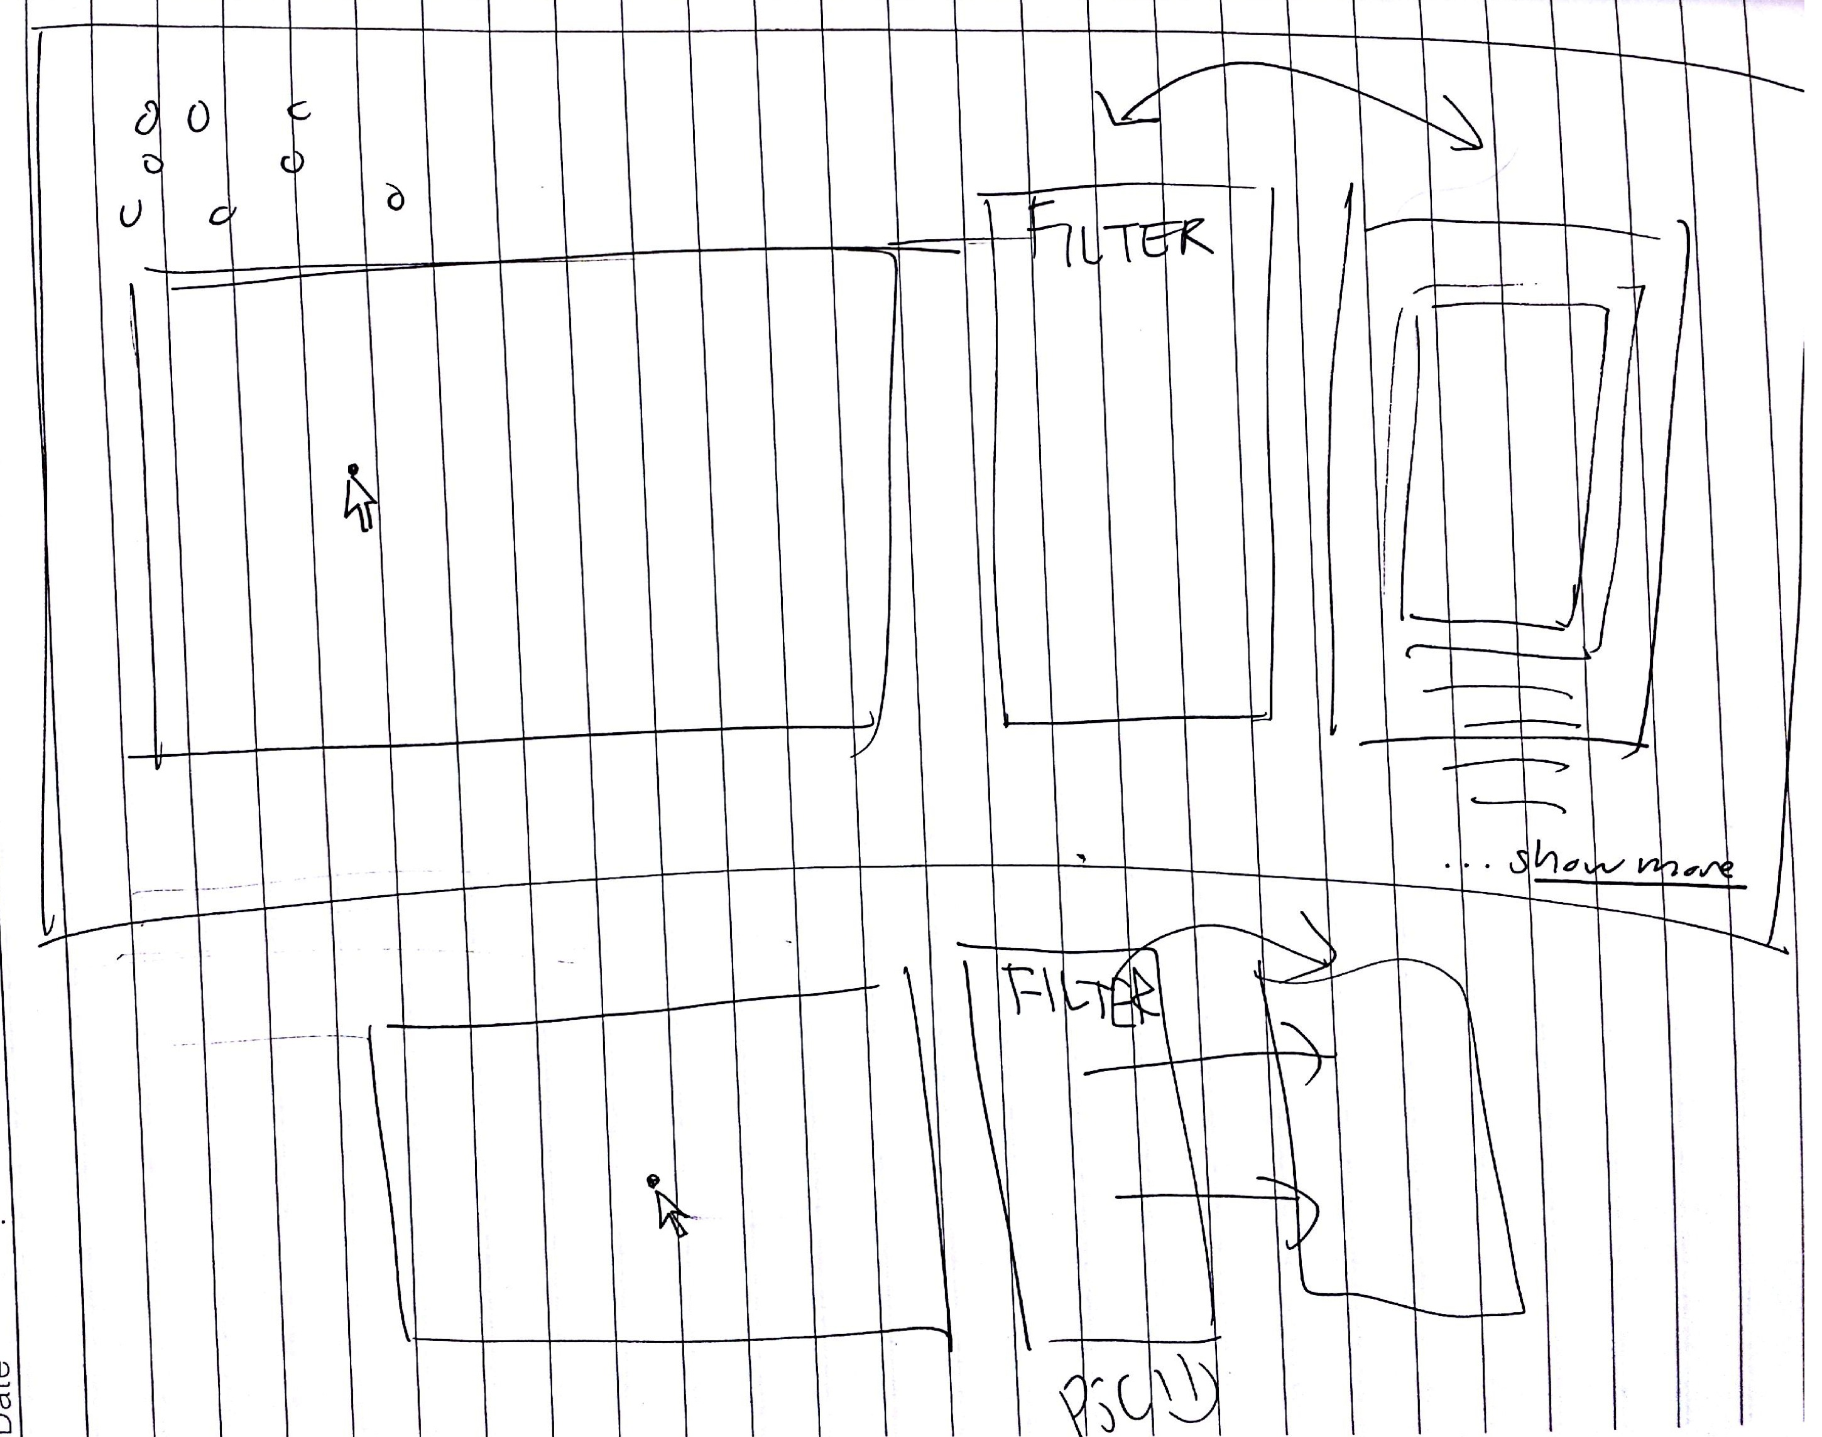
2nd idea
In addition to the first idea, we also thought of adding a second column next to the filtering column that would show the actual painting chosen and relevant details underneath the image. The arrows indicate the columns perhaps transitioning or changing location, but we aren’t exactly certain what would be the best way to arrange the filter/detail/map yet.

Slide 18
implementation
To implement our visualizations, we utilized much of the second problem set with the graph/node and the radio buttons and the fourth problem set with the geomap of the US. The main and the largest visualization is the geomap that is populated by each painting in the dataset. Since ~11,000 points is a lot and can significantly delay the visualization, conditions were made to ensure that not all of the data points are shown at once. In addition, colors would also be added to depict the artist at hand or the time period chosen to allow for easy comprehension and compartmentalization of the data for the user.

Slide 19
evaluation
To be completed

