Slide 1
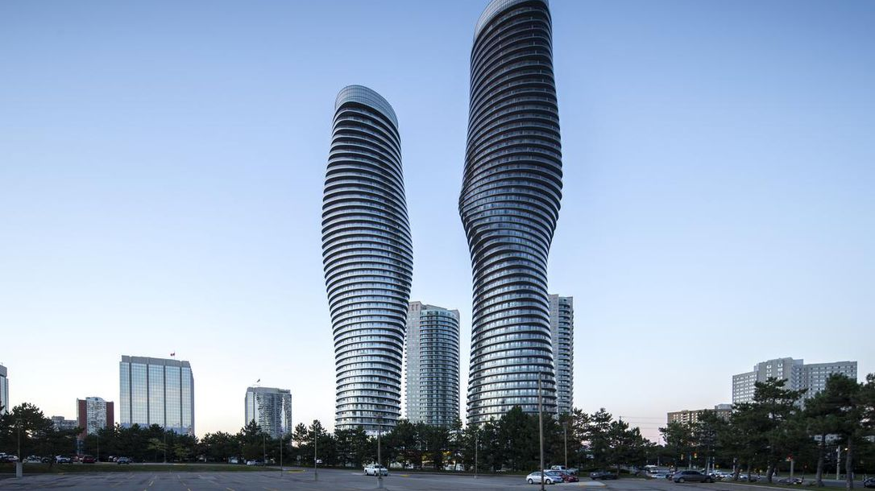



A Taste of Mississauga
bzhao225

