Slide 1
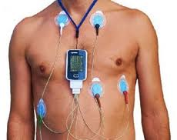
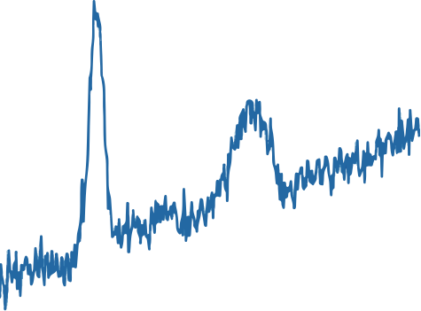

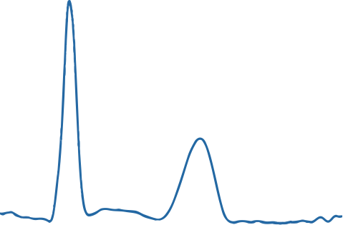
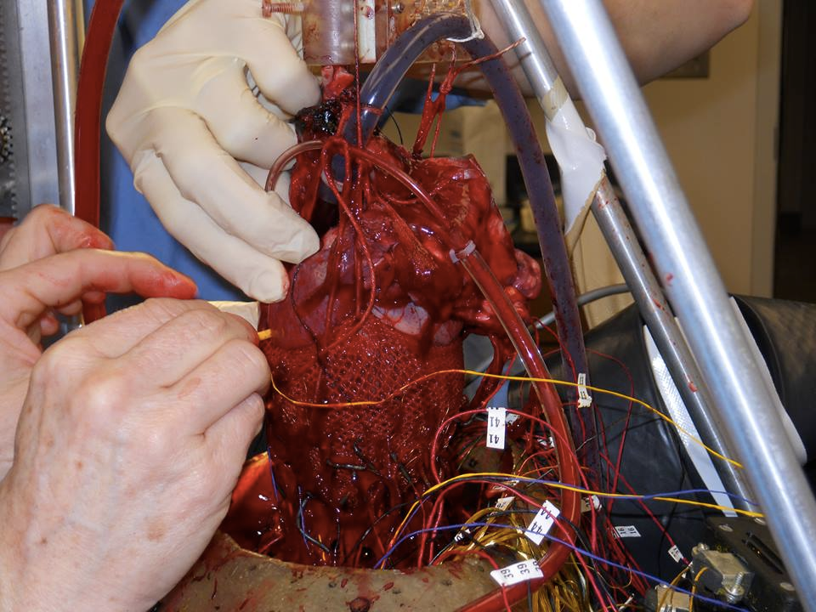
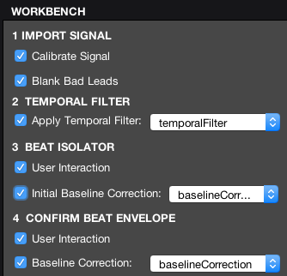
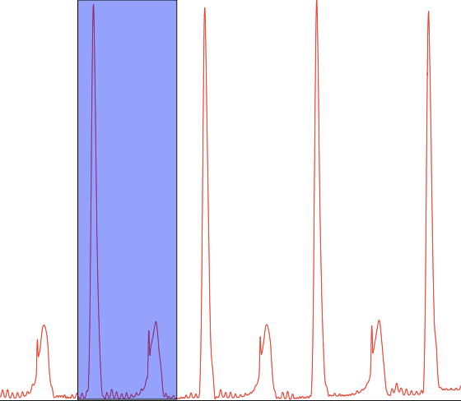
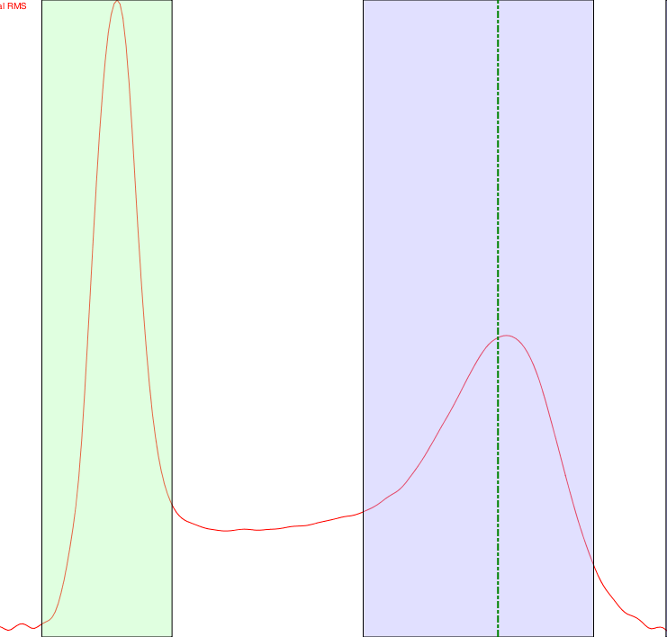
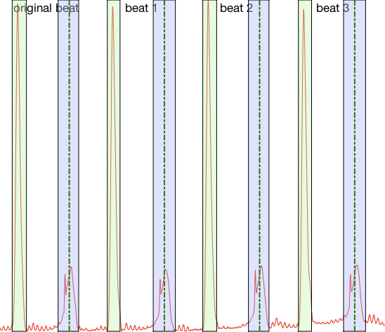

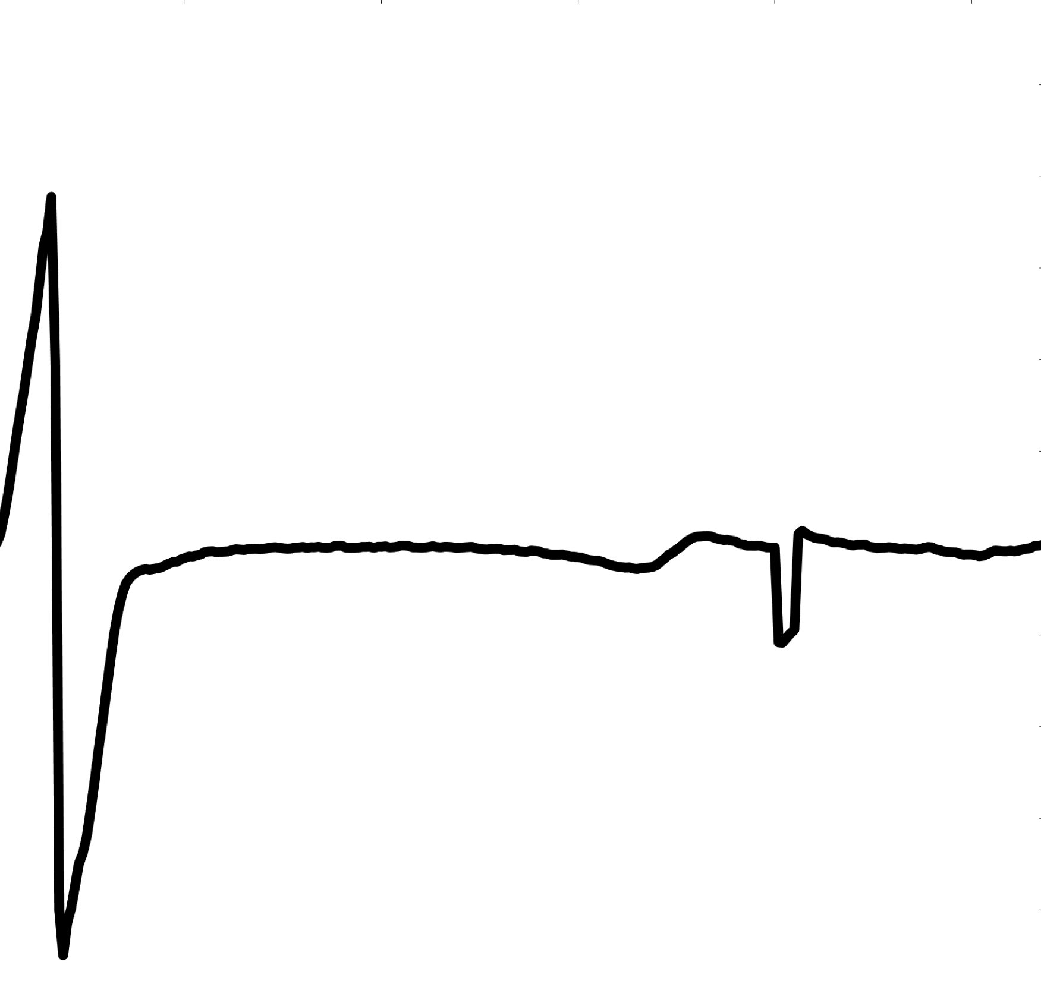
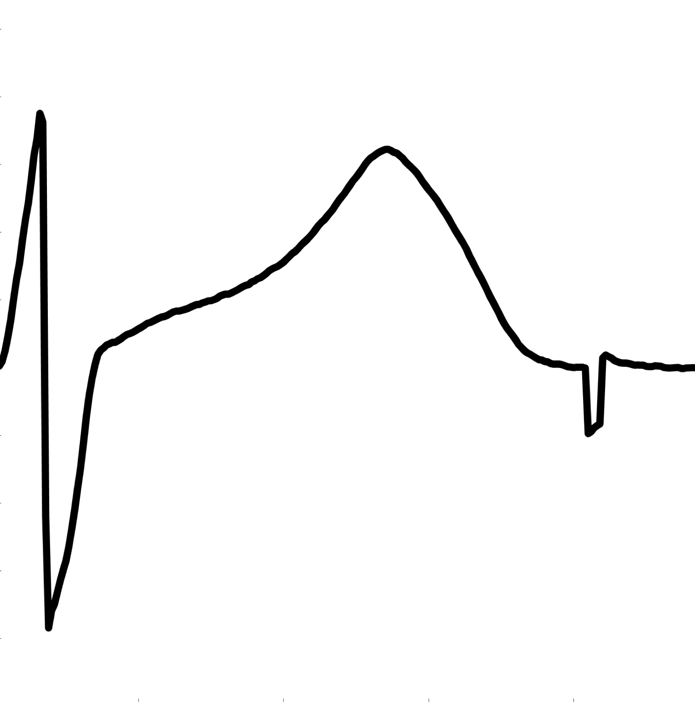
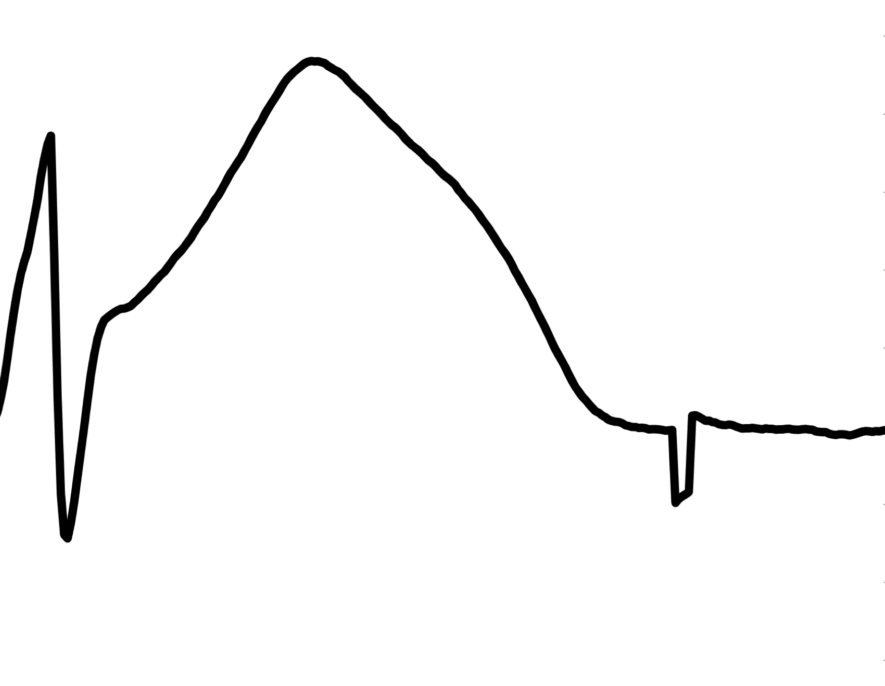
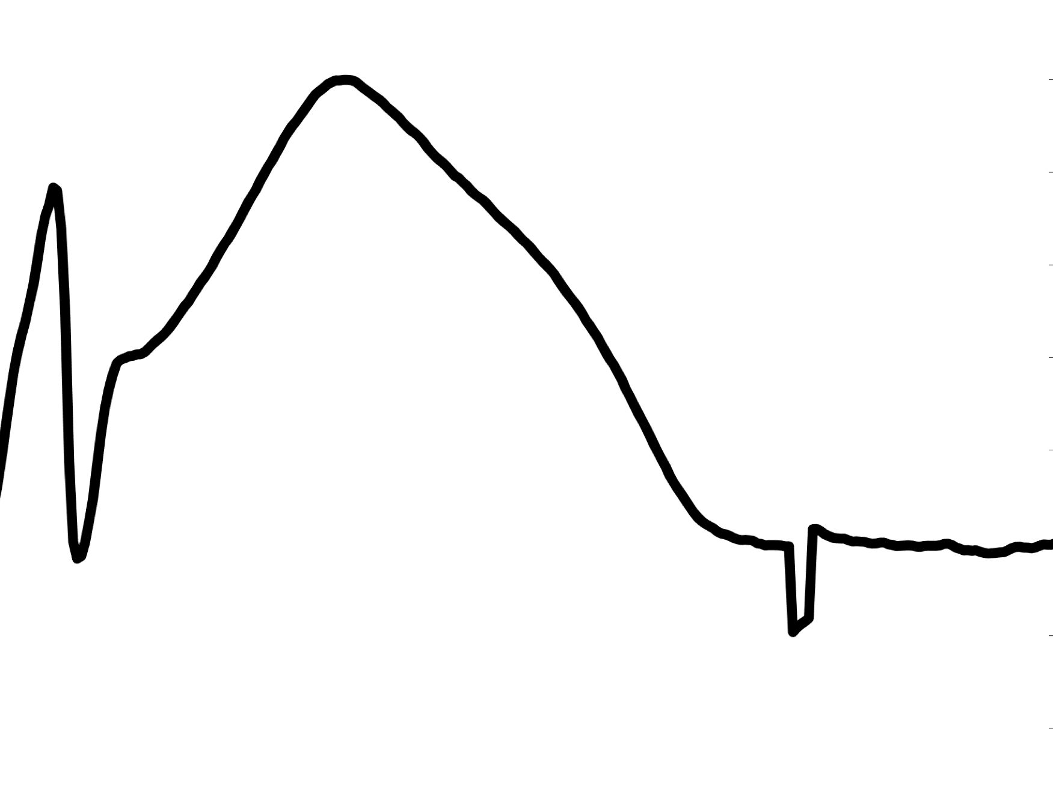
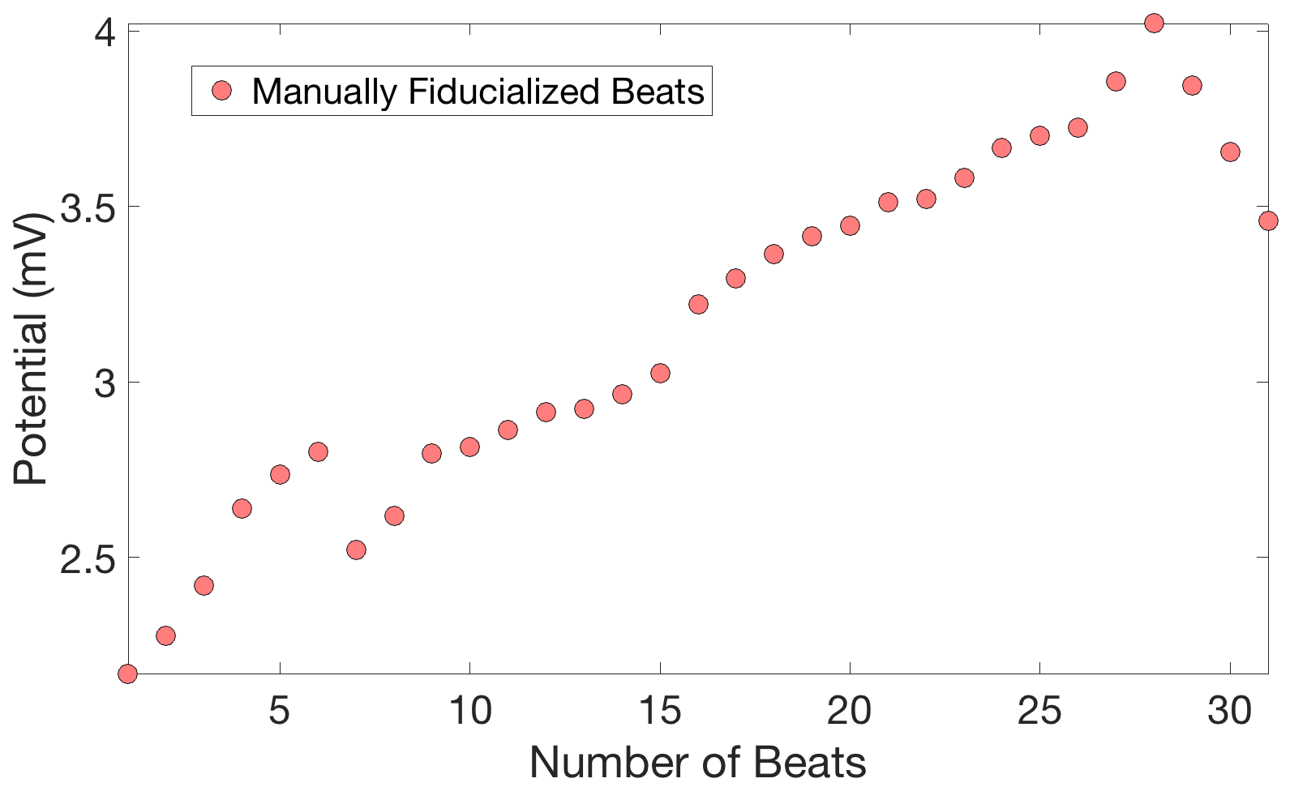
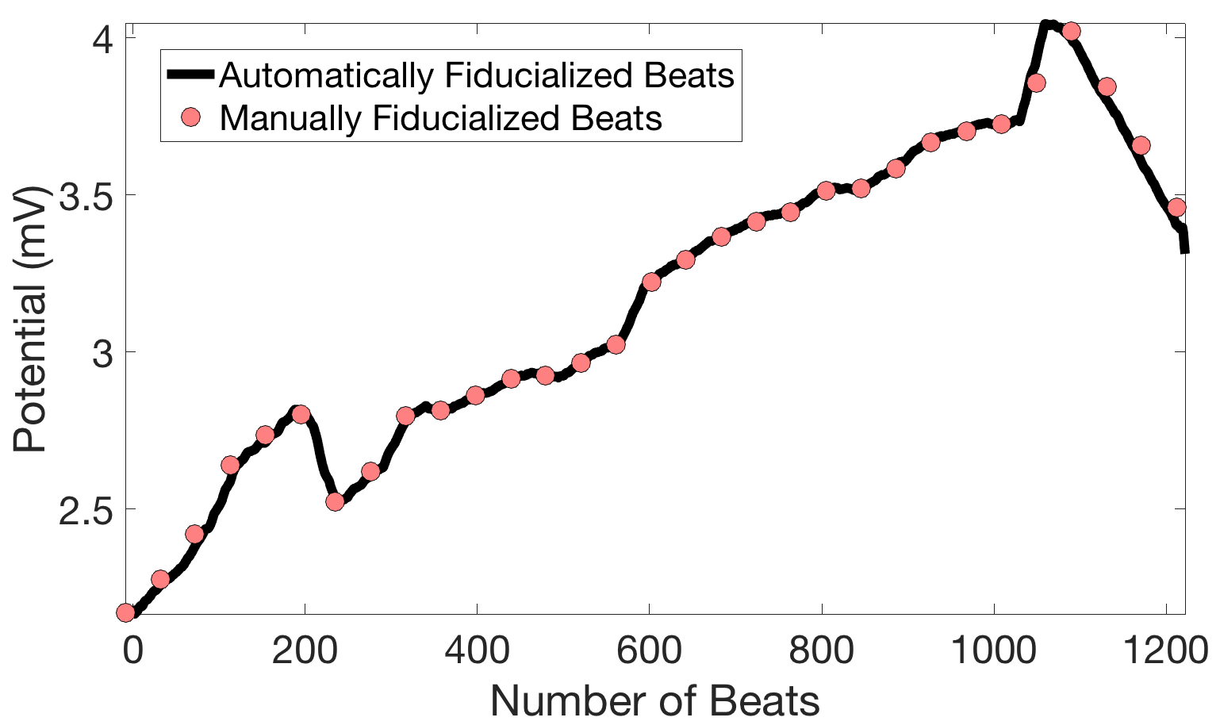
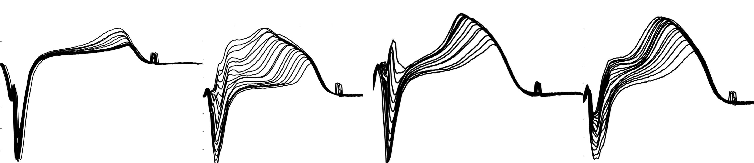






PFEIFER: A MATLAB Based Platform for Preprocessing Cardiac Electrograms
B. Zenger^{1,2}; W. Good^{1,2}; A. Rodenhauser¹; R. MacLeod, PhD^{1,2}
¹ Scientific Computing and Imaging Institute, University of Utah, Salt Lake City, UT
2 Department of Bioengineering, University of Utah, Salt Lake City, UT
Patient recordings
GUI based cardiac signal processing toolbox
Raw cardiac time signals
Processed cardiac time signals
R
removed signal drift
removed signal noise
marking of specific time instants QRST (fiducials)
other preprocessing tasks
PURPOSE OF PFEIFER
Animal experiments
Potential (mV)
Potential (mV)
T
Q
S
Time (ms)
Time (ms)
Setup PFEIFER
Import cardiac time signals
& choose processing tasks.
BEAT ISOLATION:
Use your mouse to select the start & end of a beat in RMS of signal.
MANUAL FIDUCIALIZING:
Mark fiducials within a beat using your mouse.
AUTOMATIC FIDUCIALIZING:
Manual fiducial is used to automatically fiducialize the next 30-50 beats
TYPICAL WORK FLOW
The manual approach:
Mark fiducials manually ( ) once every 15 seconds.
Leave beats in between unfiducialized ( ).
15 seconds
Timeline
End
intervention
Begin
intervention
BENEFIT OF PFEIFER
The PFEIFER approach:
30-50 Beats
PFEIFER autofiducializes ( )
beats in between manually fiducialized beats ( ).
Healthy signal
Mild ST segment elevation
Moderate ST segment elevation
Severe ST segment elevation
Without Autofiducializing
With Autofiducializing
Alternatives to manual fiducializing: Rule-based fiducializing
Acknowledgements:
Tracking of the ST segment over an intervention
Problem: Beats can vary in morphology:
Support for this work was provided in part by the NIH/NCRR Center of Integrative Biomedical Computing (CIBC), 2P41 RR0112553-12
VALIDATION
ADVANTAGE OF OUR METHOD
Rule based fiducializing can fail, especially on ischemic electrograms
Number of Fiducialized Beats
Number of Fiducialized Beats

