Slide 1


Inferring the Underlying Structure of Information Cascades
Bo Zong,
Yinghui Wu,
Ambuj K. Singh,
Xifeng Yan
12-12-2012@ICDM12

Slide 2










Information cascades in social networks
Information propagation in social networks
Cascade: a subgraph tracking propagation trace
(a) Facebook shared link
(b) Twitter retweet
Importance of Cascades
Viral marketing
Recommendation
Information Security
But missing structure:
Privacy policies
b) Crawling noise.
(a) A social graph
(b) A cascade
Notes:
In online social networks, information propagates as cascades.
On facebook, a user might share a link on price discount which is originally published by her friend
On Twitter, a user might join a topic discussion after seeing the ones she follows are talking about it.
To facilitate information search, we usually model online social network as graphs. Cascades are modeled as subgraphs tracking information propagation.
A user comes across an interesting clip, and she shares it with her friends;
After her friends see this clip, they are amazed and they cannot wait to share this clip with their friends
After they share it, some of their friends think this clip is really cool, and they take the same action share it.
In this case, the video clip triggers an information cascade, which is a sub-tree of the social graph.
Many applications rely on cascade structure information, such as viral marketing and online recommendation; however, structure information are very likely to be missing in practice.
It is an important task to infer the cascade structures based on their partial observations.

Slide 3


An example: cascade structure inference
We can fully observe a social graph, but the cascade structure is partially observed.
Alice, 1pm
David
#iPhone5
Bob, 1:50pm
Alice, 1pm
Cooper, 3pm
Bob, 1:50pm
Frank
Frank
Alice, 1pm
1. Which one?
David
David
2. How difficult?
3. Algorithms?
4. Accuracy?
Ed
Cooper, 3pm
Bob, 1:50pm
Cooper, 3pm
Notes:
Let’s take an example to see what a task to infer cascade structure is.
We have a fragment of a social graph of six users.
Among them, Alice is an agent from an advertisement company. She publishes a video link on iPhone5 at 1pm;
One of her neighbor, Bob, sees it, decides to share it at 1:50
We also find a user Cooper, he shares this link at 3pm, but we don’t see how he gets this information, since the cascade structure information is missing
To recover the missing part, we can infer the underlying structure based on the partial observation.
There might be multiple possible structures that are consistent with the observation. One possible is, …; The other is…. However, which one is more closer to the ground truth?
More questions are
Which inferred structure do we prefer?
How difficult are the structure inference task?
Can we infer the structures via efficient algorithms?
How accurately do the inferred structure recover the missing part?
In the following, I’m going to talk about how we addressed these questions.

Slide 4
Roadmap
Introduction
Preliminary
Problem definition
Our solutions
Experimental results
Conclusions

Slide 5
Preliminary
Diffusion graph, G = (V, E)
Independent Cascade Model
Diffusion function, f : E→[0,1]
Partial observation, X
B
1
A
0
0.7
D
1
0.3
2
0.5
0.8
F
0.8
0.7
0.8
0.9
0.3
0.8
0.4
E
C
0.6
3
X={ (A, 0), (B, 1), (C, 3) }
G
Notes:
Define diffusion graph
For the ease of discussion, we assume cascades unfold following the independent cascade model
Information propagates via discrete time step;
At time t+1, a node only can be influenced by one of its neighbors which are influenced at time t. In this way, a cascade will be a subtree of a social graph.
Moreover, the probabilities of a node influencing its neighbors are defined as a diffusion function from the edge set to an interval between 0 and 1.
Moreover, we consider general partial observation, that is, for each information propagation, we only observe when a node is influenced.

Slide 6
Problem definition
B 1
A 0
Minimum Perfect Consistent Tree (PCT)
Input
diffusion graph G
source s
partial observation X
Output
cascade T: a tree in G
∀(v, t)∈X, s reaches v by exactly t edges
minimize:
Variants
Weighted, PCT_{w}
Non-weighted, PCT_{min}
0.7
0.3
F
0.5
D
0.8
G
0.8
0.8
0.7
0.9
0.3
0.8
0.4
Ed
0.6
C 3
X={ (A, 0), (B, 1), (C, 2) }
T
A 0
D
0.046
0.8
0.7
0.7
C 3
B 1
F
0.9
Notes:
Add unweighted case, specify abbr

Slide 7
Problem definition (cont.)
B 1
A 0
Minimum Bounded Consistent Tree (BCT)
Input
diffusion graph G
source s
partial observation X
Output
cascade T: a tree in G
∀(v, t)∈X, s reaches v by ≤ t edges
minimize:
Variants
Weighted, BCT_{w}
Non-weighted, BCT_{min}
0.7
0.3
F
0.5
D
0.8
G
0.8
0.8
0.7
0.9
0.3
0.8
0.4
Ed
0.6
C 3
X={ (A, 0), (B, 1), (C, 2) }
T
A 0
David
0.155
0.8
0.7
0.8
C 3
B 1

Slide 8
Perfect consistent tree (PCT)
Complexity of PCT_{w} and PCT_{min}
NP-complete
APX-hard
Heuristic: bottom-up search
Perfect consistent SP tree
Reduce to Steiner tree
Approximable in for PCT_{w}
Approximable in for PCT_{min}
S
t₁
…
…
…
…
t_{i}
…
…
t_{i+1}
…
…
Shortest Path
…
t_{max}

Slide 9
Bounded consistent tree (BCT)
Complexity of BCT_{w} and BCT_{min}
NP-complete
Approximable in for BCT_{w}
Approximable in for BCT_{min}
Approximating BCT_{w} and BCT_{min}
∀(v, t)∈X, connect v to s with the shortest path

Slide 10



Datasets
Enron email
G: 86,808 nodes and 660,642 edges
260 cascades (depth ≥ 3, #nodes ≥ 8)
Twitter hashtag retweets
G: ≥ 17M nodes, ≥ 1,400M edges, ≥ 70M Retweets
321 cascades (depth ≥ 4, #nodes ≥ 10)
Synthetic cascades on Facebook
G: ≥ 3M nodes, ≥ 28M edges
Diffusion functions are learned.
Notes:
Maximum 81 nodes
Learning algorithm: Saito 2008

Slide 11
Metrics
Partial observation
define uncertainty
randomly remove nodes from T and add them into X until σ is reached.
Performance metric
precision: rate of #correct estimates to # estimates
recall: rate of # correct estimates to # missing nodes
Notes:
Add data information
How to get ground truth

Slide 12
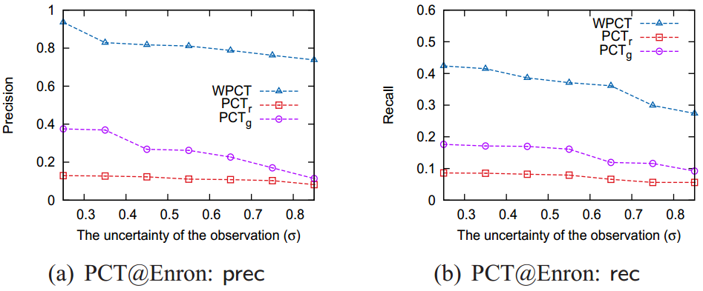
Effectiveness on Perfect Consistent Tree

Slide 13
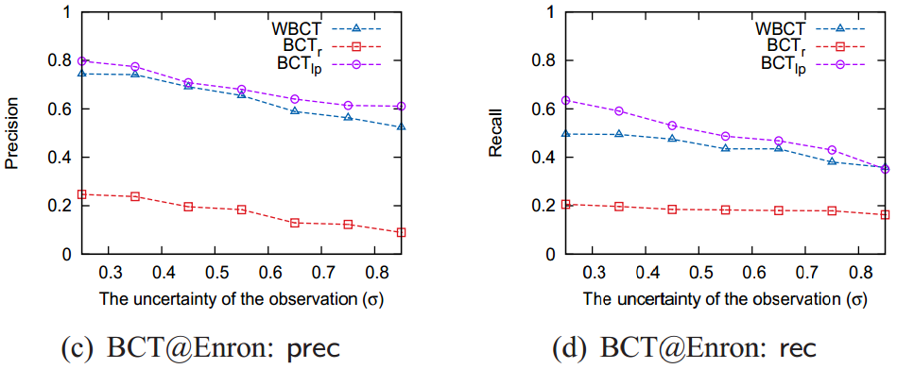
Effectiveness on Bounded Consistent Tree

Slide 14
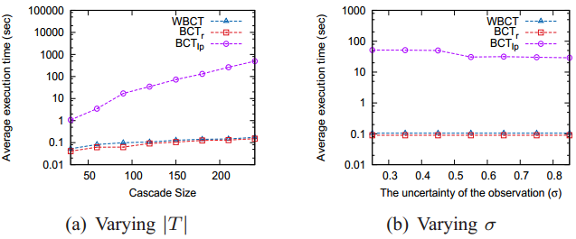
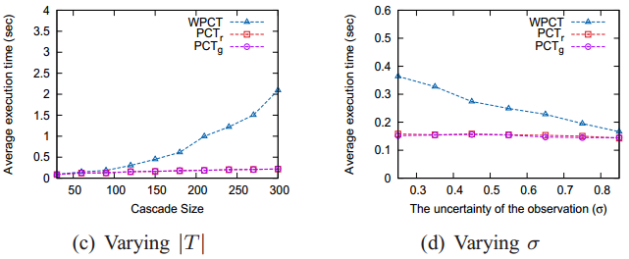
Scalability on PCT and BCT

Slide 15
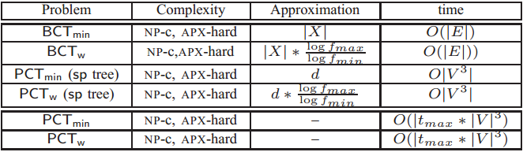
Conclusions
Defined the cascade structure inference problem
perfect and bounded consistent trees;
metrics for quality of consistent trees
Investigated the cascade structure inference problem
Analyzed the problem complexity
Proposed approximations and heuristics
Experimental results verify the effectiveness and efficiency of our solutions
Notes:
Add table

Slide 16
Thanks
Questions?

