Slide 1




Towards Scalable Critical Alert Mining
Bo Zong¹
with Yinghui Wu¹, Jie Song², Ambuj K. Singh¹, Hasan Cam³, Jiawei Han⁴, and Xifeng Yan¹
¹UCSB, ²LogicMonitor, ³Army Research Lab, ⁴UIUC

Slide 2
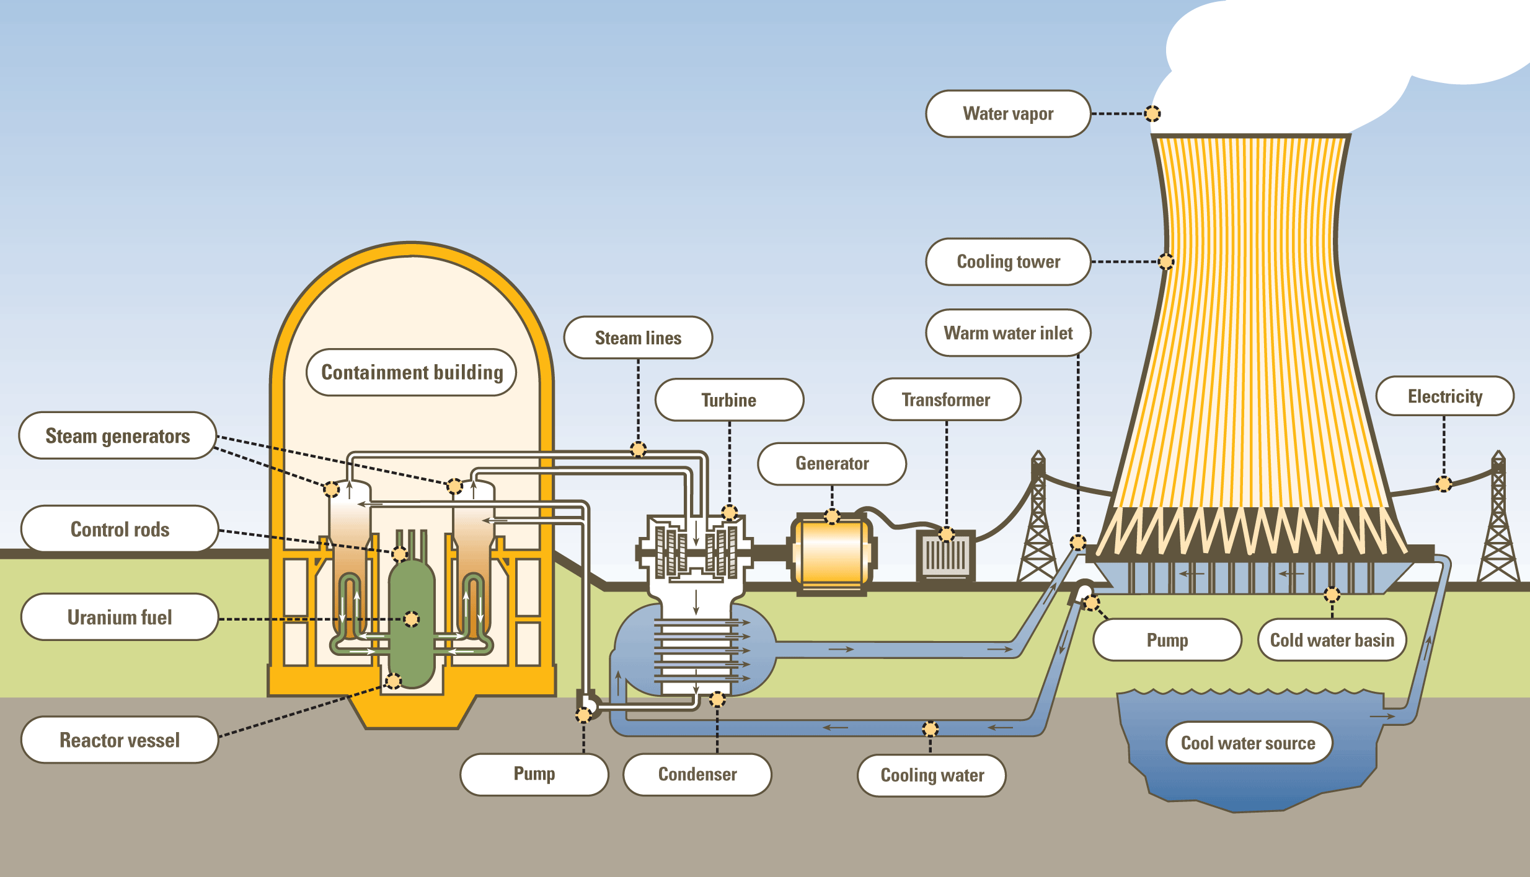

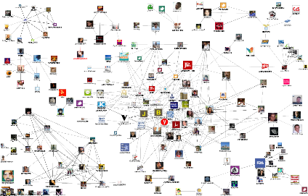
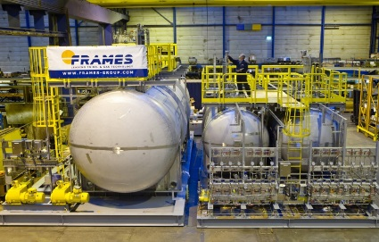
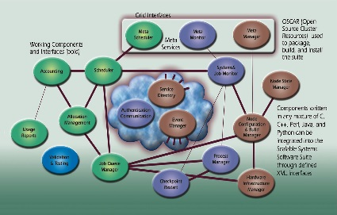
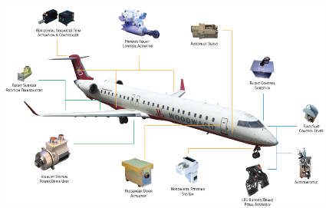
Big Data Analytics in Automated System Management
Complex systems are ubiquitous
Tons of monitoring data generated from complex systems
Big data analytics are desired to extract knowledge from massive data and automate complex system management
Nuclear power plant
Computer network
Social media
Chemical production system
Software system
Aircraft system

Slide 3
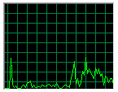

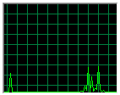
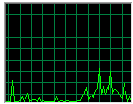
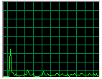
Massive Monitoring Data in Complex Systems
Example: monitoring data in computer networks
@Server-A
Data center
Monitoring data
#MongoDB backup jobs:
Apache response lag:
Mysql-Innodb buffer pool:
120-server data center can generate monitoring data 40GB/day
SDA write-time:
… …

Slide 4

System Malfunction Detection via Alerts
Example: alerts in computer networks
Complex systems could have many issues
For the 40GB/day data generated from the 120-server data center, we will collect 20k+ alerts/day
Alert @server-A
01:20am: #MongoDB backup jobs ≥ 30
01:30am: Memory usage ≥ 90%
01:31am: Apache response lag ≥ 2 seconds
01:43am: SDA write-time ≥ 10 times slower than average performance
…
09:32pm: #MySQL full join ≥ 10
09:47pm: CPU usage ≥ 85%
09:48pm: HTTP-80 no response
10:04pm: Storage used ≥ 90%
…
Which alert should I start with?
Monitoring data

Slide 5

Mining Critical Alerts
Example: critical alerts in computer networks
Critical!
Disk Read Latency @Server-A
#MongoDB backup jobs @Server-B
CPU cores busy @Server-B
CPU cores busy @Server-B
MongoDB busy @Server-B
Mcollective reg status @Server-C
How to efficiently mine critical alerts from massive monitoring data?

Slide 6

Pipeline
Our focus
Offline dependency rule mining
On-demand critical alert mining
Offline dependency rule mining
Online alert graph maintenance
On-demand critical alert mining
Online
alert graph maintenance
[0, 1, …, 1, 1]
[1, 1, …, 1, 0]
[0, 0, …, 1, 1]
…
…
…
…
…
…
user
History alert log
Dependency rules
t₁
t₂
t₃
time
Incoming
alerts
Alert graph

Slide 7
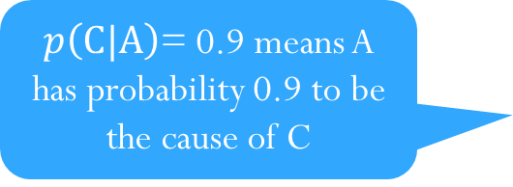
Alert Graph
Alert graphs are directed acyclic (DAG)
Nodes: alerts derived from monitoring data
Edges
Indicate the probabilistic dependency between two alerts
Direction: from one older alert to another younger alert
Weight: the probability that the dependency holds
Example
Alert graph G
A
How to measure an alert is critical?
$p\left(C|A\right)$= 0.9 means A has probability 0.9 to be the cause of C
0.72
0.1
0.9
C
0.71
0.3
0.6
0.5
0.5
0.8
0.7

Slide 8
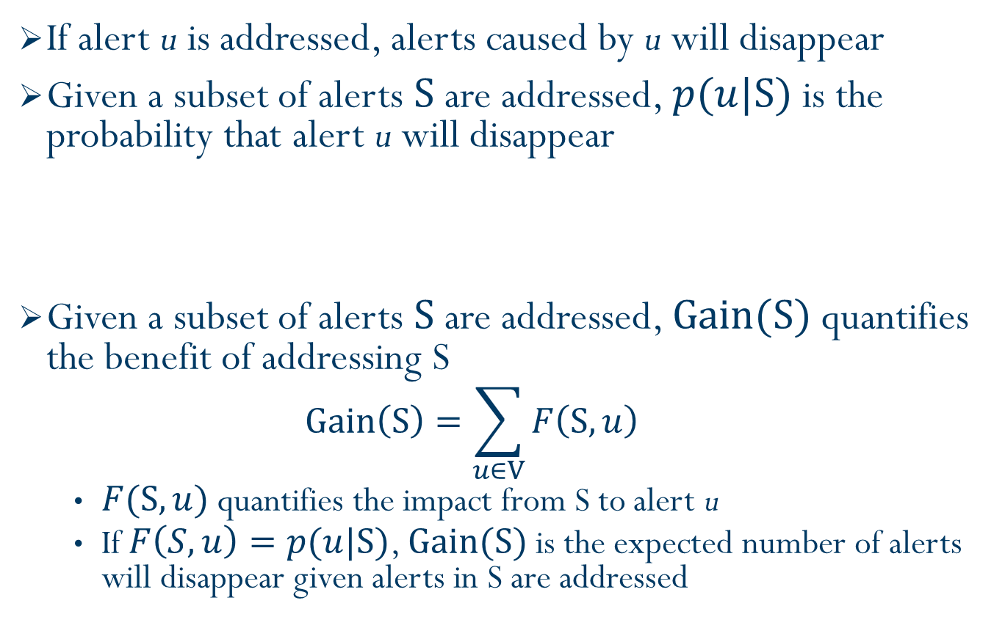
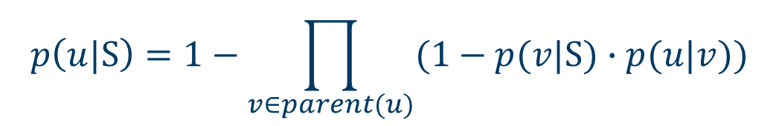
Gain of Addressing Alerts
If alert u is addressed, alerts caused by u will disappear
Given a subset of alerts $S$ are addressed, $p(u|S)$ is the probability that alert u will disappear
Given a subset of alerts $S$ are addressed, $Gain(S)$ quantifies the benefit of addressing S
$$Gain\left(S\right)=\sum_{u∈V}{F\left(S, u\right)}$$
$F(S, u)$ quantifies the impact from S to alert u
If $F\left(S,u\right)=p(u|S)$, $Gain(S)$ is the expected number of alerts will disappear given alerts in S are addressed
The cause of u disappears given S is addressed
$$p\left(u|S\right)=1−\prod_{v∈parent(u)}{(1−p(v|S)∙p(u|v))}$$

Slide 9

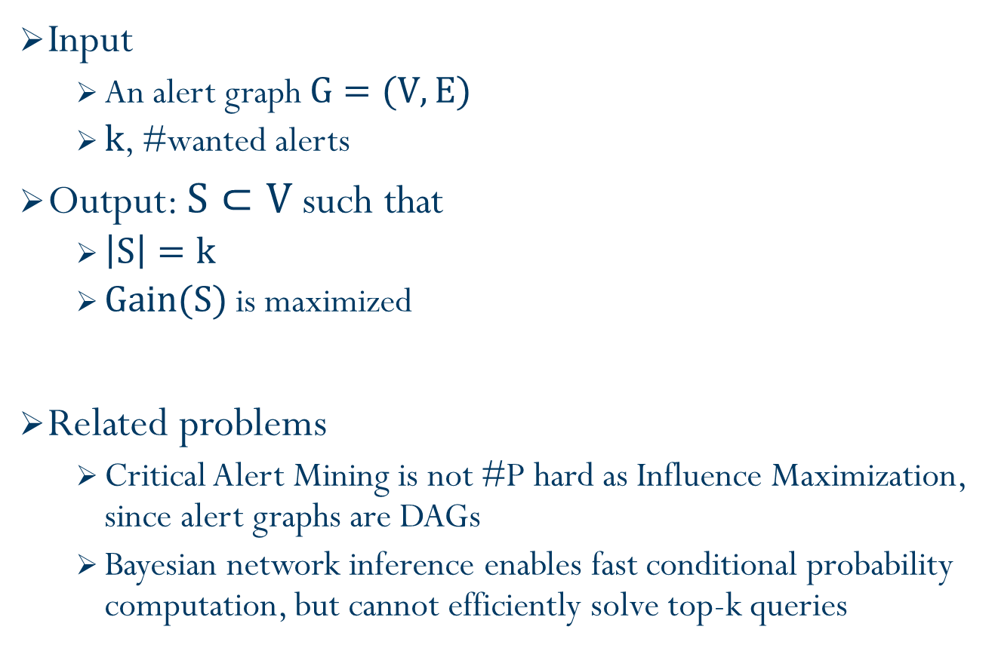
Critical Alert Mining
Which are the top-5 critical alerts?
Input
An alert graph $G=(V, E)$
$k$, #wanted alerts
Output: $S⊂V$ such that
$\left|S\right|=k$
$Gain(S)$ is maximized
Related problems
Critical Alert Mining is not #P hard as Influence Maximization, since alert graphs are DAGs
Bayesian network inference enables fast conditional probability computation, but cannot efficiently solve top-k queries
NP-hard

Slide 10

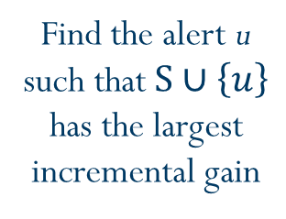
Naive Greedy Algorithm
Greedy search strategy
Greedy algorithms have approximation ratio 1 - $\frac{1}{e}$ ($≈$0.63)
Efficiency issue: time complexity $O(k|V||E|)$
Alert graph G
Find the alert u such that $S∪\left\{u\right\}$ has the largest incremental gain
A
B
S
{ }
0.72
0.1
A
B
0.9
0.71
0.3
0.6
0.5
0.5
0.8
0.7
How to speed up greedy algorithms?

Slide 11


Bound and Pruning Algorithm (BnP)
Pruning unpromising alerts by upper and lower bounds
Drawback: pruning might not always work
Alert graph G
A
Bound estimation
Lower
Upper
0.72
0.1
$$2.5≤Gain(S∪\{A\})≤4$$
0.9
0.71
C
0.5
0.5
$$1.2≤Gain(S∪\{C\})≤2$$
0.3
0.6
0.8
0.7
Unpromising
LocalGain
SumGain
Can we trade a little approximation quality for better efficiency?

Slide 12
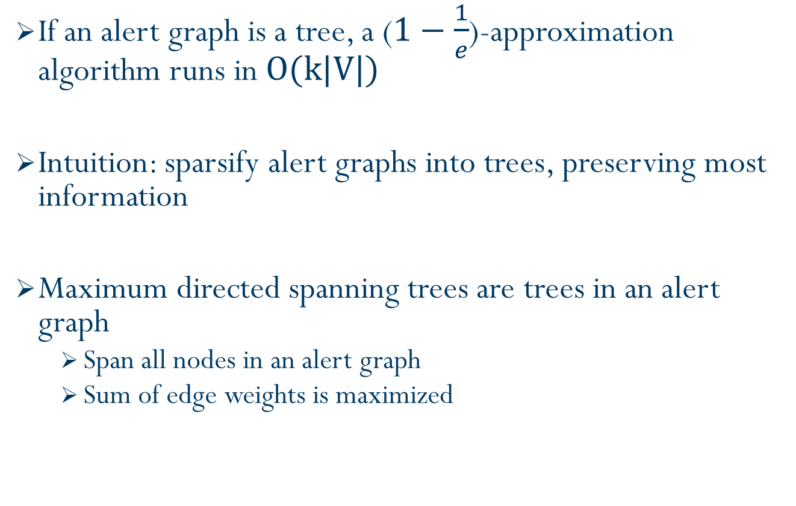
Single-Tree Approximation
If an alert graph is a tree, a ($1−\frac{1}{e}$)-approximation algorithm runs in $O(k|V|)$
Intuition: sparsify alert graphs into trees, preserving most information
Maximum directed spanning trees are trees in an alert graph
Span all nodes in an alert graph
Sum of edge weights is maximized

Slide 13

Single-Tree Approximation (cont.)
Linear-time algorithm to search maximum directed spanning tree
Drawback: accuracy loss in Gain estimation
Edge of the highest weight is always selected
Edges of similar weight never get selected
G
T*
Tree sparsification
Gain estimation
0.72
0.1
0.72
0.1
0.9
0.9
$$\tilde{Gain}$$
0.71
0.3
0.6
0.5
0.5
0.3
0.5
0.8
0.7
0.8
0.7

Slide 14



Multi-Tree Approximation
Sample multiple trees from an alert graph
T₁
Gain estimation
G
$${Gain}_{T_{1}}$$
Tree sampling
0.72
0.1
0.9
0.71
…….
Average Gain
0.3
0.6
0.5
0.5
$$\tilde{Gain}$$
T_{L}
0.8
0.7
$${Gain}_{T_{L}}$$

Slide 15
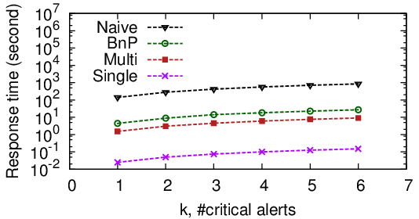
Experimental Results
Efficiency comparison on LogicMonitor alert graphs
BnP is 30 times faster than the baseline
Multi-tree approximation is 80 times faster with 0.1 quality loss
Single-tree approximation is 5000 times faster with 0.2 quality loss

Slide 16
Conclusion
Critical alert mining is an important topic for automated system management in complex systems
A pipeline is proposed to enable critical alert mining
Tree approximation practically works well for critical alert mining
Future work
Critical alert mining with domain knowledge
Alert pattern mining
if two groups of alerts follow the same dependency pattern, they might result from the same problem
Alert pattern querying
if we have a solution to a problem, we apply the same solution when we meet the problem again

Slide 17
Questions?
Thank you!

Slide 18

Experiment Setup
Real-life data from LogicMonitor
50k performance metrics from 122 servers
Spans 53 days
Offline dependency rule mining
Training data: the latest 7 consecutive days
Mined 46 set of rules (starting from the 8th day)
Learning algorithm: Granger causality
Alert graphs
Constructed 46 alert graphs
#nodes: 20k ~ 25k
#edges: 162k ~ 270k

Slide 19
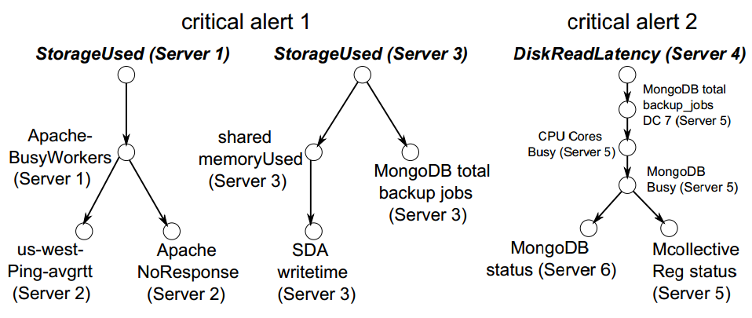
Case study

