Slide 1


Cloud Service Placement via Subgraph matching
Bo Zong (UCSB)
Ramya Raghavendra (IBM T.J. Watson)
Mudhakar Srivatsa (IBM T.J. Watson)
Xifeng Yan (UCSB)
Ambuj K. Singh (UCSB)
Kang-Won Lee (IBM T.J. Watson)

Slide 2



Cloud datacenters
Datacenters shared by multiple customers
Popular cloud datacenters
Provider: Amazon EC2, Microsoft Azure, Rackspace, etc
Customers: renting virtual machines for their services
Profitable business
In 2013, Microsoft Azure sold $1 billion services
By 2015, Amazon web services worth ~$50 billion

Slide 3
Cloud service placement
User-defined cloud service
Node: functional component
Edge: data communication
Label: required resources
Placement
Place the service into a cloud datacenter
A set of servers hosting the service
cloud service
Memory requirement
v₁
8G
1 Mbps
v₃
2 Mbps
v₆
v₂
4G
1 Mbps
v₃
2G
v₁
v₂
v₅
1 Gbps
v₄
2G
10 Mbps
2 Mbps
v₅
12G
1 Mbps
v₄
1 Mbps
v₇
v₆
32G
v₇
32G

Slide 4
Compatible placement
Cloud abstraction
…
Cloud abstraction
Node: servers
Edge: communication link
Label: available resources
Compatible placement requires
Isomorphic substructure
Sufficient resources
Benefit both customers and providers
Customer: expected performance
Provider: higher throughput
…
…
…
Cloud service
v₃
v₆
v₁
v₂
v₅
v₄
v₇
How to find compatible placement?

Slide 5
Outline
Introduction
Problem statement
Gradin
Graph index for frequent label updates
Accelerate fragment join
Experiment results

Slide 6
Dynamic subgraph matching
0.6
Input
Data graph G (frequently updated numerical labels)
Query graph Q
Output: Q’s compatible subgraphs from G
Q
v₃
0.1
v₁
v₂
NP-hard
0.7
v₄
0.3
0.1
0.9
0.9
S₁
S₂
S₃
0.2
0.2
0.2
0.1
0.9
0.9
0.1
0.5
0.3
NOT compatible
NOT compatible
Compatible

Slide 7
Existing techniques for subgraph matching
Graph indexing techniques
Include exact, approximate, or probabilistic subgraph matching
Cannot adapt to graphs of partially ordered numerical labels
Cannot scale with frequent label updates
Non-indexing techniques
Cannot scale with the size of data/query graphs

Slide 8
Outline
Introduction
Problem statement
Gradin
Graph index for frequent label updates
Accelerate fragment join
Experiment results

Slide 9
Offline graph index construction
v₁: 0.1
Canonical labeling
Decompose graph information
Structure: canonical labeling
Label: vectors
Indexing graphs of numerical labels
1 → 2 2 → 3 2 → 4 4 → 1
v₂: 0.7
ID
(v₃, v₂, v₁, v₄)
Label
(0.6, 0.7, 0.1, 0.3)
v₃: 0.6
v₄: 0.3
G
Label vectors for fragments (subgraphs)
s₁
s₂
s₃
labeling(s₁)
labeling(s₂)
labeling(s₃)
s₄
s₅
labeling(s₄)
labeling(s₅)

Slide 10
Online query processing
Large search space
C_{q1}
q₁
Graph Index
q₂
C_{q2}
+
Output
Q
...
...
q_{k}
C_{qk}
Query graph
Query fragments
Index filtering
Compatible
graph fragments
Fragment
join
Compatible subgraphs
Frequent label updates

Slide 11
Outline
Introduction
Problem statement
Gradin
Graph index for frequent label updates
Accelerate fragment join
Experiment results

Slide 12
Frequent label updates
Where are the label updates from?
Cloud services come and go
Upgrade hardware in datacenters
30% of node labels are updated in a 3000-node data graph
> 5M graph fragments will be updated
State-of-the-art R-tree variant takes > 5 minutes
Inverted index scans all fragments for searching
FracFilter
Fast fragment searching
Fast index updating

Slide 13
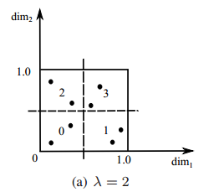
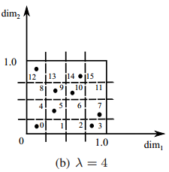
FracFilter: construction
Index label vectors
Grid index for each indexed structure
Map fragments into grids
Grid density λ: #partitions in each dimension
Partition the space into grids
Label vectors for fragments (subgraphs)
labeling(s₁)
labeling(s₂)
labeling(s₃)
labeling(s₄)
labeling(s₅)

Slide 14
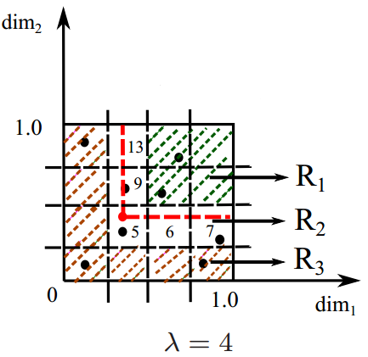
FracFilter: search
Input: label vector of a query fragment
Output: compatible graph fragments
Procedure:
Find the grid for query fragment
Fragments in R₁ are compatible
Fragments in R₃ are not compatible
Verify fragments in R₂
Parsimonious verification
Reduce ~ 80% comparisons
No quality loss

Slide 15
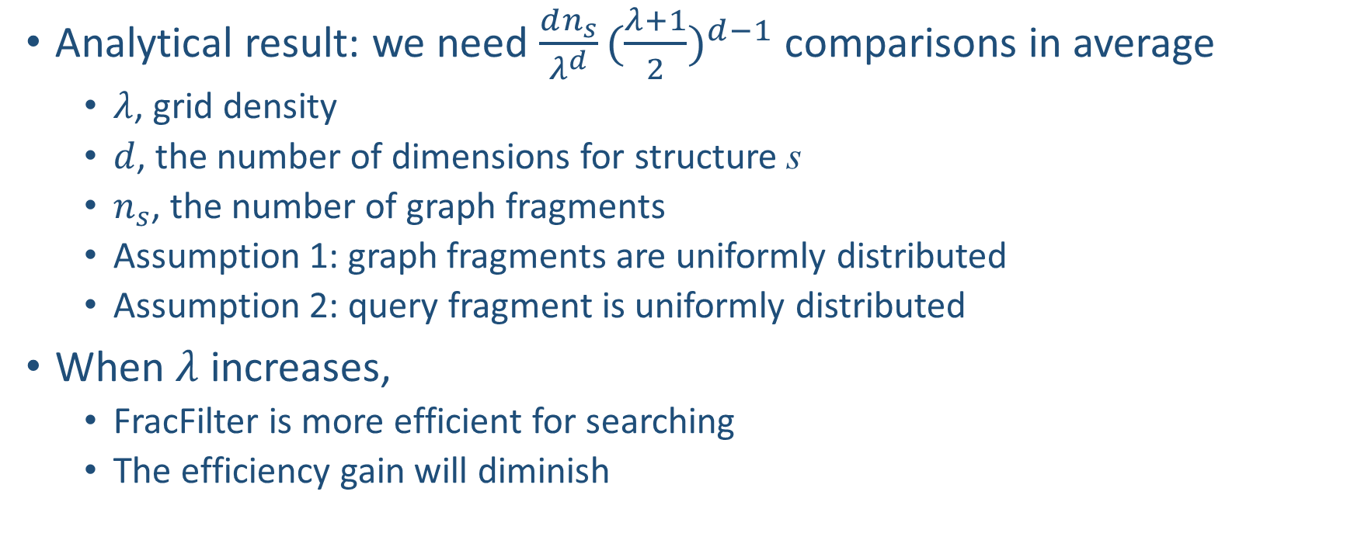
Tune searching performance by grid density
Analytical result: we need $\frac{dn_{s}}{λ^{d}}{(\frac{λ+1}{2})}^{d−1}$ comparisons in average
$λ$, grid density
$d$, the number of dimensions for structure s
$n_{s}$, the number of graph fragments
Assumption 1: graph fragments are uniformly distributed
Assumption 2: query fragment is uniformly distributed
When $λ$ increases,
FracFilter is more efficient for searching
The efficiency gain will diminish

Slide 16
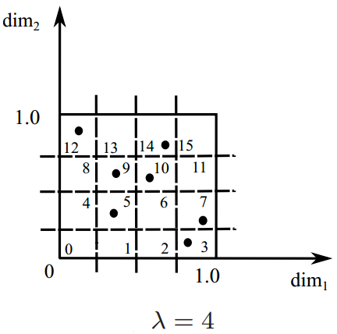
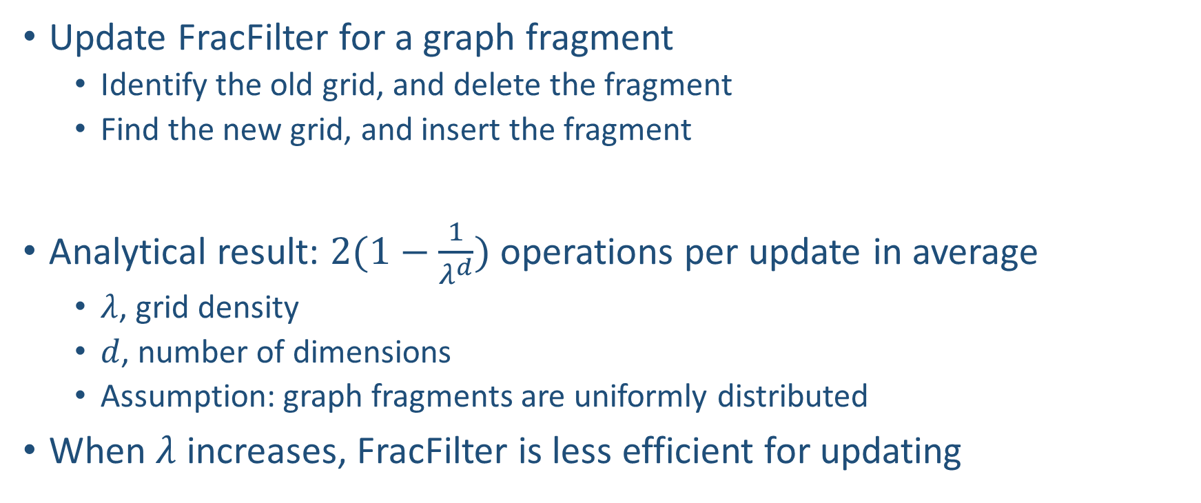
FracFilter: update
Update FracFilter for a graph fragment
Identify the old grid, and delete the fragment
Find the new grid, and insert the fragment
Analytical result: $2(1−\frac{1}{λ^{d}})$ operations per update in average
$λ$, grid density
$d$, number of dimensions
Assumption: graph fragments are uniformly distributed
When $λ$ increases, FracFilter is less efficient for updating

Slide 17
Outline
Introduction
Problem statement
Gradin
Graph index for frequent label updates
Accelerate fragment join
Experiment results

Slide 18
Large search space
A small query graph can have many query fragments
A 10-star query has 720 3-star query fragments
Only need some of them to cover the query graph
Which query fragments do we need?
Minimum fragment cover

Slide 19
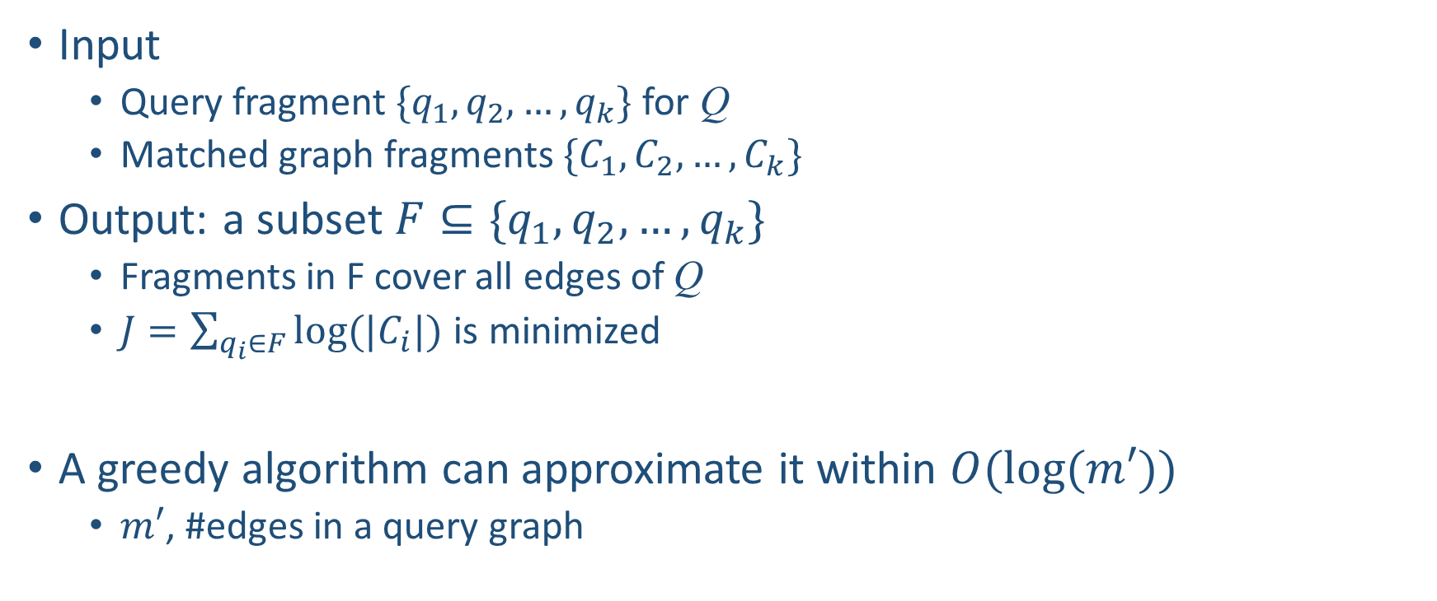
Minimum fragment cover
Input
Query fragment $\{q_{1}, q_{2},…,q_{k}\}$ for Q
Matched graph fragments $\{C_{1}, C_{2},…,C_{k}\}$
Output: a subset $F⊆\{q_{1}, q_{2},…,q_{k}\}$
Fragments in F cover all edges of Q
$J=\sum_{q_{i}∈F}{log⁡(|C_{i}|)}$ is minimized
A greedy algorithm can approximate it within $O(log⁡(m′))$
$m′$, #edges in a query graph
NP-hard

Slide 20
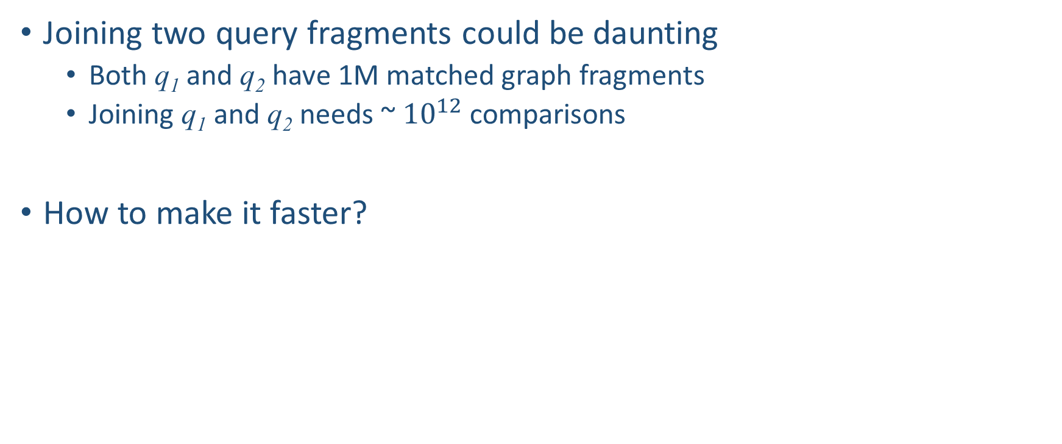
Large search space (cont.)
Joining two query fragments could be daunting
Both q₁ and q₂ have 1M matched graph fragments
Joining q₁ and q₂ needs ~ ${10}^{12}$ comparisons
How to make it faster?
Fingerprint based pruning

Slide 21
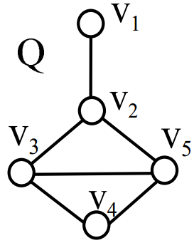
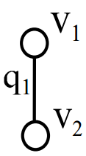
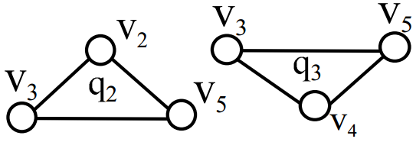
Fingerprint based pruning
Given a fragment join order, extract fragment fingerprints in linear time
Minimum fragment cover
Organize fragments by fingerprints
q_{i}
Join order: q₁ → q₂ → q₃
Fingerprint
C_{i}
Graph fragments
f₁
f₂
…
…
(v₁, v₂)
(v₂, v₃, v₅)
(v₃, v₅, v₄)
…
…
f_{n}

Slide 22

Fingerprint based pruning (cont.)
q_{i+1}
q₁ → … → q_{i}
Prune unnecessary search q_{i} → q_{i+1}
Graph fragment g, a partial match from q₁ → … → q_{i}
Extract the fingerprint f’ which g is looking for
Check the graph fragments in $C_{i+1}$ of fingerprint f’
…
Fingerprint
C_{i+1}
g
graph fragments
→ f’
f₁
…
…
f₂
…
…
…
…
…
f_{n}

Slide 23
Outline
Introduction
Problem statement
Gradin
Graph index for frequent label updates
Accelerate fragment join
Experiment results

Slide 24
Setup
Data graph
BCUBE: 3000 ~ 15000 nodes, average degree 18~20
CAIDA: 26475 nodes, 106762 edges
Numerical labels and updates
Label generator derived from ClusterData
Query graph
All possible graphs of no more than 10 edges
Generate Labels from Uniform(0, 1)
Baselines: VF2, UpdAll, UpdNo, NaiveGrid, and NaiveJoin

Slide 25
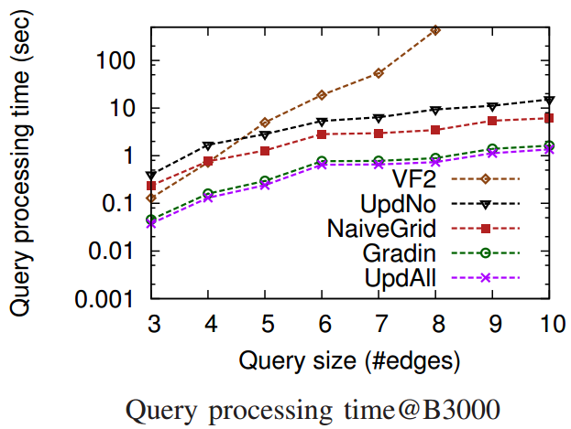
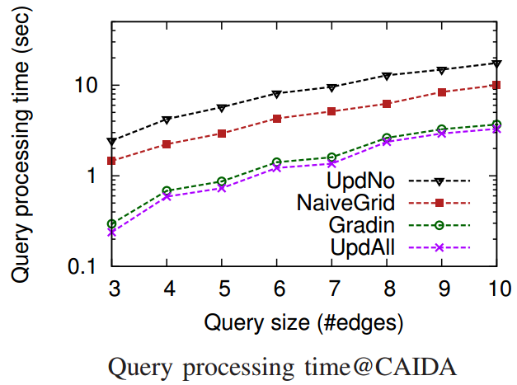
Query processing
Return up to 100 compatible subgraphs in < 2 seconds
Up to 10 times and 5 times faster than UpdNo and NaiveGrid
Close to UpdAll

Slide 26
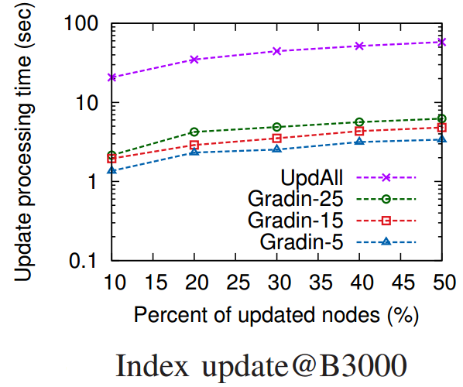
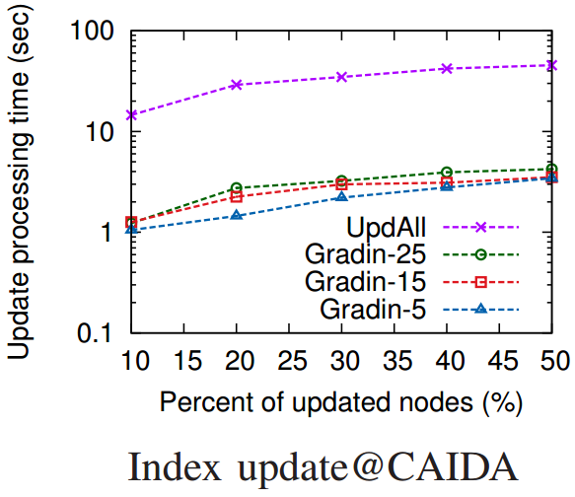
Index updating
Process 9M updates in 2 seconds
Up to 10 times faster than UpdAll

Slide 27
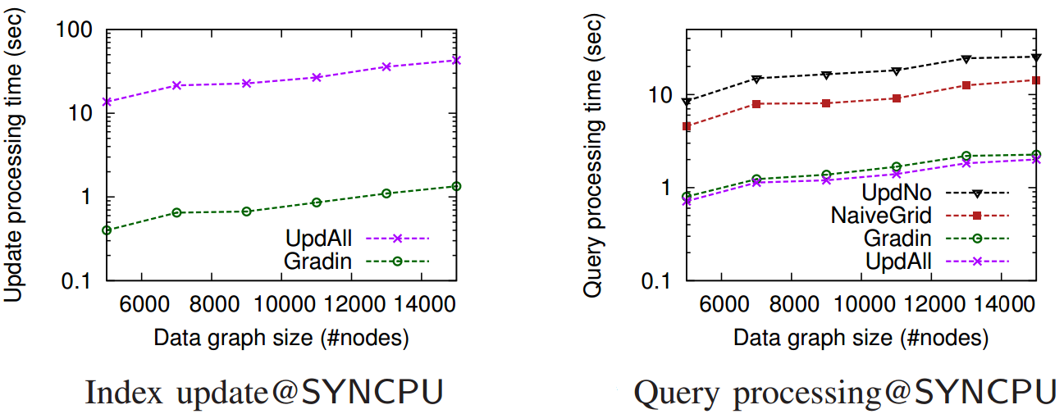
Scalability
Gradin is up to 20 times faster than UpdAll on index update
Gradin is 10 times and 8 times faster than UpdNo and NaiveGrid

Slide 28
Conclusion
Cloud service placement via subgraph matching
Gradin
Indexing graphs of numerical labels
Fast query processing
Fast index updating
Gradin outperforms the baseline algorithms on query processing and index updating.
Notes:
First, we proposed the idea of using subgraph matching queries to search compatible subgraphs for cloud service placement.
Second, we proposed a graph indexing technique Gradin to approach the problem.
Gradin can …
Those features fit the applications in cloud service placement
In addition, experimental results show that…

Slide 29
Thank you

