Slide 1
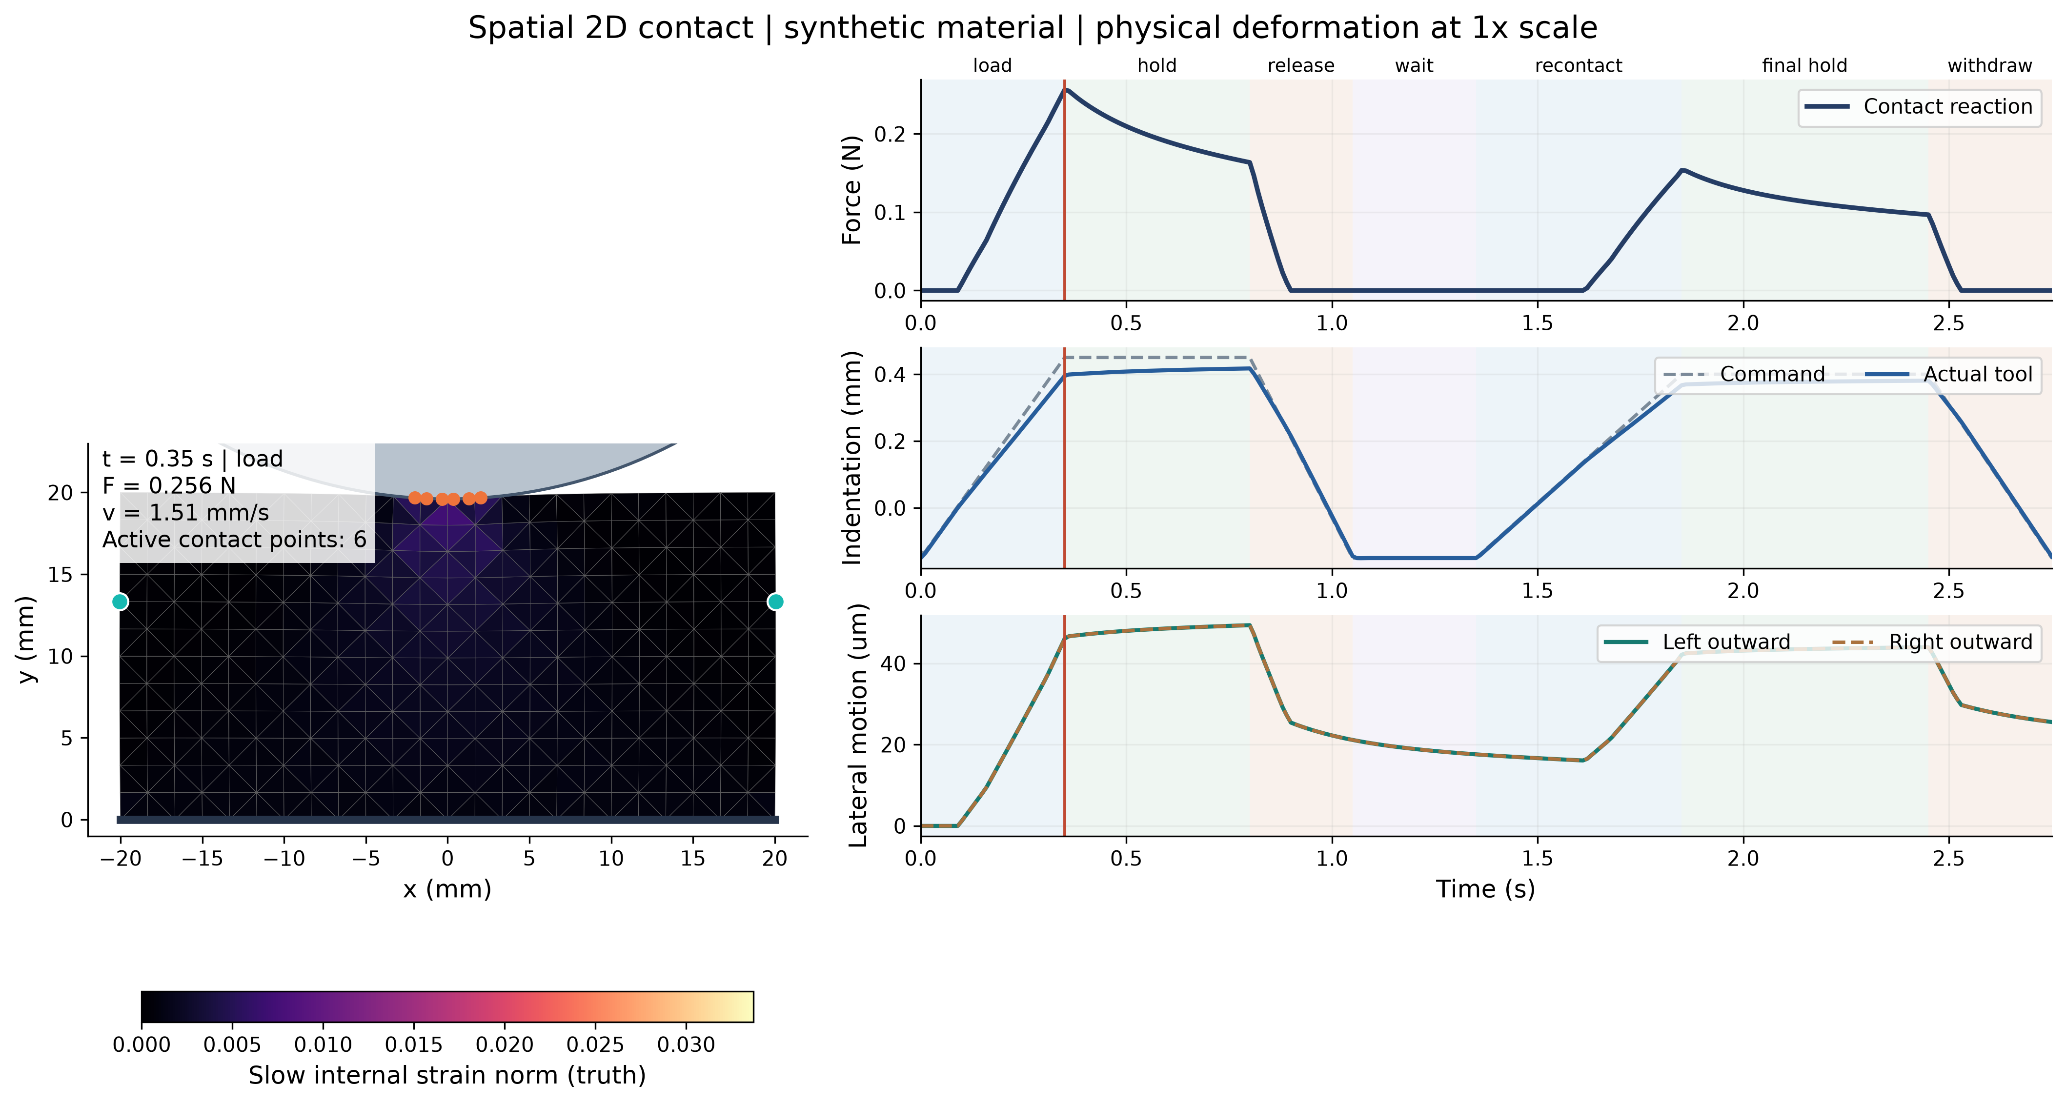
Spatial 2D contact
Fixed bottom, free sides, one round rigid indenter. The deformation comes from the FEM solution.
Recorded 2D pilot. Synthetic material. Quasistatic body with a dynamic tool. Deformation shown at 1x scale.
01
Notes:
上周已经看到历史能帮助预测，但经典估计器很强，共同反馈下还没有有效动作收益。这周我把一维例子扩展成空间二维接触模型，进一步检查当前观测和历史分别提供什么信息。物体底边固定、侧边自由，压头加载、保持、释放、等待和再接触。压头离开后力为零，侧向形状仍在恢复。这是合成材料仿真。
Sources (relative to the repository):
2D/runs/2d_contact/pilot_c9dd23016896/figures/01_spatial_process.json
2D/runs/information/channels_contact_20261026/physics.json
2D/src/nr2d/physics.py

Slide 2
Observations and history
Same physical histories, prediction time, future solver and observed noise draw.
Information | Motion + force | Motion + force + lateral shape
Current sample | Position, velocity, total force | The same sample plus two lateral markers
Recent history | The same channels over 0.2 or 0.8 s | The same window plus lateral history
24 independent loading histories
Three separate calibration histories
Three noise draws per history.
History, rather than noise draw, is the statistical unit.
Equal tuning budgets select one shared preset.
Estimate once, then predict Slow and Fast press.
Prediction starts at 1.40 s. Disabled channels are absent from both initialization and fitting.
02
Notes:
我固定物理系统和未来预测模型，只改变允许使用的观测通道和历史。比较当前运动与力、当前加侧向、运动与力的历史，以及加入侧向历史。使用24条独立加载历史，每条三次独立噪声；独立样本数仍是24。三条另外的校准历史选择共同设置。
Sources (relative to the repository):
2D/runs/information/channels_contact_20261026/study.json
2D/runs/information/channels_contact_20261026/calibration.json
2D/runs/information/channels_contact_20261026/verification/data_contract.json
2D/tests/test_observer_config.py

Slide 3
Current lateral shape
Force RMSE for Slow press, averaged within history and then across 24 histories.
Force RMSE (mN)
9.31 mN
paired reduction in error
95% interval: 7.06 to 11.57 mN
Shape exposes recovery
while contact force is zero.
Both lateral markers share one underlying mode in this symmetric model. Their measurement noise is independent.
03
Notes:
当前侧向形变已经提供大量预测信息。在慢压预测中，力RMSE从约11.5毫牛降到2.2毫牛。这说明研究隐藏状态时，首先需要说清楚当前传感器能够看到什么。本实验的两个对称侧向标记主要反映同一个形变模式。
Sources (relative to the repository):
2D/runs/information/channels_contact_20261026/summary.json
2D/runs/information/channels_contact_20261026/metrics.csv
Intervals: 2,000 whole-history bootstrap resamples, pointwise exploratory 95% intervals.

Slide 4
History and contact data
Latest 0.2 s: detached wait. Latest 0.8 s: contact, release and recovery.
Recent window
Earlier contact plus propagation
Force RMSE (mN)
Channels | Recent wait | Earlier contact
Without lateral | 12.75 mN | 0.48 mN
With lateral | 1.29 mN | 0.39 mN
Current lateral: 2.20 mN
Recent lateral wait: 1.29 mN
Recent 0.8 s with lateral: 0.23 mN
Window duration (s)
Without lateral
With lateral
Recovery dynamics and noise averaging both may help. Contact and duration are not completely disentangled.
04
Notes:
加入侧向后，0.2秒历史的误差约1.29毫牛，0.8秒约0.23毫牛。但最近0.2秒全是脱离后的等待，0.8秒包含接触，不能只按时间长度解释。更早接触估计再传播也有帮助，但它额外使用了传播区间的运动记录，目前还没有完全分离接触、时长和降噪。下一步先用经典递推观察器，把接触信息带过释放与等待，再检查共同反馈下是否有动作收益。
Sources (relative to the repository):
2D/runs/information/channels_contact_20261026/summary.json
2D/runs/information/channels_contact_20261026/RESULTS.md
2D/runs/information/channels_contact_20261026/coverage.json
2D/runs/2d_contact/pilot_c9dd23016896/RESULTS.md

Slide 5
Questions for discussion
Research focus
We want to study hidden state beyond the current observation.
Could too much focus on elasticity shift the project toward soft robotics?
Physical experiment
We can build the model. How should we carry out
these experiments on a real robot?
Broader research question
After studying hidden state through fast and slow forces,
how do we develop the broader idea from this specific case?
05
Notes:
我想讨论三个问题。第一，我们研究的是当前观测之外的隐藏状态。如果太关注弹性，会不会让研究方向偏向软体机器人？第二，模型可以建立，但真正上实机时，这个实验应该怎么做？第三，我们已经把 hidden state 具体化到快慢力这个点，接下来如何再升华回来，回到更一般的隐藏状态研究问题？
Sources (relative to the repository):
User-provided voice memo: Penn Engineering.m4a (78.396 s). Research focus: 00:00-00:30; real-robot experiments: 00:31-00:46; broader research question: 00:54-01:16. The user confirmed the final word as shenghua (conceptual development).
research/presentations/10.2/assets/question_source.json
These are discussion questions paraphrased from the user-provided memo, not additional experimental findings or attributed adviser instructions.

