Slide 1
ssGSEA
Charlie Whittaker – BIG meeting 12/3/14
From documentation:
Where GSEA generates a gene set’s enrichment score with respect to phenotypic differences across a collection of samples within a dataset, ssGSEA calculates a separate enrichment score for each pairing of sample and gene set, independent of phenotype labeling.
In this manner, ssGSEA transforms a single sample's gene expression profile to a gene set enrichment profile. A gene set's enrichment score represents the activity level of the biological process in which the gene set's members are coordinately up- or down-regulated.
This transformation allows researchers to characterize cell state in terms of the activity levels of biological processes and pathways rather than through the expression levels of individual genes.
ssGSEA projection transforms the data to a higher-level (pathways instead of genes) space representing a more biologically interpretable set of features on which analytic methods can be applied.
Barbie et al., 2009 and Verhaak et al., 2010 are the references. There is no publication devoted to the tool because reviewers felt it was too closely related to GSEA.
Very useful when you lack phenotypic contrast (Barbie and Verhaak examples), when you wish to compare results from multiple contrasts (example 1) or in extremely complex experiments (example 2)

Slide 2
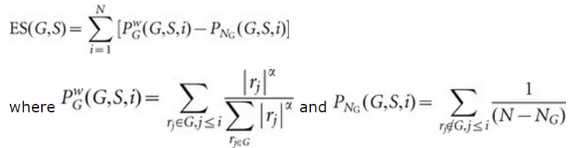
ssGSEA – from Barbie et al., 2009
The ‘single sample’ extension of GSEA⁷ allows one to define an enrichment score that represents the degree of absolute enrichment of a gene set in each sample within a given data set. The gene expression values for a given sample were rank-normalized, and an enrichment score was produced using the Empirical Cumulative Distribution Functions (ECDF) of the genes in the signature and the remaining genes. This procedure is similar to GSEA but the list is ranked by absolute expression (in one sample). The enrichment score is obtained by an integration of the difference between the ECDF.
Gene Set – Remaining Genes
As you progress along the rank ordered list of genes, the algorithm looks for a difference in encountering the genes in the gene set compared to the non-gene set genes. If the gene set genes are encountered relatively early in the list the ES is negative, late in the list the ES is positive and encountered at roughly the same rate as the non-gene set genes the ES is near 0.

Slide 3
Input is a gct file of expression data and a gm[xt] file of gene sets.
Running from GenePattern
http://genepattern.broadinstitute.org/gp/pages/index.jsf
Module and Documentation are here:
http://genepattern.broadinstitute.org/gp/pages/index.jsf?lsid=urn:lsid:broad.mit.edu:cancer.software.genepattern.module.analysis:00270:5
http://www.broadinstitute.org/cancer/software/genepattern/modules/docs/ssGSEAProjection/5
Running from R
Download from GenePattern by selecting Export from ssGSEA module page:
http://genepattern.broadinstitute.org/gp/pages/index.jsf?lsid=urn:lsid:broad.mit.edu:cancer.software.genepattern.module.analysis:00270:5
Set up working directory, source relevant files and execute ssGSEA:
http://rowley.mit.edu/caw_web/ssGSEAProjection/run_ssGSEA.r
setwd("Z:/charliew/caw_web/ssGSEAProjection")
source('Z:/charliew/caw_web/ssGSEAProjection/common.R')
source('Z:/charliew/caw_web/ssGSEAProjection/ssGSEAProjection.R')
source('Z:/charliew/caw_web/ssGSEAProjection/ssGSEAProjection.Library.R')
ssGSEA.project.dataset(javaexec = "ssgseaprojection.jar", jardir = getwd(), input.ds = "testSet_rand1200.gct",
output.ds = "test", gene.sets.dbfile.list = "randomSets.gmx")
Output is gct file with one row per geneset and a columns for each sample.
Projected data can be visualized and analyzed in the same way as gene expression data.

Slide 4
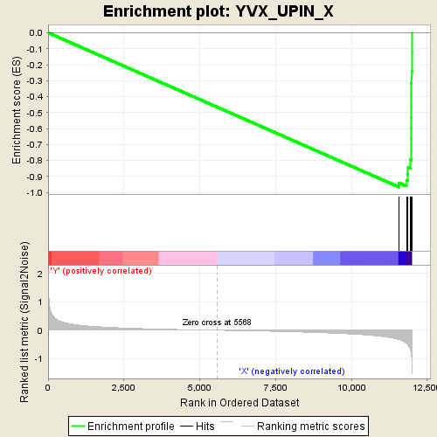
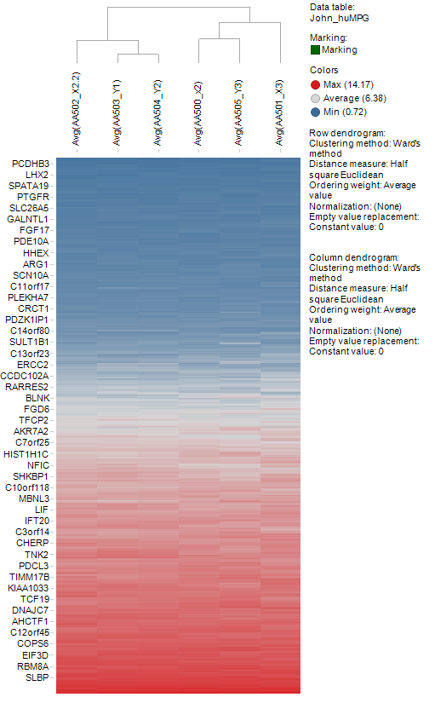
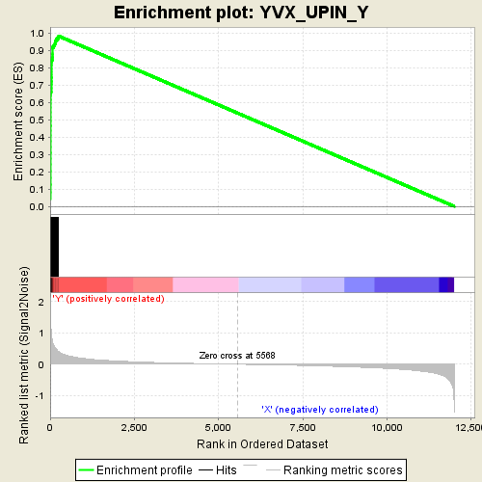
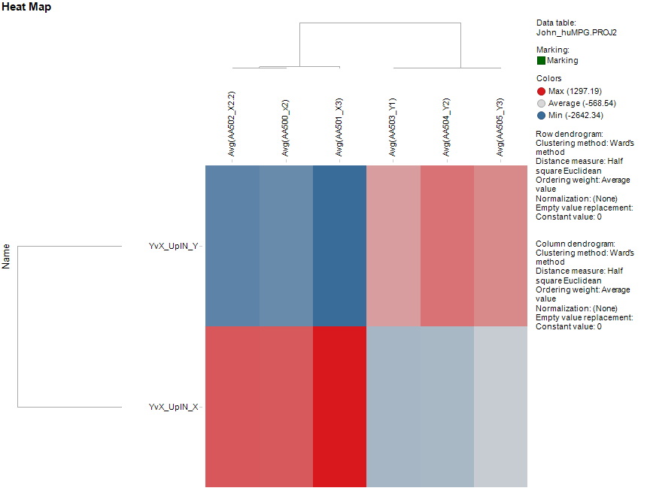
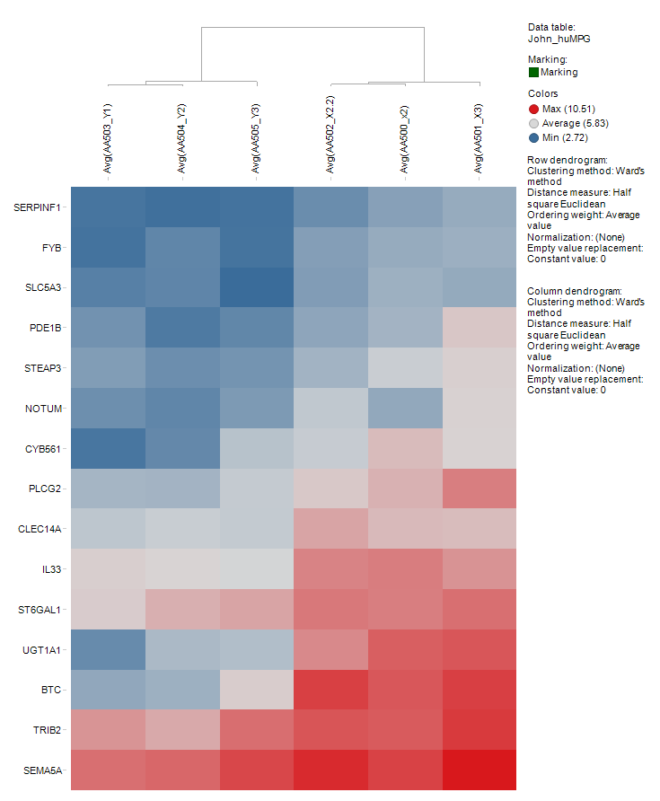
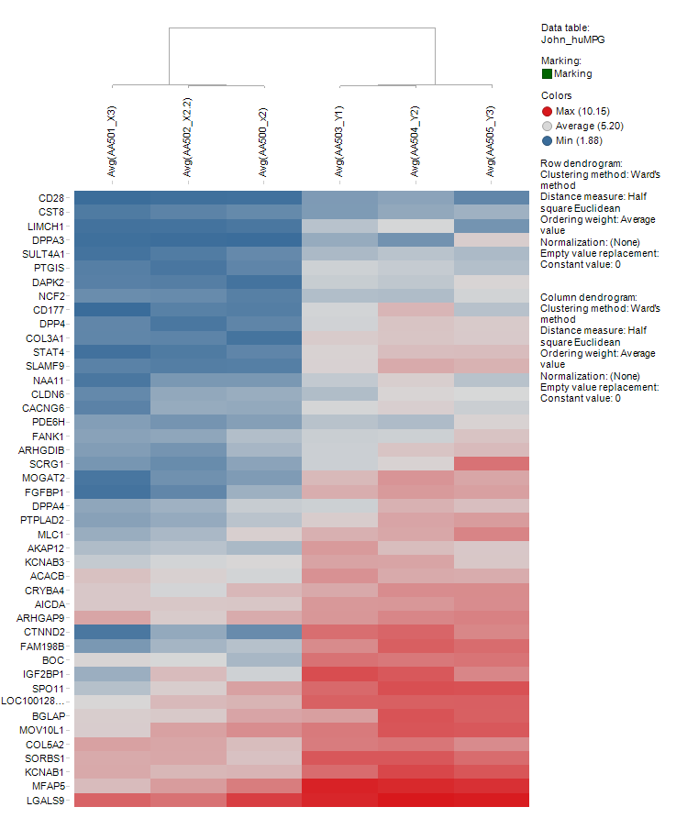

Slide 5
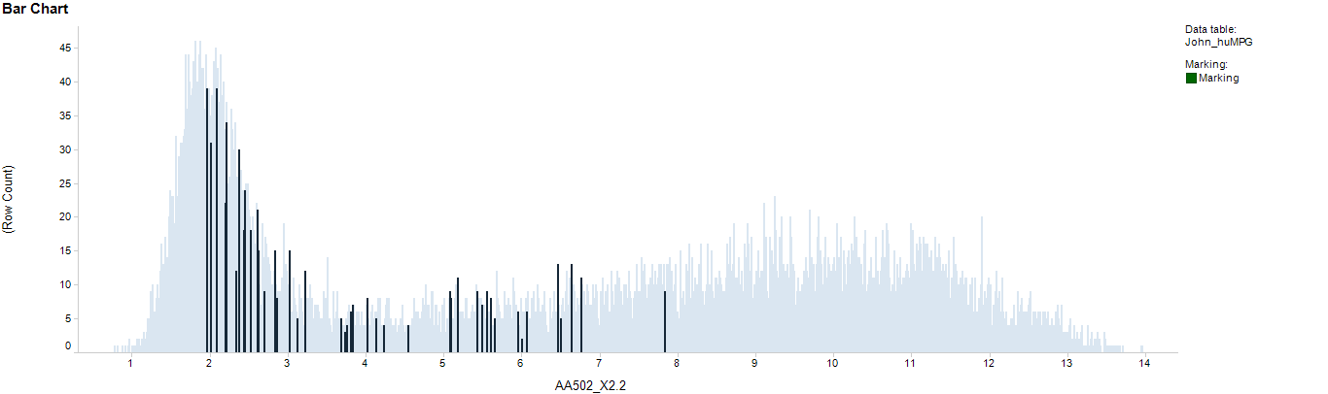
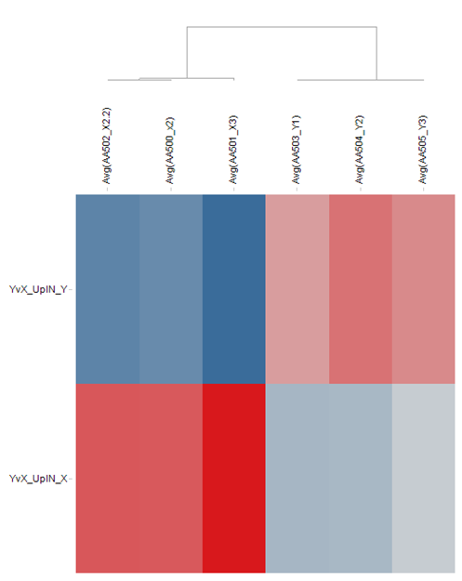
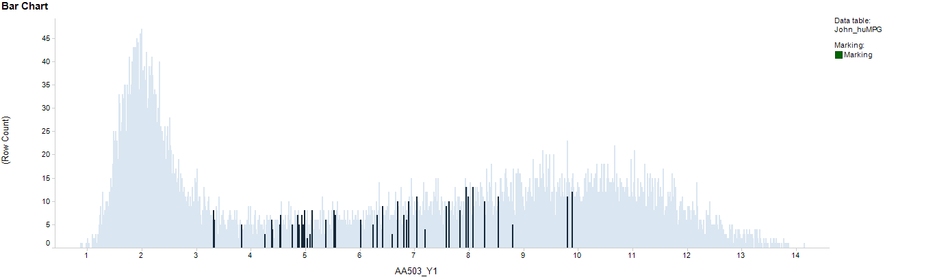
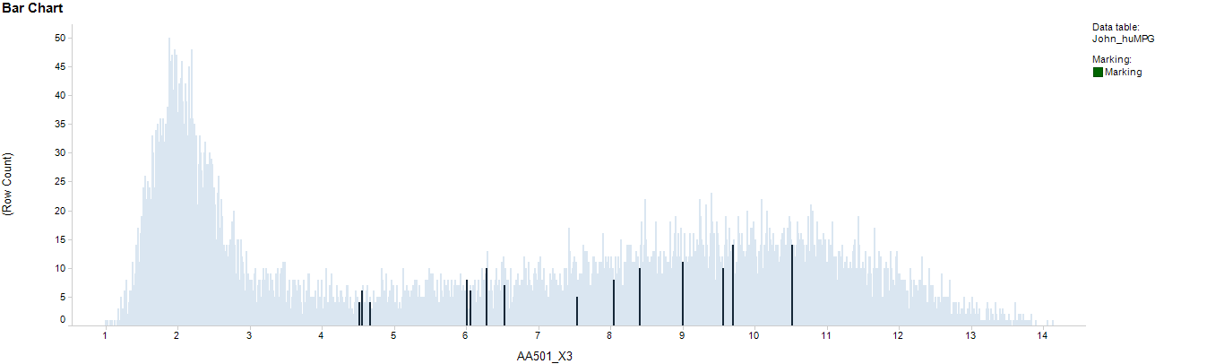
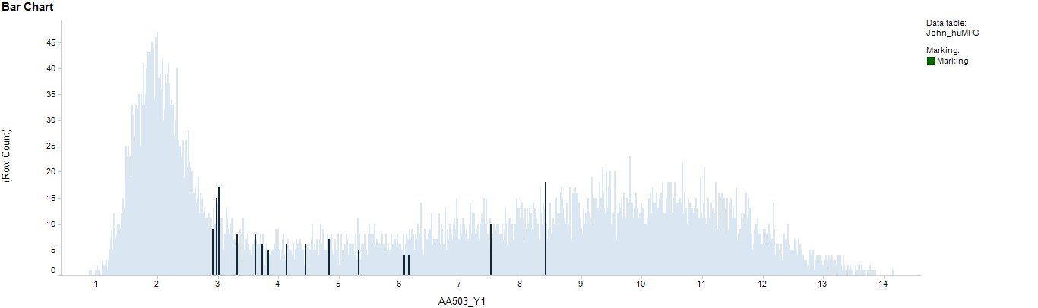
X2
Y1
Up In Y
*
*
*
*
Up In X
X3
Y1

Slide 6
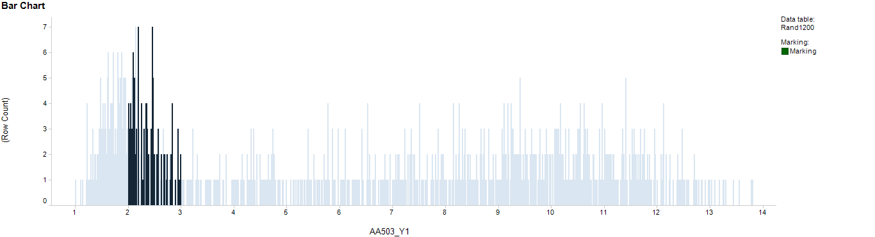
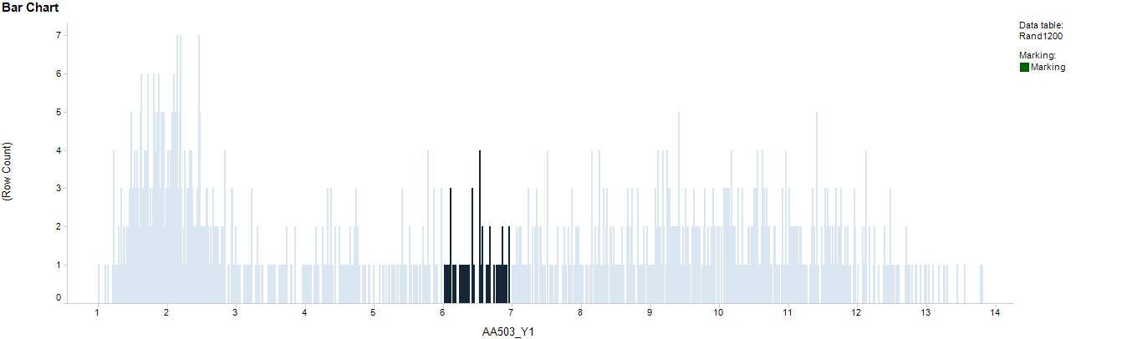
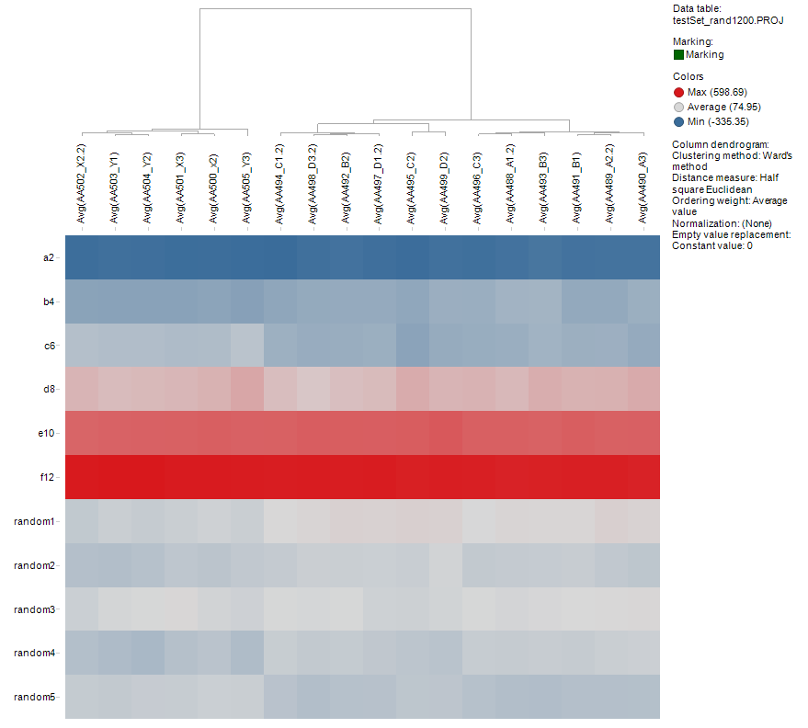
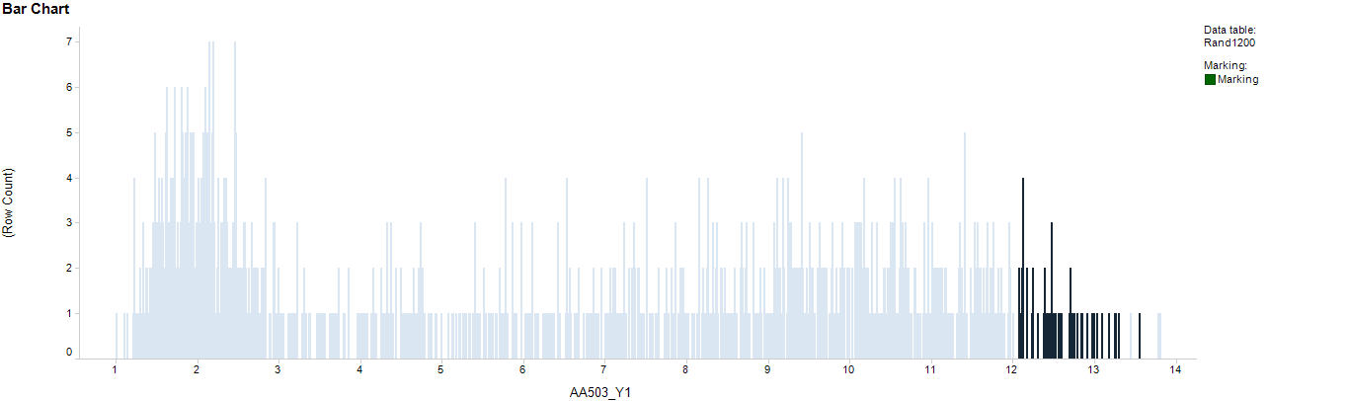
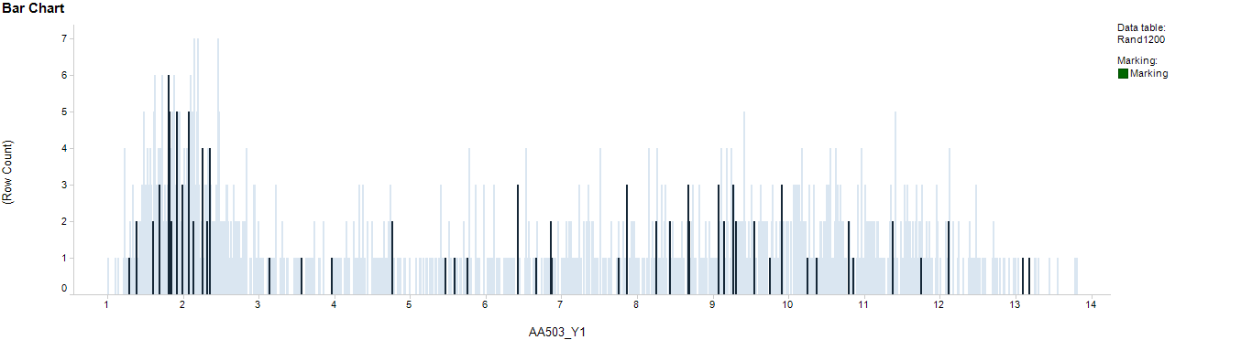
1200 randomly selected genes
5 random gene sets
6 gene sets randomly selected from 6 different levels of expression.
All gene sets consist of about 50 genes
Level 2
Level 6
Level 12
rand 4

Slide 7
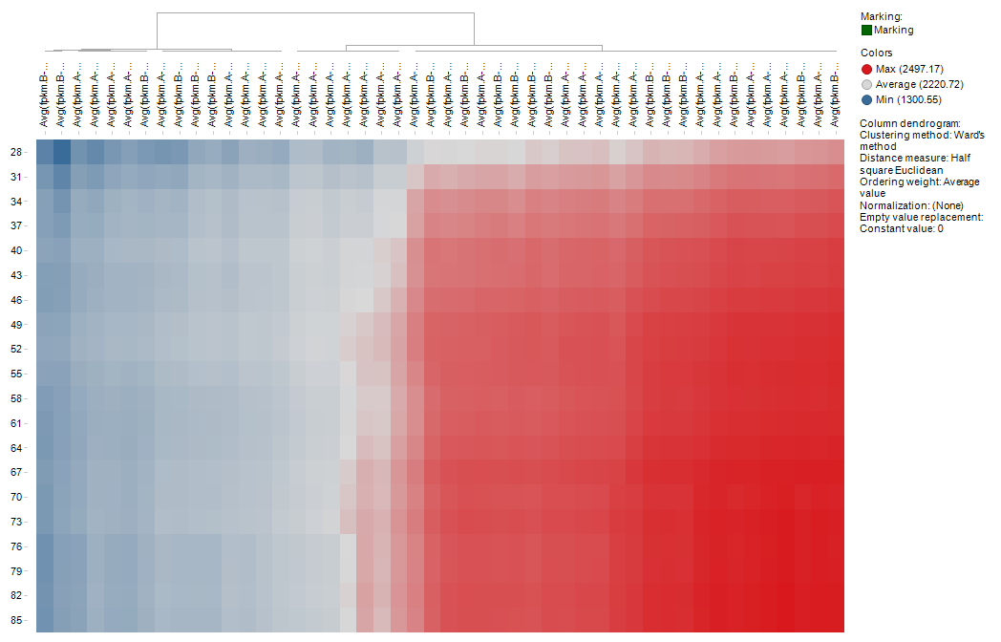
Gene Set Sizes and Enrichment Scores
Size of Gene Set

Slide 8
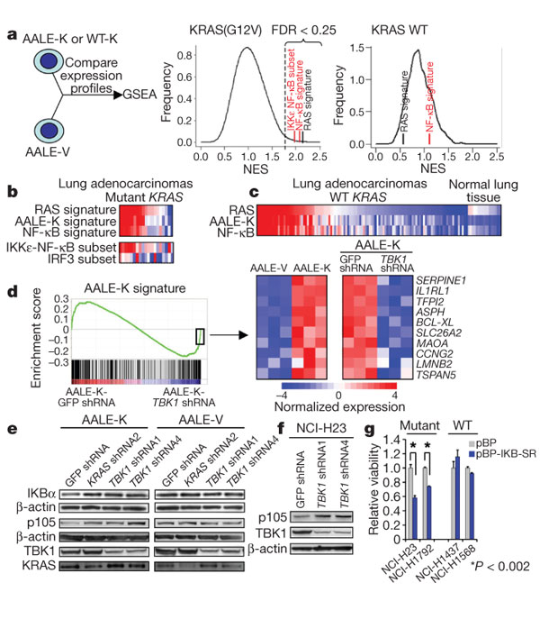
Barbie et al., 2009
Fig 3: b, RAS signatures in mutant KRAS lung adenocarcinomas correlate with NF-κB but not IRF3 signatures (red denotes activation, blue denotes inactivation). c, RAS and NF-κB signature expression in wild-type KRAS lung adenocarcinomas and normal lung tissue.
No phenotype contrast and downstream manipulation of projection results.

Slide 9
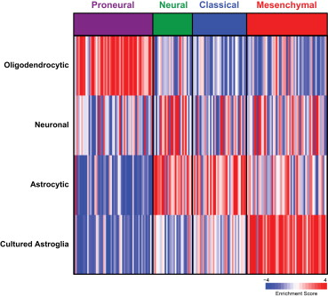
Verhaak et al., 2010
Gene expression signatures of different GBM subtypes were identified and validated. ssGSEA used to compare these signatures to gene expression profiles from normal cells.
Figure 4. Single Sample GSEA Scores of GBM Subtypes Show a Relationship to Specific Cell Types
Gene expression signatures of oligodendrocytes, astrocytes, neurons, and cultured astroglial cells were generated from murine brain cell types (Cahoy et al., 2008). Single sample GSEA was used to project the four gene sets on samples on the Proneural, Classical, Neural, and Mesenchymal subtypes. A positive enrichment score indicates a positive correlation between genes in the gene set and the tumor sample expression profile; a negative enrichment score indicates the reverse. Also see Figure S6 (shows histological data).
No phenotype contrast, cross-species analysis.

Slide 10
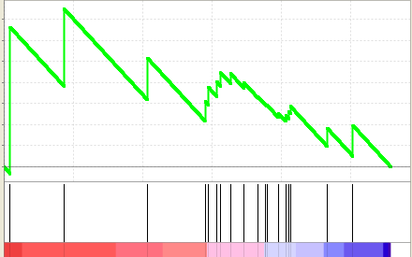
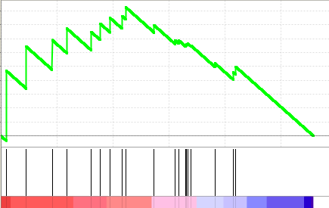
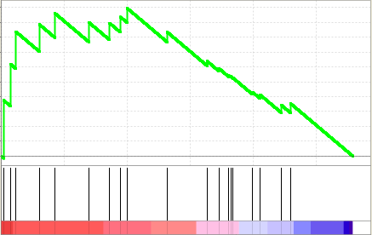
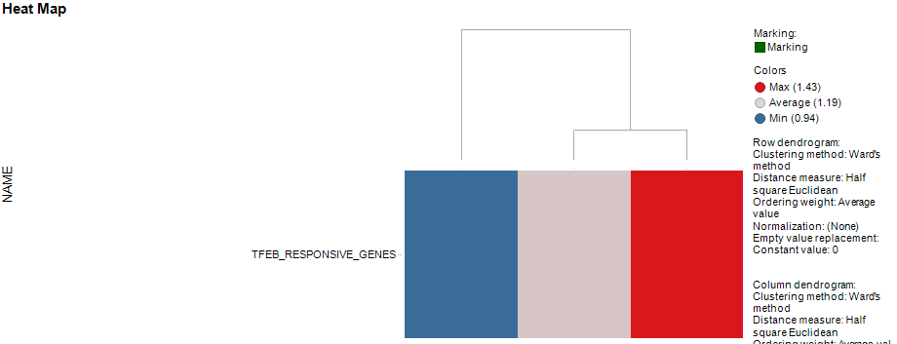
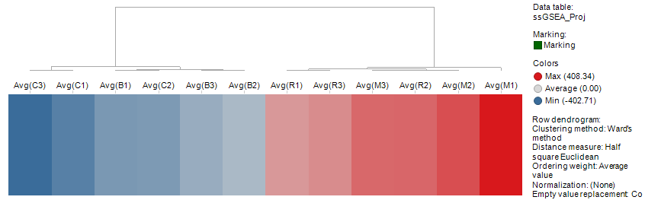
ssGSEA and multiple GSEA contrasts.
Enrichment of gene set in treatment “R” supports a working hypothesis
B - 0.94
R - 1.23
M - 1.42
NES work – Treatment vs Control structure is available
B – 0.94
R – 1.23
M – 1.42
Row-centered ssGSEA Projections
Visualize replicates and controls

Slide 11
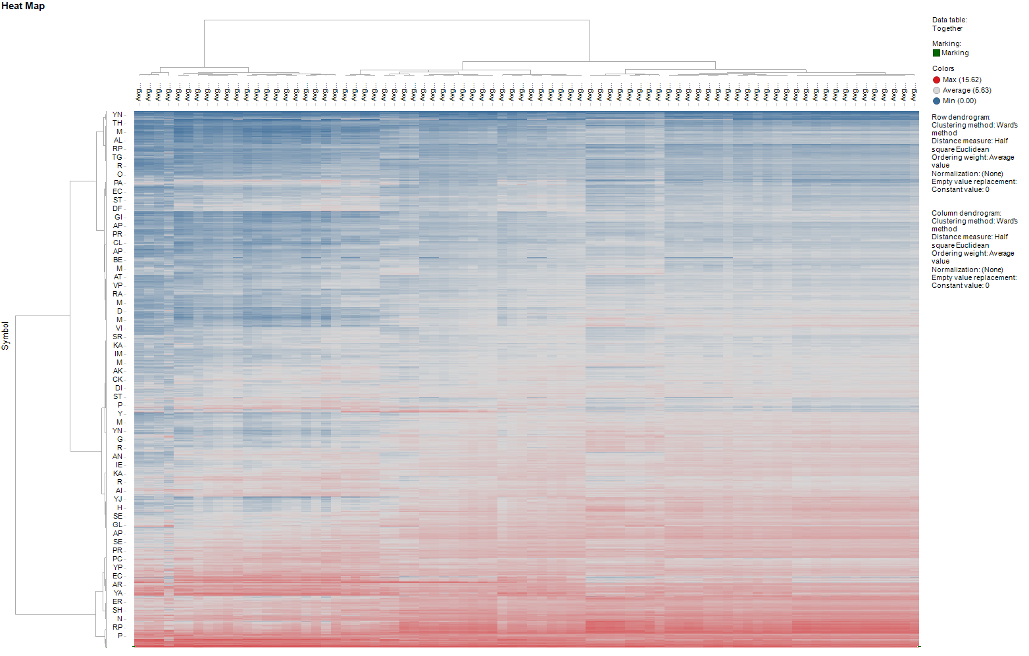
ssGSEA facilitates analysis of high complexity experiments
5 strains derived from 3 different organisms.
3 genome sequences – 2 closely related, one more distant. Variant analysis between close relatives.
RNAseq data for 16 culture conditions
16 relevant intra-organism comparisons
Many inter-organism comparisons
3 replicates of each condition
47 pathways or gene sets of critical interest

Slide 12
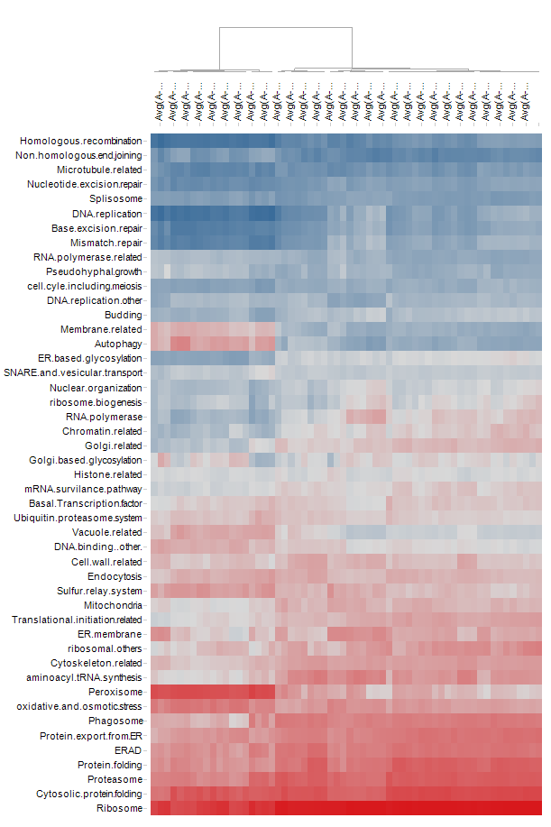
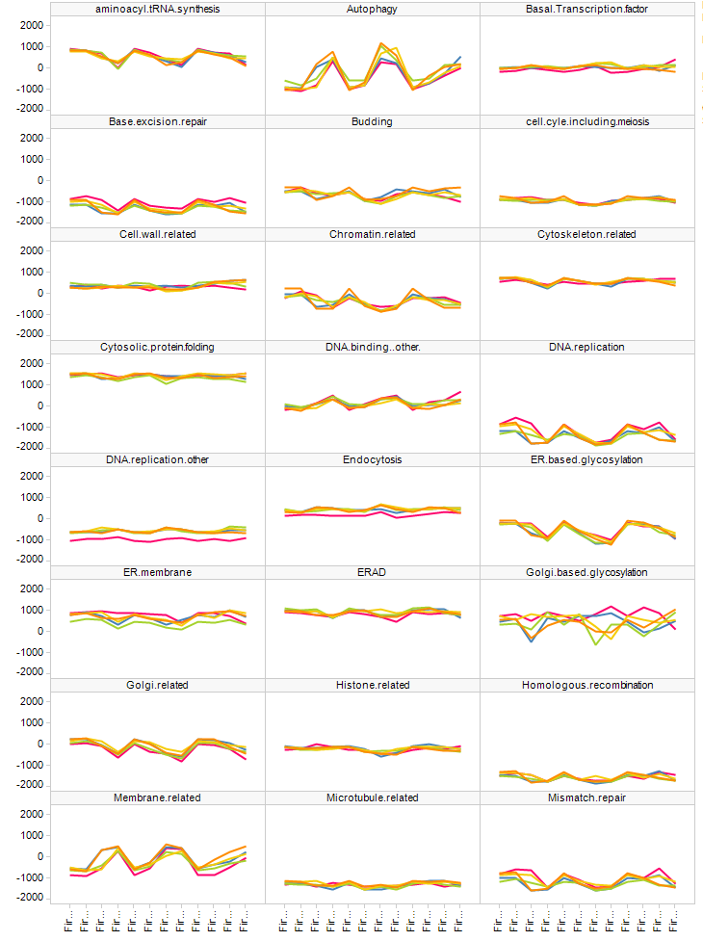
ssGSEA and Functional Analysis - Gene Sets and Strans

Slide 13
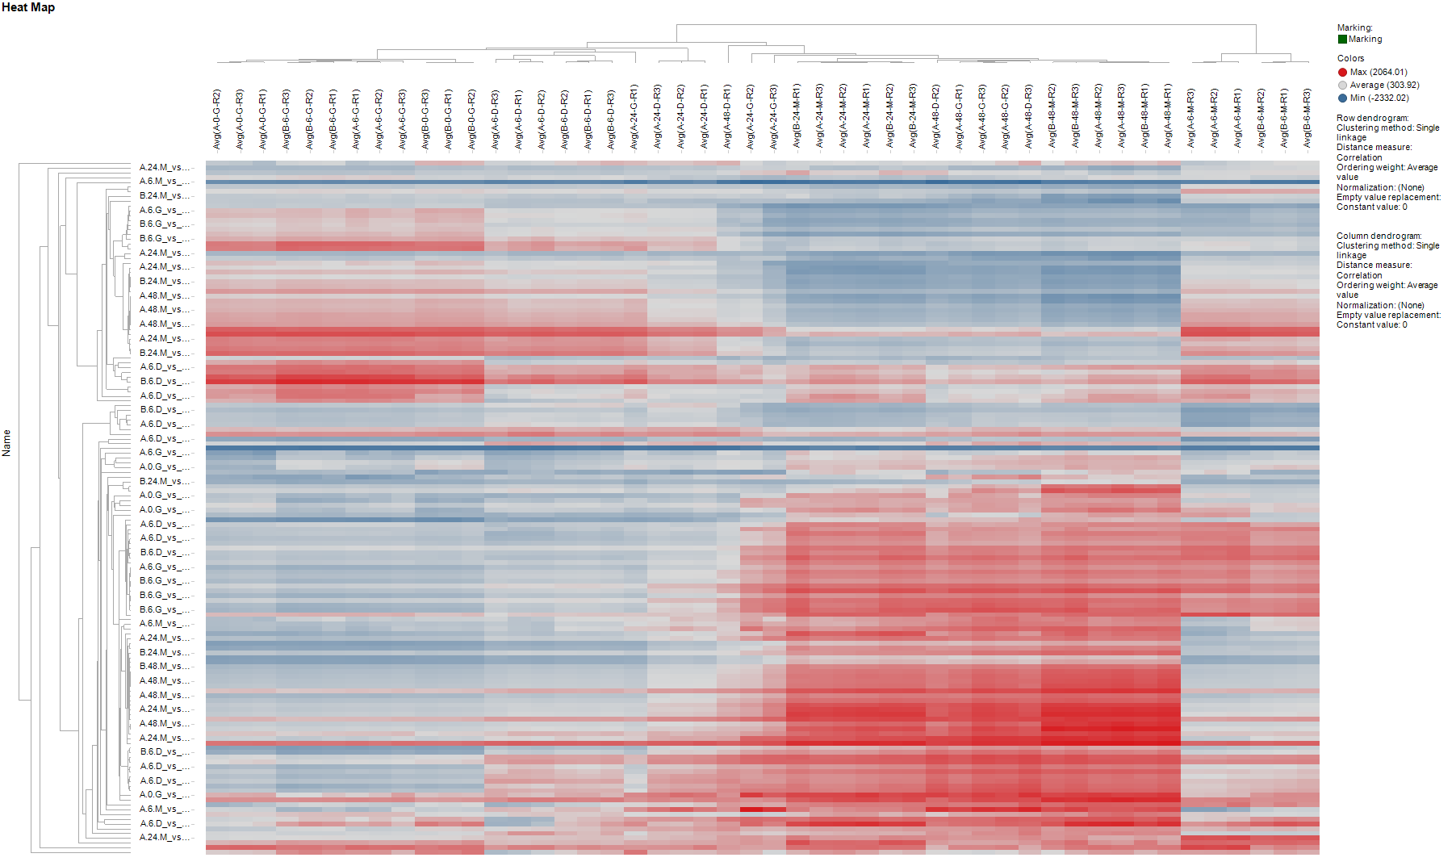
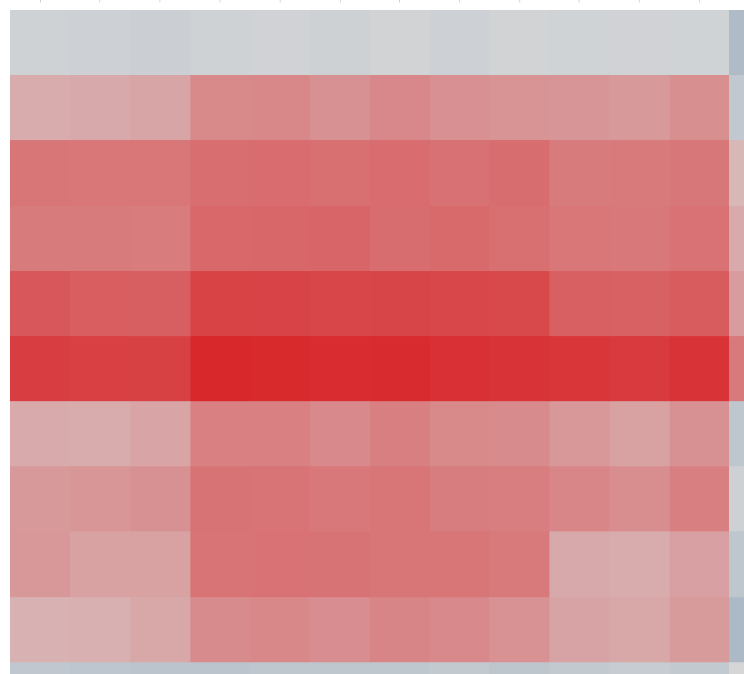
ssGSEA and Differential Expression Analysis (Jie)
48 gene expression samples (for each strain)
146 gene sets @ LogFC1, 0.05FDR – 16 comparisons, 5 strains, up+down
A/B_0/6_G
upInB6G

Slide 14

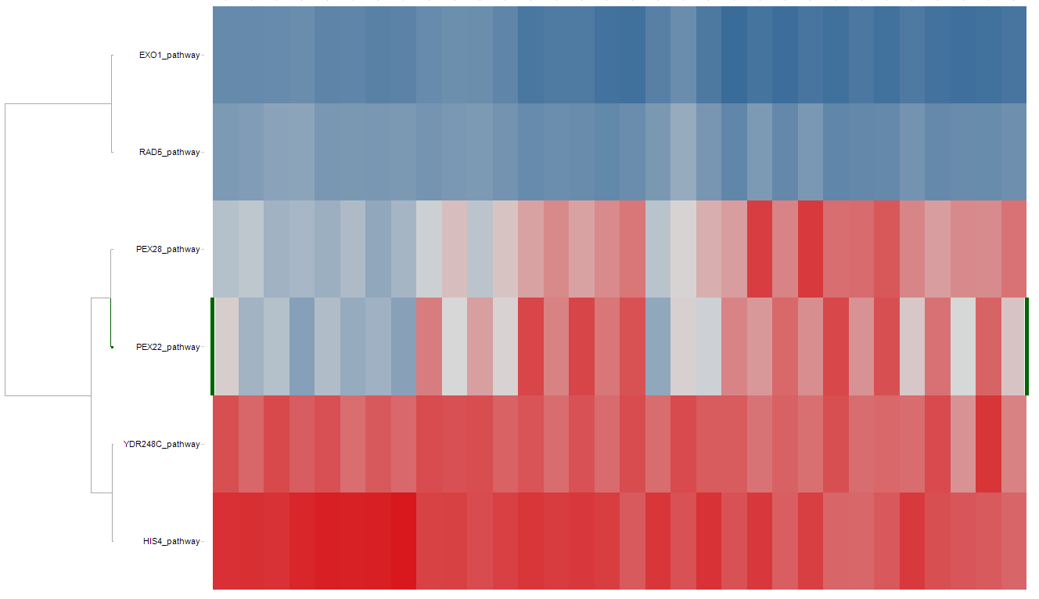
ssGSEA and pathway analysis
~35 non-synonymous point mutants detected between 2 strains (Duan)
Are pathways surrounding these genes transcriptionally altered?

Slide 15
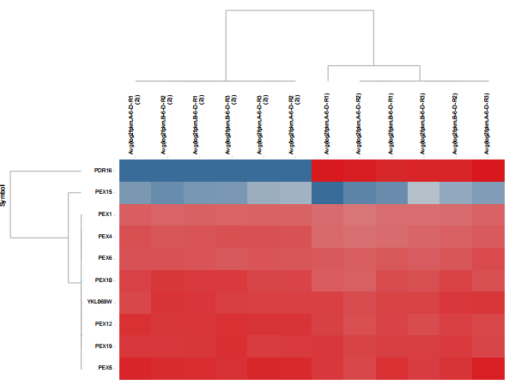
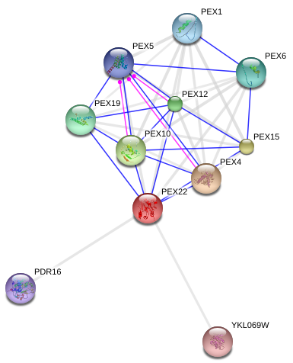
PDR16 pathway analysis
Strain A
Strain B
An assembly issue results in multiple copies of PDR16 in one strain but not the other. Differences in expression are caused by low mapping quality of PDR16 reads in one strain.

