Slide 1
Yggdrasil
A Runtime Governance Architecture
for Generative Systems Operating Under Uncertainty
Ben Thompson
Experimental Research Implementation
https://github.com/bzt-sys/Yggdrasil-Memory-Architecture

Slide 2
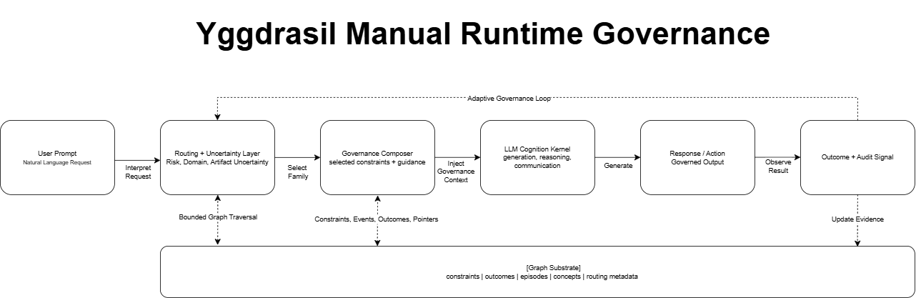

Slide 3
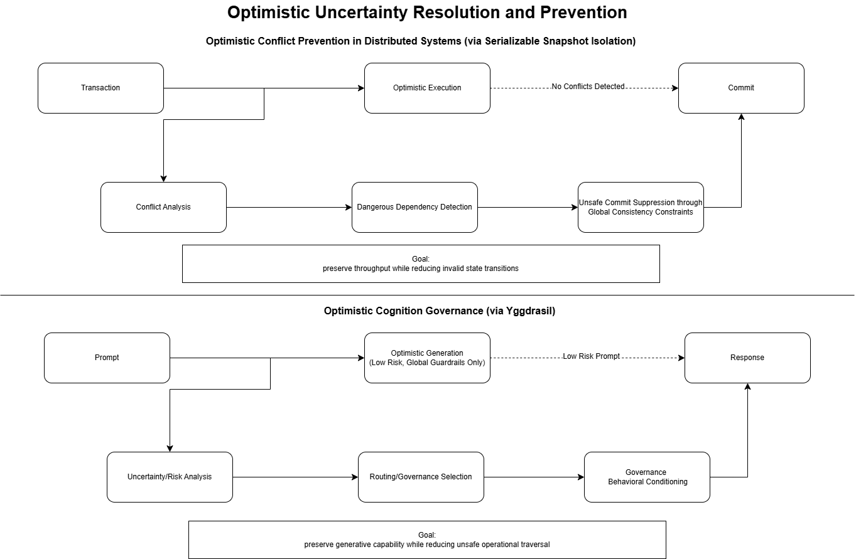

Slide 4
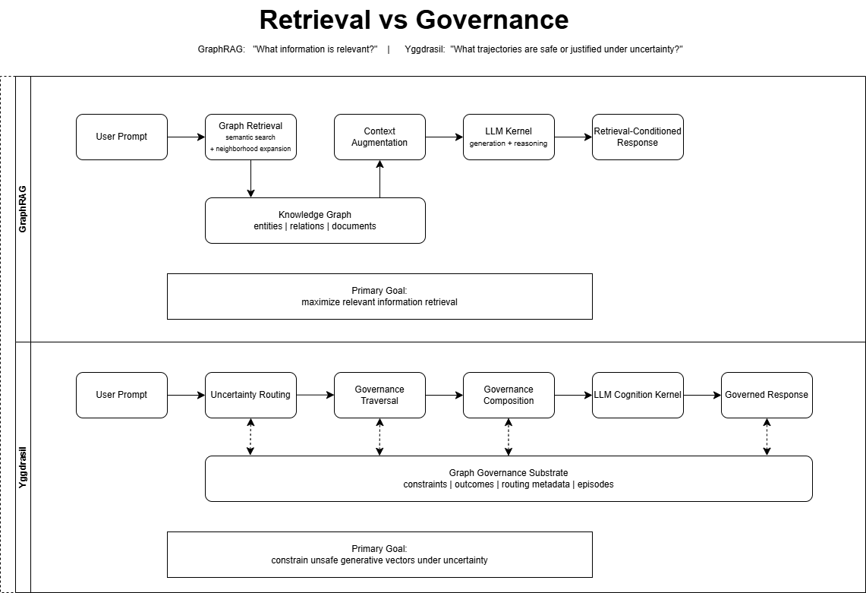

Slide 5
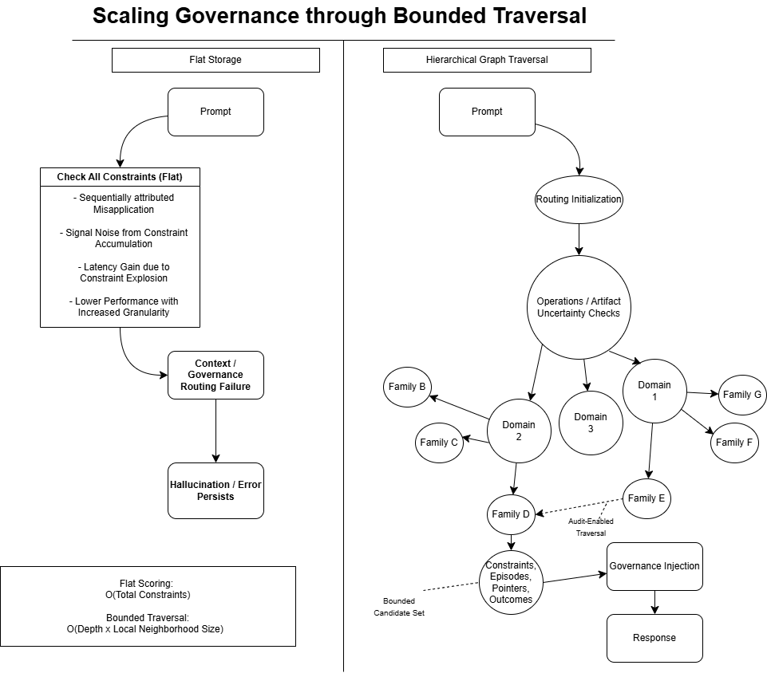

Slide 6
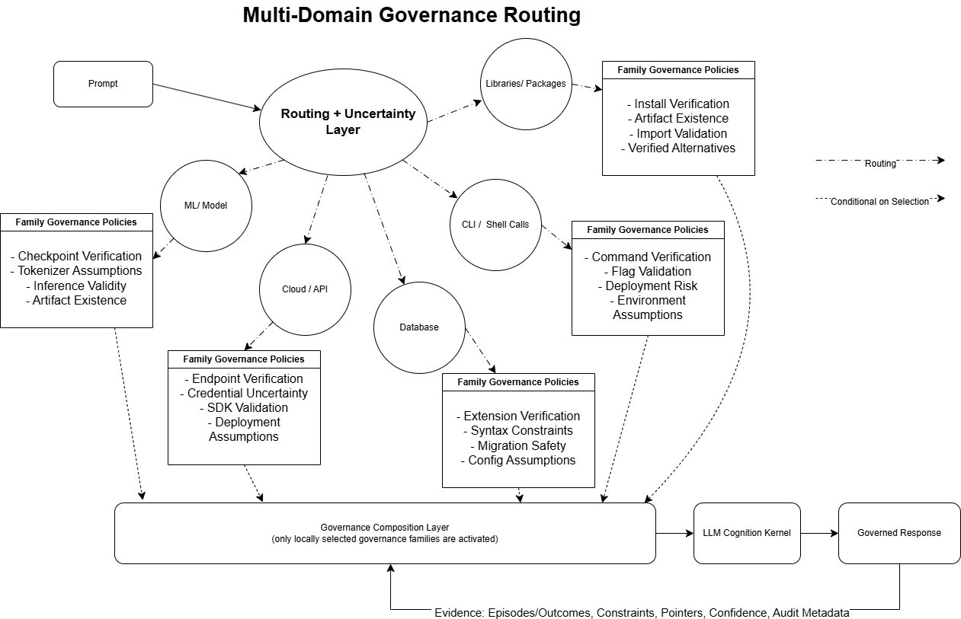

Slide 7
