Slide 1
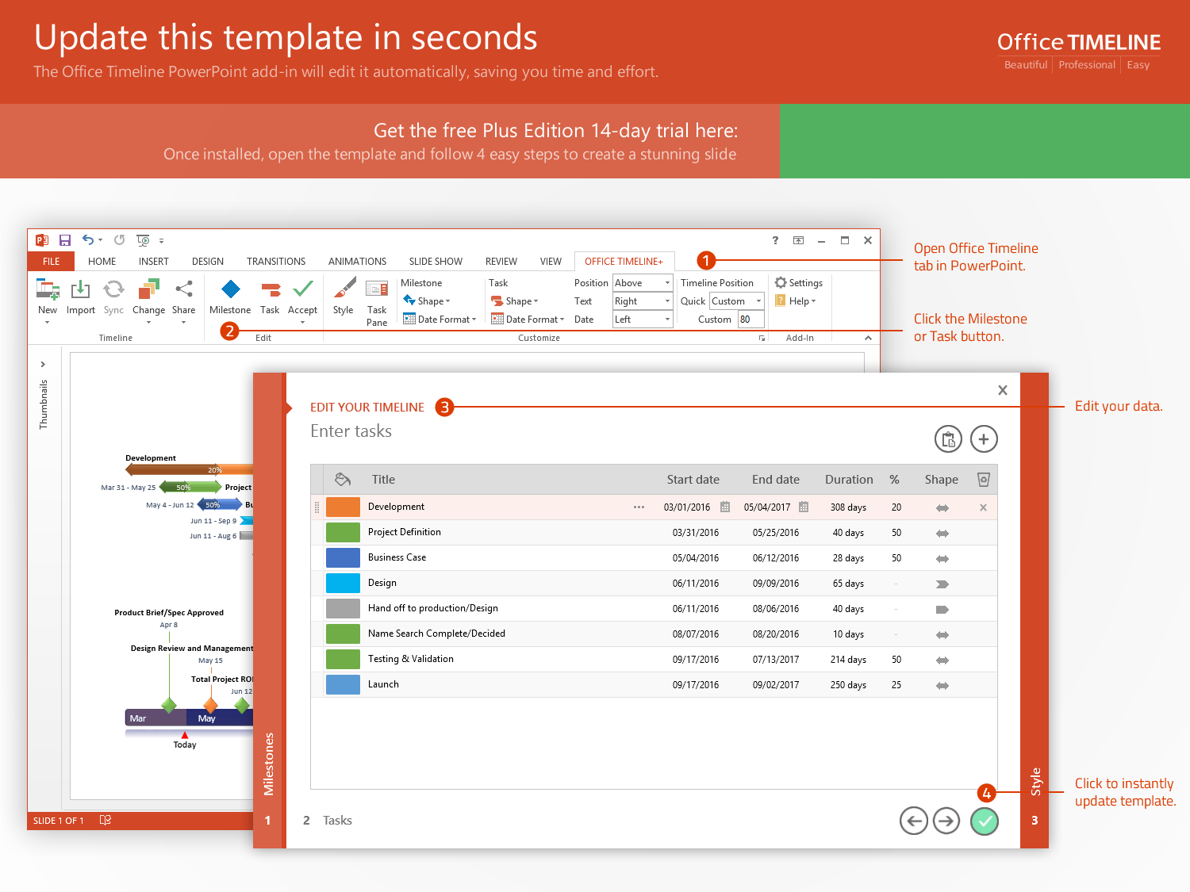
https://www.officetimeline.com/14-days-trial

Slide 2
Milestone 2
Sep 4
Milestone 1
Milestone 3
Milestone 4
Milestone 5
Aug 29
Sep 7
Sep 18
Oct 3
2017
Day 1
4
7
10
13
16
19
22
25
28
31
34
2017
9/3 - 9/17
Today
Phase 1
10 days
9/3 - 9/4
Sub-task 1
1 day
9/5 - 9/9
Sub-task 2
4 days
9/10 - 9/16
Sub-task 3
5 days
9/17
Sub-task 4 - zero duration
0 days
9/18 - 10/3
Phase 2
12 days
9/18 - 9/23
Sub-task 1
5 days
9/24 - 9/26
Sub-task 2
2 days
9/27 - 10/3
Sub-task 3
5 days
9/27 - 10/2
Sub-task 4
4 days

