Slide 1
OF their bones are coral made: Machine learning, the titanic, and the lusitania
Courtney Buchanan

Slide 2
Project scope
Use classification machine learning models in R to analyze passenger data from the RMS Titanic and predict the survivability rate
Analyze the factor values that influence the survival rate of passengers on the RSM Titanic
Apply the machine learning models to data from the tragic final voyage of the RMS Lusitania

Slide 3
The data

Slide 4
What data did we use?
Publicly accessible passenger manifests from the RMS Titanic and RMS Lusitania
Data required munging and imputation in order to make the factor variables comparable between datasets.
Due to the use of Random Forest in the Mice library for the imputation process, some of the results may be less accurate
Additional features were created, most notably the family size and the title / salutation of a passenger

Slide 5
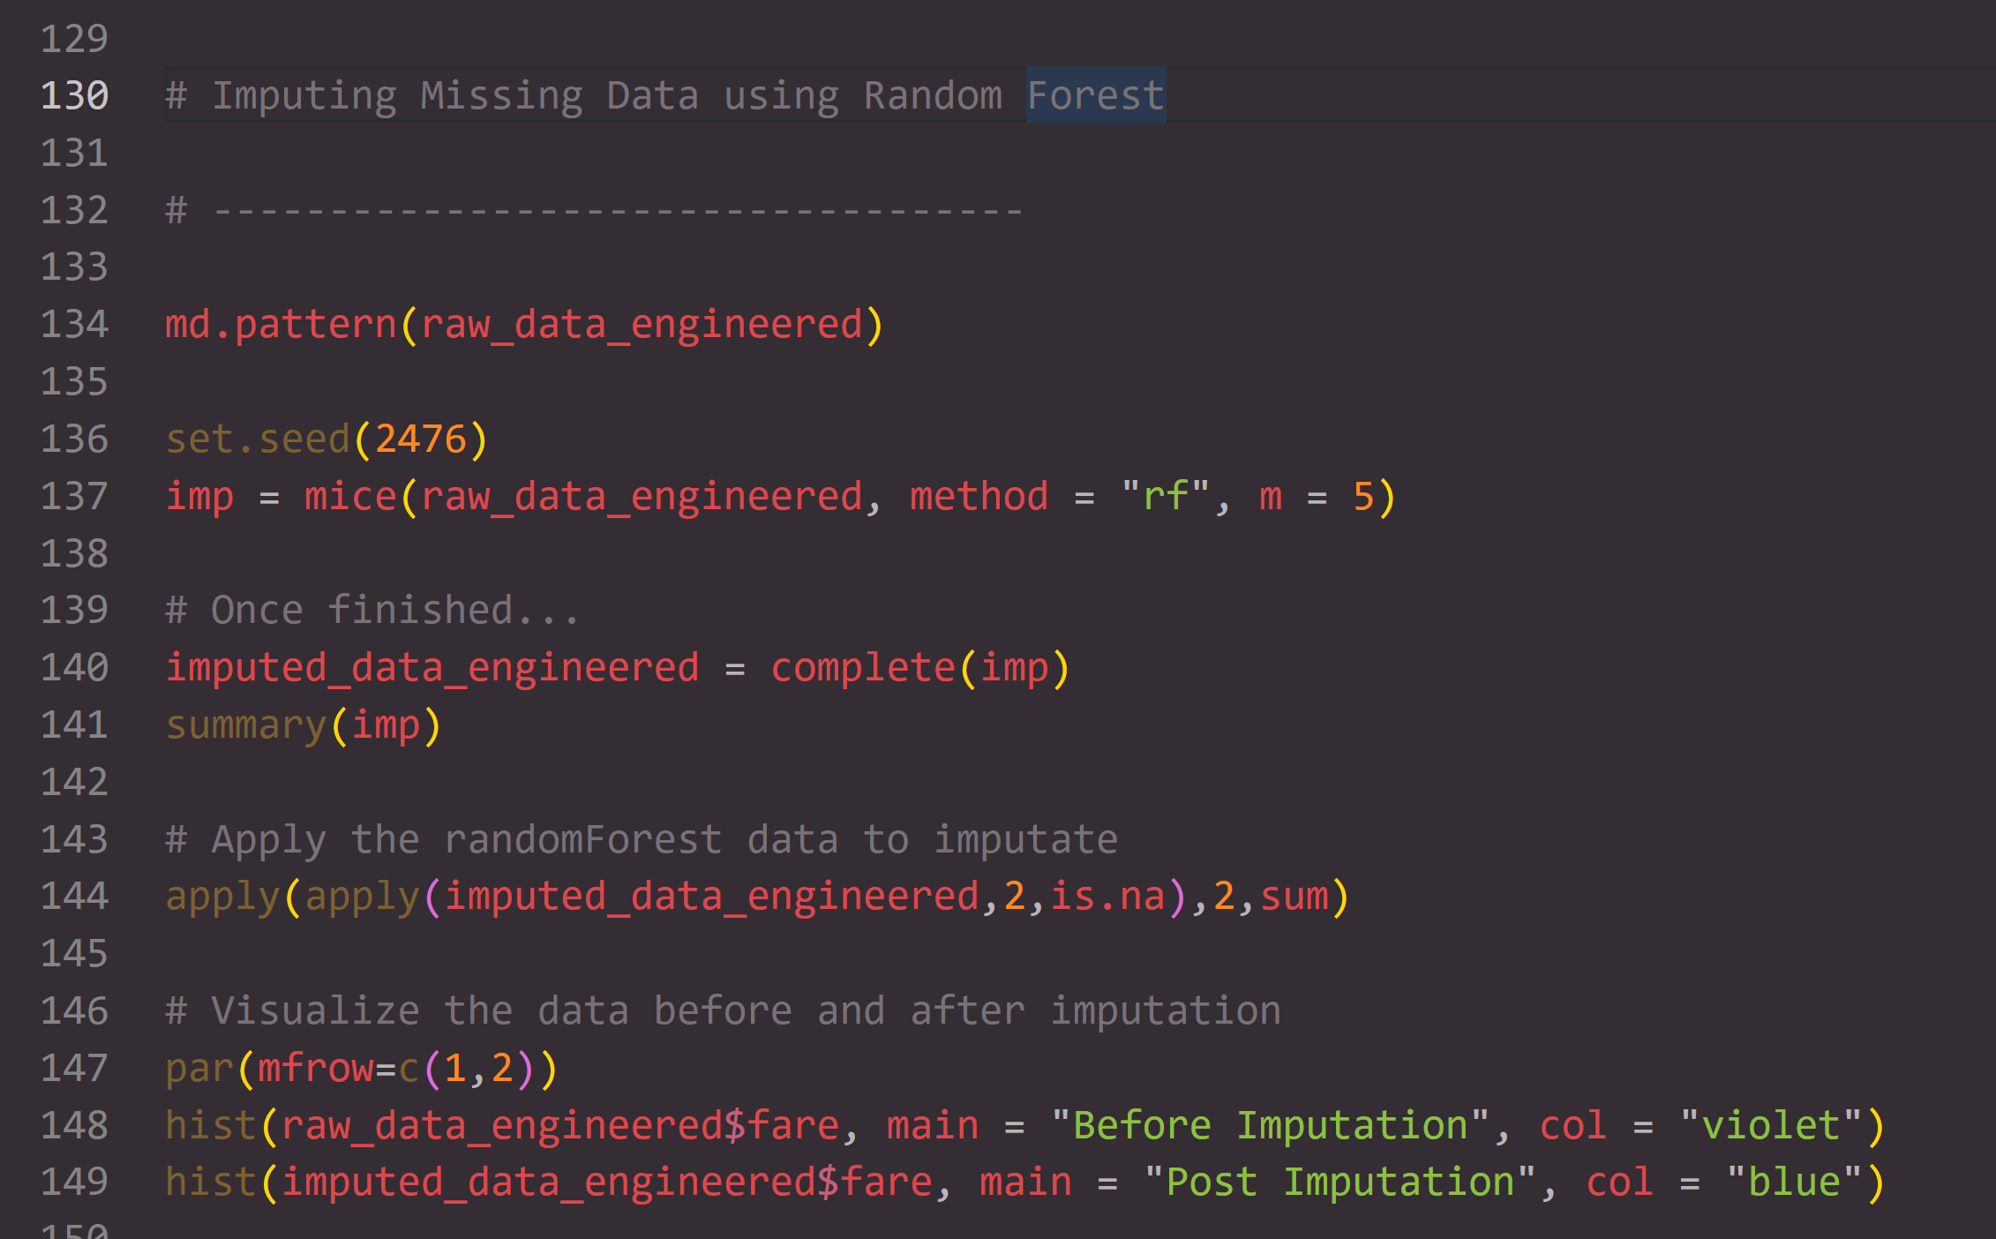
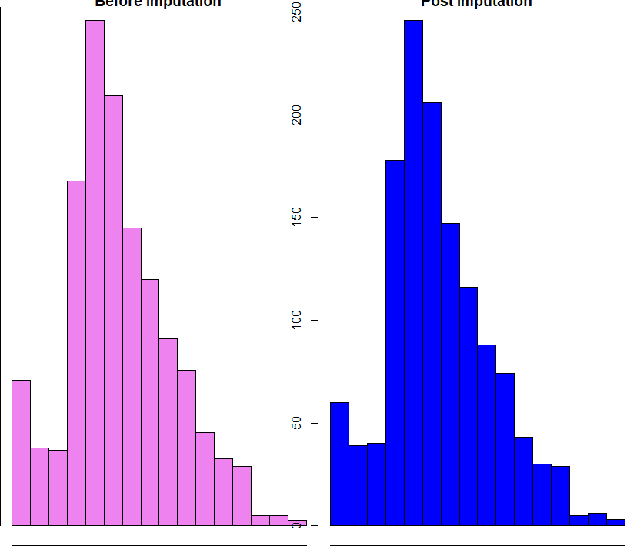
Data imputation code

Slide 6
Machine learning modules

Slide 7
Classification models used
Logistic Regression
Random Forest
K-Nearest Neighbors
Source Vector Machine
Linear Discriminant Analysis
Ensemble Model

Slide 8
Logistic regression

Slide 9
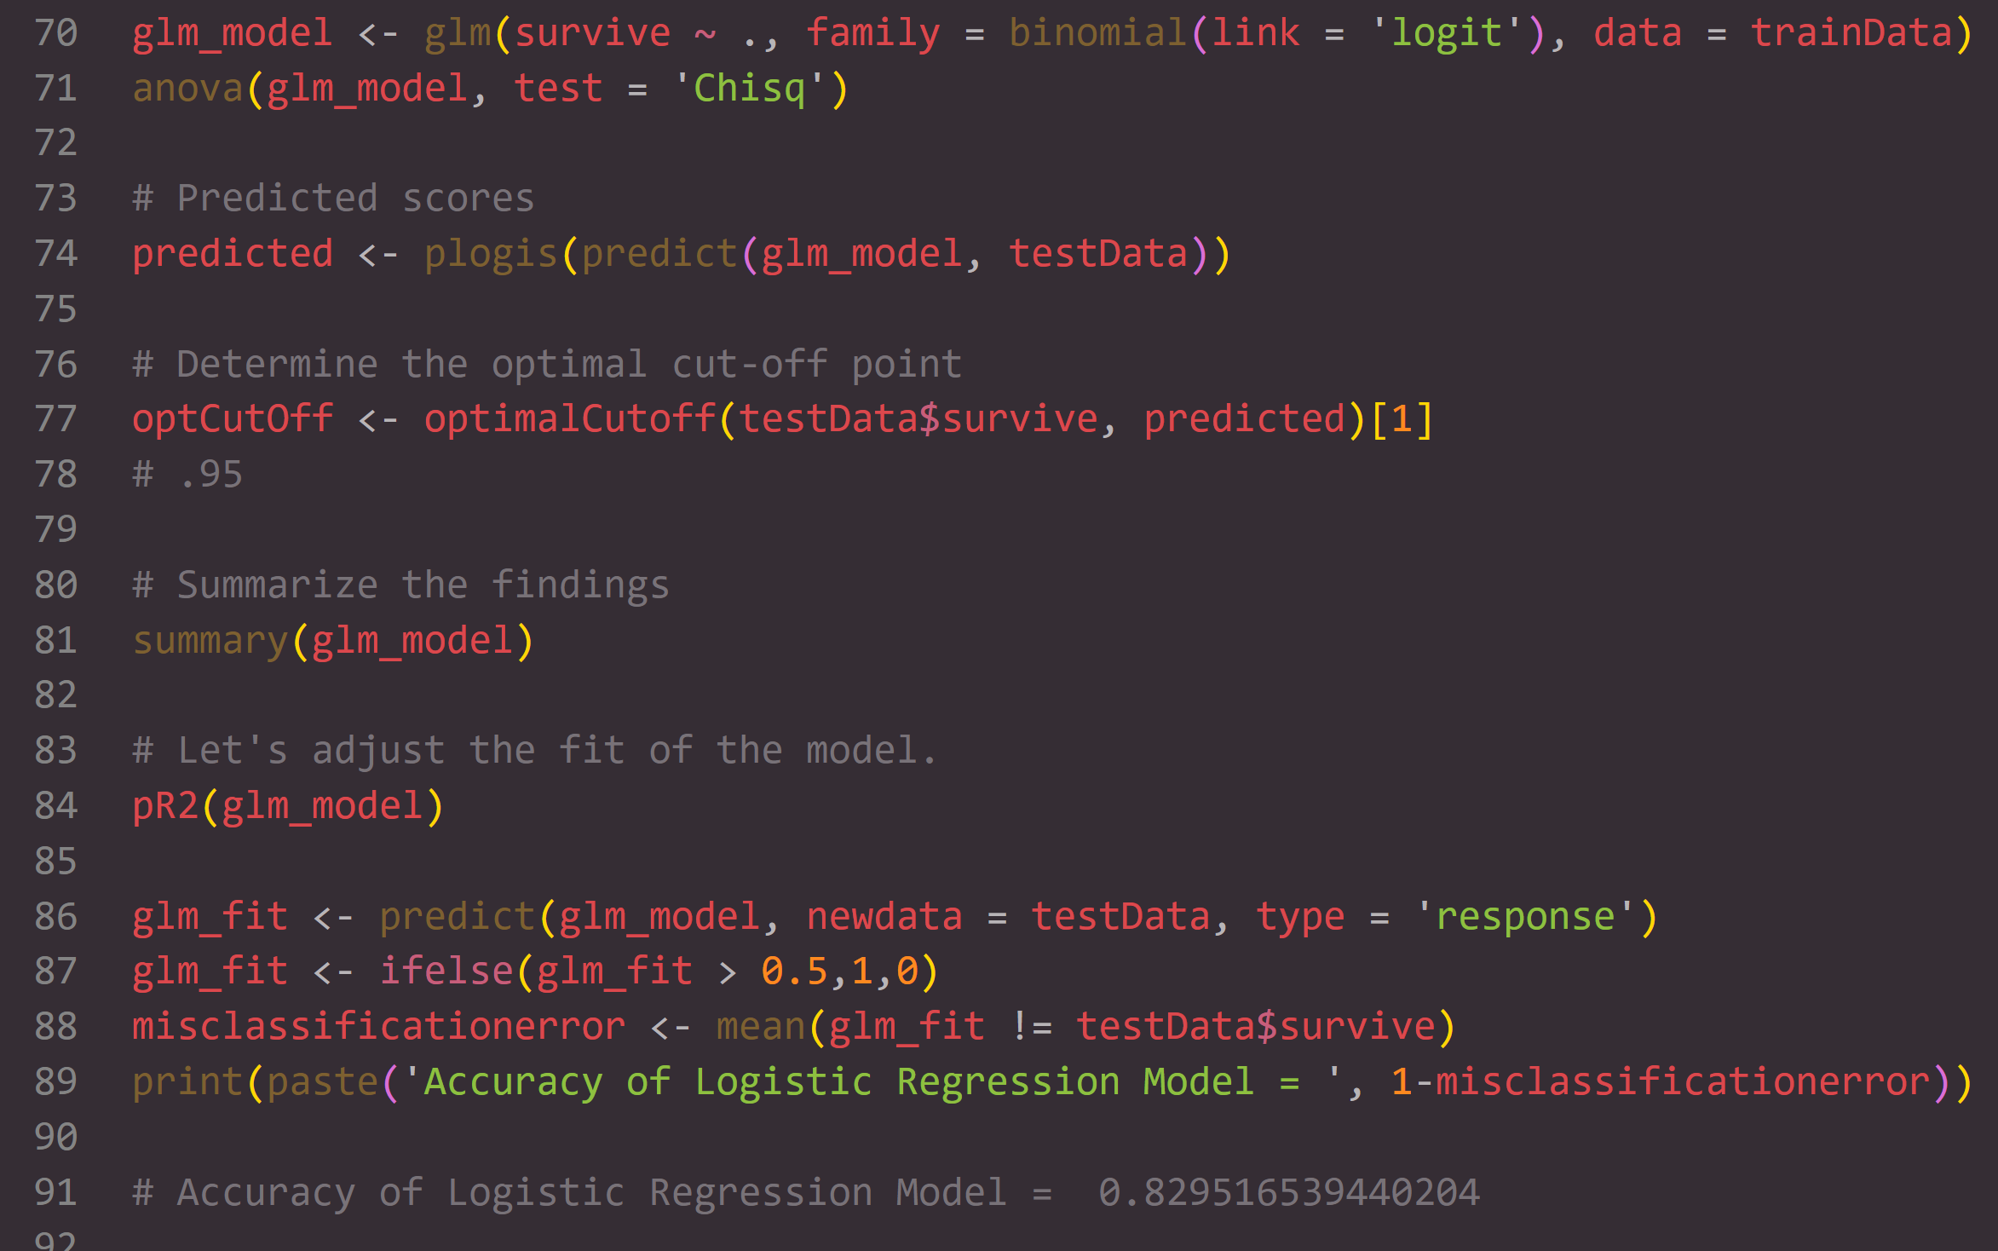
Code and measurements

Slide 10
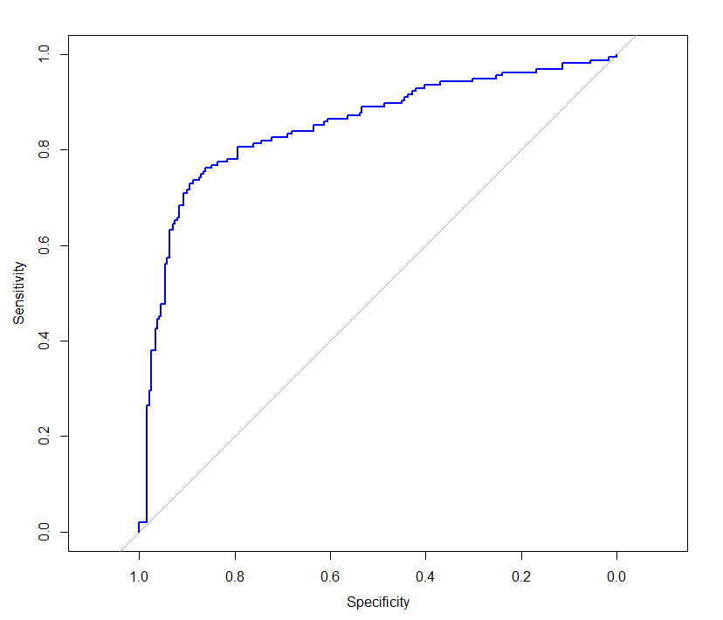
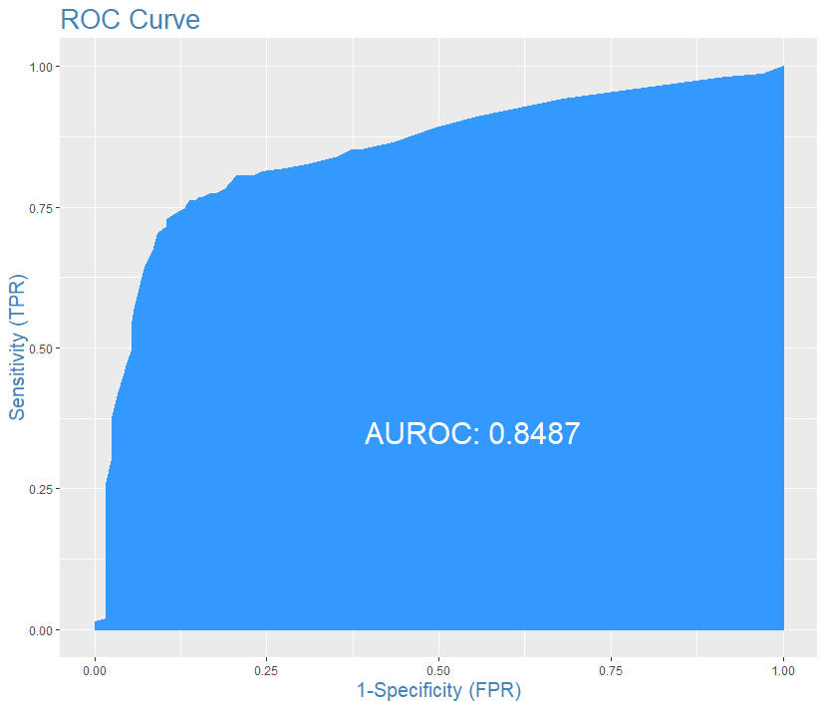
Sensitivity, specificity, roc curve and auc

Slide 11
Random forest

Slide 12
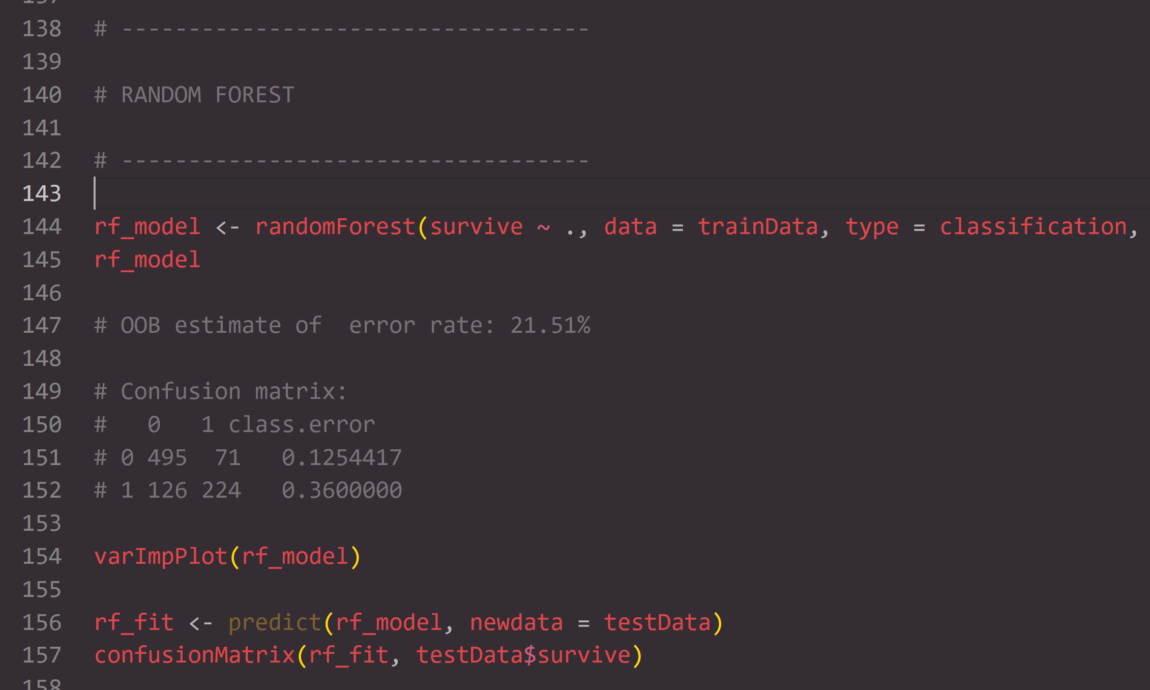
Code and measurements

Slide 13
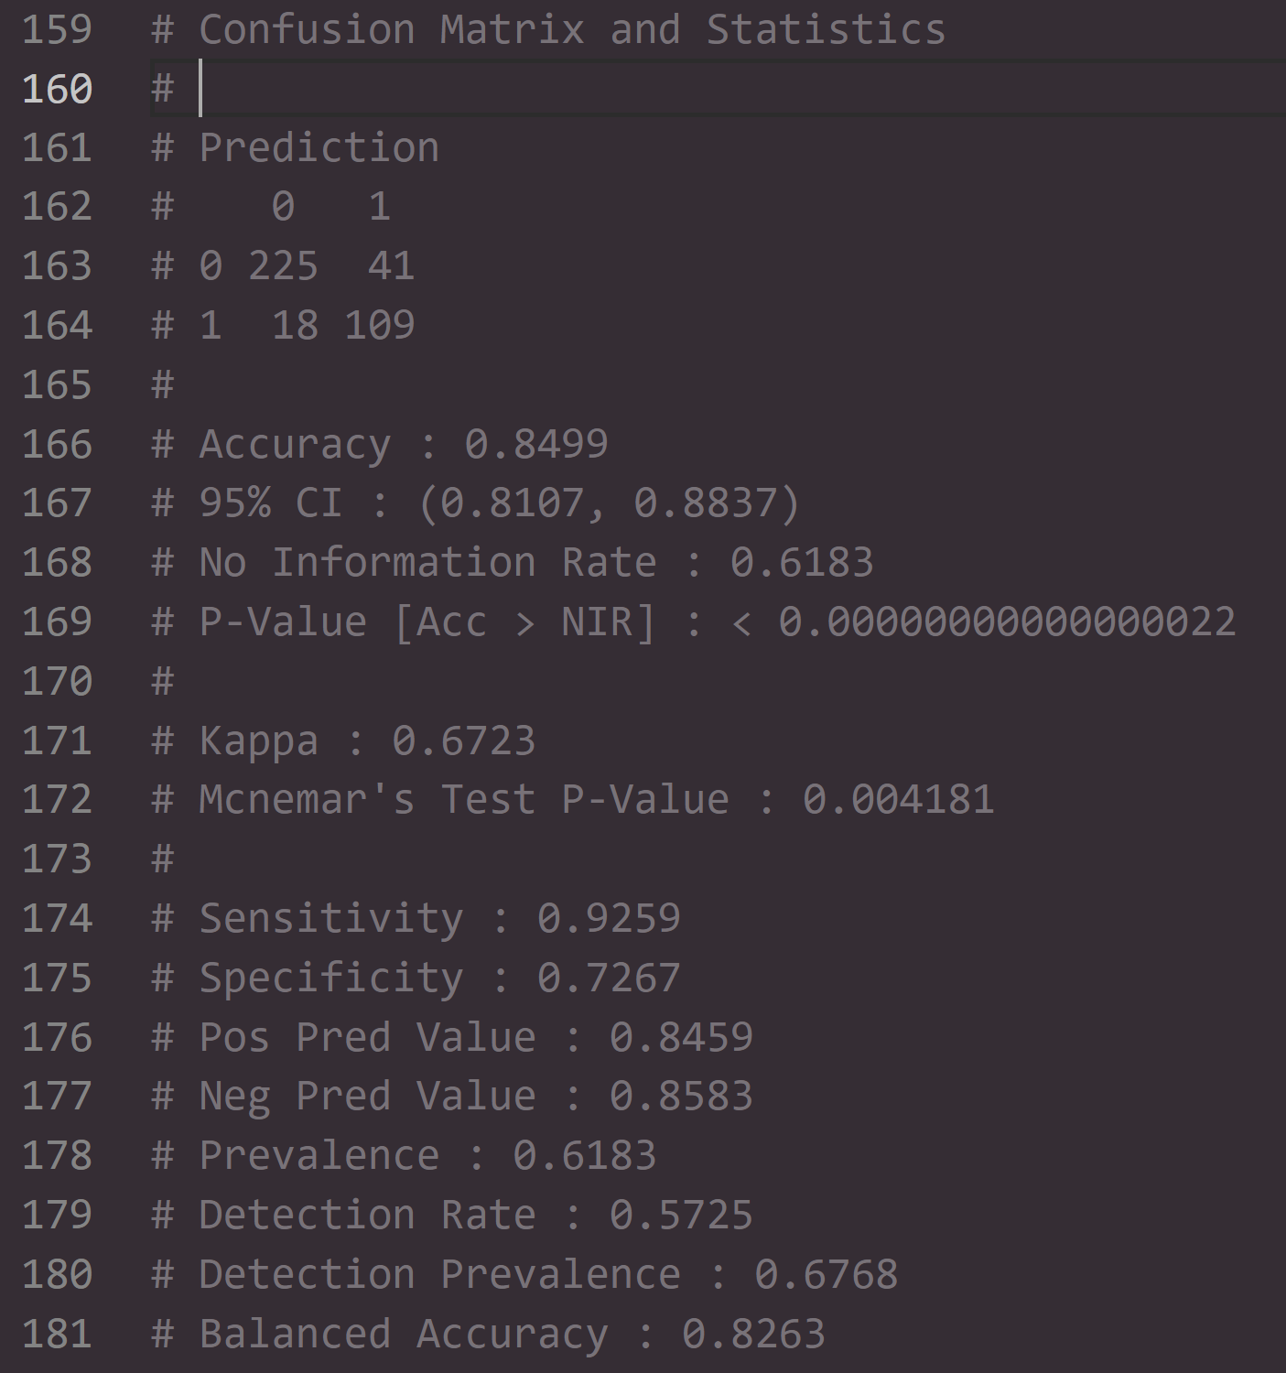
analysis

Slide 14
Source vector machine

Slide 15
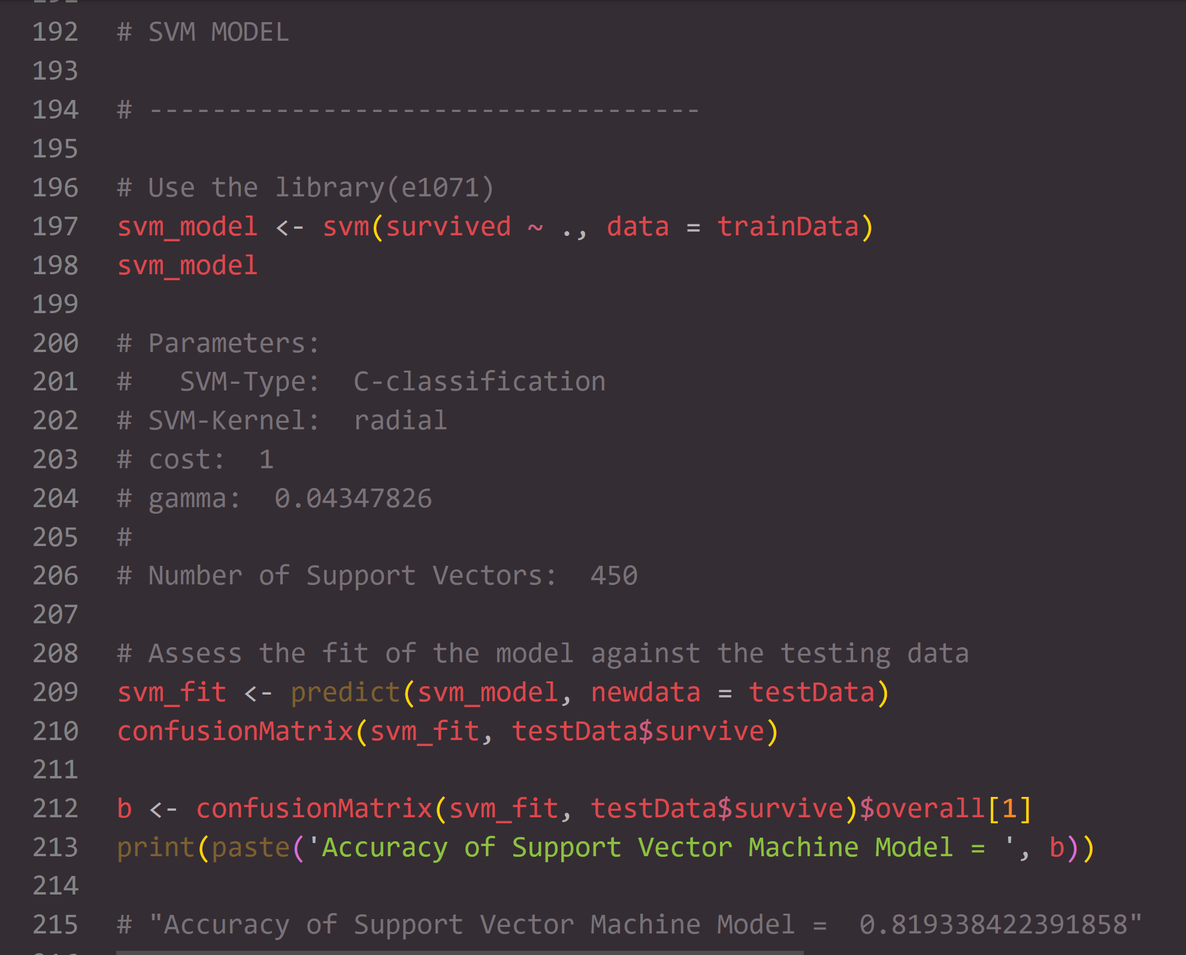
Code and measurements

Slide 16
Linear discriminant analysis

Slide 17
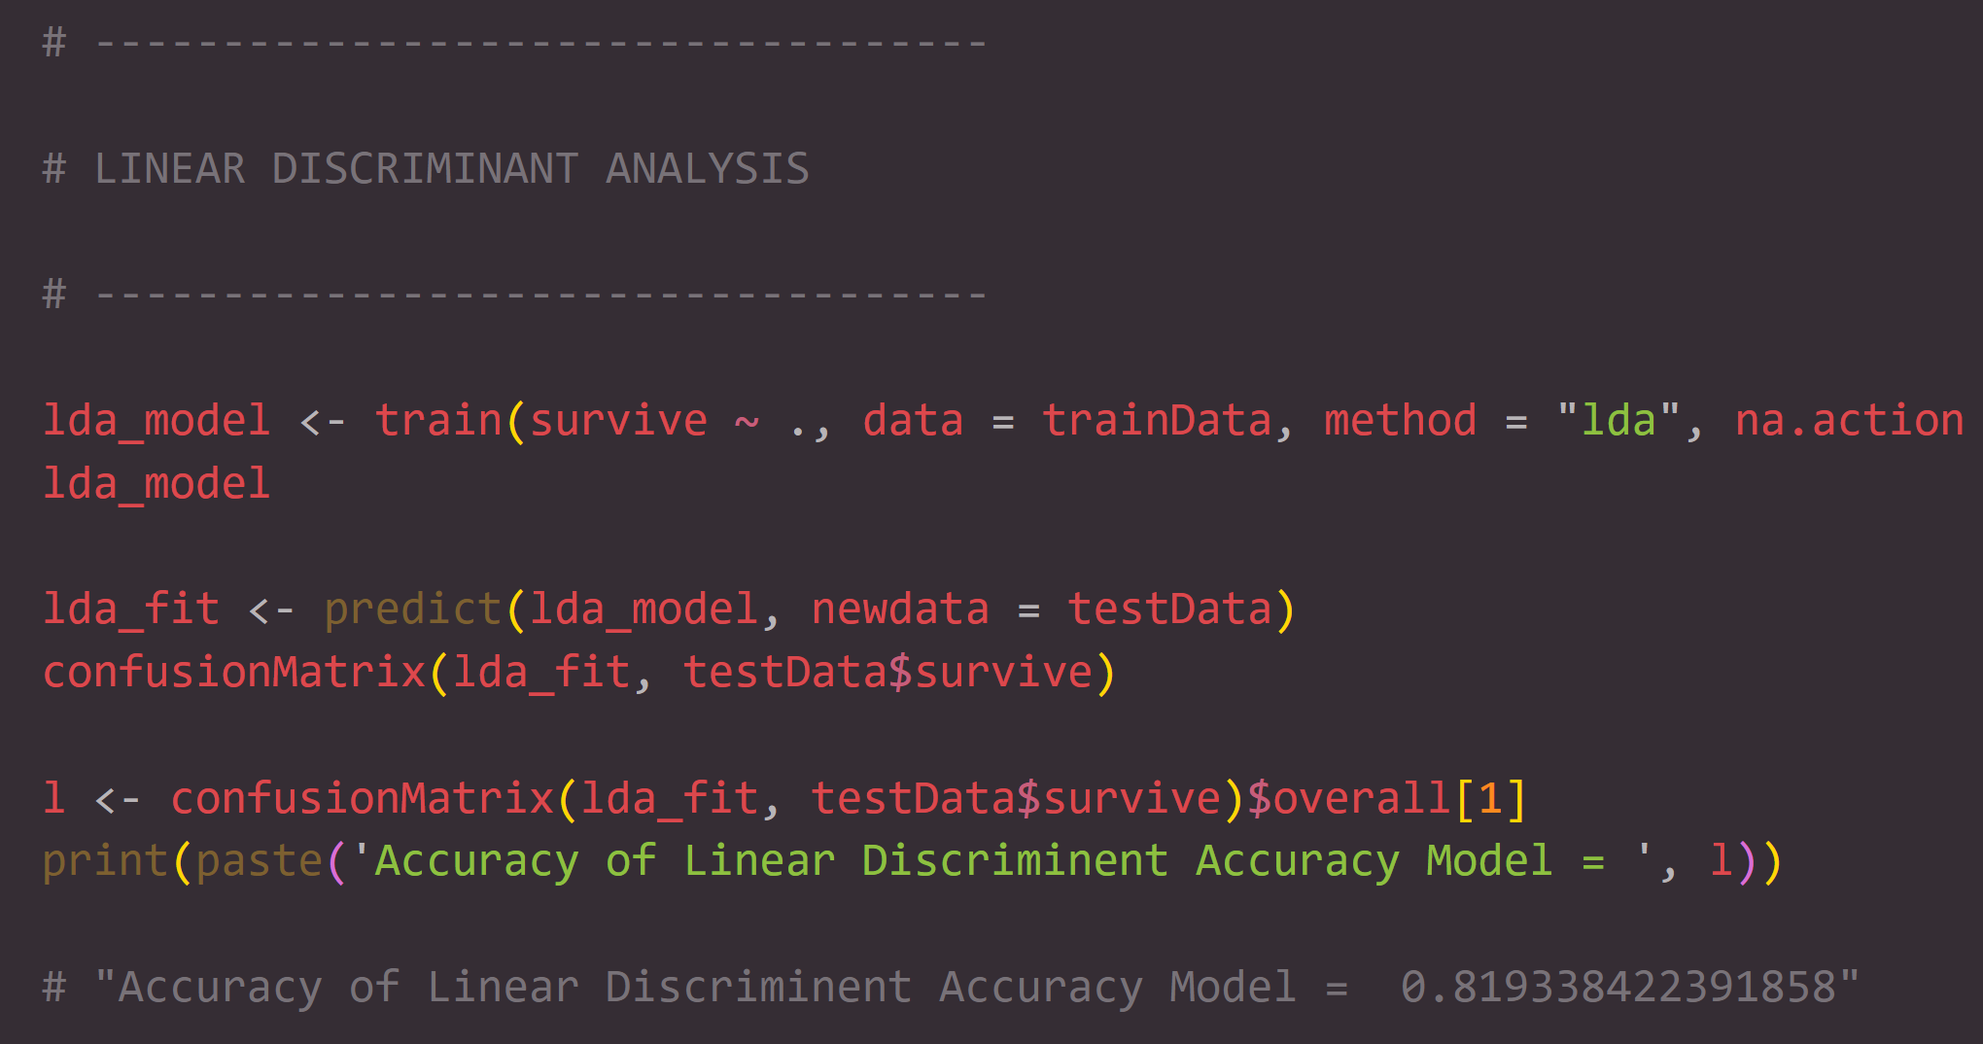
Code and measurements

Slide 18
K nearest neighbors

Slide 19
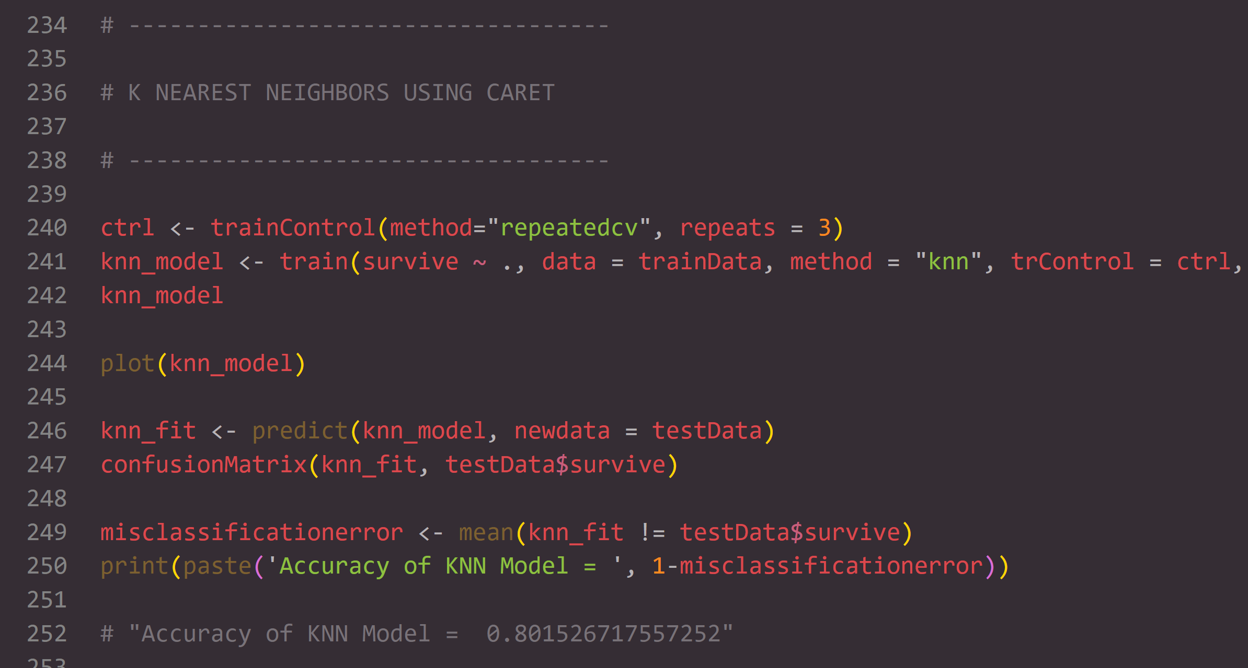
Code and measurements

Slide 20
Ensemble model

Slide 21
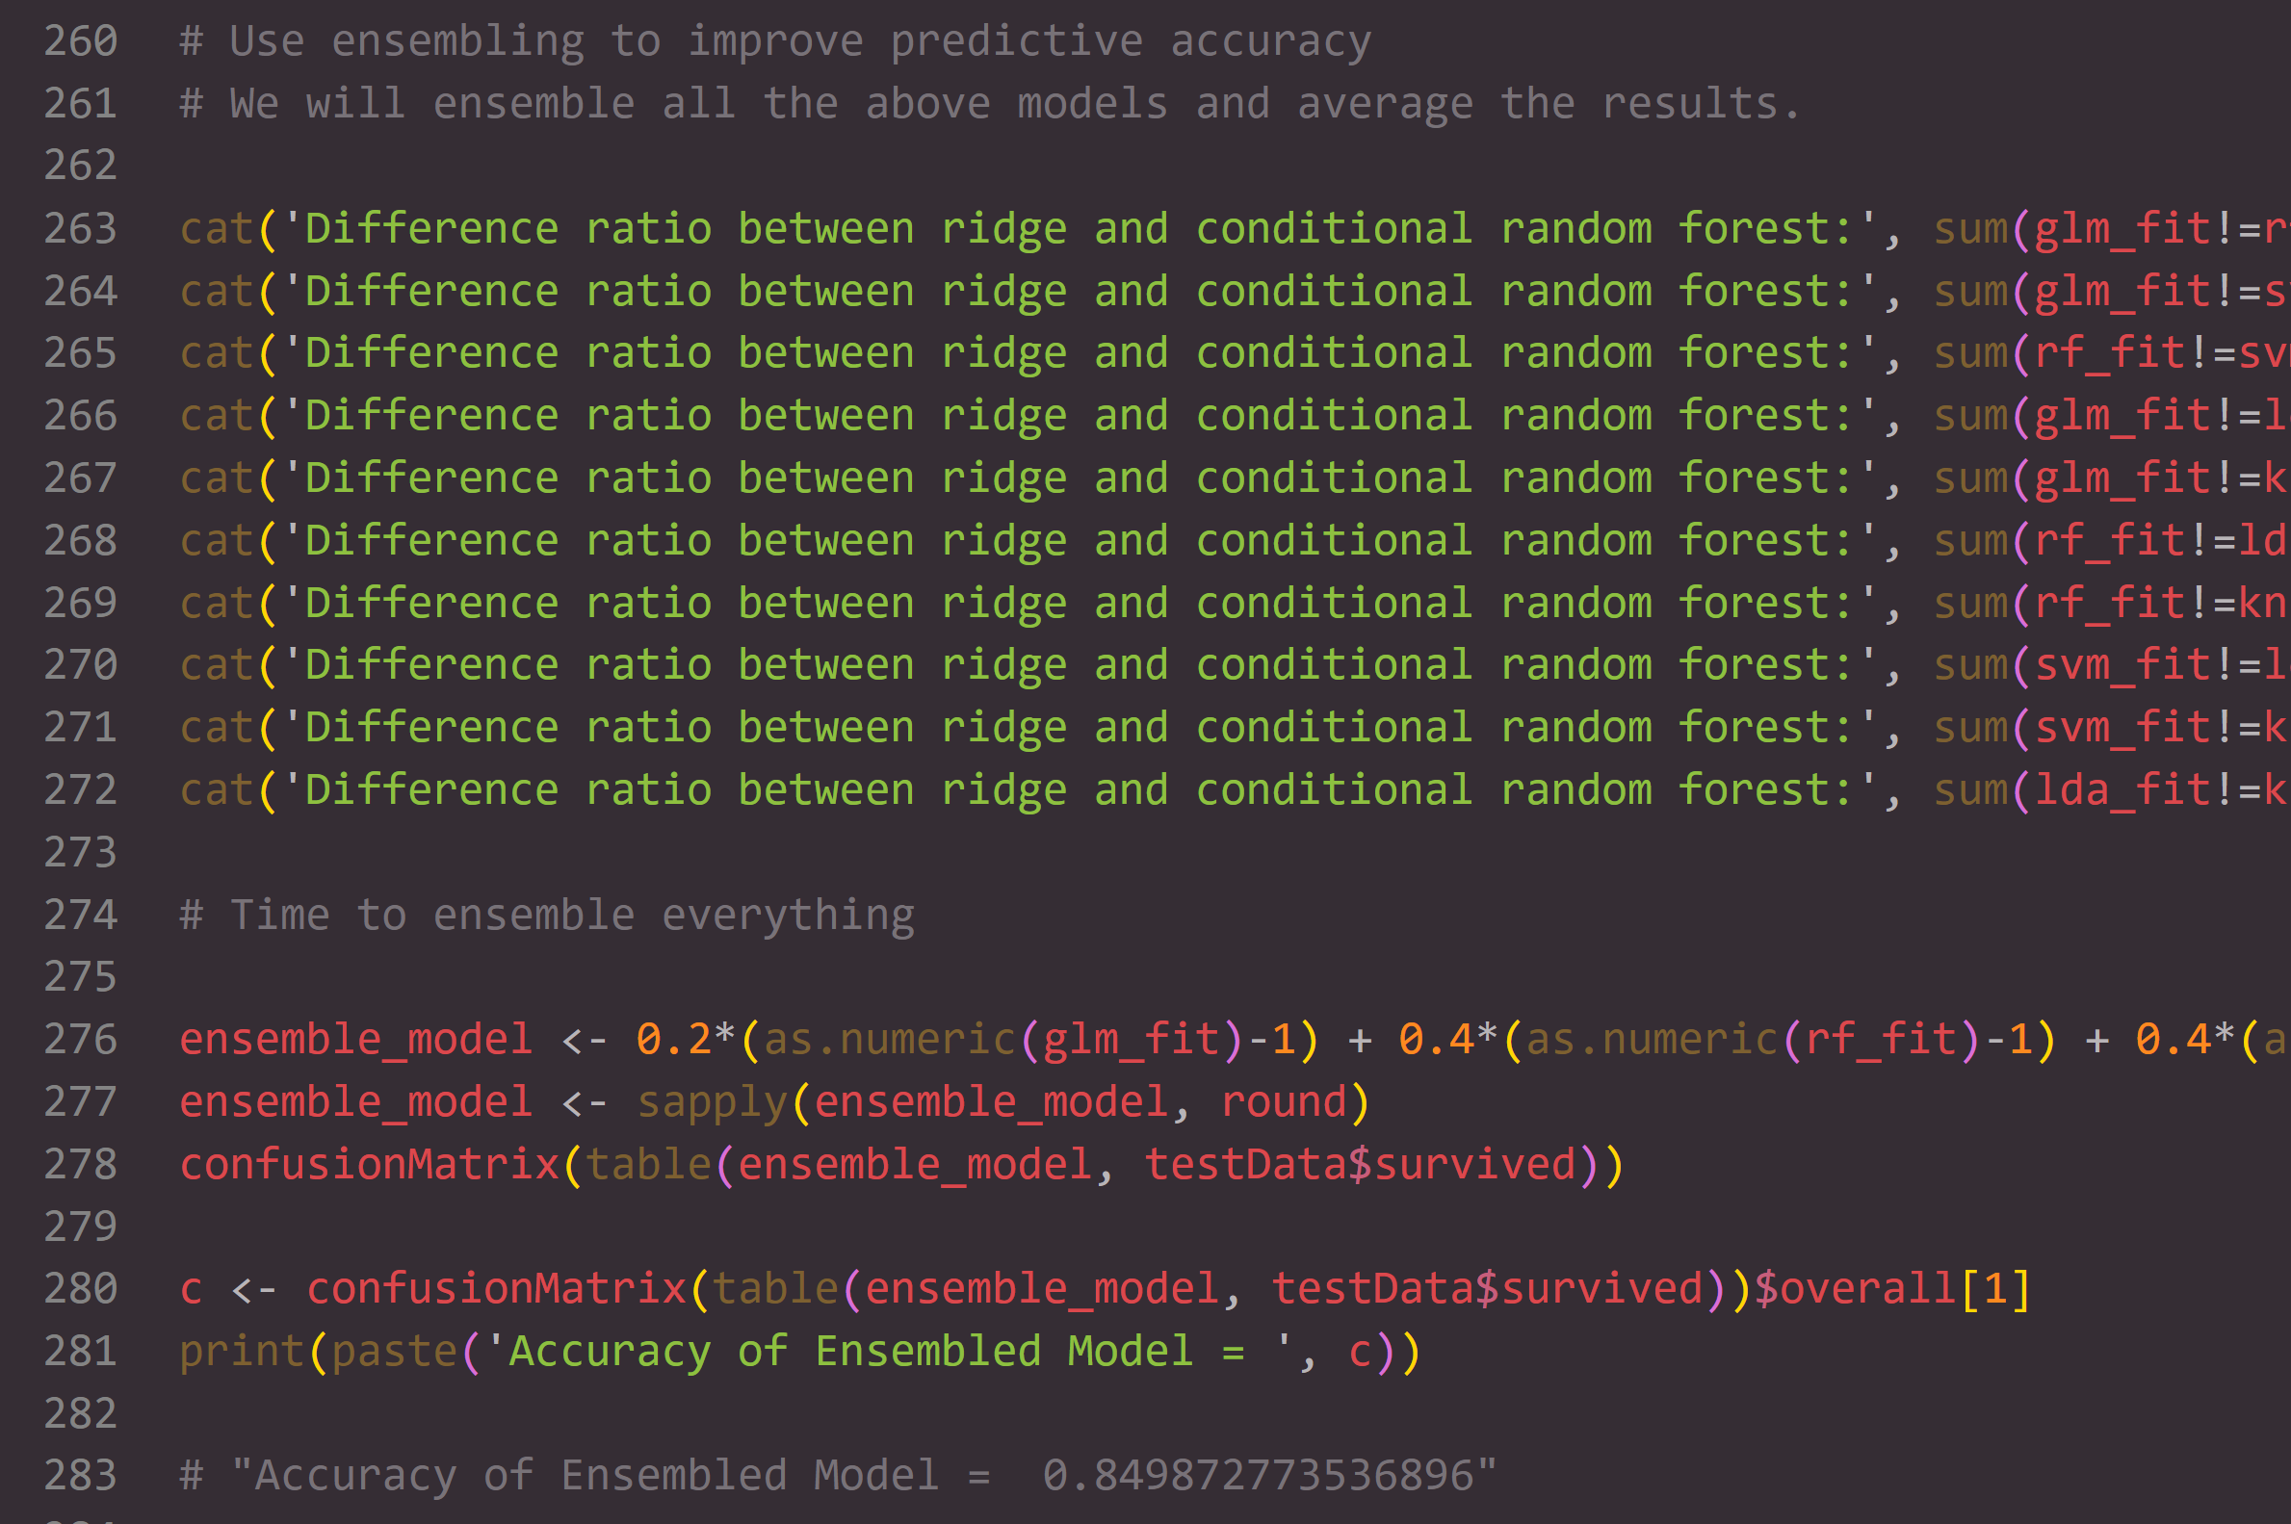
Compare the previous models

Slide 22
Visualizations

Slide 23
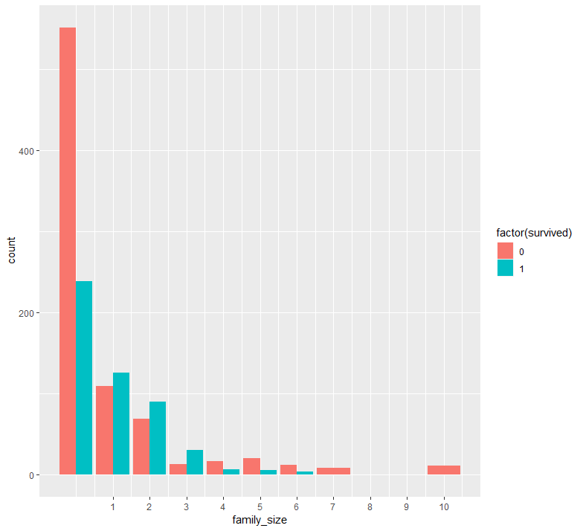
Survival VS Family Size

Slide 24
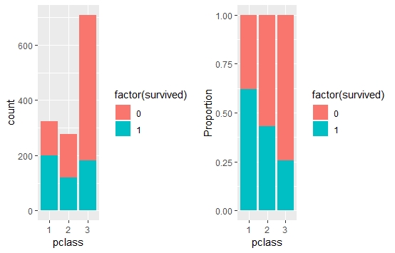
Class vs SURVIVAL

Slide 25
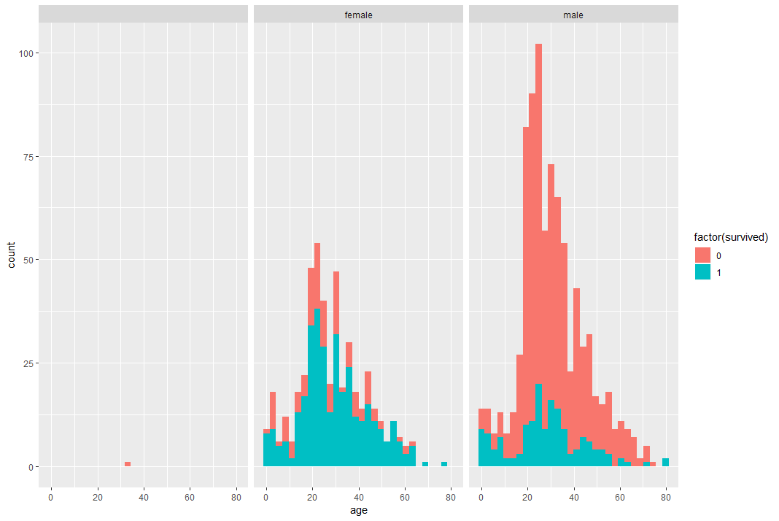
Age, Gender, and Survival

Slide 26
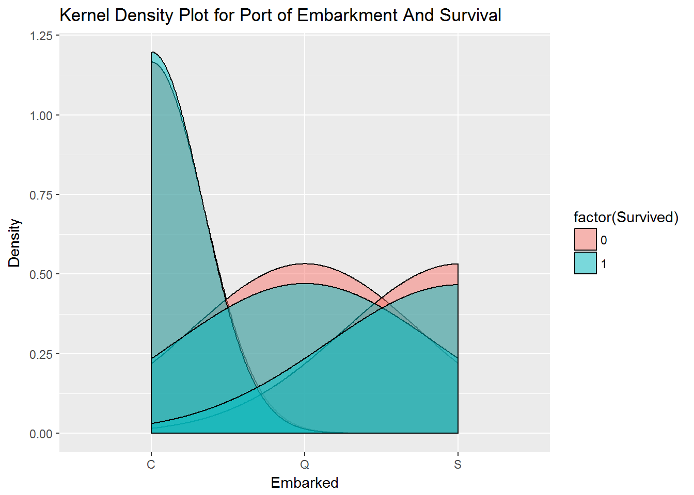
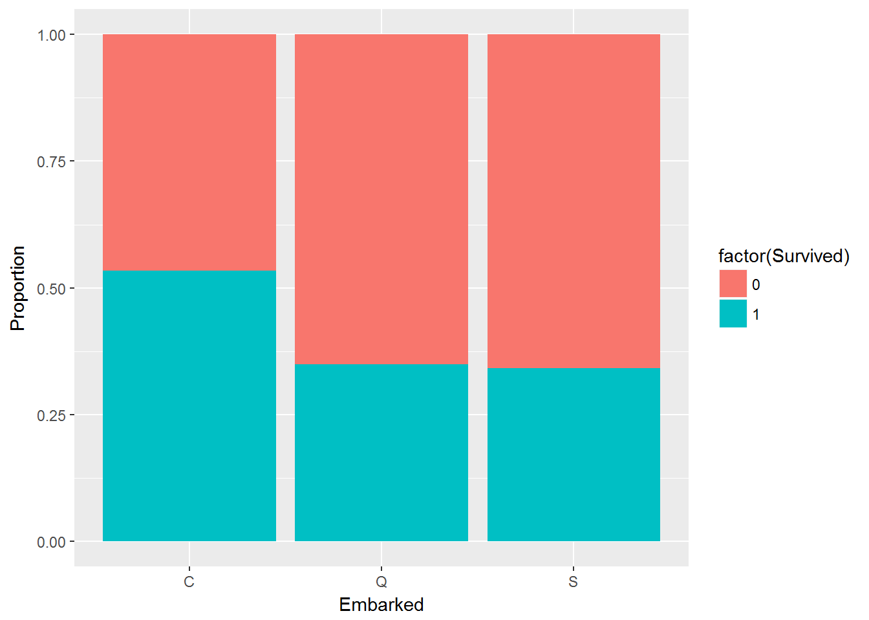
Survival and point of embarkment

Slide 27
Conclusions

Slide 28
How do the titanic models compare?
Model | Accuracy
Logistic Regression | 82.95%
Random Forest | 84.98%
K-Nearest Neighbor (KNN) | 81.93%
Source Vector Machine | 96.54%
Linear Discriminant Analysis | 81.93%
Ensemble Model | 84.98%

Slide 29
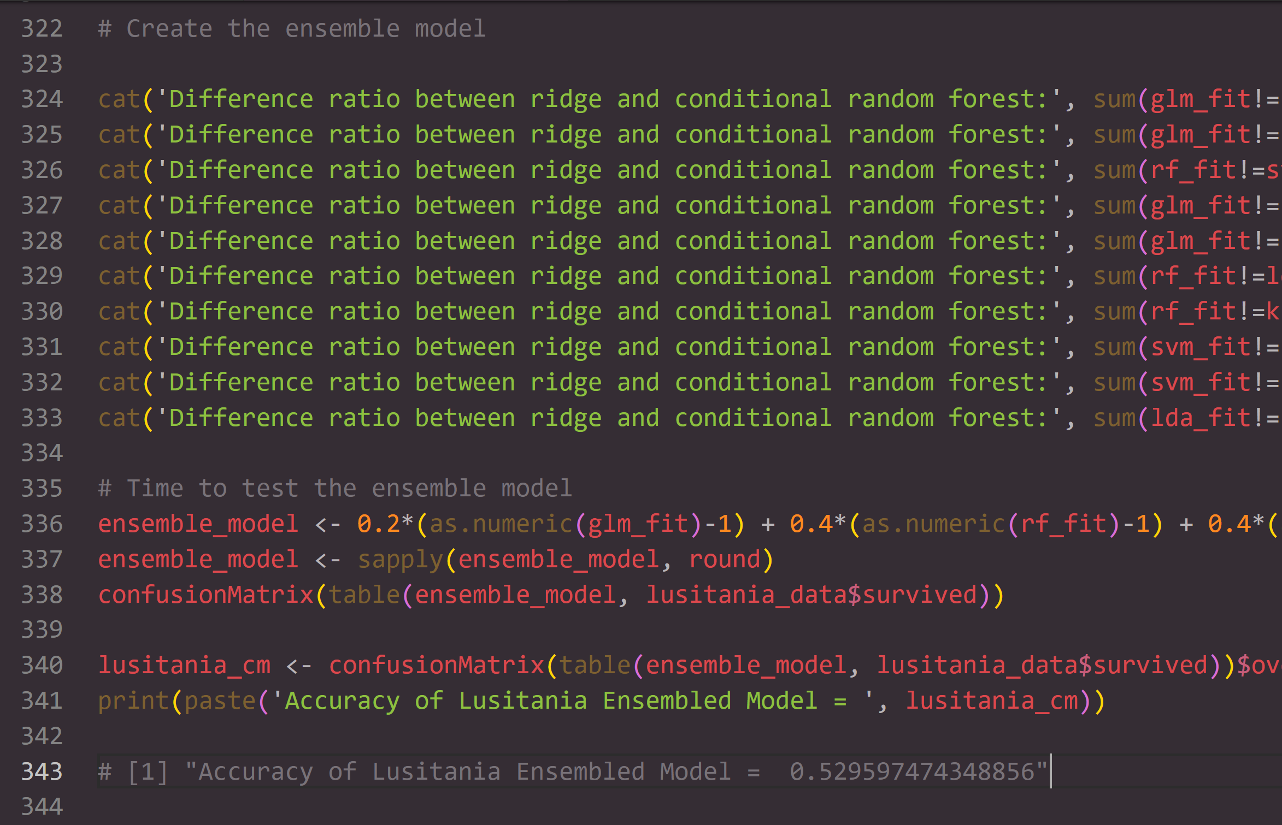
Testing the models on the Lusitania data
So, what happened? Why only 52.95% accurate compared to the Titanic data?
Due to the survivability biases in the Titanic dataset compared to the Lusitania data, which skewed towards gender and socioeconomic status as major factor variables

Slide 30
Post mortem
Limited dataset: Difficulties with finding useful data on wines for free
Data biased towards red whines and mid-tier wines
Given more time, we would like to refine our models and find alternative datasets in order to get the most accurate results at predicting the quality of a wine

Slide 31
Moving forward
Create more machine learning models in R, including but not limited to Decision Tree, Neural Network, Deep Neural Network, and XG Boost
Further explore the differences between the two datasets
Perform a more in depth analysis of the Lusitania dataset
Create a website and R Shiny application for the project

Slide 32
Any questions?

