Slide 1
The challenge of Predicting wine quality
Areej, Courtney, Isaac, Justin, and Sandra

Slide 2
Project scope
Use machine learning models to analyze wine data to predict and classify wine quality (as judged by experts) based on twelve traits like acidity, residual sugar, and alcohol concentration
Compare various classification machine learning models to determine which is the best suited for our purposes

Slide 3
Libraries and modules used
Sci-Kit Learn
RandomForestRegressor
Matplotlib, NumPy, Seaborns
Pandas ML
Tableau
R

Slide 4
The data

Slide 5
What data did we use?
Publicly accessible wine data intended for research
P. Cortez, A. Cerdeira, F. Almeida, T. Matos and J. Reis. Modeling wine preferences by data mining from physicochemical properties. In Decision Support Systems, Elsevier, 47(4):547-553, 2009.

Slide 6
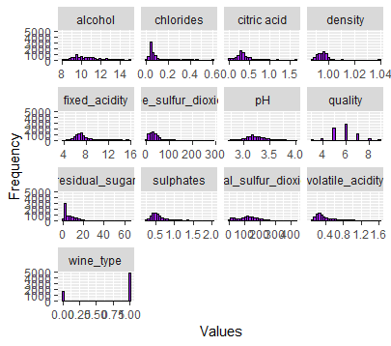
A quick look
Twelve factors used to judge quality of red and white wines
Data irregularities
significantly more red wines than white wines
Quality score ranges from 1 – 10 yet we have significantly more mid-tier wines

Slide 7
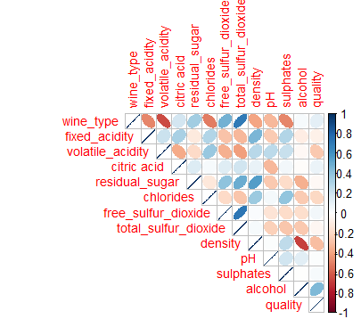
Correlations
Strong positive correlation between wine type and sulfur dioxide
Semi-strong positive correlation between alcohol level and quality
Strong negative correlation between wine type and fixe acidity
Strong negative correlation between density and sulphates

Slide 8
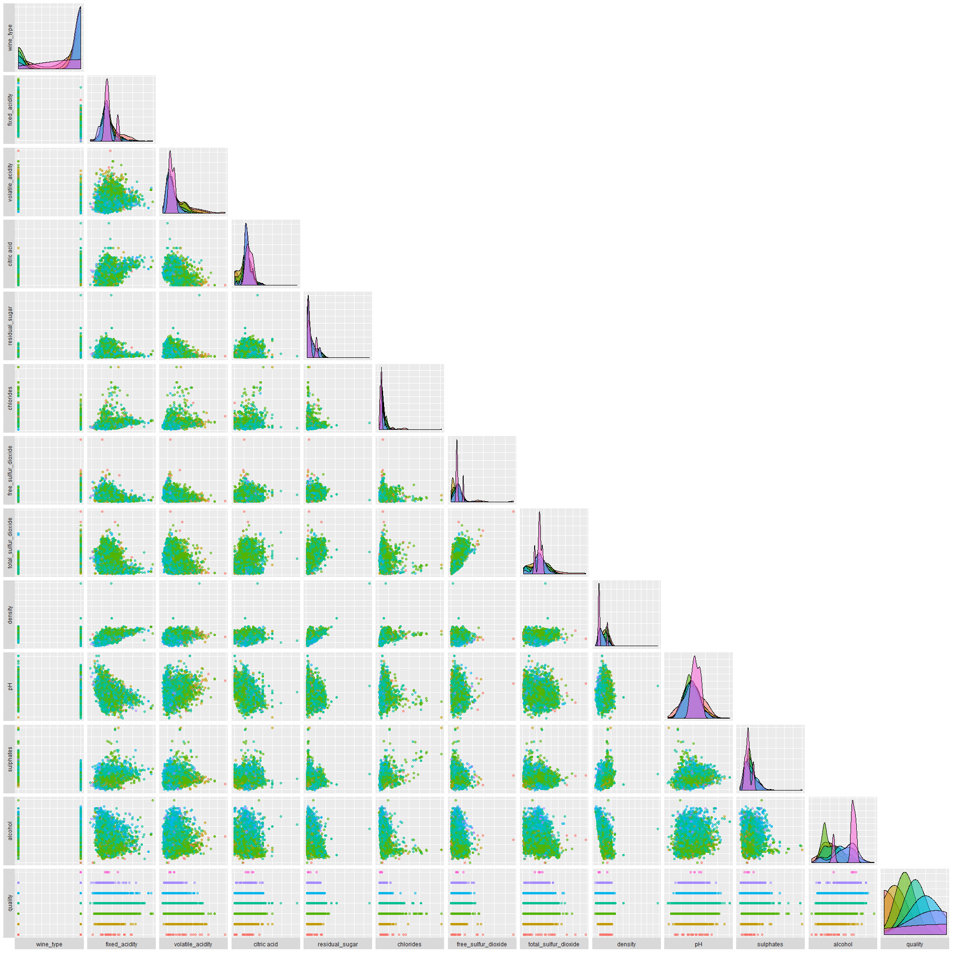
A Pairwise correlation chart for ants

Slide 9
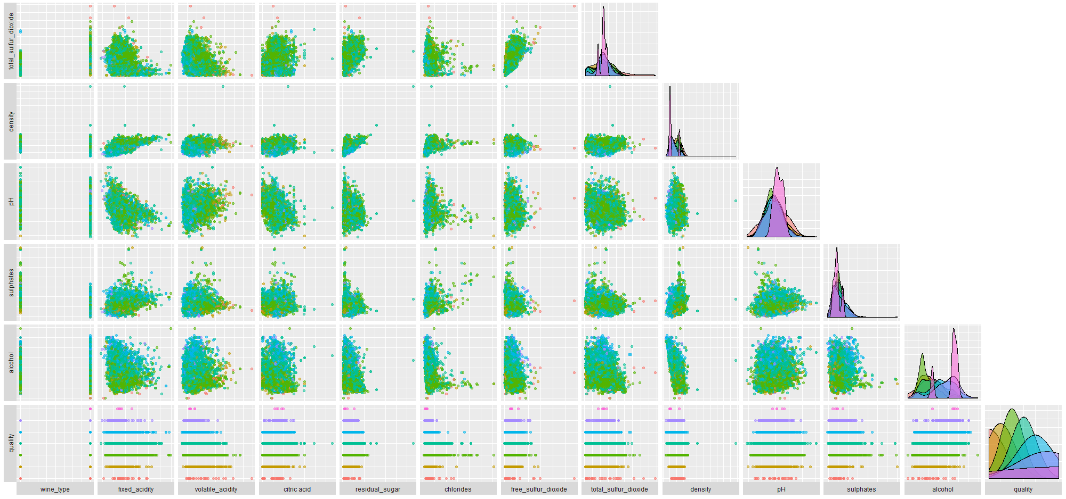
A better look

Slide 10
Machine learning modules

Slide 11
Classification models
other models
Linear regression
kmeans (In both pyton and r)
Source vector Classification
Random Forest
K-nearest neighbor
Logistic regression
Neural network
XG Boost

Slide 12
Source vector machine

Slide 13
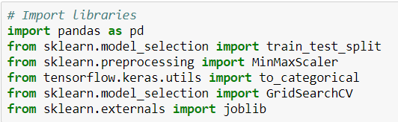
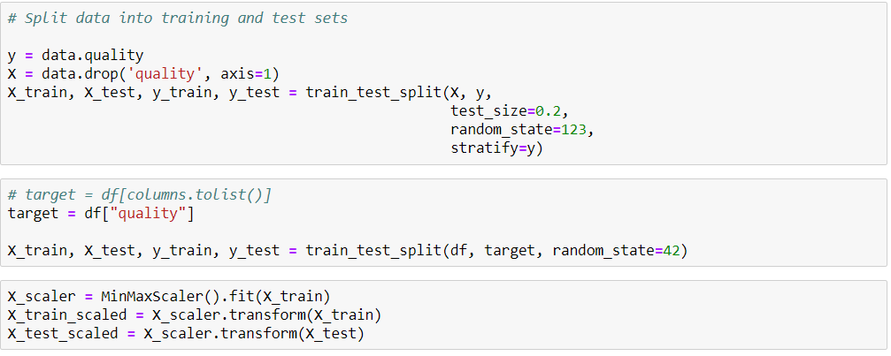
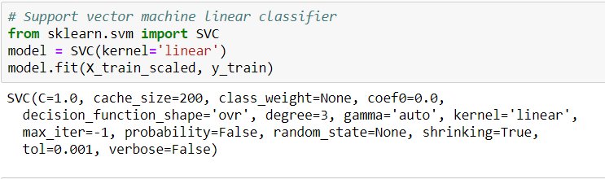
Code and measurements

Slide 14
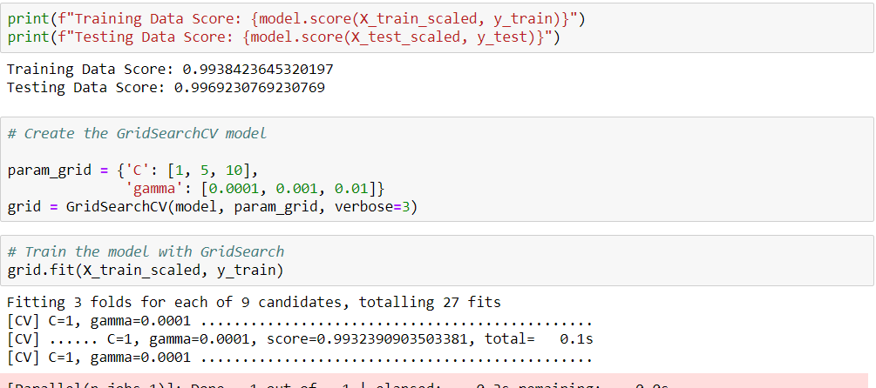

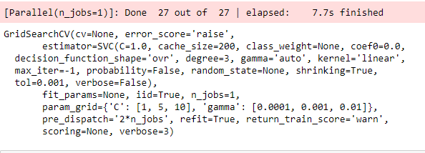

Slide 15
analysis

Slide 16
Random forest

Slide 17
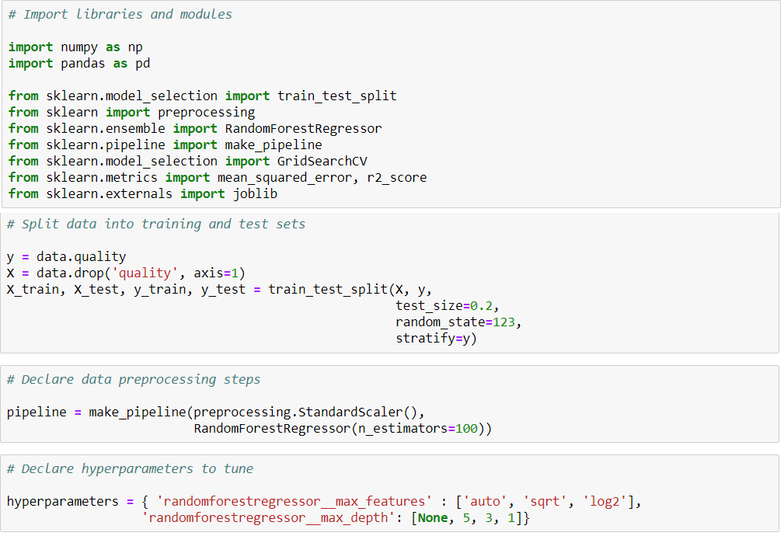
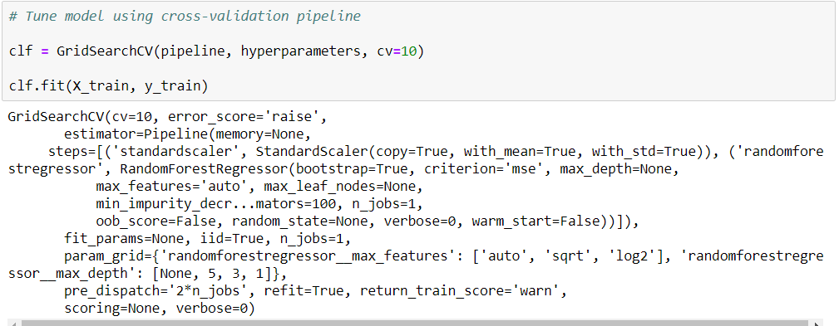
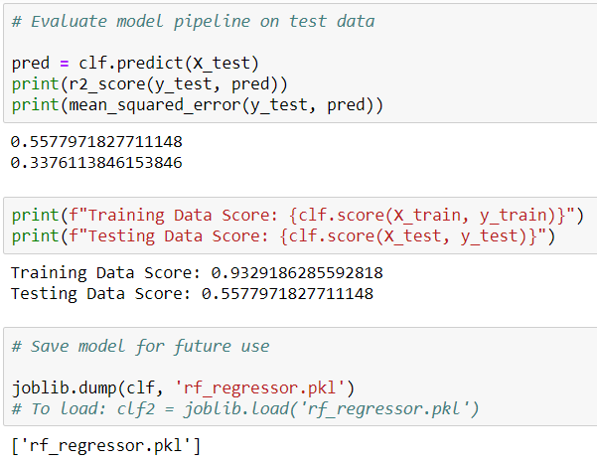
Code and measurements

Slide 18
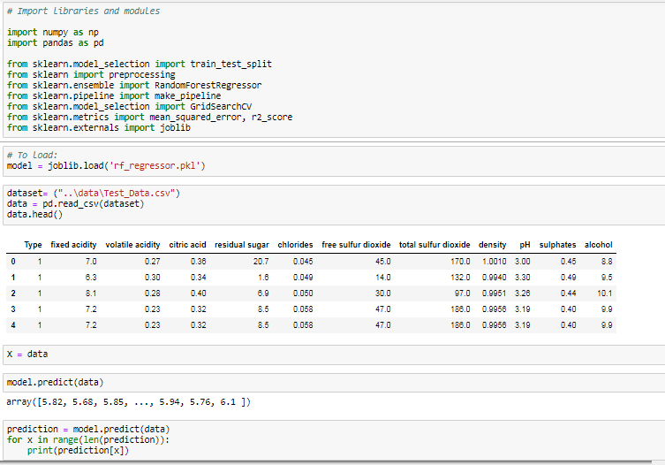
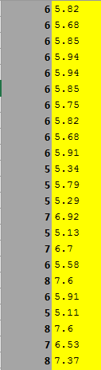
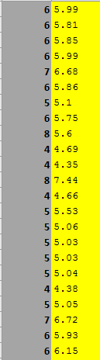
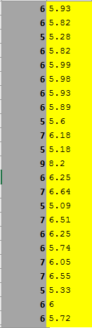
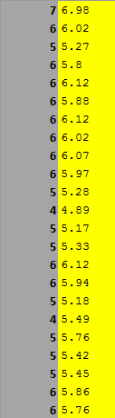
analysis

Slide 19
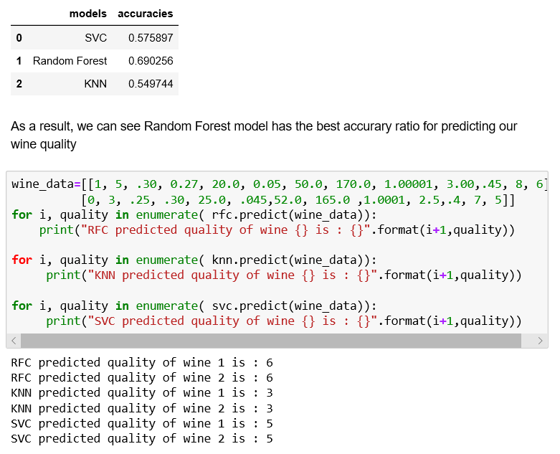
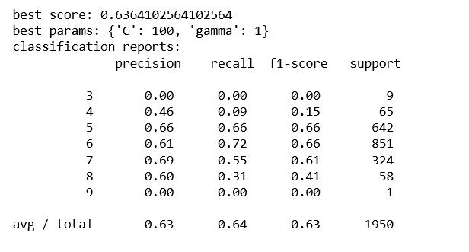
Classifications

Slide 20
Classifications

Slide 21
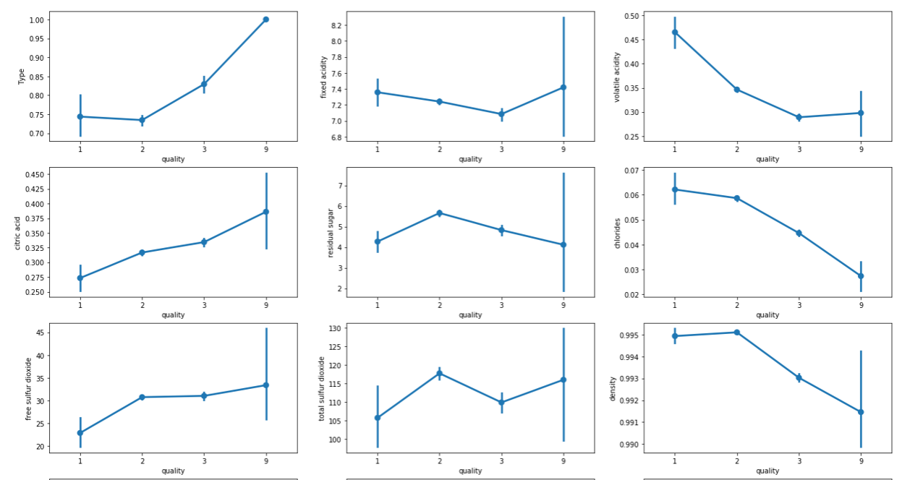
analysis

Slide 22
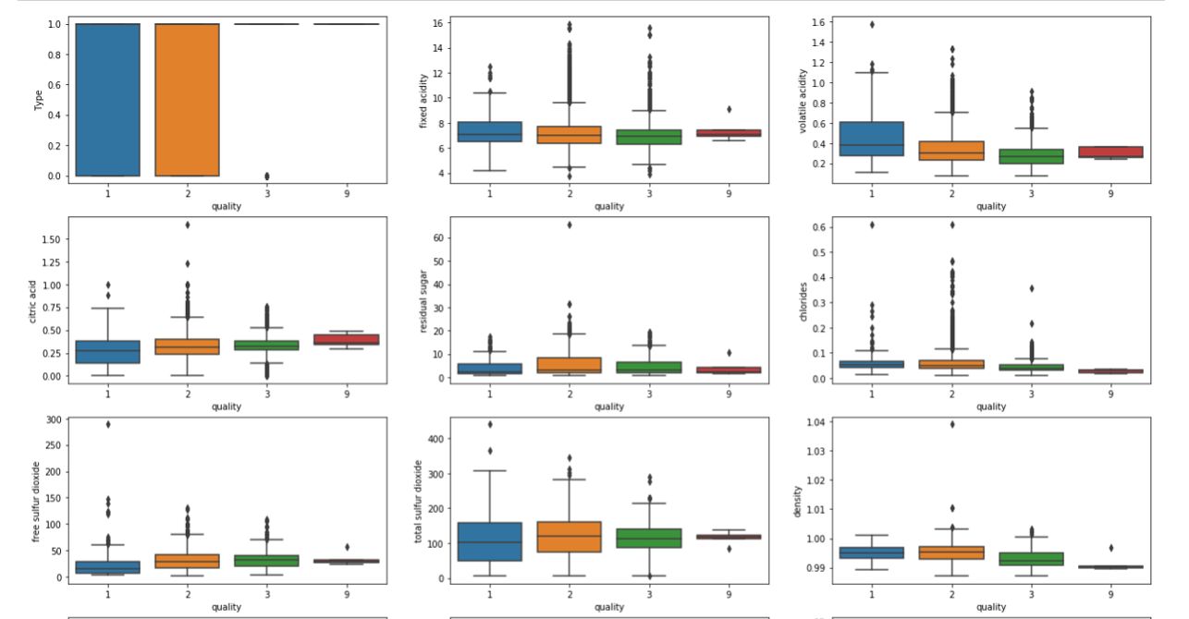

Slide 23
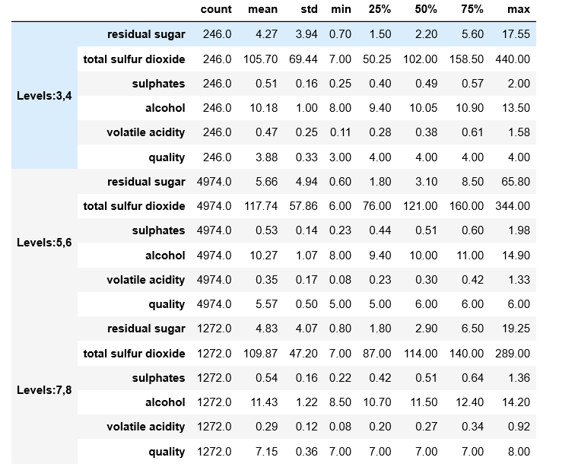
Statistical analysis

Slide 24
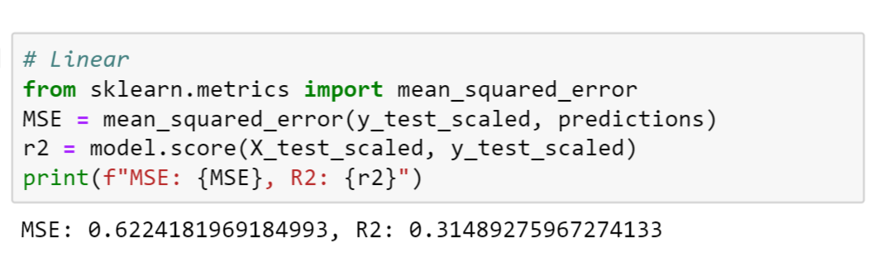
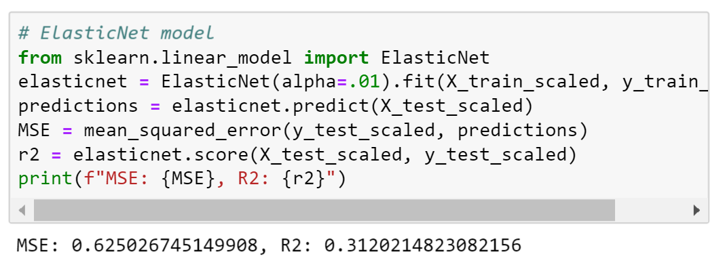
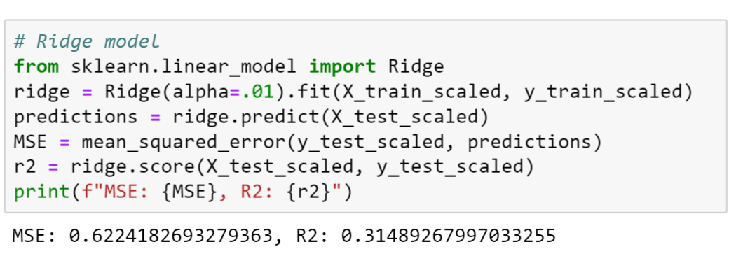
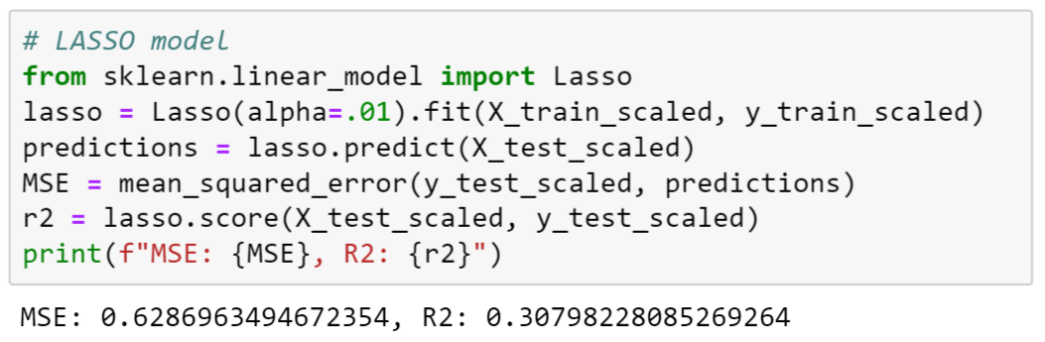
Linear Regression - Code and measurements
Data is non linear
MSE describes the avG error
R2 percent is low
Linear regression is not suitable for this data set

Slide 25
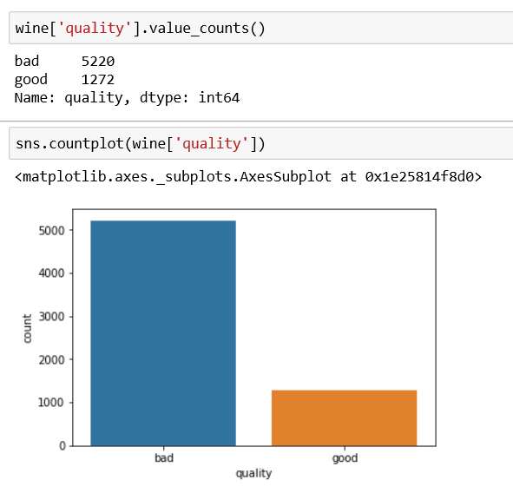
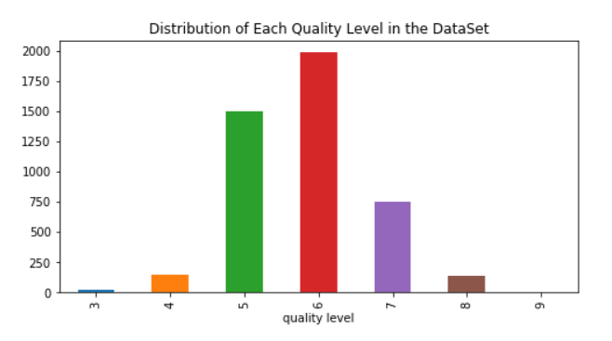
Distribution and Classification

Slide 26
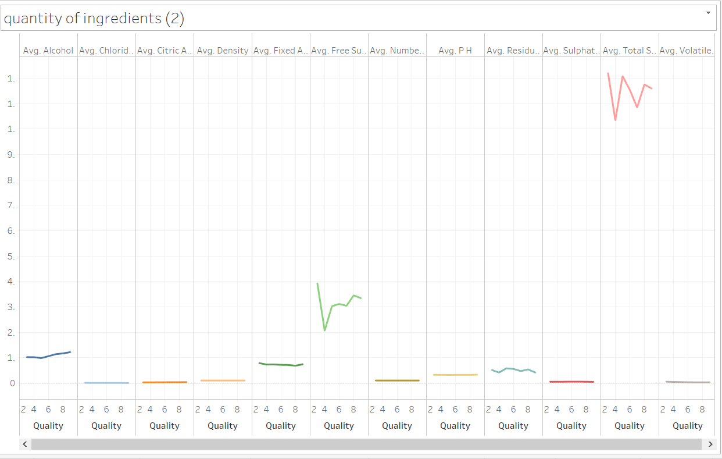
Quality correlation to ingredients

Slide 27
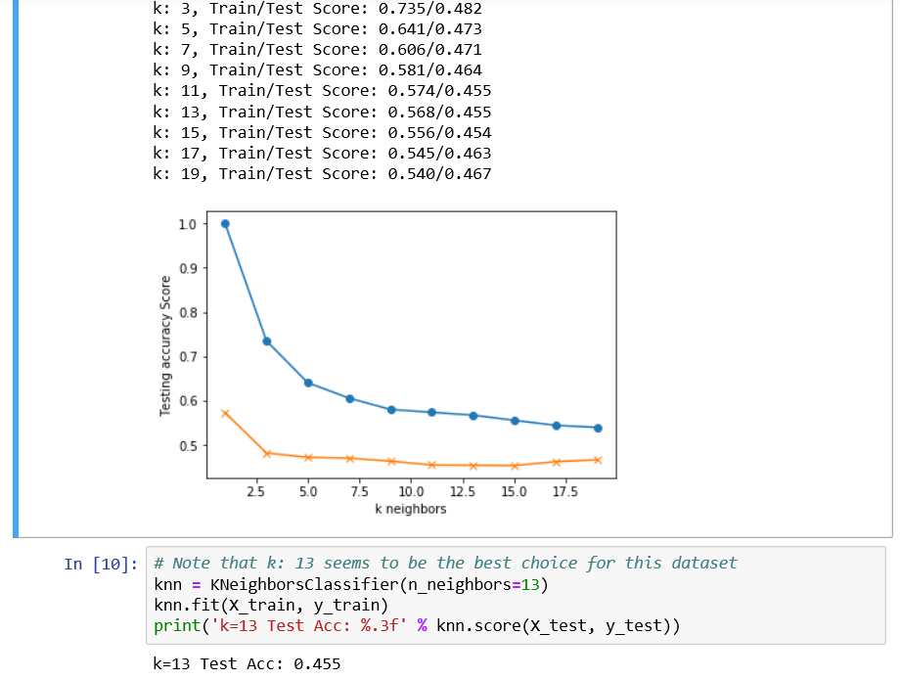
K-nearest neighbor
Accuracy 45%
Leveled out at K 13

Slide 28
Logistic regression

Slide 29
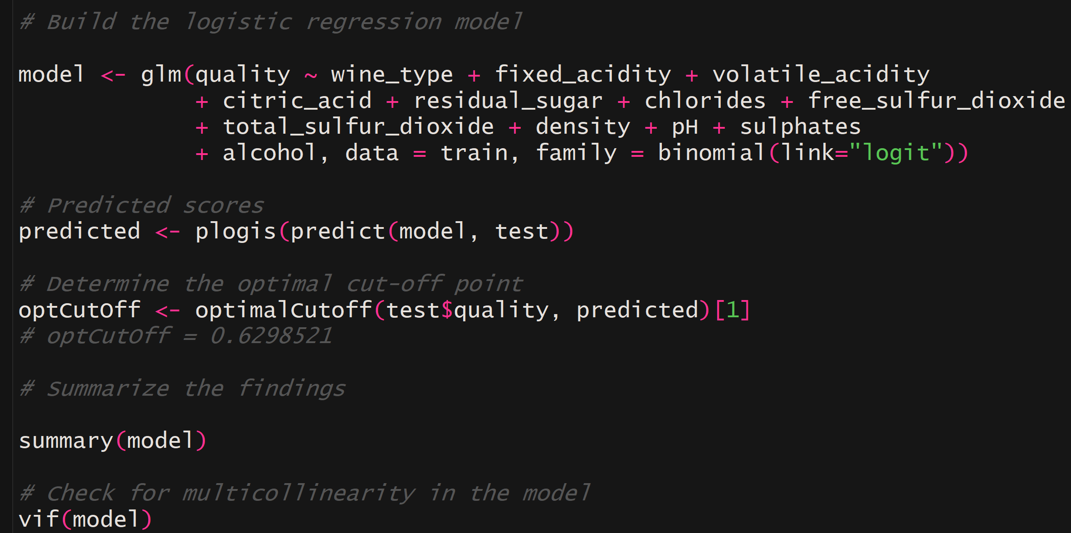
Code and measurements

Slide 30
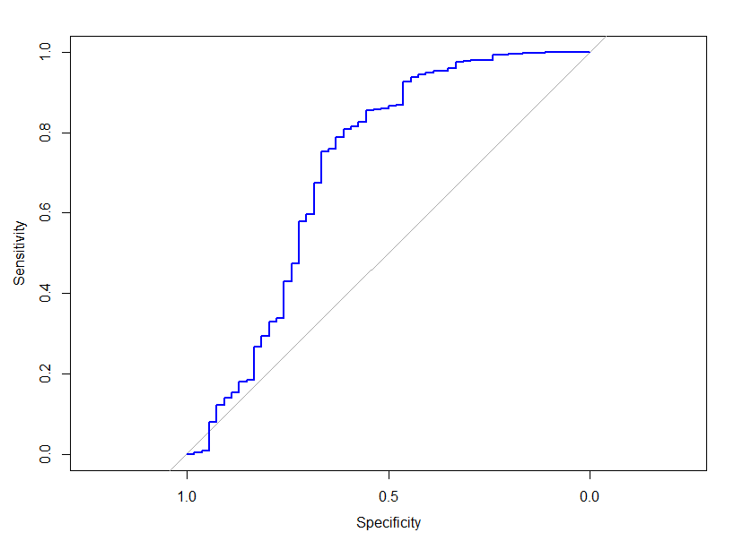
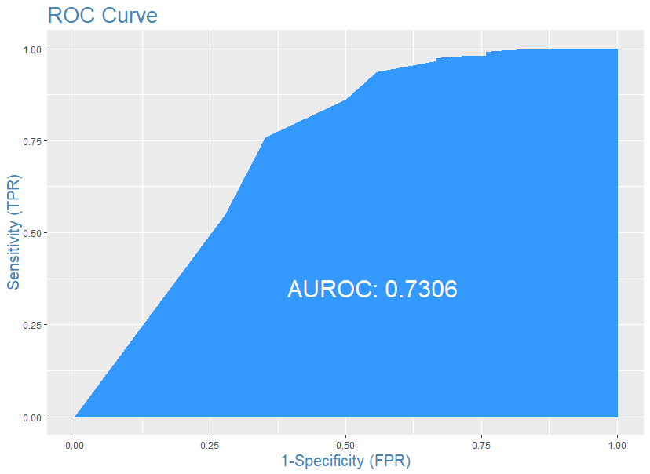
Sensitivity, specificity, roc curve and auc
Accuracy: 96.54%
Precision: 96.82%
Recall: 99.84%

Slide 31
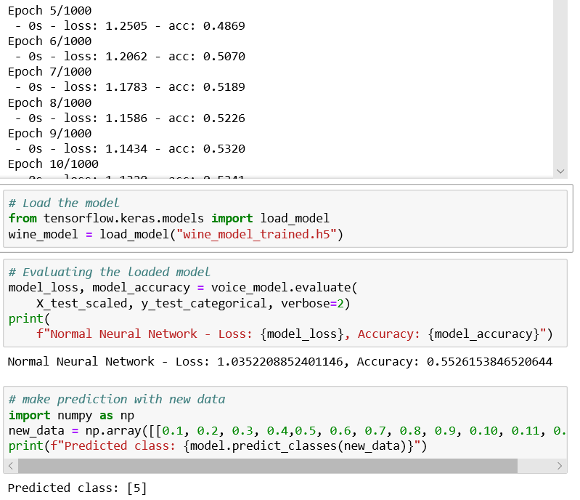

Neural network
Predicted 5
Accuracy 55%
Ran 1000 Epoch

Slide 32
Xg boost

Slide 33
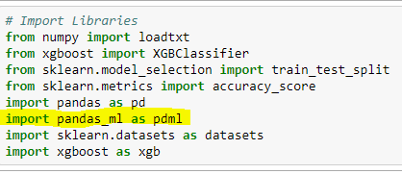
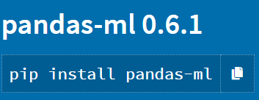
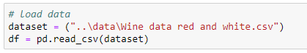
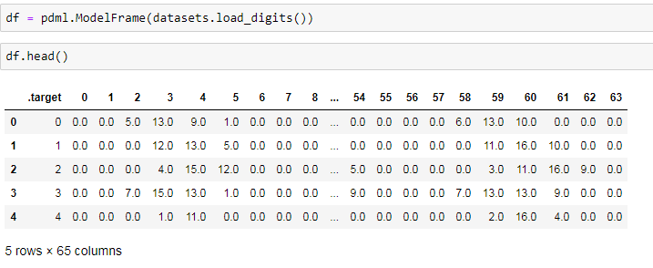
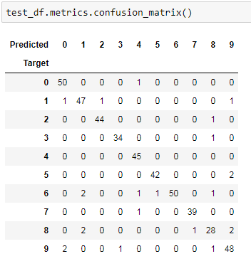
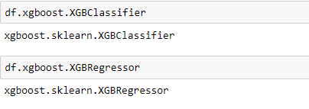
Code and measurements

Slide 34
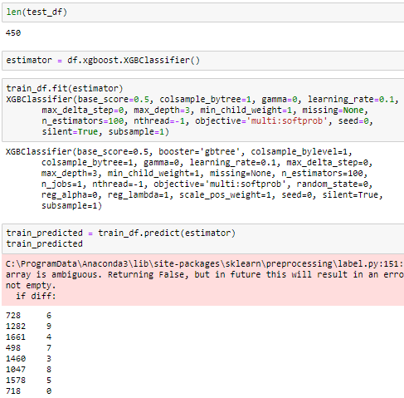

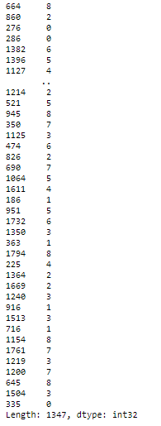

Slide 35
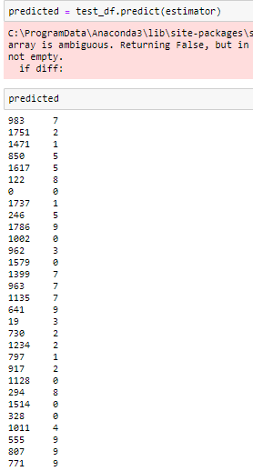
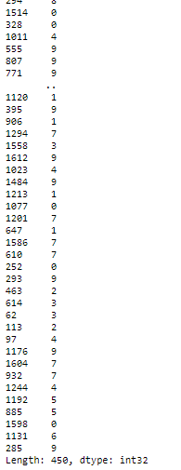
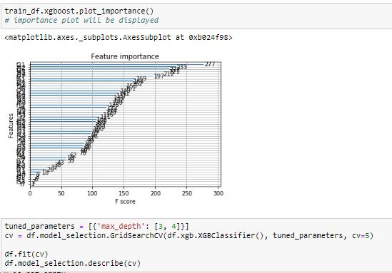
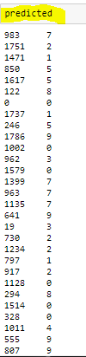
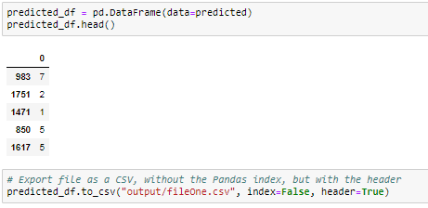

Slide 36
analysis

Slide 37
Conclusions

Slide 38
How do the models compare?
Model | Accuracy | Precision | Recall
Source Vector Classification (SVC) | 57.589% | 86% | 83%
Random Forest | 69.025%
K-Nearest Neighbor (KNN) | 54.97%
Logistic Regression | 96.54% | 96.82% | 99.84%
Neural Network
XG Boost

Slide 39
Post mortem
Limited dataset: Difficulties with finding useful data on wines for free
Data biased towards red whines and mid-tier wines
Given more time, we would like to refine our models and find alternative datasets in order to get the most accurate results at predicting the quality of a wine

Slide 40
Any questions?

