Slide 1
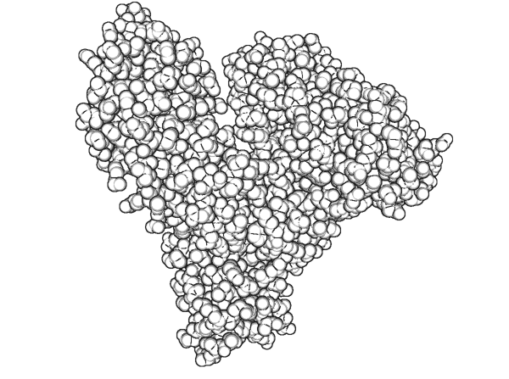
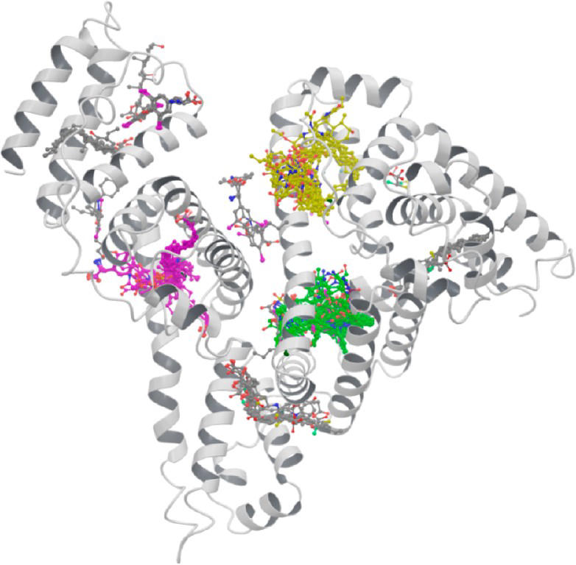
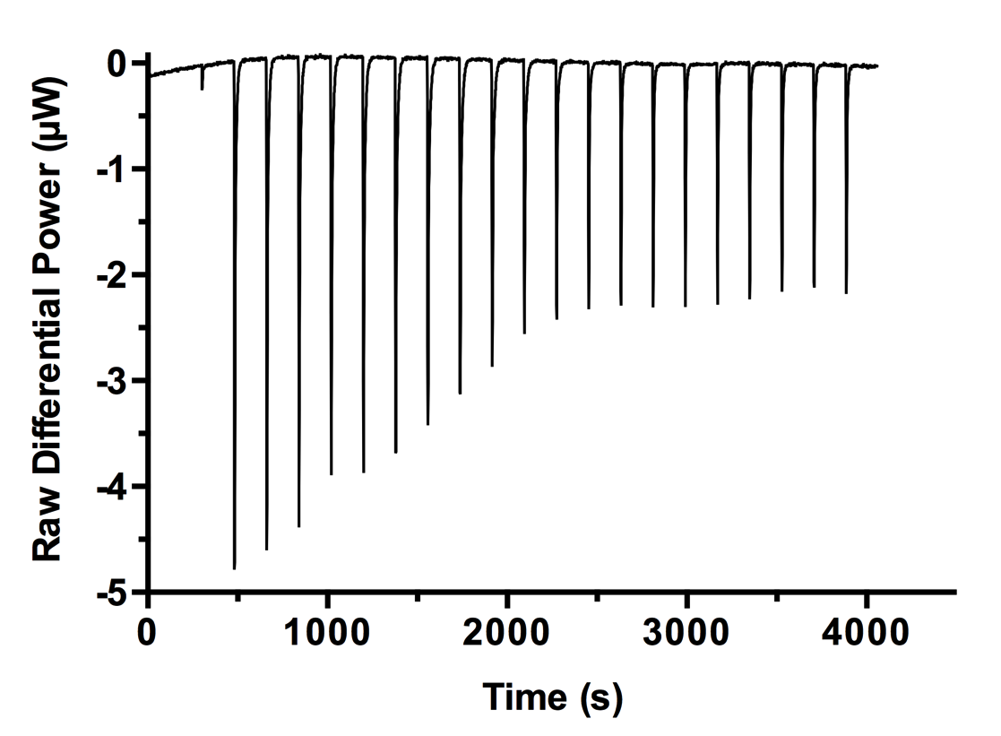
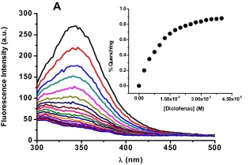
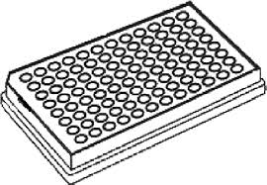


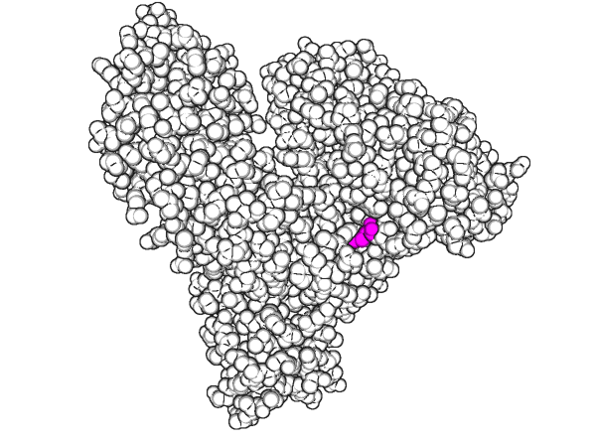
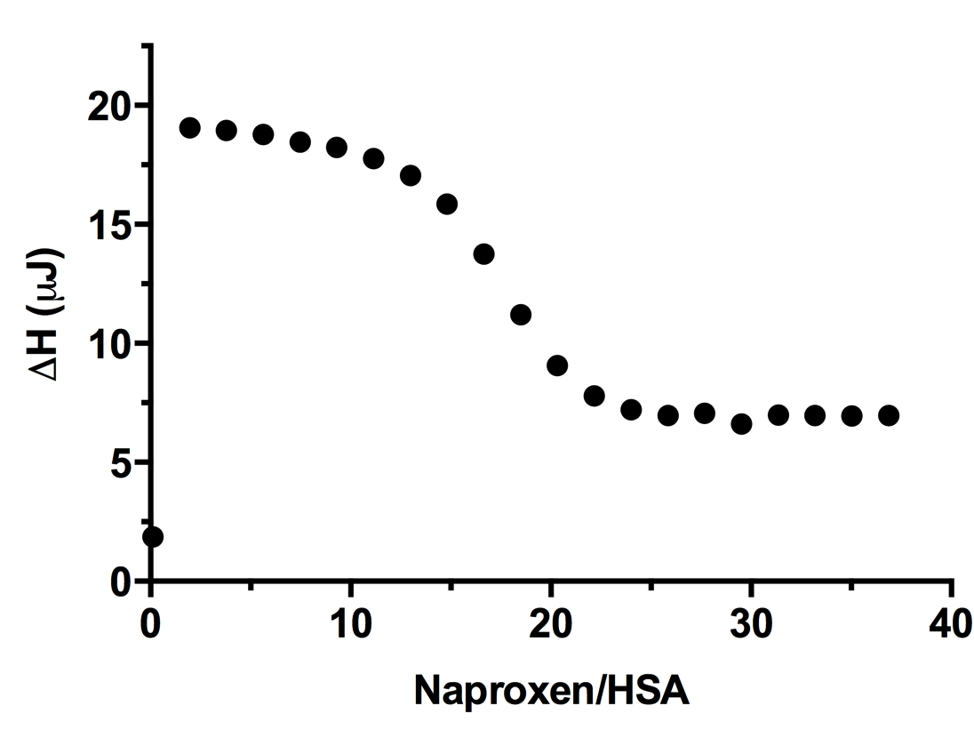
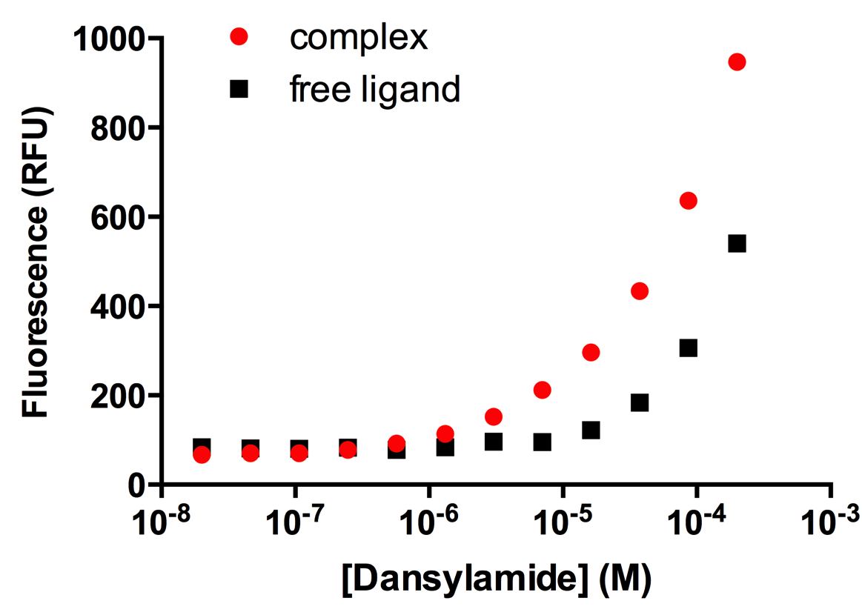
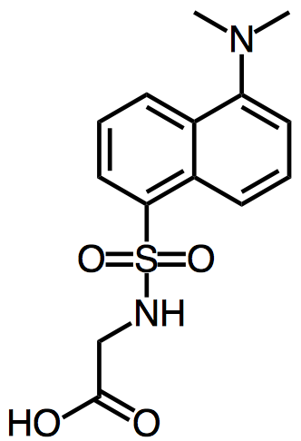
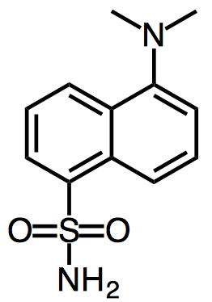
A
B
C
E
SAMPL6: wild-type HSA
fragment
library
mutation introduced
to binding site
D
F
Site II Dansylglycine
Site I
Dansylamide
SAMPL7: mutant HSA
fragment
library
Figure 1. (A) Wild type Human Serum Albumin (HSA) is proposed to be the first target of SAMPL6 challenge with its selected set of ligands. Ligand set with wide range of affinities will be constructed by screening small molecule fragment libraries. By introducing a mutation to one of the binding pockets, we will create a second challenge target. (B) HSA with drug molecules superimposed to their positions in crystal structures with HSA (Figure created by Michelle Lynn Hall et al. 2013). [m1] HSA has up to 8 binding sites drug molecules were observed to bind. Green and purple colored ligands indicate major drug binding sites Site I (Sudlow’s Site I) and Site II (Sudlow’s Site II), respectively. Dansylamide and dansylglycine excibit binding-enhanced fluorescence upon binding to HSA, thus a binding curve can be constructed based on increase in fluorescence emission at 480 nm. Dansylamide was shown to bind primarily to Site I (K_{d} ~ 5 μM) and dansylglycine was shown to bind primarily to Site II (K_{d} ~ 2 μM) [m2] with (C) Binding assay of HSA and Naproxen Sodium measured by Isothermal Titration Calorimetry (ITC). Lower figure is enthalpy change vs. Naproxen Sodium to HSA molar ratio of each injection. (D) Fluorescence emission of HSA changing depending on Diclofenac concentration. Inset plot shows binding curve constructed of percent tryptophan quenching (at 346 nm) vs. Diclofenac concentration. [m3]. Diclofenac is a fluorescent ligand reported to bind Site II [m4]. (E) Direct fluorescence binding assay of Dansylamide (fluorescent ligand) and HSA. Binding curve can be constructed based on binding-induced fluorescence emission at 480 nm.
[m1] Hall, Michelle Lynn, William L. Jorgensen, and Lewis Whitehead. “Automated Ligand- and Structure-Based Protocol for
in Silico Prediction of Human Serum Albumin Binding.” Journal of Chemical Information and Modeling 53, no. 4
(April 22, 2013): 907–22. doi:10.1021/ci3006098.
[m2] Muller, N., F. Lapicque, E. Drelon, and P. Netter. “Binding Sites of Fluorescent Probes on Human Serum Albumin.” Journal of Pharmacy and Pharmacology 46, no. 4 (1994): 300–304.
[m3] Bou-Abdallah, Fadi, Samuel E. Sprague, Britannia M. Smith, and Thomas R. Giffune. “Binding Thermodynamics of Diclofenac and Naproxen with Human and Bovine Serum Albumins: A Calorimetric and Spectroscopic Study.” The Journal of Chemical Thermodynamics 103 (December 2016): 299–309. doi:10.1016/j.jct.2016.08.020.
[m4] Ràfols, Clara, Sílvia Zarza, and Elisabeth Bosch. “Molecular Interactions between Some Non-Steroidal Anti-Inflammatory Drugs (NSAID׳s) and Bovine (BSA) or Human (HSA) Serum Albumin Estimated by Means of Isothermal Titration Calorimetry (ITC) and Frontal Analysis Capillary Electrophoresis (FA/CE).” Talanta 130 (December 2014): 241–50. doi:10.1016/j.talanta.2014.06.060.

