Slide 1

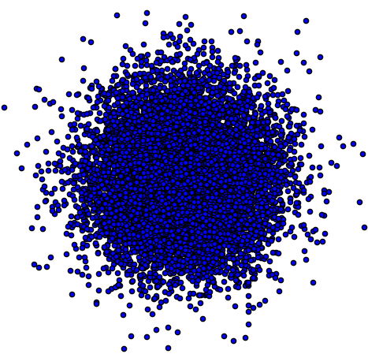

protonation
states
metal ions
cofactors
binding site
flexibility
multiple
binding sites
A
Challenges involved in predicting protein:ligand binding
B
Multiple protein crystal structures
Known bacterial expression
Availability of multiple purchasable known ligands
Tractable experimental affinity measurements
HSA:indoxyl sulfate
TetR:tetracycline
experimental tractability criteria
Streptavidin:biotin
HIV-1 RT:nevirapine
Ligand protonation state and tautomer effects
Protein protonation state effects
Protein conformational change upon binding
Presence of PTMs affecting affinity
Coordinated metals
Ordered waters
HSA:warfarin
T4 Lysozyme L99A
isolated challenge filters
tautomerization
CYP450 BM3:mefenamic acid
most protein
targets
Cytochrome C Peroxidase
CA II:chlorthalidone
Figure 4. Mining model protein:ligand systems to focus on individual modeling challenges via a structural and chemical informatics
platform. SAMPL7-10 will feature the introduction of new model protein:ligand systems designed to focus on individual challenges judged to be of critical immediate importance following current D3R/SAMPL blind competitions. (A) Since most protein targets of pharmaceutical interest feature a multitude of conflated challenges to quantitative accuracy, our goal is to identify model protein targets that isolate individual effects to focus community efforts by fielding new blind challenges. Some example protein:ligand pairs and the conceptual challenge categories they fall under are shown in the figure: T4 Lysozyme L99A [m5], HSA [m6], Carbonic anhydrase II (CAII) [m6, m7], Cytochrome C Peroxidase [m8], Cytochrome P450 BM3 M11 (CYP450 BM3) [m9], HIV-1 Reverse Transcriptase(HIV-1 RT) [m10, m11], Streptavidin [m10], Tet repressor protein (TetR) [m10, m12] (B) In order to rapidly develop new experimentally and computationally-tractable model protein:ligand systems, we have developed a structural and chemical informatics system that applies successive filters to the set of all potential protein:ligand systems for which structural data is available. Suitable model systems should meet all experimental tractability criteria (green box) and only possess a few of challenging properties, ideally only one (blue box).
T4 Lysozyme L99A
[m5] Mobley, David L., Alan P. Graves, John D. Chodera, Andrea C. McReynolds, Brian K. Shoichet, and Ken A. Dill. “Predicting Absolute Ligand Binding Free Energies to a Simple Model Site.” Journal of Molecular Biology 371, no. 4 (August 2007): 1118–34. doi:10.1016/j.jmb.2007.06.002.
HSA, CAII
[m6] Martin, Yvonne Connolly. “Let’s Not Forget Tautomers.” Journal of Computer-Aided Molecular Design 23, no. 10 (October 2009): 693–704. doi:10.1007/s10822-009-9303-2.
CAII
[m7] Temperini, Claudia, Alessandro Cecchi, Andrea Scozzafava, and Claudiu T. Supuran. “Carbonic Anhydrase Inhibitors. Comparison of Chlorthalidone, Indapamide, Trichloromethiazide, and Furosemide X-Ray Crystal Structures in Adducts with Isozyme II, When Several Water Molecules Make the Difference.” Bioorganic & Medicinal Chemistry 17, no. 3 (February 2009): 1214–21. doi:10.1016/j.bmc.2008.12.023.
Cytochrome c peroxidase
[m8] Rocklin, Gabriel J., Sarah E. Boyce, Marcus Fischer, Inbar Fish, David L. Mobley, Brian K. Shoichet, and Ken A. Dill. “Blind Prediction of Charged Ligand Binding Affinities in a Model Binding Site.” Journal of Molecular Biology 425, no. 22 (November 2013): 4569–83. doi:10.1016/j.jmb.2013.07.030.
P450 BM3
[m9] Venkataraman, Harini, Marlies C.A. Verkade-Vreeker, Luigi Capoferri, Daan P. Geerke, Nico P.E. Vermeulen, and Jan N.M. Commandeur. “Application of Engineered Cytochrome P450 Mutants as Biocatalysts for the Synthesis of Benzylic and Aromatic Metabolites of Fenamic Acid NSAIDs.” Bioorganic & Medicinal Chemistry 22, no. 20 (October 2014): 5613–20. doi:10.1016/j.bmc.2014.06.022.
HIV-1 RT
[m10] Gunasekaran, Kannan, and Ruth Nussinov. “How Different Are Structurally Flexible and Rigid Binding Sites? Sequence and Structural Features Discriminating Proteins That Do and Do Not Undergo Conformational Change upon Ligand Binding.” Journal of Molecular Biology 365, no. 1 (January 2007): 257–73. doi:10.1016/j.jmb.2006.09.062.
[m11] Khunnawutmanotham, Nisachon, Nitirat Chimnoi, Arunee Thitithanyanont, Patchreenart Saparpakorn, Kiattawee Choowongkomon, Pornpan Pungpo, Supa Hannongbua, and Supanna Techasakul. “Dipyridodiazepinone Derivatives; Synthesis and Anti HIV-1 Activity.” Beilstein Journal of Organic Chemistry 5 (July 22, 2009). doi:10.3762/bjoc.5.36.
TetR
[m12] Aleksandrov, Alexey, Juliane Proft, Winfried Hinrichs, and Thomas Simonson. “Protonation Patterns in Tetracycline:Tet Repressor Recognition: Simulations and Experiments.” ChemBioChem 8, no. 6 (April 16, 2007): 675–85. doi:10.1002/cbic.200600535.

