Slide 1
Differentiated Thyroid Cancer Query Results
Using MySQL
Carmen Chai

Slide 2
Purpose
The purpose of this project is to conduct exploratory analysis on patients with differentiated thyroid cancer using SQL queries. I ask five major questions I want to know about before querying.
The csv file was obtained from Kaggle and downloaded into my local computer so that I can use MySQL.

Slide 3
Question 1
How many female and male patients have diagnosed differentiated thyroid cancer?

Slide 4
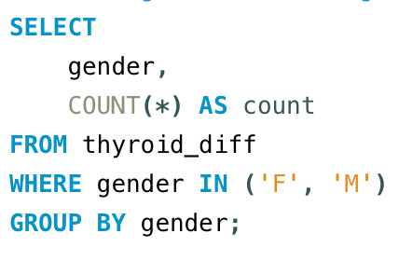
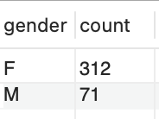
Question 1 Query Results

Slide 5
Question 2
What is the patient count for both genders in the T, N, and M stages?

Slide 6
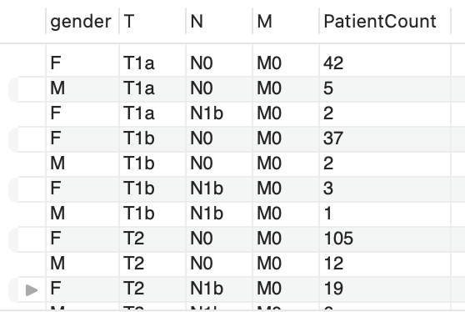
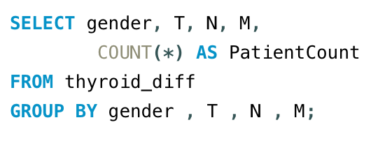
Question 2 Query Sample Results

Slide 7
Question 3
Are there any correlations between risk levels and other variables?

Slide 8
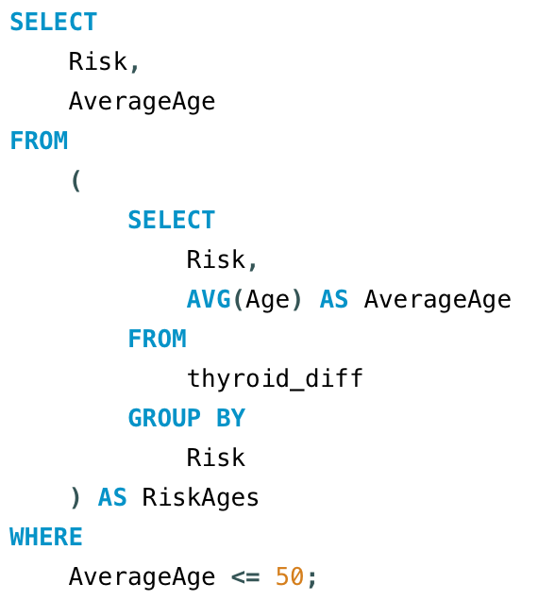
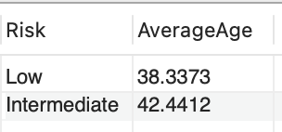
Question 3 Sample Query Results

Slide 9
Question 4
What is the average age of patients in the T, N, and M stages?

Slide 10
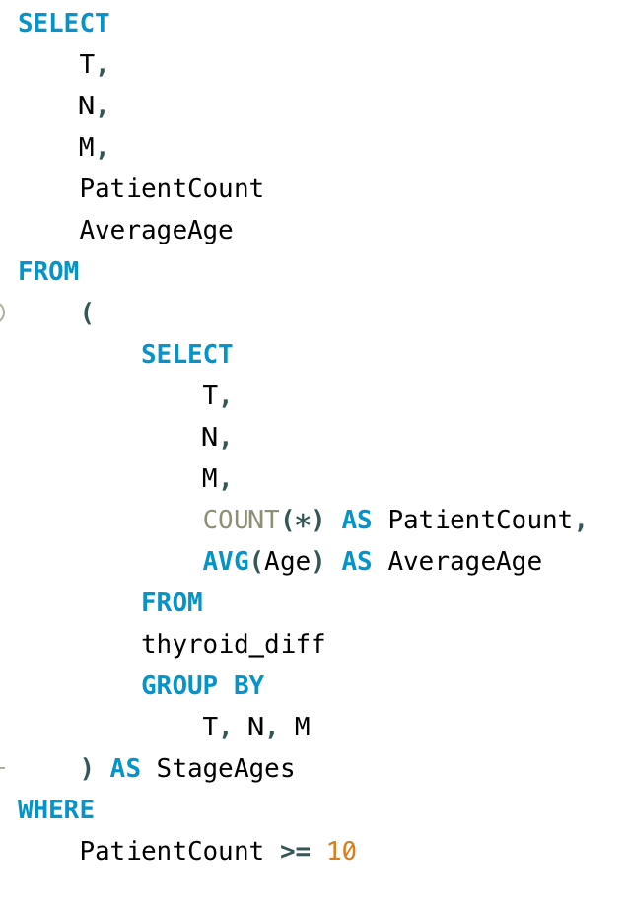
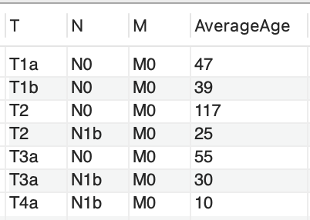
Question 4 Sample Query Results

Slide 11
Question 5
What is the distribution of pathology results among patients and percentage of recurrence after treatment?

Slide 12
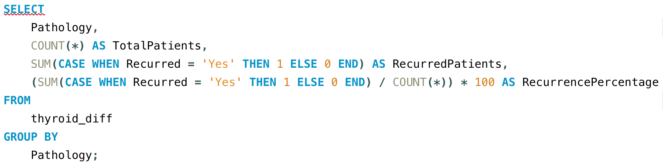
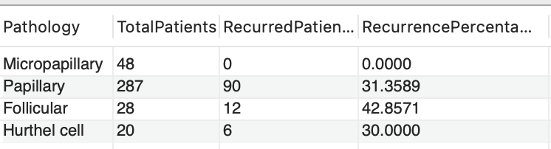
Question 5 Sample Query Results

