Slide 1
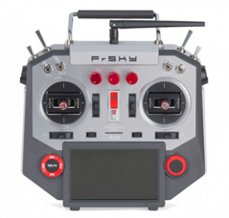
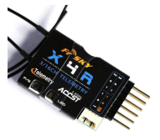
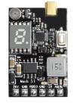
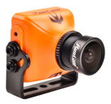
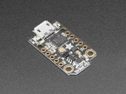
Smart Audio Protocol
(non-inverted half-duplex 4800 baud)
MSP over FrSky Telemetry
MSP over S.Port Protocol
(inverted half-duplex 57600 baud)
Lua Scripts

