Slide 1
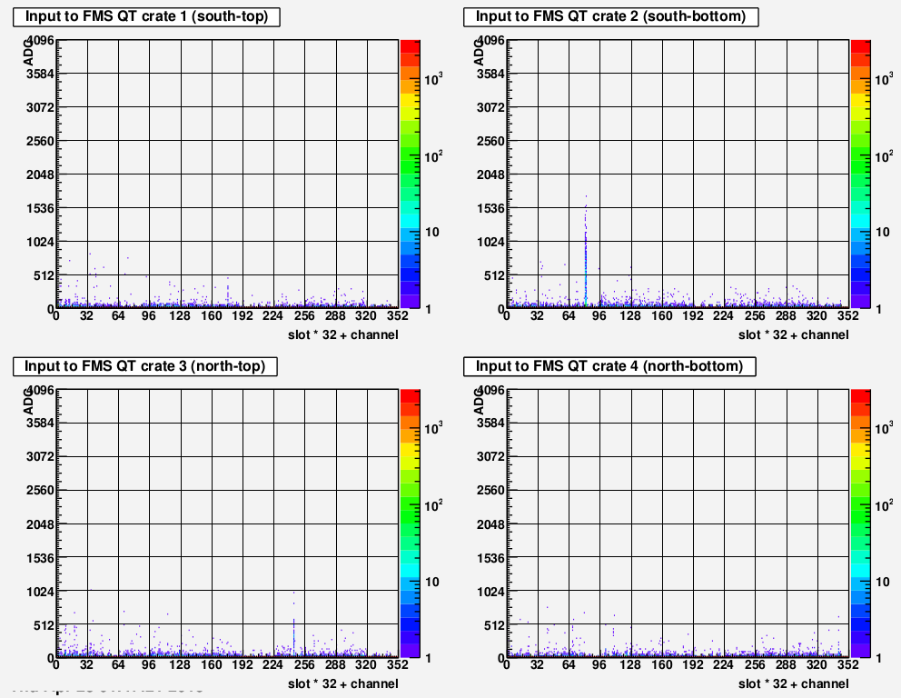


FMS – ADC Tab – ADC counts vs. channel
>>04/30/2015<<
Under normal operation, all four plots should look similar to the bottom right (QT crate 4) plot
  No channels have anomalously high ADC counts
  There is a constant horizontal red line along ADC=0 across mostly all channels
Two example hot towers are circled in red:
  Hot towers appear as ADC “spikes” in a channel (and can cause high FMS trigger DAQ rates)
  Call an FMS expert any are seen, and they will work to suppress them

Slide 2
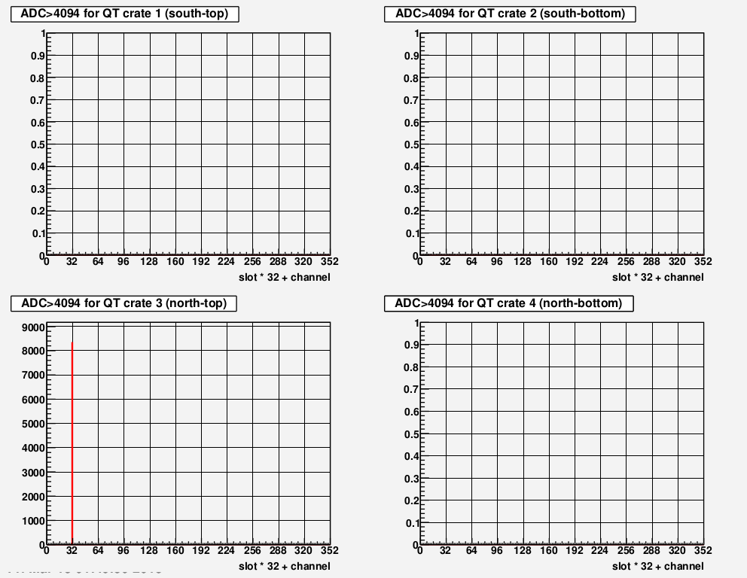


FMS – Critical Tab – Channels with ADC=0xFFF
>>04/30/2015<<
No entries,
scale = 1,
normal
operation
Critical spike
and scale
not =1
Normal operation: nothing in these plots & all vertical scales should range from 0-1
Any red spikes indicate an ADC=0xFFF problem
  Call an FMS expert if this is seen

